Slide 1
GTAP air pollution, GTAP-Power, Shared socioeconomic pathways (SSP) databases for GTAP
Presented by
Maksym Chepeliev
23rd Annual Conference on Global Economic Analysis (Virtual Conference)
June 17-19, 2020

Slide 2
Outline
1. GTAP-Power database
2. GTAP non-CO₂ emissions database
3. GTAP air pollution database
4. Shared Socioeconomic Pathways (SSP) database for GTAP

Slide 3
1.1. GTAP-Power 10a: Introduction
Standard GTAP Data Base reports single electricity sector.
GTAP-Power 9 database (Peters, 2016) disaggregated electricity sector into 11 generation technologies + transmissions and distribution.
GTAP-Power 10a database addresses several limitations identified in GTAP-Power 9, including:
Both heat and electricity generation volumes are used to provide GTAP “ely” sectors split.
Country and year-specific shares of transformation and distribution costs in electricity tariff are introduced.
Levelized costs of electricity (LCOE) generation are updated and made year-specific (IEA/NEA (2010) is used for 2004, 2007 and 2011; IEA/NEA (2015) is applied for 2014).
Documentation of the GTAP-Power 10a database is provided in the GTAP Research Memorandum No. 31 (Chepeliev, 2020a).

Slide 4
1.2. GTAP-Power 10a: Treatment of the co-generation
Share of heat generation in aggregate electricity and heat production by selected countries in 2014, %
Source: IEA (2015).
World average shares of heat generation by technologies
Source: IEA (2015).

Slide 5
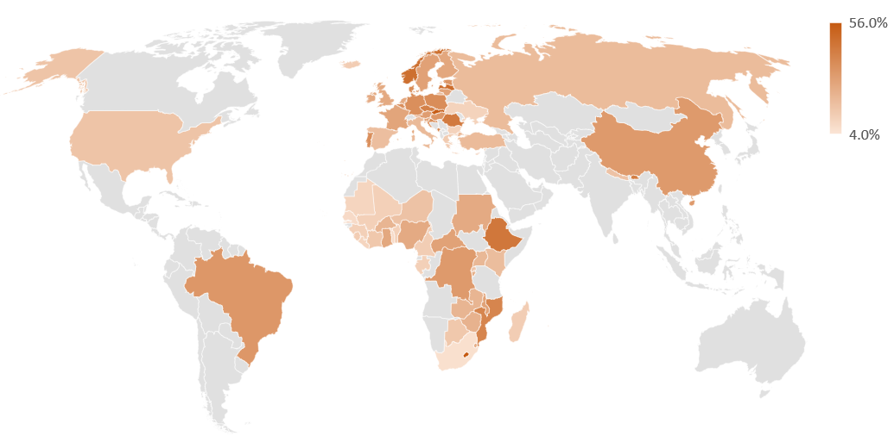
1.3. GTAP-Power 10a: Transmission and distribution costs
Shares of transmission and distribution in the total non-tax value of electricity output by countries in 2014 (or closest available year)
Source: Developed by author using EIA (2013), EIA (2018), Trimble et al. (2016), Eurostat (2019), ENTSO-E (2017), NERC (2015), NERC (2014), He et al. (2015), Siyambalapitiya (2018), ADB (2010), EY (2018), WB (2019) and NEEA (2008).
Note: Countries colored in grey do not have available data.

Slide 6
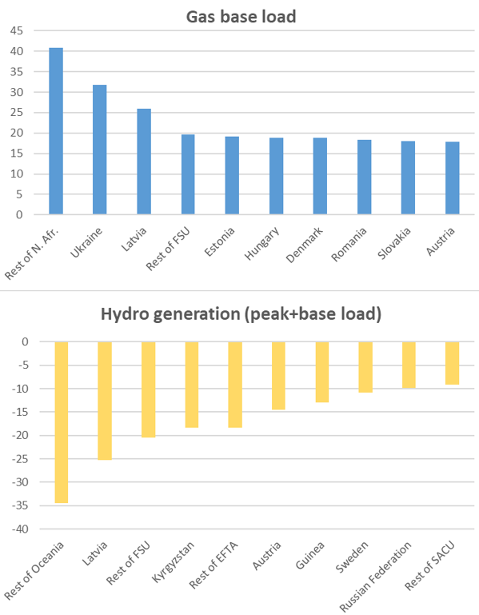
1.4. Comparisons for the GTAP-Power 9a database
Shares of global electricity and heat generation from different technologies reported in GTAP-Power 9a for 2011 reference year under different input data assumptions, %
Source: GTAP-Power Data Base, erp.har, header: GWHR.
Note: “v9a (updated inputs)” corresponds to the database developed in this note; “v9a (initial inputs)” corresponds to the database developed in Peters (2016). In Peters (2016) only electricity generation is reported in the “GWHR” header.
Change in generation shares, percentage points

Slide 7
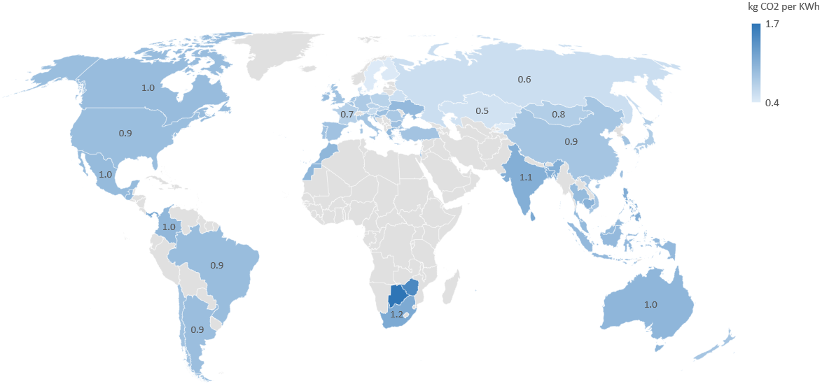
1.5. Illustrative application: carbon intensity of the coal power
Intensities of the CO₂ emissions embodied into the final consumption of domestic electricity and heat from coal base load generation in 2014 by countries, kg CO₂ per Kwh
Note: Only individual countries with coal base load generation over 100 GWh per year are plotted on the map. Countries colored in grey do not have available data or have coal base load generation below 100 GWh per year.

Slide 8
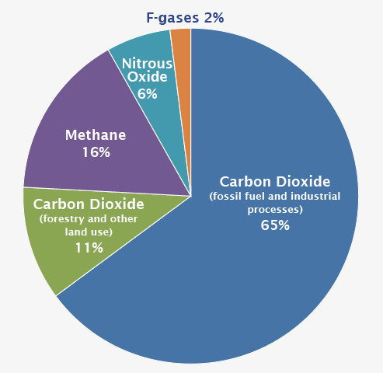
2.1. GTAP Non-CO₂ emissions database: Introduction
Standard GTAP Data Base reports only CO₂ from fossil combustion (less than 65% of global GHG emissions).
Since GTAP 6 a special version of the GTAP non-CO₂ emissions dataset has been constructed, using different approaches.
Current release introduces some additional updates:
Four GTAP 10 reference years;
Reporting of the land-use related emissions;
Updates of the Global Warming Potentials (GWPs);
Updates of the emission mappings.
Documentation of the GTAP 10a non-CO₂ emissions database is provided in the GTAP Research Memorandum No. 32 (Chepeliev, 2020b).
Global greenhouse gas emissions by gas and source in 2010, %
Source: IPCC (2014).

Slide 9
2.2. Non-CO₂ emissions database: General approach
Key data sources: EDGAR (non-agriculture) and FAOSTAT (agriculture and land use).
Data treatment: gap-filling and mapping to GTAP economic drivers.
Four GHGs are reported: CO₂, CH₄, N₂O and F-gases.
Input data:
EDGAR v5 (JRC/PBL, 2019); EDGAR v4.2 (JRC/PBL, 2011); FAO (2019).
Processing steps:
data gap filling (emission growth approach);
mapping to GTAP regions.
Output data:
2004, 2007, 2011 and 2014 emissions;
3 GHGs, 141 regions, 10 emission categories for FAOSTAT and 40 emission categories for EDGAR.
Output-linked emissions (GQO; NCQO)
Endowment-linked emissions (GQE; NCQE)
Consumption-linked emissions (GQF, NCQF, GQP, NCQP)
GTAP 10a non-CO₂ database construction process
Note: In the final GTAP 10a non-CO₂ database emissions are provided in Gigagrams and mil. Mt of CO₂-eq.

Slide 10
2.3. Land use GHG emissions
Distribution of global land use net GHG emissions in 2014 by gases and categories
Source: FAO (2019).
Notes:
Land use GHG emissions are reported for consistency purposes, they are not linked to emission drivers, as we do not have explicit land use accounting by types in the standard GTAP.

Slide 11
2.4. GTAP non-CO₂ emissions database: An overview
Global non-CO₂ GHG emissions by economic drivers in 2014
Source: Chepeliev (2020b).
Global GHG emissions embodied into final households’ consumption by GTAP agricultural and food sectors, 2014
Source: Estimated by authors based on GTAP 10a non-CO₂ database.
Note: carbon intensities are indicated by orange dots (right axis).

Slide 12
3.1. GTAP air pollution database: Introduction
Ambient air pollution is the cause of 4.2 million deaths, making it the fifth-ranked global risk factor (Cohen et al., 2017).
While GHGs are usually well represented in most global economic databases, including GTAP, air pollution flows in many cases are not reported.
Current effort is aimed to fill this gap.
Key features of the developed air pollution database include:
Nine emission substances (BC, CO, NH₃, NMVOC, NO_{x}, OC, PM₁₀, PM_{2.5}, SO₂).
Emissions are linked to the emission drivers; emission factors are used to assist with the reallocation.
Land-use emissions are estimated by land cover types, based on the volumes of burned biomass and emission factors;
Special treatment of the PM_{2.5} from bio and fossil sources.
Documentation of the GTAP 10a air pollution database is provided in the GTAP Research Memorandum No. 33 (Chepeliev, 2020c).

Slide 13
3.2. GTAP air pollution database: An overview
Global average distribution of air pollutants by sources (2004, 2007, 2011 and 2014 weighted average)
Source: Author’s estimates based on EDGAR v5.0 database (Crippa et al., 2020) and GTAP 10a air pollution database.
Global non-GHG emissions by GTAP 10a reference years and pollutants
Source: Estimated by author based on EDGAR v5.0 database (Crippa et al., 2020) and GTAP 10a air pollution database.

Slide 14
3.3. Land use emissions
Land use emission estimates are constructed using FAO-reported volumes of biomass burning by land cover types and emission factors compiled from different sources.
Land use emissions are not directly linked to emissions drivers.
Global non-GHG emissions from forests and organic soils burning
Source: Estimated by author based on FAO (2020), Akagi et al. (2011), Yokelson et al. (2013) and Hu et al. (2018).

Slide 15
4.1. SSP database for GTAP: Introduction
Standard GTAP Data Base represents a specific reference year.
For the dynamic modelling (e.g. GDyn, GTAP-RD) assumptions about future development have to be made.
Shared Socioeconomic Pathways (SSPs) database (Riahi et al., 2017):
Time framework—2010-2100
Population—source IIASA
  Age (5-year cohorts), gender, education (four levels—none, primary, secondary, tertiary)
GDP
  3 sources—IIASA, OECD, PIK
  All harmonized to same (IIASA) demographic scenarios
  IIASA and OECD country-level
Urbanization—source NCAR

Slide 16
4.2. SSP database: GDP and population

Slide 17
4.3. SSP database for GTAP 10
Data processing
  Population and GDP data are splined to cover annual steps.
  The country coverage has been expanded to cover 230 UN countries further mapped to the 141 GTAP 10 regions.
  Per capita GDP is reported in MER and PPP in 2011 and 2014 constant USD.
  Actual 2011-2018 GDP growth rates are introduced to the database.
Historical 1961-2015 GDP and population growth rates for 230 countries are compiled (World Bank, Penn World Tables, Angus Maddison dataset).
Constructed database is integrated to the GTAP-RD data aggregator.
GTAP SSP database documentation forthcoming.

Slide 18
GTAP air pollution, GTAP-Power, Shared socioeconomic pathways (SSP) database for GTAP
Thank you!

Slide 19
References
Chepeliev, M. 2020a. GTAP-Power 10 Data Base: A Technical Note. GTAP Research Memorandum No. 31. https://www.gtap.agecon.purdue.edu/resources/res_display.asp?RecordID=5938
Chepeliev, M. 2020b. Development of the Non-CO2 GHG Emissions Database for the GTAP Data Base Version 10A. GTAP Research Memorandum No. 32. https://www.gtap.agecon.purdue.edu/resources/res_display.asp?RecordID=5993
Chepeliev, M. 2020c. Development of the Air Pollution Database for the GTAP Data Base Version 10A. GTAP Research Memorandum No. 33. https://www.gtap.agecon.purdue.edu/resources/res_display.asp?RecordID=6163
Peters, J. 2016. The GTAP-Power Data Base: Disaggregating the Electricity Sector in the GTAP Data Base. Vol. 1, No. 1, pp. 209-250. DOI: http://dx.doi.org/10.21642/JGEA.010104AF
Riahi et al. 2017. The Shared Socioeconomic Pathways and their energy, land use, and greenhouse gas emissions implications: An overview. Global Environmental Change. Vol. 42, January 2017, p. 153-168. https://doi.org/10.1016/j.gloenvcha.2016.05.009

