Slide 1
GTAP Analysis: ADB’s Updated Assessment of COVID-19 Economic Impact
James Villafuerte
Badri Narayanan
23rd Annual Conference on
Global Economic Analysis
Global Economic Analysis Beyond 2020
17-19 June 2020

Slide 2
Key Results
The ADB 2020 COVID-19 global impact assessment of $2.0 trillion (short containment) to $4.1 trillion (long containment) has been raised to $5.8 trillion to $8.8 trillion (6.4% to 9.7% of global GDP).
Globally, job losses equivalent to 158 million to 242 million are expected with $1.2 trillion to $1.8 trillion in foregone wage income.
In the long containment scenario, the number of poor will increase by about 56 million for the $1.9/day poverty threshold and 140 million for the $3.2/day.
Direct support to income and revenue will raise global GDP by $1.7 trillion to $3.4 trillion or 1.9% to 3.7% of global GDP.
Government policy responses—such as direct interventions on income and revenues—will soften the global impact by 30%‒40%, from $4.1 trillion to $5.4 trillion or 4.5% to 5.9% of global GDP.

Slide 3
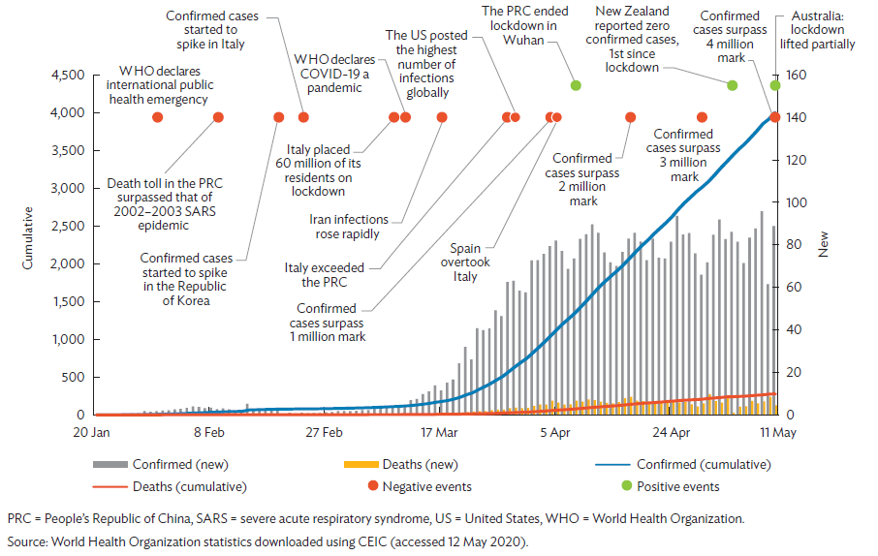
Global COVID-19 Confirmed Cases, Deaths ('000)
PRC = Peoples’ Republic of China, SARS = severe acute respiratory syndrome, WHO = World Health Organization.
Source: World Health Organization statistics downloaded using CEIC (accessed 5 May 2020).

Slide 4
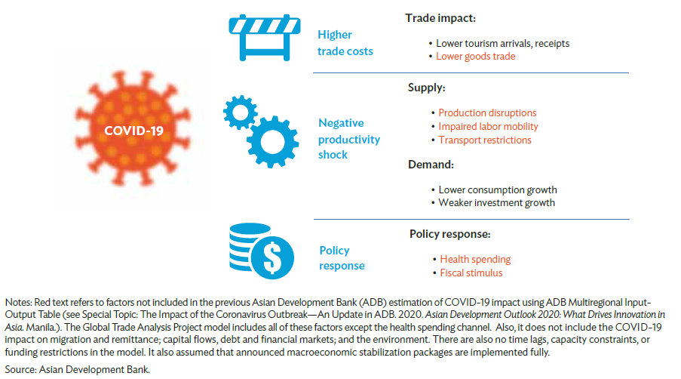
How COVID-19 Affects the Economy

Slide 5
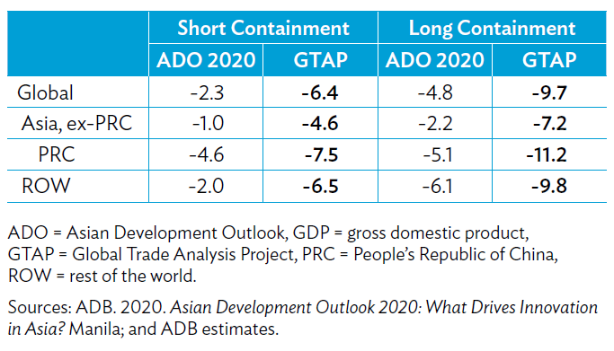
Updated GDP Impact Assessment
Deviation from the non-COVID-19 baseline, %

Slide 6
Key Differences: ADO vs. GTAP
Numerical differences:
Infection level was less than a million in the ADO; now more than 4 million.
ADO 2020 analysis had 13 outbreak-affected economies; GTAP analysis covered 96 outbreak-affected countries and territories, with 1000+ infections each.
ADO analysis accounts for 3 channels: tourism, consumption and investment, and trade and production linkages; GTAP covers these plus 3 more: 1) increase in trade costs, 2) production disruptions, and 3) government policy responses.
The size of the shocks to tourism receipts, consumption and investment are larger in the GTAP analysis than in the ADO (see details in the extra slide).
Theoretical differences:
ADO analysis uses fixed shares; GTAP uses consumer and producer behaviors, which generate stronger demand and supply linkages.
GTAP accounts for price effects which is not captured in the MRIOT for ADO.

Slide 7
Scenario Design
Shocked the countries differently based on their extent of impact – calibrated using real data for quarterly economic summary reports for EU, USA, China.
Consumption is shocked by swapping with productivity variable (aoreg), so that the supply side disruptions are captured alongside the demand adjustment.
Tourism is shocked as a change across the economy in total production (new variable qoreg, swapped with aoreg).
Investment is shocked by swapping it with the savings shifter dpsave – we don’t assume productivity implications of investment
Trade costs are modeled using the variable ‘ams’
All the components were run separately and then combined together to analyse the results
Closure assumptions: unemployment in unskilled labor; others are standard
Two scenarios: short containment (by July) and long containment (by Dec)

Slide 8
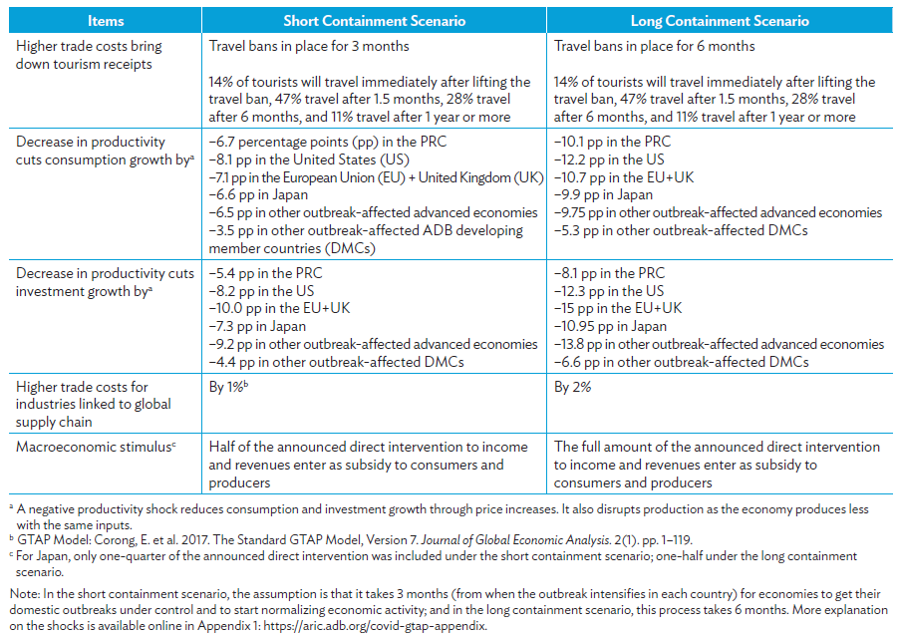
Shock Calibration

Slide 9
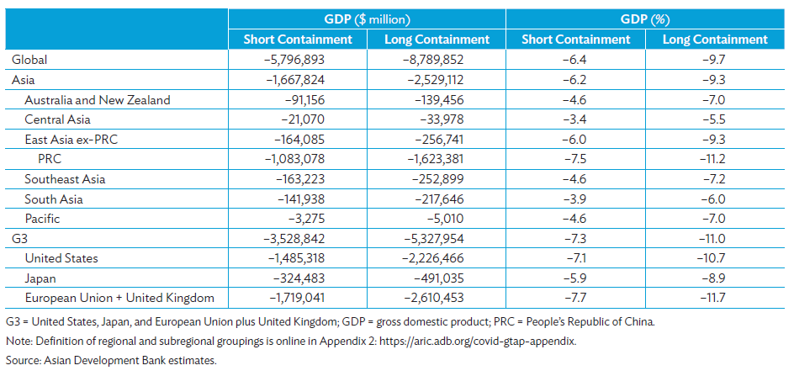
GDP Impact (excluding policy measures)
Deviation from the non-COVID-19 baseline

Slide 10
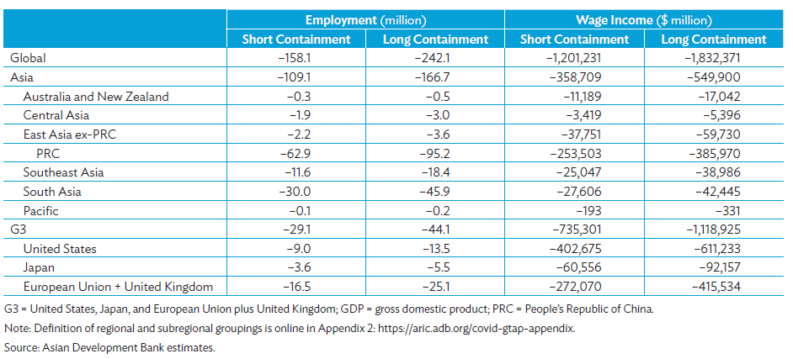
Labor Market Impact
Deviation from the non-COVID-19 baseline

Slide 11
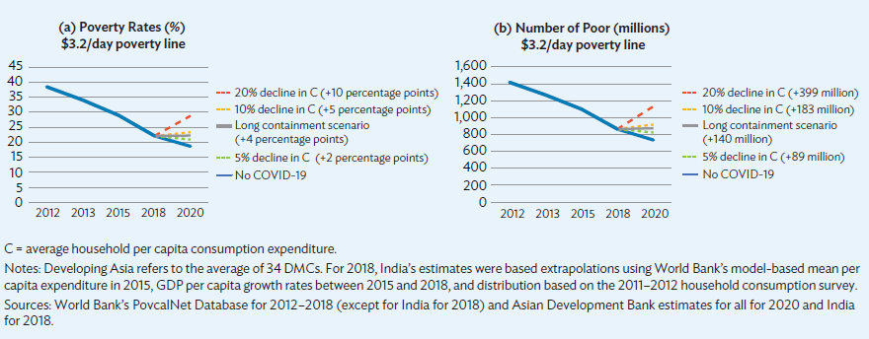
Poverty Estimates in Developing Asia for the $3.2/day
Poverty Line (with and without COVID-19)

Slide 12
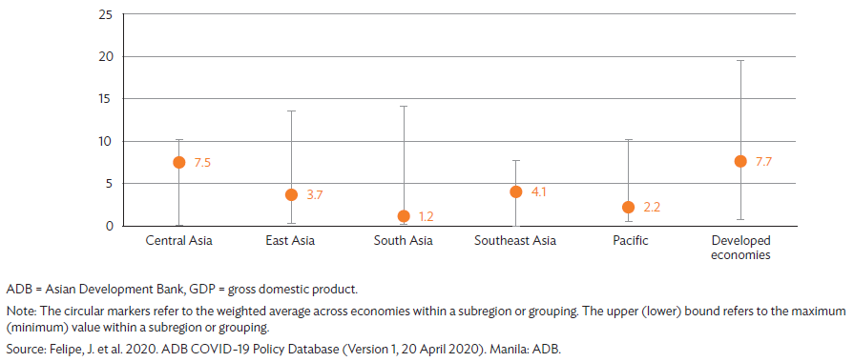
Direct Support to Income or Revenue in Response to COVID19—ADB member economies (% of GDP)

Slide 13
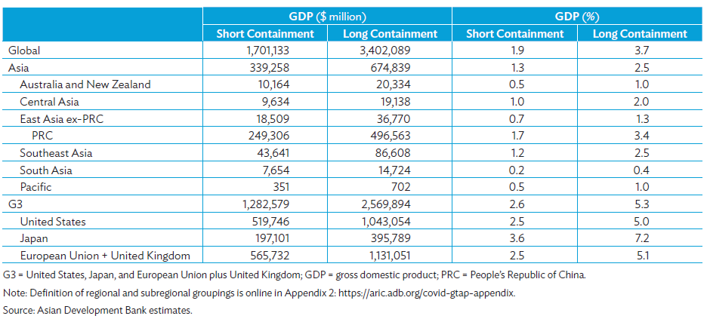
Impact of Direct Support to Income and Revenues
Deviation from the non-COVID-19 baseline

Slide 14
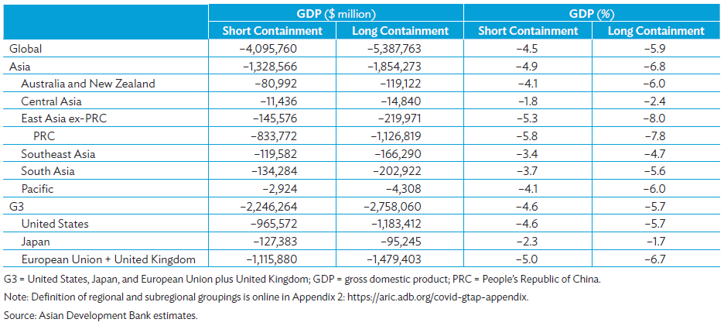
GDP Impact with Policy Interventions
Deviation from the non-COVID-19 baseline

Slide 15
Policy Support to Areas Badly Hit by the Pandemic
Policymakers should aim to contain the outbreak quickly—the longer the containment period, the greater economic losses will be.
The pandemic disproportionately affects MSMEs, especially tourism, transportation, and recreation ad retail services, with profound employment effects, especially on the unskilled.
The pandemic impacts vulnerable jobs harder, worsens poverty, and exacerbates existing inequalities.
Fiscal stimulus targeted at strong income and employment protection is essential to avoid possible long-term economic scarring.

Slide 16
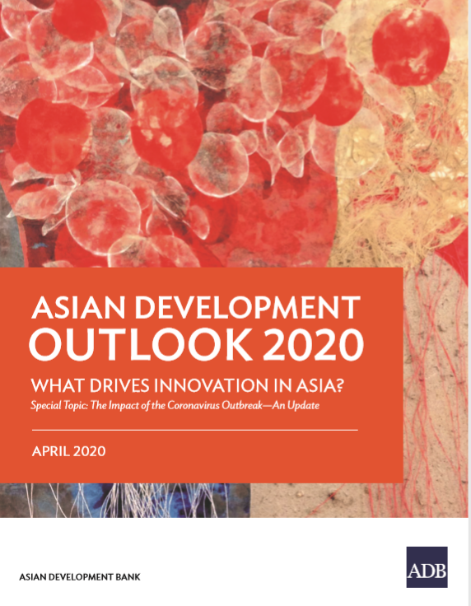
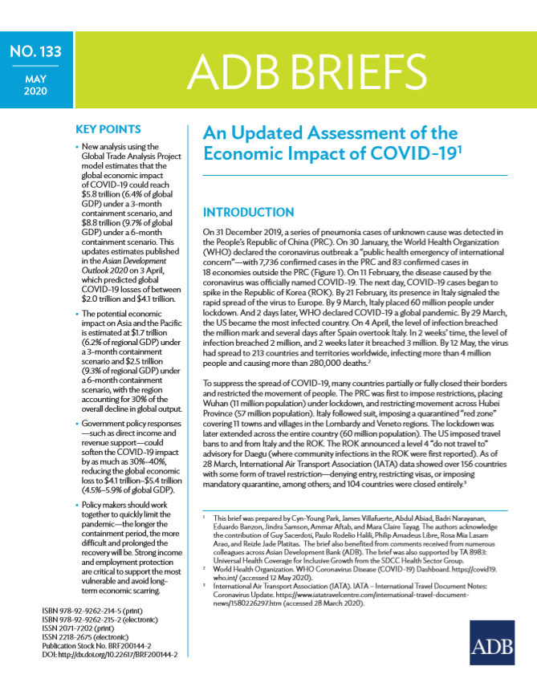
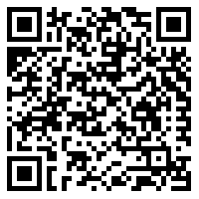
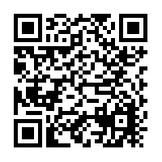
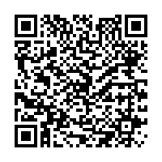
Thank you!
ABFER Commentary The COVID-19 Pandemic Exposes Asian Banks’ Vulnerability to US Dollar Funding
ADB Brief No. 133:
An Updated Assessment of the Economic Impact of COVID-19
ADB’s Asian Development Outlook 2020

