Slide 1
Incorporating Nutritional Information to the GTAP 10 Data Base
Presented by
Maksym Chepeliev
23rd Annual Conference on Global Economic Analysis (Virtual Conference)
June 17-19, 2020

Slide 2
1. Outline
1. Motivation and objective
2. Methodological approach
3. Key challenges
4. Overview of the constructed database
5. Conclusions and further steps

Slide 3
2. Motivation and objective
Assessing the impacts of different policies on nutritional outcomes is a desired feature for many applications
    Elimination of global hunger is one of the key goals of the Sustainable Development agenda, as over 820 million people (approximately 1 in 9) were undernourished in 2017 (UN, 2015).
    More than 1.9 billion adults worldwide are overweight and 650 million are obese (WHO, 2020).
Explicit accounting of food production and consumption patterns is important for long-run dynamic simulations
Allows to represent plausible per capita calorific consumption in the long run (and perhaps other nutritional indicators), as well as the evolution of agricultural and food sectors
Enhance GTAP to provide representation of the nutritional accounts
Notes:
Major transformations in food systems play an important role in the environmental agenda.

Slide 4
3. Overview of the existing approaches
Number of studies have focused on the representation of nutritional accounts in the CGE framework
    Single country CGE-microsimulation framework (e.g. Minot, 1998; Pauw and Thurlow, 2011).
    GTAP-based assessments
      Direct mapping of the nutritional content (Hertel et al., 2007 – focus on China and India; Verma and Hertel, 2009 – nutritional poverty in Bangladesh; Chepeliev and Aguiar, 2019 – nutritional implications of the global GHG taxes).
      Nutritional data incorporation to the GTAP via input-output linkages – Rutten et al. (2013), Britz (2020).
      CGE models with nutritional accounts: FARM (Sands et al., 2014), AIM (Hasegawa et al., 2015), MIRAGRODEP (Bouët et al., 2014).
Limitations of the existing approaches:
    No accounting for the transformation from primary to processed commodities
    No accounting for the food supplied by service sectors, e.g. restaurants, hotels, etc.
    No direct accounting of some derived commodities, e.g. oils and oil cakes.
    No direct accounting of the distribution between food, feed, seed, other uses, etc.
    Nutritional accounting is not revised during the simulations – pre-modelling implementation.
    Not publicly available.

Slide 5
4. Methodological approach: An overview
Use FAO food balance sheets, production data and nutritive factors to estimate nutritional content of primary commodities.
  Food, feed, seed, losses and other use categories are identified.
  Trade in both primary and processed commodities is taken into account.
Leontief inverse to redistribute nutritional data by GTAP sectors, operating only over those sectors (and uses) that supply food.
  Consider GTAP primary commodity sectors, food processing sectors and service sectors that supply food.
  Calories, fats, proteins and carbohydrates are estimated and reported.
Nutritional information is tracked by primary commodity equivalents.
Approach is applied to all four GTAP 10 reference years and could be replicated for each simulated year in the context of dynamic policy runs.

Slide 6
5. Data processing steps
(3) Primary domestic supply estimates
Data: FAOSTAT primary commodities production; data on non-food categories (feed, seed, loss, etc.) from food balance sheets; bilateral trade data; commodity balances for non-food supply (e.g. oil cake); nutritive factors.
(4) Redistribute nutritional supply by GTAP sectors
Data: Primary domestic supply estimates; Leontief inverse.
(1) Estimate Leontief inverse
Data: GTAP 10 Data Base, four reference years (2004, 2007, 2011 and 2014).
Estimate Leontief inverse, identify food, feed, seed and other supplying instances.
Estimation of the primary food supply, processing-related food supply (e.g. oils) and non-food supply by primary commodity equivalents.
(2) Bilateral trade data construction
Data gap-filling and mapping, construction of the bilateral trade in fish and aquaculture.
Data: FAOSTAT, FishstatJ trade data for 522 primary and processed commodities.
Nutritional supply by GTAP sectors and primary commodity equivalents.
(5) Trade-related nutritional supply
Data: Bilateral trade data; nutritive factors; technical conversion factors.
Nutritional supply by GTAP sectors and primary commodity equivalents.
(6) Final database construction
Data: Domestic and trade-related nutritional supply; food balance sheets.
Redistribution of food supply between domestic and imported/exported flows; additional adjustments to match the food balance sheet accounts.

Slide 7
6. Selected challenges: overview
Primary equivalents in the Food Balance Sheets
  Do not know the composition of each category (e.g. wheat and products)
GTAP sectors are highly aggregated
  Assume uniform shares within commodity groups (e.g. vegs, fruits and nuts)
Input-output tables structure
  Inconsistent with food and other use shares suggested by FAO -> IOT adjustments?
  High heterogeneity in implied prices (especially between different uses: feed, seed, etc.)
Differences between FAO and GTAP
  Trade data inconsistencies (+differences in use shares)-> might result in negative domestic supply estimates at the commodity level!
  Agricultural output (next slide).

Slide 8
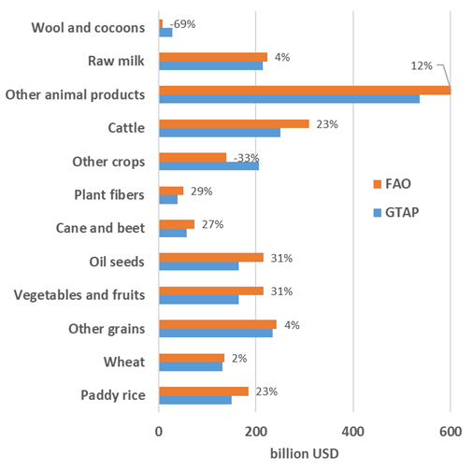
7. Selected challenges: output inconsistencies (1)
Three sectors with <5% difference.
  Raw milk, Other grains and Wheat.
In most cases FAO data is closer to the national statistics/international reports than GTAP-based.
  Paddy rice (Indonesia).
  Vegetables and fruits (Brazil, grapes in EU).
  Oil seeds (olives in EU).
  Wool and cocoons (major producers).
Larger discrepancies observed at the country/regional levels.
Less straightforward to compare processed commodities.
FAO vs GTAP (2011)

Slide 9
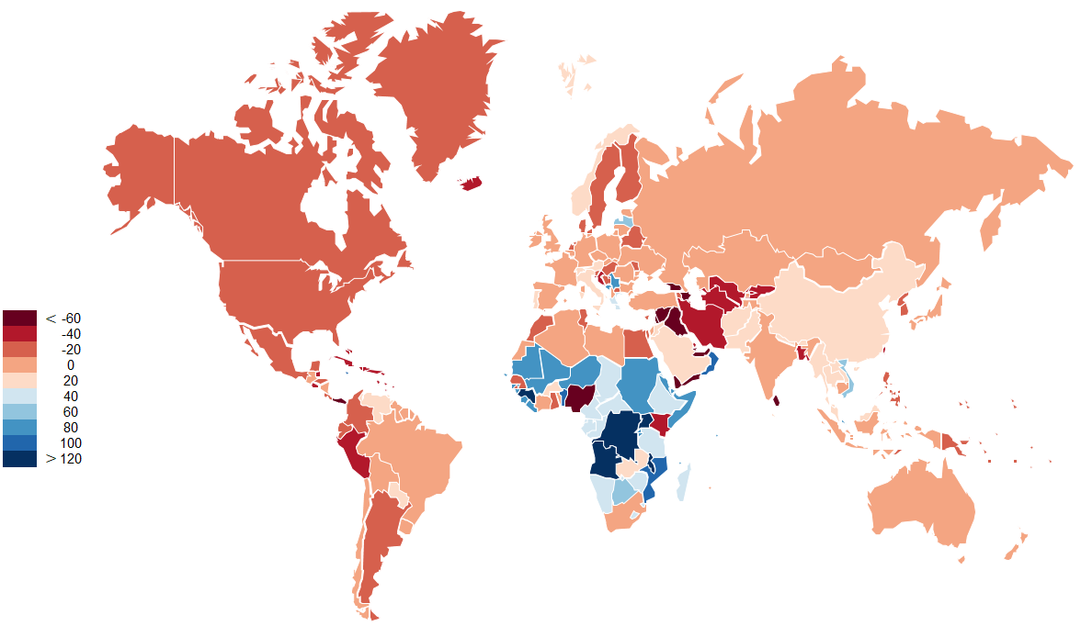
8. Selected challenges: output inconsistencies (2)
Difference between aggregate agricultural output for 2011 with FAO-based APT and standard GTAP data inputs, %

Slide 10
9. Database overview (1)

Slide 11
10. Database overview (2)
  Share of the ‘out of home’ food consumption: USA (34%), Norway (24.6%), France (17%), Denmark (27.6%), Greece (13.2%).

Slide 12
10. Carbon intensity of food consumption

Slide 13
11. Conclusions and further steps
GTAP nutritional database:
  Provides FAO-consistent accounting of the nutritional accounts for CGE modeling.
  Allows for the explicit tracking and redistribution of primary commodities between. food and other categories enabling application in dynamic simulations.
  Needs further verification for the food supplied by service sectors.
Further steps:
  Develop a special release of the GTAP 10 nutritional database.
  GTAP Research Memorandum with documentation.
Notes:
(calories, fats, proteins and carbohydrates)
(feed, seed, losses, other uses)
(based on country-specific data).

Slide 14
Thank you!
Questions/Comments?
mchepeli@purdue.edu

Slide 15
References
Bouët, A., L. Deason, and D. Laborde. 2014. “Global Trade Patterns, Competitiveness and Growth Outlook.” In Promoting Agricultural Trade to Enhance Resilience in Africa, ReSSAKS, Annual Trends and Outlook Report, 2013, eds.O. Badiane, T. Makombe and G. Bahiigwa. Washington DC: IFPRI.
Britz, W. 2020. Maintaining plausible calorie intakes, crop yields and crop land expansion in long-run simulations with Computable General Equilibrium Models. Discussion Paper 2020:2. University of Bonn. https://ageconsearch.umn.edu/record/302922
Chepeliev, M. and Aguiar, A. 2019. Global Greenhouse Gas Taxes on Food Products: Economy-wide, Environmental and Dietary Implications. Paper prepared for the 22nd Annual Conference on Global Economic Analysis, June 19-21, Warsaw, Poland. https://www.gtap.agecon.purdue.edu/resources/download/9976.pdf
Hasegawa T., Fujimori S., Takahashi K. and Masui T. 2015. Scenarios for the Risk of Hunger in the 21st Century using Shared Socioeconomic Pathways, Environmental Research Letters, 10(1), 014010. (http://iopscience.iop.org/1748-9326/10/1/014010)
Hertel, T.W., Verma, M., Bouet A., Cranfield, J.A., and Preckel, P.V. 2007. Global nutrition impacts of rapid economic growth in China and India. Paper prepared for the Tenth Annual Conference on Global Economic Analysis, Purdue University, June 7-9, 2007, as well as the annual meetings of the AAEA, Portland, Oregon, July 29-31. http://ageconsearch.umn.edu/bitstream/9841/1/sp07he06.pdf.
Rutten, M., Tabeau, A., and Godeschalk, F. 2013. A new methodology for incorporating nutrition indicators in economy-wide scenario analyses. FoodSecure Technical Paper No 1, December 2013.
Sands, R. D., Jones, C. A., and Marshall, E. 2014. Global Drivers of Agricultural Demand and Supply (Washington, DC: US Department of Agriculture, Economic Research Service) ERR-174 September 2014.
United Nations (UN). 2015. Sustainable Development Goals. https://sustainabledevelopment.un.org/?menu=1300
Verma, M., and Hertel, T.W. 2009. Commodity price volatility and nutrition vulnerability. Selected paper prepared for presentation at the Agricultural & Applied Economics Association 2009 AAEA & ACCI Joint Annual Meeting, Milwaukee, Wisconsin, July 26-29, 2009. http://ageconsearch.umn.edu/bitstream/49344/2/AAEA%202009%20price%20volatility.pdf
World Health Organization (WHO). 2020. Obesity and Overweight. https://www.who.int/news-room/fact-sheets/detail/obesity-and-overweight

