Slide 1


Challenges and Opportunities of
Economy-Wide Decarbonization Pathways in California
Mei Yuan
Karen Tapia-Ahumada
Sergey Paltsev
23rd Annual Conference on Global Economic Analysis
June 17-19, 2020

Slide 2
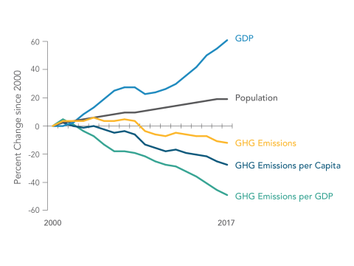
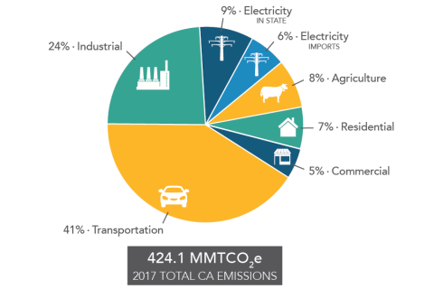
The state’s progress in achieving the statewide GHG target of 431 MMTCO₂e by 2020
GHG and GDP Trend in California
(2000-2017)
GHG Emissions by Economic Sector
(2017)
Source: California Air Resource Board. Available at: https://ww2.arb.ca.gov/ghg-inventory-data

Slide 3
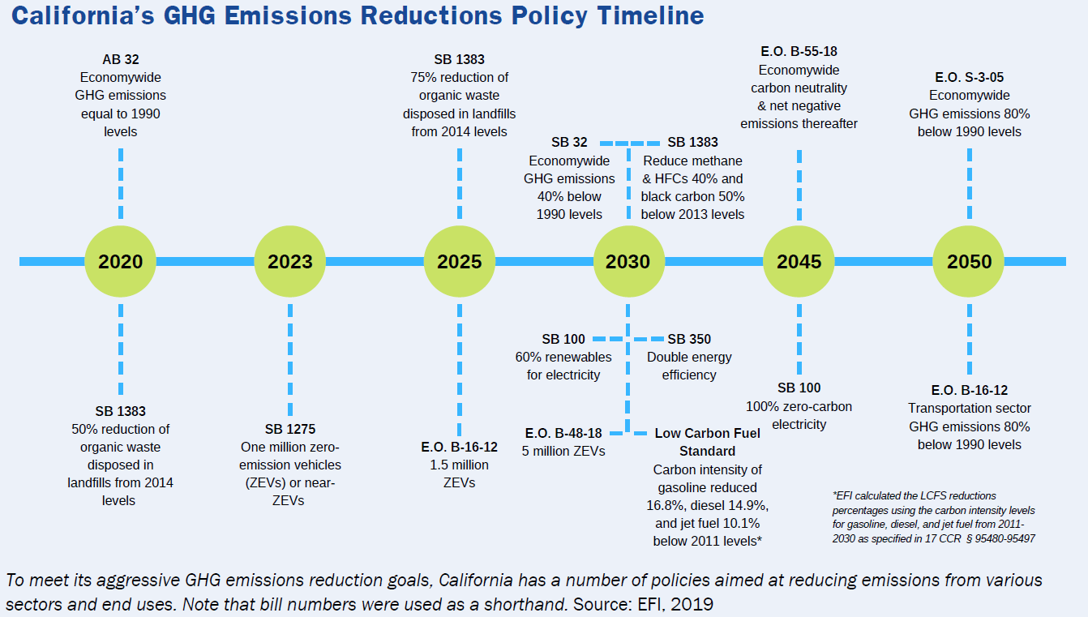
Represented Policy
Electricity Sector
Buildings and Appliances
Partially Represented Policy
Transportation Sector
Economy-wide Emissions

Slide 4
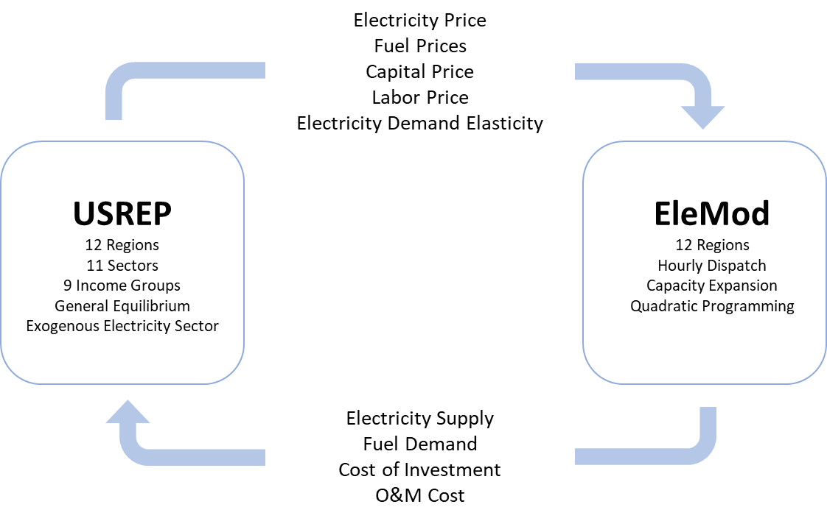
An economy-wide analysis requires an approach that represents technology details in a complete economic system
Incorporating electricity sector details
The key to the economy-wide analysis is to ‘represent’ the technology detail oriented sector in a complete economic system where all production sectors, final consumers, and government interact to take into account the feedback effect
Coupling the Top-Down Macro Model and Bottom-Up Electricity Model
The top-down model determines price responses
The bottom-up model determines quantity responses
A local demand elasticity is estimated to aid convergence in electricity price

Slide 5
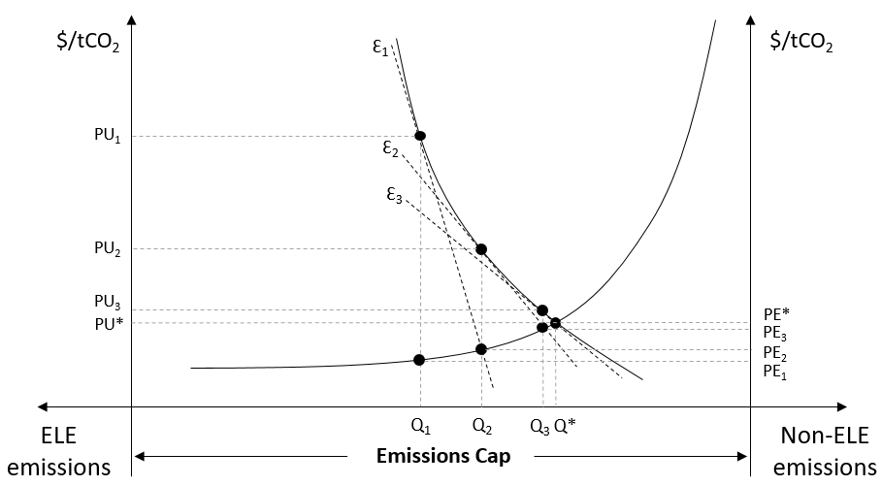
The approach to couple the macro model and the electricity model is extended to the carbon market
Linking carbon market
An economy-wide emissions cap requires marginal cost of abatement to be equalized across all sectors in the economy. An economy-wide carbon market in the electricity model was built as an instrument to implement an emissions trading scheme between the electricity and non-electricity sectors
Non-Electricity Sector Emissions Market in the Electricity Model
The marginal abatement cost (MAC) curve of the electricity sector corresponds to the non-ELE emissions supply curve
The non-ELE emissions demand curve represents MAC of the non-ELE sectors
Marginal cost of abatement is equalized across all sectors
A local demand elasticity is estimated to aid convergence in electricity price

Slide 6
Mitigation pathways represents short-term economic response and the long-term adaptation
The Reference Scenario
Sales-weighted average LDV fuel economy
Renewable Portfolio Standards (RPS)
Deployment target of zero emissions vehicles (ZEV)
Low-carbon fuel standards (LCFS)
REF
Economy-wide GHG emissions reductions of 20% by 2020 and 40% by 2030 from the 1990 level
State’s RPS raised to 50% by 2026, 60% by 2030
The Deployment of Current Technology Scenario
DCT_ATI
State’s clean energy standard to achieve zero emissions in electricity generation by 2045
More important role of renewable natural gas (RNG) feedstock as a perfect substitute for natural gas
Economy-wide GHG emissions reductions of 80% by 2050 from the 1990 level
The Accelerated Technology Innovation Scenario
The High Renewable Natural Gas Scenario
Greater rate of expansion since 2030 with a technology breakthrough around 2040
HiRNG

Slide 7
Transportation decarbonization remains a challenge
Carbon Emissions by Sector
(MMTCO₂)
Despite substantial reductions in transportation emissions, the share of transportation emissions [marked by the percentage in the figure] remains large by 2050, implying a lack of cost-effective mitigation options for the sector
60%
50%
70%
60%

Slide 8
Greater rate of expansion in RNG leads to a reduction in marginal cost of abatement
RNG Consumption and Prices
Carbon Prices (2018$/tCO₂)
Carbon Emissions by Sector (MMTCO₂)
Welfare Change (Equivalent Variation)

Slide 9
RNG provides flexibility for the energy system transition although its role is limited by the mid-term
Evolution of Electricity Generation
(TWh)

Slide 10
Main takeaways
High carbon price by the midterm suggests challenges to meet the targets given the limitation of existing technologies
Potential to cut emissions by displacing natural gas in various sectors by mid-century (2050) provides opportunities in developing mitigation strategies for long-term goals
Increasing dependence on renewables demands greater system flexibility such as the deployment of fast-response electric generating units, additional reserve requirements, transmission interconnections across regions, and energy storage units

Slide 11
Caveats and future direction
Improve the RNG supply representation
Improve the transportation representation
Improve the calibration of electricity generation to historical data
Improve the demand-side technology representation
Account for hourly demand response
Switch to an open-source database for USREP
Extend the study to policy coordination across sectors

Slide 12
Thank you!
Mei Yuan <yuanmei@mit.edu>
Karen Tapia-Ahumada katapia@mit.edu
Sergey Paltsev paltsev@mit.edu

