Slide 1
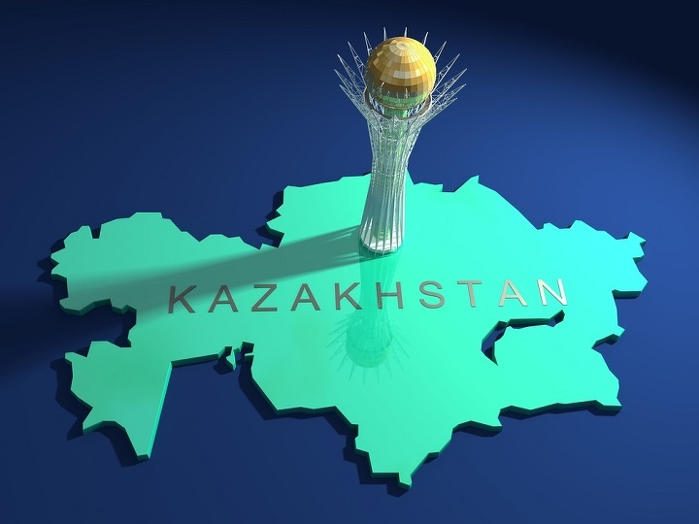
Trade Policy Issues of Oil-rich but Land-locked Country Case: Focusing on Kazakhstan post-WTO entry
Inkyo Cheong
Valijon Turakulov

Slide 2
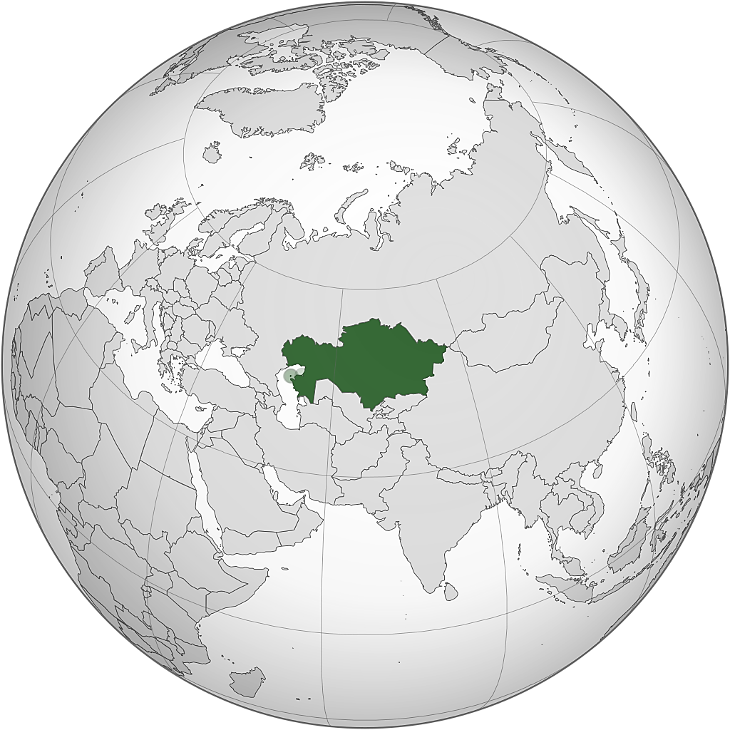
 | Barrels | Global Rank
Oil Reserves | 30,000,000,000 | 12th in the world

Slide 3
Story of Kazakhstan
Kazakhstan WTO accession

Slide 4
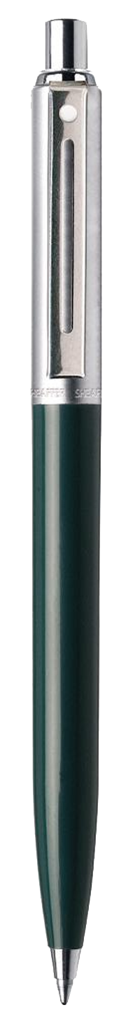
Kazakhstan does/did not gain from the accession
…neutral opinions
Abrash, 2013
Economists Olzhas Khudaibergenov…
Balzhigit and Jun, 2018
…and Zharas Akhmetov, 2015
Director Center for Analysis of Public Issues – Kanat Berentaev
Blyalov, B.E. and Zenich, VA, 2016
Leader of the People's Communist Group – Vladislav Kosarev
Chairman of the Almaty Public Antimonopoly Commission – Petr Svoik
Currency Strategist – Alexander Egorov
Sources are mostly in Kazakh or Russian languages…

Slide 5

What experts say?
Table 1: A literature review whether WTO membership benefits developing countries
Author(s) | It does
Drabek and Bacchetta, 2004 | The WTO membership brings several vital benefits to the Members, but there are limits on how far and how much the Agreements can help.
Tomz, M. et al., 2007 | Trade is higher when both countries had GATT rights and obligations, either as formal members or as nonmember participants, compared with dyads in which neither country belonged to the agreement.
Tang and Wei, 2009 | On average, economic growth rises by 2.5% for at least five years after a country's GATT/WTO accession, leading to a permanently higher output of about 20%.
Felbermayr and Kohler, 2010 | WTO membership results in higher trade for developing countries than for industrial ones. WTO membership results in higher bilateral trade of about 40%, on average.
Chang and Lee, 2011 | The GATT/WTO membership has a significant trade-promoting effect for dyads that have both chosen to be members. (The effect is more substantial than bilateral trade preference arrangements, GSP, and larger than when only one country in a dyad has chosen to be a member.)
Eicher and Henn, 2011 | WTO membership fosters regional trade integration among developing country members at the expense of more distant trade.
Allee and Scalera, 2012 | The more rigorous a state's accession to WTO, and thus the more significant the policy change required, the higher the benefits it will receive from membership in the organization.
Larch, M. et al., 2019 | GATT/WTO promoted trade between all countries (increased by 171%), the impact was much more vital for developing economies.
Author(s) | It does not
Campos, 2004 | WTO membership had a minor impact on trade openness, FDI, and growth, but a positive effect on domestic reform.
Subramanian and Wei, 2007 | WTO membership appears to be more effective in terms of trade-creation for industrial countries than for developing countries.
Drabek and Woo, 2010 | Disappointment and lesser benefits from the WTO membership usually happen when benefits are overestimated while implementation costs are underestimated.
Rose, 2004, 2005, 2007 | Gravity model shows that belonging to WTO matters very little and hard to demonstrate GATT/WTO has encouraged trade.

Slide 6
What domestic experts say?
Table 2: Literature review regarding the opinions of Kazakh experts on the accession
Author(s) | Main conclusion
Sagadiyev, 2003 | The advantages of Kazakhstan's membership in WTO are of a more distant, long-term nature and therefore are not very obvious, while the downsides will quickly and painfully affect the entire domestic economy.
Abdrash, 2012 | Tremendous natural resources, scientific potential, skilled labor - all this can make Kazakhstan competitive in the global economy after the WTO entry.
Abdrash, 2013 | WTO was created by developed countries, which now dictate the rules for entry and the entire legal framework of the process. So, what Kazakhstan sells today to the world market, it can sell without entering the WTO.
Onyusheva and Nizamova, 2015 | Kazakhstan's auto industry is significantly affected as the tariff for importing cars will be declined significantly – from 27.9% to 13.3%.
Blyalov and Zenich, 2016 | The WTO membership increases the competitiveness, industrial production, and quality while weakens the positions of domestic producers due to lower price and reduces the state support.
Amirbekova et al., 2017 | From WTO accession, Kazakhstan's metallurgy industry, and chemical industry benefit while agriculture faces some challenges due to the reduction in state subsidy.
Balzhigit and Jun, 2018 | Low- and middle-income countries do not gain much from the WTO membership, and neither does Kazakhstan.

Slide 7




Economic modelling of Kazakhstan’s accession
Kazybayeva and Tanyeri-Abur (2003)
Jensen and Tarr (2007)
Hindley (2008)
Song (2010)
50% reduction of tariffs in individual sectors and all sectors:
GDP and welfare increased,
Unemployment decreased
100% tariff in individual sectors, and all sectors protection under import substitution policy:
GDP and household welfare decreased,
Unemployment rate increased
The membership in the WTO would have more impact on imports than exports.
The largest source of gains would come from a better institutional framework, liberalization of foreign investments, and a reduction in corruption
Kazakhstan would gain 6.7% of the value of consumption in the medium run
17.5% in the long run…
FDI liberalization in services could account for 70% of the total gains.
Kazakhstan's GDP would increase by 0.02% following WTO membership.
FTAs with Korea, Japan, and China appears to improve Kazakhstan's terms of trade…
…although joining the WTO has an insignificant effect on Kazakhstan's terms of trade

Slide 8
Kazakhstan does/did not gain from the accession
…neutral opinions
Abrash, 2013
Economists Olzhas Khudaibergenov…
Balzhigit and Jun, 2018
…and Zharas Akhmetov, 2015
Director Center for Analysis of Public Issues – Kanat Berentaev
Blyalov, B.E. and Zenich, VA, 2016
Leader of the People's Communist Group – Vladislav Kosarev
Chairman of the Almaty Public Antimonopoly Commission – Petr Svoik
Currency Strategist – Alexander Egorov
Sources are mostly in Kazakh or Russian languages…

Slide 9

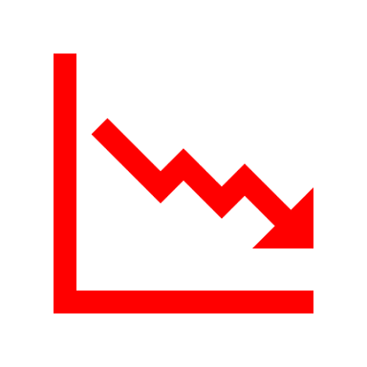

However, our findings highlight that the economic recession of Kazakhstan is NOT due to the WTO membership…
STEP 01
STEP 02
STEP 03
RELIANCE ON RAW MATERIAL
TERMS OF TRADE
CGE SIMULATION
- 35% of the country’s GDP comes from oil and gas.
- 75% of total exports.
- Relationship between economic growth and terms of trade (Kose, 2002; Mendoza, 1995; Cakir, 2009).
Trade liberalization scenario
Oil price shock scenario

Slide 10
Kazakhstan WTO accession
The world oil price dramatically decreased in 2013-2015, it led to significant terms of trade shock for the Kazakhstan economy (Madani, 2016).
Kose (2002) mentions the impact of changes in world prices has a significant effect on the economic cycle, especially in developing countries.
The terms of trade of Kazakhstan are usually defined by the change in the oil price and its production (World Bank, 2018).

Slide 11
Many studies such as Kose (2002), Mendoza (1995), Cakir (2009) have already proved that there is a relationship between the terms-of-trade and economic growth.
Mendoza (1997) explains that instability in terms of trade reduces savings activities, which negatively affects capital accumulation and economic growth.

Slide 12
Brief Conclusion
Economic slowdown post-WTO membership is a continuation of the recession that originated in 2012-13 because of the oil price plunge.
Drop in the world oil price (as well as Kazakhstan’s involvement in EAEU) is one of the main contributors to weakening the terms of trade.
The economic growth declined.

Slide 13
Simulation model and database [GTAP v10, static CGE]
Figure 3: Regional and sectoral aggregation
8 Regions | 10 Sectors
1 Kazakhstan | 1 Agri
2 China | 2 Minerals
3 Japan | 3 Oil_Gas
4 Korea | 4 Foods
5 US_Canada | 5 Manufact
6 EU_28 | 6 Chemical
7 EAEU_CIS | 7 Metals
8 RestofWorld | 8 Pas_Vehicles
 | 9 Com_Vehicles
 | 10 Services
Source: Aggregated by the authors in GTAPAgg2

Slide 14
Simulation model and database
Figure 5: RunGTAP scenarios' description
Scenario | Scenario 1: Implementing the final bound rate | Scenario 2: 10% drop in the oil price | Scenario 3: 20% drop in the oil price
Description | Import tariff reduction because of the WTO accession | Along with FBR implementation, a 10% reduction in the oil price | Along with FBR implementation, a 20% reduction in the oil price
Aggregation | 8 regions and 10 sectors | 8 regions and 10 sectors | 8 regions and 10 sectors
Reference year | 2014 (GTAP v10's benchmark year) | A new baseline based on Scenario 1 | A new baseline based on Scenario 1

Slide 15
Simulation model and database
Kazakhstan WTO accession
Shock year tariff rate
By the end of 2020, Kazakhstan will have lowered 3,512 import tariff lines to an average of 6.1%.

Slide 16
Results
Figure 6: Macroeconomic changes in the region's economy
 | Welfare change, $ million |  |  | change (%), in
 |  |  |  | real GDP |  |  | TOT
 | S1 | S2 | S3 | S1 | S2 | S3 | S1 | S2 | S3
1 Kazakhstan | 631 | -4612 | -9686 | 0.2 | -0.04 | -0.17 | -0.04 | -3.86 | -7.84
2 China | 221 | 27802 | 53007 | 0.0 | 0.02 | 0.04 | 0.01 | 0.47 | 0.89
3 Japan | 6 | 21309 | 42668 | 0.0 | 0.05 | 0.10 | 0.00 | 1.62 | 3.30
4 Korea | 188 | 12740 | 25706 | 0.0 | 0.12 | 0.24 | 0.03 | 1.28 | 2.61
5 US_Canada | -56 | 9109 | 5316 | 0.0 | -0.01 | -0.09 | 0.00 | 0.28 | 0.56
6 EU_28 | 109 | 53290 | 105735 | 0.0 | 0.05 | 0.09 | 0.00 | 0.53 | 1.09
7 EAEU_CIS | -214 | -15000 | -27016 | 0.0 | 0.52 | 1.28 | -0.04 | -2.66 | -5.42
8 RestofWorld | -354 | -88999 | -199338 | 0.0 | -0.04 | -0.20 | 0.00 | -0.81 | -1.58
Source: Authors' calculation in static CGE model

Slide 17
Results
Figure 7: Changes in Kazakhstan's economic sectors
 | change (%) in
 | Export |  |  | Import |  |  | Import price
 | S1 | S2 | S3 | S1 | S2 | S3 | S1 | S2 | S3
1 Agri | 1.3 | 6.2 | 13.1 | 3.0 | -2.4 | -5.0 | -1.8 | -0.3 | -0.6
2 Minerals | 0.3 | 2.9 | 5.8 | 0.2 | -0.8 | -2.0 | -0.3 | -0.5 | -0.8
3 Oil_Gas | 0.1 | 3.1 | 8.2 | 0.0 | 39.5 | 124.3 | 0.0 | -8.7 | -17.8
4 Foods | 0.5 | 5.3 | 11.1 | 3.9 | -3.0 | -6.3 | -2.5 | -0.4 | -0.7
5 Manufact | 1.2 | 10.7 | 22.6 | 1.0 | -1.8 | -3.8 | -1.3 | -0.1 | -0.3
6 Chemical | 0.3 | -9.7 | -23.8 | 1.5 | 1.4 | 4.1 | -1.0 | -1.5 | -3.0
7 Metals | 0.4 | 9.8 | 19.9 | 1.7 | -2.1 | -4.3 | -0.9 | -0.3 | -0.6
8 Pas_Vehicles | 2.9 | 7.8 | 16.1 | 6.2 | -1.9 | -4.0 | -12.1 | -0.2 | -0.4
9 Com_Vehicles | 0.4 | 6.3 | 12.1 | -0.6 | -2.0 | -4.0 | 0.9 | -0.6 | -1.1
10 Services | 0.2 | 7.0 | 14.6 | 0.2 | -3.7 | -7.4 | 0.0 | 0.2 | 0.4
Total | 7.6 | 49 | 100 | 17.1 | 23.0 | 91.8 | -19.0 | -12.6 | -24.9
Source: Authors' calculation in static CGE model

Slide 18
Conclusion Remarks
The trade liberalization scenario found out that the lower tariffs improve consumer's welfare and the GDP.
The number of imported and exported goods increases.
Kazakh consumers enjoy the cheaper imported goods in their local market.

Slide 19
Conclusion Remarks
However, a potential drop in the energy price could worsen off the country's welfare and the terms of trade as well as could decrease the GDP growth.
  This potentiality should be a signal for the Kazakh policymakers to foster diversifying the economy.

Slide 20
Thanks for your attention!
Inkyo Cheong: Ph.D., Prof. Of international trade, Inha University, Incheon, Korea, inkyoc@gmail.com
Turakulov Valijon: Ph.D. Student of international trade, Inha University, Incheon, Korea, valiy.uz@gmail.com

