Slide 1
Regional Trade and Economic Development : Options for Pakistan
Muhammad Aamir Khan , PhD
Assistant Professor
COMSATS University, Islamabad.

Slide 2
Pakistan Trade Agreements
PAKISTAN
Free Trade Agreement (FTA)
Preferential Trade Agreement (PTA)
Multilateral Free Trade Agreement
Preferential Arrangement
EU GSP Plus (2014)
South Asia Free Trade Agreement (2006)
Iran (2004)
Indonesia(2005)
Mauritius (2007)
PTA-D8**
Sri Lanka (2004)
China (2007)
Malaysia (2007)
Turkey*
Thailand*
South Korea*
* Potential Pakistan Free Trade Agreements (Ministry of Commerce, 2018)
** The 8 African and Asian developing countries include Pakistan, Egypt, Nigeria, Bangladesh, Turkey, Malaysia, Iran, Indonesia.

Slide 3
Pakistan-China Free Trade Agreement
Phase 1:
  July 2007 to Dec-2012
  Pakistan gave market access in 5686 Tarif lines out of a total of 6711.
  China offered access to in 6418 tariff lines out 7550.
Phase 2:
  Initially, Pakistan and China agreed to implement the second phase in 2013 – elimination in 90 percent of all tariff lines.
  Phase 3: Phase- II effective from 1st Jan, 2020.
“Pakistan get market access at par with ASEAN”.

Slide 4
Pakistan-China Trade Agreement
In 2006, 9.8% of all imports in Pakistan were from China.
By the end of the fiscal year 2017, this had expanded to around 40%.
Trade Deficit :
2006-7 = 3.2 Billion $
2017 = 14 Billion $

Slide 5
Issues with Pakistan-China Free Trade Agreement (Phase I)
Unequal utilization:
  Pakistan could only exploit 350 tariff lines out of 7,550 total. (i.e, 4.5% utilization)
  China utilized 60 % of Pakistan’s concessions in 1st Phase (2007-12).
ASEAN-China FTA
  Implemented in July 2005
  ASEAN was granted more concessions than Pakistan in key products where they are competitors.

Slide 6
Chinese Tariff on Pakistan and ASEAN goods
 | 2007 |  | 2014
Sector Detail | Tariffs on Pakistan goods % | Tariff on ASEAN goods % | Tariffs on Pakistan goods % | Tariff on ASEAN goods %
Grain Crops | 22.61 | 2.94 | 4.57 | 2.03
Veg and Fruit | 7.56 | 0.39 | 12.1 | 0
Meat Livestock | 11.36 | 6.00 | 7.22 | 0
Wood n Paper | 4.52 | 0.93 | 2.8 | 0.5
Other Food | 4.68 | 8.96 | 6.99 | 2.2
Leather | 6.95 | 8.02 | 5.87 | 0
Wearing apparel | 12.76 | 11.72 | 8.6 | 0
Textiles | 3.11 | 6.70 | 2.9 | 0.2
Chemical Rubber | 6.98 | 3.75 | 4.8 | 1.79
Machinery | 3.29 | 2.98 | 10.8 | 0
Source: GTAP Data base 10a (Base year 2007 + 2014)

Slide 7
South Asian Free Trade Agreement (SAFTA)
January 2004: South Asian Free Trade Agreement was reached at the 12th SAARC summit at Islamabad, Pakistan.
Created a framework for a Free Trade area covering 1.7 Billion people in the region.
Zero customs duty on the trade of practically all products in the region by the end of 2016.
Not fully Operational yet.

Slide 8
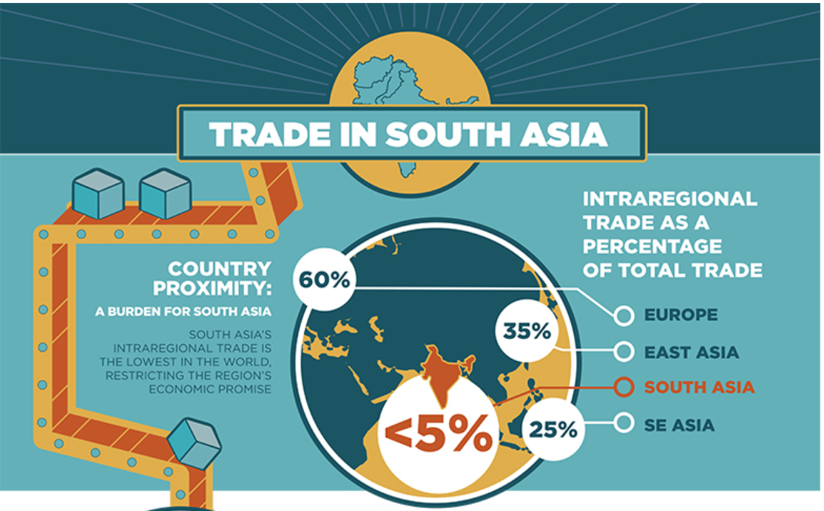
Source: World Bank Report (2016)

Slide 9
Pakistan-India Trade
Pakistan shares its longest land border with India but Trade b/w 2 countries is well below Potential.
Pak Exports to India (2018) = 1930 Million US $
India Exports to Pak (2018) = 383 Million US $
India withdrawn Pakistan’s MFN/NDMA status in 2019.
India imposed 200% import duty on Pakistani products.
WORLD BANK – 2018 “without artificial barriers, Pakistan and Indian potential trade should be $37 billion.”
Source : A Glass Half Full : The Promise of Regional Trade in South Asia

Slide 10
Experiments
Sim I - Extended Pakistan-China FTA (PC-EXT)/ Phase II : MFN Tariffs. Same Concession as awarded to ASEAN.
Sim II – (PI-Pal) Indian recent Tariff Increase by 200 Percent for Pakistani Commodities.
Sim III - Potential Pak-India MFN/NDMA : Pakistan-India NDMA (MFN Rates) + Trade Facilitation ( 10 percent)
Sim IV- SAFTA: Full implementation of South Asian Free Trade Agreement (SAFTA)

Slide 11
METHODOLOGY

Slide 12
Database
Two comprehensive datasets are applied in this study using MyGTAP data facility (Minor and Walmsley, 2016):
  The GTAP Data base 10a (Aguiar et.al 2019)
  The latest available comprehensive Pakistan SAM 2011 (IFPRI, 2016)

Slide 13
Global Economic Trade Model
Global Commutable General Equilibrium Model
      MyGTAP Model (Walmsley and Minor, 2016)
      Separate Govt and Private HH
      Multiple HH and Factors. (16 HH , 12 FoP)
      Transfer b/w HH and Government
      Foreign Aid and Remittances

Slide 14
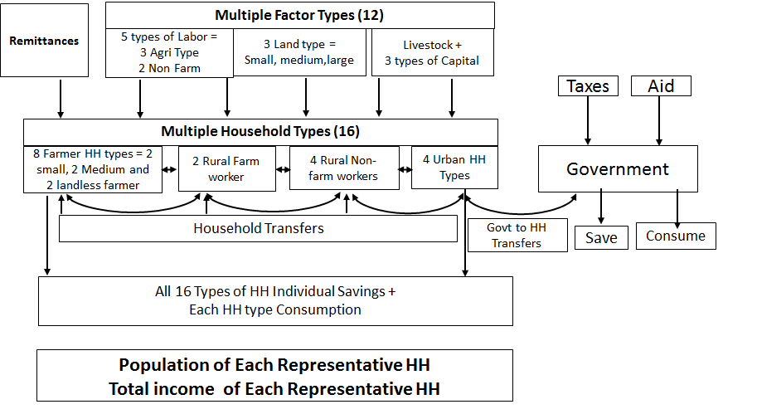
Multiple HH using MyGTAP
Source: Author(s)’s own design

Slide 15
Representative Households (Pakistan)
No | Pakistan Household Types | HH Code | Members per group | Income per capita | Income per day (US $)
1 | Rural farm worker (quartile 1) | hhd-rw1 | 6.3 | 20,682 | 0.66
2 | Rural non-farm (quartile 1) | hhd-rn1 | 12.6 | 28,571 | 0.91
3 | Urban (quartile 1) | hhd-u1 | 5.9 | 38,720 | 1.23
4 | Rural landless farmer (quartile 1) | hhd-rl1 | 8.3 | 42,379 | 1.35
5 | Rural non-farm (quartile 2) | hhd-rn2 | 4.2 | 43,075 | 1.37
6 | Rural small farmer (quartile 1) | hhd-rs1 | 3.3 | 46,231 | 1.47
7 | Rural medium+ farmer (quartile 1) | hhd-rm1 | 10.9 | 49,587 | 1.58
8 | Urban (quartile 2) | hhd-u2 | 8.8 | 65,159 | 2.08
9 | Rural farm worker (quartile 234) | hhd-rw234 | 9.1 | 83,320 | 2.65
10 | Rural non-farm (quartile 3) | hhd-rn3 | 15.6 | 84,887 | 2.70
11 | Urban (quartile 3) | hhd-u3 | 0.2 | 88,147 | 2.81
12 | Rural landless farmer (quartile 234) | hhd-rl234 | 7.3 | 99,296 | 3.16
13 | Rural small farmer (quartile 234) | hhd-rs234 | 11.5 | 111,089 | 3.54
14 | Rural non-farm (quartile 4) | hhd-rn4 | 6.3 | 207,343 | 6.61
15 | Rural medium+ farmer (quartile 234) | hhd-rm234 | 2.9 | 220,813 | 7.03
16 | Urban (quartile 4) | hhd-u4 | 17.1 | 414,874 | 13.22

Slide 16
RESULTS

Slide 17
Macroeconomic impacts (% changes)
 | Sim-I | Sim-II | Sim-III | Sim-IV
 | Ext-Pak China | India Tariff-200 | PK-India NDMA | SAFTA
 | % Change (Monetary Change) Million US $ | % Change (Monetary Change) Million US $ | % Change (Monetary Change) Million US $ | % Change (Monetary Change) Million US $
Real GDP | 0.016 (39) | -0.003(-7) | 0.12 (290) | 0.19 (463)
Real Exports | 1.95 (596 ) | -0.13 (-42) | 2.764 (841) | 5.1 (1532)
Real Imports | 1.07 (621 ) | -0.152 (-88) | 1.38 (800) | 3.9 (2240)
Terms of Trade | 0.029 | -0.108 | -0.071 | 1.17

Slide 18
Pakistan Exports (% changes)
 |  | Sim-I | Sim-II | Sim-III | Sim-IV
Sectors | BAU (2014) Million US $ | P-C Ext (%) | Ind T + 200 (%) | PK-IND NDMA (%) | SAFTA (%)
Grain Crops | 2653 | -1.73 | -0.45 | 2.78 | -1.34
Veg and Fruit | 662 | 2.38 | -9.581 | 25.0 | 42.90
Meat Livestock | 415 | -0.04 | -0.252 | 2.23 | -2.436
Wood n Paper | 148 | 1.53 | 0.05 | 1.80 | 30.35
Other Food | 1525 | 0.04 | 0.42 | 0.31 | 19.74
Textile | 9783 | 4.6 | 0.47 | 1.73 | 6.6
Wearing apparel | 4938 | -0.47 | 1.07 | 0.12 | -8.1
Leather | 715 | 10.6 | -3.65 | 17.2 | 8.2
Chemical Rubber | 1209 | 0.04 | 0.42 | 0.31 | 19.75
Machinery | 213 | 2.9 | 0.14 | 2.77 | 65.56
Motor Vehicle | 110 | 3.4 | 0.08 | 1.9 | 0.72
Metals | 1615 | 2.14 | -0.425 | 4.008 | 4.252

Slide 19
Pakistan Imports (% changes)
Exports | Sim-I | Sim-II | Sim-III | Sim-IV
 | P-C Ext | Ind T + 200 | PK-IND NDMA | SAFTA
Grain Crops | 1.48 | -0.39 | 7.03 | 10.74
Veg and Fruit | 0.76 | -0.60 | 3.59 | 7.40
Meat Livestock | 2.80 | -0.20 | 1.21 | 4.57
Wood n Paper | 0.78 | -0.11 | -0.23 | 3.45
Other Food | 0.52 | -0.25 | 2.61 | 5.17
Textile | 6.35 | -0.31 | 4.61 | 9.03
Wearing apparel | 11.76 | -0.50 | 1.78 | 10.36
Leather | 9.69 | -0.34 | 0.41 | 4.85
Chemical Rubber | 0.41 | -0.12 | 2.76 | 5.46
Machinery | 0.71 | -0.05 | 0.32 | 1.91
Motor Vehicle | 1.84 | -0.06 | 0.45 | 2.75
Metals | 1.568 | -0.095 | 0.656 | 4.421

Slide 20
Pakistan Real Household Income (% changes)
 |  | Sim-I | Sim-II | Sim-III | Sim-IV
 |  | P-C Ext | Ind T + 200 | PK-IND NDMA | SAFTA
hhd-rs1 | Rural small farmer (Q1) | 0.522 | -0.293 | 0.476 | 1.643
hhd-rs234 | Rural small farmer (Q234) | 0.534 | -0.292 | 0.476 | 1.639
hhd-rm1 | Rural medium+ farmer (Q1) | 0.616 | -0.153 | 0.182 | 1.051
hhd-rm234 | Rural medium+ farmer (Q234) | 0.603 | -0.128 | 0.128 | 0.972
hhd-rl1 | Rural landless farmer (Q1) | 0.559 | -0.304 | 0.481 | 1.619
hhd-rl234 | Rural landless farmer (Q234) | 0.483 | -0.221 | 0.307 | 1.383
hhd-rw1 | Rural farm worker (Q1) | 0.18 | -0.143 | 0.208 | 1.404
hhd-rw234 | Rural farm worker (Q234) | 0.055 | -0.113 | 0.118 | 1.381
hhd-rn1 | Rural non-farm (Q1) | -0.318 | -0.035 | -0.151 | 1.22
hhd-rn2 | Rural non-farm (Q2) | -0.343 | -0.038 | -0.165 | 1.253
hhd-rn3 | Rural non-farm (Q3) | -0.358 | -0.039 | -0.173 | 1.278
hhd-rn4 | Rural non-farm (Q4) | -0.365 | -0.039 | -0.169 | 1.342
hhd-u1 | Urban (Q1) | -0.202 | -0.075 | -0.062 | 1.299
hhd-u2 | Urban (Q2) | -0.278 | -0.055 | -0.118 | 1.275
hhd-u3 | Urban (Q3) | -0.314 | -0.048 | -0.143 | 1.288
Hhd-u4 | Urban (Q4) | -0.335 | -0.042 | -0.152 | 1.038
Quartiles (Q) also represent ecological zones. Quartile 1 or Q1 represents the largest province in Pakistan, Punjab; while Quartile 234 represents Sindh, Khyber Pakhtunkhwa and Baluchistan provinces.

Slide 21
Pakistan Real Factor Wages (% changes)
 |  | Sim-I | Sim-II | Sim-III | Sim-IV
 |  | P-C Ext | Ind T + 200 | PK-IND NDMA | SAFTA
hhd-rs1 | Rural small farmer (Q1) | 0.788 | -0.211 | 0.735 | 0.971
hhd-rs234 | Rural small farmer (Q234) | 0.742 | -0.048 | 0.406 | 0.47
hhd-rm1 | Rural medium+ farmer (Q1) | 0.765 | -0.196 | 0.741 | 0.962
hhd-rm234 | Rural medium+ farmer (Q234) | -0.14 | 0.053 | 0.059 | 0.529
hhd-rl1 | Rural landless farmer (Q1) | -0.255 | 0.043 | -0.027 | 0.386
hhd-rl234 | Rural landless farmer (Q234) | 0.96 | -0.412 | 1.057 | 1.209
hhd-rw1 | Rural farm worker (Q1) | 0.915 | -0.158 | 0.52 | 0.328
hhd-rw234 | Rural farm worker (Q234) | 0.859 | 0.157 | -0.142 | -0.754
hhd-rn1 | Rural non-farm (Q1) | 0.519 | -0.007 | 0.488 | 1.077
hhd-rn2 | Rural non-farm (Q2) | 0.89 | 0.01 | 0.202 | -0.326
hhd-rn3 | Rural non-farm (Q3) | -0.193 | 0.046 | 0.039 | 0.462
hhd-rn4 | Rural non-farm (Q4) | -0.231 | 0.04 | 0.001 | 0.415
hhd-u1 | Urban (Q1) | 0.788 | 0.046 | 0.735 | 0.971
hhd-u2 | Urban (Q2) | 0.742 | 0.04 | 0.406 | 0.47
hhd-u3 | Urban (Q3) | 0.765 | -0.211 | 0.741 | 0.962
Hhd-u4 | Urban (Q4) | -0.14 | -0.048 | 0.059 | 0.529

Slide 22
Income Inequality (Gini Coefficient)
 |  | Sim-I | Sim-II | Sim-III | Sim-IV
 |  | Ext-Pak China | India Tariff-200 | PK-India NDMA | SAFTA
 | Base Gini Value | % Change | % Change | % Change | % Change
Gini Coefficient | 0.4485 | -0.013 | 0.008 | -0.04 | -0.001

Slide 23
Conclusion and Recommendation
Extended Pakistan China - FTA: With same Tariff concession as awarded to ASEAN, there is a positive impact on Pakistan Economy.
Normalizing trading relations with India : Win-Win Scenario
Full implementation of SAFTA : Positive impact on Pakistan Real GDP, Trade + reduces the gap between the poor and the rich households in Pakistan.
Multilateral Trade Liberalization is generally better for Pakistan compared to bilateral trade Liberalization.

Slide 24

THANKS

