Slide 1
Impacts of climate and biophysical variability on global agriculture markets
Xin Zhao,
K. Calvin, A. Snyder,
M. Wise, S. Waldhoff,
M. Hejazi, and J. Edmonds
Joint Global Change Research Institute

Slide 2

Xin Zhao
Hooded by
Dr. Wallace Tyner

Slide 3
Impacts of climate and biophysical variability on global agriculture markets
Xin Zhao,
K. Calvin, A. Snyder,
M. Wise, S. Waldhoff,
M. Hejazi, and J. Edmonds
Joint Global Change Research Institute

Slide 4
Perfect foresight or not?
  Decisions of land allocation, irrigation, management
  Time lag between planting and harvesting
  Suboptimal decisions
  Endogenous market fluctuation
Decisions
in the
real world
  Incorporate expectation schemes from economic literature into model
  Adaptive expectation (Nerlove, 1958)
    Adaptively adjust expectations based on new information
    Supported by some empirical studies
Expectation
scheme
Perfect foresight
in
economic modeling
Ignore the time lag between planting and harvesting
Perfectly predict future climate (weather) and market conditions
Make adjustments in decisions immediately
Convenient assumption but criticized in economic literature

Slide 5
Why is separating planting & harvesting important?
Assessing the interannual variability of climate impacts on agriculture and land use
  Relationship between climate variability and economic responses
Modeling
chain
Climate model
Crop model
Economic Model
(GCAM)
Temperature
Precipitation
Etc.
Biophysical yield
Harvested area
Production
Consumption
Prices
Etc.
Variable
  Biophysical yield is an agronomic representation of all climate variables
  Annual projections of biophysical yield were not used
    Longer time steps in economic models (AgMIP focused on 2050; Nelson et al. 2014)
    Perfect foresight assumption

Slide 6
GCAM
GCAM
  Dynamic recursive PE
    Detailed representation energy, agriculture, land, water, climate, etc.
    14 crops & 6 livestock sectors
    32 regions * 232 water basins
    2010 base year
    5-year step; changed to annual step
  Baseline
    SSP2 & growing global crop yields (FAO)
  Used in AgMIP

Slide 7
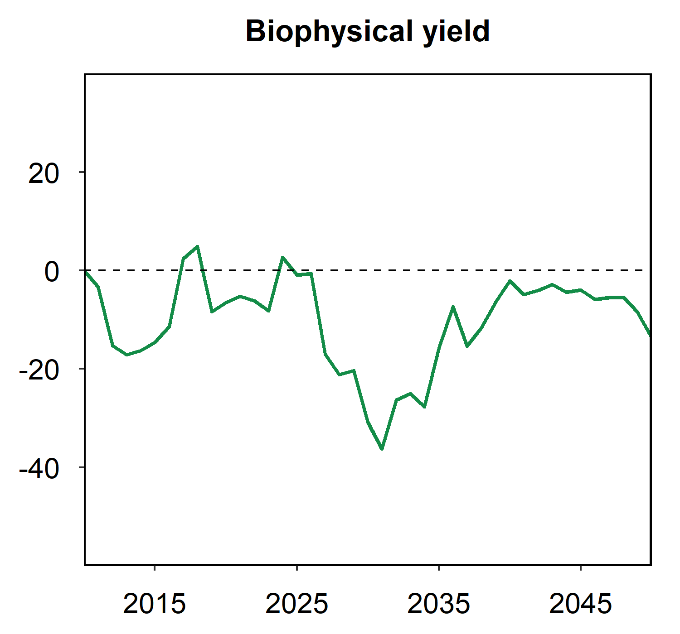
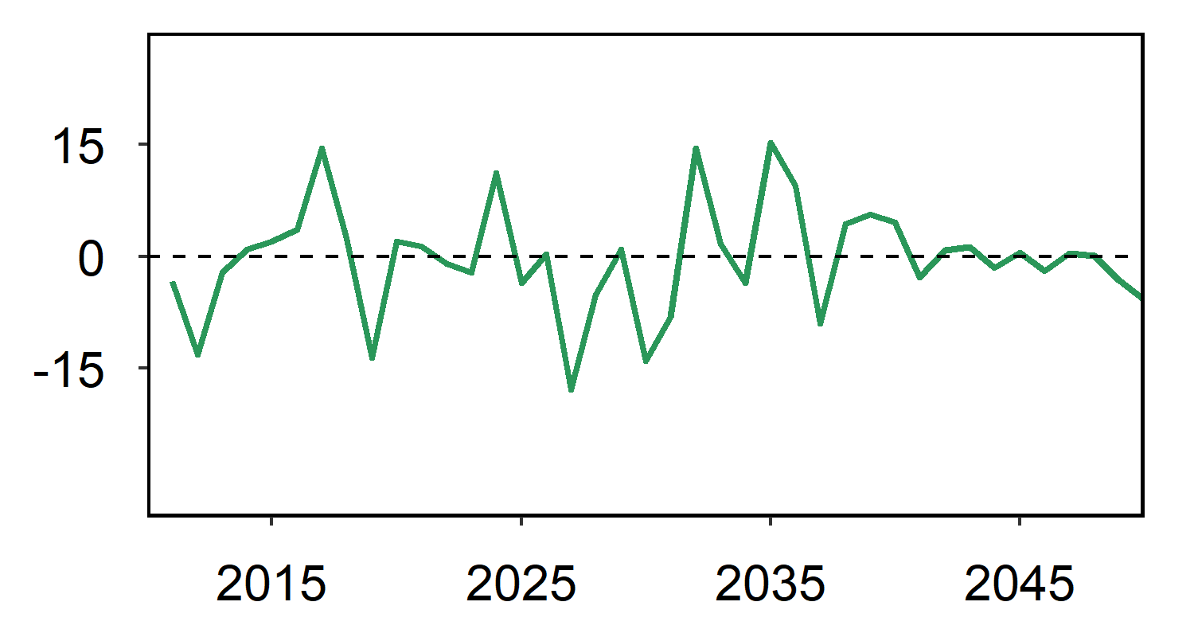
Biophysical yield shocks
A high-emissions scenario
  RCP8.5 & GFDL-EPIC
  AgMIP data
Interannual variability (IAV)
  SD of annual percent change (log diff.)
  US oil crop (soybeans): 7.4%
Climate vs. no climate (%)
-14%
US oil crop
(soybeans)
7.4%
Interannual (%)

Slide 8
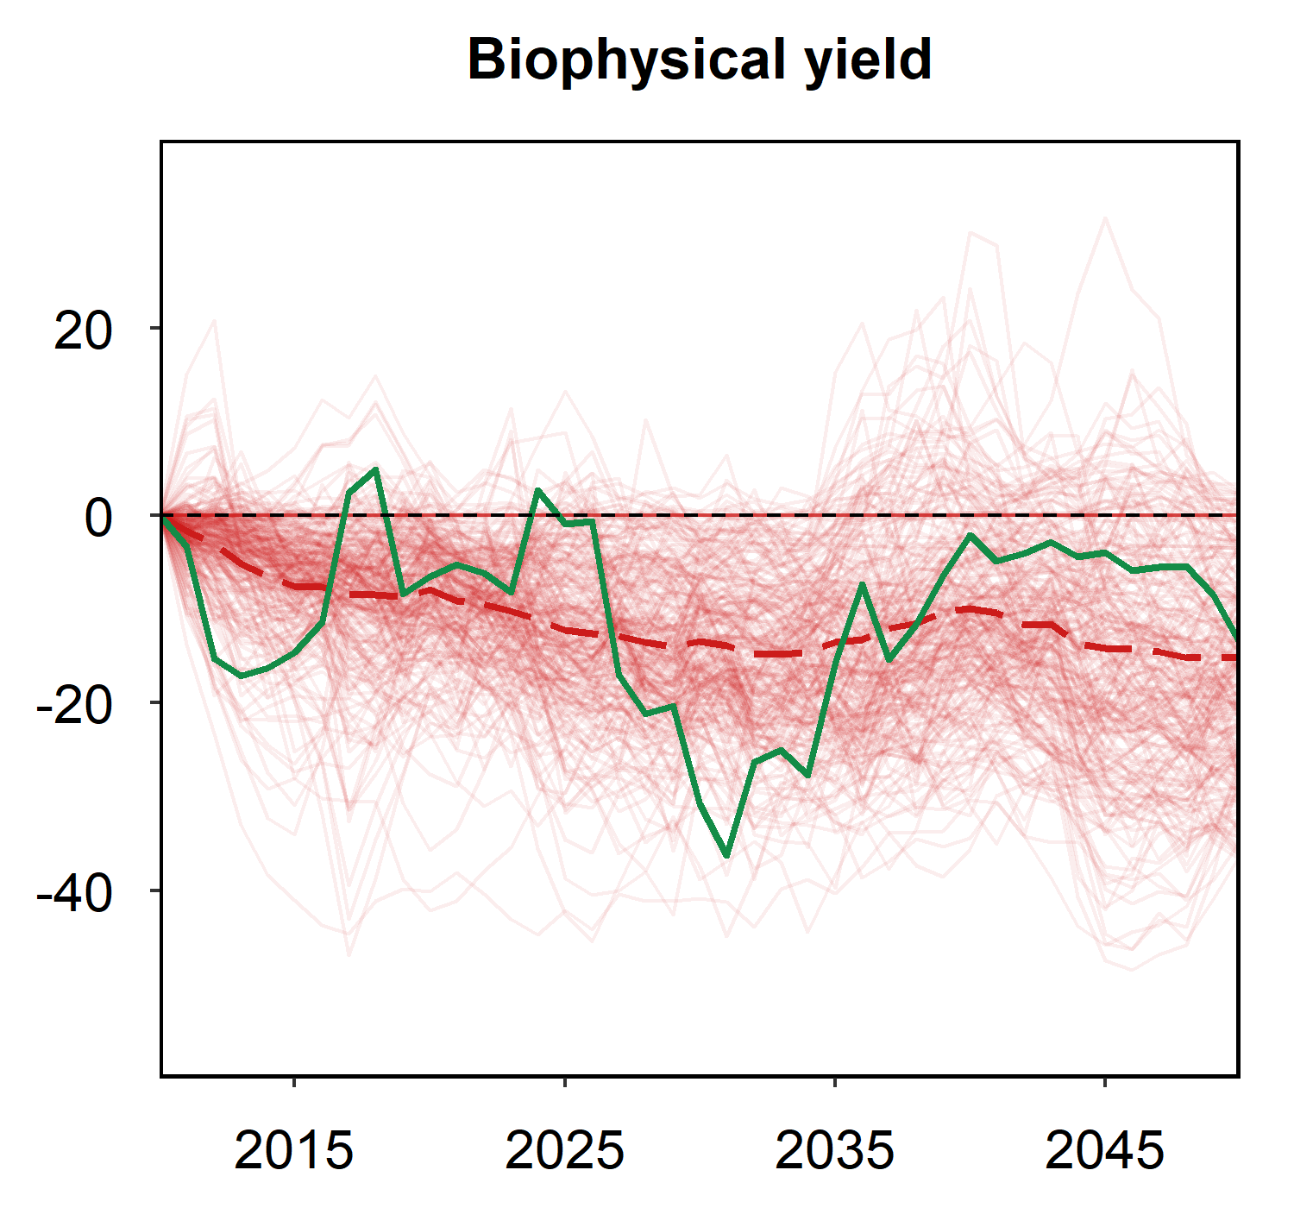
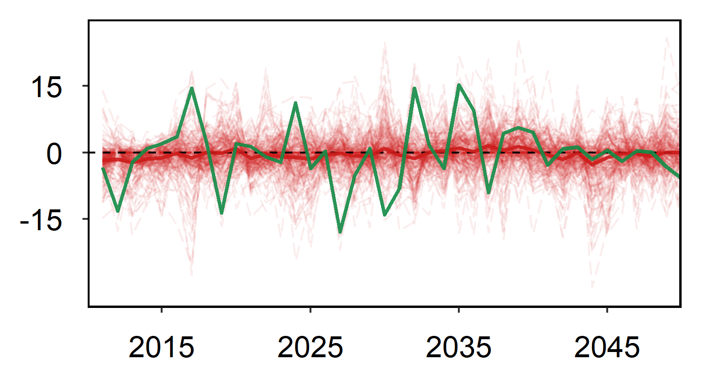
Biophysical yield shocks
A high-emissions scenario
  RCP8.5 & GFDL-EPIC
  AgMIP data
  Mapped to 12 GCAM crops * 32 region
    C3/C4 average impacts
Interannual variability (IAV)
  SD of annual percent change (log diff.)
  US oil crop (soybeans): 7.4%
  World: 4%
Other
region-crops
Climate vs. no climate (%)
-14%
World
average
-15%
US oil crop
(soybeans)
7.4%
Interannual (%)
4.0%

Slide 9
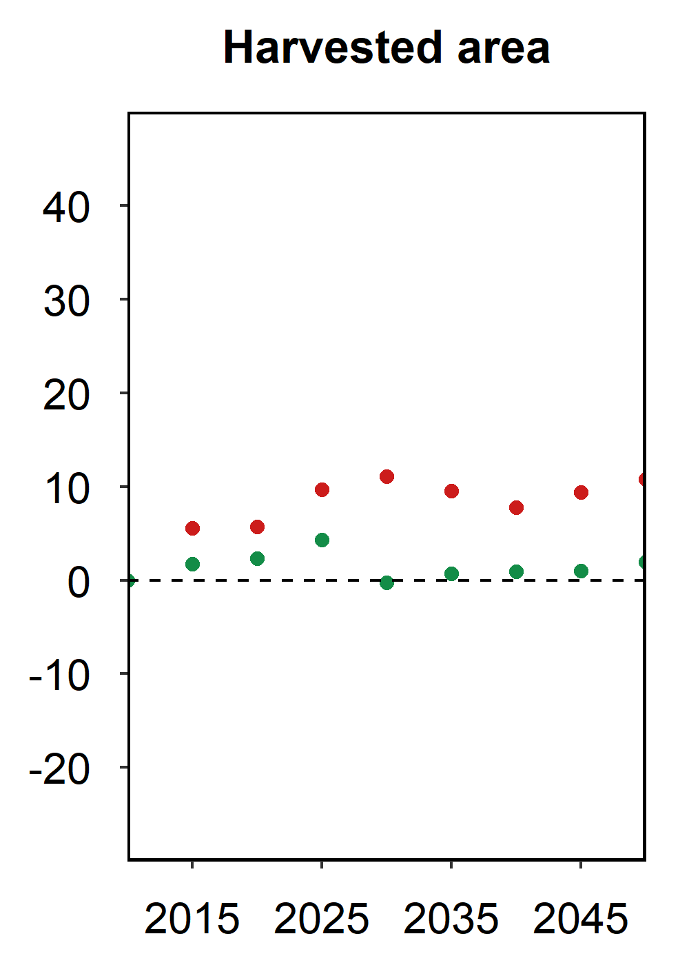
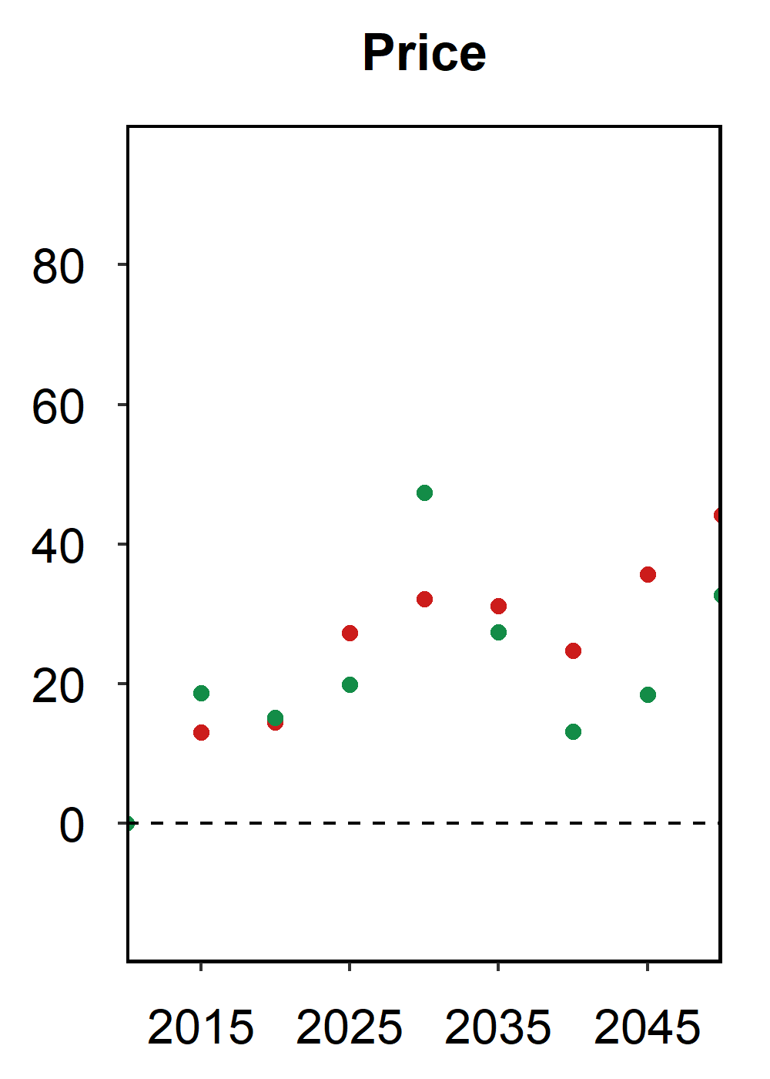
Climate impacts on agriculture
Original GCAM results
Other
region-crops
World average
Climate vs. no climate (%)
Climate vs. no climate (%)
World
average
US oil crop
(soybeans)
US oil crop
(soybeans)
7.4%
Interannual (%)
4.0%

Slide 10
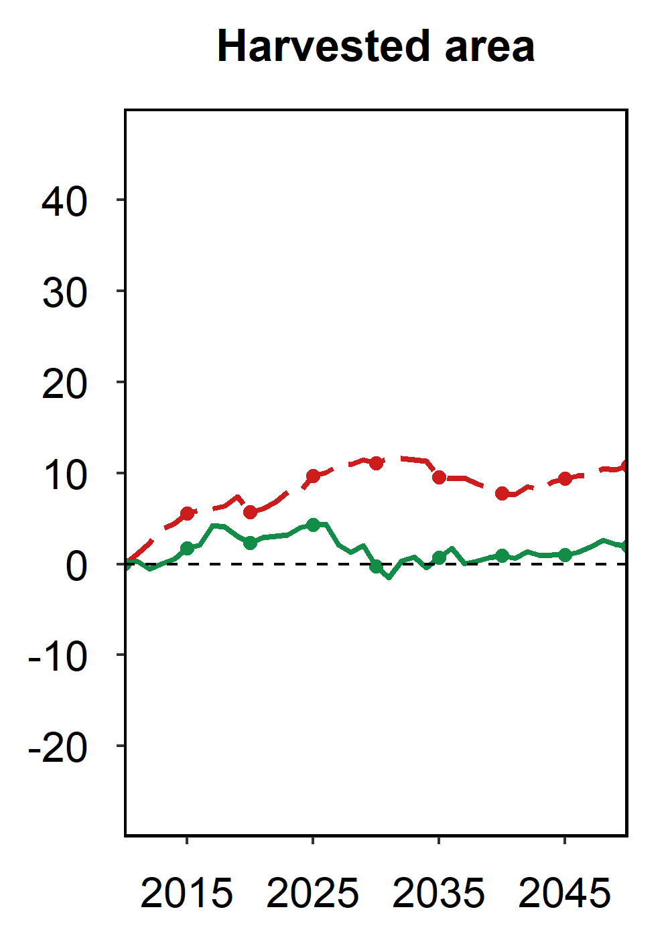
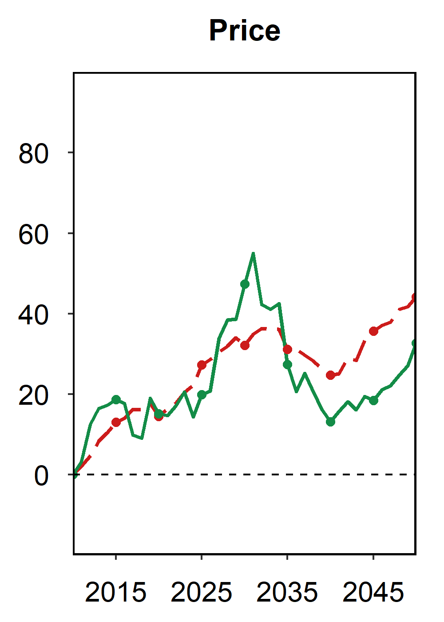
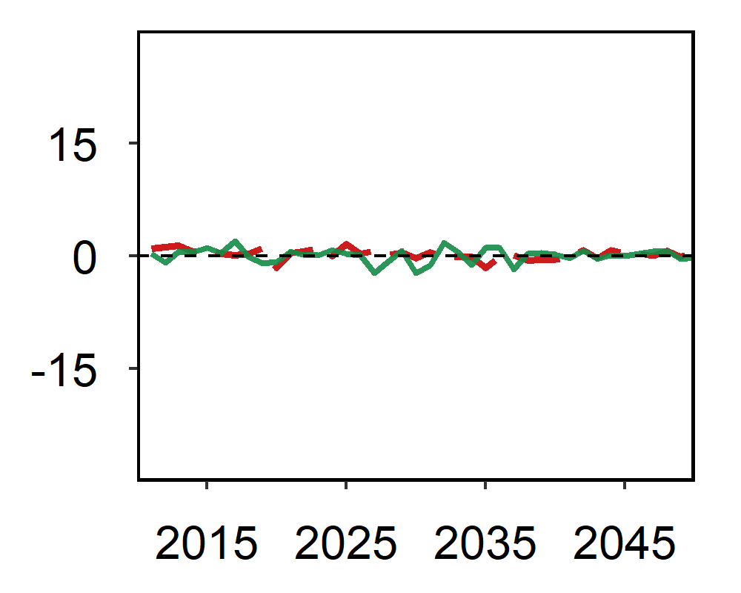
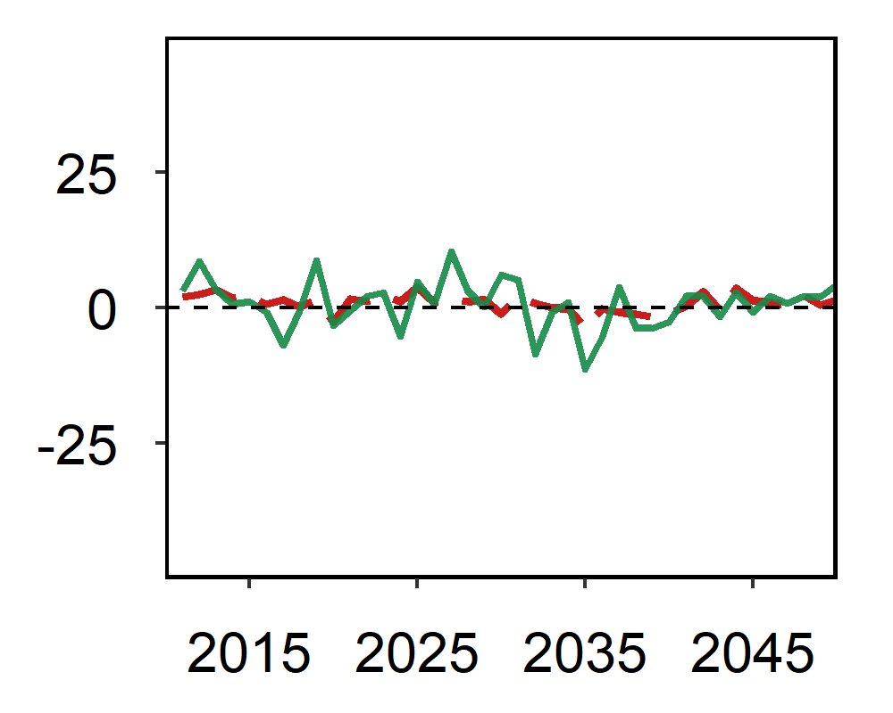
Climate impacts on agriculture
Run GCAM annually
Other
region-crops
World average
Climate vs. no climate (%)
Climate vs. no climate (%)
World
average
US oil crop
(soybeans)
US oil crop
(soybeans)
7.4%
Interannual (%)
Interannual (%)
4.0%

Slide 11
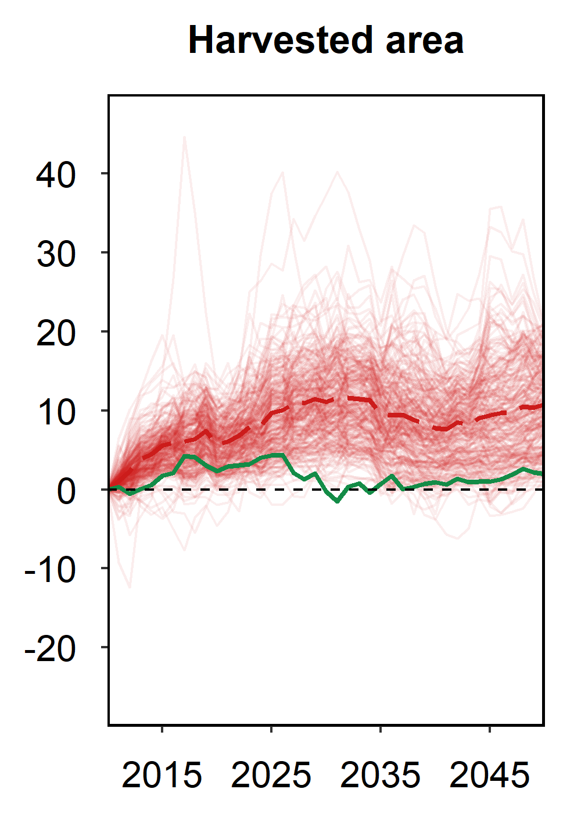
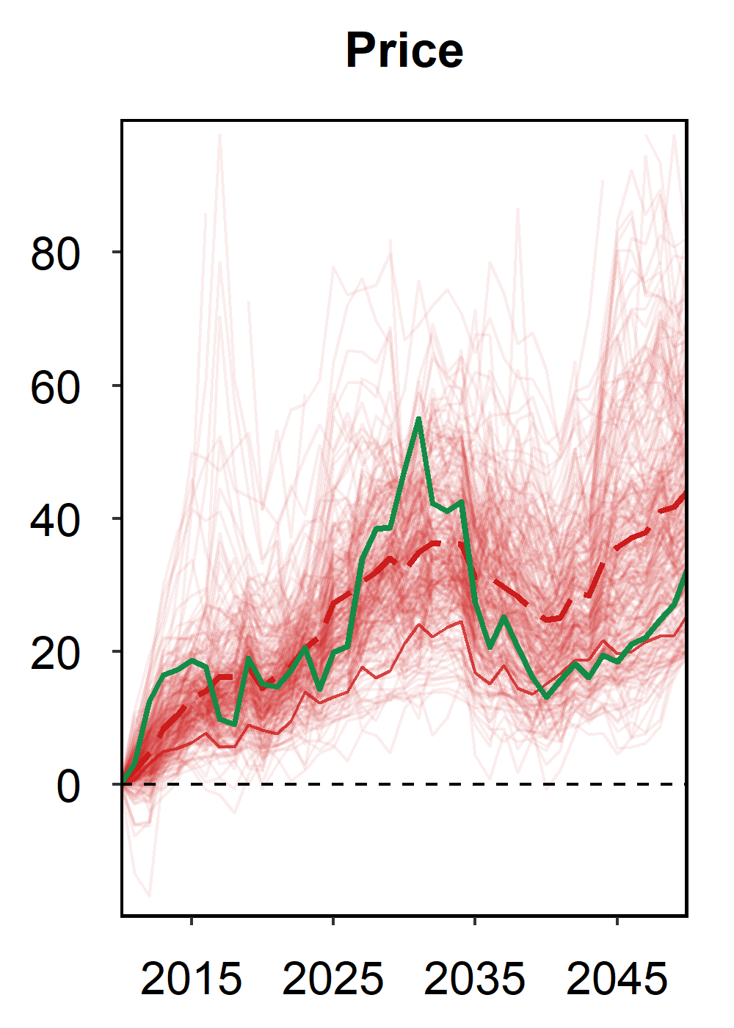
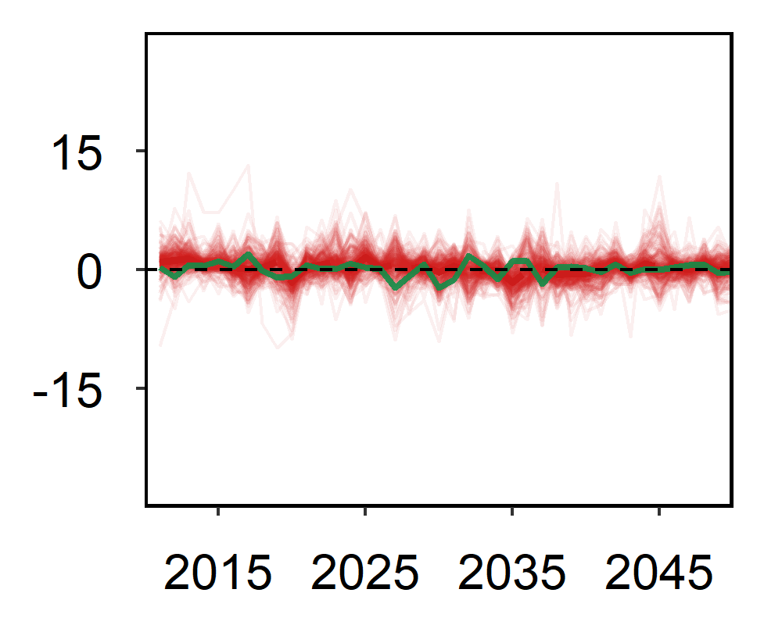
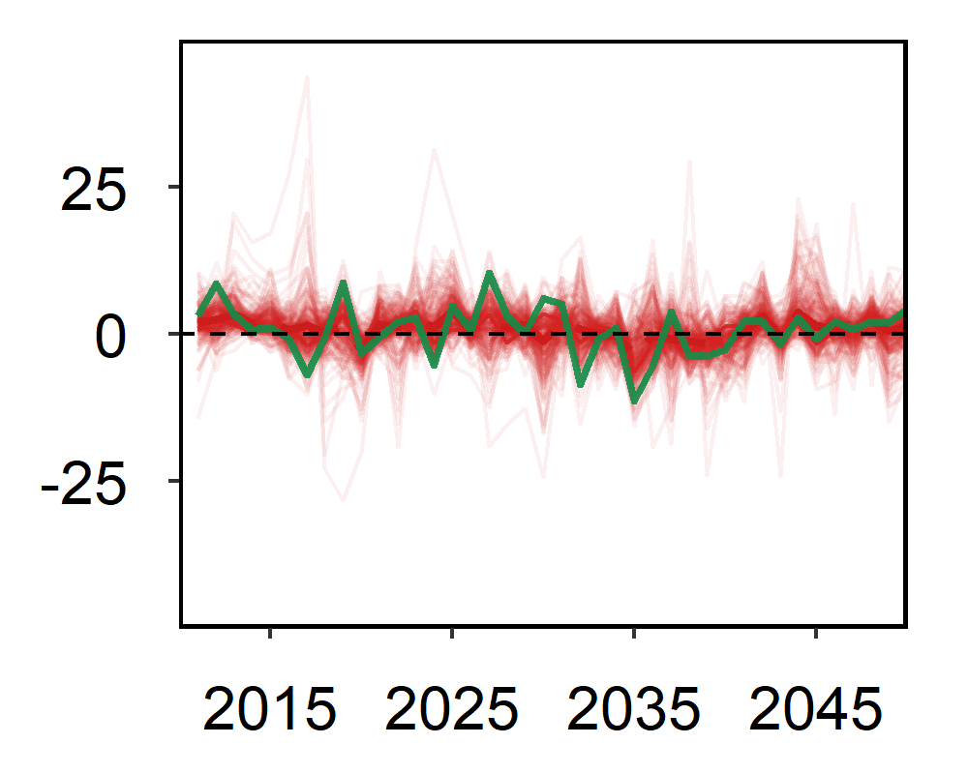
Climate impacts on agriculture
Run GCAM annually + all region-crops
Other
region-crops
Other
region-crops
Climate vs. no climate (%)
Climate vs. no climate (%)
World
average
US oil crop
(soybeans)
US oil crop
(soybeans)
7.4%
US oil crop
(soybeans)
0.9%
4.5%
Interannual (%)
Interannual (%)
World
average
4.0%
1.3%
4.4%

Slide 12
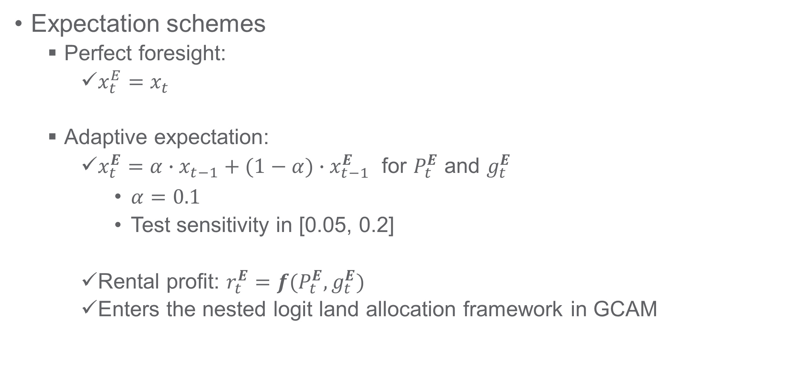
Adaptive expectation in GCAM
Expectation schemes
  Perfect foresight:
    $x_{t}^{E}=x_{t}$
  Adaptive expectation:
    $x_{t}^{E}=α∙x_{t−1}+(1−α)∙x_{t−1}^{E}$ for $P_{t}^{E}$ and $g_{t}^{E}$
      $α=0.1$
      Test sensitivity in [0.05, 0.2]
    Rental profit: $r_{t}^{E}=f(P_{t}^{E},g_{t}^{E})$
    Enters the nested logit land allocation framework in GCAM

Slide 13
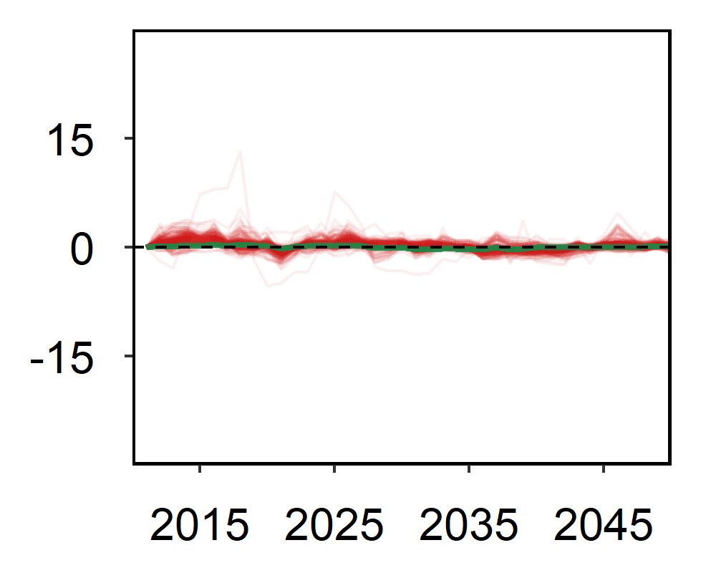
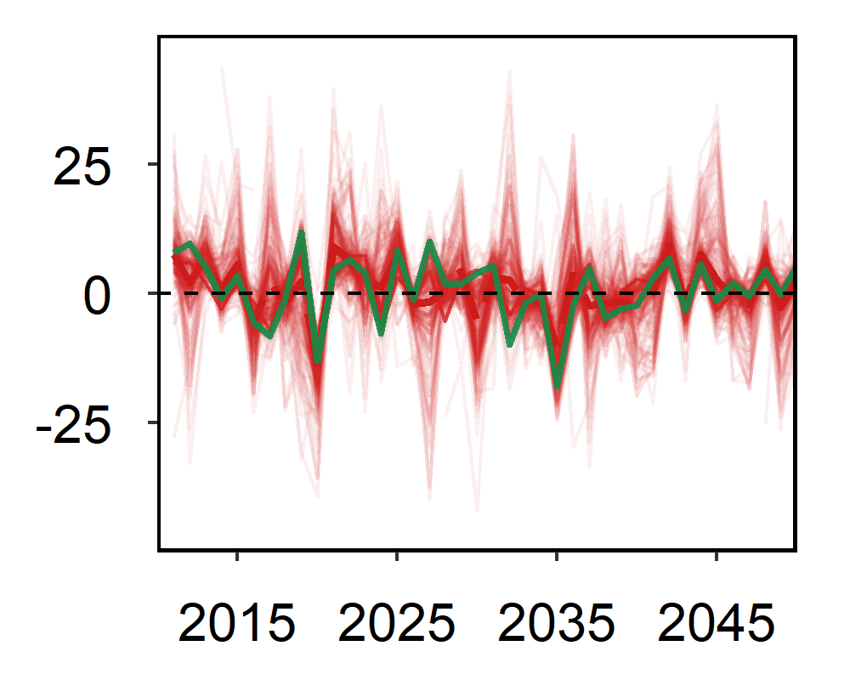
Climate impacts on agriculture
Adaptive expectations
Imperfect foresight
Smaller variation for area
  Slower adaptation
  Effectively more rigid acreage responses
Higher price volatility
  Endogenous market fluctuation
0.2%
6.4%
Adaptive expectation
Interannual (%)
0.6%
10.6%
7.4%
US oil crop
(soybeans)
0.9%
4.5%
Interannual (%)
Perfect foresight
Interannual (%)
World
average
4.0%
1.3%
4.4%

Slide 14
Other scenarios
Four scenarios under RCP 8.5 from AgMIP
  GFDL-EPIC; GFDL-LPJGUESS
  HadGEM2-EPIC; GFDL-LPJGUESS
Climate impacts by 2050 or interannual mean
  Generally consistent with AgMIP
New insights from IAV
  Scenario comparison
  ANOVA (AgMIP; Nelson et al. 2014)
    IAV (year) is more important than region and crop
    Climate models contributed more to IAV than crop models
  More results in the paper

Slide 15
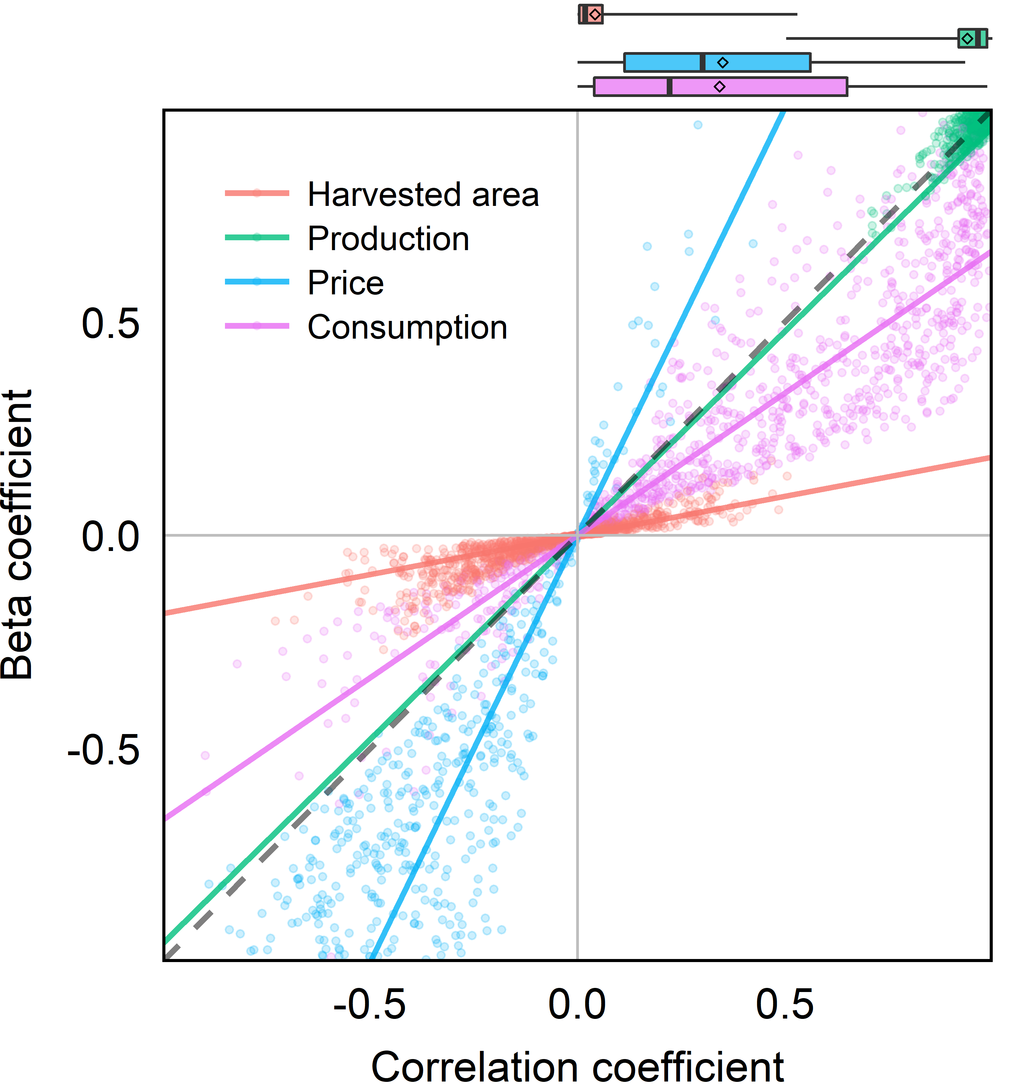
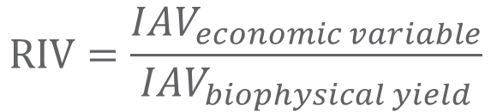
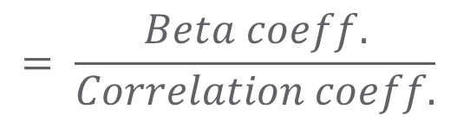
Relative interannual variability
How IAV in climate and biophysical shocks are transformed and transferred to global agricultural markets?
Relative interannual variability (RIV)
Vulnerability to climate variability
  For a crop-region under a climate scenario
Consistent generally across scenarios
  at the global scale
2.8
0.85
$$IAV=SD\left[\log\left({variable}_{t}\right)−\log{({variable}_{t−1})}\right]$$
0.25
$$RIV=\frac{{IAV}_{economic variable}}{{IAV}_{biophysical yield}}$$
$$= \frac{Beta coeff.}{Correlation coeff.}$$

Slide 16
Regional heterogeneity in variability
Crop-regions with higher IAV of biophysical yield shocks tend to have a smaller magnitude of variance transmission (smaller RIV) to consumption or price responses
  Regional interannual variation is mediated through trade.
  Historical evidence for maize (Villoria and Chen, 2018)
See paper for more details
  Results are consistent across climate scenarios
  Interannual variability in climate and biophysical shocks are transformed and transferred to crop market and magnified by endogenous market fluctuations.

Slide 17
Why is separating planting & harvesting important?
The trend and variability of climate impacts can be more useful than point estimations
Parameter calibration
  Better hindcast performance with planting and harvesting separated
Other applications
  Value of better predictions/forecasts
  Extreme weather events
  Risk aversion behaviors

Slide 18
Limitations
Limited consideration of extreme weather events and policy
Parameter uncertainty
Storage!
  Difficult to incorporate competitive storage model under RE
    Stocking cost
    Wright and Williams 1982
  Smaller alpha?
Extension of previous studies
  Diffenbaugh et al., 2012; Urban et al., 2012
  Femenia and Gohin, 2011
  AgMIP 2014

Slide 20
Assessing climate impacts on AgLU
Modeling
chain
Climate model (GCM)
Global crop model (GGCM)
Economic Model (GCAM)
Temperature
Precipitation
Surface radiation
Wind speed
Air pressure
Humidity
CO₂ concentration
Time: day
Space: grid
Biophysical yield
  Carbon forcing
  Irrigation forcing
Time: year
Space: grid
Crop: major crops
Realized yield
Production
Land use
Consumption
Trade
Prices
Time: 2050
Space: basin
Crop: GCAM crops
Model
variable
annual
Variability
Notes:
Unconditional yield

Slide 21
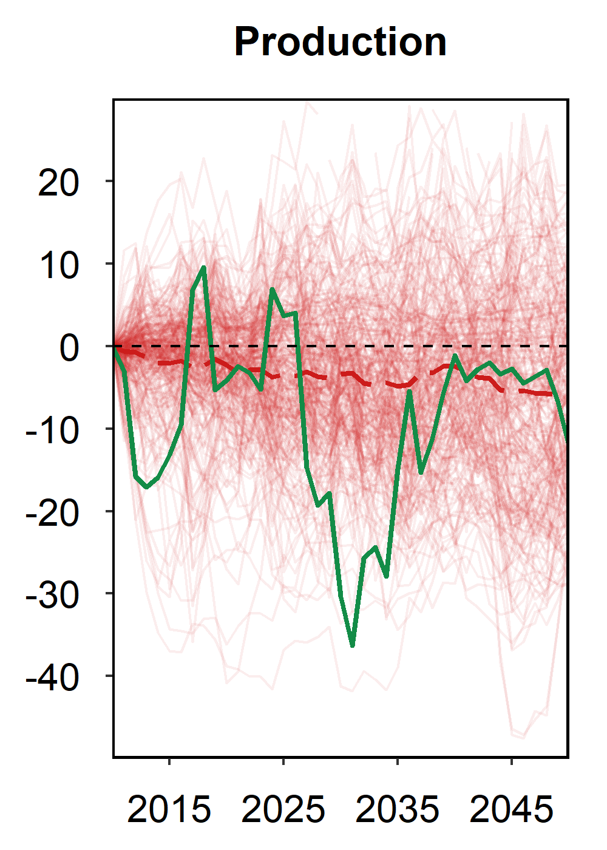
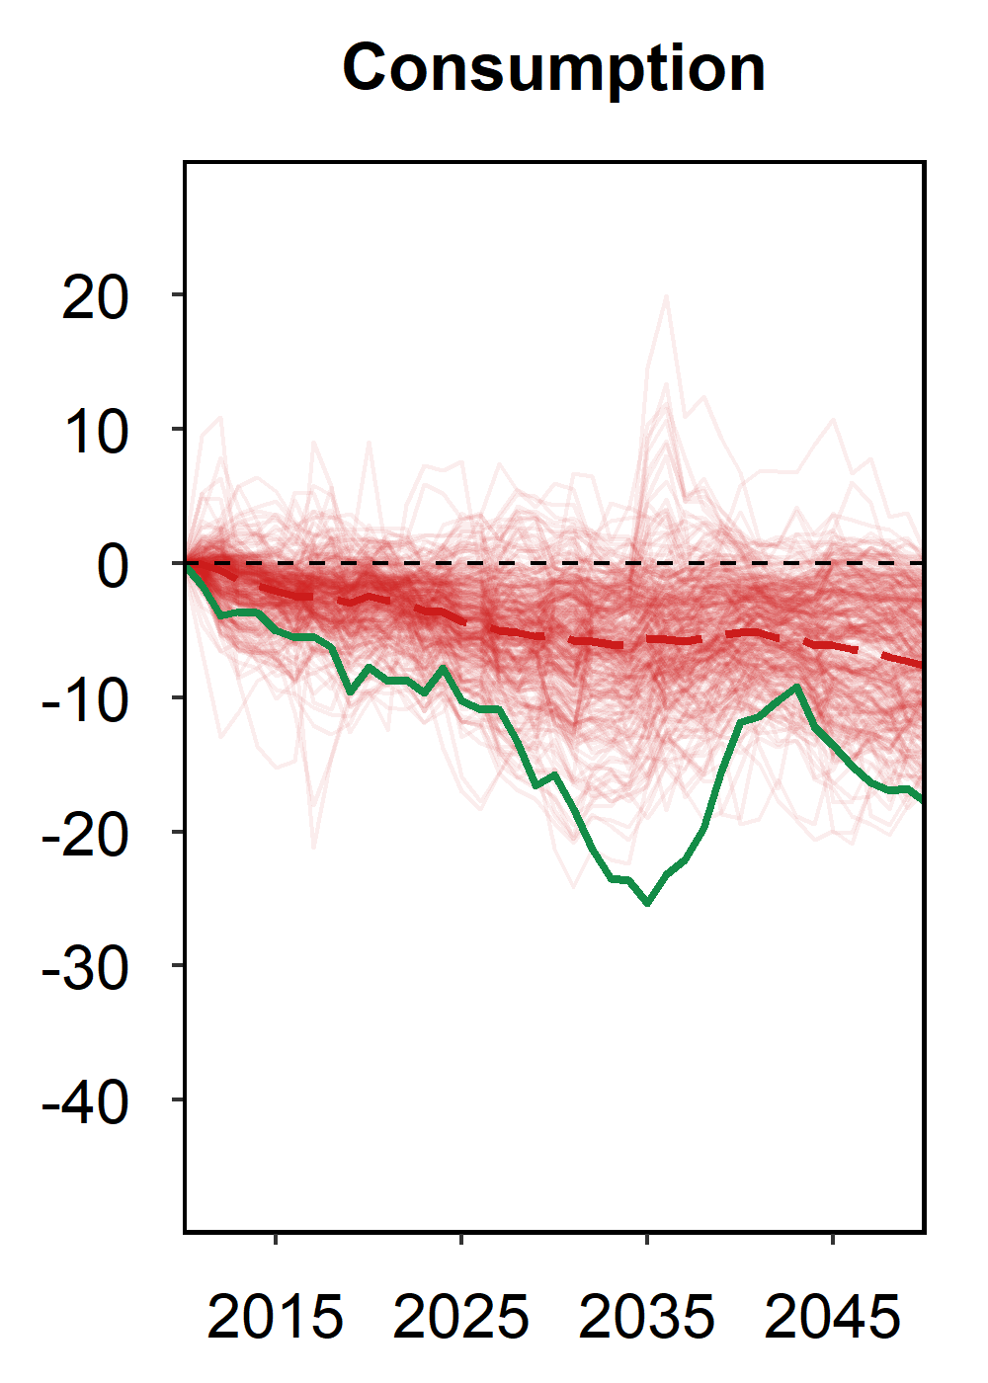
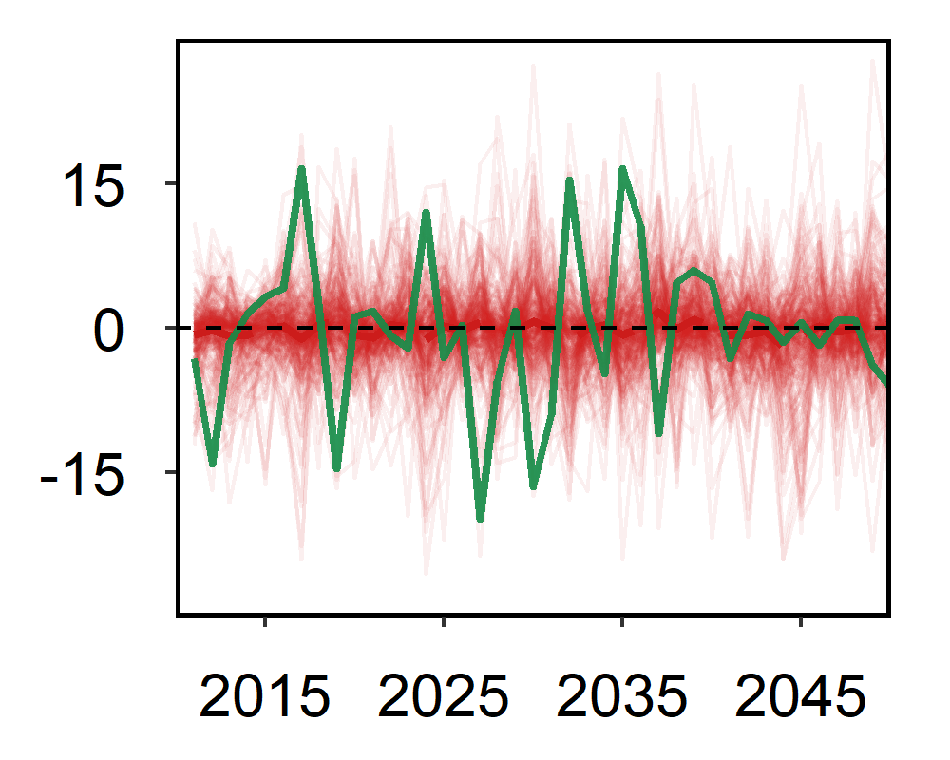
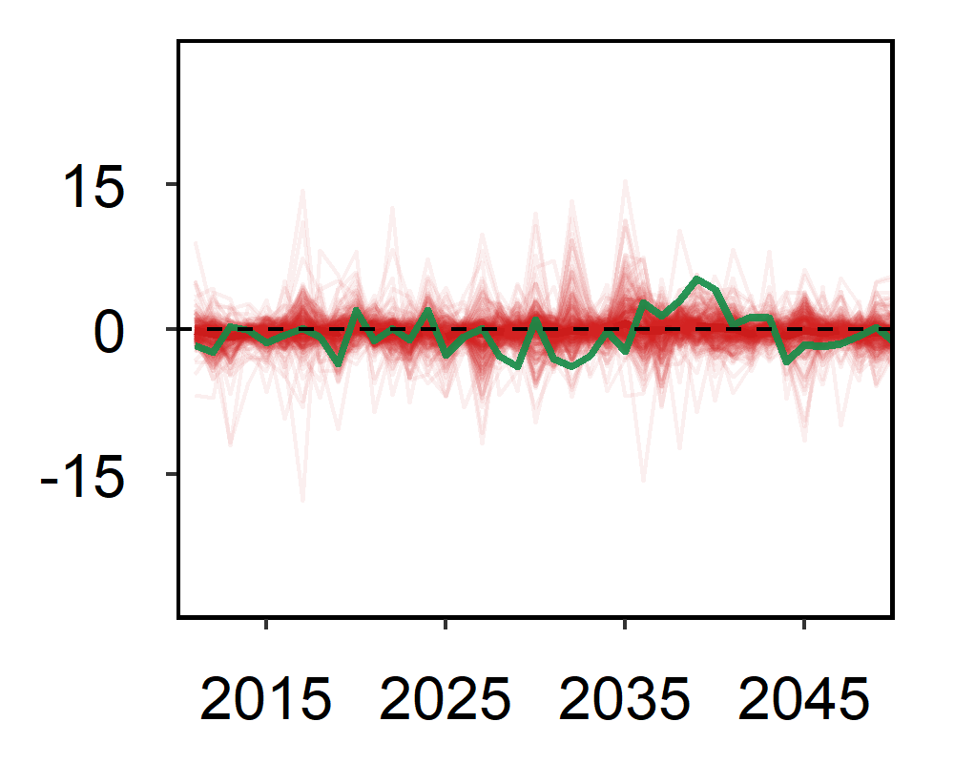
Climate impacts on agricultural economics
World average
Climate vs no Climate (%)
US oil crop
(soybeans)
Interannual (%)

Slide 22
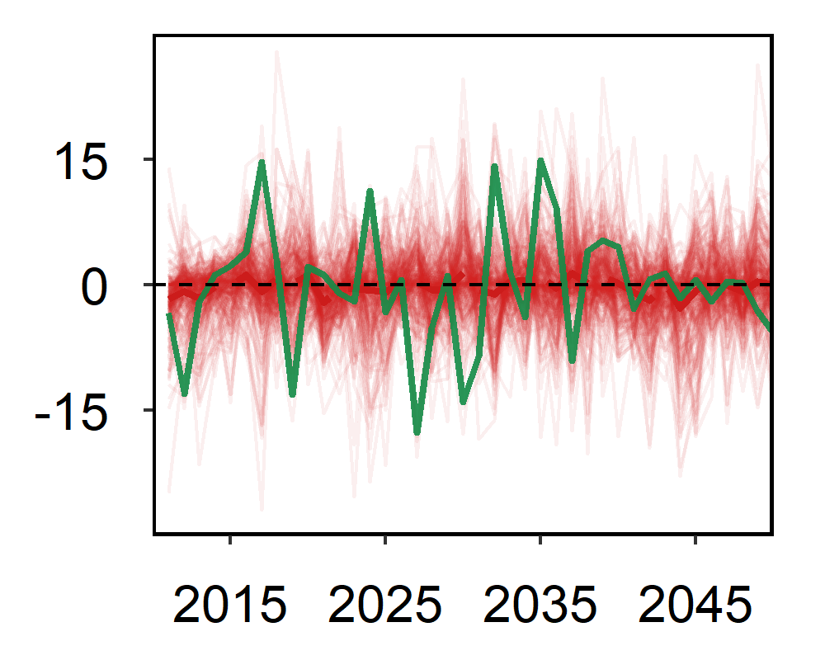
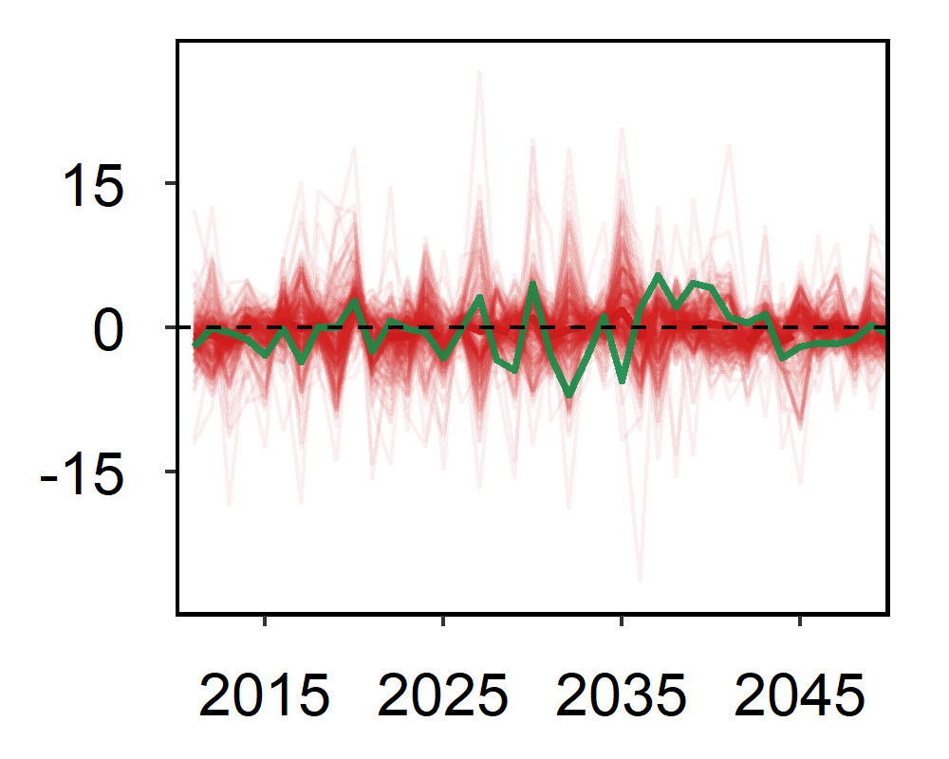
Relative interannual variability
Perfect foresight
0.38
1.0
0.8
1.2
Cumulative
percent change
Annual
percent change
0.13
1.3
0.29
0.6
Adaptive expectation
0.18
1.0
1.7
3.1
Annual
percent change
0.03
1.1
0.34
0.9

Slide 23
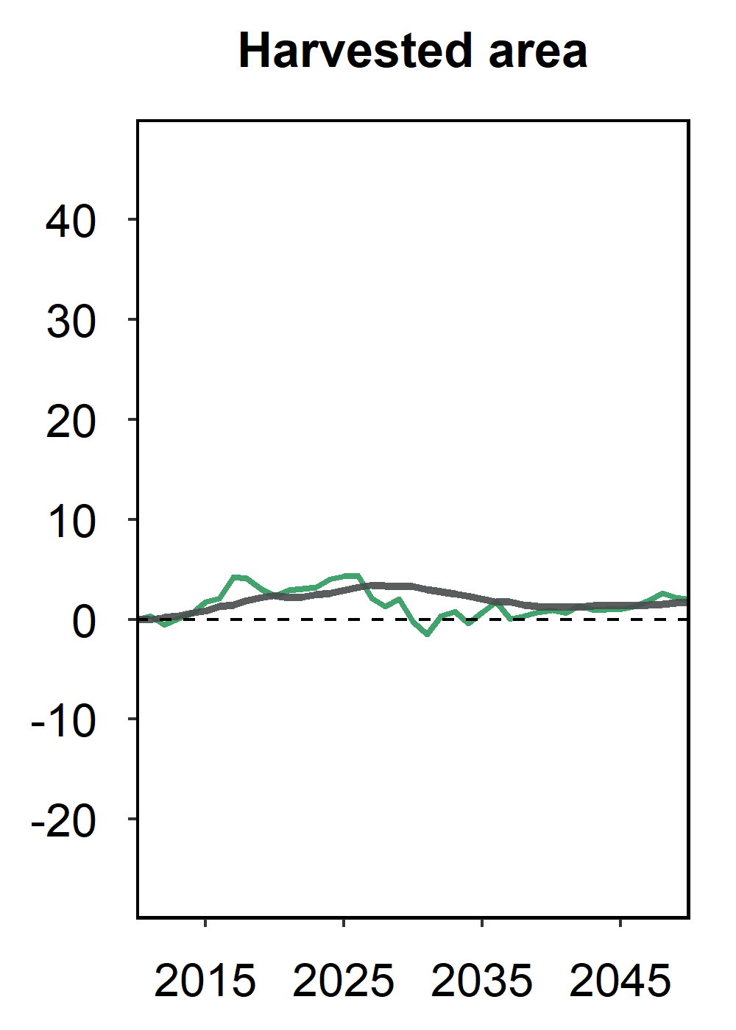
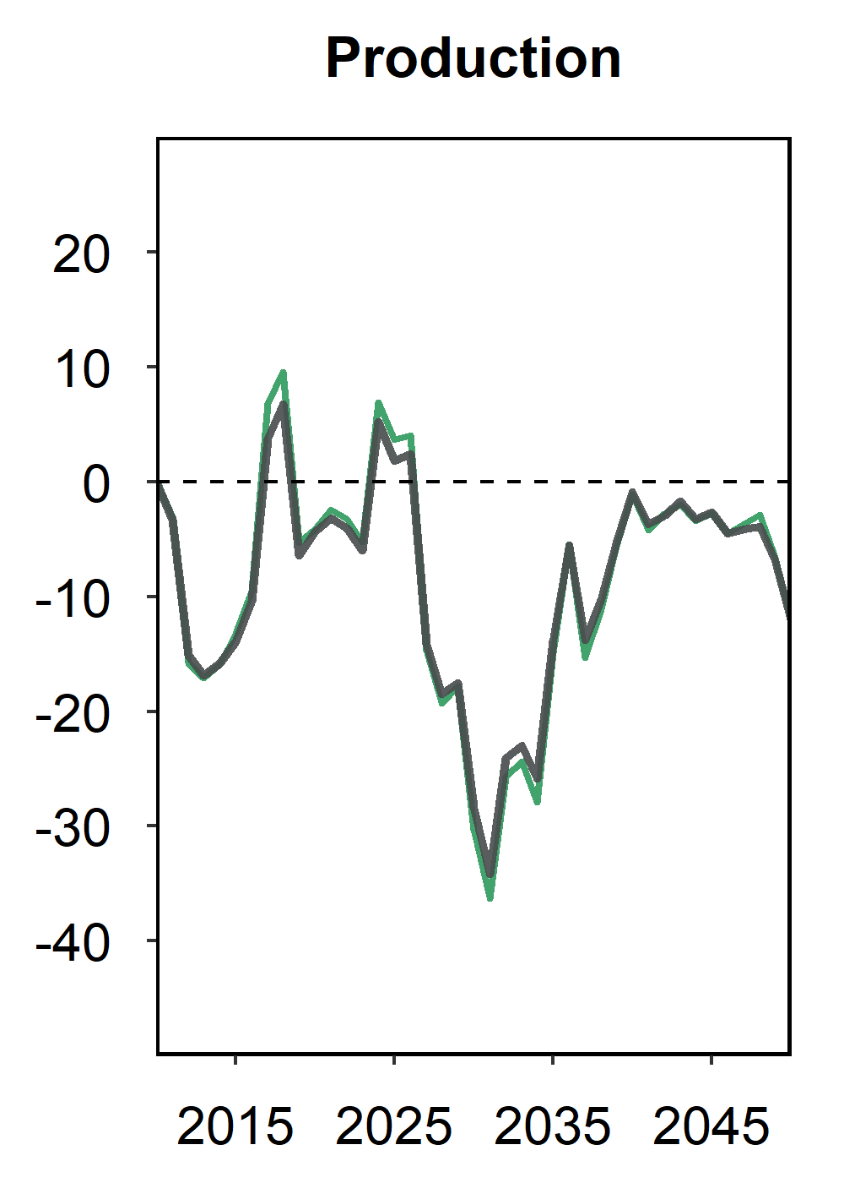
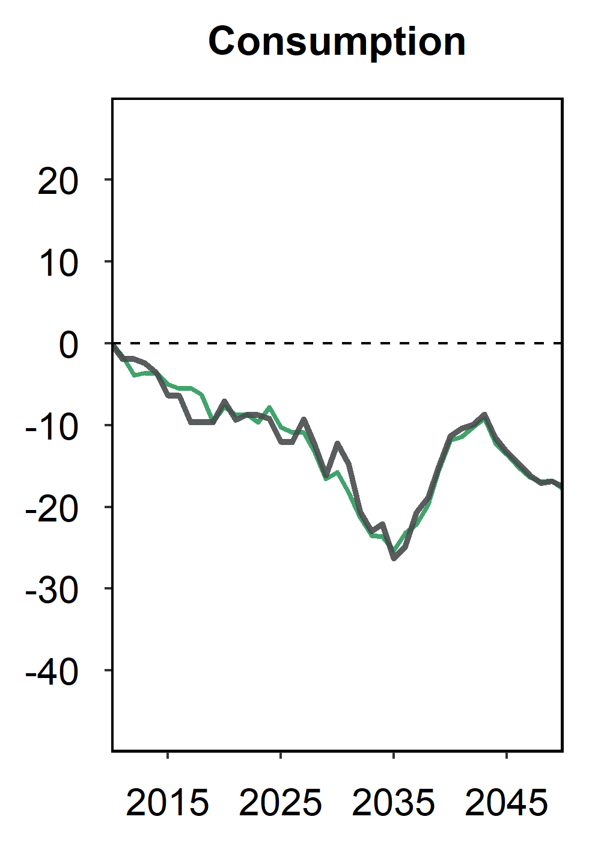
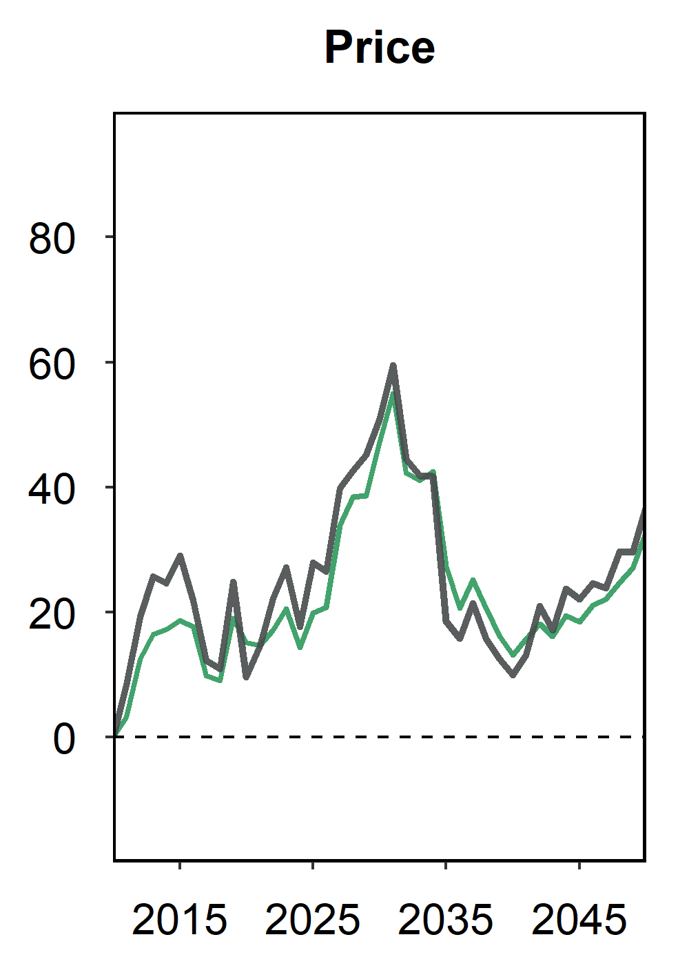
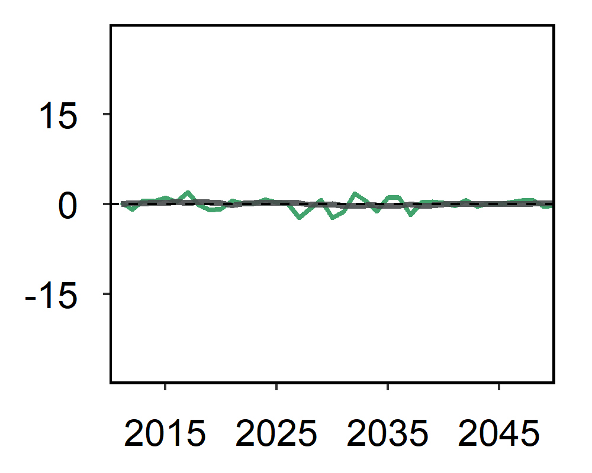
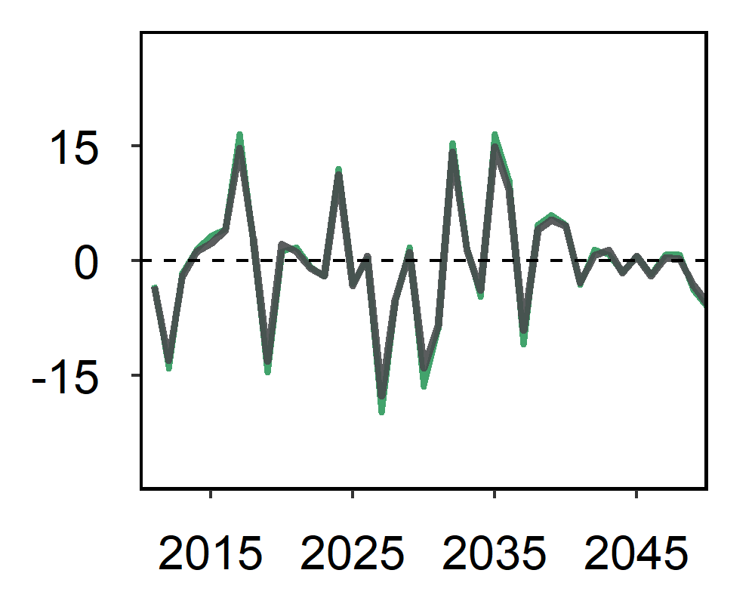
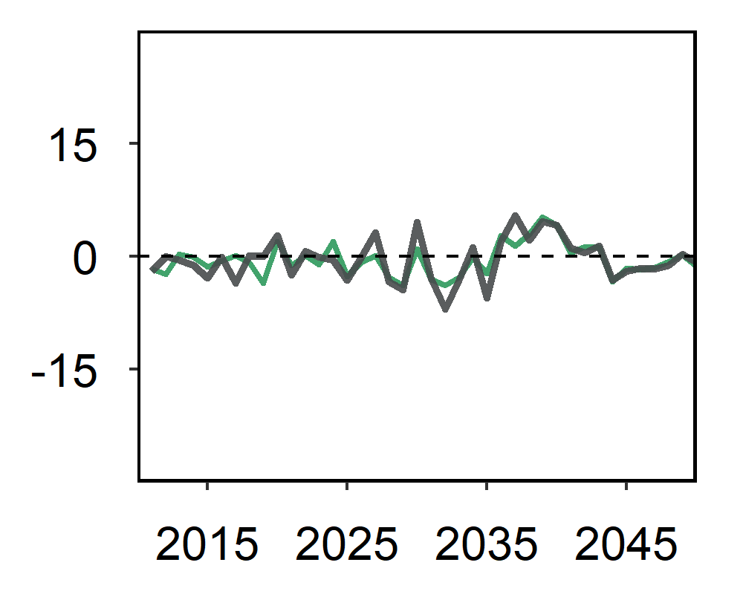
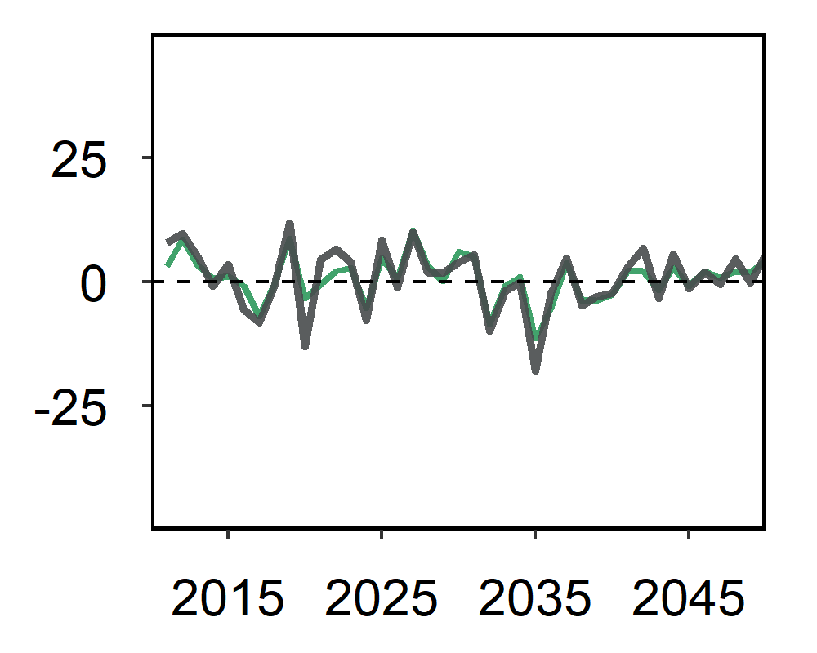
Incorporating adaptive expectations
Adaptive expectations
Cumulative
percent change
US Oil crops
Annual
percent change

Slide 24
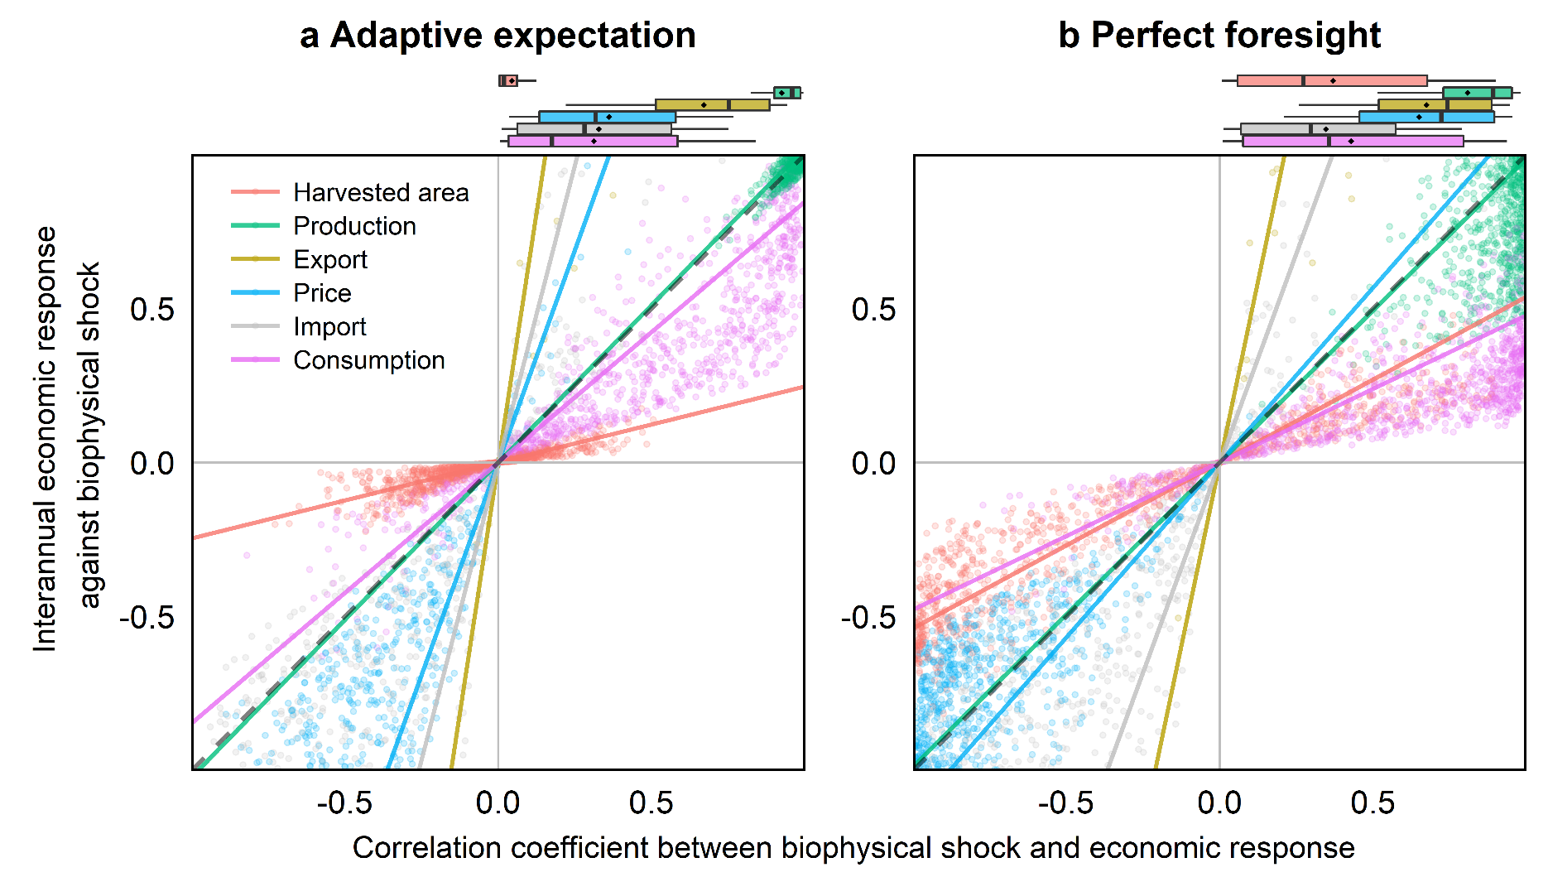
Interannual economic responses and correlations to biophysical yield shocks

Slide 25
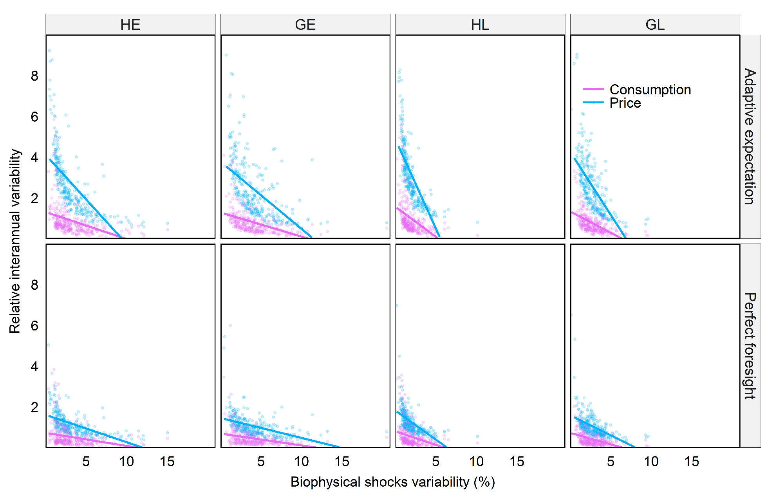
Relationship between the RIV of consumption and price and the IAV of biophysical shock

Slide 26
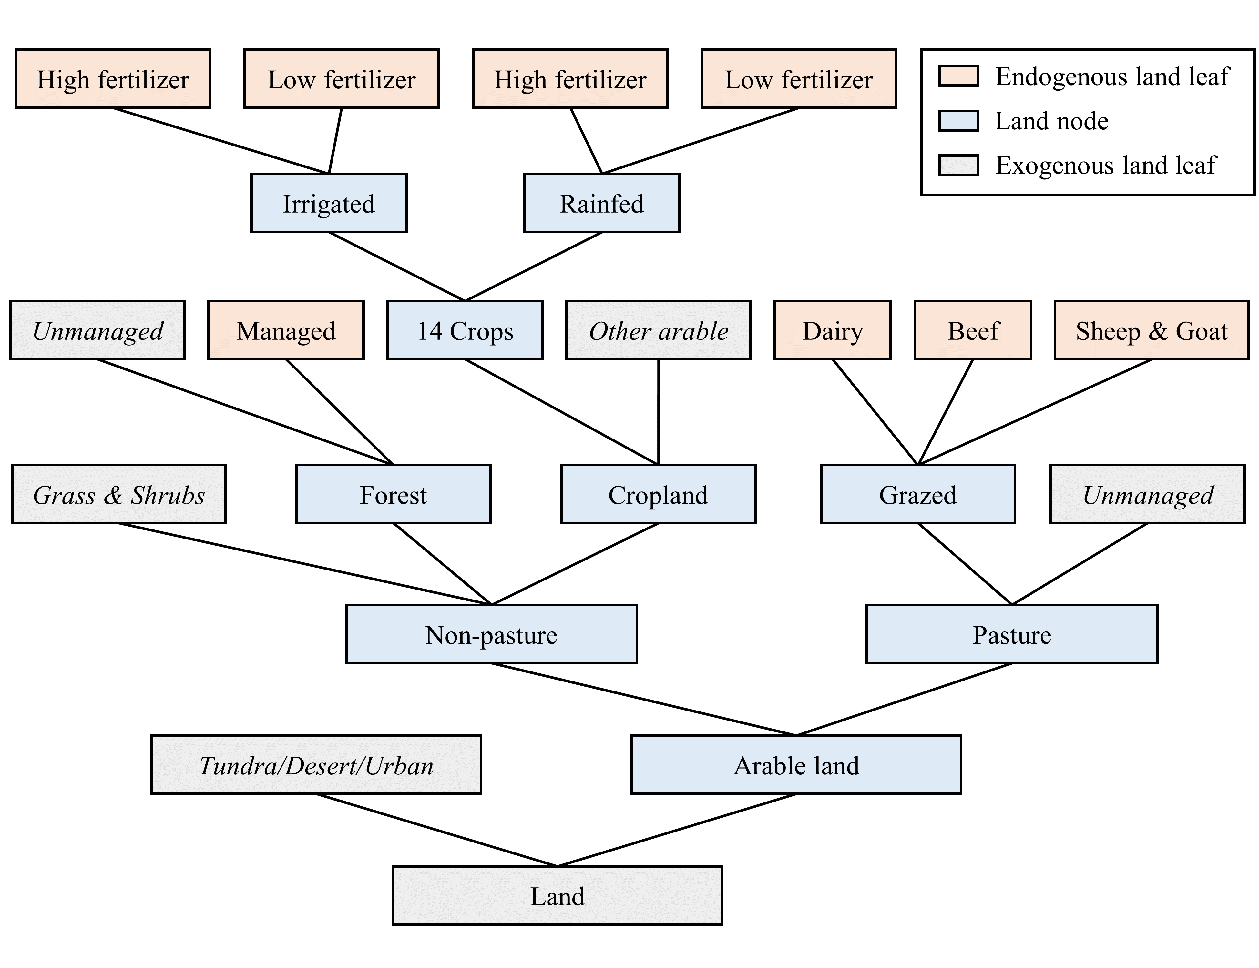
GCAM land use nesting structure

Slide 27
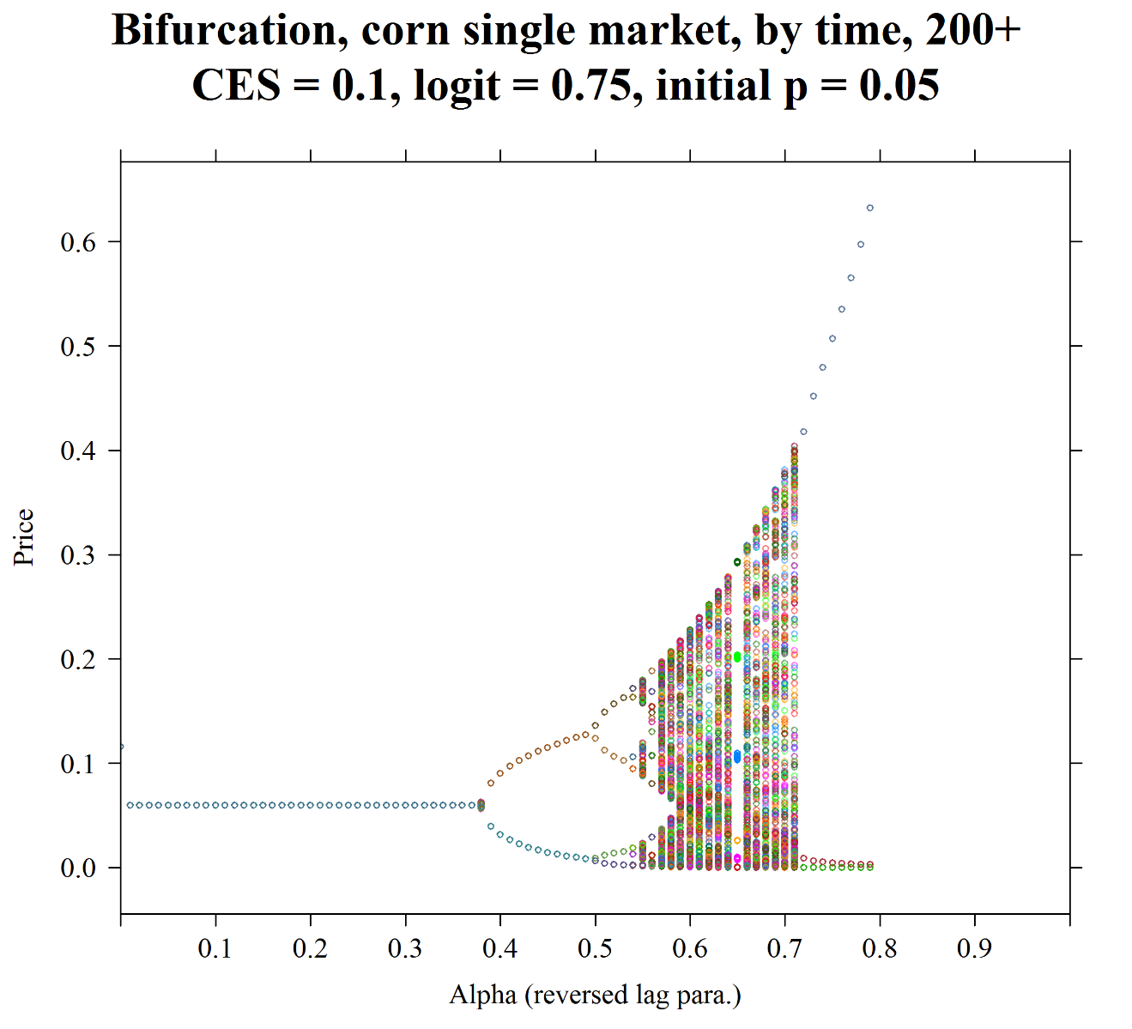
Coefficient of expectation

Slide 28
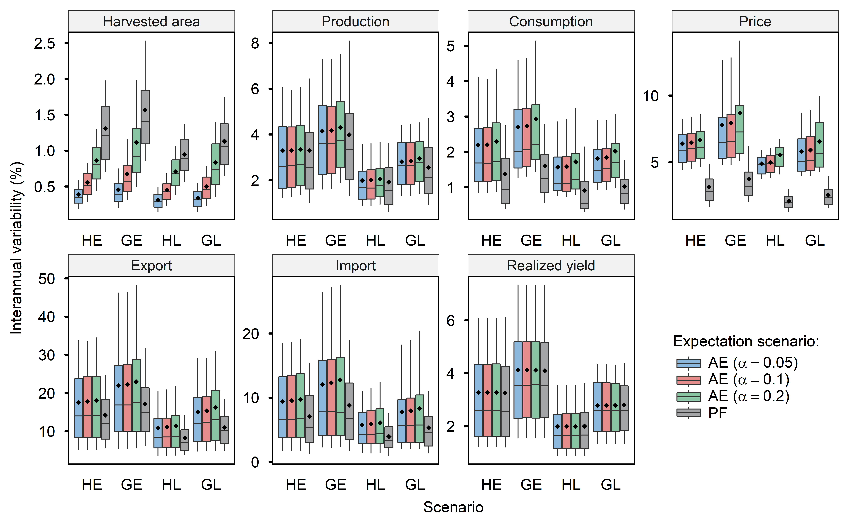
Sensitivity of alpha

