Slide 1
Economic and distributional impacts of the CPTPP, EVFTA and RCEP in Vietnam
Authors:
Maryla Maliszewska, Maria Pereira, Israel Osorio-Rodarte, Zoryana Olekseyuk

Slide 2
Overview
Methodology
Scenarios
Closures
Tariffs reductions
Results
  CGE
  Poverty and Gini Coeff.
Key findings and caveats

Slide 3
Methodology
Top-down macro micro modeling framework
On the top side:
ENVISAGE – CGE model
Multi-regional and multi-sectoral GE model
GTAP version 10 (covering 121 countries/regions and 65 sectors)
Recursive dynamic – 2014-2035
On the down side:
Global Income Distribution Dynamics (GIDD)
Vietnam Household Living Standards Survey (VHLSS 2016)
POVCALNET – poverty numbers for Vietnam, 2018

Slide 4
ENVISAGE & GIDD
ENVISAGE & GIDD are linked through some key variables:
  Population structure:
    Age groups, gender, and education
    Additional layer (labor force participation status)
  Labor:
    Number of worker by type (skilled, and non-skilled)
    Labor and non-labor incomes
  Prices
    Food/Non-food prices

Slide 5
Scenarios
Baseline
  Continuation of past trends along with the implementation of existing FTAs up to 2030 as in the ITC data (MacMap, 2016)
CPTPP scenario
  Starting year: 2020
  Reduction of tariffs as per the TPP tariff commitment scheduled (ITC)
  50% reduction of non-measure tariffs in goods and services progressively over the years
EVFTA scenario
  Starting year: 2020
  Reduction of tariffs as per EVFTA tariff commitment schedule
  15% reduction of non-measure tariffs in goods and services progressively over the years
RCEP scenario
  Starting year: 2020
  Reduction of tariffs (Maliszewska et all. 2018)
  15% reduction of non-measure tariffs in goods and services progressively over the years

Slide 6
Closures
Government expenditures are held constant as a share of GDP, fiscal balance is exogenous while direct taxes adjust to cover any changes in the revenues to keep the fiscal balance at the exogenous level.
Investment-saving balance. Households save a portion of their income, with the average propensity to save influenced by elderly and youth dependency rates, as well as GDP per capita growth rates. Government and foreign savings are exogenous, investment is savings driven.
External balance. Foreign savings, and therefore the trade balance, were fix, hence changes in trade flows result in shifts in the real exchange rate.

Slide 7
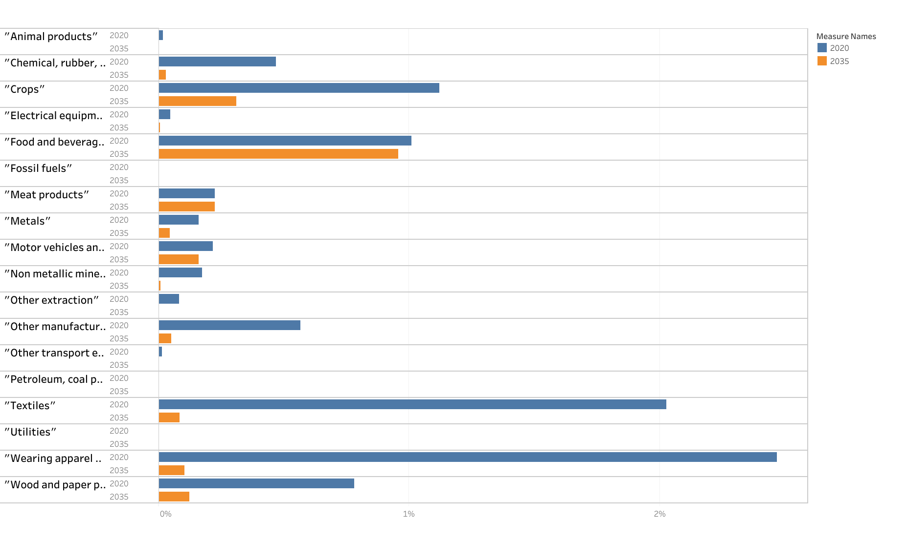
CPTPP –
Tariffs reduction imposed by
Vietnam

Slide 8
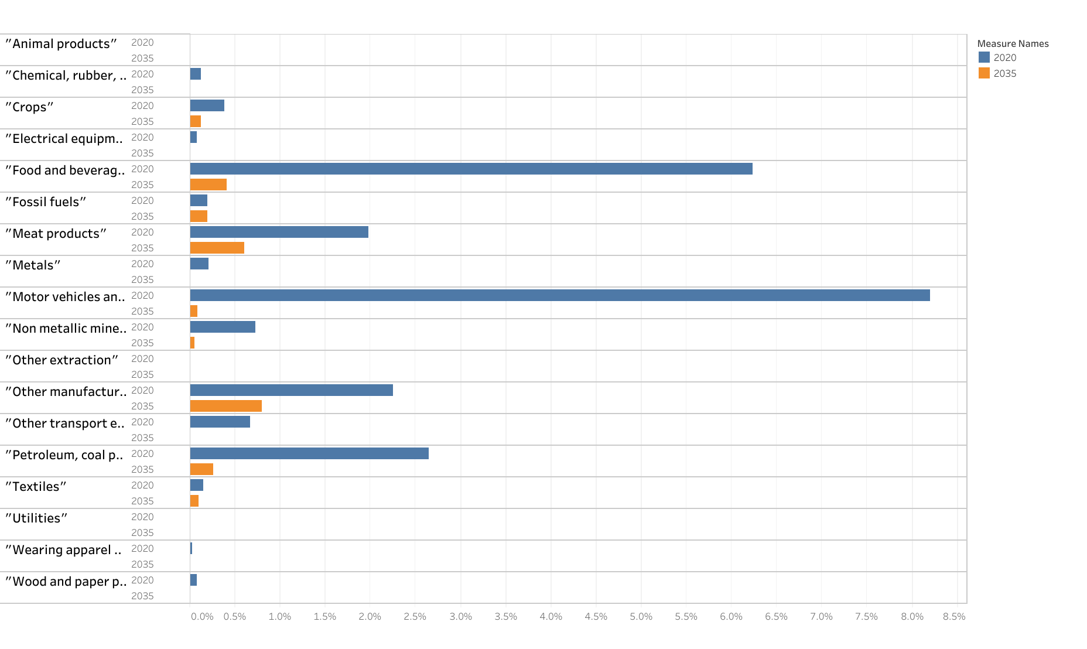
CPTPP –
Tariffs reduction faced by
Vietnam

Slide 9
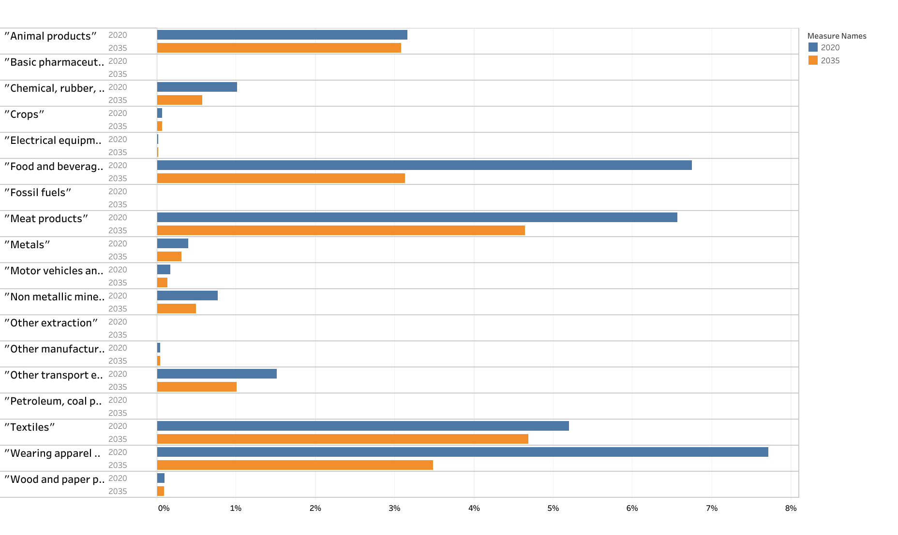
EVFTA –
Tariffs reduction imposed by Vietnam

Slide 10
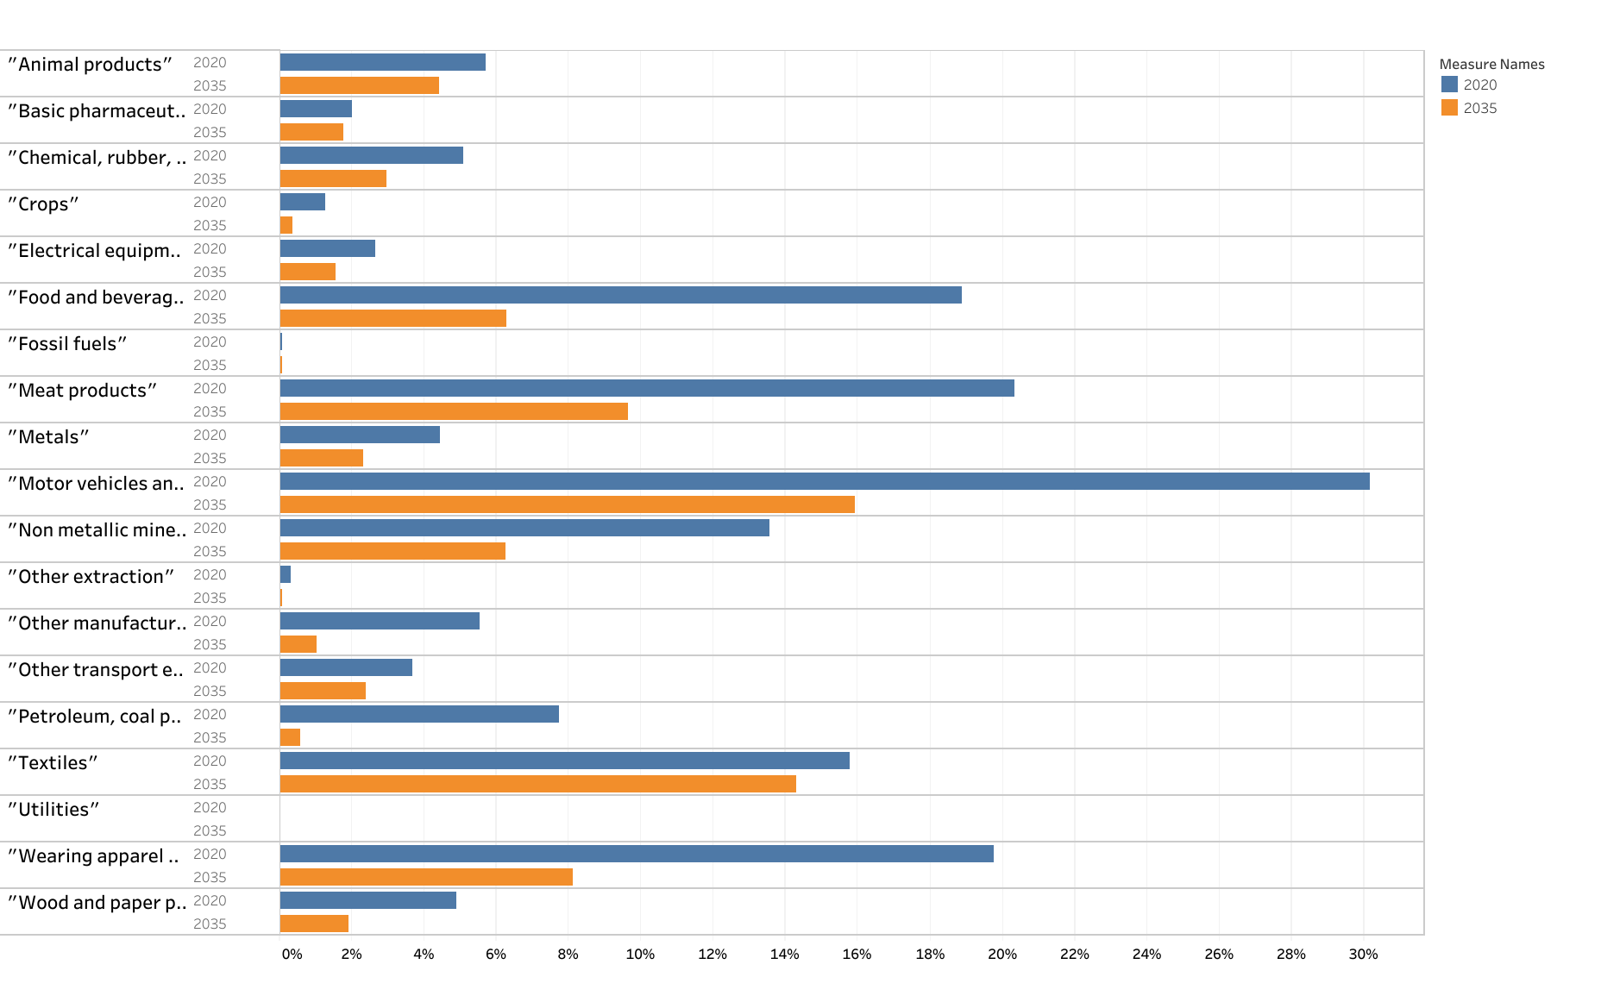
EVFTA –
Tariffs reduction faced by Vietnam

Slide 11
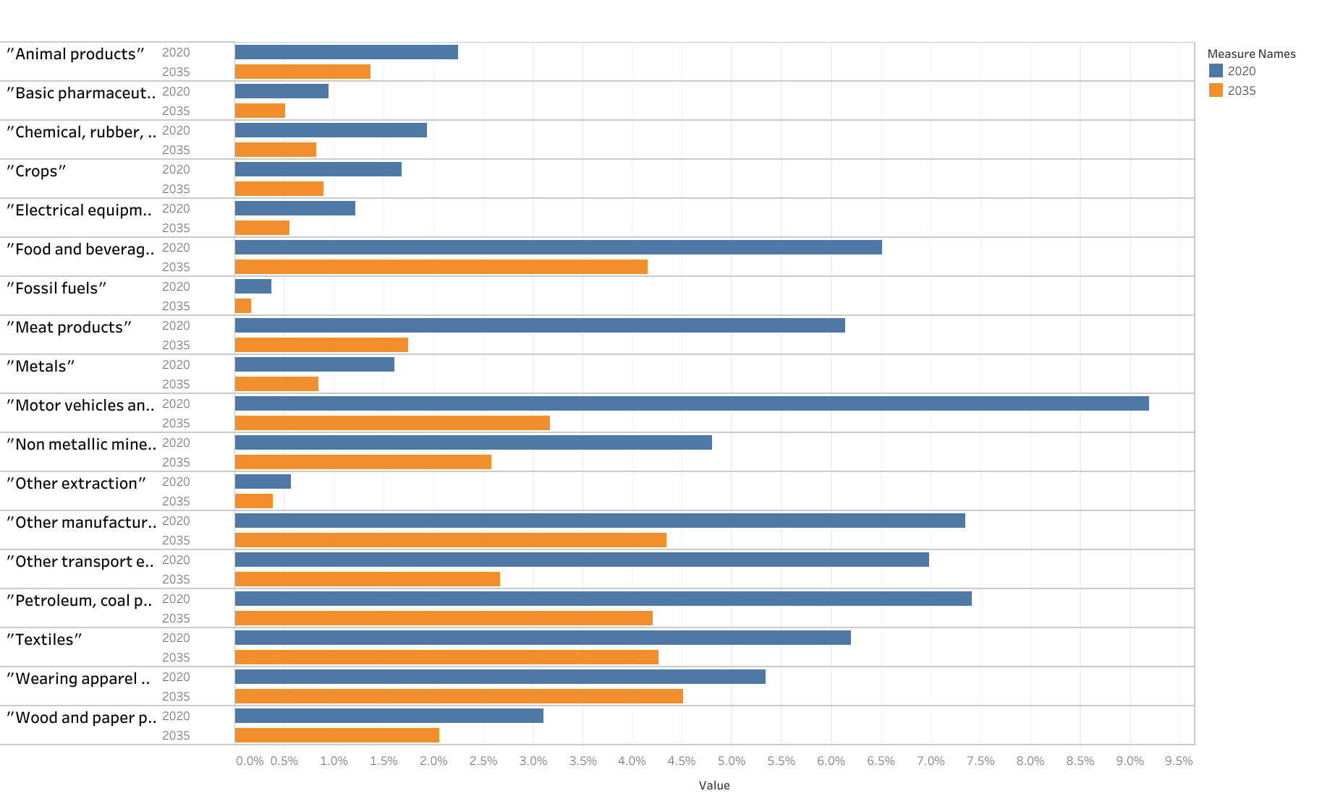
RCEP –
Tariffs reduction imposed by Vietnam

Slide 12
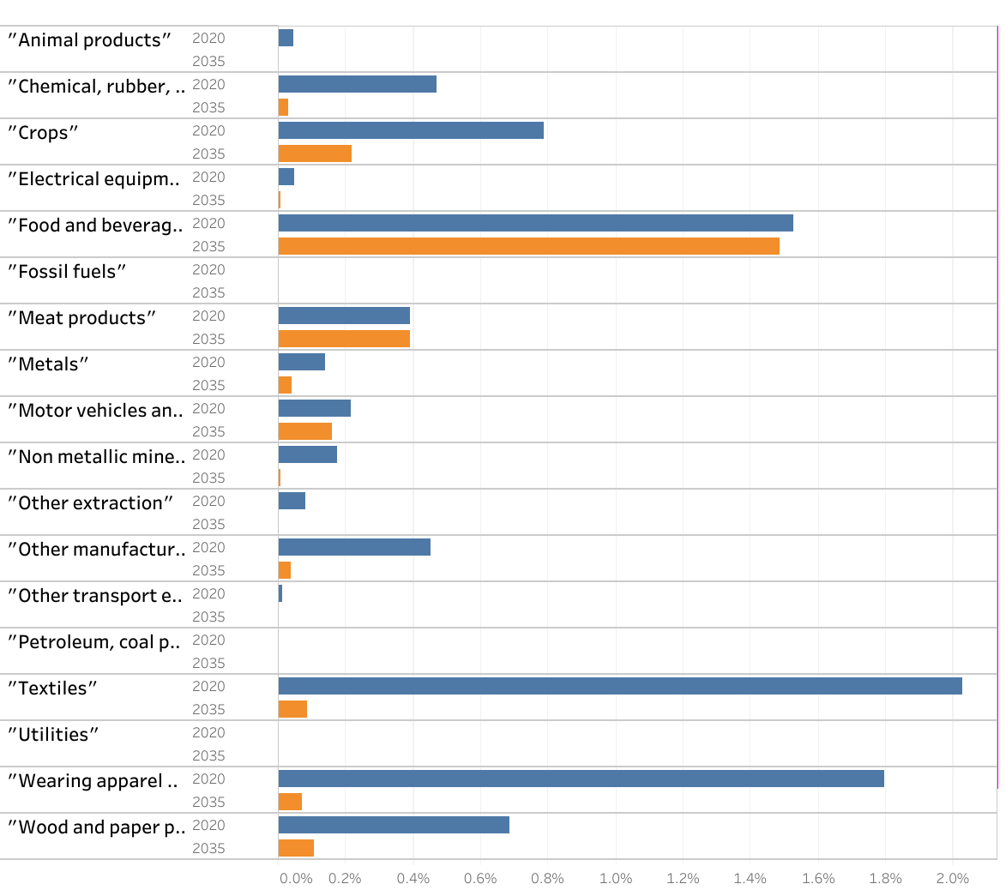
RCEP –
Tariffs reduction faced by Vietnam

Slide 13
Macro Results
 | CPTPP | EVFTA | RCEP | CPTPP & EVFTA | CPTPP, EVFTA & RCEP
EV | 0.49 | 0.49 | 2.22 | 0.97 | 3.41
Nominal GPD | 0.96 | 0.88 | 2.97 | 1.82 | 5.34
Real GDP | 0.81 | 0.26 | 2.30 | 1.05 | 3.25
Exports | 5.16 | 0.77 | 5.61 | 5.91 | 10.84
Imports | 4.19 | 0.96 | 4.88 | 5.13 | 9.73

Slide 14
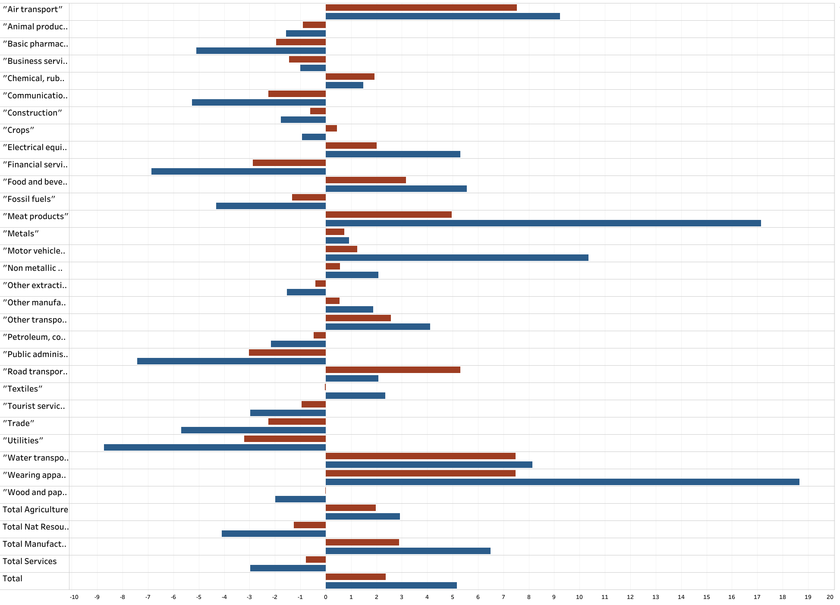
CPTPP - Exports

Slide 15
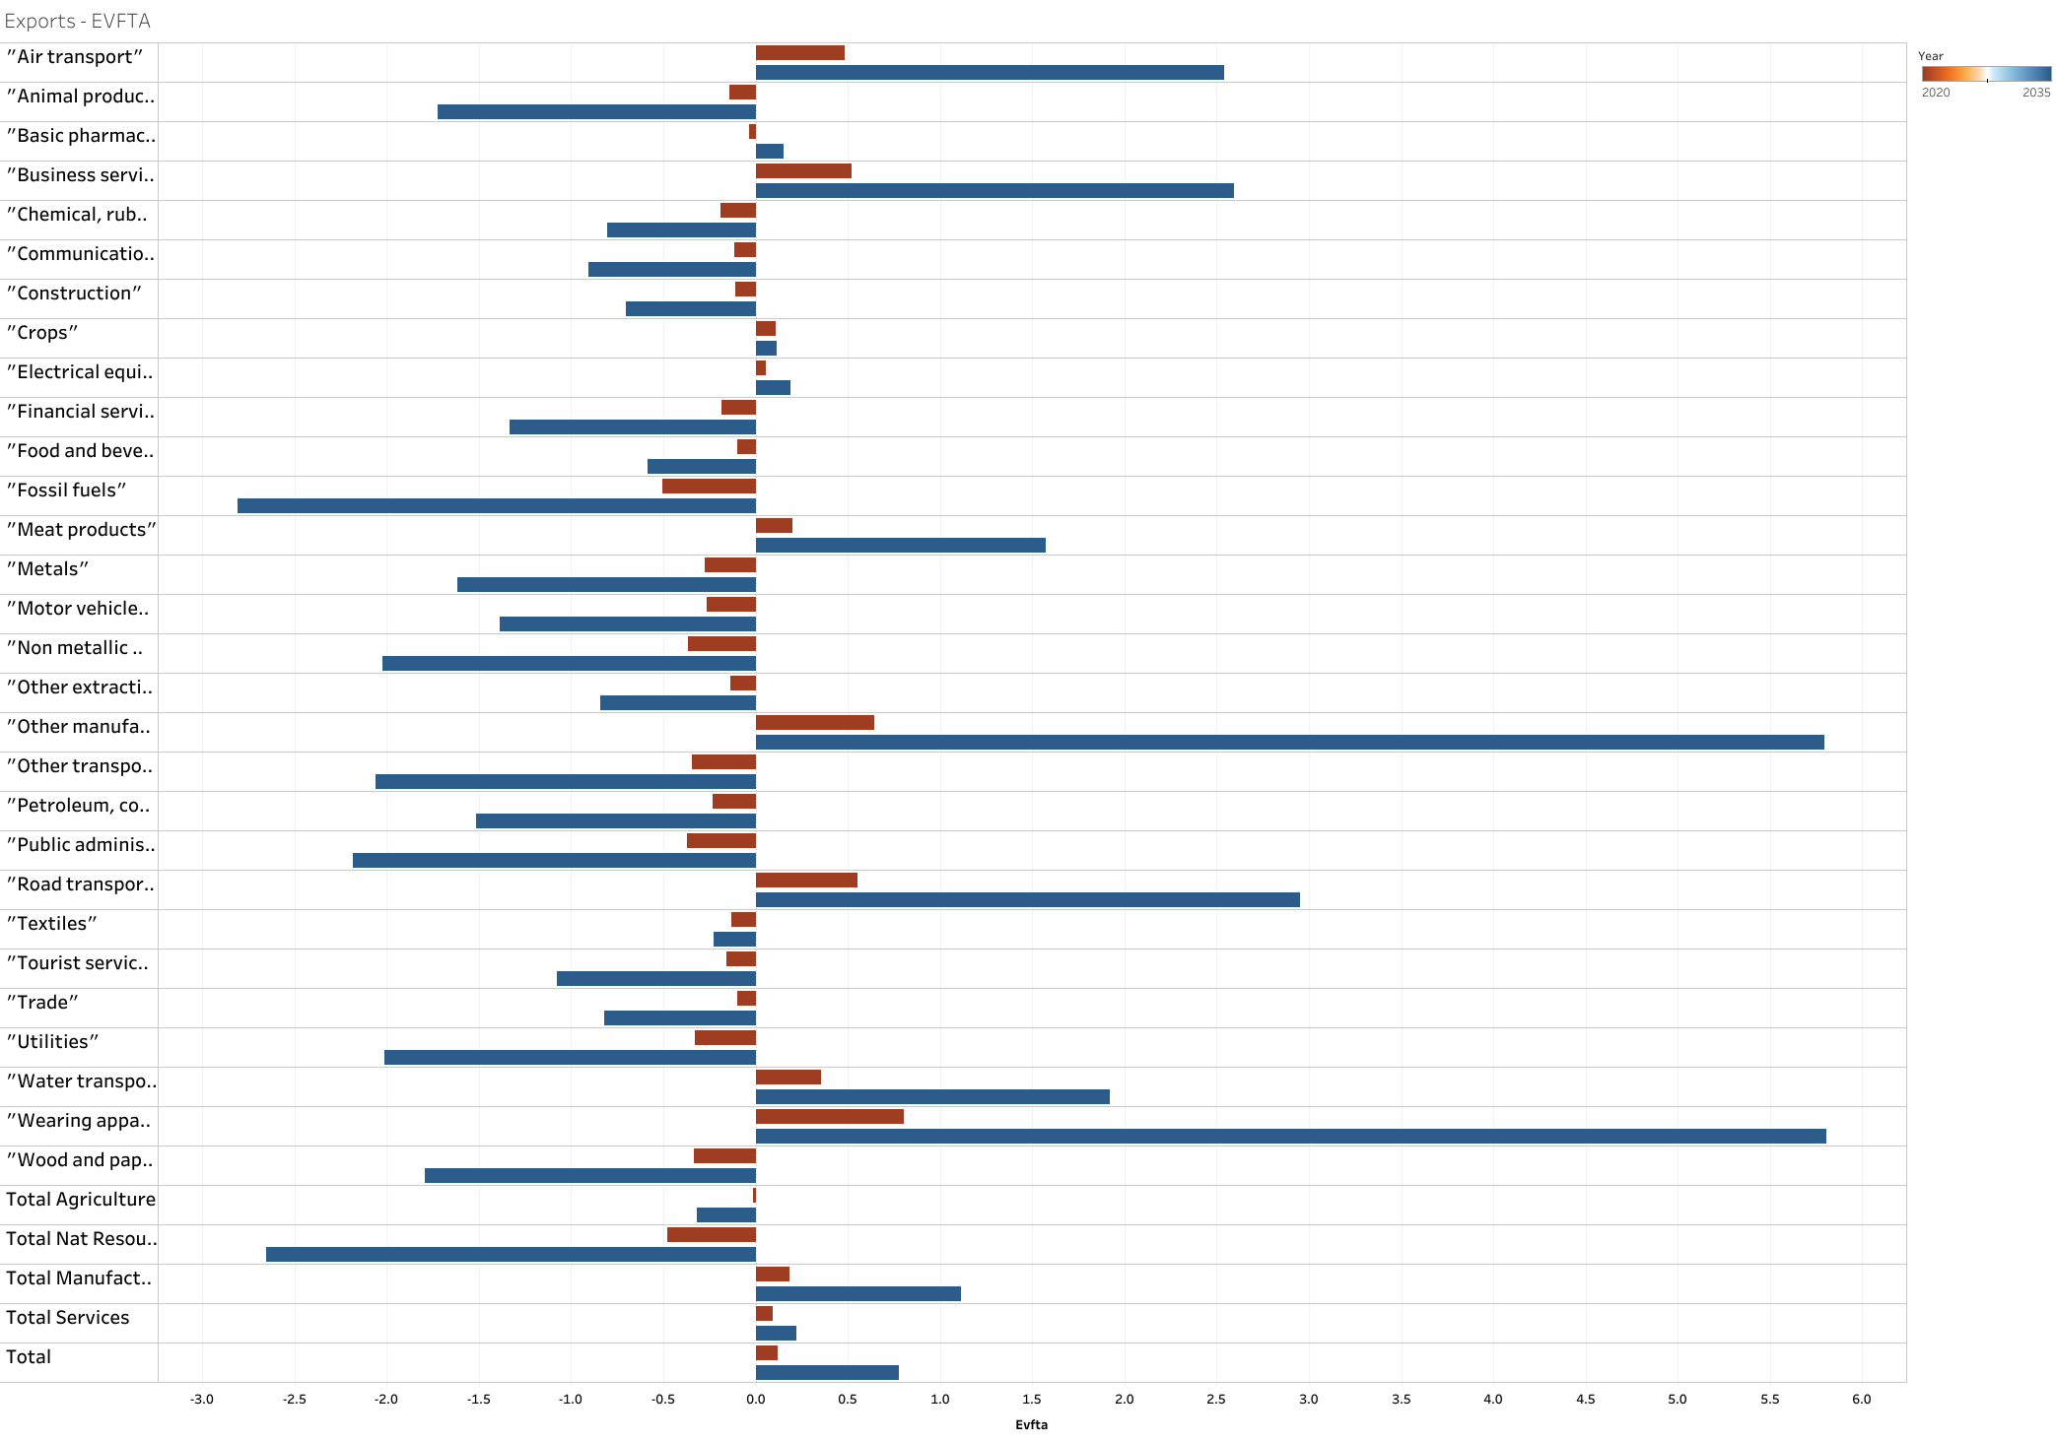
EVFTA –
Exports

Slide 16
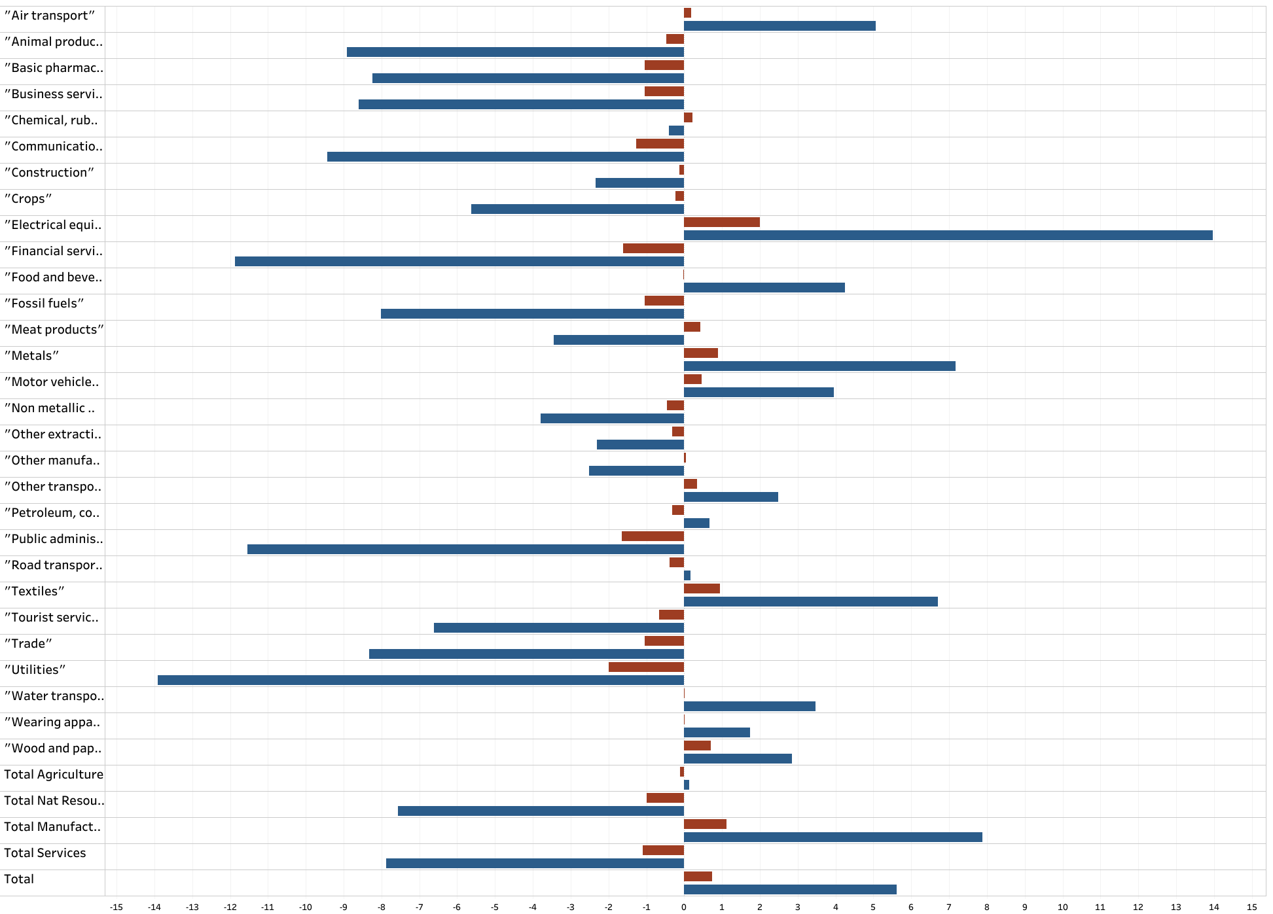
RCEP –
Exports

Slide 17
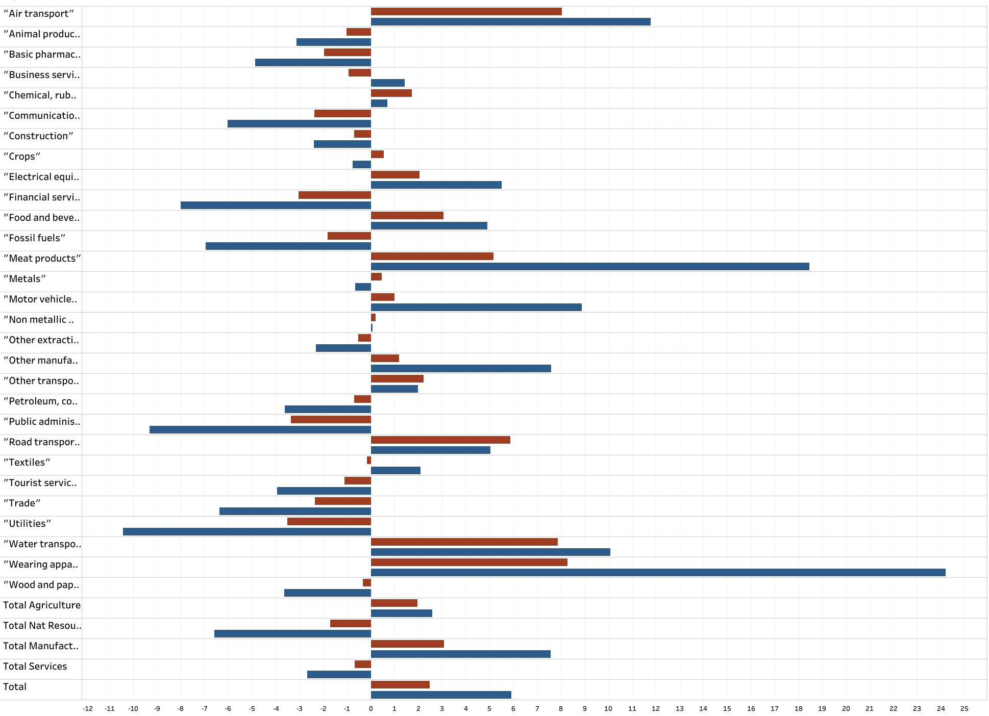
CPTPP &
EVFTA –
Exports

Slide 18
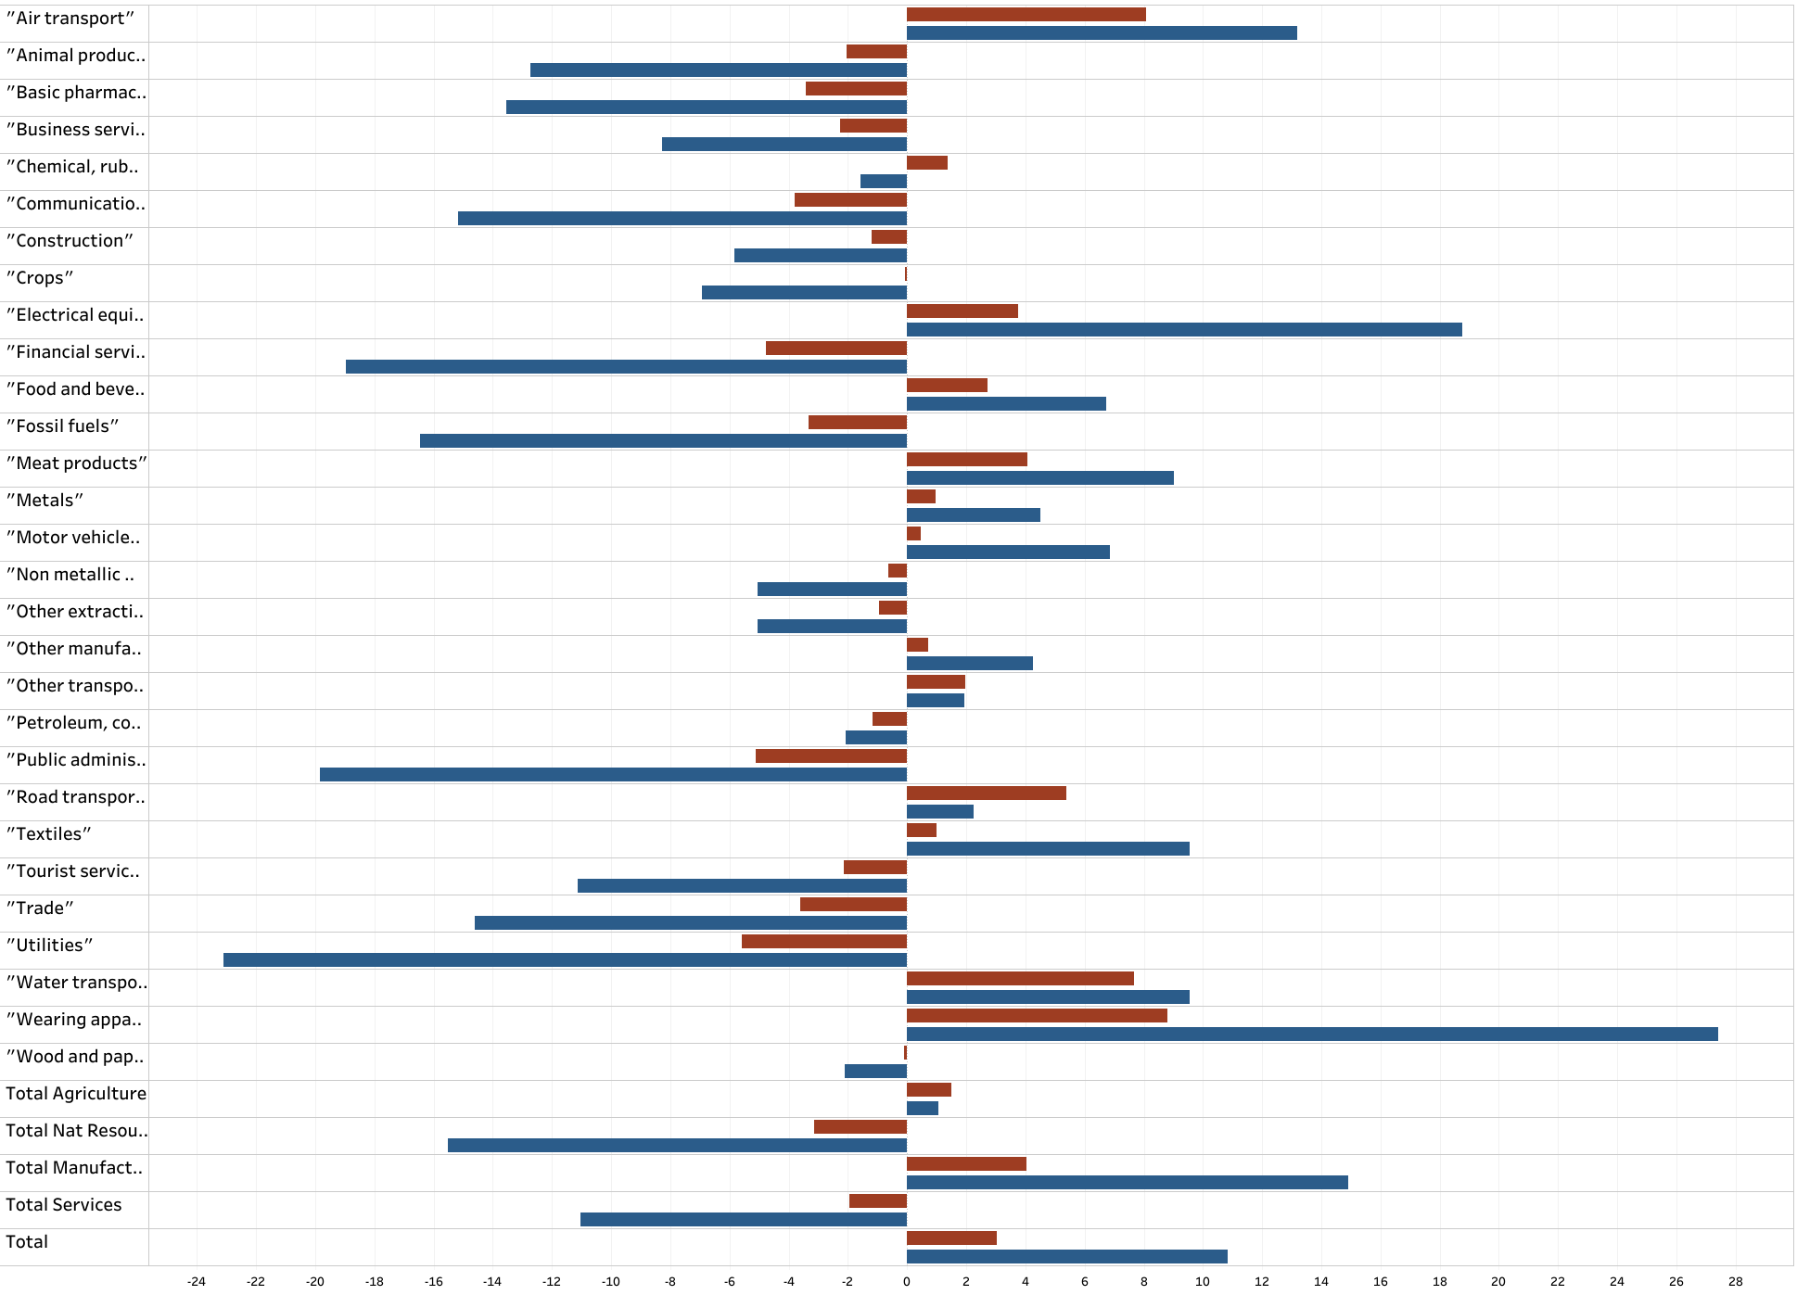
CPTPP,
RCEP
& EVFTA –
Exports

Slide 19
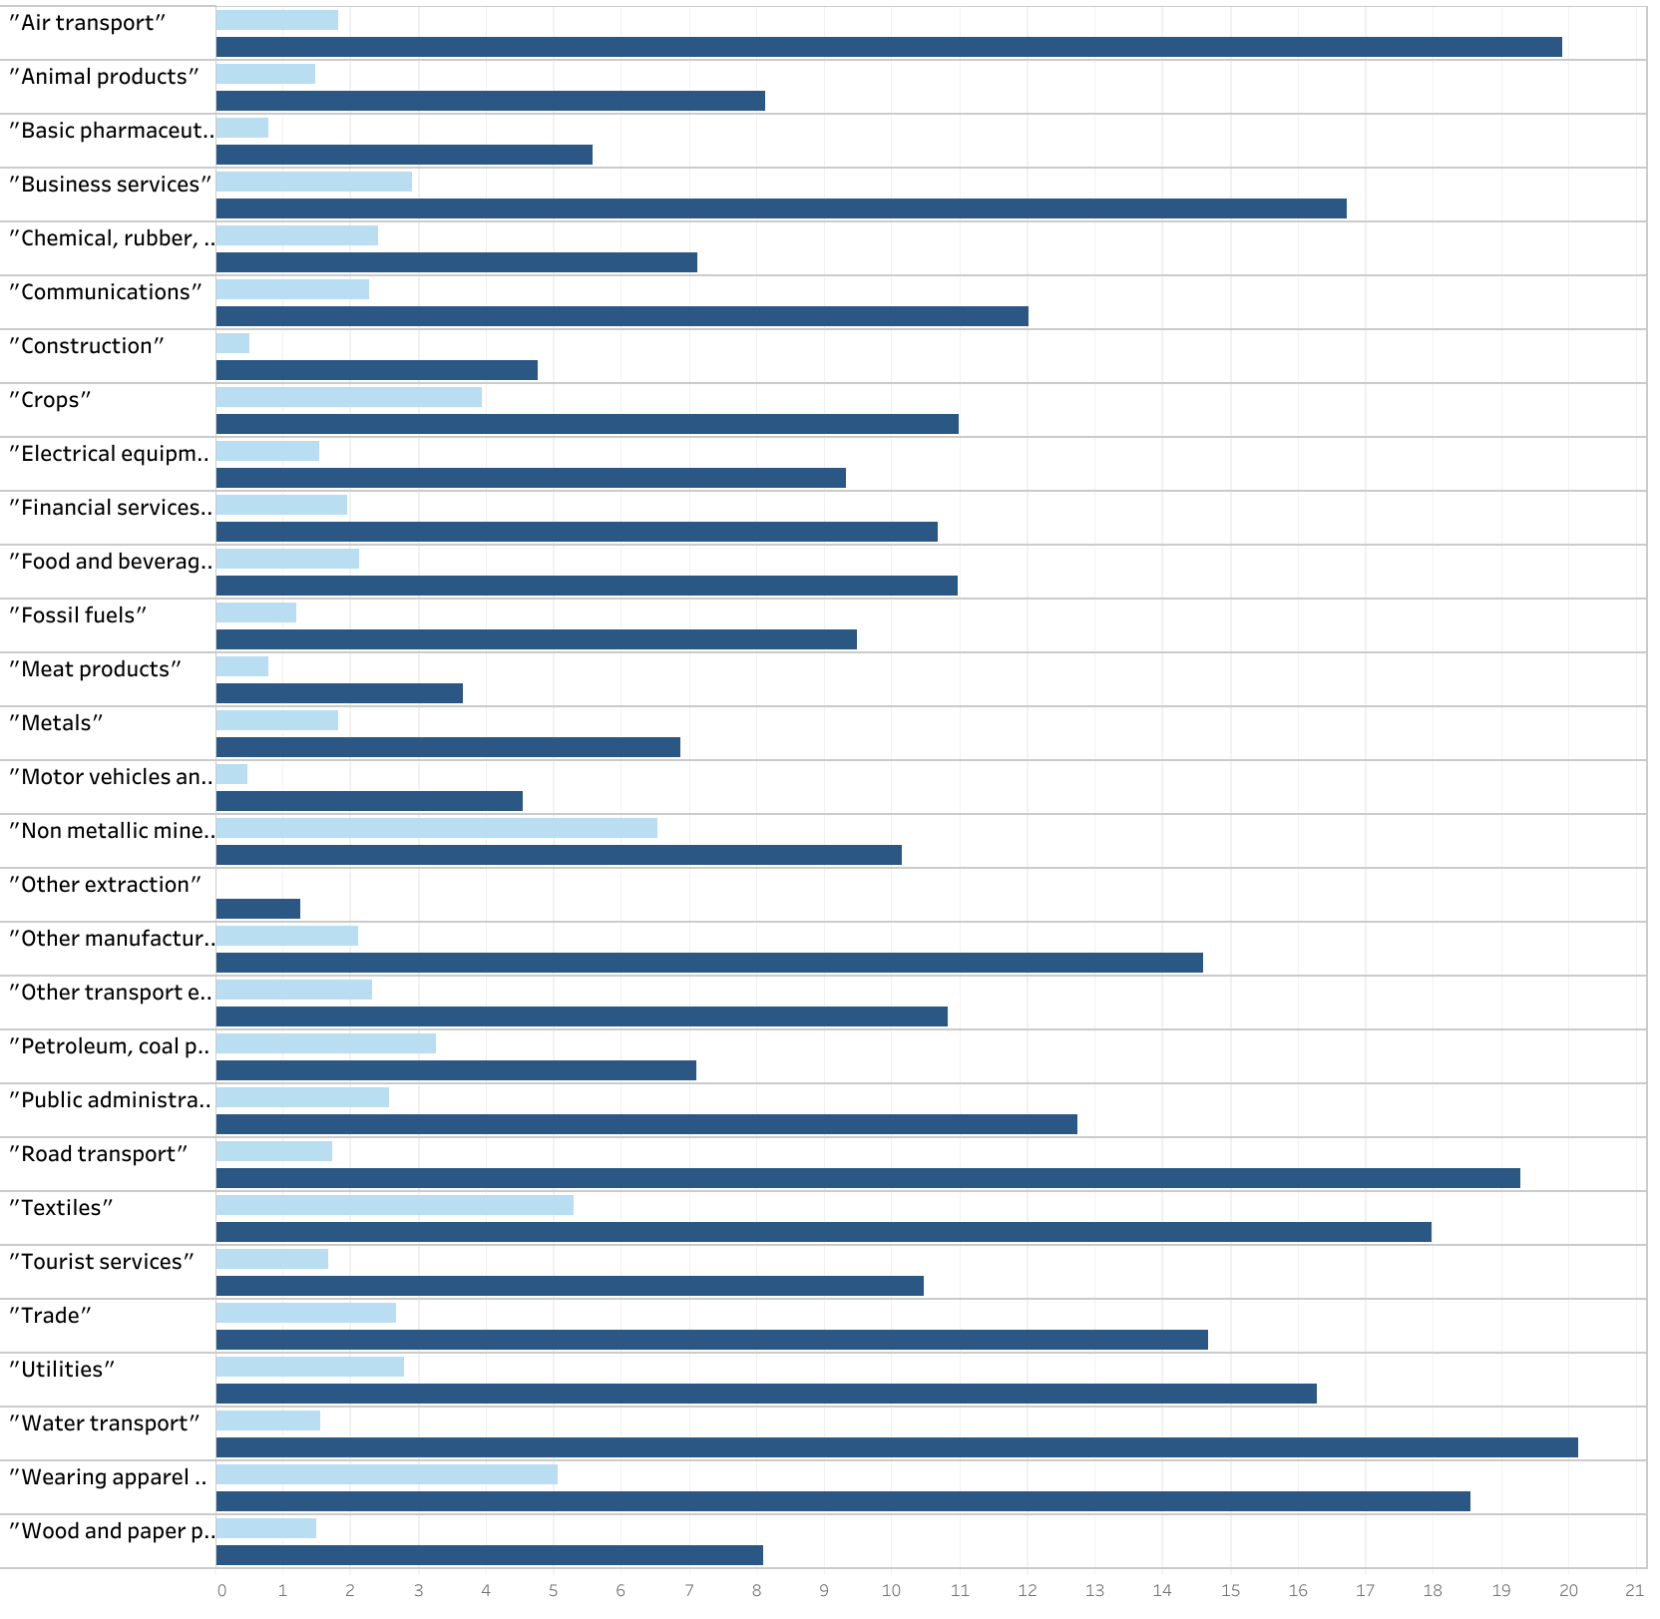
CPTPP,
RCEP
& EVFTA –
Imports

Slide 20
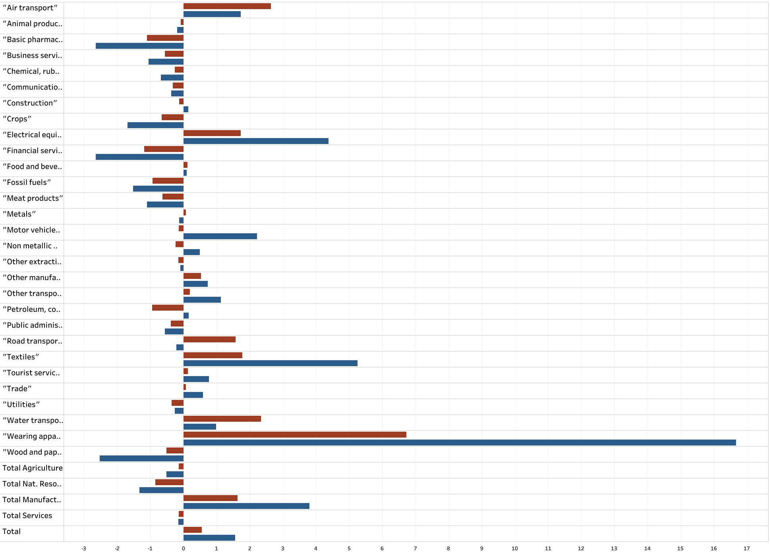
CPTPP–
Output

Slide 21
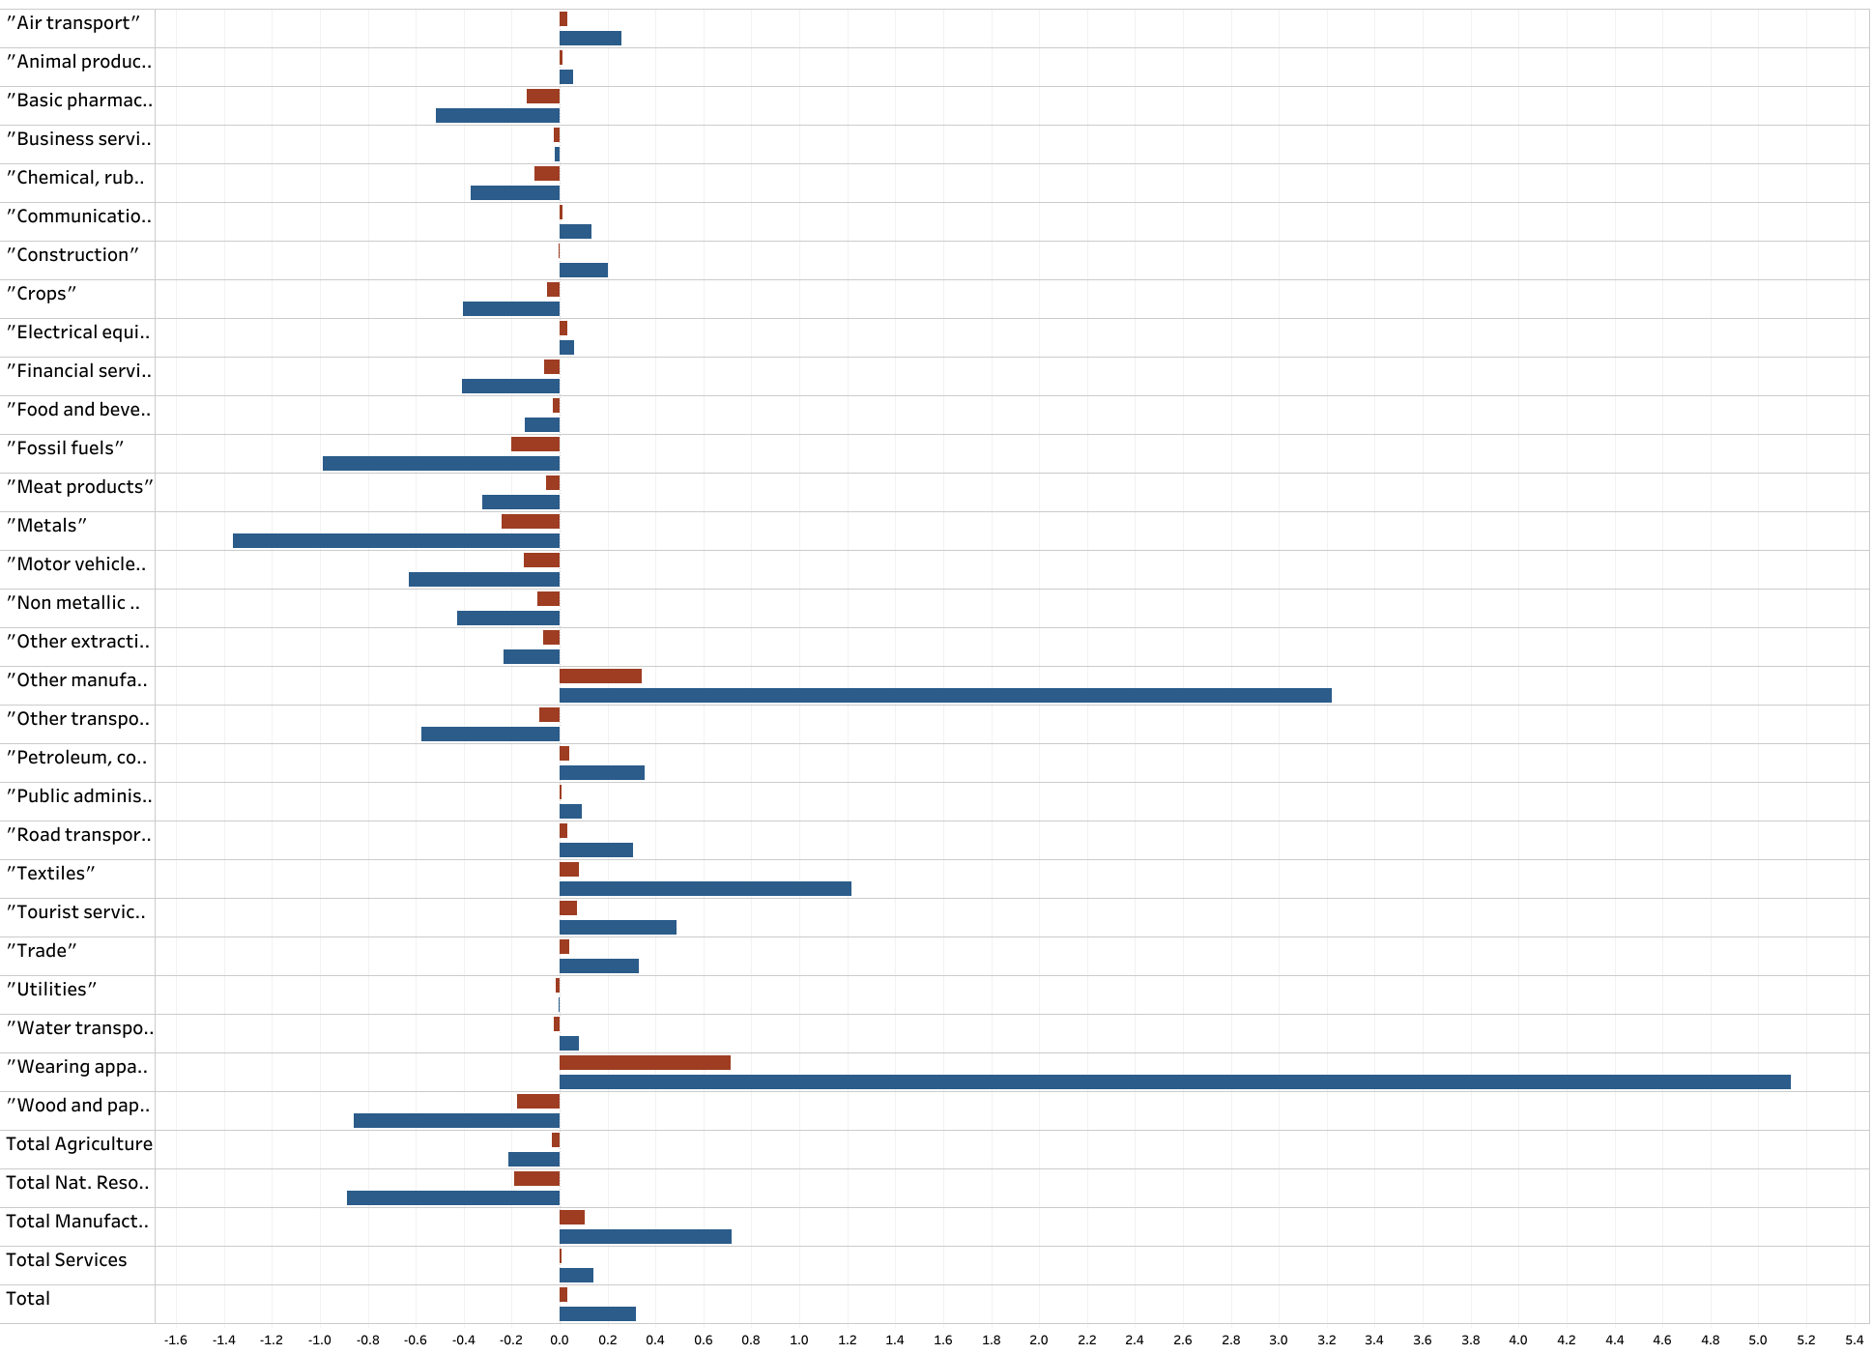
EVFTA–
Output

Slide 22
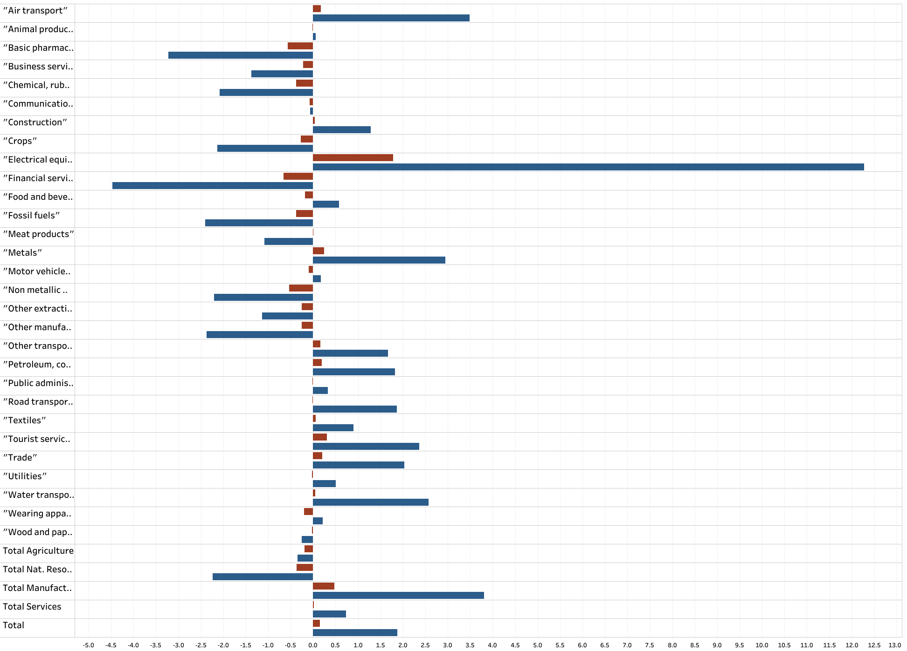
RCEP–
Output

Slide 23
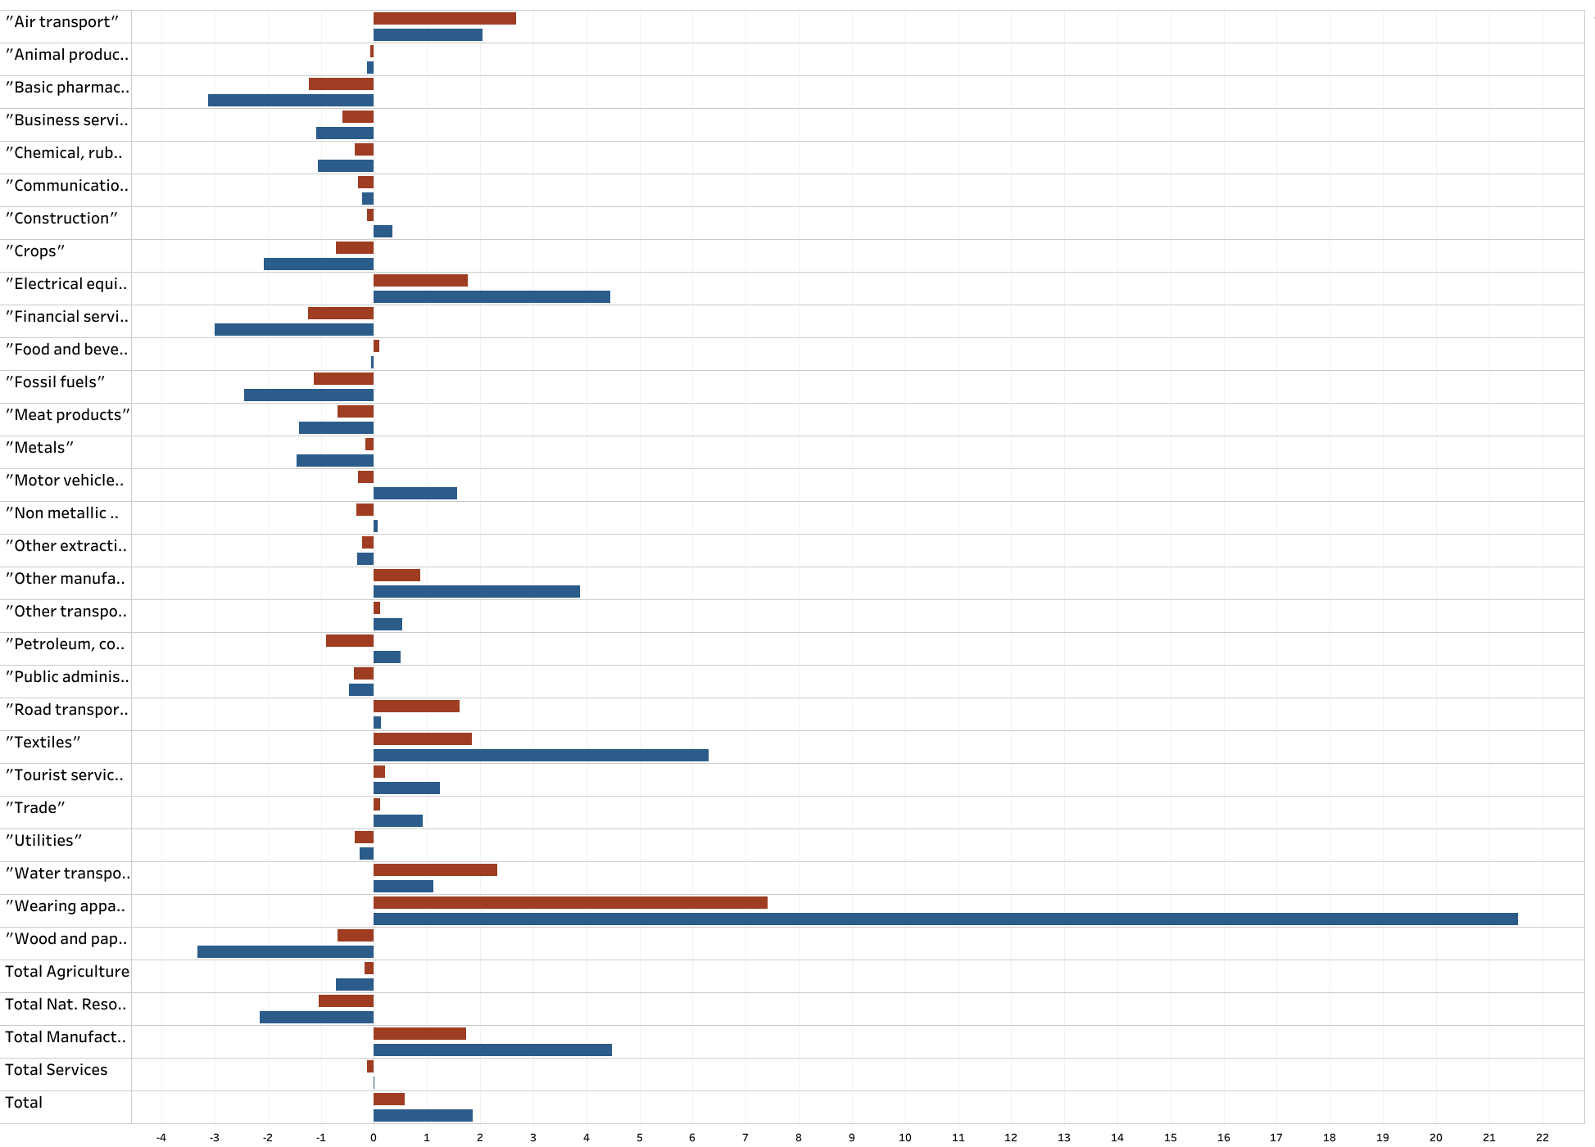
CPTPP & EVFTA–
Output

Slide 24
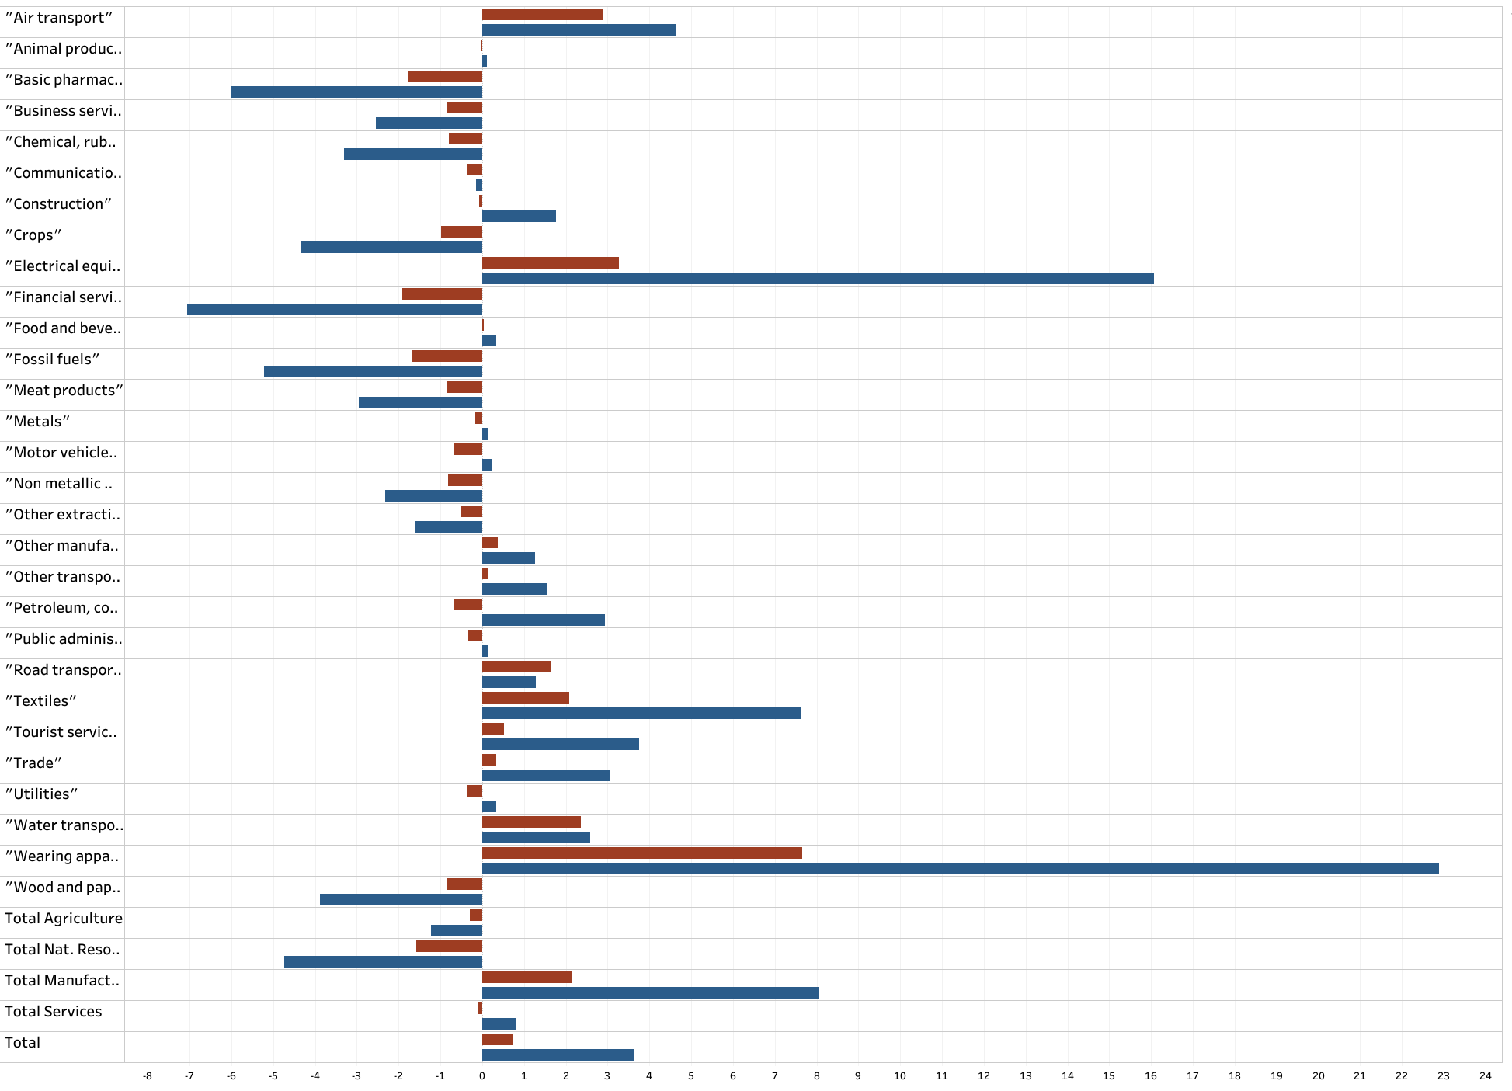
CPTPP,
EVFTA &
RCEP–
Output

Slide 25
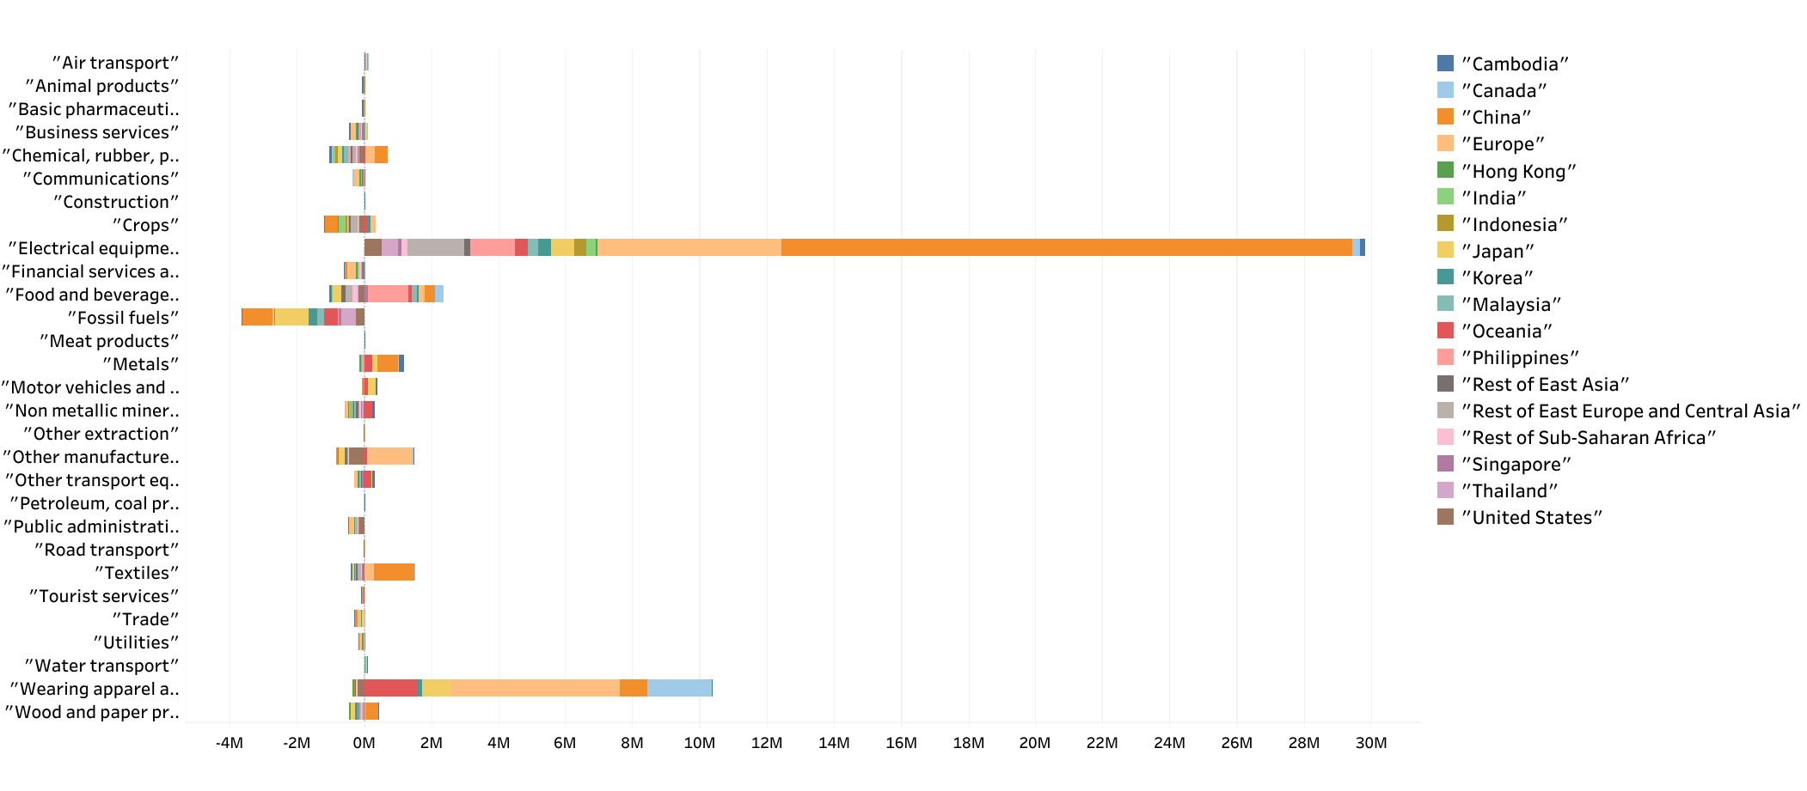
Vietnam exports (difference from the baseline)
CPTPP, EVFTA and RCEP scenario

Slide 26
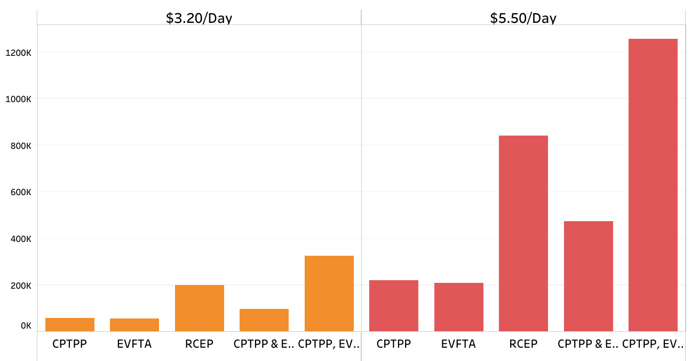
People lifted from poverty (relatively to baseline)

Slide 27
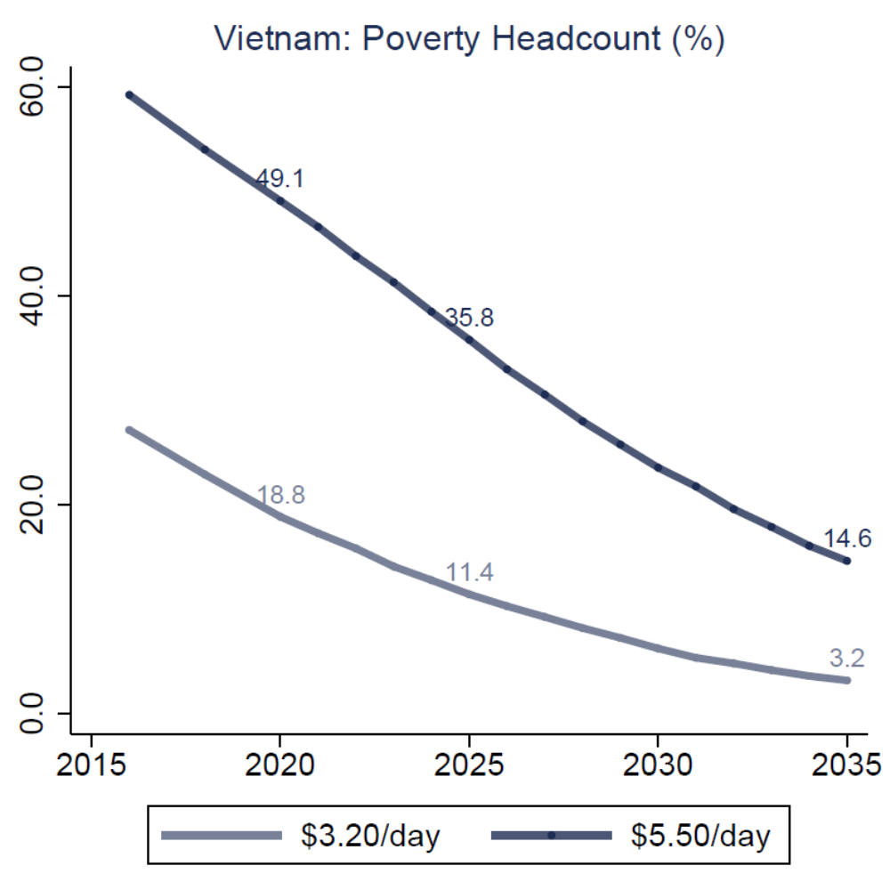
CPTPP –
Poverty headcount

Slide 28
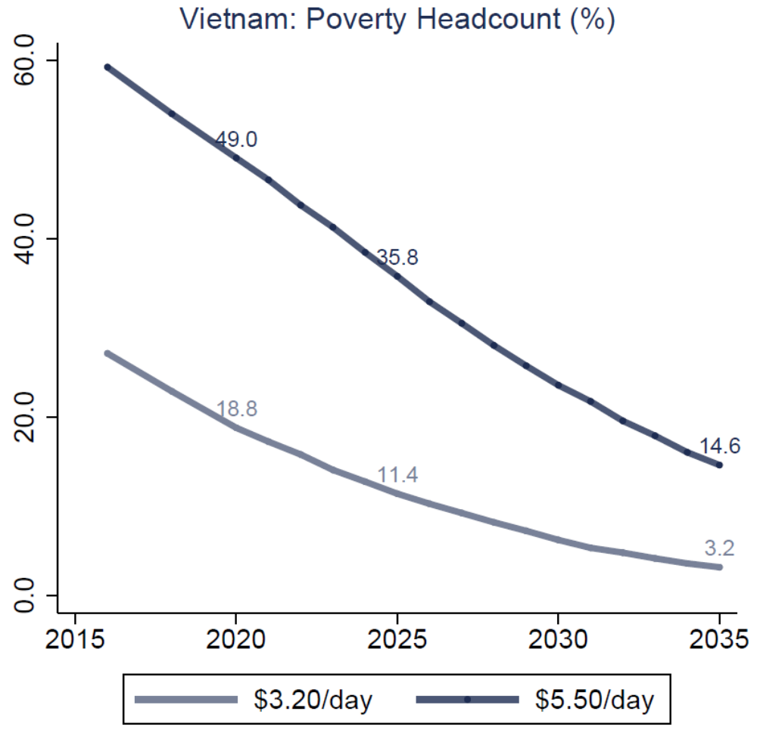
EVFTA –
Poverty headcount

Slide 29
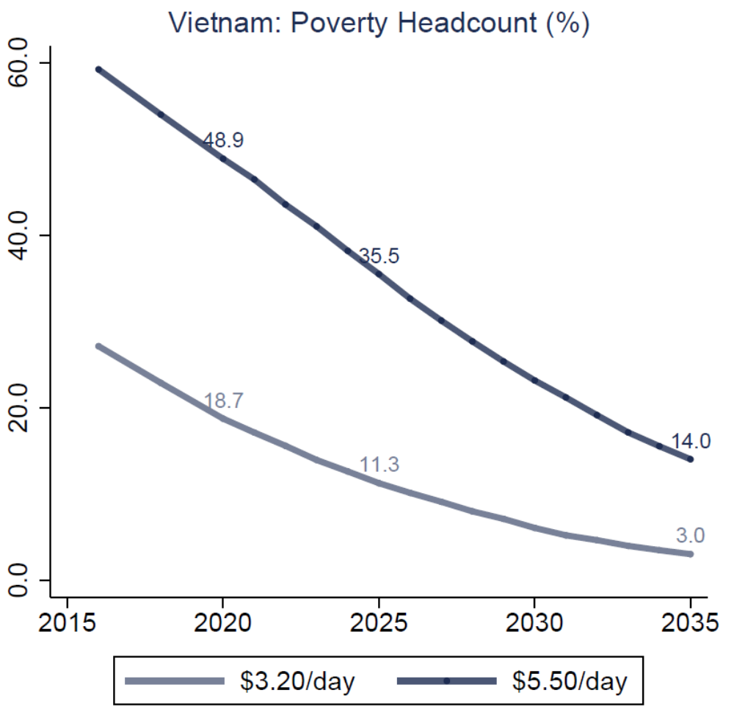
RCEP –
Poverty headcount

Slide 30
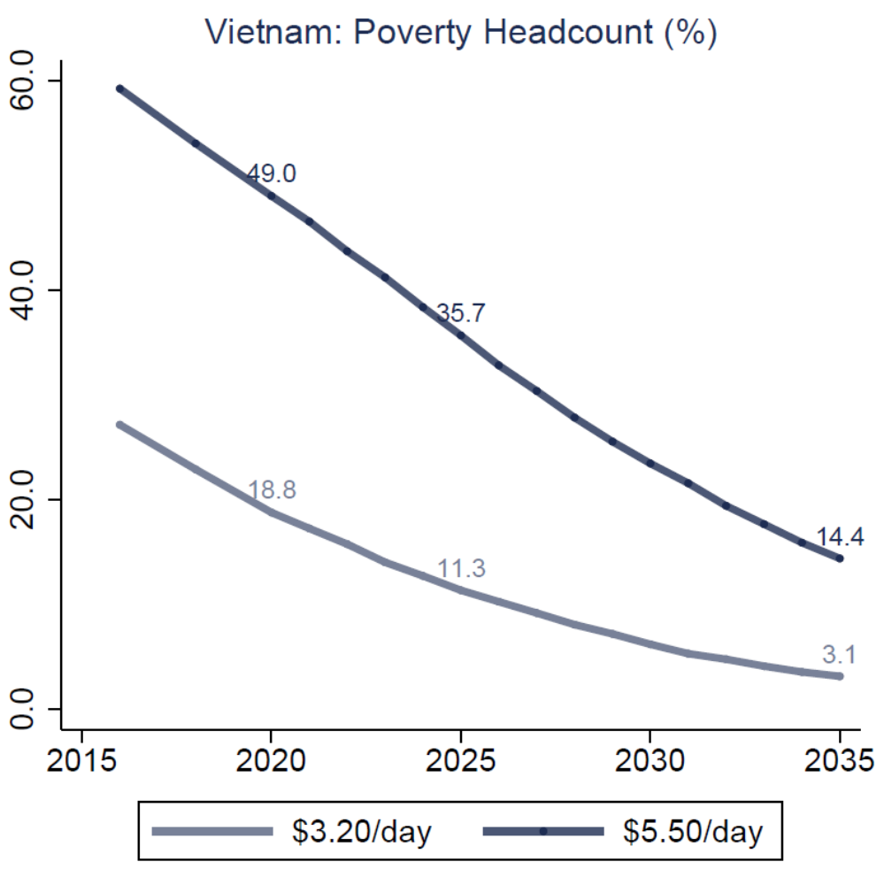
CPTPP &
EVFTA –
Poverty headcount

Slide 31
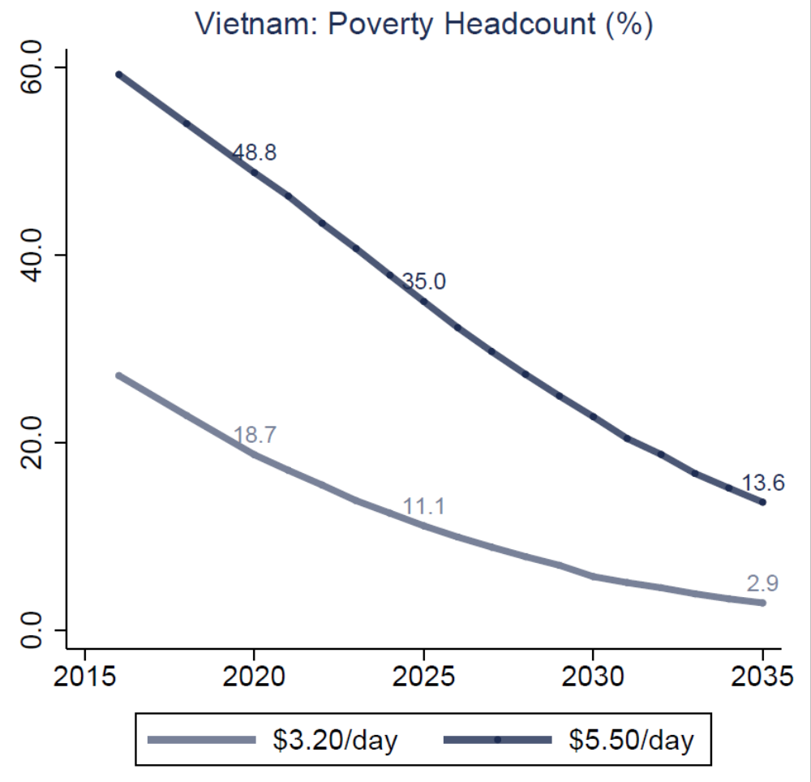
CPTPP, EVFTA
& RCEP –
Poverty headcount

Slide 32
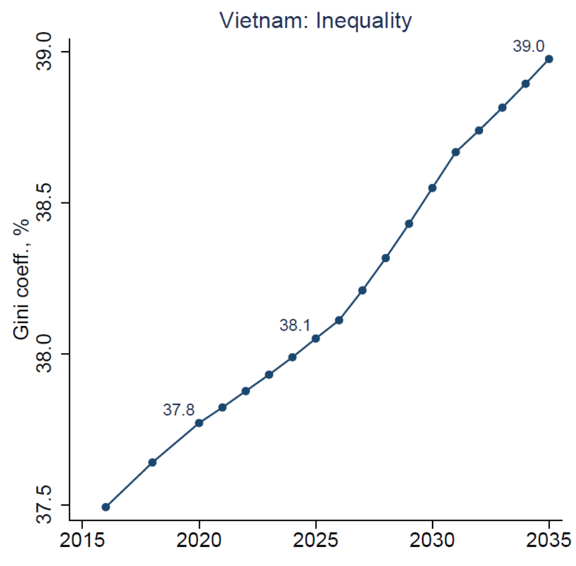
CPTPP, EVFTA
& RCEP –
Gini coeff. – greater inequality

Slide 33
Key findings
The combined scenario brings more benefits to Vietnam, due to a broader set of potential markets and lower tariffs. Manufacturing is the sector that most benefits with the treaty, while natural resources and services see a reduction in terms of exports and output.
RCEP has an higher impact in the Vietnam economy, as an individual country, due to a broader number of partners involved in the treaty and due to the high reduction of tariffs. RCEP also gives access to big markets such as China and developed economies such as Japan and South Korea.
All the treaties help Vietnam in lifting people out of the poverty, however it also creates the risk of higher inequality. To protect the ones more negatively impacted by trade liberalization is necessary to implement a set of public policies and safety nets.

Slide 34
Caveats
Results might underestimate actual gains:
  The study does not model FDI (trade liberalization is likely to attract additional investment flows)
  The model does not capture new products or markets where Vietnam might become competitive
The results might be overestimating the gains in the short term:
  CGE simulations assume a fixed trade balance.
    Imports might increase faster than exports, so there might be a transitional trade balance deterioration. However, in the medium-term, this could mean an underestimation of gains, if productivity improves and leads to positive changes in trade balance
We assume that the rate of unemployment remains at the initial level and all new entrants to the labor market find gainful employment

