Slide 1


Introducing the Water-Energy link in a General Equilibrium Model:
ICES-WN
Elisa Bardazzi*, Gabriele Standardi , Ramón E. Key Hernández, Francesco Bosello
elisa.bardazzi@cmcc.it

Slide 2
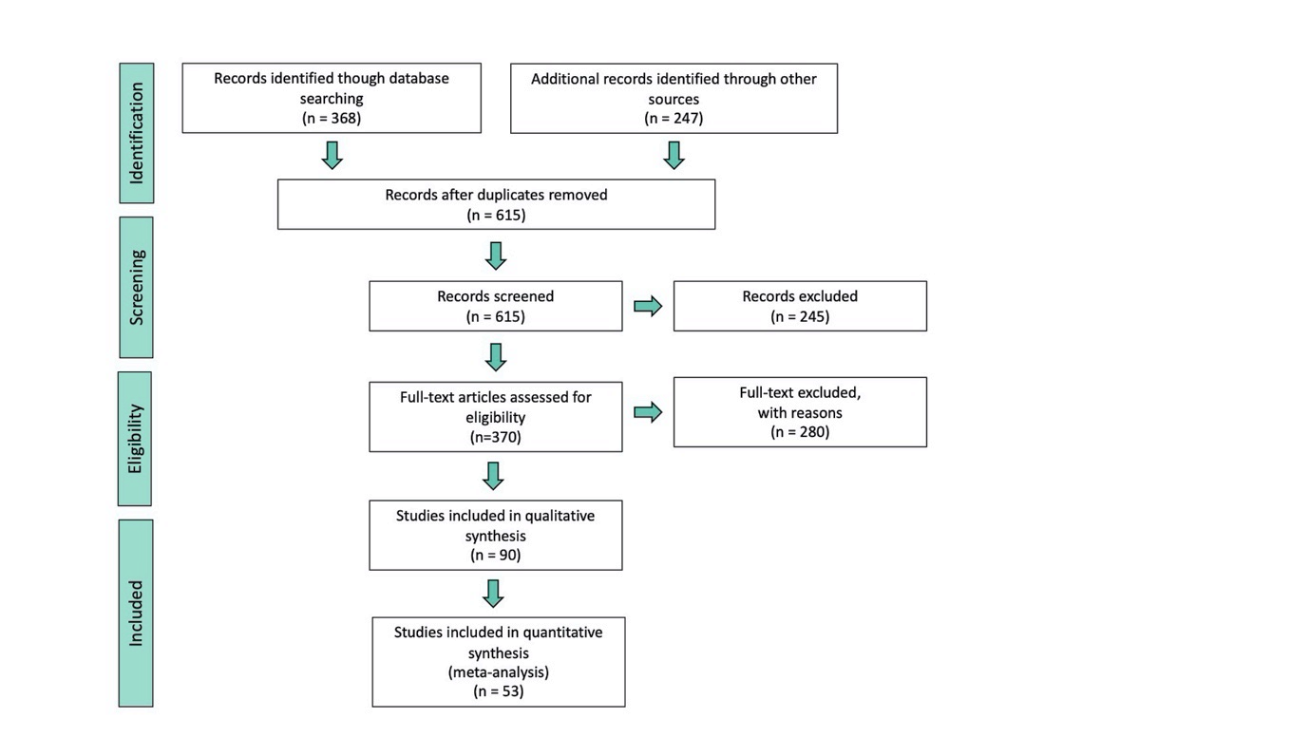

1. Introduction: Why focus on Water
Keywords: Water AND Energy AND Food AND Nexus AND CGE (and Subsets)
GTAP-W-BIO
(Haqiqi, 2016;
Taheripour et al., 2020, 2013a, 2007)
Li et al., 2015;
Nechifor and Winning, 2018 (Rescu-water Gtap-based)
Teotónio et al., 2020
Last Update: February 2021

Slide 3
1. Project Outline
What:
Fill the gap in CGE the literature about integrating the nexus, specifically the Water-Energy link
How:
Assign a value added for the water endowment in Energy sector (database modification)
Allow the perception of this value added: modification of production function introduce water
Methodological basis: Gtap-W (Calzadilla, Rehdanz, Tol, 2011a; Calzadilla, Rehdanz, Tol; 2011b) and
Gtap-W-BIO (Haqiqi, 2016; Taheripour et al., 2020, 2013a, 2007)

Slide 4
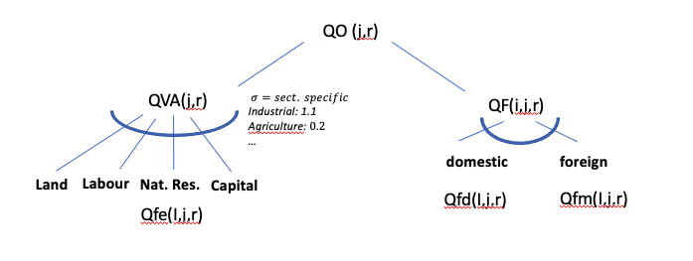
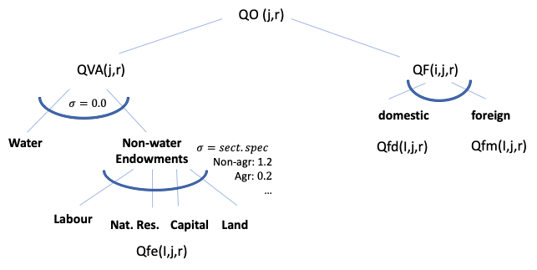
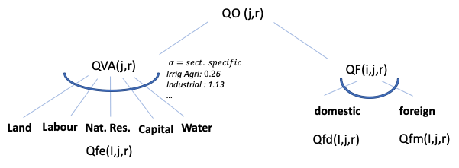
2. Modifications: Production Function
Before: ICES production function
Option a:
Option b:
Basis: Nechifor and Wwinning, 2018; IEA 2012, 2016

Slide 5
2. Modifications: Database
VA_{ijr} = P_{ir} * Q_{ijr}
Inputs:
Value Added: GTAP-W-BIO (Expansion GTAP9) – (F. Taheripour, T. W. Hertel, and J. Liu, 2013; Haqiqi et al., 2016)
Q water for irrigated agriculture (on which GTAP-W-BIO is calibrated): FAO- AQUASTAT
Q water for Energy from World Energy Outlook (IEA)
Extraction water value added from Capital Value added (based on Hertel and J. Liu, 2019)
Prices are assumed same regionally for all the sectors as the supply sites are the same and the risk (e.g. climate change) are share by everyone, so scarcity issues are homogeneous btw sectors
Region | Energy Water Withdraw (billion m3) | Water Value Added in Energy |  |  | Capital Value Added in Energy Sector |  |  | Share of Capital directed to Water (%)
 |  | VFM | EVFA | EVOA | VFM | EVFA | EVOA | VFM | EVFA | EVOA
OECDAmerica | 241 | 11679.1 | 10268.5 | 10746.3 | 299185.5 | 309022.1 | 4823449.0 | 3.9 | 3.3 | 0.2
China | 106 | 2993.3 | 2375.7 | 2959.8 | 95477.6 | 95614.3 | 2925523.3 | 3.1 | 2.5 | 0.1
India | 40 | 974.1 | 974.7 | 938.8 | 36455.9 | 36476.5 | 684071.6 | 2.7 | 2.7 | 0.1
OECDEU | 61 | 2475.2 | 2379.5 | 2282.1 | 260282.0 | 265589.3 | 6401322.5 | 1.0 | 0.9 | 0.0
Othereueurasia | 95 | 1256.4 | 1274.6 | 1188.0 | 193118.7 | 196711.0 | 1151904.3 | 0.7 | 0.7 | 0.1
Latinamerica | 16 | 487.5 | 492.1 | 453.7 | 128161.7 | 129287.0 | 1575094.0 | 0.4 | 0.4 | 0.0
Asia | 11 | 165.1 | 166.1 | 155.1 | 92483.1 | 93151.9 | 1224403.5 | 0.2 | 0.2 | 0.0
OECDoceania | 5 | 158.8 | 147.5 | 146.6 | 91064.7 | 93576.5 | 3067511.3 | 0.2 | 0.2 | 0.0
Africa | 5 | 67.7 | 68.1 | 57.7 | 158781.4 | 160577.1 | 720084.2 | 0.0 | 0.0 | 0.0
Middleeast | 3 | 45.0 | 45.5 | 43.6 | 522909.8 | 528546.4 | 1377191.8 | 0.0 | 0.0 | 0.0

Slide 6
3.1 Simulations
Systematic shocks on water endowment 10% to %50
2 production functions (original, Leontief)
2 versions of database: 1 sector; 2 sectors
Varying assumptions on Water* and Land Mobility between sectors
12 different composition for 5 water scenarios
60 simulations
* Water mobility applies only to the two sectors cases

Slide 7
3.1 Results: Global Impacts: GDP for the different model specifications
Original funct
(2 sec)
Original funct
(1 sec)
Original
funct
(2 sect)
SLUG
Modified
Funct (2 sec)
Modified
funct (1 sec)
Modified function
(2 sect) SLUG

Slide 8
3.1 Results: Economic justification of scenarios selection
In consideration of these results and acknowledging the strong dependence of several energy production techniques from water availability (IEA, 2012, 2016) we consider the two sector Leontief with mobile land and water as the most theoretically coherent version and the next sections will concern only this specification (ICESWN).
the decision to alter the standard land mobility assumption (slug between sectors) was due to:
Assuming ICESWN, 30% water shock:
! & Technological shift assumption

Slide 9
3.3 Results - Regional Impacts (30% Water Scarcity Scenario): Output
Irrigated
Agriculture
Energy

Slide 10
3.3 Results - Regional Impacts (30% Water Scarcity Scenario): Prices
Irrigated
Agriculture
Energy

Slide 11
3.3 Results - Regional Impacts (30% Water Scarcity Scenario): Imports
Irrigated
Agriculture
Energy

Slide 12
3.3 Results - Regional Impacts (30% Water Scarcity Scenario): Water demand

Slide 13
3.3 Results - Regional Impacts (30% Water Scarcity Scenario): Water share
Energy
Irrig. agr.
Before
After

Slide 14
Thank you for your attention.
For any question please write to;
elisa.bardazzi@cmcc.it

