Slide 1
Tracking calories in CGE models: from fork to farm
Ron Sands
USDA Economic Research Service
Kansas City, Missouri
2021 GTAP Virtual Meeting
June 23-25, 2021
The findings and conclusions in this presentation are those of the author and should not be construed to represent any official USDA or U.S. Government determination or policy.

Slide 2
Motivation
A major challenge for economic modelers is matching monetary flows in the benchmark social accounting matrix (SAM) with quantity flows
  energy (joules)
  agricultural commodities (calories)
  or land (hectares)
For questions related to world food demand and food security, it is necessary to match flows of agricultural commodities, in physical units, to corresponding monetary flows
This paper describes a methodology developed for the Future Agricultural Resources Model (FARM), a global computable general equilibrium (CGE) model
  Demand-driven analysis
  Three diet scenarios
  Crop calories chosen as unit for comparison to food calories
  Implied demand for crop calories is greater than demand for food calories

Slide 3
Outline
Economic Framework
  Global computable general equilibrium
  Simulation of world agriculture through 2050
Methodology
  Demand-driven analysis
  Food balance sheets
  Merging social accounting matrix and food balances
Application to global diet scenarios
  Static diet (reference scenario)
  Income-driven diet
  50 percent EAT-Lancet healthy diet
  Demand for food calories varies by diet scenario
  Implied demand crop calories greater than demand for food calories

Slide 4
Economic Framework
The Future Agricultural Resources Model (FARM)
  Recursive dynamic CGE model: essentially a sequence of static equilibria with capital stocks updated between time steps, but lacking foresight of future economic variables
  Land use can shift among crops, pasture, and managed forests in response to population growth and changes in income, with behavioral responses determined by price and income elasticities
  FARM can substitute other inputs for land if land becomes expensive
  Crop yield is endogenous, even with underlying productivity trends that are exogenous to the model
Key data sets
  Global social accounting matrix (SAM) from GTAP
  Food balance sheets from the Food and Agriculture Organization (FAO) of the United Nations
  Tables for converting food consumption by weight to calories

Slide 5
Agricultural production sectors and first-stage mapping for demand system
Group | Subgroup | Symbol | Description | Grain prods | Veg. oils | Sugar prods | Fruits & veg | Other crops | Animal prods | Forest prods
Primary agriculture | Crops | WHT | Wheat | X
 |  | PDR | Paddy rice | X
 |  | GRO | Other grains | X
 |  | OSD | Oilseeds |  | X
 |  | C_B | Sugar (cane and beet) |  |  | X
 |  | V_F | Vegetables and fruits |  |  |  | X
 |  | PFB | Plant fibers |  |  |  |  | X
 |  | OCR | Other crops |  |  |  |  | X
 | Fisheries | FSH | Fish |  |  |  |  |  | X
 | Forestry | FRS | Forestry |  |  |  |  |  |  | X
 | Ruminant | CTL | Cattle and other ruminants |  |  |  |  |  | X
 |  | RMK | Raw milk |  |  |  |  |  | X
 |  | WOL | Wool |  |  |  |  |  | X
 | Non-ruminant | OAP | Other animal products |  |  |  |  |  | X
Food processing |  | VOL | Vegetable oils |  | X
 |  | PCR | Processed rice | X
 |  | SGR | Sugar |  |  | X
 |  | B_T | Beverages and tobacco products |  |  |  |  | X
 |  | OFD | Other food |  |  |  |  | X
 |  | CMT | Meat from cattle and other ruminants |  |  |  |  |  | X
 |  | MIL | Dairy products |  |  |  |  |  | X
 |  | OMT | Other meat products |  |  |  |  |  | X

Slide 6
Standard Food Balance Sheet structure (thousand metric tons) USA 2013
 | PROD | +IMP | +STOCK | -EXP | -FEED | -SEED | -WASTE | -PROC | -OTHER | = FOOD
Wheat | 57,967 | 5,491 | 5,284 | 34,691 | 6,196 | 2,096 |  |  | 16 | 25,742
Rice | 5,745 | 923 | -27 | 3,522 |  | 109 | 200 | 464 | 142 | 2,203
Barley | 4,683 | 864 | 16 | 696 | 1,440 | 107 |  | 3,161 |  | 160
Maize | 353,699 | 3,595 | -39,863 | 24,655 | 128,024 | 582 |  | 23,230 | 137,023 | 3,917
Source: Food and Agriculture Organization (FAO) of the United Nations
PROD = production
IMP = imports
STOCK = change in crop storage
EXP = exports
FEED = animal feed
SEED = seed for crops
WASTE = waste during storage and transportation
PROC = food processing
OTHER = other uses, mostly corn for ethanol
FOOD = food available for consumption

Slide 7
Calorie map between production sectors
Subgroup | Symbol | feed | VOL | PCR | SGR | B_T | CMT | MIL | OMT | LUM PPP | other | Consumer Demand
Crops | WHT | kcal |  |  |  | kcal |  |  |  |  |  | kcal
 | PDR | kcal |  | kcal |  |  |  |  |  |  |  | kcal
 | GRO | kcal |  |  |  |  |  |  |  |  | kcal | kcal
 | OSD | kcal | kcal |  |  |  |  |  |  |  | kcal | kcal
 | C_B | kcal |  |  | kcal |  |  |  |  |  |  | (kcal)
 | V_F |  |  |  |  | kcal |  |  |  |  |  | kcal
 | PFB |  |  |  |  |  |  |  |  |  |  | $
 | OCR | $ |  |  |  |  |  |  |  |  |  | $
Fisheries | FSH |  |  |  |  |  |  |  |  |  |  | kcal
Forestry | FRS |  |  |  |  |  |  |  |  | $ |  | -
Ruminant | CTL |  |  |  |  |  | kcal |  |  |  |  | (kcal)
 | RMK |  |  |  |  |  |  | kcal |  |  |  | (kcal)
 | WOL |  |  |  |  |  |  |  |  |  |  | $
Non-ruminant | OAP |  |  |  |  |  |  |  | kcal |  |  | kcal
Food processing | VOL |  |  |  |  |  |  |  |  |  |  | kcal
 | PCR |  |  |  |  |  |  |  |  |  |  | $
 | SGR |  |  |  |  |  |  |  |  |  |  | kcal
 | B_T |  |  |  |  |  |  |  |  |  |  | kcal
 | CMT |  |  |  |  |  |  |  |  |  |  | $
 | MIL |  |  |  |  |  |  |  |  |  |  | $
 | OMT |  |  |  |  |  |  |  |  |  |  | kcal
 | OFD |  |  |  |  |  |  |  |  |  |  | $
Forest products | LUM |  |  |  |  |  |  |  |  |  |  | $
 | PPP |  |  |  |  |  |  |  |  |  |  | $

Slide 8
Diet scenarios
Static diet (reference scenario): All world regions maintain their 2011 historical diet. There is no income or price response in this scenario.
Income-driven diet: based on historical food consumption patterns in response to increasing per capita income. The general pattern is for total per capita calories to increase, along with a greater share of animal products in the diet.
50 percent EAT-Lancet healthy diet: 50 percent convergence from 2011 historical diet toward the Healthy Reference Diet in Willet et al. (2019). With full convergence, average consumption of food calories becomes 2500 kcal/person/day within each world region, which is an increase for developing countries and a decrease for wealthy countries. Consumption of animal products increases in developing countries but declines in wealthy countries.
W. Willett et al. (2019) Food in the Anthropocene: the EAT–Lancet Commission on healthy diets from sustainable food systems, The Lancet 393: 447-492.

Slide 9
Historical diet patterns

Slide 10
Long-run income response of animal product consumption to per-capita income

Slide 11
Food calories to crop calories
There is no unique measure of agricultural production – it could be metric tons, calories, or an economic quantity index with prices as weights
  Tons are useful for aggregation for a limited number of similar goods, such as grains
  We use calories to aggregate or compare all agricultural products
Crop calories are always greater than food calories because calories of animal feed are greater than calories of animal products
Food calories
  Final calories are those that can be consumed as food, covering all food products
  Calibrated to FAO food balance sheets
Crop calories
  Primary (crop) calories are produced from the land, before processing into animal or food products
  Crop calories are greater than food calories, due to losses as feed is converted to meat, dairy products, and eggs
  At the country level, crop calories produced may be different than crop calories utilized, due to international trade
  At the world level, international trade nets to zero, and production of crop calories equals utilization of crop calories

Slide 12
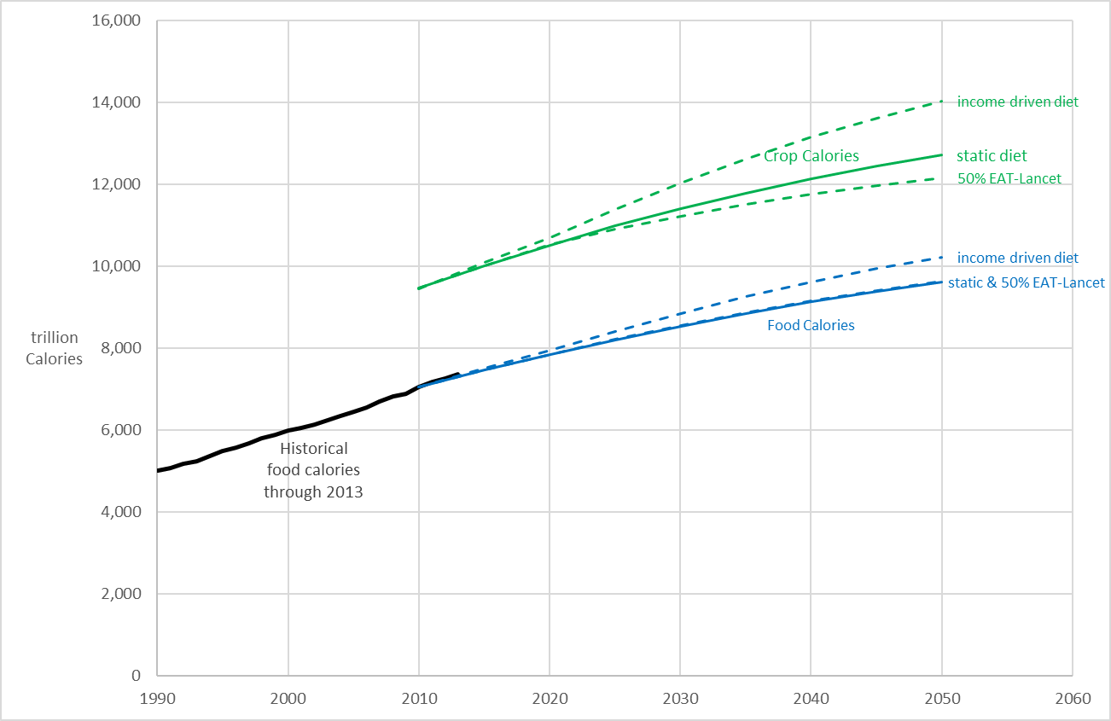
World food calories and crop calories in three diet scenarios

Slide 13
Summary
This study provides a methodology for projecting the demand for crop calories implied by alternative diet scenarios
The range of demand for world crop calories (across diet scenarios) is wider than the range of demand for food calories
With an income-driven diet, and population growth based on United Nations medium projections, the world demand for crop calories increases by 48 percent from 2010 to 2050
With the income-driven diet, per capita consumption of food calories increases in developing countries, but the effect is magnified in the demand for crop calories due to feed requirements of animal products
The EAT-Lancet healthy reference diet highlights the distinction between food calories and crop calories: they can move in opposite directions. World food calories increase slightly with this scenario, but crop calories decline relative to the reference (static diet) scenario

