Slide 1

Agri-food trade in GTAP-HET: Returns to scale in agriculture, and the Melitz model
Michael Bourne, Clare Gray, Lee Humphries – Defra, UK
Edgar Cooke – Ashesi University, Ghana

Slide 2
Motivation
Trade policy makers want to know….
What are the opportunities:
for innovative and competitive producers to increase their customer base,
for consumers to benefit from increased choice and
for consumers to benefit from lower food prices?
What are the threats:
to less efficient producers from increased competition,
to standards on food safety, animal welfare and the environment?
Notes:
Also, potential gains from resource allocation away from inefficient producers

Slide 3
Possibilities
Applying the Melitz model in agrifood would allow analysis of the following effects:
Firms expanding or leaving the sector
Endogenous productivity response
Love of variety
Notes:
Lowering of trade barriers reduces (fixed and/or variable) costs of sales to one or more non-domestic market, so firms which were already selling to this market increase their sales and marginal firms which were not quite efficient enough to sell in this market will be, after the cost reduction. Thus the most efficient firms (those already exporting and the most efficient of those previously selling only to the domestic market) expand.
Expansion of these firms increases demand for inputs, which pushes up the price of both inputs used in the industry. This increases the cost of production across the industry, which pushes up the productivity threshold, and means that some of the least efficient firms exit the industry, as their variable costs now exceed their revenues.
Net result is an overall increase in average productivity in the industry as a result of trade liberalisation, as more inputs are being used by high productivity firms, and fewer by low productivity firms, so mean efficiency of input use is higher.
Need to be clear that in this framework the model says nothing about the productivity of individual firms (which remains exogenous to the model), only average productivity of all the firms remaining in the industry, weighted by production shares. Nevertheless, this is a marked advance over earlier models based on the assumption of perfect competition and a single representative firm in each industry.
In the UK, one of Defra’s stated goals is to ‘make [the farming sector] more prosperous and resilient, championing productive farming…’ (Defra, 2018). As the UK negotiates a number of Free Trade Agreements, the impact of these reductions to trade barriers on agri-food sector productivity will be of great interest to Ministers and policy makers.
Consumers gain welfare from the increased choice available in terms of different varieties of a given commodity. The removal of trade barriers will have a mixed impact on this welfare: a gain from the increase in imported varieties may be (more than) offset by the loss of domestic varieties if a large number of domestic firms are leaving the sector.
Welfare gains, or losses, to consumers are clearly of interest to policy makers, but the ambiguity here is a nuance not previously available to global trade models, and hence largely unquantifiable. Whilst numerical results should always be communicated with care, narrative insights and ‘direction of travel’ results on this issue could play a valuable role in filling out the picture of trade policy analysis.

Slide 4
Agriculture issues
There are some complicating factors specific to agriculture:
Returns to scale
Subsidies
Indirect trade
Notes:
If the evidence were to support agri-food CRTS, then many of the arguments for a Melitz treatment of this sector would lose their potency.
Obvious difficulties associated with measuring returns to scale, as data is generally commercially sensitive, so comparison of firm-level costs relative to output, which would be the obvious method for observing the presence or absence of returns to scale, is impossible
At the industry level, as the number of data points is so drastically reduced, a change of approach is needed. Fixed cost shares are seen as a reasonable indicator of returns to scale, since the lower this share is, and hence the higher the share of variable costs in total costs, the closer the costs:output relationship will be to 1:1, or constant returns to scale. Conversely, a high fixed cost share suggests a given increase in output will result in a less than proportionate increase in total costs, indicating increasing returns to scale. Unfortunately, costs are not necessarily split into ‘fixed’ and ‘variable’ in an internationally or inter-sectorally consistent manner.
Payments to farmers introduce a further complicating factor. The minimum productivity threshold is determined by the point at which revenues from sales cover the cost of production, but payments represent a form of ‘fixed benefit’, as they are only accessed by firms in the farming sector, so should be netted out from fixed costs.
Prehn (2012) has demonstrated the theoretical validity of the Melitz model in a sector where trade is largely conducted through intermediates, such as agriculture.

Slide 5
Method
This approach takes the following steps to assessing returns to scale and estimating the necessary parameters, mostly following Akgul at al. 2016, but with a twist:
Industry mark-up
Fixed cost shares
Elasticity of substitution between varieties
Productivity distribution shape parameter
Fixed trading cost shares

Slide 6
Fixed cost shares
Definitions
‘Gross’: Fixed costs over total costs.
‘Net’: Fixed costs minus subsidies, over total costs minus subsidies.
Data sources
USA: USDA ERS Farm Business Income Statements. ‘Total cash expenses’, ‘Fixed expenses’ and ‘Government payments’.
EU: European Commission, Farm Accountancy Data Network. ‘Total inputs’, ‘Total farming overheads’ and ‘Total subsidies – excluding on investments’.
England: Defra Farm Accounts in England.
Remember: Low fixed cost shares suggests more homogenous goods, and closer to perfect competition.

Slide 7
Fixed cost shares 1
All farms
Sources: USDA Farm Business Income Statement, Defra Farm Accounts England, European Commission Farm Accountancy Data Network public database
Notes:
Below illustrative manufacturing lines suggests closer to CRTS, above suggest greater degree of IRTS.

Slide 8
Fixed cost shares 2
Cereals
Sources: USDA Farm Business Income Statement, Defra Farm Accounts England, European Commission Farm Accountancy Data Network public database

Slide 9
Fixed cost shares 3
Fruit and veg
Sources: USDA Farm Business Income Statement, Defra Farm Accounts England, European Commission Farm Accountancy Data Network public database
Notes:
USA – crops sectors seem to be closer to CRTS than average, not true for EU or England

Slide 10
Fixed cost shares 4
Pigs and poultry
Sources: USDA Farm Business Income Statement, Defra Farm Accounts England, European Commission Farm Accountancy Data Network public database

Slide 11
Fixed cost shares 5
Other livestock
Sources: USDA Farm Business Income Statement, Defra Farm Accounts England, European Commission Farm Accountancy Data Network public database
Notes:
Grazing livestock in EU and England seem closest to CRTS, or even DRTS.

Slide 12

Sigma
Elasticity of substitution between varieties
Fixed setup costs + Fixed trading costs = Total costs over sigma
Fixed cost share = one over sigma
$$σ_{i,r}=\frac{1}{{FixedCostShare}_{i,r}}$$
Remember: High sigma suggests more homogenous goods, and closer to perfect competition.

Slide 13
Sigma
Elasticity of substitution between varieties

Slide 14

Markup = ${σ_{i}}/{σ_{i}−1}$

Slide 15

Shape parameter >$σ_{i}−1$

Slide 16
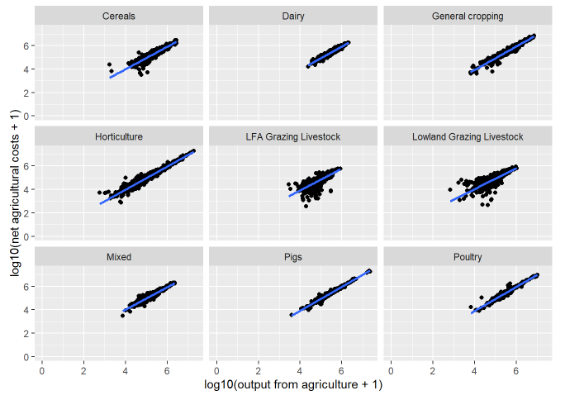
Alternative method
Source: Defra Farm Business Survey 2013/14 – 2017/18
Notes:
Linearity suggestive of CRTS, which calls into question the results above, or at least paints them as high end estimates.

Slide 17
Implications
Parameter | Formula | High- or low-end estimate? | Implication
Fixed cost share | Data | High | Industries could be closer to CRTS than results suggest
Elasticity of substitution between varieties (𝜎) | 1 / 𝐹𝑖𝑥𝑒𝑑𝐶𝑜𝑠𝑡𝑆ℎ𝑎𝑟𝑒 | Low | Varieties could be more homogenous than results suggest
Industry mark-up | 𝜎 / (𝜎 - 1 ) | High | Profits could be lower than results suggest
Shape parameter | > 𝜎 - 1 | Double low | Could be fewer high productivity firms than results suggest

Slide 18
Thank you
Michael.bourne@defra.gov.uk

