Slide 1
Effects of Covid on the U.S. economy: update after 4 quarters of data
by Peter B. Dixon, Maureen T. Rimmer, James Giesecke
and Nick Sheard
Centre of Policy Studies, Victoria University
Presented by Maureen Rimmer at
GTAP Conference
June 23-25, 2001
This material is part of the work required under Federal Award no. 17STQAC00001-04-01 (Amendment 03), Subaward no. ASUB00000508 issued by the U.S. Department of Homeland Security. The project is titled Economic impacts of COVID-19 follow-on studies and is being undertaken by the Centre of Policy Studies at Victoria University in Melbourne through the Center of Excellence for Accelerating Operational Efficiency (CAOE) at Arizona State University.
Disclaimer. The views and conclusions contained in this document are those of the authors and should not be interpreted as necessarily representing the official policies, either expressed or implied, of the U.S. Department of Homeland Security.

Slide 2
The project
Aim. Produce regular updates on the effects of Covid on U.S. macroeconomic, industry and regional variables.
Method. Compare two runs of the USAGE-Covid model:
(a) no-Covid baseline run showing how the economy was expected to evolve
before the onset of Covid; and
(b) Covid run incorporating data up to February 5, 2021 and projections
reflecting the Covid environment.
USAGE. This is a detailed computable general equilibrium model that has been developed over the last 20 years and applied in studies for the U.S. International Trade Commission, and the U.S. Departments of Agriculture, Commerce, Energy, Homeland Security and Transportation.

Slide 3
Main features of USAGE-Covid
(1) Quarterly
(2) Sticky-wage adjustment, allowing unemployment of labor
Sticky adjustment of rental rates on capital allowing excess capacity

Slide 4
Main features of USAGE-Covid
(1) Quarterly

Slide 5
Main features of USAGE-Covid
(2) Sticky-wage adjustment, allowing unemployment of labor

Slide 6
Main features of USAGE-Covid
(3) sticky real rental adjustment giving excess capacity & avoiding unrealistic real devaluation and increase in exports
KU=KE
Rental on
capital
.
.
.
Base solution
.
D(baseline)
Perturbed solution
Excess capacity
D(perturbed)
Perturbed solution
Full capacity
KU

Slide 7
Excess capacity

Slide 8
No-Covid baseline run
The no-Covid baseline run is a bland forecast based on data available in 2019 (pre-Covid). The main input is IMF forecasts from World Economic Outlook, 2019.
In the no-Covid baseline, employment grows at 0.24 per cent per quarter or 0.9 per cent per year for the 8 quarters starting January 1, 2020 and ending December 31, 2021, and real GDP grows at 0.47 per cent per quarter or 1.9 per cent a year.

Slide 9
April 2020: shocks in the initial COVID-19 run

Slide 10
February 2021: we build in more information as it becomes available
. The February Covid run incorporates data for:
Employment in 59 industries for the 4 quarters of 2020 (Y20Q1, Y20Q2, Y20Q3, Y20Q4).
Source: BLS, Table B-1, Employment situation – February 2021 https://www.bls.gov/webapps/legacy/cesbtab1.htm
Output in 56 industries for Y20Q1, Y20Q2 and Y20Q3
Source: BEA, Real gross output by industry – December 2020 https://www.bea.gov/data/industries/gross-output-by-industry
Macro variables (GDP, C, I, G and Inventories) for Y20Q1, Y20Q2, Y20Q3, Y20Q4
Source: BEA, NIPA tables 1.1.6 and 3.9.6 – January 2021 https://apps.bea.gov/iTable/index_nipa.cfm
Exports in 14 categories and imports in 13 categories for Y20Q1, Y20Q2, Y20Q3, Y20Q4
Source: BEA, NIPA tables 4.2.3 – January 2021 https://apps.bea.gov/iTable/index_nipa.cfm
Visitor arrivals in the U.S. and Passenger throughput at U.S. airports for Y20Q1,Y20Q2, Y20Q3 and Y20Q4
Sources: Data published by the International Trade Administration in Dept. of Commerce (up to end Nov 2020) and the TSA (up to end Jan 2021), see
Share of saving in household disposable income for 4 quarters of 2020 (Y20Q1, Y20Q2, Y20Q3, Y20Q4).
Source: BEA, NIPA table 2.1– January 2021 https://apps.bea.gov/iTable/index_nipa.cfm
Output by detailed agricultural industry for 2020
Source: The Food and Agricultural Policy Research Institute (FAPRI), Report #04-20 (August 2020)
Foreign student enrolment in U.S. education to end of 2020
Source:
Employment by state for the four quarters of 2020, Y20Q1 – Y20Q4 Source: BLS compressed data at
Data are introduced mainly with endogenous shift variables. Beyond the data these shift variables are exogenized and gradually returned to baseline levels.
For GDP we assumed 5% year-on-year in 2021 and deduced the required stimulus package.

Slide 11
Why 5 per cent for year-on-year growth in 2021?
Strong growth in 2021 is physically feasible: underemployed capital and labor can be brought back on line.
Strong growth in 2021 is fiscally feasible: it will require a stimulus package between $1 and $1.5 trillion, within the range of current political discussions.
Strong growth in 2021 is consistent with a continuation of the V-shaped recovery developed in 2020

Slide 12
What are other forecasters saying?
Starting in the second half of 2020, macro forecasters have been adjusting upwards as rapid recovery of the U.S. economy became apparent in Y20Q3 and was sustained in Y20Q4

Slide 13
Why forecasters have been becoming more optimistic about 2021
(index numbers, for real GDP and gross private investment)
Early in 2020 forecasters anticipated a large sustained reduction in investment, as in the GFC. However, in year-on-year terms the reduction in investment has been mild (-5.3%), limiting the year-on-year decline in GDP
real GDP
Covid
real gross private
investment
In the GFC investment plummeted and recovered only slowly over several years. With Covid, investment fell sharply in one quarter and recovered immediately in the next. The GFC directly damaged the financial system that is responsible for connecting savers and investors. This has not been the case with Covid, and after an initial hiccup it appears that investors have taken the view that the Covid crisis will be resolved in 2021.
quarters
GFC

Slide 14
Main assumptions for the quarters beyond the data
General method: Beyond the data, shift variables are exogenized and gradually returned to baseline levels.
Real GDP grows in each quarter of Y21 by 1.6 per cent (giving 5 per cent year-on-year growth).
The fiscal stimulus package will be sufficient to raise private consumption to the level necessary to achieve the assumed rate of growth of GDP. USAGE indicates that the required package will be between $1.1 and $1.5 trillion, depending on the extent to which households increase their spending in response to stimulus.
Investment in 2020 fell by less than could be expected on the basis of developments in the rest of the economy, indicating an increase in investor confidence. Through 2021 we assume that investor confidence returns to normal levels.
Employment data up to Y20Q4 and output data up to Y20Q3 indicate that employment in many industries has not fully adjusted to reduced output, that is there was disequilibrium employment in Y20Q4. We assume that disequilibrium employment in each industry is gradually eliminated through 2021. For industries with positive disequilibrium employment, USAGE implies that employment in 2021 grows slowly relative to output.

Slide 15
Main assumptions for the quarters beyond the data
Covid will be a strong inhibitor of domestic and international tourism to the middle of 2021. Tourism activities will gradually recover in the second half of 2021.
Beyond Y20Q4, the foreign demand curve for each U.S. commodity (not tourism) moves back towards its baseline position subject to overall growth in the world economy being consistent with the IMF forecast of 5.5 per cent (Table 1 World Economic Outlook Update, January 2021 )
Thus, USAGE implies that exports of commodities such as aircraft that have been
particularly depressed in 2020 will grow more quickly than aggregate exports in 2021.
Beyond Y20Q4, the U.S. demand curve for each imported commodity (not tourism) moves back towards its baseline position.
Beyond Y20Q4, public consumption grows at its baseline rate, 0.17 per cent per quarter.

Slide 16
What Covid is doing to the U.S. economy: GDP

Slide 17
What Covid is doing to the U.S. economy: Employment

Slide 18
What Covid is doing to the U.S. economy: Private consumption
12

Slide 19
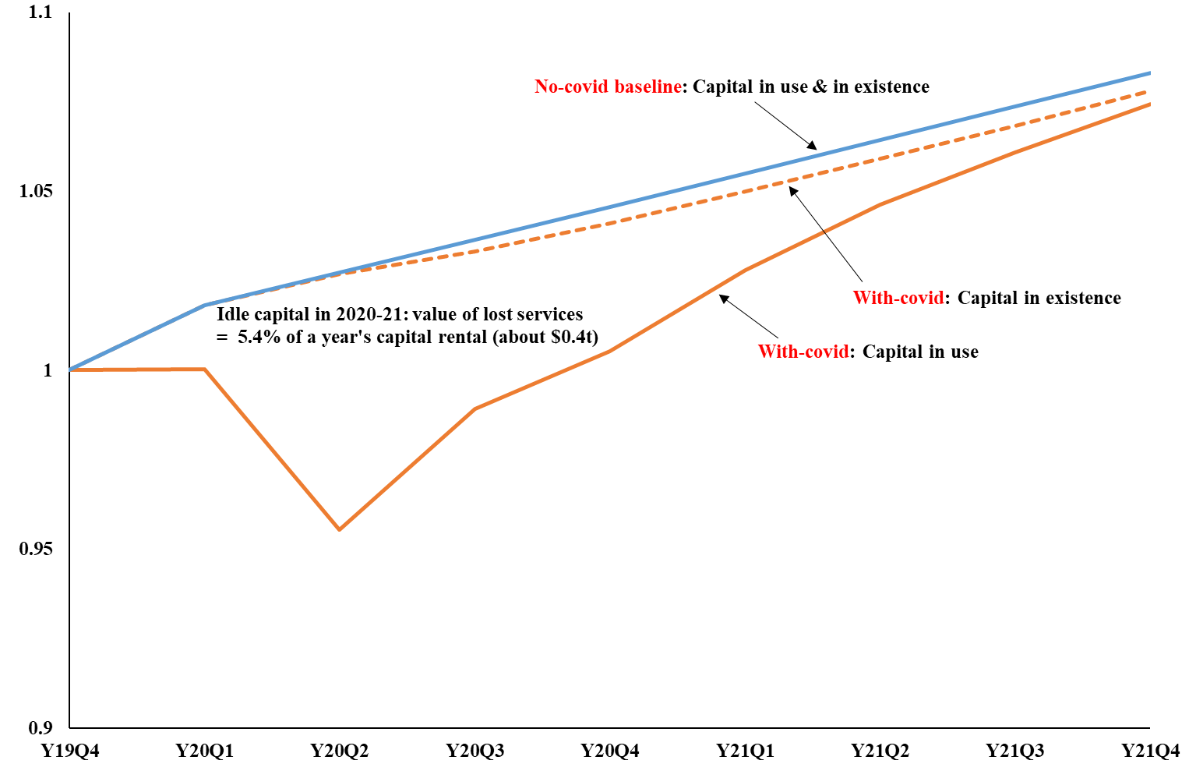
What Covid is doing to the U.S. economy:
Idle capital

Slide 20
Effects of Covid on industry outputs (31-order) in the U.S.: percentage deviations from no-Covid baseline

Slide 21
Employment by state: percentage deviations from level in 4th quarter of 2019
(BLS data for 4 quarters of 2020 followed by USAGE model projections)
14

Slide 22
Concluding remarks
The Covid downturn will be mild relative to the GFC and will not be long-lived.
Over the 2 years from Y20Q1 to Y21Q4, the pandemic will cost the U.S. economy about 8 per cent of a year’s GDP. Present indications are that by 2022 GDP will be back close to its no-Covid path.
By comparison, over the two years from Y08Q3 to Y10Q2, the GFC cost the U.S. economy about 9.4% of a year’s GDP, and the negative effects continued for at least another two years.
Through 2021, tourism-related industries and regions will remain depressed, but the rest of the economy is likely to recover.
In making our forecasts for 2021, we assumed that the Biden administration will implement a stimulus package sufficient to generate 5 per cent year-on-year growth in GDP. The size of the required package depends on reactions of households and other actors in the economy. If households adopt normal spending patterns, then a relatively small package will be adequate, a little over $1 trillion. On the other hand, if households adopt a consumption propensity on stimulus payments that is half of that on normal income, then a package of over $1.5 trillion ill be required.

