Slide 1


Holistic approach to assess the impact of green Investments using the MAGNET model
Presentation prepared for the GTAP Conference, June 2021

Slide 2
Outline
Introduction
Methodological approach
Baseline and green investments scenarios set-up
Results
Conclusion

Slide 3
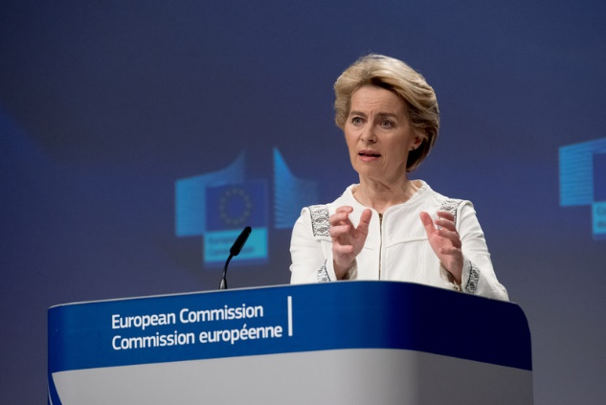
Context of the research
The Paris Agreement, adopted by 196 Parties, aims to limit global warming to well below 2, preferably to 1.5 degrees Celsius.
New growth strategy of the EU, which aims to transform the EU into a resource-efficient and competitive economy where there are no net emissions of greenhouse gases in 2050.
A need to evaluate the ex-ante impacts of a potential investment boost in low-carbon economy (green investments).
A brand new concept of green investment: defined as a public investment with a “greening” character: green infrastructure, green non-infrastructure spending with an investment character such as forestry and green R&D.

Slide 4
Objectives of the study
Main goal: To evaluate the economic, environmental and social impacts of a potential boost of green investments in the EU using a CGE framework
Partial goals:
  To enhance further MAGNET model for modelling possible impacts of increased Green Investments
  In a set of exploratory scenarios targeting green energy sectors as an example, to investigate the effects of increasing sector-specific investments under different assumptions of financing and productivity effects resulting from technology learning.

Slide 5
Outline
Introduction
Methodological approach
Baseline and green investments scenarios set-up
Results
Conclusion

Slide 6

Methodological approach - MAGNET model
Neoclassical, recursive dynamic model based on Global Trade Analysis project (GTAP) model and the associated GTAP database (version 9.2 of the GTAP database)
Modular approach – easy to turn on/off each module depending on the question analysed
Well equipped to analyse “food-land-energy-water-climate nexus”: detailed bioeconomy and food sectors, flexible multi-level production function, dedicated modules on GHG, waste, natural resources extraction, climate damage function, SDGs module, etc.
https://magnet-model.netlify.app/

Slide 7
Methodological improvements of MAGNET to model green investments
Step-by-step approach:
  Step 1: Convert MAGNET to a recursively-dynamic model with sector specific investment allocation -> introduce sector-specific capital markets
  Step 2: Introduce exogenous sector-specific investments -> steer investment mix to green sectors
  Step 3: Implement technology learning effects in the green sectors -> stimulate green transition

Slide 8
Effects of technology learning
The most common model used in the energy literature to forecast change in technology cost is the one factor learning curve (Rubin et al., 2015)
Two-factor learning curve:
  Learning by doing (productivity effects from cumulative investment installations)
  Learning by research (productivity effects from R&D)
Capital accumulation
Learning by doing
Replacement of fossil energy sources
Green sectors
Green Capital Investments
Green Capital stock
↓ Production costs
↑ Clean energy inputs
↓ Total Emissions
Knowledge accumulation
R&D investments in green energy
Learning by research
R&D sector
Knowledge stock

Slide 9
Overview of learning rates implemented in MAGNET
Learning by doing: implemented in 9 “green sectors”
Learning by research: implemented in 3 green sectors
Learning rates taken from GEM-E3 and Zauner et al. (2019) D7.5 Store&Go Horizon 2020 project
*Note: R&D learning rates for biomass should be still further investigated – limited evidence in the literature, despite the ongoing R&D investments in biomass

Slide 10
Outline
Introduction
Methodological approach
Baseline and green investments scenarios set-up
Results
Conclusion

Slide 11
Summary of baseline characteristics

Slide 12
Green investment scenarios – focus on green energy sectors
Focus on the green energy part, simulate an increase in green investments in 2020-2030 cumulative by 700 billion USD (7% share of total Net zero plan¹)
Distribute over EU countries and green sectors proportionally to baseline investments in 2020
Investment shocks are considerable compared to baseline levels but rather negligible w.r.t. economic structure
R&D shock: increase annual R&D investments in energy technology by 25% compared to 2020 levels: implemented in 2020-2030
¹“McKinsey 2020: Net-Zero Europe, Decarbonization pathways and socioeconomic implications”

Slide 13
Review of baseline and green investment scenarios
Multi-dimensional set-up: financing alternatives x technology learning effects
Alternative crowd-out effects:
  On the regional level: different investment mix, budget neutral
  On the world level: total investments in Europe ↑, ROW ↓
  No crowd-out at all: additional investments financed from increased savings

Slide 14
Outline
Introduction
Methodological approach
Baseline and green investments scenarios set-up
Results
Conclusion

Slide 15
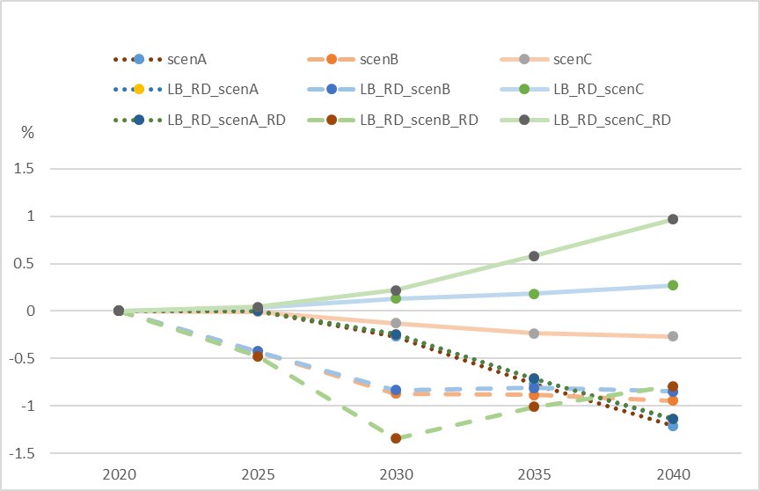
GDP growth in the EU: scenarios vs baseline
GDP impacts range from -1.3 to 0.2% in short term (2030) and from -1.2% to 0.9% in long term (2040). Visible long-term effects – widening impacts.
Funding mechanisms have larger impacts than the assumption on technology learning (next slide).
Positive GDP effects are found in case of financing from abroad together with tech learning

Slide 16
GDP effect – an interplay of drivers
Effect of financing:
  Crowding-out effect on regional level lowers GDP-suboptimal allocation of investments within the EU
  Crowding-out effect on the world level (together with technology learning and R&D investments) may increase GDP in the EU – investments are financed from abroad, which happens on account of the RoW (see next slide)
  Financing investments from domestic savings reduces GDP in the EU – there is a leakage of funds to the rest of the world
Effect of technology learning:
  Enhances the effects – can add up to 0.7 pp to GDP

Slide 17
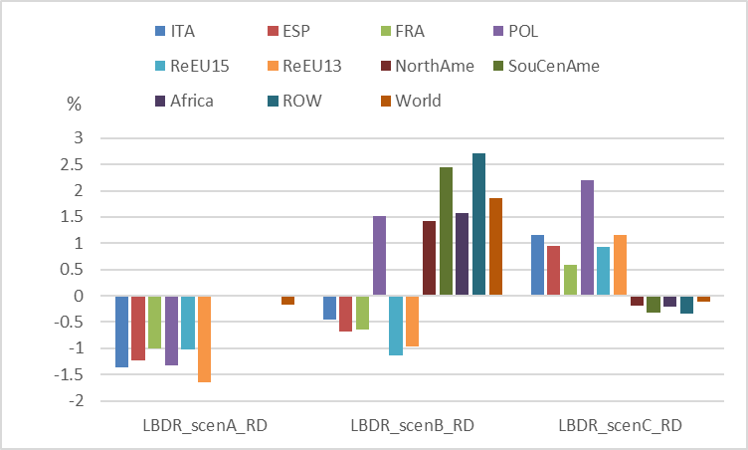
Regional GDP growth relative to baseline
Regions within the EU largely share a trend in GDP growth given a financing assumption
Regions outside of the EU also share a trend in GDP growth.
Trade-off is clearly seen if financing goes beyond neutral within the EU

Slide 18
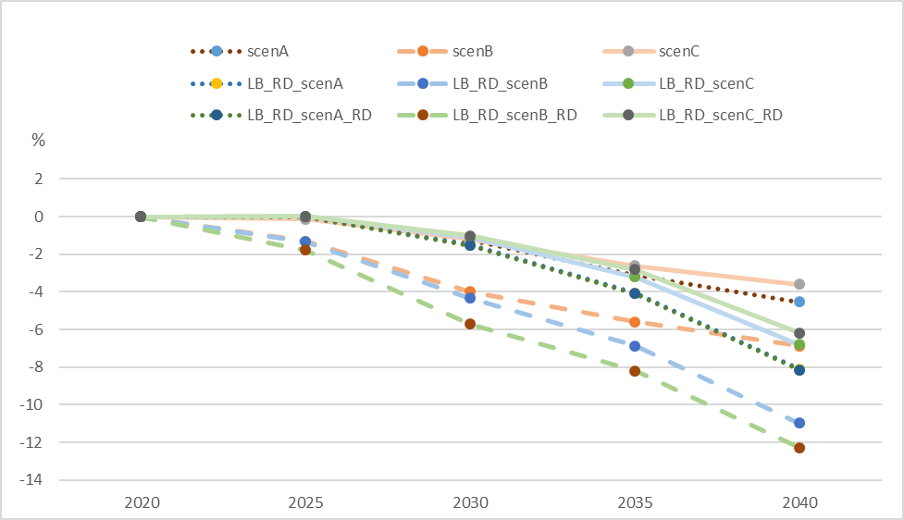
Emissions change in the EU: scenarios vs baseline
GDP effect: explains why emissions decline least in scenarios with increased saving rate (B-scenarios)
Greening effect and technology learnings: explains why emissions decline in scenario with positive GDP growth (LBRD_ScenC and LBRD_ScenC_RD)
Funding through savings increase shows greater declines in GHG emissions, due to more subdued economic activities.

Slide 19
Interplay of various drivers in total emissions and world impacts
EU emissions drop more significantly compared to the rest of the world.
Budget neutral sees emissions decline in the EU and the rest of the world
Budget increase creates some leakages reflected by small increases in global emissions.

Slide 20
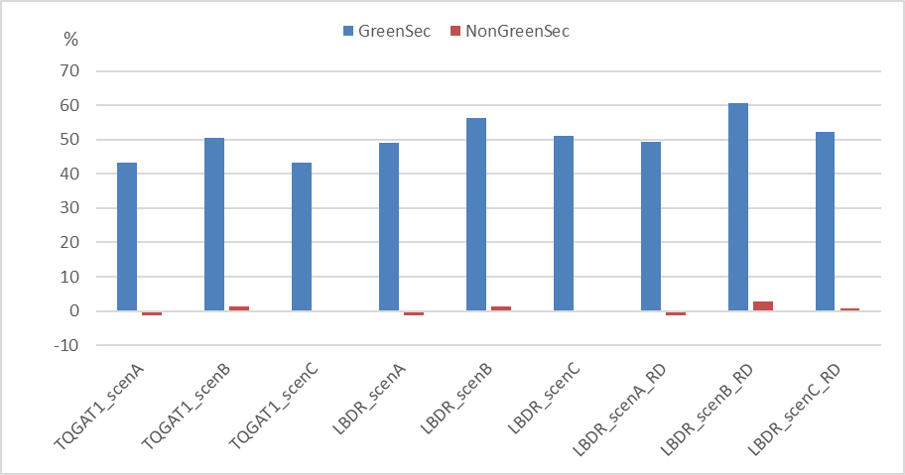
Green sectors vs. non-green sectors
Outputs in green sectors show more pronounced increases relative to non-green sectors, regardless of scenarios
Technology learning and R&D investments reinforce the relative growth trend in green sectors
Sectoral trade-off can be seen in scenarios with neutral budget within the EU.
Budget increase may benefit both green and non-green sectors

Slide 21
Impact on green sectors and agriculture
Green sectors flourish across all scenarios, impact of technology learning significant, additional R&D has low impact (only implemented in 3 sectors)
Cross-sectoral impacts on agriculture are also noted – technology learning effects may turn impact from negative to positive

Slide 22
Outline
Introduction
Methodological approach
Baseline and green investments scenarios set-up
Results
Conclusion

Slide 23
Conclusion
Increasing investments in green sectors produces visible effects in emission reduction, but alternatives for financing are important to determine if resulting GDP effect will be positive or negative (alternative financing via increased savings rate seems not to be desirable)
Important linkages with the rest of the world – EU investment boost impacts both GDP and emission abroad
Next steps:
  Introduce cumulative savings to model debt and long-run closure to improve model solutions in multi-annual steps
  Integrate with other MAGNET instruments of climate change mitigation: Include CO2 taxes, MAC curves, natural resource supply module
  Further work to be done on the R&D effects of green investments

Slide 24
Thank you for your attention

Slide 25
Selected sources
Following the approach in Klaassen, G., Miketa, A., Larsen, K., & Sundqvist, T. (2005): The impact of R&D on innovation for wind energy in Denmark, Germany and the United Kingdom. Ecological economics, 54(2-3), 227-240.
Zauner, A., Böhm, H., Rosenfeld, D. C., & Tichler, R. (2019). Innovative large-scale energy storage technologies and Power-to-Gas concepts after optimization. D7. 7. Analysis on future technology options and on techno-economic optimization. Report Ares, 4315303.
Wiesenthal, T., Dowling, P., Morbee, J., Thiel, C., Schade, B., Russ, P., ... & Londo, M. (2012). Technology learning curves for energy policy support. JRC scientific and policy reports, 332.
Rubin, E. S., Azevedo, I. M., Jaramillo, P., & Yeh, S. (2015). A review of learning rates for electricity supply technologies. Energy Policy, 86, 198-218.

Slide 26
Necessary steps in implementing learning by research in MAGNET
Obtain historical flows of R&D investments needed to build knowledge stocks:
  R&D relevant for Green Deal – R&D expenditures in Energy Technology (database provided by International Energy Agency)
Choose an appropriate form of building knowledge stocks (R&D lags and depreciation rates)
Calibrate base year value of knowledge stocks
Implement equations of knowledge stock accumulation in MAGNET

Slide 27
Historical R&D flows in energy technology
Boom in R&D spending after 2000, last periods rather slow down
Renewables R&D contribute by 45% to total energy R&D
Share of R&D investment in energy technology in 2019, source: IEA

Slide 28
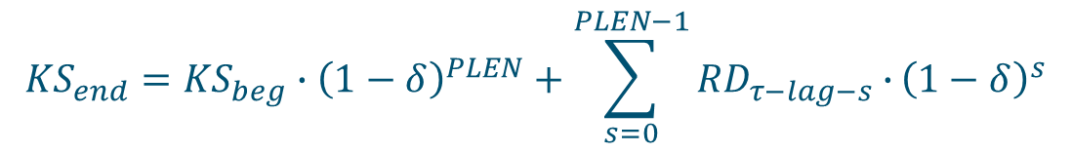
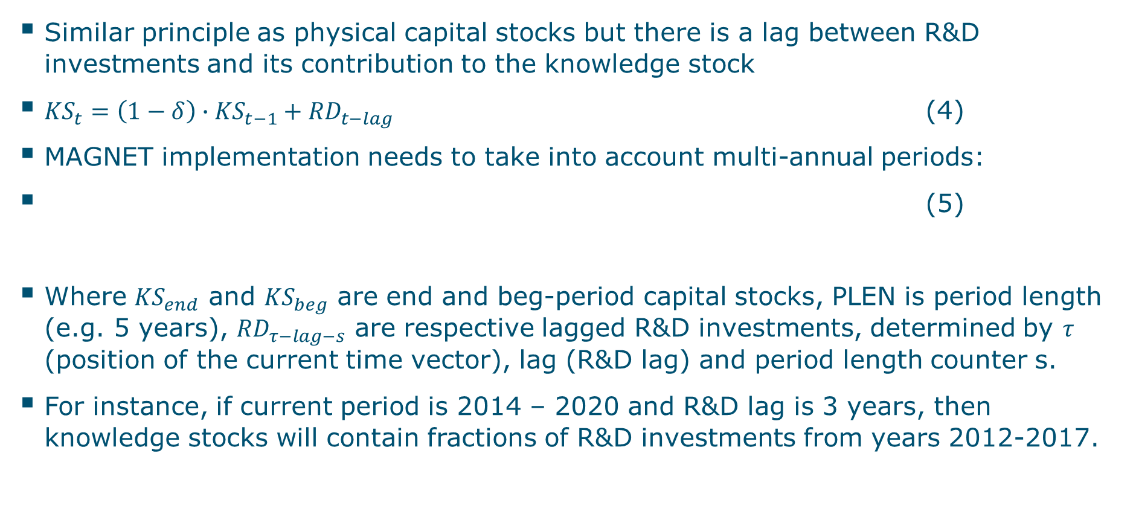
Building knowledge stocks
Similar principle as physical capital stocks but there is a lag between R&D investments and its contribution to the knowledge stock
${KS}_{t}=\left(1−δ\right)∙{KS}_{t−1}+{RD}_{t−lag}$ (4)
MAGNET implementation needs to take into account multi-annual periods:
(5)
Where ${KS}_{end}$ and ${KS}_{beg}$ are end and beg-period capital stocks, PLEN is period length (e.g. 5 years), ${RD}_{τ−lag−s}$ are respective lagged R&D investments, determined by $τ$ (position of the current time vector), lag (R&D lag) and period length counter s.
For instance, if current period is 2014 – 2020 and R&D lag is 3 years, then knowledge stocks will contain fractions of R&D investments from years 2012-2017.
$${KS}_{end}={KS}_{beg}∙{\left(1−δ\right)}^{PLEN}+\sum_{s=0}^{PLEN−1}{{RD}_{τ−lag−s}∙}{\left(1−δ\right)}^{s}$$

Slide 29
Building knowledge stocks
Similar principle as physical capital stocks but there is a lag between R&D investments and its contribution to the knowledge stock
${KS}_{t}=\left(1−δ\right)∙{KS}_{t−1}+{RD}_{t−lag}$ (4)
MAGNET implementation needs to take into account multi-annual periods:
(5)
Where ${KS}_{end}$ and ${KS}_{beg}$ are end and beg-period capital stocks, PLEN is period length (e.g. 5 years), ${RD}_{τ−lag−s}$ are respective lagged R&D investments, determined by $τ$ (position of the current time vector), lag (R&D lag) and period length counter s.
For instance, if current period is 2014 – 2020 and R&D lag is 3 years, then knowledge stocks will contain fractions of R&D investments from years 2012-2017.
$${KS}_{end}={KS}_{beg}∙{\left(1−δ\right)}^{PLEN}+\sum_{s=0}^{PLEN−1}{{RD}_{τ−lag−s}∙}{\left(1−δ\right)}^{s}$$

Slide 30
Comparison MAGNET investment versions
Production volume (% change) (World) (2020-2030)
Capitally-intensive sectors deviate the most – often already in the Recursive Dyn version
The sector-specific (Tobin Q) poses additional issues due to rigidity in production structure – case of plan or c_oil (2 fixed factors)
Aggregated variables show similar development across the different investment specifications
Production volume (% change) (Agri_Prim) (2014-2020)

Slide 31
Summary comparison of investment versions
Endogenously-determined growth of capital stock is higher than exo version-> capital stock grows faster than GDP
Aggregate impacts are quite comparable, but endogenous versions lead to a higher production volume
Capital prices decline faster, prices of other factors on the other hand grow more, related to the lower productivity adjustment (aoreg) required to obtained desired GDP
Endogenous capital accumulation favours sectors with high capital intensity such as bioenergy, industry, residues, very sensitive to high increases in capital stock
Sector-specific investment allocation poses challenges for those sectors that have high share of fixed inputs in their value added (capital+land, capital+natural resource) such as plantations, forestry, crude oil
Adjustment of substitution elasticities where possible (e.g. for forestry and c_oil NEST 1 from 0.4 to 0.8), plantations NEST 2 (0.2 to 0.4) -> facilitates absorption of the capital stock

Slide 32
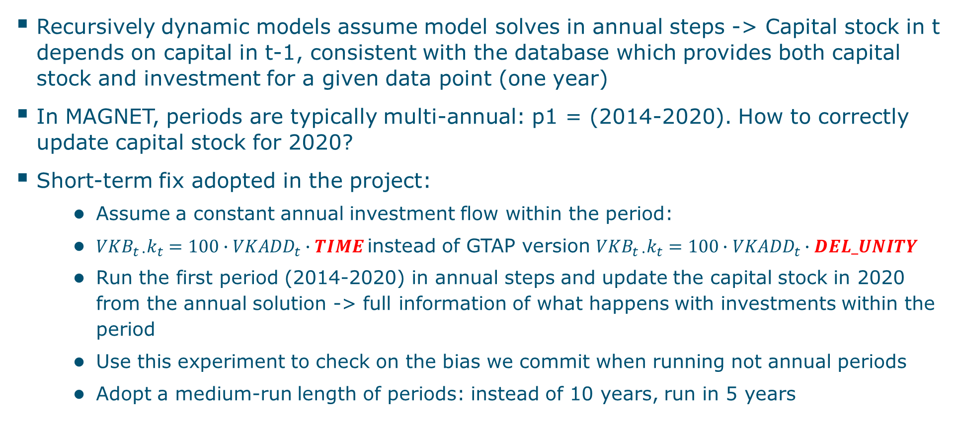
Multi-year periods when running dynamic MAGNET
Recursively dynamic models assume model solves in annual steps -> Capital stock in t depends on capital in t-1, consistent with the database which provides both capital stock and investment for a given data point (one year)
In MAGNET, periods are typically multi-annual: p1 = (2014-2020). How to correctly update capital stock for 2020?
Short-term fix adopted in the project:
  Assume a constant annual investment flow within the period:
  ${{VKB}_{t ∙}k}_{t}=100∙{VKADD}_{t}∙TIME$instead of GTAP version ${{VKB}_{t ∙}k}_{t}=100∙{VKADD}_{t}∙DEL_UNITY$
  Run the first period (2014-2020) in annual steps and update the capital stock in 2020 from the annual solution -> full information of what happens with investments within the period
  Use this experiment to check on the bias we commit when running not annual periods
  Adopt a medium-run length of periods: instead of 10 years, run in 5 years

Slide 33
Comparison annual vs multi-annual version of MAGNET
Solving in multi-annual step produces limited bias
For most cases, multiplying 2014 investments by period length (6) works ok
On world level 2-3% difference, only FRA and ITA get about 6% higher capital stock based on period update.

Slide 34
Definition of scenario – background document
Use a show-case scenario that demonstrates the new features of MAGNET model to simulate the impact of green investments
Inspiration from a McKinsey document: “Net-Zero Europe, Decarbonization pathways and socioeconomic implications”
28 trillion EUR needed to reach net zero Europe over 2020-2050
In 2020-2030, 840 billion EUR annually, from which power is 7%
The McKinsey plan assumes that about ¼ of total investments are reallocated and total investments increase by about 7%
Net-Zero Europe (McKinsey, 2021)

Slide 35
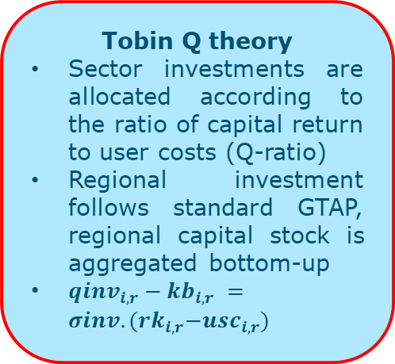
Step 1 - Overview of investment modelling approaches
Regional investments and capital stock
Sectoral investments and capital stock
Tobin Q theory
Sector investments are allocated according to the ratio of capital return to user costs (Q-ratio)
Regional investment follows standard GTAP, regional capital stock is aggregated bottom-up
${qinv}_{i,r}−{kb}_{i,r} =σinv.{(rk}_{i,r}−{usc}_{i,r})$
Equalization of expected returns
End-period sectoral capital stock is allocated to equalize expected rates of return.
Regional investment and capital stock is aggregated bottom-up
Standard MAGNET version
End capital stock exogenous, follows growth of GDP
GDP and population grow according to SSP2
Recursive Dynamic version:
End capital stock endogenous, follows investment path
GDP and population grow according to SSP2
Not suitable for implementing sector-specific Green Deal shocks
Not stable when used in large commodity aggregations
Works best with more detailed commodity aggregation

Slide 36
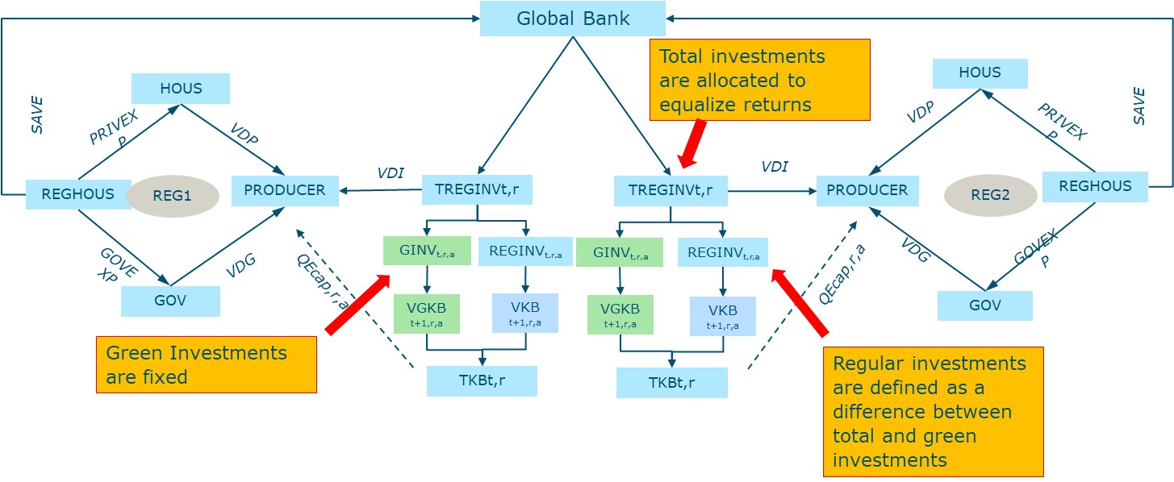
Step 2 - Framework of green and other investments
Disaggregate sector investments on exogenous (green) and other (regular)
Sector-specific green investments introduced as change variable (del_qginva) and shocked (normally to zero, in scenarios non-zero)
The remaining investments are allocated based on the market mechanism

Slide 37
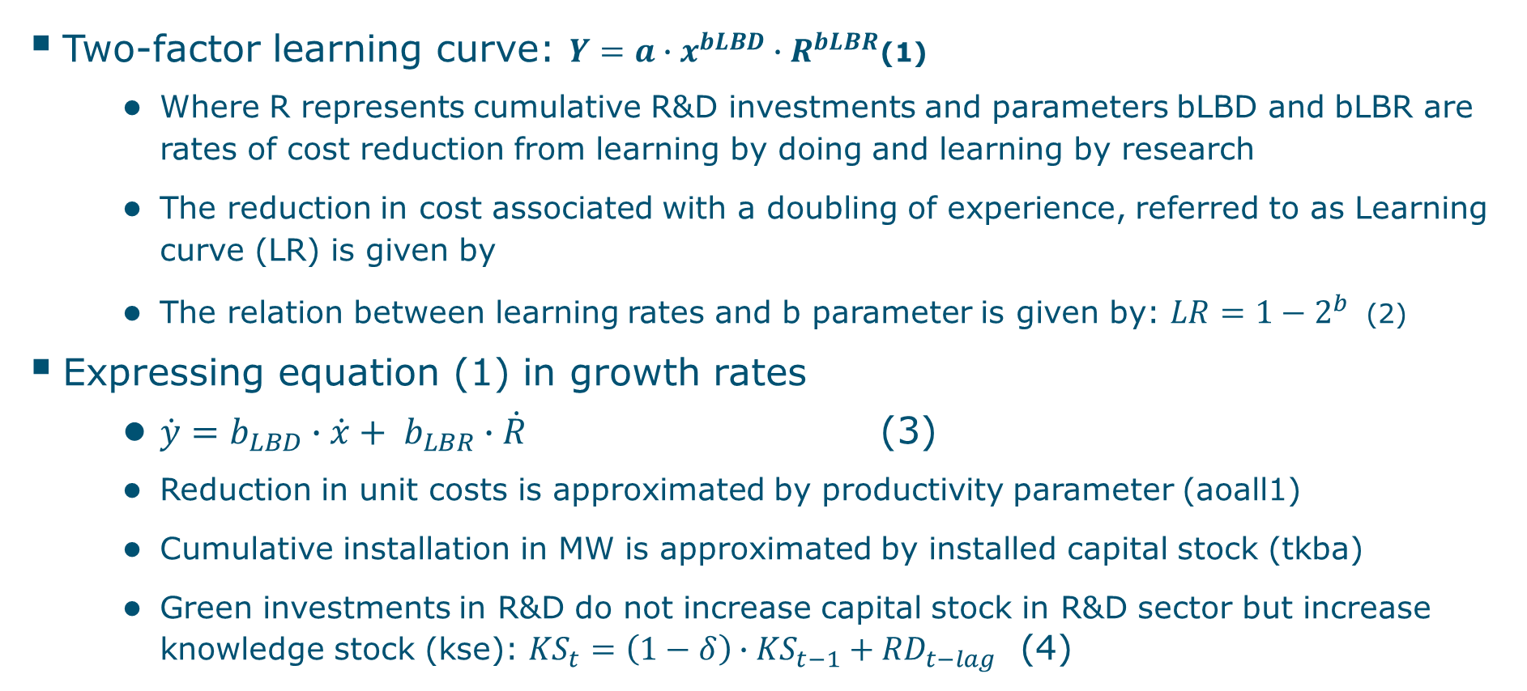
Implementation of technology learning in MAGNET
Two-factor learning curve: $Y=a∙x^{bLBD}∙R^{bLBR}$ (1)
  Where R represents cumulative R&D investments and parameters bLBD and bLBR are rates of cost reduction from learning by doing and learning by research
  The reduction in cost associated with a doubling of experience, referred to as Learning curve (LR) is given by
  The relation between learning rates and b parameter is given by: $LR=1−2^{b}$ (2)
Expressing equation (1) in growth rates
  $\dot{y}=b_{LBD}∙\dot{x}+ b_{LBR}∙\dot{R}$ (3)
  Reduction in unit costs is approximated by productivity parameter (aoall1)
  Cumulative installation in MW is approximated by installed capital stock (tkba)
  Green investments in R&D do not increase capital stock in R&D sector but increase knowledge stock (kse): ${KS}_{t}=\left(1−δ\right)∙{KS}_{t−1}+{RD}_{t−lag}$ (4)

Slide 38
Alternatives for crowd-out effects and financing
Alternative crowd-out effects:
  On the regional level: different investment mix, budget neutral
  On the world level: total investments in Europe ↑, ROW ↓
  No crowd-out at all: additional investments financed from increased savings

