Slide 1
Linking the EU and Chinese ETS
GTAP Conference, June 23rd, 2021
Malte Winkler, Sonja Peterson, Sneha Thube
Funded by German Federal Ministry of Education and Research (BMBF)
Part of EMF round 36: Carbon Pricing after Paris

Slide 2
Linking ETS
Background
Linking of ETS has several advantages (Alexeeva and Anger, 2016; Nong and Siriwardana, 2016; Hawkins and Jegou, 2014):
  increases liquidity of the carbon market
  decreases risk of carbon leakage
  supports multilateral climate action
  increases “where-flexibility”
Potentially beneficial to both partners: allowance buyers pay lower price for allowances, allowance sellers generates revenue from selling
BUT: Linking can lead to welfare losses in allowance selling partner through ToT effects (e.g. Flachsland et al. 2009)

Slide 3
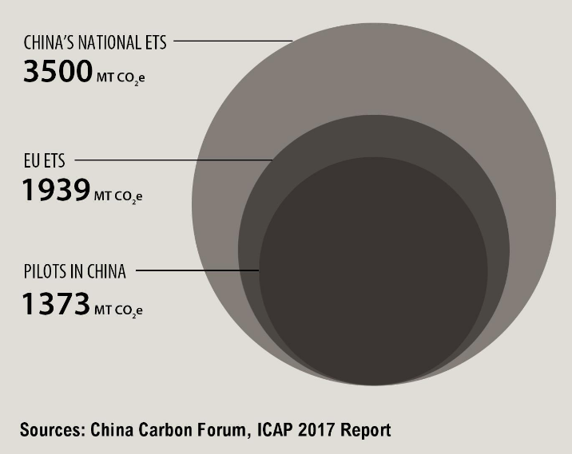
EU ETS and Chinese ETS
Background
Two largest ETS in the world
Coverage: mainly CO2 from electricity production and industry
Together, around 20 % of global CO2 emissions covered
Notes:
EU ETS: 3,61%; China ETS: 23,34%

Slide 4
Linking the EU and Chinese ETS
Background
Full linking would yield around 34 % of potential efficiency gains (compared to a situation with global emission trading in all sectors; Akın-Olçum et al., submitted)
Gains from linking can be marginal or even negative for China (Hübler et al., 2014; Fujimori et al., 2016; Gavard et al., 2016; Li et al., 2019)
Restricted trading volume of allowances can help China (Gavard et al., 2016; Li et al., 2019)
transfer payments can counteract indirect market effects in a global ETS (Peterson and Weitzel, 2016)
How can a link be established, which is beneficial to all trading partners?

Slide 5
Model settings
Study Set-up
 | Regions |  | Sectors
Countries (non-EU) |  | Non-electric Energy
 | China (CHN) |  | Coal (COL)
 | United States (USA) |  | Petroleum and coal products (OIL)
 | Canada (CAN) |  | Crude oil (CRU)
 | Japan (JPN) |  | Natural gas (GAS)
 | South Korea (KOR) | Electricity
 | Russia (RUS) |  | Nuclear electr. (Enuclear)
 | India (IND) |  | Coal based electr. (Ecoal)
 | Australia and New Zealand (ANZ) |  | Gas based electr. (Egas)
 | Brazil (BRA) |  | Oil based electr. (Eoil)
Aggregated regions (non-EU) |  |  | Wind based electr. (Ewind)
 | Middle East (MEA) |  | Hydro based electr. (Ehydro)
 | Africa (AFR) |  | Solar based electr. (Esolar)
 | Other Americas (OAM) |  | Electr. from other sources (Eother)
 | Other Asia (OAS) | Other sectors/aggregates
Europe |  |  | Energy-intensive industries (EIT)
 | EU (ETS) (EU_Tr) |  | Transport (TRN)
 | France (FRA) |  | Agriculture (AGR)
 | Germany (GER) |  | Other manufacturing (MFR)
 | Great Britain and Ireland (GBR) |  | Services (SER)
 | Belgium, Netherlands, Luxembourg (BLX)
 | Scandinavia (SCA)
 | Southern Europe (SEU)
 | Eastern Europe (EEU)
 | Rest of Europe (non-ETS) (REU)
DART model, based on GTAP9 Power database (Peters, 2016)
Disaggregated electricity sector
Disaggregated EU
Calibrated to meet GDP and regional CO2-emissions of IEA World Energy Outlook 2018
Base year: 2011
Model horizon: 2030
All regions meet their NDCs in 2030

Slide 6
Scenarios
Study Set-up
Two sets of scenarios:
  limits to traded allowance volume
                No Link: no allowance trading between EU and China
                Full Link: unrestricted allowance trading between EU and China
                In between: allowance trading restricted to x % of the volume traded under Full Link
  Adjusted emission endowments
  stricter emission target for the EU (by 10%, 20%,…, 50%)
  Less strict emission target for China
  Combined emissions remain unchanged
  → Mimic compensation payments from EU to China

Slide 7
Scenario Set 1: Restricted allowance trading
Results
→ China maximizes welfare at 50% traded allowances, EU at 100%

Slide 8
Scenario Set 2: Adjusted emission endowments
Results
High CO2 price in EU, if traded allowance volume is restricted
EU always gains from full link, regardless of transfer payments
China gains more, if traded allowance volume is restricted
Notes:
EU allowance price: full link max. 13$/t Co2; HalfLink max. 58$/tCO2; noLink: 75$/tCO2

Slide 9
Conclusions
Conclusions
In most scenarios EU benefits more than China, but there are exceptions:
  Allowance trading restricted to less than 30%
  Significant transfer payments + allowance trading restricted to 50%
China favors restricted allowance trading, EU favors full trade (+ transfers)
Linking not always beneficial for both partners
Also inner-European regions favor different options
→ Finding linking solutions is not trivial, but there are options for compromises!

Slide 10
Thank you for your attention!
Notes:
There is one scenario, namely reaching the NDC targets with halved Armington elasticities in all sectors and fully linked ETS, in which China slightly loses from linking (0.001%).

Slide 11
NDC targets
Backup

Slide 12
Armington elasticitities
Backup

Slide 13
Scenario Set 3: Altering Armington elasticities
Results
Gains from allowance trading more even with higher Armington elasticities
Chinese NDC non-binding in halveALL + linking
Gains from trading for both partners higher for lower trade elasticities in ETS sectors
Notes:
EITE: no big change, because goods and allowances are substitutes
High CO2 price in China halveAll: CHN exports less → lower emissions, low price. With link to EU, allowances are sold to EU, so price increases

Slide 14
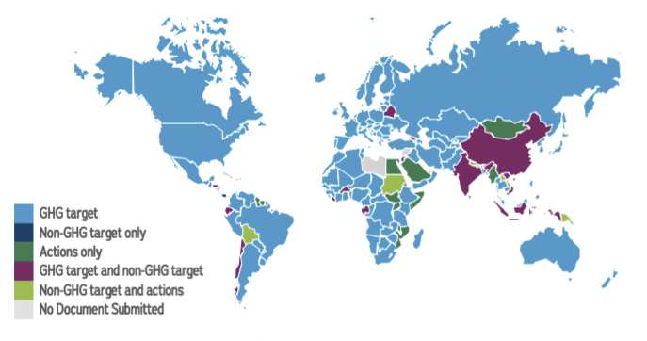
Carbon Pricing after Paris
Background
Paris Agreement (COP21): NDCs and 2° target
Carbon Pricing → Emission Trading
Source: CAIT Climate Action Tracker.

