Slide 1
Heat stress, labor, global sectoral and poverty impacts of climate change
Wajiha Saeedª, Iman Haqiqiª, Thomas Hertelª,
Qinqin Kong^{b} and Matthew Huber^{b}
24th Annual Conference on Global Economic Analysis
^{June 23, 2021}
ª Center for Global Trade Analysis, Purdue University
^{b} Earth, Atmospheric, and Planetary Sciences, Purdue University

Slide 2
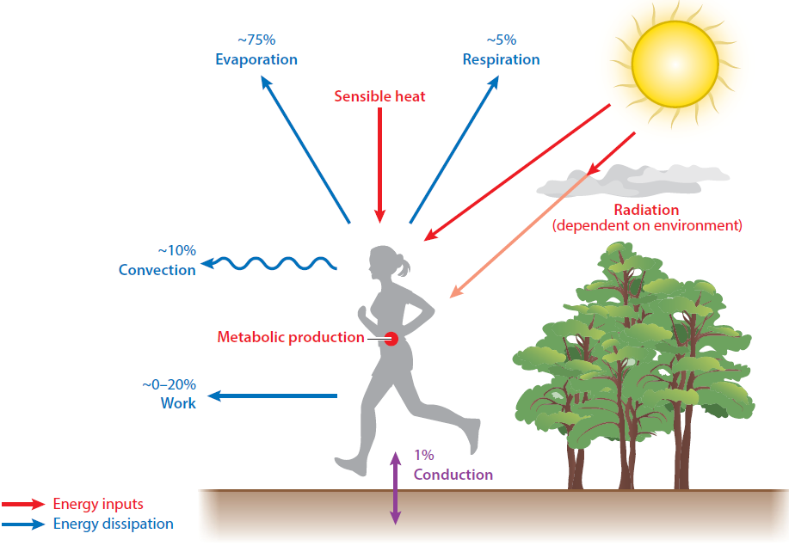


Heat stress in humans arises when the body cannot dissipate heat
This arises under:
  Manual labor
  High temperatures
  High solar radiation
  Humid conditions
This looks a lot like farming and construction work in the tropics!
Source: Buzan and Huber, Annual Review of Earth and Planetary Sciences, 2020

Slide 3
Heat stress causes labor productivity loss
A body of scientific literature estimates this loss of productivity
  Physiological methods; empirical methods
We assess the economic implications of this loss of productivity:
  We account for heterogeneity of labor types, their work intensity, and exposure to the sun within the same sector
  Analysis at a disaggregated level: 65 sectors, 137 regions, 4 labor types
  Also assess implications on poverty headcounts in a subset of regions

Slide 4
Data and Methods
1. Climate Projections
2. Heat Stress
3. Labor Capacity Losses
4. Economic Impacts
4a. Macro Effects
4b. Poverty Effects
3b. By region, sector, labor-type
3a. By grid-cell, work intensity, and sun exposure

Slide 5
Data and Methods
Climate model: 11 climate models (14 ensemble members)
Variables: temp., humidity, wind, air pressure, solar rad.
Scenario: mean global temperatures increase by 3C relative to 1960-1989
Resolution & Frequency: grid-cell level data at 3-hourly frequency
1. Climate Projections
2. Heat Stress
3. Labor Capacity Losses
4. Economic Impacts
4a. Macro Effects
4b. Poverty Effects
3b. By region, sector, labor-type
3a. By grid-cell, work intensity, and sun exposure
Metric: Wet Bulb Globe Temperature (WBGT)
Method: Liljegren et. al. (2008)

Slide 6
Data and Methods
1. Climate Projections
2. Heat Stress
3. Labor Capacity Losses
4. Economic Impacts
4a. Macro Effects
4b. Poverty Effects
3b. By region, sector, labor-type
3a. By grid-cell, work intensity, and sun exposure
3b BLS data: used to estimate labor capacity losses specific to sectors and labor types
3a Labor Response Function: ISO7243 standard (Bröde et. al. 2018)

Slide 7
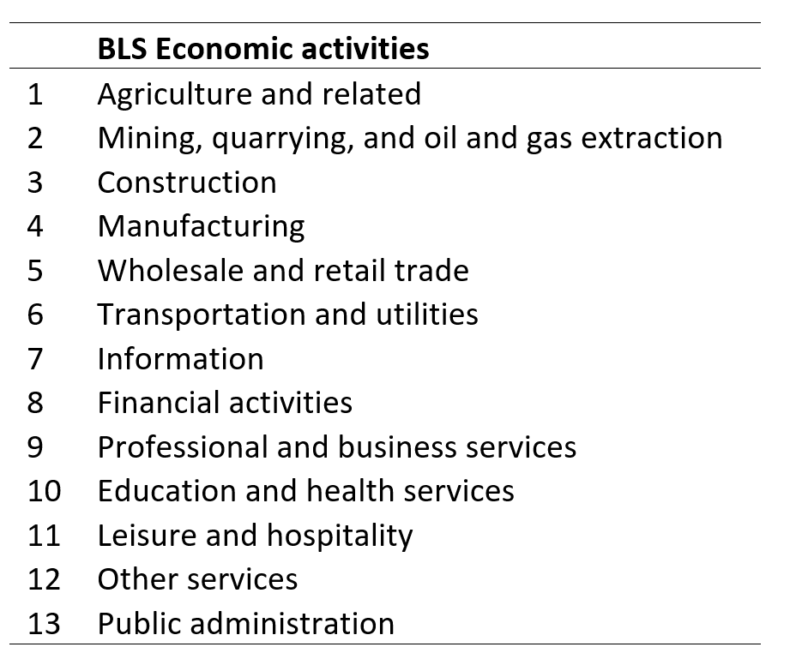
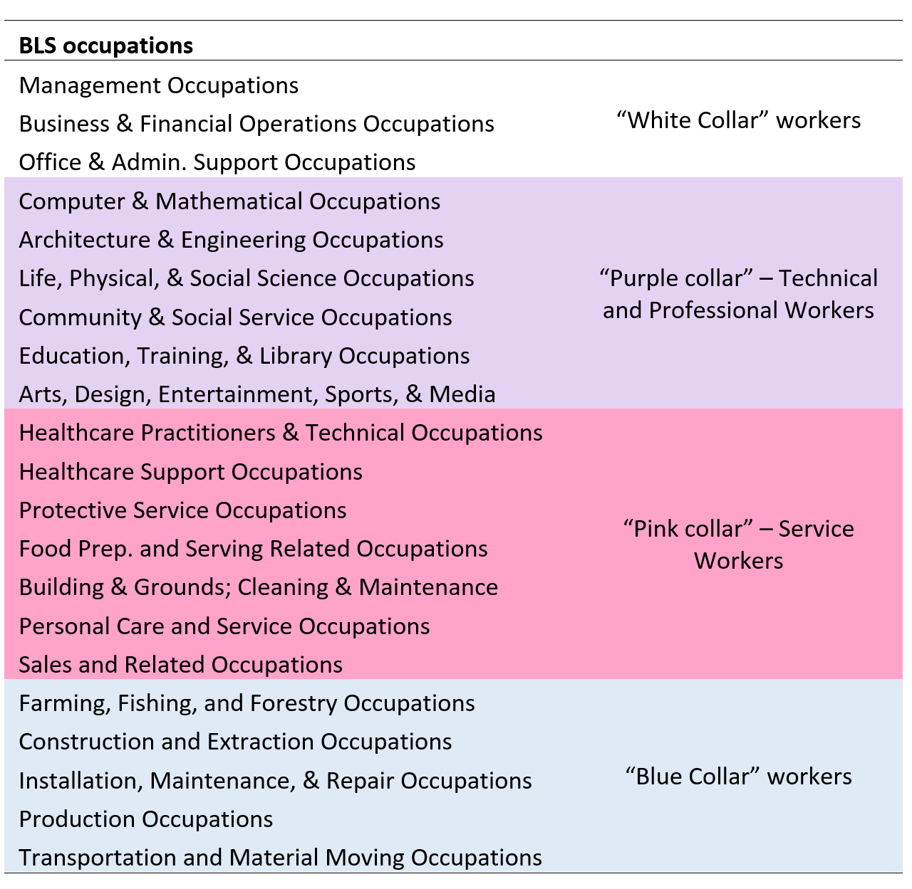
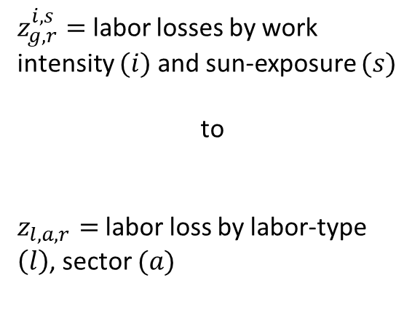
e.g. Agriculture
e.g. “Blue Collar” Occupations
Constant
Frequent
By sector/economic activities
Labor Type/Occupation
Exposure to Outdoors
Seldom
Never
Sedentary
Light
Medium
Heavy
Work Intensity
Very Heavy
$z_{g,r}^{i,s}=$ labor losses by work intensity $(i)$ and sun-exposure $(s)$
to
$z_{l,a,r}=$labor loss by labor-type $\left(l\right)$, sector $(a)$

Slide 8
Data and Methods
1. Climate Projections
2. Heat Stress
3. Labor Capacity Losses
4. Economic Impacts
4a. Macro Effects
4b. Poverty Effects
3b. By region, sector, labor-type
3a. By grid-cell, work intensity, and sun exposure
Model: GTAP-POV (with modifications)
Data: GTAP Database v10 (Base 2014)
Data: Updated poverty data for the 27 ‘POV’ countries

Slide 9
Impacts on output and employment
Equation ENDWDEMAND
# demands for endowment commodities (HT 34) #
(all,i,ENDW_COMM)(all,j,PROD_COMM)(all,r,REG)
qfe(i,j,r) = (Ch. in labor demand =
qva(j,r) Expansion effect
- ESUBVA(j,r) * [pfe(i,j,r) - pva(j,r)] + Subst. Effect
+ ESUBVA(j,r) * afe(i,j,r) - afe(i,j,r) ; + Biased Tech. Ch.)
Equation VAPRICE
# effective price of primary factor composite in each sector/region (HT 33) #
(all,j,PROD_COMM)(all,r,REG)
pva(j,r) = sum(k,ENDW_COMM, SVA(k,j,r) * [pfe(k,j,r) - afe(k,j,r)]);

Slide 10
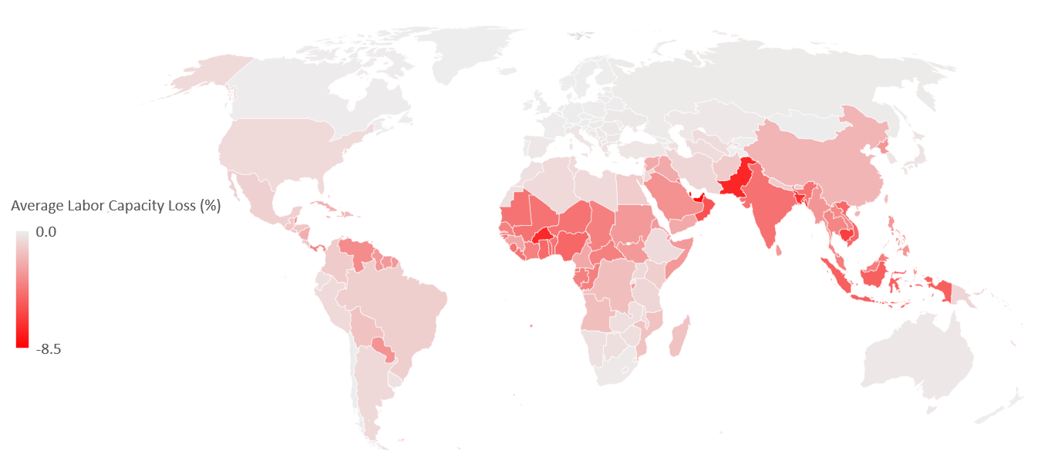
National labor capacity losses largest in the tropics

Slide 11
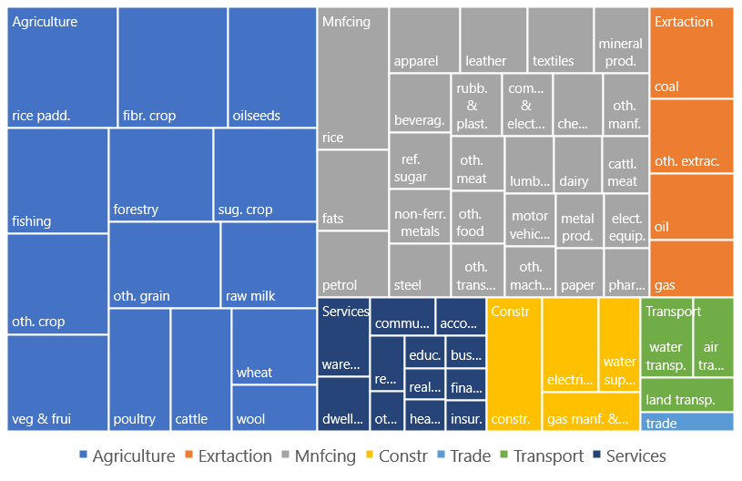
Sectoral labor capacity losses largest in Agriculture

Slide 12
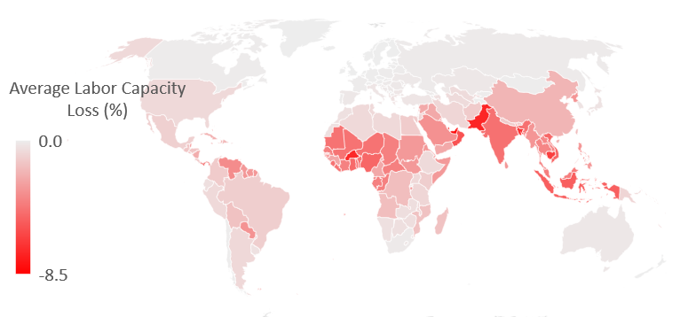
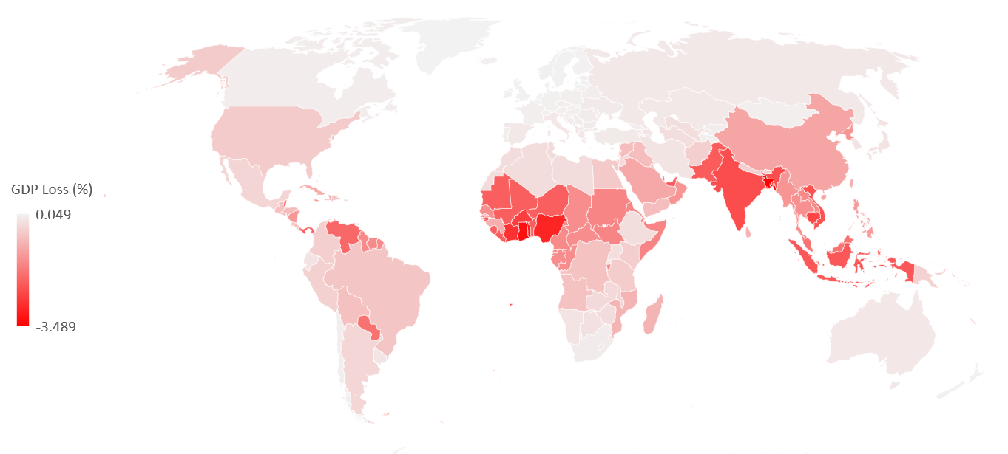
Labor capacity losses translate to lower GDP

Slide 13
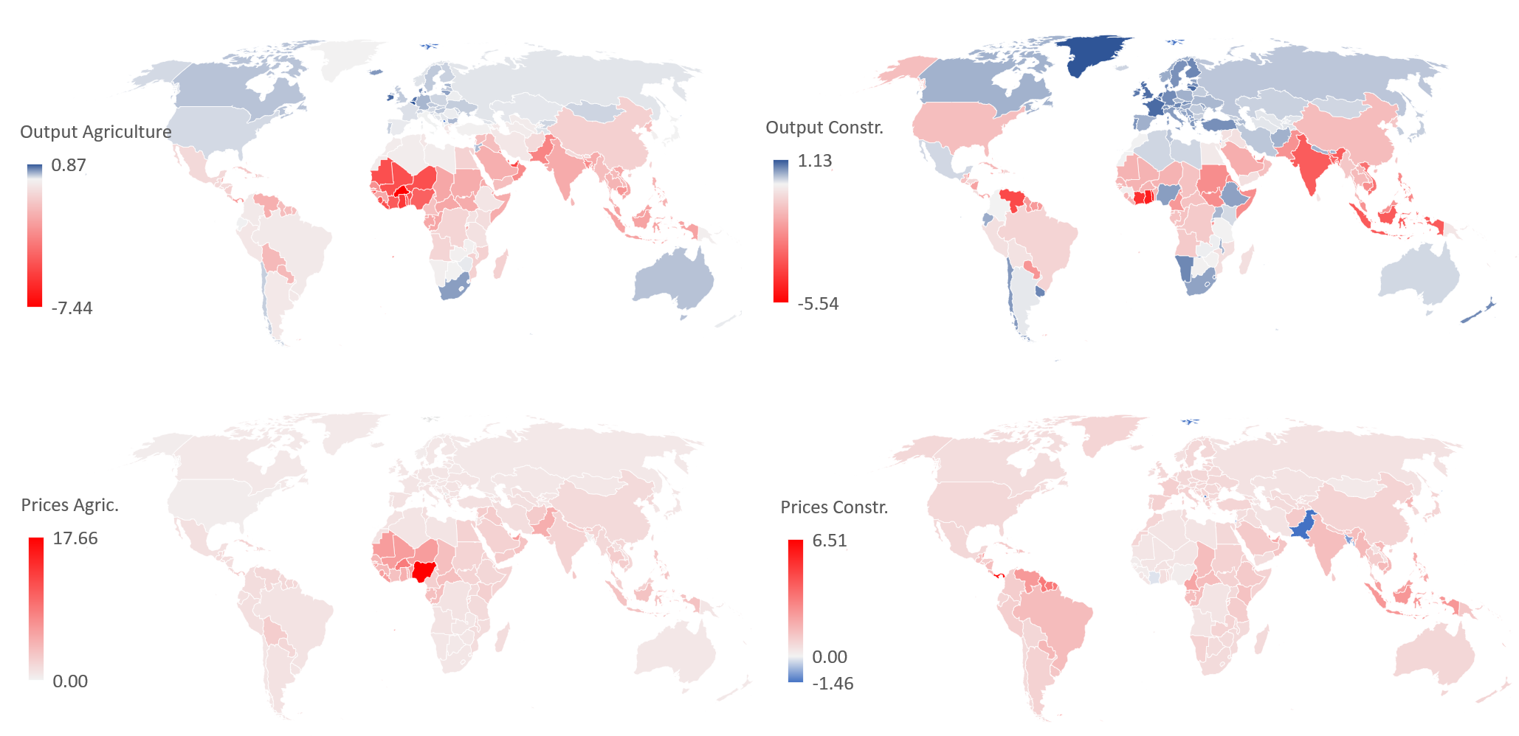
Across the tropics,
Output of Ag. and Construction declines:
Leading to higher prices:
Agriculture Construction

Slide 14
Despite capital-labor substitution, agriculture and construction draw in more labor
Perc. ch. in employment of agg. labor, by agg. sectors
Asia
Africa
Constr., Indones.
Agric., Nigeria

Slide 15
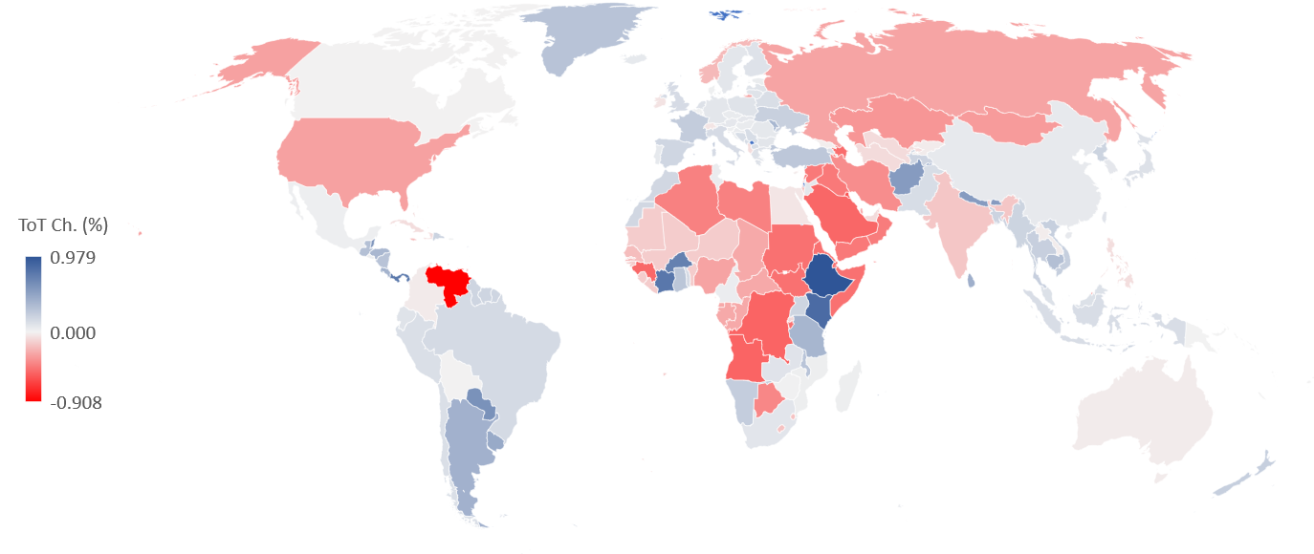
Economic geography: Combined global impact of climate change on each individual country’s ToT

Slide 16

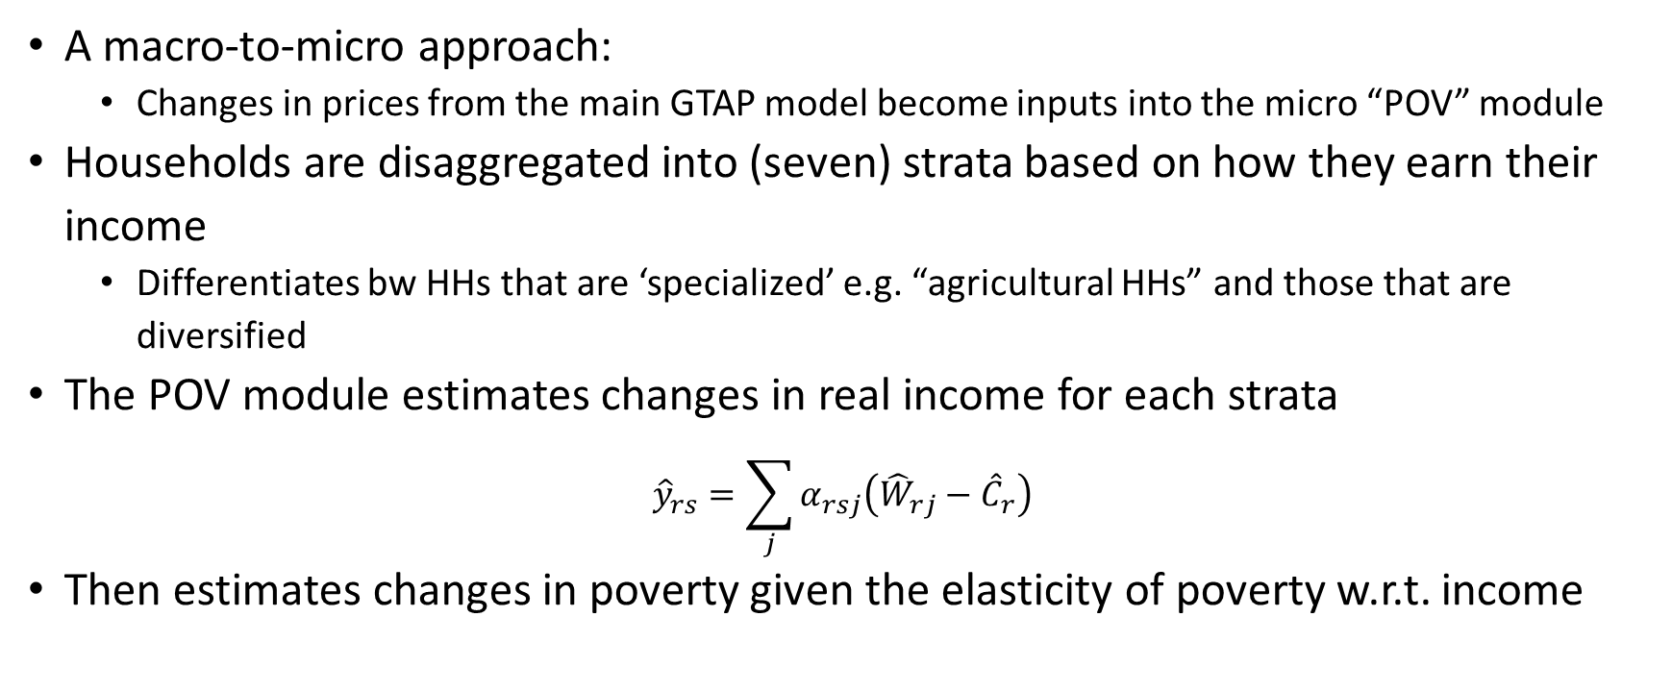
Data and Methods
GTAP-POV
A macro-to-micro approach:
  Changes in prices from the main GTAP model become inputs into the micro “POV” module
Households are disaggregated into (seven) strata based on how they earn their income
  Differentiates bw HHs that are ‘specialized’ e.g. “agricultural HHs” and those that are diversified
The POV module estimates changes in real income for each strata
$${\hat{y}}_{rs}=\sum_{j}{α_{rsj}\left({\hat{W}}_{rj}−{\hat{C}}_{r}\right)}$$
Then estimates changes in poverty given the elasticity of poverty w.r.t. income
Share of income earned from factor $j$ by stratum $s$

Slide 17
Perc. Ch. in Factor Returns (povinc)
Notes:
Circle idn ag – check if deflated - label

Slide 18
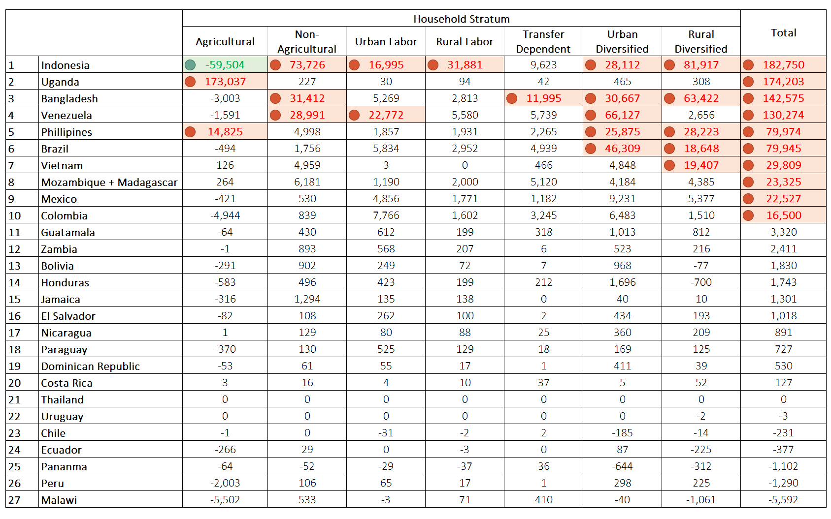
Ch. in Poverty Headcount (Numbers)

Slide 19
Thank you

Slide 20
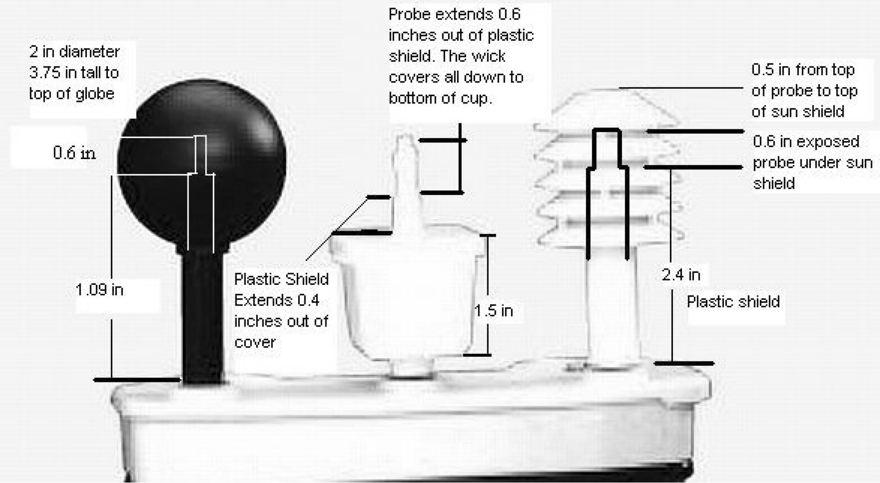
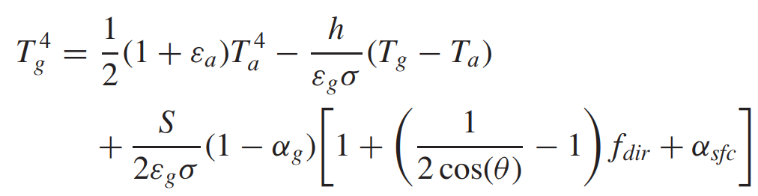
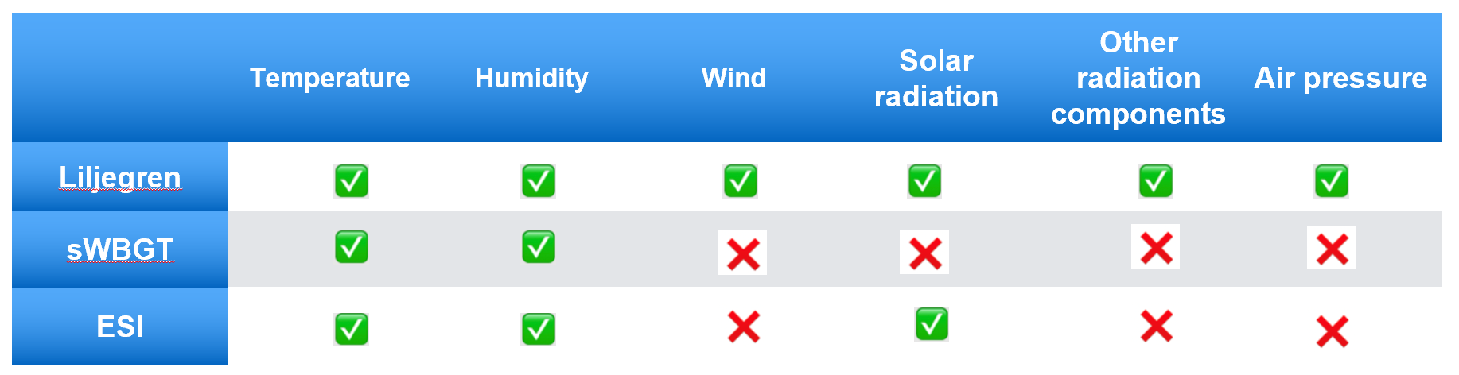
WBGT accounts for all factors; we use the more accurate Lijegren approximation
The recommended approximation:
Liljegren et al (2008)

Slide 21
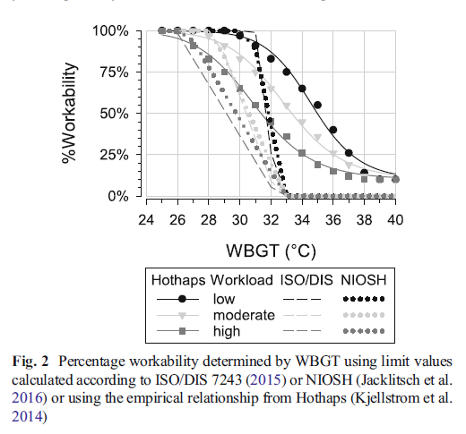
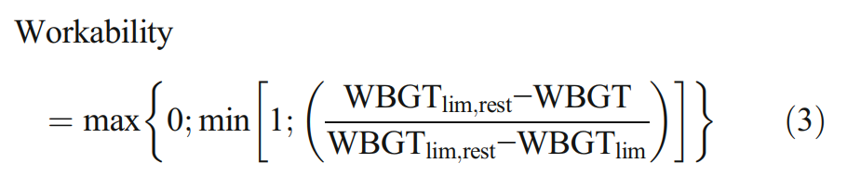
Estimated work ability in warm outdoor environments
(Bröde et. al. 2018)

Slide 22
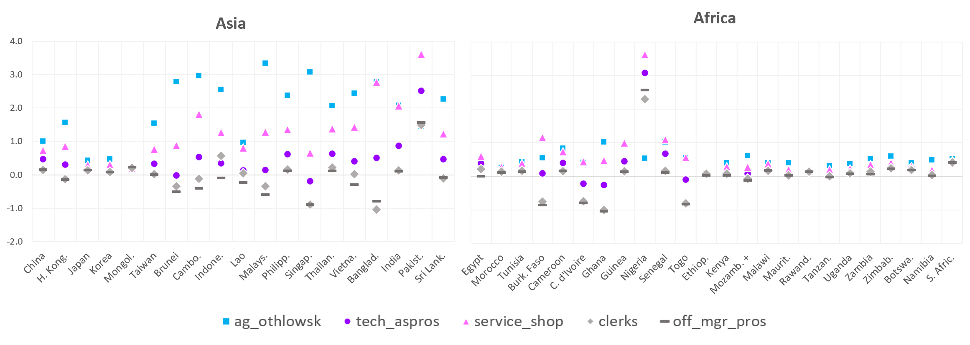
Ch. in employment by Labor Type
Construction

Slide 23
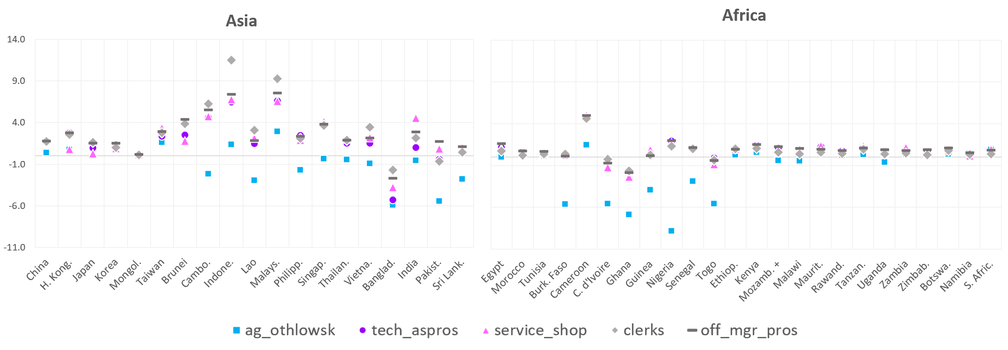
Ch. in employment by Labor Type
Agriculture

Slide 24
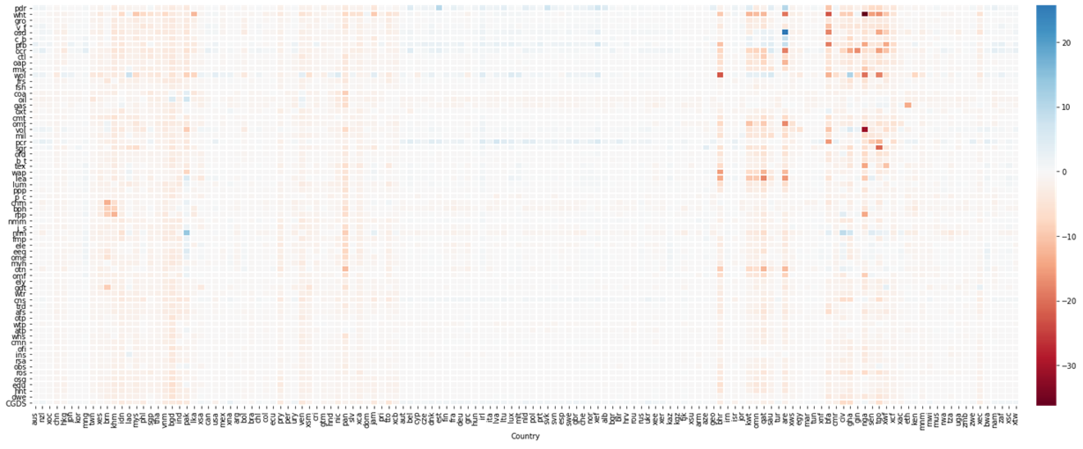
Perc. Ch. in Output, all sectors & countries
Agric.
Min
Manf.
Trd, Cns
Services
East Asia
Asi
N. Amer.
Central Amer.
Europe
Mid. East
West. Afr.

Slide 25
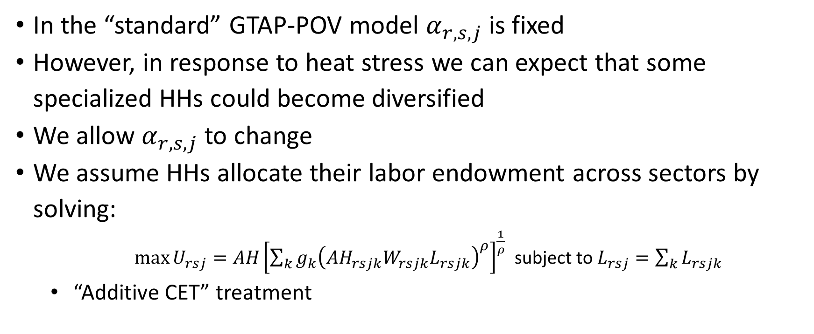
Data and Methods
GTAP-POV Modifications
In the “standard” GTAP-POV model $α_{r,s,j}$ is fixed
However, in response to heat stress we can expect that some specialized HHs could become diversified
We allow $α_{r,s,j}$ to change
We assume HHs allocate their labor endowment across sectors by solving:
  $\max{U_{rsj}=AH{\left[\sum_{k}{g_{k}{\left({AH}_{rsjk}W_{rsjk}L_{rsjk}\right)}^{ρ}}\right]}^{\frac{1}{ρ}}}$ subject to $L_{rsj}=\sum_{k}{L_{rsjk}}$
  “Additive CET” treatment
Notes:
Check Dr. H notes

