Slide 1

Impact of Non-Tariff Measures in the Indian Ocean Rim Association (IORA): A CGE Approach
24th Annual Conference on Global Economic Analysis
Abdallah Akintola
Sultan Qaboos University
24th June 2021
Co-Authors:
Houcine Boughanmi (Associate Professor SQU & WTO Chair)
Alessandro Antimiani (Ph.D, European Commission-DG Trade Unit)

Slide 2
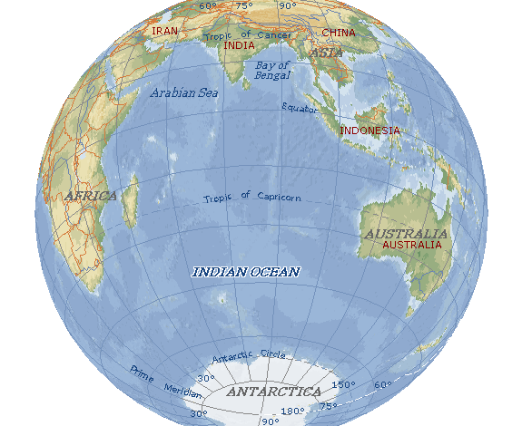

Outline
IORA Country Quick fact
Outlook of NTMs in IORA, tariff & Trade Facilitation
METHODOLOGY
RESULTS
Modeling Issues

Slide 3
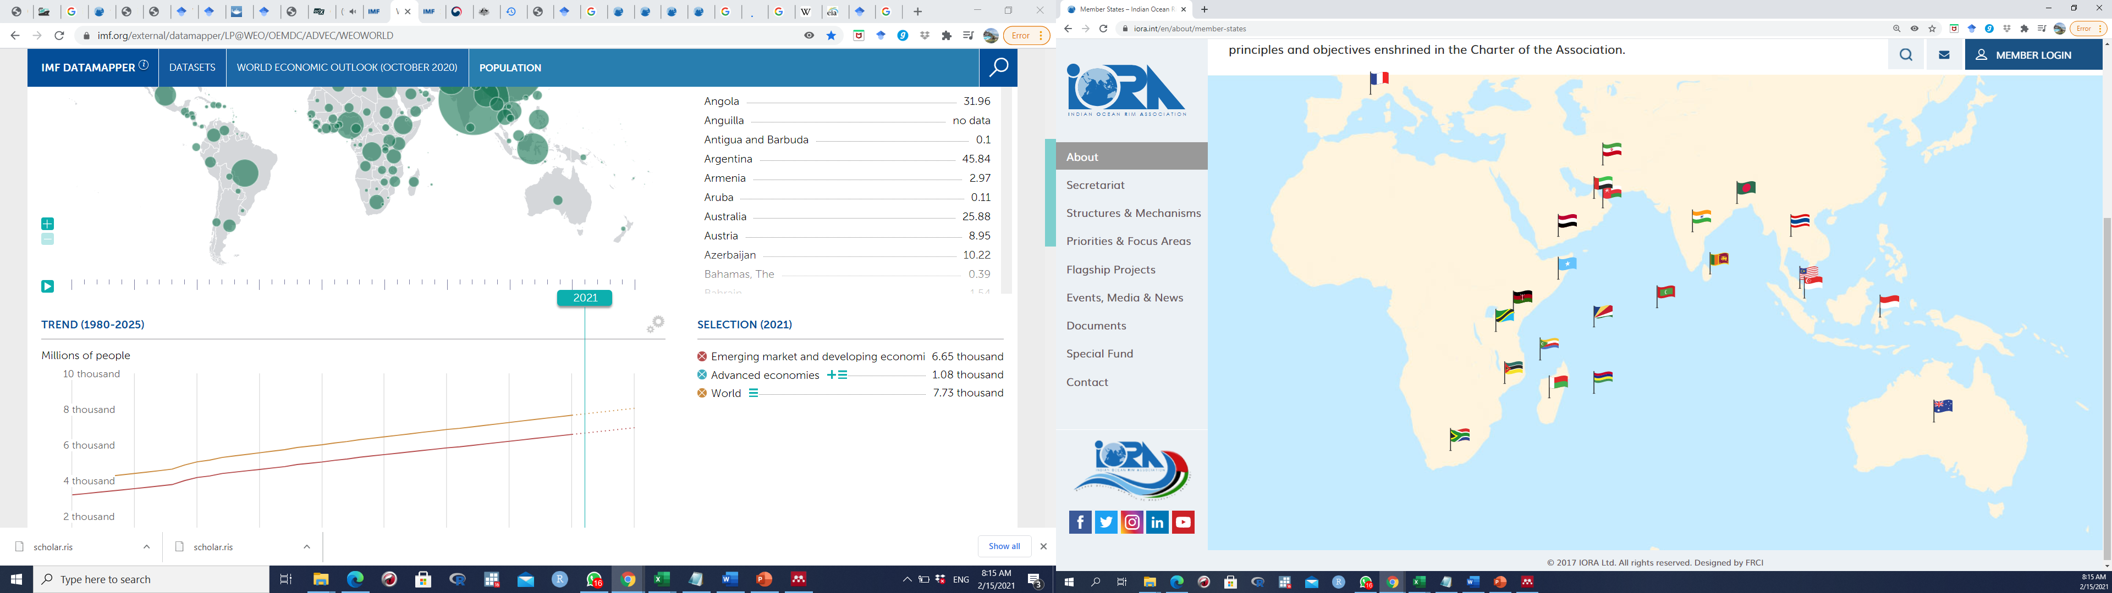
IORA Quick fact : IORA MEMBERS
France
Iran
UAE
Oman
Bangladesh
Yemen
India
Thailand
Malaysia
Somalia
Sri Lanka
Kenya
Singapore
Maldives
Indonesia
Tanzania
Seychelles
Comoros
Mozambique
Mauritius
Madagascar
Australia
South Africa
Indian Ocean
Reunion Island
Source : IORA, ( 2020)
(https://www.iora.int/en/about/member-states )
Notes:
Initiative started in march 1995 with seven members and with 14 members in march 1997
IORA presently comprises of 21 member states with 7 dialogue partners (China, France, Japan, United States, Egypt, Germany, United Kingdom) and an observer group called Indian Ocean Research Group (IORG). Australia, India, Kenya, Mauritius, Oman, Singapore and South Africa
Australia, India, Kenya, Mauritius, Oman, Singapore and South Africa Indonesia, Malaysia, Sri Lanka, Yemen, Tanzania, Madagascar and Mozambique

Slide 4
IORA Quick fact : Socio-economic
Region | Countries* | GDP/ Capital (US$) | Population (Millions) | Area (Sq. Km) | Resources Endowment
Australasia | Australia^{H} | 51,886 | 25.7 | 7741220 | Coal, iron ore (+15)
Southeast Asia | Indonesia^{UM} | 4,038 | 269.6 | 1913580 | Petroleum, Tin (+9+
 | Malaysia^{UM} | 10,193 | 33 | 330345 | Tin, Petroleum (+5)
 | Singapore^{H} | 58,484 | 5.8 | 719 | Fish, Deepwater ports
 | Thailand^{UM} | 7,295 | 69.8 | 513120 | Tin, Rubber, Fish (+10)
South Asia | Bangladesh^{LM} | 1,888 | 168.3 | 147630 | Natural gas, Arable land (+2)
 | India^{LM} | 1,877 | 1,381.60 | 3287259 | Coal, Iron ore (+9)
 | Maldives^{UM} | 12,464 | 0.4 | 298 | fish
 | Sri Lanka^{LM} | 3,698 | 21.9 | 65610 | Limestone, Arable land (+6)
West Asia | Iran^{UM} | 7,257 | 84.1 | 1745150 | Petroleum, Natural gas (+8)
 | Oman^{H} | 14,423 | 4.3 | 309500 | Petroleum, Copper (+5)
 | UAE^{H} | 31,948 | 11.1 | 83600 | Petroleum, Natural gas
 | Yemen^{L} | 645 | 32.5 | 527970 | Petroleum, Fish (+8)
Eastern Africa | Comoros^{L} | 1,337 | 0.9 | 1861 | Fish
 | Kenya^{LM} | 2,075 | 48.7 | 580370 | Limestone, Wildlife (+8)
 | Madagascar^{L} | 515 | 27.6 | 587295 | Graphite, Chromite,fish(+9)
 | Mauritius^{H} | 8,951 | 1.3 | 2040 | Arable land, Fish
 | Seychelles^{H} | 12,323 | 0.1 | 460 | Fish, Coconuts(+1)
 | Somalia^{L} | . | . | 637660 | Uranium, Iron ore (+7)
 | Tanzania^{LM} | 1,106 | 58 | 947300 | Hydropower, Tin, Gold(+7)
Southern Africa | Mozambique^{L} | 455 | 32 | 786380 | Coal, titanium(5)
 | South Africa^{UM} | 4,736 | 59.7 | 1219090 | Gold, chromium (+14)
 | Reunion Island (France) | 26,221 | 0.9 | 2517 | Fish, arable land, hydropower
*Income level : H – High Income, UM-Upper Middle income, LM-Lower middle Income, L- Lower income
Notes:
Vary in terms of geographical location size, gdp and resurce edownment
Adressing the protective and ditortionary measures of NTMs, and given the region wide diversity in terms of income, population, resource endowment and trade structures, is expected to foster intra-regional trade (IRT) and promote further regional integration (Anderson, 2002; Dabee & Reddy, 2001).

Slide 5
IORA Quick fact
Share of IORA in World GDP , Export and Import
Accommodates 30 percent of the world population (Huge market demand)
Half of the world's container ships and two thirds of the world's oil shipments pass through the Indian Ocean
It is based on the principles of Open Regionalism
big players in global trade belong to IORA Dialogue group (China, US)
Comprises of emerging economies
(India, Tanzania, Bangladesh)
Source: Authors calculations using ITC database
Notes:
In the face of economic challenges and geopolitical shifts, Oman is investing in its strategic partnership with India to diversify Muscat’s web of international allies………Narrow sea passage between Persian Gulf and Indian Ocean……Strategic location of Oman
Establishment of Fisheries Support Unit located in Oman
Large financial share to the association trust fund

Slide 6
IORA Quick fact : IORA intra-regional trade share
intra-trade in agrifood is higher compared to manufacturing and total trade
Source: Authors calculations using ITC database
Notes:
Irt been doing fine but would have done better if there was a legal binding, countries like comoros…… depend on agicultural trade from within the region

Slide 7

Outlook of NTMs in IORA & tariff
Applied Tariff Rate : Simple Average (2019)
Country | % | Country | %
Australia | 2.0 | Singapore | 1.2
Bangladesh | 12.2 | Maldives | 18.9
Comoros | 12.5 | South Africa | 8.4
India | 10.2 | UAE | 4.2
Indonesia | 6.7 | Sri Lanka | 16.4
Iran | 16.2 | Tanzania | 12.2
Kenya | 13.1 | Thailand | 8.0
Madagascar | 8.9 | Yemen | 5.8
Malaysia, | 6.2 | Mozambique | 9.0
Mauritius | 1.3 | Seychelles | 8.9
Oman | 3.3
Percentage of IORA Notification in World Notification
 | SPS | TBT | QR | TRQ | XS | Others | Total
 | 12.0 | 18.7 | 30.6 | 7.7 | 11.9 | 64.6 | 17.5
Percent Notification for Agricultural in Total IORA Notification
 | 90.9 | 39.2 | 31.4 | 95.9 | 84.4 | 25.3 | 45.5
Quantitative Restrictions [QR], Sanitary and Phytosanitary [SPS], Technical Barriers to Trade [TBT] , Tariff-rate quotas [TRQ], Export Subsidies [XS], others :Countervailing [CV],Anti-dumping [ADP], Safeguards [SG], Special Safeguards [SSG]
Source: NTMs from WTO Integrated Trade Intelligence Portal (I-TIP) : Applied Tariff from WITS database
Notes:
This is also problem statement that NTM usage is high in the region. THIS GRAPH MIGHT BE UNDERESTIMATED BECOS some countries missing, however Kenya, Thailand, austraila , india uae oman still have high amount of notification. Qr still dominates the region. SPS affects agric a lot as expected

Slide 8
Average Trade Facilitation Performance of IORA (2017- 2019)
2
22
21
OECD 11 Trade Facilitation indicators
Most of the countries in the high-income group (Australia, Mauritius, Oman, Singapore) were the best performer except for UAE
Countries in the lower-middle and lower-income group performed below average
1
3
Source: OECD

Slide 9
METHODOLOGY
GTAP database version 10A(2014)
The following scenarios were simulated :
(i) Scenario I : (Regional trade integration scenario ): Tariff cut gradual over 10 years (2021-2030) within IORA in a reciprocal fashion
(ii) Scenario II : Scenario I + 50% NTM reduction + Trade Facilitation
31 COUNTRIES
31 SECTORS
Dynamic model
(Rundynam)
Notes:
Is RTA better than open regionalism for IORA, if IORA goes into RTA , how far would gradual removal of tariff and NTM coupled with TF benefit iora than OR

Slide 10
Results: Welfare Effects of IORA Countries (Equivalent Variation: % of GDP)
Warnings: we are still working on welfare decomposition because of static/dynamic issue

Slide 11
Results: Effect real GDP (relative to baseline,2030)
High Income
Upper Middle Income
Lower Middle Income
Low income
Notes:
Most countries in lower middle and low income class benefited a lot. Only Iran negative but better of in ntm and tf

Slide 12
Results: Effect on Value of Merchandise Export in IORA (relative to baseline,2030)
Notes:
Most countries in lower middle and low income class benefited alot

Slide 13
Results: Effect on Value of Merchandise Import in IORA (relative to baseline,2030)
Notes:
Most countries in lower middle and low income class benefited alot

Slide 14
Results: Effect on Capital Accumulation (relative to baseline,2030)
Notes:
Mauritius turned positive, Indonesia negative, Kenya investment increased most

Slide 15
IORA simulation in Rundynam and GTAP-RD frameworks
Capital accumulation
The dynamic paths, i.e. capital accumulation, is similar between Rundynam and GTAP-RD, however, in absolute terms, it is lower for the GTAP-RD

Slide 16
IORA simulation in Rundynam and GTAP-RD frameworks
Capital accumulation
However, when comparing single countries differences arise. The comparison shows the large differences for:
Among countries subject to the shocks
Between developed and developing/LDC countries

Slide 17
IORA simulation in Rundynam and GTAP-RD frameworks
GDP results
Rundynam takes into account international transfer of capital. It turns that under this perspective the model is better suited to more possible FDI inflows due to the FTA. In other words, in all countries where FDI are relevant , GTAP-RD could underestimate the impact.
On average GDP impact is similar between the two models. But,
Rundynam tends to show higher GDP impacts than GTAP-RD for some of the countries involved in the scenario.
In four cases (Australia, Bangladesh, India and Madagascar) the GDP impact is higher in GTAP-RD than Rundynam.

Slide 18
IORA simulation in Rundynam and GTAP-RD frameworks
GDP results
GTAP-RD show higher GDP impact for Australia and India. But while for Australia it is consistent with higher capital accumulation, for India capital accumulation is bigger in Rundynam
It seems the two models have different response between developed and developing countries
On average GDP impact is similar between the two models. But,
Rundynam tends to show higher GDP impacts than GTAP-RD for some of the countries involved in the scenario.
In four cases (Australia, Bangladesh, India and Madagascar) the GDP impact is higher in GTAP-RD than Rundynam.

Slide 19
IORA simulation in Rundynam and GTAP-RD frameworks
Trade results: export
Due to the (extra) capital inflows from equity the trade picture can be quite different, with Rundynam showing higher exports change for the countries involved in the policy scenario
China, USA and Japan show opposite impact

Slide 20
IORA simulation in Rundynam and GTAP-RD frameworks
Trade results: Import
Similar to export impact, import change is also higher for Rundynam than GTAP-RD.
On import side, however, results are fully consistent as sign

Slide 21
IORA simulation in Rundynam and GTAP-RD frameworks
?
Due to the identity X-M = S-I, it seems that Rundynam dynamic, which include equity from abroad, can overestimate the trade impact
Due the lack of any international capital reallocation, it seems that GTAP-RD can underestimate the GDP impact
It seems that parametrization in both model is not consistent with the differences between developing and developed countries since results are puzzled when comparing these two categories
Should Rundynam and GTAP-RD be used in different analysis, i.e. are not substitutes?

Slide 22

Thank you
&
Contributions
Notes:
Update/add/delete parts of the copy right notice where appropriate.
More information: https://myintracomm.ec.europa.eu/corp/intellectual-property/Documents/2019_Reuse-guidelines%28CC-BY%29.pdf

