Slide 1
Education, Labor Force Composition, and Growth
A General Equilibrium Analysis
Roberto Roson
Ca’ Foscari University Venice; Loyola Andalusia University; GREEN Bocconi University Milan. E-mail: roson@unive.it

Slide 2
Introduction
Whereas the role of human capital and education in economic development is well understood, both conceptually and theoretically, empirical studies on the field are lacking.
The few examples of education-oriented CGE analysis found in the literature are based on a hybrid approach, whereby micro-economically formulated education investments, having weak empirical support, are combined with data-intensive CGE settings.
Rather than inserting microeconomic-based assumptions of human capital formation inside a CGE setting, we look for an empirical relationship between labor force composition and expenditure in education services.

Slide 3
Education and Labor Force Mix
We found some empirically robust relationships between workers’ shares in the labor force and educational expenditure, in real terms and per capita.
More educated workers can find employment in industries where they can get higher wages, reflecting higher marginal productivity. This shift would increase labor productivity in the aggregate.
We found that the best performing relationship is between the logarithm of the labor category share and the logarithm of total (private, public, by firms) real expenditure in education (l_ES).

Slide 5
Estimated labor force composition as a function of real education expenditure per capita

Slide 6
Relative wages vs. labor shares, globally

Slide 7
Relative wages vs. labor shares, Ethiopia

Slide 8
Relative wages vs. labor shares, United States

Slide 9
Simulating the multiplicative effects of educational investments
We simulate the long run impact of a 10% increment in the expenditure for educational services, realized by the public sector in Ethiopia.
The initial demand push stimulates an increase in the production of education services.
With more education provided, the composition of the labor force would change.
Higher productivity brings about lower prices and higher income, which boost the demand for education services, further raising productivity.

Slide 10
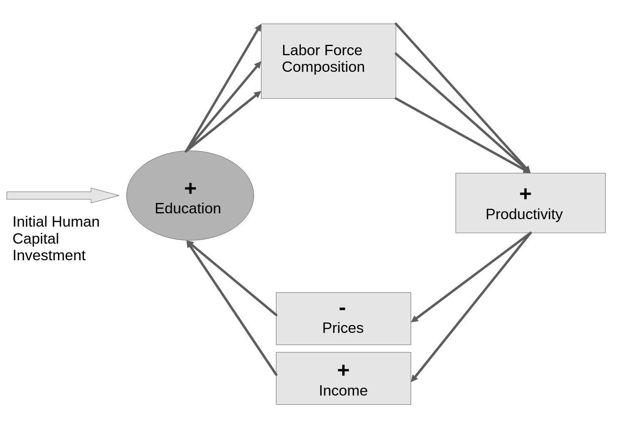

Slide 11
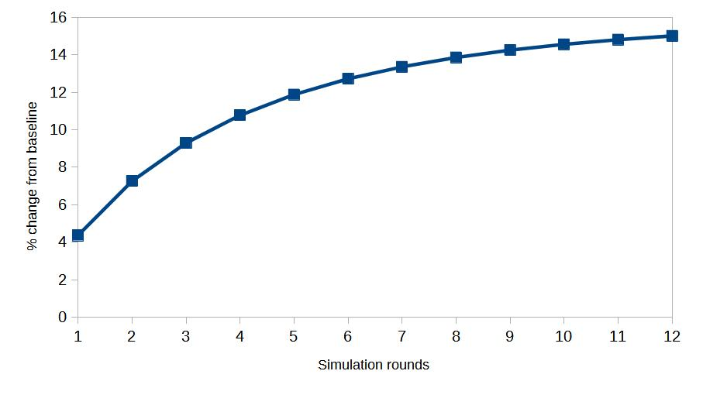
Iterative convergence of Education industry output (% change)

Slide 12
Key findings
Labor supply, in efficiency units, for the officials, managers and professionals category ultimately increases by 17.24%. Technicians rise by 15.57%, service and shop workers 12.41%, clerks 10.77%. Agriculture and other non-skilled workers decrease by -2.65%.
Real GDP increases by 1.57%, whereas the equivalent variation, an aggregate monetary measure of welfare impact, amounts to 789 million of US$ (1.42% of the baseline GDP).
The extra +10% expenditure in education service is partly compensated by the generally decreasing prices. In the final equilibrium state, public expenditure grows by just 2.27%.

Slide 13
Variation in the price of primary factors (% change)

Slide 14
Variation in the price of produced goods and services (% change)

Slide 15
Variation in the quantity of produced goods and services (% change)

Slide 16
Variation in sectoral trade balances (change, million US$)

Slide 17
Any comment or suggestion will be appreciated
This is a work in progress

