Slide 1
DRAFT - Estimating Energy Substitution Parameters in GTAP-E
Rohan O’Reilly, Siobhan Prendiville, Lee Humphreys
Disclaimer: Views expressed herein are those of the authors and do not represent the views of the Department for International Trade, United Kingdom

Slide 2
Overview
Elasticities of substitution are central to Computable General Equilibrium (CGE) models
New elasticities of substitution between capital and energy included in this model are set generically for every sector and country
Task: understand sensitivity of model to these parameters, and estimate more specific elasticities
Approach: use methodology of Costantini & Paglialunga with recent data to estimate sector specific elasticities as broadly as possible

Slide 3
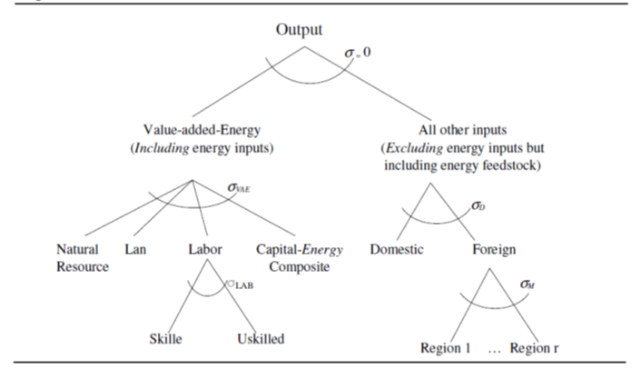
Elasticity of Substitution

Slide 4
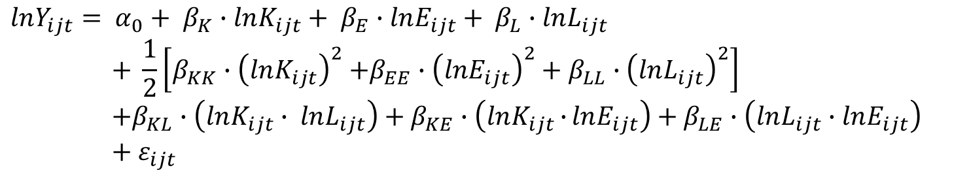
Estimation
Data
    Panel dataset of economic output, investment, labour and energy consumption – primarily from OECD STAN
    Transformations to create suitable capital stock values, and PPP adjusted figures
  Regression
    Construct linear regression model using panel data
    Translog model specification and between estimator
$$lnY_{ijt}= α_{0}+ β_{K}∙lnK_{ijt}+ β_{E}∙lnE_{ijt}+ β_{L}∙lnL_{ijt}$$
$$+ \frac{1}{2}\left[β_{KK}{∙\left(lnK_{ijt}\right)}^{2}+β_{EE}{∙\left(lnE_{ijt}\right)}^{2}+ β_{LL}∙{\left(lnL_{ijt}\right)}^{2}\right]$$
$$+β_{KL}∙\left(lnK_{ijt}∙ lnL_{ijt}\right)+β_{KE}∙\left(lnK_{ijt}∙{lnE_{ijt}}\right)+β_{LE}∙\left(lnL_{ijt}∙lnE_{ijt}\right)$$
$+ ε_{ijt}$

Slide 5
Modelling
Model A - $5 Carbon Tax
$5 carbon tax on every region in the aggregation
Model B – Fictional US-UK FTA
Full liberalisation of all tariffs between the UK and USA
Closure swap fixes price of capital and endogenises quantity

Slide 6
Model A - $5 global carbon tax

Slide 7
Model B – Fictional US-UK FTA

Slide 8
Conclusion
Estimation method yielded feasible elasticities for 5 sectors including 2 services sectors
For carbon abatement policies, results suggest that default elasticities may overestimate the effectiveness of a given carbon price level – but underestimate cost
For FTA modelling, estimated elasticities made minimal difference to results
Future extensions to this research could answer questions on country heterogeneity, inter-fuel substitution elasticity and a wider range of policy scenarios.

