Slide 2
Disaggregating air, land and maritime transport sectors in the GTAP database
Ana Norman-López, Krzysztof Wojtowicz, Rafael Garaffa, Marie Tamba
Session #44 – Transportation and Infrastructure
GTAP, 8 June 2022

Slide 3
Objective and motivation
  What? To split the GTAP transport sectors (air, land, water) to account for operations (freight/passenger) in specific transport sectors (air, road, rail, water)
  Why? Extend analytical capacity CGE model (JRC-GEM-E3) and allow interaction with other models
  How?
  Consistency – across existing statistics and GTAP structure
  Transparency – open discussion of our experience splitting the data
  Work in progress… Transport split is still not finished

Slide 4
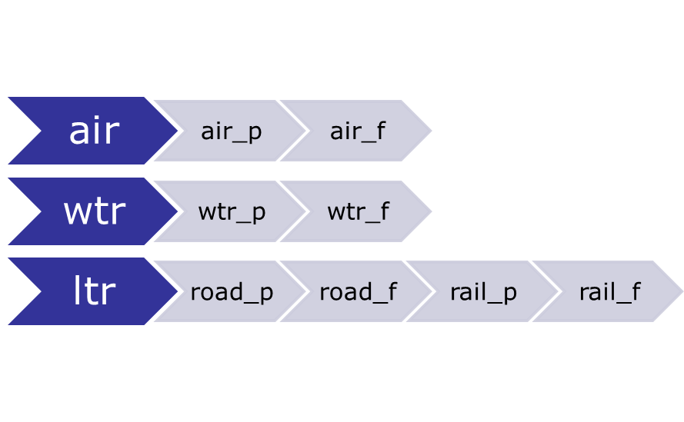
Beginning of the split
  GTAP sectors - Target GTAP sectors
34 sectors and 49 countries and regions
Countries and regions
- America (Arg, Bra, Can, Mex, USA, OAM)
- Pacific (Aus, Idn)
- Europe (EU27 (disaggregated), UK, Rus, Tur, EFA, REA)
- Asia (Chn, Ind, Jpn, Kor, Sau, MEA, OAS)
- Africa (Saf, AFR)
Notes:
This is the start. There are 3 GTAP transport sectors, we aim to split air and maritime into 2 subsectors each, and land into 4 subsectors.

Slide 5
Overview - GTAP’s transport and margins sectors structure
GTAP’s representation of international transport
Non margin sectors (VXMD)
3 Transp.sectors(air, land, water)
- Passengers + Other(e.g., cargo handling, storage and warehousing not included in freight, air traffic control, cleaning, etc)
- Data from BPM6 (UN, Eurostat)
-No O-D information
-Transport service transaction
International transport margins
Usage (VTWR) Supply (VST)
- International freight
Data from merchandise trade & rebalance BPM6 Quality?
  O-D information (Usage VTWR)
  Transport service export (Supply VST)
Notes:
GTAP represents transport of passengers and freight in two broad categories.
NON MARGIN TRANSPORT SECTORS includes International transport of passengers in 3 transport sectors (air, land and sea). The GTAP parameter associated to international exports is VXMD.
In addition to passengers, this sector also includes and ‘other catergory’ which represents Other transport services include services that are auxiliary to transport and not directly provided for the movement of goods and persons. The definition is derived from the IMF Balance of Payments category.
The second broad category are INTERNATIONAL TRANSPORT MARGINS. This category purely includes the international movement of goods (freight). GTAP represents international transport margins into USAGE (GTAP parameter VTWR) and SUPPLY (GTAP parameter VST). The representation of freight into two margin categories allow to differentiate between the physical movement of goods (usage) and the supply of a transport service (VST).
The mapping of non margin transport sectors is fairly straightforward, since the sectoral classification in the services area was designed with this data source in mind. Bilateral balance of payments services trade data (including transport) come from two sources, the UN Service Trade website and EUROSTAT’s International trade in services (BPM6). These sources subdivide transportation in two different ways, by function and by mode. By function, transport data is divided into passenger, freight, and other; by mode, into sea, air, and other. This results in nine transport sectors across functions and modes (e.g., maritime passenger transport, etc). However, data is scarce for the mode classification, but abundant for the functional classification and the mode-by-function cross-classification. Also, there is inconsistency in reporting between countries. This means data needs to be manipulated to fill-in missing values and balance import and exports trade data.
Given that only service trade data (BPM6) is used to identify passenger transport services, there is no Origin-Destination movement of passengers. This is a significant simplification of reality. As an example, imagine a Greek company purchasing a ticket from Singapore airlines for an employee flying from the Philippines to Australia. In this case, the only detail available in GTAP will be the export value of the air transport service from Singapore to Greece (VXMD parameter), ignoring the Origin-Destination pair of the flight. At least for aviation, which accounts for the majority of international passenger transport, the shortfall in GTAP’s database affects climate change studies looking into the impacts of CO₂ emissions from aviation.
On the other hand, the representation of international margin services in GTAP does account for merchandise trade data. GTAP’s representation of international transport freight into margin services (usage and supply) considers the fact that the origin of the merchandise can be different to the country supplying the transport service. As an example, a pharmaceutical product sent by plane with a German air company (e.g., Lufthansa) from Canada to France. To allow this level of detail in GTAP’s data base, the transport margin supply array (VST) is indexed by margin commodity and country of origin, and the margin usage array (VTWR) is indexed by margin commodity, merchandise commodity, country of origin of the merchandise, and country of destination. For the example above, the data base specifies the value of air transport services supplied by Germany, and the value of air transport services used in exporting pharmaceutical products from Canada to France, without showing the explicit link.
Managing transport merchandise and services trade data together can result in conflicting information. In these occasions, GTAP adjusts the services freight transport data to agree with the merchandise trade data. This is because, at the relevant level of detail, the merchandise trade data is considered to be more firmly based. Having said this, until recently, merchandise trade data was purely based on US data which was a significant oversimplification. Nuno-Ledesma and Villoria (2019) improved modal shares in GTAP 9.0 Data Base (Aguiar et al., 2016) by bringing a more comprehensive set of merchandise trade by transport mode, covering around 65% of global trade in 2004 and 55% in 2011. A comparison revealed that the role of water transportation services international trade in GTAP had been underestimated, while that of air transportation had been overestimated. Subsequently, their data has been used to estimate transport margins by mode in later versions of GTAP Data Base.

Slide 6
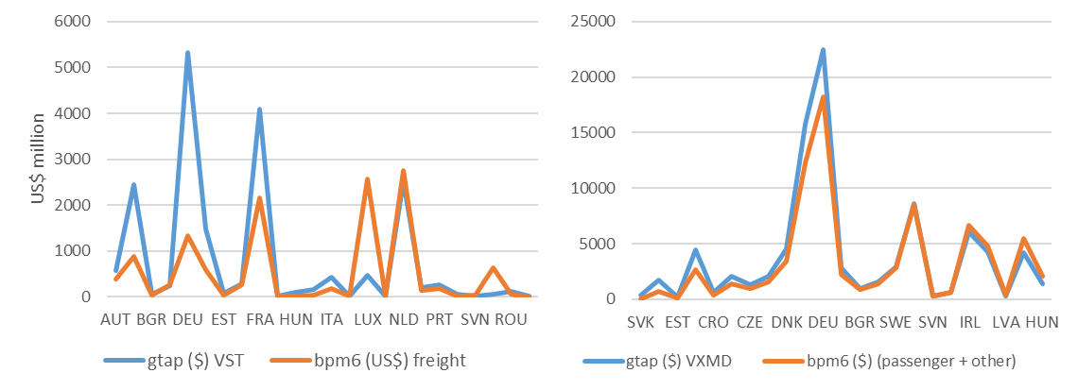
GTAP’s transport and margins sectors structure
GTAP transport representation & conflict between data sources
GTAP export parameters VST (left) and VXMD (right) versus service trade data statistics from Eurostat BPM6
Notes:
Given that transport margins use merchandise data instead of balance of payments’ freight transport data, it should not come at a surprise that GTAP’s transport margin (VST), which covers freight, varies from services trade statistics. While on the other hand, GTAP’s transport service exports (VXMD), which covers passengers, has a closer trend to services trade statistics. Figure 1 highlights these differences and similarities between GTAP’s VST and VXMD parameters compared to EU’s transport service trade statistics (BPM6).

Slide 7
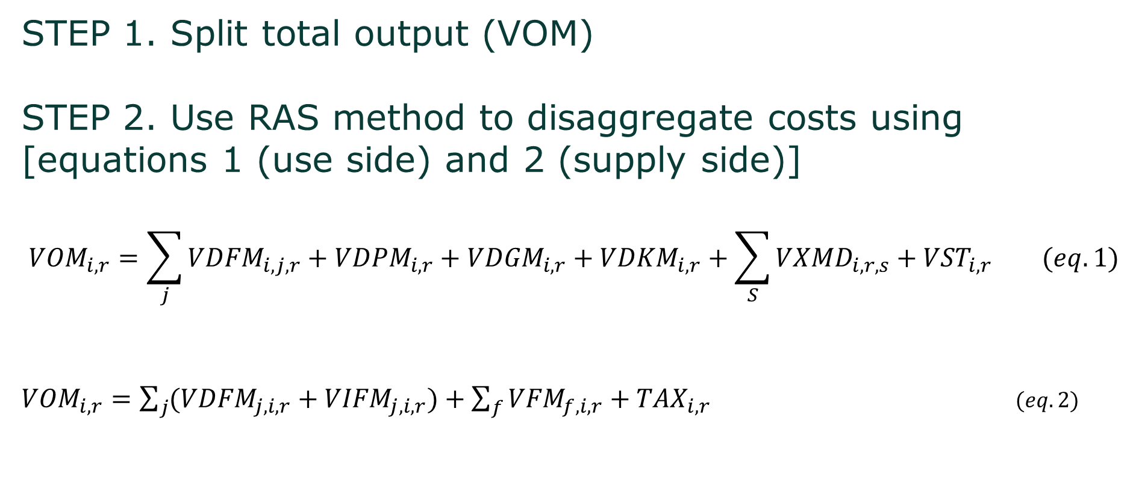
Methodology for split
STEP 1. Split total output (VOM)
STEP 2. Use RAS method to disaggregate costs using [equations 1 (use side) and 2 (supply side)]
$${VOM}_{i,r}=\sum_{j}{{VDFM}_{i,j,r}+{VDPM}_{i,r}+{VDGM}_{i,r}+{VDKM}_{i,r}+\sum_{S}{{VXMD}_{i,r,s}+{VST}_{i,r} (eq. 1)}}$$
${VOM}_{i,r}=\sum_{j}{({VDFM}_{j,i,r}+{VIFM}_{j,i,r})}+\sum_{f}{{VFM}_{f,i,r}}+{TAX}_{i,r}$ $(eq. 2)$
Intermediate inputs
Final consumption (private, government, investments)
Exports
Allocation to transport pool
Intermediate inputs (domestic and imports
Production factors (L,K)
Taxes
Notes:
EQUATION 1. USE SIDE
Total output = Intermediate inputs + Final consumption (Private, government, investment) + Exports + Allocation to transport pool
EQUATION 2. SUPPLY SIDE
Total output = Intermediate inputs (domestic and imports) + production factors (L,K) + Taxes

Slide 8
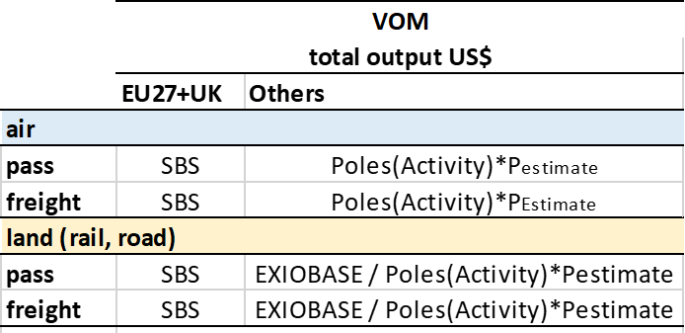
Methodology – Step 1: Split VOM
We split the output of each sub-sector as shares of the parent sector (air, land, water) using external data
, water
Notes:
We begin with the split of the output (VOM) into subsequent subsectors.
For EU we use SBS data on the value of output as a shares to calculate VOM for disaggregated subsectors
However for air transport we correct (increase) value of freight output (as some of freight is transported via passenger flights)
For non EU (due to lack of statistical data) we estimate output values using POLES statistics on activities plus assumption on relative prices (costs) of passenger/freight transport

Slide 9
Methodology – Step 2: simple RAS (x2)
Disaggregate costs in air sector
Create row and column totals (VOM) for RAS
Weights in RAS set to 1, unknown use of pass. and freight by 3 sectors
 |  |  | Country A
 |  |  | air | aip | aif
Interm. domestic inputs by sectors | Country A | 1 | 10 | 1 | 1
 |  | 2 | 20 | 1 | 1
 |  | 3 | 5 | 1 | 1
Interm. import inputs | Country B | 1 | 15 | 1 | 1
 |  | 2 | 30 | 1 | 1
 |  | 3 | 10 | 1 | 1
 | VA & taxes |  | 10 | 1 | 1
 | VOM^{S} |  | 100 | 80 | 20
 |  |  | Country A
 |  |  | air | aip | aif
Interm. domestic inputs by sectors | Country A | 1 | 10 | 8 | 2
 |  | 2 | 20 | 16 | 4
 |  | 3 | 5 | 4 | 1
Interm. import inputs | Country B | 1 | 15 | 12 | 3
 |  | 2 | 30 | 24 | 6
 |  | 3 | 10 | 8 | 2
 | VA & taxes |  | 10 | 8 | 2
 | VOM^{S} |  | 100 | 80 | 20
Results
Notes:
Exiobase used in land to split road and rail before using the same RAS method to split passenger and freight

Slide 10
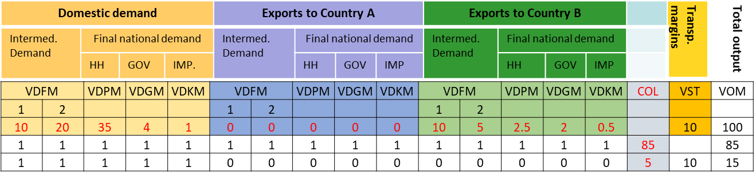
Methodology – Step 2: simple RAS (x2)
Split Use in Air
1. Split row and column totals (VOM) for RAS
2. Adjust VST (only freight)
3. Set weights for RAS matrix
Pass.
Frght
Notes:
- For an initial sector with a total VOM = 100. The subsectors VOM is 85 (pass.) and 15 (freight). – Shares derived from outside sources (SBS in EU27 for example).
GTAP VST is 10 and we know it can only be freight. This leaves freight with only 5 to distribute within domestic demand. Hence, the weights of 1 in domestic demand and zero in Exports to Country A and Country B.
Remind freight is not exported in VXMD only as international margin.
On the other hand, passengers are not included in transport margins. This means the total output of 85, needs to be distributed across domestic and international demand. The weights in RAS matrix were set to 1.
In LAND, bpm6 has been used to obtain the shares between rail passenger and road passenger

Slide 11
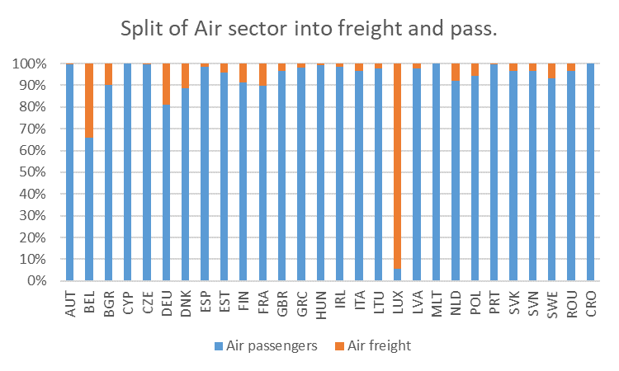
WARNING need to readjust shares!
Belly cargo in passenger flights
Freight and passenger separate except in air
Belly cargo in passenger flights account for almost half total freight
It is an issue if freight is under/over represented by the shares
Eurostat SBS shares
Notes:
air passenger transport represents most air total output in EU27+UK countries, as expected. Only Luxembourg (6%) and Belgium (66%) were smaller than 80%. The small air freight shares meant that we could not assume VST only came from air freight when doing the split. VST_{i,r} represents the value of sales of tradable commodity ‘i’ to the international transport sector in region ‘r’, evaluated at market prices. However, given that most passenger flights carry some freight along with passengers and their baggage, it is plausible that VST combines both air passenger and air freight transport.

Slide 12
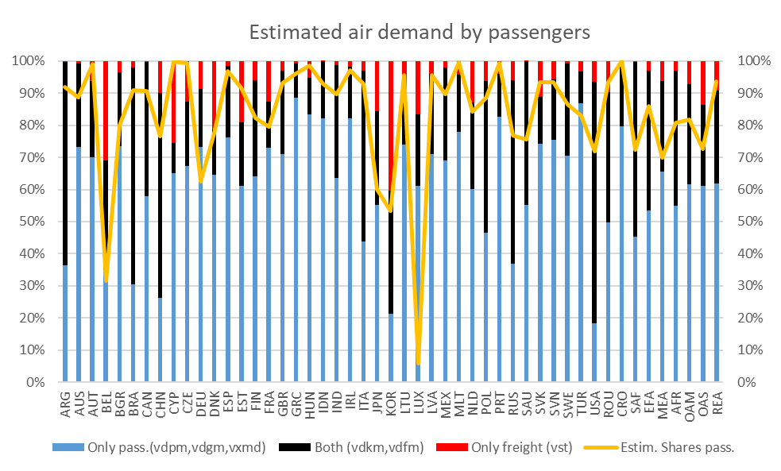
Results – preliminary checks air transport demand
$${VOM}_{i,r}=\sum_{j}{{VDFM}_{i,j,r}+{VDPM}_{i,r}+{VDGM}_{i,r}+{VDKM}_{i,r}+\sum_{S}{{VXMD}_{i,r,s}+{VST}_{i,r} }}$$
GTAP requirements
Freight
VST
Passenger
VDPM+VDGM+VXMD
Either
VDKM+VDFM
Notes:
When splitting the air sector, we understand some categories should only be consumed by passengers (VDPM+VDGM+VXMD), and others only by freight (VST). Then, there are investments and intermediate firm purchases (VDKM+VDFM) that we understand can use passenger and freight transport
The graph provides GTAP’s data division between passengers and freight air transport demand. If we assume passengers only consume the blue bar (VDPM+VDGM+VXMD) and freight only consumes the red bar (VST). And the black bar is consumed by both, passenger and freight (VDKM+VDFM). The division should occur somewhere within the black bar.
A subdivision above the black bar would indicate passenger demand is also consuming VST. This is the case in 12 countries (AUT, CYP, CZE, EST, HUN, LTU, MLT, PRT, SVK, ROU, CRO, REA) (red circles)
A subdivision below the black bar (i.e, within the blue bar) would indicate HH are consuming freight. This is the case in 4 countries (BEL, DEU, LUX, TUR) This is wrong because GTAP requires passengers to cover VDPM+VDGM+VXMD

Slide 13
Conclusions
Passenger and freight transport is implicitly accounted in GTAP
Transport data is hard to find. EU seems to have the most complete data but still has gaps
Differences between available statistics and GTAP structure/data makes the split (pass./freight) trickier
Today’s air split results are work in progress

Slide 14
Thank you
Contact: ana.norman@ec.europa.eu

Slide 15
Methodology – Step 1: Split VOM – EU27+UK
Eurostat SBS has empty values
Notes:
The EU has the most complete transport data set split by function (passenger/freight) and mode. Eurostat provides annual detailed enterprise statistics for services using NACE Rev.2 classification. To split the VOM (total output) we use SBS ‘production value’ (in million euros) in 2014.
Having said this, Eurostat still had many categories with empty values that required an approximation using interpolation with other years and similar categories (turnover).
The table provide examples from some EU countries. Red and Green values are the differences from the column and row totals. The values in grey and blue are estimates derived from other years and proxy data “turnover of gross premium”

Slide 16
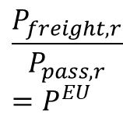
Methodology – Step 1: Split VOM – non EU
Data available
GTAP VOM
Activity
Pass/km
Activity
Ton/km
Activity from PRIMES for EU27+UK and POLES for non EU countries (air & land available)
𝑉𝑂𝑀𝑓𝑟𝑒𝑖𝑔ℎ𝑡,𝑟=𝑃𝑓𝑟𝑒𝑖𝑔ℎ𝑡,𝑟∗𝑄𝑓𝑟𝑒𝑖𝑔ℎ𝑡,𝑟
𝑉𝑂𝑀𝑝𝑎𝑠𝑠,𝑟=𝑃𝑝𝑎𝑠𝑠,𝑟∗𝑄𝑝𝑎𝑠𝑠,𝑟
P^{EU} from EU aggregated data
Estimated data
SBS shares
P_{pass}
eq
P_{freight}
eq
$$\frac{P_{freight,r}}{P_{pass, r}}=P^{EU}$$

Slide 17

Methodology – Step 1: Split VOM – non EU
Data available
GTAP VOM
Activity
Pass/km
Activity
Ton/km
Non EU freight & pass prices solved from 2 unknowns
𝑉𝑂𝑀_{𝑟𝐺𝑇𝐴𝑃}=𝑃_{𝑓𝑟𝑒𝑖𝑔ℎ𝑡,𝑟}∗𝑄_{𝑓𝑟𝑒𝑖𝑔ℎ𝑡,𝑟} + 𝑃_{𝑝𝑎𝑠𝑠,𝑟}∗𝑄_{𝑝𝑎𝑠𝑠,𝑟}
$$\frac{P_{freight,r}}{P_{pass, r}}=P^{EU}$$
Estimated data
SBS shares
P_{pass}
eq
P_{freight}
eq
$$\frac{P_{freight,r}}{P_{pass, r}}=P^{EU}$$

Slide 18
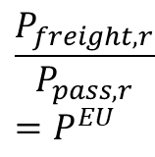
Methodology – Step 1: Split VOM – non EU
Data available
GTAP VOM
Activity
Pass/km
Activity
Ton/km
Non EU VOM freight & pass solved
𝑉𝑂𝑀𝑓𝑟𝑒𝑖𝑔ℎ𝑡,𝑟=𝑃𝑓𝑟𝑒𝑖𝑔ℎ𝑡,𝑟∗𝑄𝑓𝑟𝑒𝑖𝑔ℎ𝑡,𝑟
𝑉𝑂𝑀𝑝𝑎𝑠𝑠,𝑟=𝑃𝑝𝑎𝑠𝑠,𝑟∗𝑄𝑝𝑎𝑠𝑠,𝑟
P_{pass}
eq
P_{freight}
eq
$$\frac{P_{freight,r}}{P_{pass, r}}=P^{EU}$$
Estimated data
SBS shares
Total output from rail passenger, rail freight, road passenger, road freight estimated in a similar manner, after EXIOBASE had split GTAP’s land sector into the two subsectors rail and road.

Slide 19
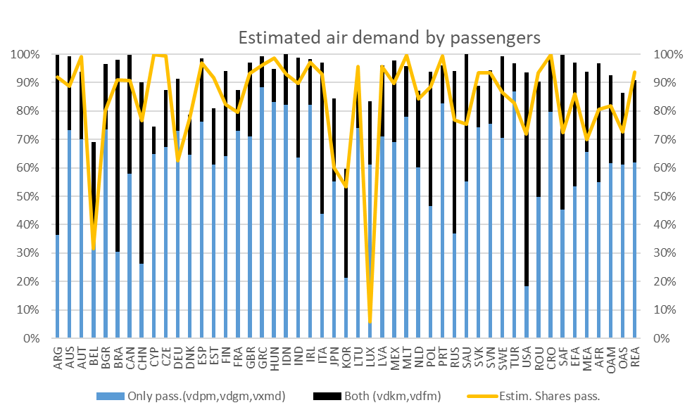
Results – preliminary checks air transport demand
$${VOM}_{i,r}=\sum_{j}{{VDFM}_{i,j,r}+{VDPM}_{i,r}+{VDGM}_{i,r}+{VDKM}_{i,r}+\sum_{S}{{VXMD}_{i,r,s}+{VST}_{i,r} }}$$
GTAP requirements
Freight
VST
Passenger
VDPM+VDGM+VXMD
Either
VDKM+VDFM
Notes:
When splitting the air sector, we understand some categories should only be consumed by HH (VDPM+VDGM+VXMD), and others only by freight (VST). Then, there are investments and intermediate firm purchases (VDKM+VDFM) that we understand can use passenger and freight transport
The graph provides a rough indication of division between passengers and freight air transport demand. The division should occur somewhere within the black bar.
A subdivision above the black bar would indicate passenger demand is also consuming VST. This is the case in 12 countries (AUT, CYP, CZE, EST, HUN, LTU, MLT, PRT, SVK, ROU, CRO, REA) (red circles)
A subdivision below the black bar (i.e, within the blue bar) would indicate HH are consuming freight. This is the case in 4 countries (BEL, DEU, LUX, TUR) This is wrong because GTAP requires passengers to cover VDPM+VDGM+VXMD

