Slide 1

Poverty and Inequality impact of the AfCFTA: Focus on a selected African Countries
Souleymane Sadio Diallo
GTAP Conference, June 2022

Slide 2
Poverty Impact Assessment of the AfCFTA
I- INTRODUCTION
II- OBJECTIVE
III- METHODOLOGICAL ASPECTS
IV- RESULTS
V- CONCLUDING REMARKS

Slide 3
INTRODUCTION
launched officially on January 1, 2021, the African Continental Free Trade Area (AfCFTA) is the largest free trade area in the world in terms of the number of members.
It aims, among others, to expand intra-African trade through better harmonization and coordination of trade liberalization and facilitation.
It should boost economic growth in Africa and contribute to achieve the targets of the SDGs and those of the 2063 African Union's Agenda, including poverty and inequality reductions.

Slide 4
INTRODUCTION
Poverty reduction a major objective in Africa:
Africa has made significant progress in recent decades. Economic growth in recent years has contributed to reducing extreme poverty rate by 13 percentage points between 1990 and 2015.
However, at the same time, the number of poor has increased from about 278 million in 1990 to 413 million in 2015.
Thus, Africa's contribution to world poverty tends to increase so that, in 2015, 3 in 5 poor persons in the world lived in the African continent (Christiaensen and Hill, 2019).

Slide 5
INTRODUCTION
An evaluation from World Bank (2020) showed that the AfCFTA could have positive effects in terms of poverty reduction.
Its results indicate that as much as 67.9 million people could be lifted out of poverty in 2035.
However, those results are assessed from the implementation of a reform that goes beyond strictly the AfCFTA Agreement.
It includes measures to facilitate trade across borders within the multilateral framework of the WTO TFA.
As such, we suspect that the effects of the sole AfCFTA reform on poverty reduction would be positive but significantly lower in reality.

Slide 6
OBJECTIVES
The objective of this study is to assess the impact of AfCFTA implementation on poverty and income distribution in Africa strictly in line with the content of the Agreement as it emerged from the negotiations.
By focusing strictly on the content of the agreement, it aims to contribute to the debates on the next phases of the negotiations
This study is part of ATPC/ECA's activities to inform discussions on the potential impact of the AfCFTA.

Slide 7
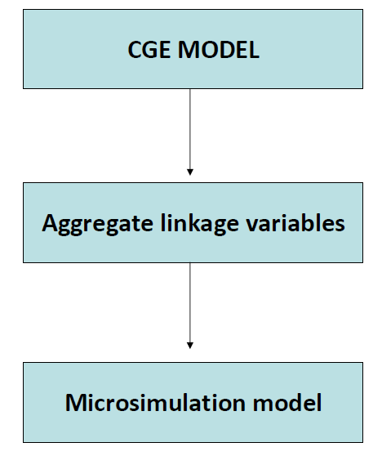
METHODOGICAL ASPECTS
The methodological approach used is a sequential combination of a macro model with a microeconomic model.

Slide 8
METHODOGICAL ASPECTS
We use the reweighting approach, pioneered by Meagher (1993)
The CGE model is the MIRAGE-e 1.1 model (Fontagne, Foure, and Ramos, 2013). This is a multi-sectoral and multi-regional CGE model.
It is able to capture the complex economic interactions taking place between economic agents and within and between countries and sectors.
The MIRAGE model is calibrated with the GTAP 10 database: it gives us the ability to explicitly model 26 African countries with the rest of Africa being aggregated into six blocks of countries.

Slide 9
METHODOGICAL ASPECTS
The microsimulation model captures income distribution and consumption behavior changes across the population based on the estimation of the income probability distribution as proposed by Lee and Judge (1996)..
It is built to capture the changes in the probabilities associated with individual income levels induced by changes in mean (per capita) income through a “generalized entropy” measure.

Slide 10
METHODOGICAL ASPECTS
Considering the limitations of the solver, the regions and activities are aggregated to facilitate the convergence of the CGE model.
The geographical and sectoral aggregation will take into account the quality of the data and the priority sectors in the economic and social development of the African continent.
Among the 30 regions, 18 are African countries, members of the AfCFTA, which were modeled individually
The microsimulation model use household survey data collected from AfCFTA member countries.

Slide 11
GEOGRAPHIC COVERAGE
The AfCFTA scenario considers liberalization of trade in goods, coupled with a 50% reduction in existing actionable restrictions on trade in the five AfCFTA priority services sectors and in health and education services, and a 50% reduction in actionable non-tariff measures (Tariffs + 50%Services + 50%NTMs).

Slide 12
GEOGRAPHIC COVERAGE
RESULTS
Macroeconomic Impact

Slide 13
To be completed

Slide 14
THANK YOU!
www.uneca.org/atpc
Twitter: @atpc2
Facebook: @africantradepolicycentre
Email: eca-atpc@un.org

