Slide 1
Intended and Unintended Impacts of Minimum Wage Change in the Philippines
Deborah Kim Sy
Nobuhiro Hosoe
June 8, 2022

Slide 2
Research Question
Does a rise in minimum wage
affect the economy negatively?
decrease international migration?
improve income inequality?
NO
NO
NO
Policy
2% minimum wage rise
Outcome variables
  Welfare level and inequality
  Sectoral output
  Migration and remittances

Slide 3
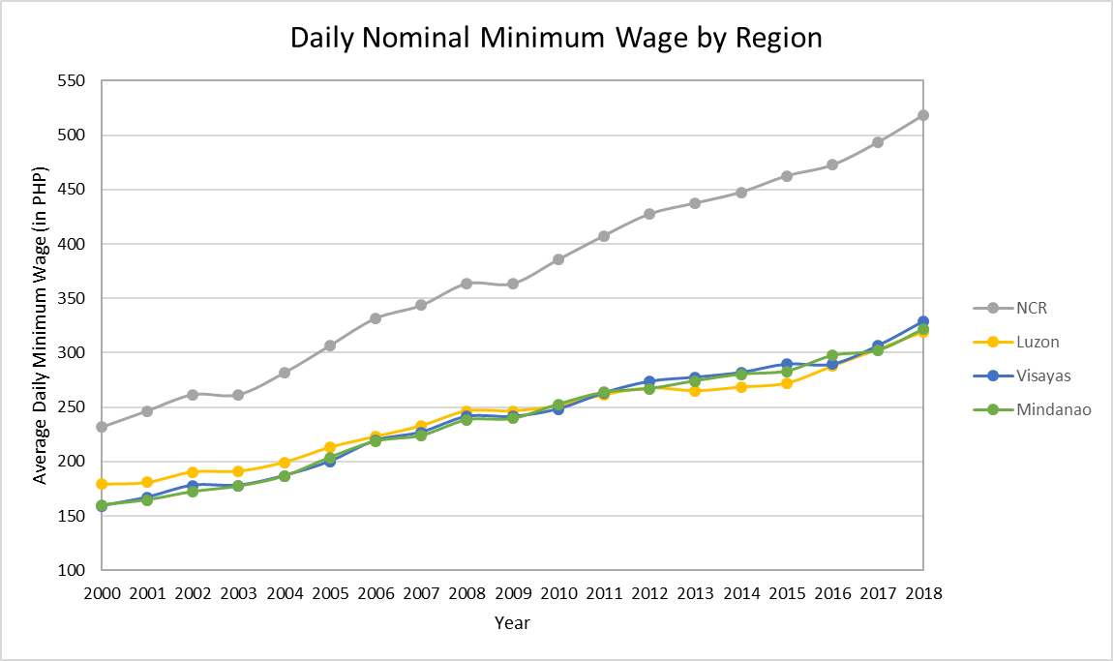
Introduction
Developing countries have
abundant labor but limited
capital
Limited endowments make
allocation crucial
Minimum wage as a tool
  Mandatory minimum wage setting
  Voluntary productivity-based wage
  setting
Theoretically, a rise in minimum wage dampens domestic employment

Slide 4
Introduction
The Philippines is one of the top labor-exporting countries
Migrants brought remittances as large as 8.9% of GDP in 2021
Migration is driven by
  a lack of domestic employment opportunities (OECD, 2017)
  the level of domestic and foreign wages (Pholphirul, 2019; Tabuga, 2018)
Migration may cause brain drain but may also boost remittances, which can cause Dutch Disease

Slide 5
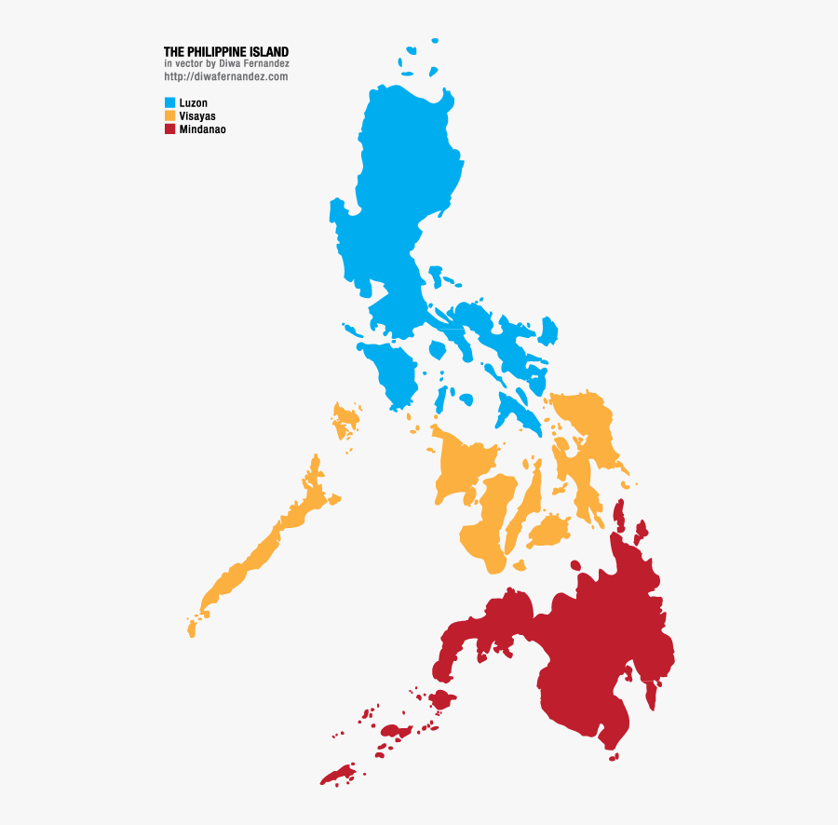
Introduction
There is income inequality among households
Remittances are comparable to non-professional labor income
Migration and remittances can influence households unevenly
Household | Labor Income |  |  |  | Capital Income | Remittance | Total | Total Per Capita Income
 | Professional | Technical | Clerical | Unskilled
NCR | 373 | 187 | 204 | 92 | 904 | 149 | 1,909 | 148,227
Luzon | 539 | 341 | 254 | 426 | 2,427 | 500 | 4,488 | 100,641
Visayas | 185 | 120 | 89 | 180 | 1,018 | 167 | 1,759 | 90,790
Mindanao | 253 | 137 | 117 | 262 | 1,009 | 119 | 1,896 | 78,559
Total | 1,350 | 786 | 63 | 959 | 5,358 | 935 | 10,052
Unit: Billion PHP
Source: Authors’ calculations

Slide 6
Review of Related Literature
Many empirical studies examine the case of marginal workers whose earnings are likely to be as low as the minimum wage (e.g., Card, 1992)
The adjustment of the minimum wage can impact a wider range of workers in the Philippines (Canales, 2014)
Rate of minimum wage compliance was 88% in 2020 according to the Department of Labor and Employment

Slide 7
Review of Related Literature
Migration studies driven by differences in personal income tax rates focus on high-income earners in developed countries (Kleven et al., 2020)
There is two-fold per capita income differential between Filipino households with migrants and those without (Gorodzeisky & Semyonov, 2014)
Migration is driven by foreign minimum wages (Bertoli et al., 2016)

Slide 8
Review of Related Literature
Higher remittances would trigger a currency appreciation (aka Dutch Disease) (Tuano-Amador et al., 2007)
Tradable sectors face cheaper imports and more expensive exports (Tuano-Amador et al., 2007)
Remittances would also initiate labor supply reduction and migration (Bayangos & Jansen, 2011)

Slide 9
Methodology
A static Computable General Equilibrium (CGE) Model with:
9 Sectors
4 Households
  National Capital Region (NCR), Luzon, Visayas, Mindanao
6 Factors
  4 labor : Professional, Technical, Clerical
  and Unskilled Labor
  2 capital : Domestic Capital, Foreign Capital

Slide 10
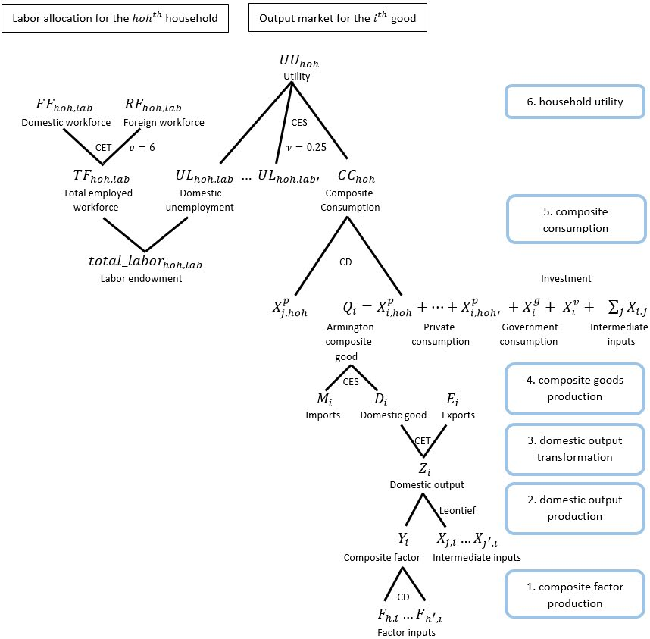
CGE Model
---Standard Features
Standard CGE
  Nested CES/CET
  Small-open
  Perfect competition
  Constant Current Account Deficits
Extensions
  Leisure
  Migration and Remittances

Slide 11
CGE Model
---Labor Market
1st Stage
  Leisure vs. Employment
2nd Stage
  Domestic employment
  vs. Foreign employment (Migration)
    Migrants remit earnings to home

Slide 12
Simulation Scenario---2%
 | Real Minimum Wage Change (in percent)
Year | NCR | Luzon | Visayas | Mindanao
2011 | 1.3 | -0.3 | 1.6 | 0.0
2012 | 1.2 | -1.2 | 0.3 | -2.3
2013 | -0.4 | -3.6 | -1.3 | -0.0
2014 | -0.3 | -1.3 | -1.0 | -0.4
2015 | 2.3 | 0.3 | 1.7 | -0.0
2016 | 0.6 | 4.1 | -1.6 | 3.4
2017 | 2.0 | 2.9 | 3.5 | -0.8
2018 | 0.9 | 1 | 3.1 | 2.3
Average | 0.56
The nominal minimum wage is deflated by the Core CPI
Rather than 0.56%,
a more aggressive
2% is assumed for
non-professional
labor
Source: Authors’ calculations

Slide 13
Simulation Results---Output
2% increase in non-professional wage
Sectors with non-professional labor-intensive technology will be more affected
Manufacturing and other primary sector would experience lower output
Service sector only suffered a small decrease in output
Sector description | Labor input share of non-professional workers | Simulation Results
 |  | Change in output (in percent) | Change in exports (in percent) | Change in imports (in percent)
Manufacturing | 23% | -2.2 | -3.1 | 0.3
Other primary sector | 17% | -1.1 | -1.9 | -0.0
Agriculture | 45% | -0.8 | -2.5 | 1.2
Wholesale and retail trade | 21% | -0.6 | -1.0 | -0.0
Food and beverages | 14% | -0.5 | -1.2 | 0.3
Petroleum | 13% | -0.5 | -0.9 | -0.1
Services | 25% | -0.3 | -0.9 | 0.4
Transportation and storage | 7% | -0.3 | -0.6 | 0.1
Finance | 18% | -0.3 | -0.2 | 0.4
Source: Column 2 is based on FIES data.

Slide 14
Simulation Results---Employment
2% increase in non-professional wage
Non-professional workers lose jobs in a similar scale
Professional labor suffers slight collateral damage
Workers in Luzon and Visayas would be more inclined to migrate
Household | Change in Domestic Labor (in percent)
 | Professional labor |  |  | Technical labor |  |  | Clerical Labor |  |  | Unskilled labor
 | Emp | Unemp | Mig | Emp | Unemp | Mig | Emp | Unemp | Mig | Emp | Unemp | Mig
NCR | -0.02 | 0.01 | 0.02 | -0.36 | 0.01 | 0.34 | -0.33 | 0.02 | 0.31 | -0.42 | 0.02 | 0.40
Luzon | -0.03 | 0.00 | 0.03 | -0.45 | 0.01 | 0.45 | -0.56 | 0.01 | 0.55 | -0.57 | 0.01 | 0.55
Visayas | -0.03 | 0.00 | 0.03 | -0.49 | 0.00 | 0.48 | -0.42 | 0.01 | 0.41 | -0.39 | 0.01 | 0.37
Mindanao | -0.02 | 0.00 | 0.02 | -0.36 | 0.01 | 0.35 | -0.39 | 0.01 | 0.38 | -0.38 | 0.01 | 0.36

Slide 15
Simulation Results---Welfare (EVs)
2% increase in non-professional wage
NCR gains the most, followed by Mindanao, Luzon and Visayas
Gini coefficient would worsen to 0.7023 from 0.7021
 |  |  | Simulation Results
 | EV |  | Per Capita Income change (PHP)
Household | Per capita (PHP) | Percent of initial income | Professional labor | Technical labor | Clerical labor | Unskilled labor | Capital | Remittance | Total
NCR | 217 | 0.17 | -146 | -21 | 39 | -16 | -423 | 685 | 118
Luzon | 60 | 0.08 | -67 | -73 | -79 | -100 | -328 | 665 | 18
Visayas | 35 | 0.05 | -52 | -99 | -10 | 10 | -317 | 468 | -0
Mindanao | 108 | 0.16 | -50 | 2 | 1 | 20 | -252 | 376 | 98

Slide 16
Simulation Results---by Income Source
2% increase in non-professional wage
NCR had largest losses in professional labor and domestic capital income
Mindanao had moderate gains in technical, clerical and unskilled labor
Luzon and Visayas received moderate remittance income gains at the expense of domestic labor incomes
 |  |  | Simulation Results
 | EV |  | Per Capita Income change (PHP)
Household | Per capita (PHP) | Percent of initial income | Professional labor | Technical labor | Clerical labor | Unskilled labor | Capital | Remittance | Total
NCR | 217 | 0.17 | -146 | -21 | 39 | -16 | -423 | 685 | 118
Luzon | 60 | 0.08 | -67 | -73 | -79 | -100 | -328 | 665 | 18
Visayas | 35 | 0.05 | -52 | -99 | -10 | 10 | -317 | 468 | -0
Mindanao | 108 | 0.16 | -50 | 2 | 1 | 20 | -252 | 376 | 98

Slide 17
Simulation Results---Tax Revenues
2% increase in non-professional wage
Effect on Government Budget
  Shift to migrant remittance income would erode one of the major tax base
  Migration reduces domestic labor resources leading to losses in indirect taxes
  Unintended tax revenue losses should be considered part of its policy costs

Slide 18
Conclusion
The consequences of a higher minimum wage:
Manufacturing and other primary sector would suffer the most in terms of output
Domestic employment would decrease as expected
The unintended effects:
Currency appreciation would harm domestic industries
Welfare of all household groups would improve due to remittances
Higher remittances would exacerbate household income disparity
Migration and remittances would also erode major tax base

Slide 19
References
Bayangos, V. & Jansen, K. (2011). Remittances and competitiveness: The case of the Philippines. World Development, 39(10), 1834-1846.
Bertoli, S., Moraga, J., & Keita, S. (2016). The elasticity of the migrant labor supply: evidence from temporary Filipino migrants. IZA Discussion Paper Series No. 10031.
Canales, K. (2014). The effects of a minimum wage on employment outcomes: An application of regression discontinuity design. Philippine Review of Economics, 51(2), 97-120.
Card, D. (1992). Using regional variation in wages to measure the effects of the federal minimum wage. Industrial and Labor Relations Review, 46(1), 22-37.
Gorodzeisky, A. & Semyonov, M. (2017). Making a living in two labor markets: earnings of Filipinos in the global and the domestic economy. Research in Social Stratification and Mobility, 37, 77-89.
Hosoe, N., Gasawa, K. & Hashimoto, H. (2010). Textbook of Computable General Equilibrium Modelling: Programming and Simulations. Palgrave McMillan.
Kleven, H., Landais, C., Munoz, M. & Stantcheva, S. (2020). Taxation and migration: Evidence and policy implications. Journal of Economic Perspectives, 34(2), 119-142.
McNelis, P. D., Glindro, E. T., Co, F. S. & Dakila, F. G. J. (2009). Macroeconomic model for policy analysis and insight (a Dynamic Stochastic General Equilibrium model for the Bangko Sentral ng Pilipinas). In BSP Working Paper Series (No. 2009-01; Bangko Sentral ng Pilipinas Working Paper Series, Issues 2009-01).
Organization of Economic Co-operation and Development/ Scalabrini Migration Center. (2017). Interrelations between public policies, migration and development in the Philippines. OECD Publishing. https://doi.org/10.1787/9789264272286-en
Pholphirul, P. (2019). South-south labour migration and sustainable development: Implications for Southeast Asian countries. Sustainable Development, 27(1), 1-12.
Tabuga, A. D. (2018). A probe into the Filipino migration culture: What is there to learn for policy intervention? (No. 2018-02; Philippine Institute for Development Studies Discussion Paper Series).
Tuano-Amador, M. C. N., Claveria, R. A., Co, F. S. & Delloro, V. K. (2007). Philippine overseas workers and migrants’ remittances: The Dutch disease question and cyclicality issue. Bangko Sentral Review, 1(1), 23.

