Slide 1
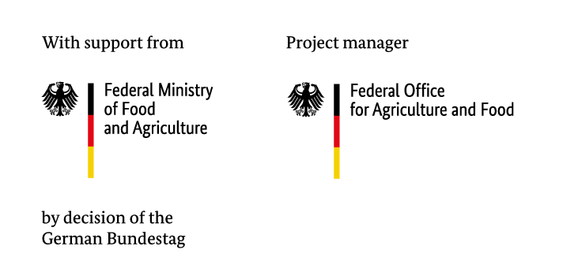



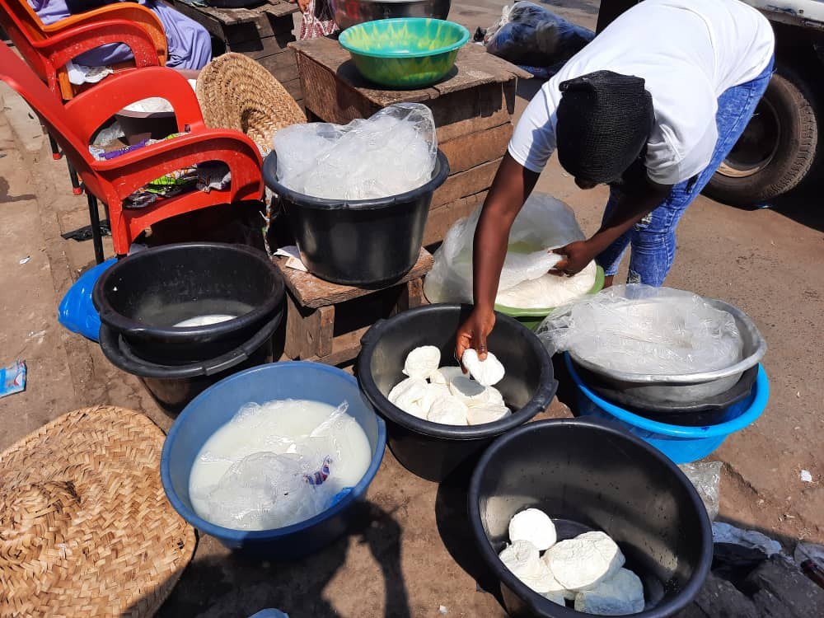
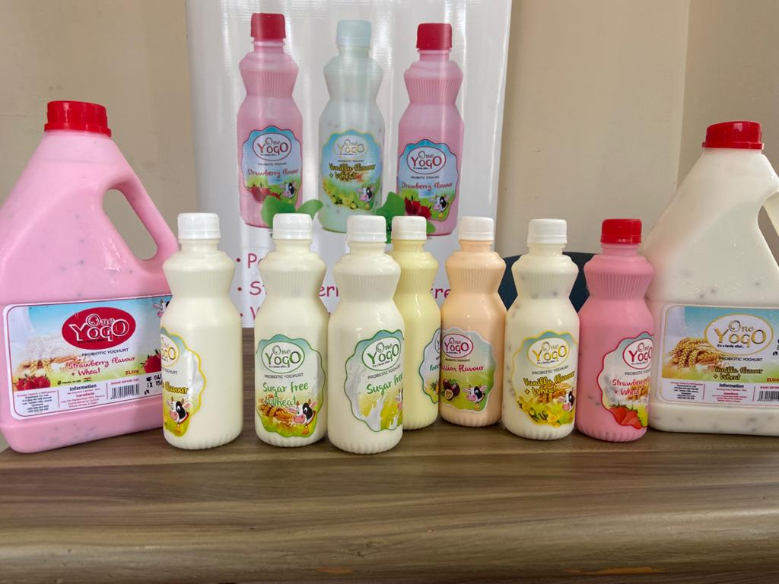
25th Annual Conference on Global Economic Analysis
Consumer behaviour towards dairy products: a cross-cultural analysis of products from three origins in Ghana and Senegal
Mavis Boimah, Thuenen Institute, Braunschweig, Germany
June 2022

Slide 2
Introduction
European dairy companies are expanding their operations in developing nations - West Africa in particular
The fast-growing dairy sector in this region makes it one of the most important among other sectors
Exports include cheese, ultra-pasteurized milk, evaporated milk, ice creams, yoghurts, and milk powder (Boimah, Weible, & Weber, 2021)
Besides, the processing industry that relies on milk powder has seen a significant growth over the last two decades (Corniaux, 2018; Oppong-Apane, 2016)

Slide 3
Introduction Cont’d.
In contrast, local milk production developed slightly or remained stagnant over the years (Zamani, Pelikan, & Schott, 2021)
This has drawn the attention of some international organizations and civil society activists
-associated the retarded growth of the local dairy sectors to the operations of European dairies in the region (e.g., Magnani, Ancey, & Hubert, 2019; Broutin, Levard, & Goudiaby, 2018; Orasmaa, Duteurtre, & Corniaux, 2016)

Slide 4
Introduction Cont’d.
Researchers over the years have placed emphasis on analyzing the dairy value chains in West Africa (e.g., Boimah, Weible, & Weber, 2021; Guri, Ameleke, & Karbo, 2018; Oppong-Apane, 2016; Corniaux, 2018; Corniaux, 2017; Corniaux & Duteurtre, 2014; Duteurtre & Corniaux, 2013)
Consumers are neglected in these studies
Dairy consumption in West Africa is diversified with a more or less segmented market with three different types of products; local, domestic and imported

Slide 5
Objectives of the study
In view of the growing criticisms and a highly competitive world market;
-it is of interest to analyze consumption habits with respect to the three different origins of dairy products in West Africa;
Identify the frequency at which yoghurt in general is consumed and the factors that determine consumption rates
To verify the influence of origin on consumer behaviour, we identify in addition to socio-demographic factors, the role of consumer attitudes and perceptions
We assess the results from the two countries to see if notable differences exist in consumer behaviour towards the three origins of yoghurt

Slide 6

Data and Method of Analysis
Primary, cross-sectional data:
Ghana – 312
Senegal – 532
Methods:
Descriptive statistics
Quantitative methods: ordered probit and logit models
Factor analysis-PCA
©Thünen, Boimah 2022

Slide 7
Dairy consumption frequency in households
 | Ghana |  | Senegal
Frequency |  | % |  | %
Four times a week or more |  | 52.6 |  | 91.2
2-3 times a week |  | 23.4 |  | 6.6
Once a week |  | 5.4 |  | 1.7
2-3 times a month |  | 5.1 |  | -
Once a month |  | 3.5 |  | -
Occasionally |  | 9.9 |  | 0.6
Never |  | - |  | -
Total

Slide 8
Products consumed by households (%)

Slide 9
Yoghurt consumption frequency

Slide 10
Factors influencing yoghurt consumption frequency - Ghana
 | 4x/week and more | 2-3x/week | once/week | 2-3x/month | Once/month | Occasionally | Never
Pred. Prob. | 0.20 | 0.22 | 0.10 | 0.11 | 0.06 | 0.26 | 0.05
Gender | 0.009 | 0.004 | 0.003 | -0.001 | -0.001 | -0.008 | -0.006
Married | -0.017 | -0.008 | -0.001 | 0.001 | 0.002 | -0.016 | 0.007
Tertiary | 0.137** | 0.061** | 0.005 | -0.010 | -0.013* | -0.130** | -0.050**
Age | 0.002 | 0.001 | 0.001 | -0.002 | -0.001 | -0.002 | 0.001
Employed | -0.105** | -0.047** | -0.004 | 0.008 | 0.010* | 0.100** | 0.038*
High income | 0.056* | 0.025 | 0.002 | -0.004 | -0.005 | -0.054* | -0.020
Childless18 | -0.007 | -0.003 | -0.001 | 0.001 | 0.001 | 0.008 | -0.001
Hhsize | -0.003 | -0.001 | -0.001 | 0.002 | 0.002 | 0.003 | -0.002

Slide 11
Factors influencing yoghurt consumption frequency - Senegal
 | 4x/week and more | 2-3x/week | once/week | 2-3x/month | once/month | Occasionally | Never
Pred. Prob. | 0.05 | 0.11 | 0.07 | 0.05 | 0.01 | 0.24 | 0.47
Gender | -0.001 | -0.001 | -0.002 | -0.001 | -0.002 | -0.003 | 0.010
Married | -0.018 | -0.029 | -0.012 | -0.001 | -0.001 | -0.012 | 0.073
Tertiary | 0.010 | 0.017 | 0.007 | 0.004 | 0.001 | 0.007 | -0.046
Age | 0.001 | 0.002 | 0.001 | 0.006 | 0.001 | 0.001 | -0.012
Employed | -0.005 | -0.008 | -0.003 | -0.002 | -0.004 | -0.003 | 0.025
High income | 0.029*** | 0.046*** | 0.019*** | 0.011*** | 0.002* | 0.019** | -0.126***
Childless18 | 0.047** | 0.077** | 0.033** | 0.019** | 0.003 | 0.032* | -0.211**
Hhsize | -0.001 | -0.002 | -0.001 | -0.004 | -0.002 | -0.003 | 0.013

Slide 12
Yoghurt consumption frequency based on origin
 | Ghana |  |  | Senegal
 | Local | Domestic | Imported | Local | Domestic | Imported
Frequency | % | % | % | % | % | %
Four times a week or more | 1.5 | 14.2 | 4.4 | 1.8 | 2.1 | 1.4
2-3 times a week | 6.8 | 28.8 | 10.5 | 6.1 | 13.2 | 10.0
Once a week | 5.8 | 8.5 | 3.4 | 19.6 | 13.2 | 6.0
2-3 times a month | 6.5 | 8.8 | 6.1 | 8.9 | 7.8 | 7.8
Once a month | 6.5 | 8.1 | 7.5 | 6.8 | 2.8 | 2.5
Occasionally | 26.2 | 27.8 | 30.3 | 42.9 | 47.7 | 54.1
Never | 43.2 | 3.7 | 37.8 | 13.9 | 13.2 | 18.1

Slide 13
Factors influencing yoghurt consumption by origin-Ghana
VARIABLES | Local | Domestic | Imported
Gender | 0.306(0.295) | -0.167(0.275) | 0.226(0.322)
Married | 0.186(0.311) | 0.134(0.313) | -0.307(0.314)
Tertiary | 1.329(0.343)*** | 0.731(0.319)** | 1.360(0.327)***
Age | 0.024(0.0116)** | -0.014(0.012) | 0.018(0.013)
Employed | -0.458(0.318) | -0.774(0.308)** | -0.296(0.305)
High-income (>551€) | 0.477(0.241)** | 0.446(0.230)* | 1.210(0.354)***
Childless18 | -0.609(0.300)** | -0.259(0.359) | -0.181(0.351)
Hhsize | 0.123(0.0434)*** | 0.002(0.044) | 0.001(0.033)
Hygiene and safety concerns (local products) | -0.501(0.129)*** | 0.256(0.134)* | 0.079(0.140)
Local advocates (ethnocentrism) | 0.134(0.139) | 0.037(0.123) | 0.483(0.147)***
Low value add. and less diverse local products | -0.376(0.139)*** | 0.054(0.129) | -0.066(0.143)
Wald chi2(11) Prob > chi2 Log-pseudo like. Pseudo R2 | 54.19 0.0000 -178.50025 0.1722 | 18.06 0.0801 -182.86967 0.0504 | 62.38 0.0000 -171.06157 0.1914

Slide 14
Factors influencing yoghurt consumption by origin-Senegal
VARIABLES | Local | Domestic | Imported
Gender | 0.036(0.232) | 0.037(0.231) | 0.052(0.233)
Married | -0.333(0.275) | -0.474(0.273)* | -0.145(0.261)
Tertiary | 0.271(0.243) | -0.040(0.237) | 0.226(0.244)
Age | 0.001(0.008) | 0.180(0.008) | -0.010(0.007)
Employed | -0.089(0.333) | -0.246(0.325) | -0.157(0.325)
High-income (>168€) | 0.276(0.161)* | 0.353(0.152)** | 0.269(0.160)*
Childless18 | 0.968(0.323)*** | 0.976(0.335)*** | 1.079(0.336)***
Hhsize | -0.016(0.021) | 0.006(0.020) | -0.002(0.021)
Hygiene and safety concerns (local products) | 0.357(0.104)*** | 0.329(0.0998)*** | 0.462(0.104)***
Local advocates (ethnocentrism) | 0.267(0.094)*** | 0.210(0.096)** | 0.187(0.096)*
Low value add. and less diverse local products | -0.440(0.103)*** | 0.499(0.105)*** | 0.382(0.104)***
High accessibility and affordability of imported products | 0.616(0.106)*** | 0.691(0.111)*** | 0.729(0.112)***
Wald chi2(12) Prob > chi2 Log-pseudo like. Pseudo R2 | 86.48 0.0000 -320.07994 0.1304 | 89.37 0.0000 -315.15289 0.1393 | 94.90 0.0000 -313.35106 0.1381

Slide 15
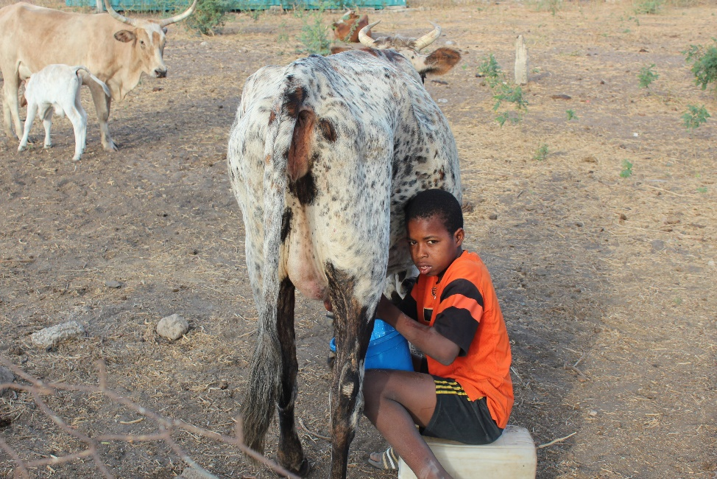
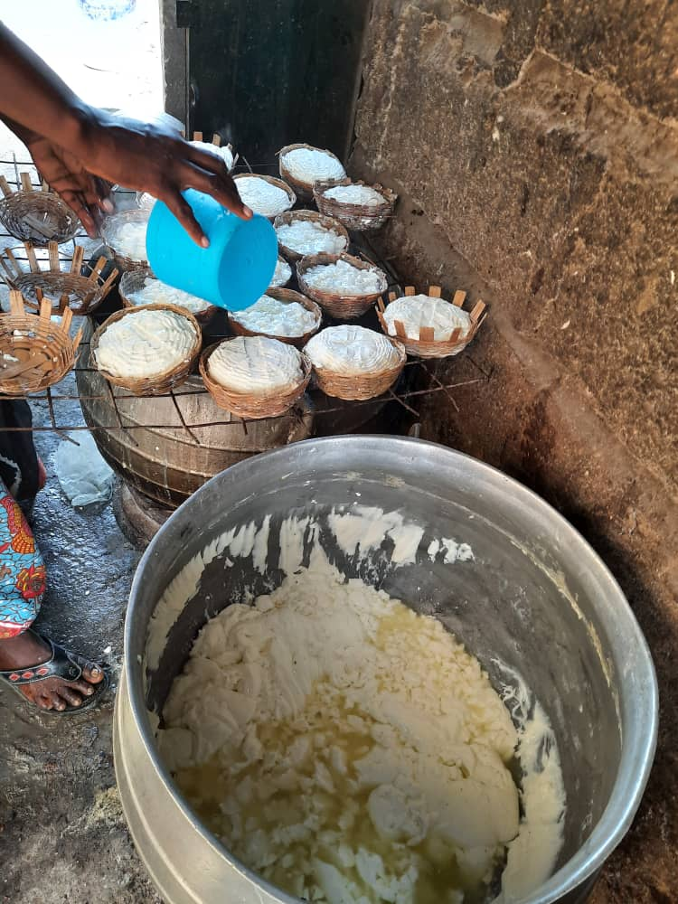
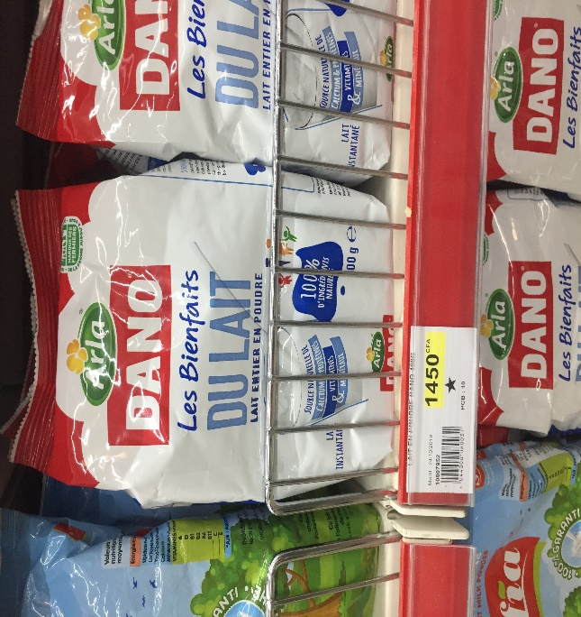

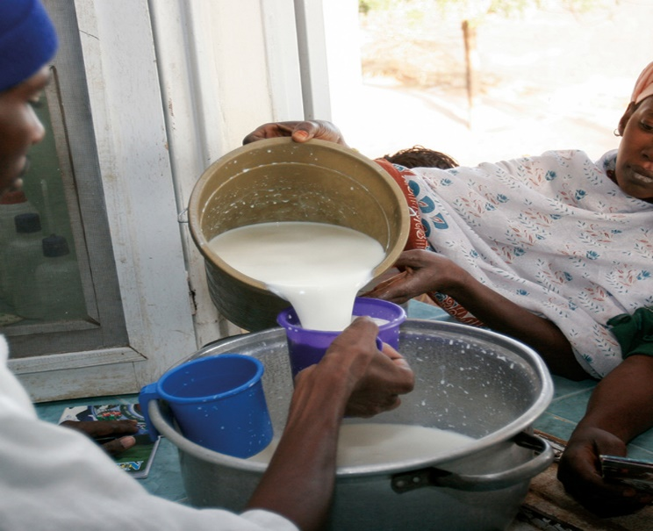
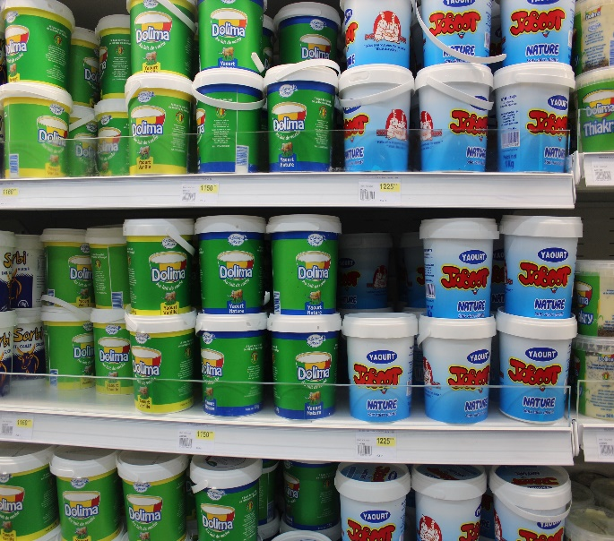
Some pictures
©STEPRI, Awuni 2021 & Lemonde.fr
©Thünen, Weible 2020

Slide 16
Conclusions and Recommendations
Consumption of yoghurt from the three origins are largely determined by socio-demographic factors and consumer perceptions and attitudes
Hygiene and safety concerns did not have a negative influence on local yoghurt consumption in Senegal as expected
-This shows that food safety indicators play a minimal role in food choice in some developing countries
However, proper handling of fresh milk all through the value chain is essential in preventing foodborne illnesses

Slide 17
Conclusions and Recommendations
On one hand, ethnocentric attitudes are displayed and expected to influence choice of local over domestic and imported yoghurts
On the other hand, a significant positive influence of ethnocentrism is seen on the consumption of domestic and imported yoghurts, revealing an “attitude-behaviour gap” in both countries.
As mentioned by consumers, imported and domestic dairy products are “more available” and “more affordable”
We assume that “product availability” plays a central role in the choice of dairy products and in the frequency of consumption, and in this case domestic and imported dairy products are favoured, consistent with Boimah & Weible (2021)

Slide 18
Conclusions and Recommendations
Moreover, consumers would prefer to have more high value-added local dairy products with quality packaging and labelling that meets the standards of imported and domestic dairy products;
-The local dairy value chain actors should consider it as an opportunity to increase revenues and hence profits noting that consumers are willing to pay higher prices for local products
From a broader lens, imported dairy products especially milk powder contribute to ensuring food security in developing countries
Imports, milk powder in particular to developing countries should therefore not be blamed entirely on EU exporters but should be considered as a “necessary evil” in meeting consumer demands

Slide 19

Thanks for your attention

Slide 20
References
Boimah, M., & Weible, D. (2021). “We Prefer Local but Consume Imported”: Results from a Qualitative Study of Dairy Consumers in Senegal. Journal of International Food and Agribusiness Marketing, 0(0), 1–17. https://doi.org/10.1080/08974438.2021.1986453
Broutin, C., Levard, L., Goudiaby, M. (2018). Quelles politiques commerciales pour la promotion de la filière " lait local " en Afrique de l ’ Ouest ? Rapport de synthèse. Paris, Gret, 100 Pages.
Corniaux C., Duteurtre G., B. C. (2014). Filières laitières et développement de l’élevage en Afrique de l’Ouest - L’essor des minilaiteries. Karthala (p. 252). p. 252.
Corniaux, Christian. (2017). Situation et potentiel du secteur laitier au Burkina Faso. CIRAD-Département ES.
Corniaux, C. (2018). Etat des filières laitières dans les 15 pays de la CEDEAO , de la Mauritanie et du Tchad Annexe 11 : Fiche Sénégal.
Guri, B.Z., Ameleke, G., Karbo, N. (2018). Etat des filières laitières dans les 15 pays de la CEDEAO , de la Mauritanie et du Tchad Annexe 5 : Fiche Ghana. CIRAD, Campus de Baillarguet 34 398 Montpellier Cedex 05, France.
Magnani, S. D., Ancey, V., & Hubert, B. (2019). Dairy Policy in Senegal: The Need to Overcome a Technical Mindset. The European Journal of Development Research, 31(5), 1227–1245. https://doi.org/10.1057/s41287-019-00208-4
Oppong-Apane, K. (2016). Review of the Livestock/Meat and Milk Value Chains and Policy Influencing them in Ghana. In Food and Agriculture Organisation of the United Nations.
Orasmaa, T., Duteurtre, G., & Corniaux, C. (2016). The end of EU milk quotas - implications in West Africa: Literature review and future perspectives. CIRAD. Retrieved from https://agritrop.cirad.fr/584599/1/The_end_of_EU_milk_quotas_2016.pdf
Zamani, O., Pelikan, J., & Schott, J. (2021). EU-Exports of livestock products to West Africa: An analysis of dairy and poultry trade data. Johann Heinrich von Thünen-Institut, 42p, Thünen Working Paper 162.

