Slide 1


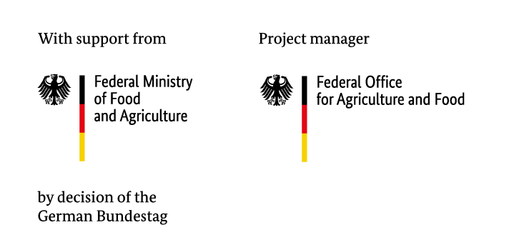

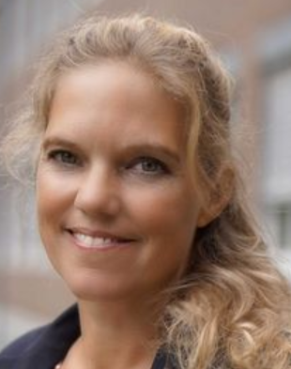
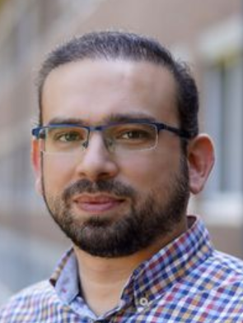


25th Annual Conference on Global Economic Analysis
Why did the chicken cross the border? Assessing the competitiveness of broiler production in Ghana and Germany
Craig Chibanda Petra Thobe Mohamad .I.Almadani Claus Deblitz Stephen Awuni
Thünen Institute of Farm Economics
June 2022

Slide 2
Background
Chicken meat consumption in Ghana has increased , however, local production is failing to keep up with the growing demand.
Consequently, Ghana is highly dependent on frozen chicken imports as it imports an estimated 65 % of its total poultry meat supply (Asante-Addo and Weible 2019).
Germany is one of the European Union (EU) countries that exports frozen whole chickens and chicken pieces to west African countries (including Ghana).

Slide 3
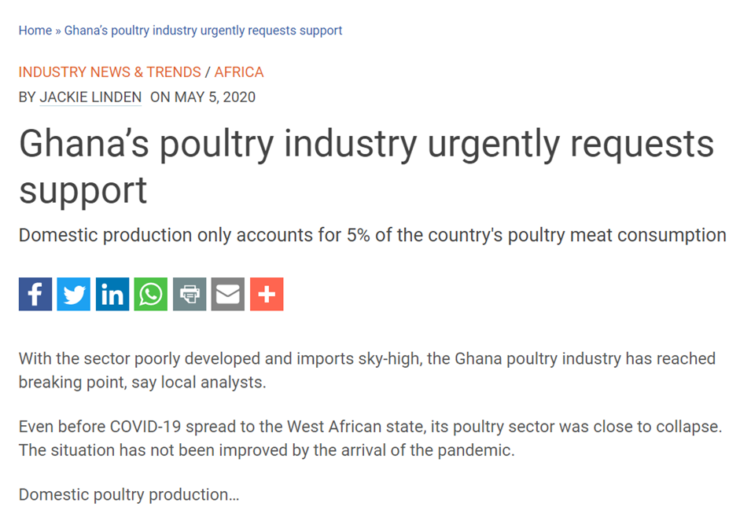
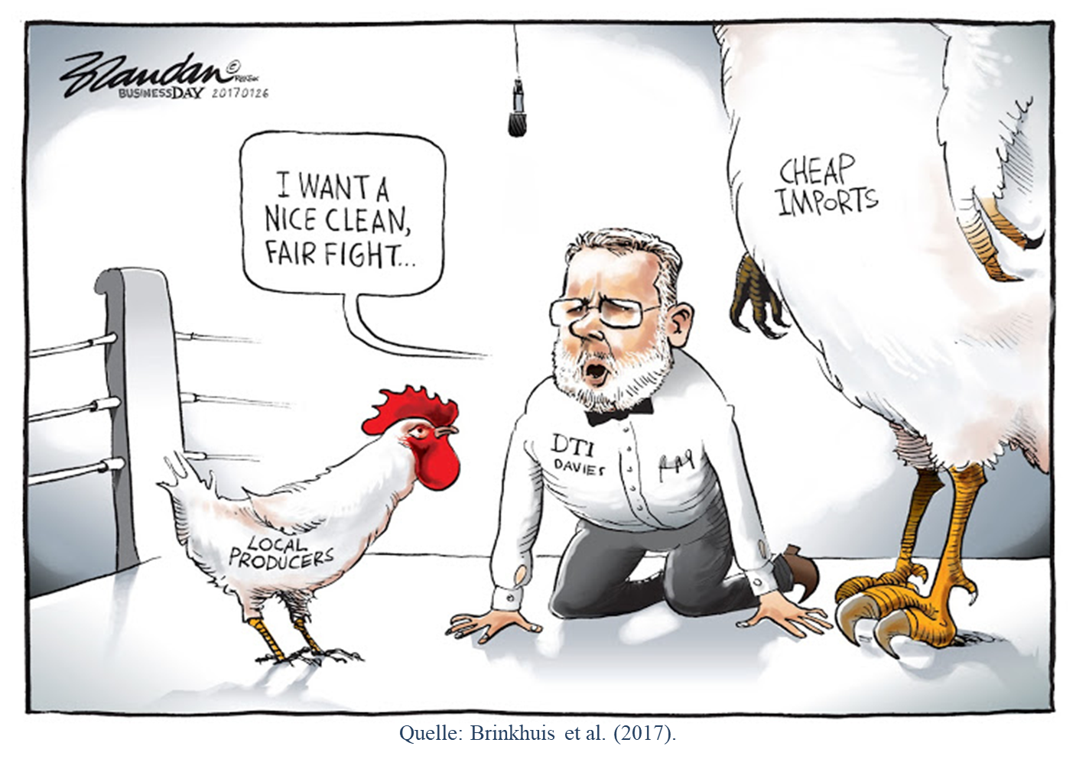
Background
Ghana’s dependency on frozen chicken imports has resulted in the imports becoming a subject of significant criticism.
“How is it possible that EU countries are able to export frozen chicken meat to Ghana at such low prices and still make a profit?”.
Source: Brinkhuis et al. (2017).

Slide 4
Background
Matthews and Soldi (2019) explain that EU countries like Germany are able to export frozen chicken cuts to African countries at low prices because EU consumers prefer to consume chicken breasts, therefore, other parts are either exported or processed into pet food.
This explanation does not address why large quantities of frozen whole “full” chickens are also exported to west Africa at a lower price than those produced locally.

Slide 5
Background
Our research examines whether the differences in farm performance and production costs between Ghanaian and German conventional broiler farms could also explain why German full chicken exports to Ghana are cheaper.
The farm level analysis complements the analyses made with CGE and PE models (see Zamani et al. (2022)) .

Slide 6
Materials and Methods
The research was conducted within the framework of the Typical Farm Approach.
Chibanda et al. (2020) define the approach as a method for developing empirically grounded farm data sets through the use of expert interviews, focus groups and farm observations.

Slide 7
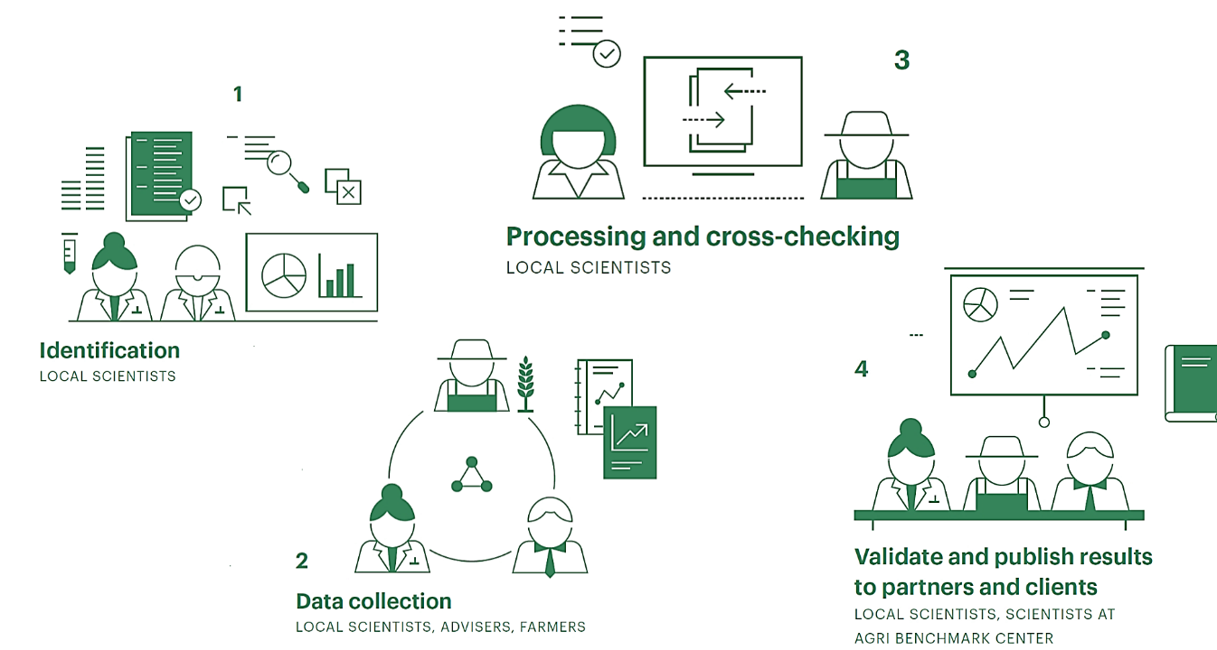
Materials and Methods
Typical Farm Approach: A method for developing empirically grounded farm data sets.
Source: Chibanda et al. (2020).

Slide 8
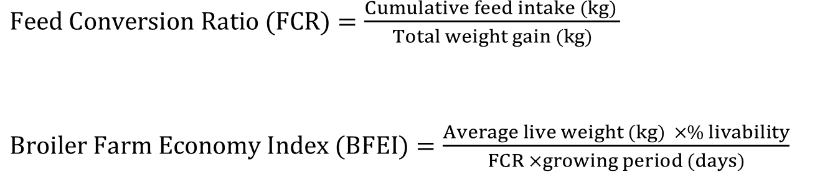
Materials and Methods
The Technology Impact Policy Impact Calculations (TIPI-CAL), a computer-based policy impact assessment tool, was used to analyze the typical farm data. Broiler Farm Economy Index (BFEI)
$Feed Conversion Ratio (FCR)=\frac{Cumulative feed intake (kg) }{Total weight gain (kg)}$
$Broiler Farm Economy Index (BFEI)=\frac{Average live weight (kg) ×\% livability}{FCR ×growing period (days)}$

Slide 9
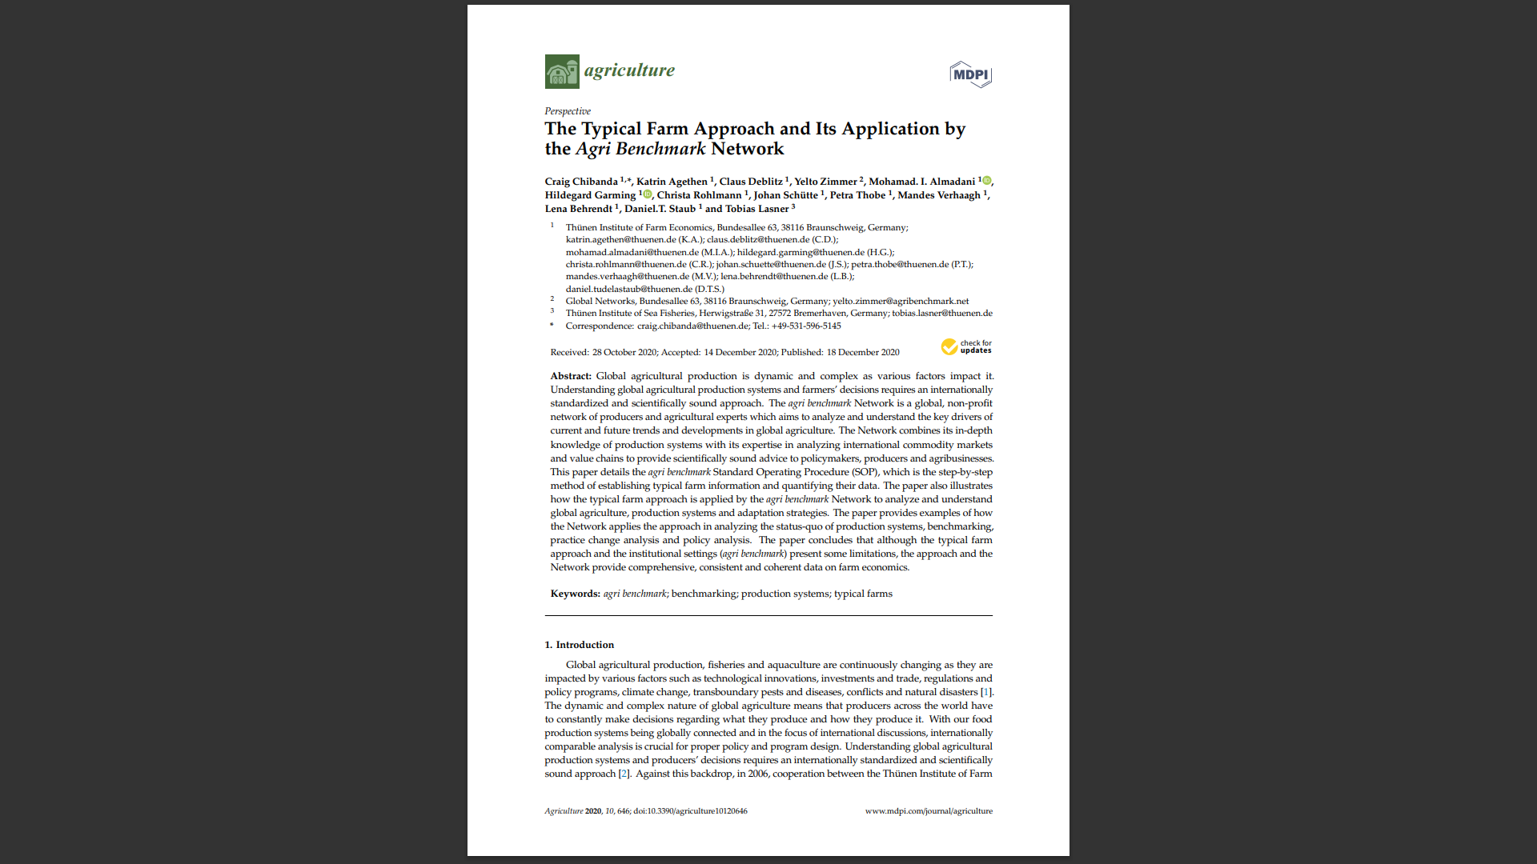
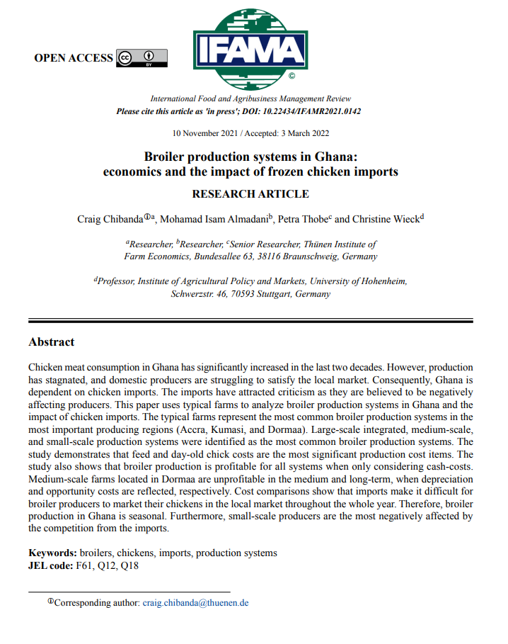
Materials and Methods

Slide 10

Results
Characteristics of the typical conventional broiler farms in Ghana and Germany
Farm name | GH_3 | GH_12 | GH_27 | DE_994
Production system | Small scale system | Medium scale system | Large scale integrated system | Highly vertically integrated system
Location | Accra | Dormaa | Kumasi | Lingen
Chickens sold/year | 3,613 | 12,086 | 27,000 | 994,826
Genotype | Ross 308 | Cobb 500 | Cobb 500 | Ross 308
Origin of day-old chicks | Imported from the Netherlands | Imported from Ivory Coast | Hatchery belonging to the farm | Contractual arrangement with a hatchery
Biosecurity measures | Low to moderate | Moderate | Moderate to high | Very high
Type of housing | Open, naturally ventilated poultry houses. | Open, naturally ventilated poultry houses. | Open, naturally ventilated poultry houses. | Environmentally controlled housing (closed barns)
Marketing channels | Sells live birds to individuals at the farmgate or at live bird markets. | Sells live birds in live bird markets. Rarely, the birds are slaughtered and sold to fast-food shops. | Slaughters its birds and sells them to retailers and restaurants. | Birds are sold to a slaughterhouse which has a contractual arrangement with the farm
Source: Own survey and calculations

Slide 11

Results
Farm performance indicators
 | GH_3k | GH_12k | GH_27k | DE_994k
Feed conversion ratios (FCR) | 2.43 | 2.08 | 2.33 | 1.56
Broiler Farm Economy Index (BFEI) | 1.90 | 2.01 | 2.03 | 3.99
Mortalities (%) | 2.88 | 4.08 | 10.00 | 1.80
Feeding period (days) | 63.00 | 45.50 | 42.00 | 42.00
Final live weight (g) | 3,000 | 2,200 | 2,000 | 2,672
Number of cycles per year | 3.72 | 3.00 | 3.00 | 7.45
Poor quality locally hatched DOCs
Low-quality feed
Poor poultry husbandry practices.
Source: Own survey and calculations

Slide 12
Results
Comparison of production costs (€/100 kg live weight)
Source: Own survey and calculations

Slide 13
Results
Comparison of total returns and profitability (€/100 kg live weight)
Source: Own survey and calculations

Slide 14
Conclusion and recommendations
The farm economic analysis revealed that the typical German conventional broiler farm (DE_994k) has better farm performance than the Ghanaian farms.
Germany's typical conventional broiler farm produces full chickens at half the cost of Ghana's farms.
Of which, the high broiler production costs in Ghana are driven by high feed and DOCs costs.

Slide 15
Conclusion and recommendations
Broiler farms in Ghana will need to reduce their costs of production so that locally produced chicken meat can compete with frozen chicken imports in terms of prices. More specifically, feed and DOCs costs will have to be reduced.

Slide 16

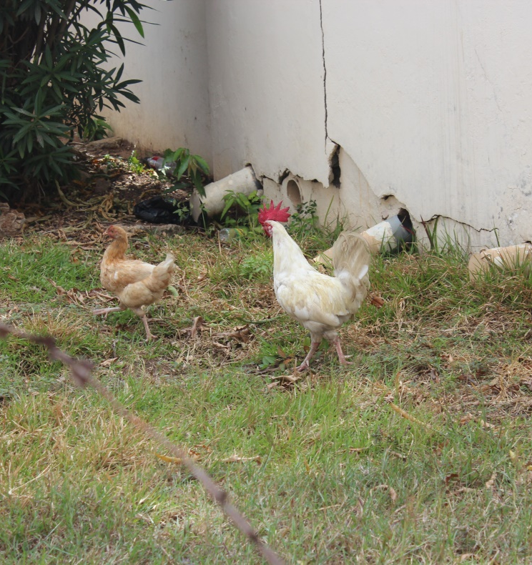
Thank you for your attention.
Craig Chibanda
Thünen Institute of Farm Economics
Bundesallee 63
38116 Braunschweig, Germany
Tel.: +49-531-596-5145/5130
Fax: +49-531-596-5199
E-mail: craig.chibanda@thuenen.de
Internet: www.thuenen.de/en/bw/
©Thünen, IMMPEX 2019

Slide 17
References
Amanor-Boadu, V; Nti, F K; Ross., K (2016): Structure of Ghana's Chicken Industry in 2015. De-partment of Agricultural Economics, Kansas State University. Manhattan.
Asante-Addo, C; Weible, D (2019): “Everybody Likes Chicken”-A Focus Group Study on Consumers in Ghana. German Association of Agricultural Economists (GEWISOLA) (No. 292291).
Chibanda, Craig; Agethen, Katrin; Deblitz, Claus; Zimmer, Yelto; Almadani, Mohamad. I.; Garming, Hildegard et al. (2020): The Typical Farm Approach and Its Application by the Agri Bench-mark Network. In Agriculture 10 (12), p. 646. DOI: 10.3390/agriculture10120646.
Chibanda, Craig; Almadani, Mohamad Isam; Thobe, Petra; Wieck, Christine (2022): Broiler pro-duction systems in Ghana: economics and the impact of frozen chicken imports. In International Food and Agribusiness Management Review (IFAMR) "In press". DOI: 10.22434/IFAMR2021.0142.

Slide 18
References
Lasner, Tobias (2020): "Being Typical" - The representative farms method in aquaculture and fisheries. In Mediterranean Fisheries and Aquaculture Research (MedFAR)) 3 (2).
Matthews, A; Soldi, R (2019): Evaluation of the impact of the current CAP on the agriculture of developing countries. Progress Consulting S.r.l Report. European Union and the Committee of the Regions.
Zamani, O; Pelikan, J; Schott, J (2021): EU-Exports of livestock products to West Africa: An analysis of dairy and poultry trade data. Thünen Working Paper. Braunschweig (162).
Zamani, O.; Chibanda, C.; Pelikan, J. (2022): Impacts of Import Restrictions on Poultry Producers in Ghana. In Q Open. DOI: 10.1093/qopen/qoac007.

