Slide 1


Using Throughflow Based Accounting framework with GTAP to untangle the global trade of externalities
Étienne Berthet¹,Timothé Beaufils^{2,3}
¹ Section for Quantitative Sustainability Assessment, Department of Technology, Management and Economics, Technical University of Denmark, 2800 Kongens Lyngby, Denmark;
² Research Department of Complexity Science, Potsdam Institute for Climate Impact Research, 14473 Potsdam, Germany;
³ Institute of Physics, Potsdam University, 14469 Potsdam, Germany;

Slide 2
Content
How the GTPA database is currently used in the Global Value Chain analysis
  Measuring trade externalities using MRIOT
  Reshaping GTAP as MRIO tables
  MRIO Recent devlopments
The Throughflow Based Accounting (TBA)
  Formal introduction
  Decomposition
Study cases
  Results comparision between GTAP and EORA
  The East Asia area GHG throughflow
Conclusion

Slide 3
1. How GTPA is currently used in the Global Value Chain analysis

Slide 4
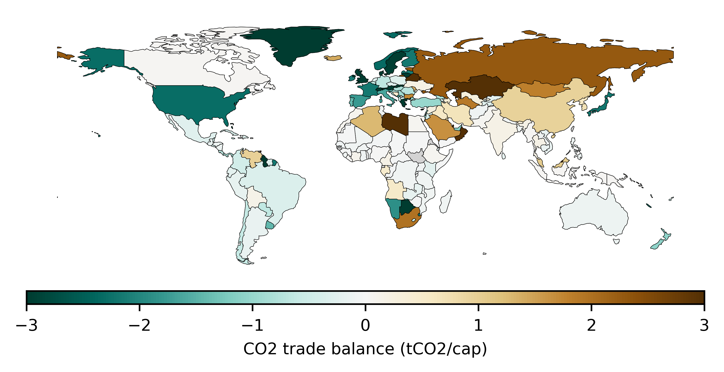
Supply chains: multiple linkages among sectors and countries
Current globalized economy is characterized by production processes that are:
  long,
  complex
  fragmented
  often international
Local externalities may occur to produce commodities consumed elsewhere:
  GHG emissions
  Deforestation
  Social impacts
  Value added
  etc…
Source: EORA 2015, PRIMAP
Notes:
Our current globalized economy is characterized by long, complex and often international production processes.
Due to the geographical disconnection between the production process and the consumption, an externality can be generated in a country for a consumption in country B.
Those externalities are usually measured by: env. externalities, social externalities or economic externalities.

Slide 5
Usually represented in a simple commodity flow….
Producer
Externality
Consumer
Commodity flow
Notes:
The traditional accounting way present

Slide 6
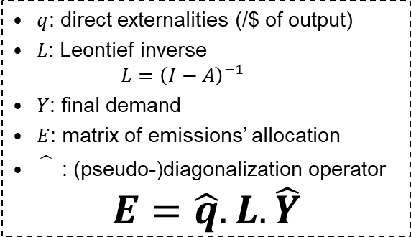


…. where externalities are measured using usual MRIO accounting frameworks…
Producer
$q$: direct externalities (/$ of output)
$L$: Leontief inverse
$L={\left(I−A\right)}^{−1}$
$Y$: final demand
$E$: matrix of emissions’ allocation
: (pseudo-)diagonalization operator
$$E=\hat{q}.L.\hat{Y}$$
Externality
Production Based Accounting (PBA)
$$PBA=E.e=Q$$
Consumer
Commodity flow
Consumption Based Accounting (CBA)
$$CBA=e.E$$
Notes:
The traditional accounting way present

Slide 7
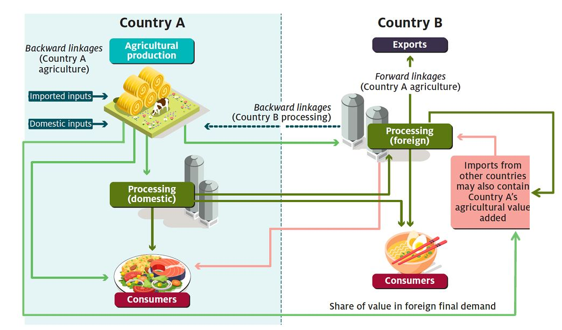
…. but the reality is a bit more complex.
Producer
Intermediate
Consumer
Source: Greenville, 2019
Notes:
Before being used at their final destination, commodities usually undergo numerous transformation steps, which involve different industries located in different countries. This complexity blurs contributions to the joint production effort and therefore dilutes responsibilities for the generation of externalities.
Over 50% of trade in goods takes place in intermediates, reflecting the fact that countries use foreign intermediate inputs to produce exports so that the destinations of exports do not always coincide with the final markets of consumption. Traditional trade statistics do not provide information on the actual patterns of production behind world trade since the value added exported by a country does not coincide with the value of that country’s exports because exports contain value added from other countries. Moreover, imports have a domestic content given by the contribution of domestic firms exporting intermediate inputs which are processed abroad and then imported back. Finally, gross recording of trade flows does not account for backward/forward trade, i.e., trade in value added between two countries occurring via a third country.

Slide 8
How to measure this the role of those intermediates in the global trade of externalities?
Producer
Externality
GVC: Global Value Chain Analysis
Intermediate
Consumer
Commodity flow

Slide 9
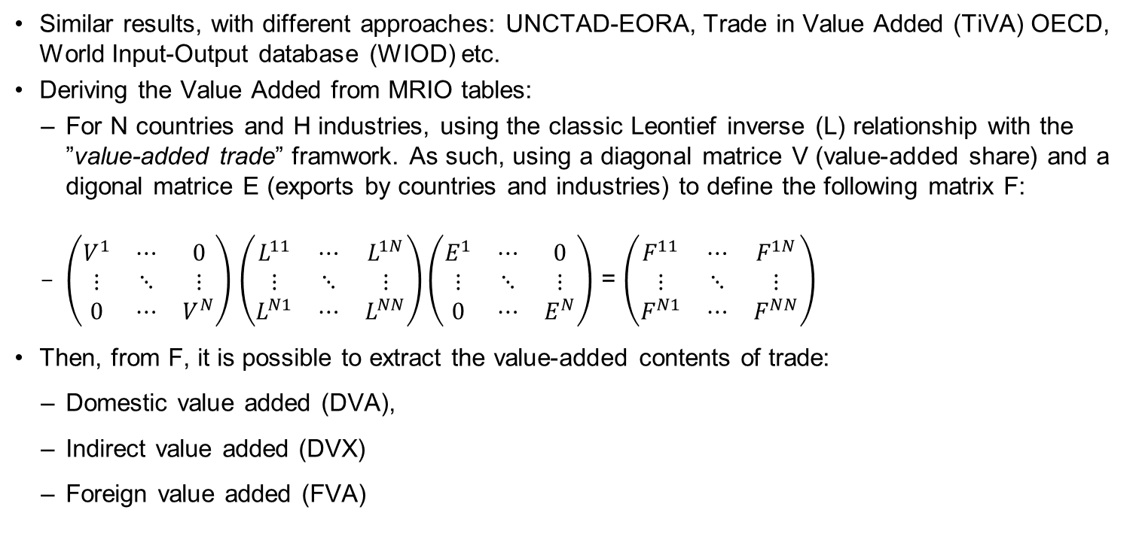
Different MRIO approaches have been previously developpped
Similar results, with different approaches: UNCTAD-EORA, Trade in Value Added (TiVA) OECD, World Input-Output database (WIOD) etc.
Deriving the Value Added from MRIO tables:
  For N countries and H industries, using the classic Leontief inverse (L) relationship with the ”value-added trade” framwork. As such, using a diagonal matrice V (value-added share) and a digonal matrice E (exports by countries and industries) to define the following matrix F:
  $\left(\begin{matrix}V^{1} & ⋯ & 0 \\ ⋮ & ⋱ & ⋮ \\ 0 & ⋯ & V^{N}\end{matrix}\right)$ $\left(\begin{matrix}L^{11} & ⋯ & L^{1N} \\ ⋮ & ⋱ & ⋮ \\ L^{N1} & ⋯ & L^{NN}\end{matrix}\right)\left(\begin{matrix}E^{1} & ⋯ & 0 \\ ⋮ & ⋱ & ⋮ \\ 0 & ⋯ & E^{N}\end{matrix}\right)$ = $\left(\begin{matrix}F^{11} & ⋯ & F^{1N} \\ ⋮ & ⋱ & ⋮ \\ F^{N1} & ⋯ & F^{NN}\end{matrix}\right)$
Then, from F, it is possible to extract the value-added contents of trade:
  Domestic value added (DVA),
  Indirect value added (DVX)
  Foreign value added (FVA)

Slide 10
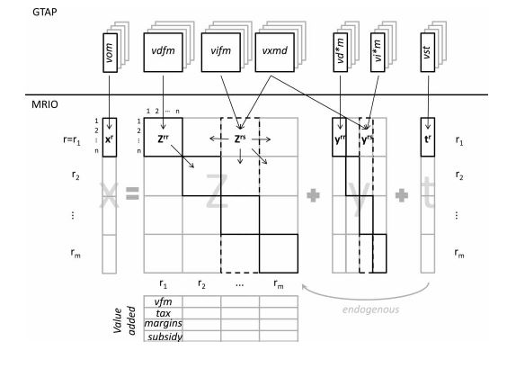
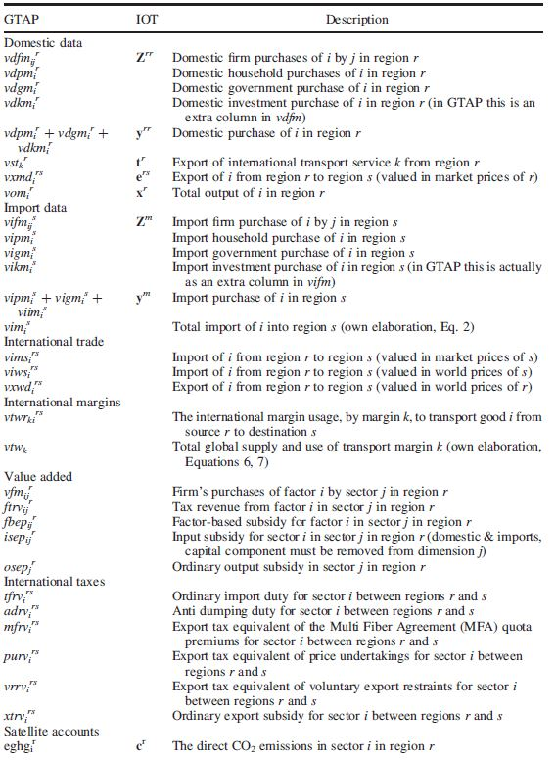
And adapted to GTAP: GTAP-VA
Source: Peter et al., 2011
Two proportionality assumptions:
At the border to split final goods and inputs
Behind the border to allocate inputs across industries.
Notes:
While these models all include both cross-industry and cross-country input-output linkages, they treat cross-country linkages in a stylized way: they assume that industry-level bilateral final and intermediate trade shares are identical, and that the allocation of imported inputs across sectors is the same as the allocation of domestic inputs. This amounts to applying two proportionality assumptions, one at the border to split final goods and inputs and another behind the border to allocate inputs across industries. In practice, neither assumption holds in available input-output data sets. To match observed expenditure allocations exactly, one needs to introduce more flexibility– e.g., additional frictions or technology differences
At the expense of stating the obvious, the construction of WIOTs – by such initiatives as the GTAP, OECD-ICIO, Eora, and WIOD – is an extensive undertaking, to harmonize and merge domestic input-output tables for many countries. The key substantive challenge here is how to credibly populate the off-diagonal block entries of a WIOT, that relay the crucial information on cross-country, cross-industry linkages. From domestic tables, what one observes is the value of imports by country-j, industry-s of goods from industry-r, but aggregated across source countries, that is respectively: (i) used as an input, ∑i≠jZijrs; and (ii) absorbed in final-use, ∑i≠jFijr. To then apportion these flows across source countries i, the standard approach is to adopt proportionality assumptions; these take the form: Z˜ijrs=ωijr∑i≠jZijrs and F˜ijr=ωijr∑i≠jFijr, where the ωijr's are suitably chosen weights. For example, Johnson and Noguera (2012) set ωijr equal to the share of imports from i in country j's total industry-r imports, while Trefler and Zhu (2010) express these imports as a share of j's absorption (output less net exports) in industry r.¹⁶
More recent WIOTs have sought to improve on this standard methodology, with a key step being to construct different proportionality weights ωijr for flows of imported intermediates and final goods respectively. This has been achieved by bringing in the UN Broad Economic Categories (BEC) classification, together with detailed product-level trade flows, to distinguish between imported products that are intermediates versus final goods. The WIOD (Dietzenbacher et al., 2013), the OECD-ICIO (Koopman et al., 2014), as well as the most recent GTAP editions (Carrico et al., 2020) have each implemented this approach.¹⁷ While clearly an improvement, note that a common set of ωijr weights continues to be applied to imports of inputs across all purchasing industries s in country j; in other words, the source-country shares of automobile products purchased by say the Automobile manufacturing industry would be identical to that purchased by the Transportation services industry. Moreover, direct information on the composition of imports of services by end-uses is even more challenging to obtain, which necessitates further assumptions.

Slide 11
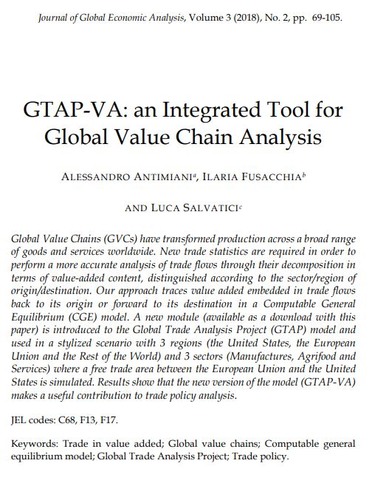
And adapted to GTAP: GTAP-VA
As such, GTAP-VA is an efficient tool to perform Global Value Chain (GVC) Analysis with GTAP data.
However, the GTAP-VA us based on the decomposition of intermediate bilateral trade flows and exclusively focus on the value added embodied in global trade flows.
The last MRIO developments about the analysis of analysis of global value chains can be used for a flow-based GVC analysis to investigate the structure of interdependencies in the global trade network.
Therefore, it is interesting to apply those last developments to the GTAP database.

Slide 12
The last MRIO developments about the analysis of analysis of global value chains
Income Based Accounting (Liang et al, 2017)
  Supply driven version of the CBA
Betweenness Based Accounting (Liang et al, 2016)
  Network-based approach
Hypothetical Extraction (Tokito et al, 2020; Hanaka et al, 2021)
  Throughflow Based Accounting (Beaufils et al, 2022): TBA

Slide 13
2. The Throughflow Based Accounting (TBA) framework

Slide 14

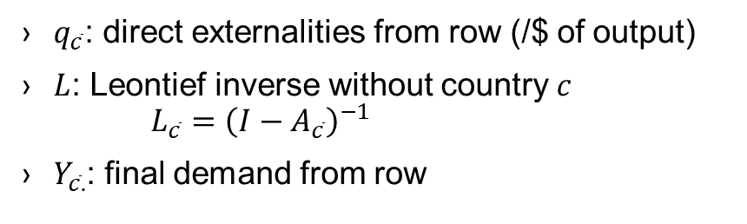

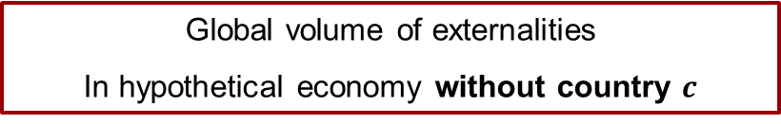

Hypothetical Extraction
From (Beaufils et al, 2022), global externalities in absence of country $c$
$$HE_{c}=q.L.Y−q_{\overline{c}}.L_{\overline{c}}.Y_{\overline{c}.}$$
Global volume of externalities
Global volume of externalities
In hypothetical economy without country $c$
$q$: direct externalities (/$ of output)
$L$: Leontief inverse
$L={\left(I−A\right)}^{−1}$
$Y$: final demand
$q_{\overline{c}}$: direct externalities from row (/$ of output)
$L$: Leontief inverse without country $c$
$L_{\overline{c}}={\left(I−A_{\overline{c}}\right)}^{−1}$
$Y_{\overline{c}.}$: final demand from row

Slide 15
The throughflow
From (Beaufils et al, 2022) and based on interpretation from (Tokito et al, 2020)
Externalities embodied in supply chains
    Starting from country c
    Passing through country c
    Ending in country c
$$TBA_{c}=HE_{c}=q.L.Y−q_{\overline{c}}.L_{\overline{c}}.Y_{\overline{c}.}$$

Slide 16
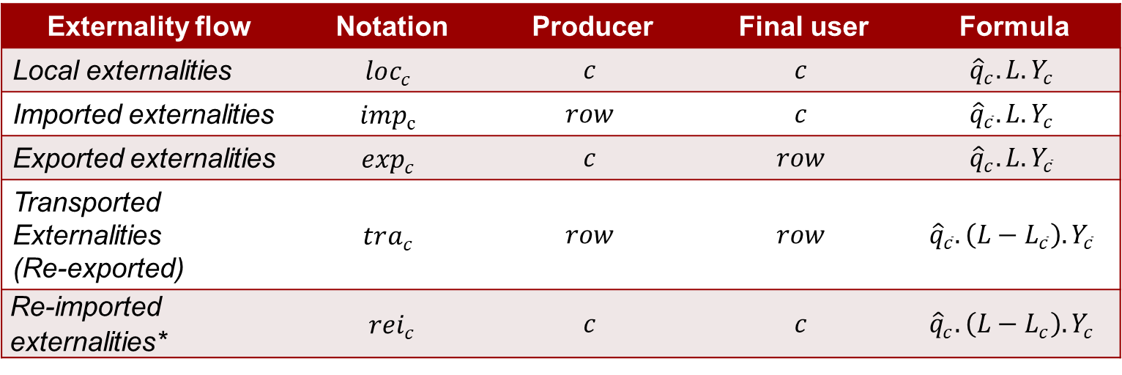
Decomposition of the throughflow
From (Beaufils et al, 2022) and Building on (Hanaka et al, 2021)
$$TBA_{c}=loc_{c}+imp_{c}+\exp_{c}+tra_{c}$$
Externality flow | Notation | Producer | Final user | Formula
Local externalities | $$loc_{c}$$ | $$c$$ | $$c$$ | $${\hat{q}}_{c}.L.Y_{c}$$
Imported externalities | $$imp_{c}$$ | $$row$$ | $$c$$ | $${\hat{q}}_{\overline{c}}.L.Y_{c}$$
Exported externalities | $$\exp_{c}$$ | $$c$$ | $$row$$ | $${\hat{q}}_{c}.L.Y_{\overline{c}}$$
Transported Externalities (Re-exported) | $$tra_{c}$$ | $$row$$ | $$row$$ | $${\hat{q}}_{\overline{c}}.\left(L−L_{\overline{c}}\right).Y_{\overline{c}}$$
Re-imported externalities* | $${rei}_{c}$$ | $$c$$ | $$c$$ | $${\hat{q}}_{c}.\left(L−L_{c}\right).Y_{c}$$
*embodied in local externality flow
Source: Beaufils et al, 2022

Slide 17
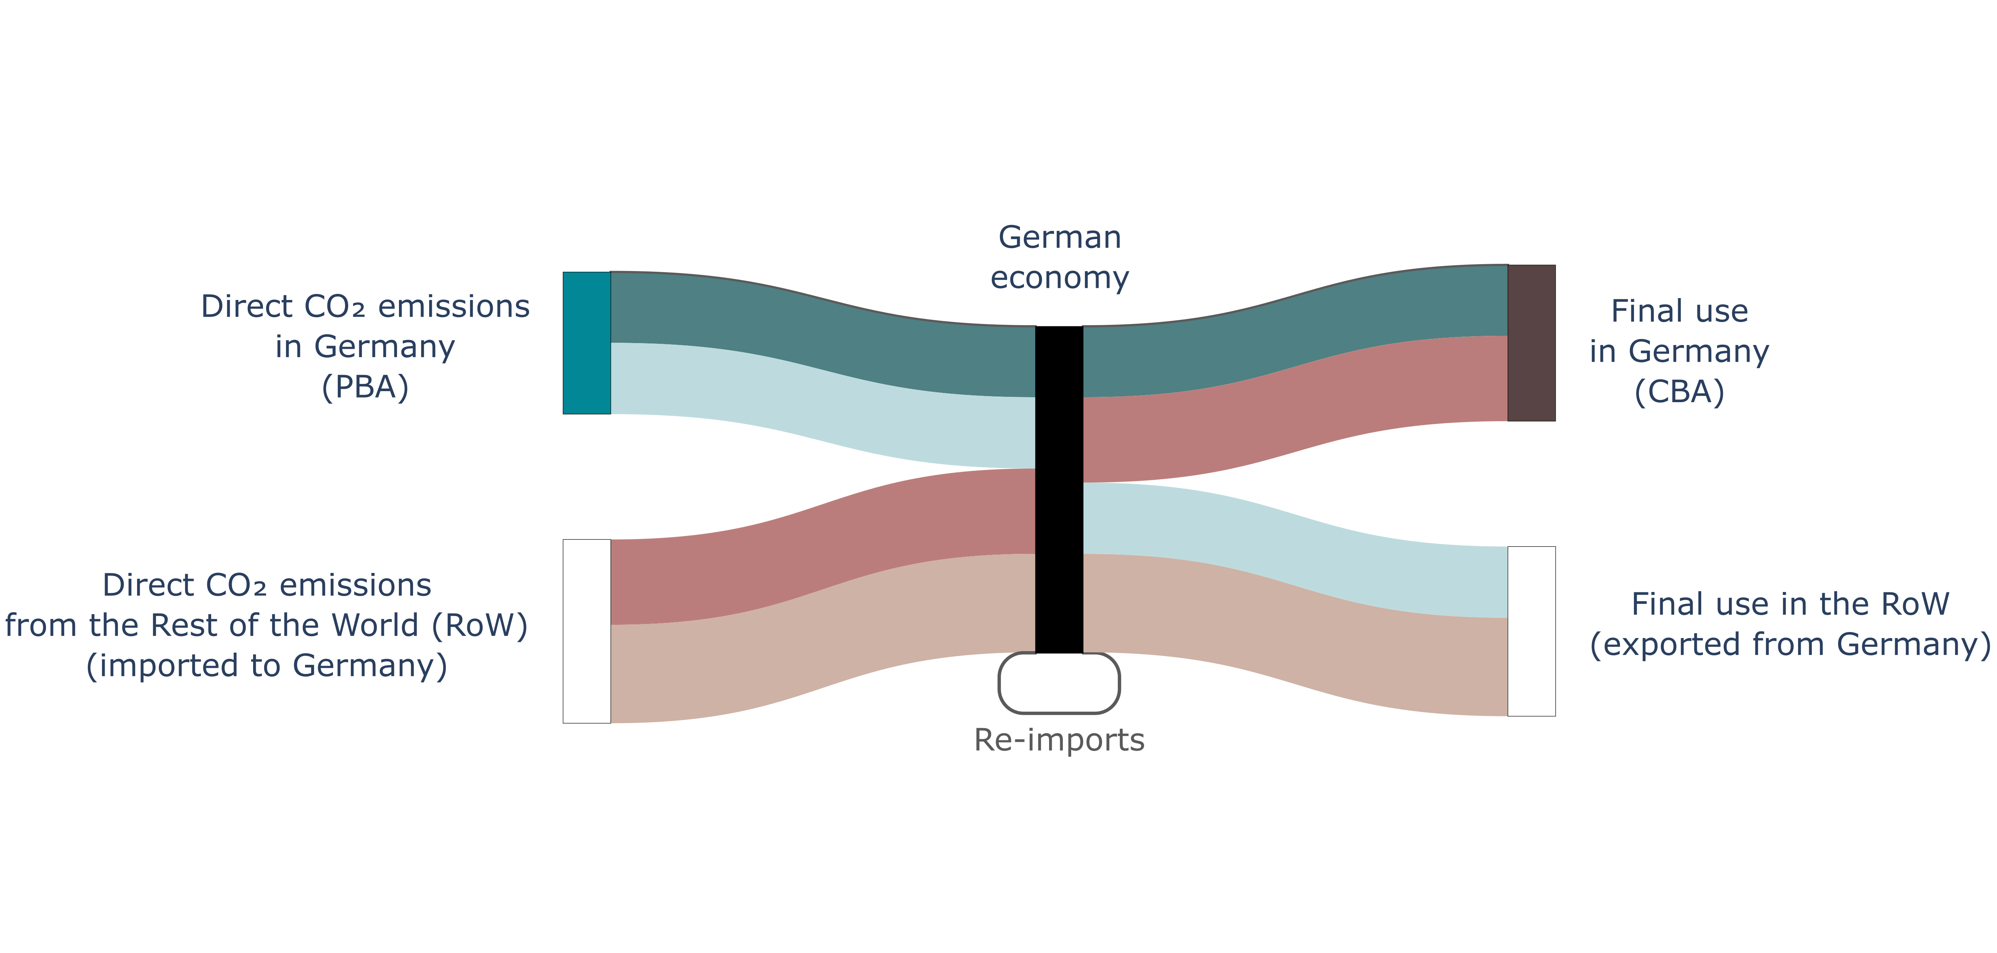
Illustration with one country
Source: Beaufils et al, 2022

Slide 18
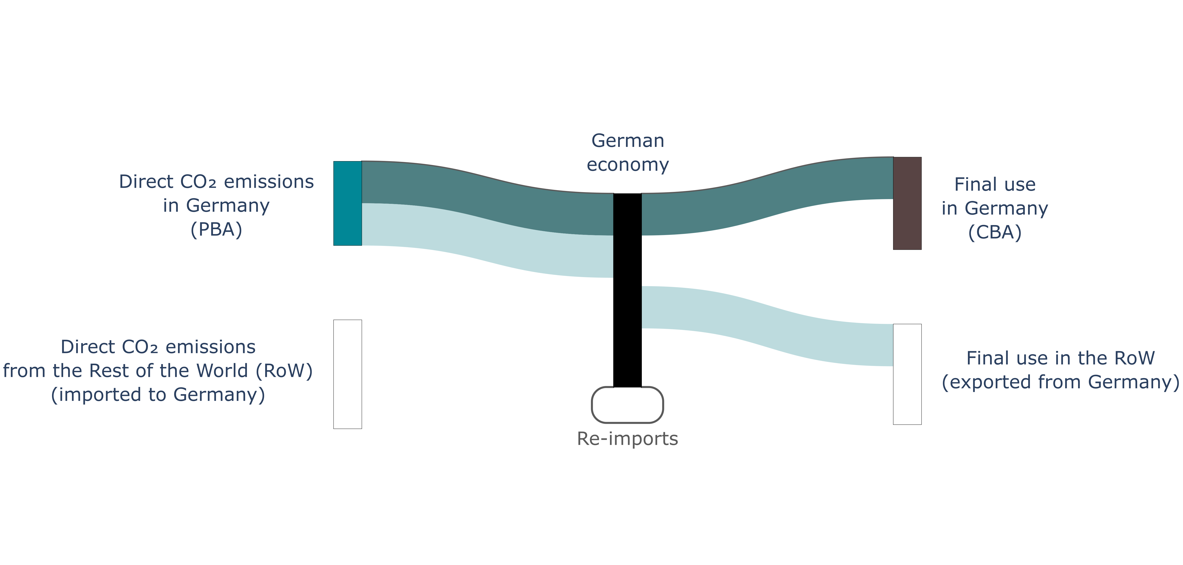
Illustration with one country
Source: Beaufils et al, 2022

Slide 19
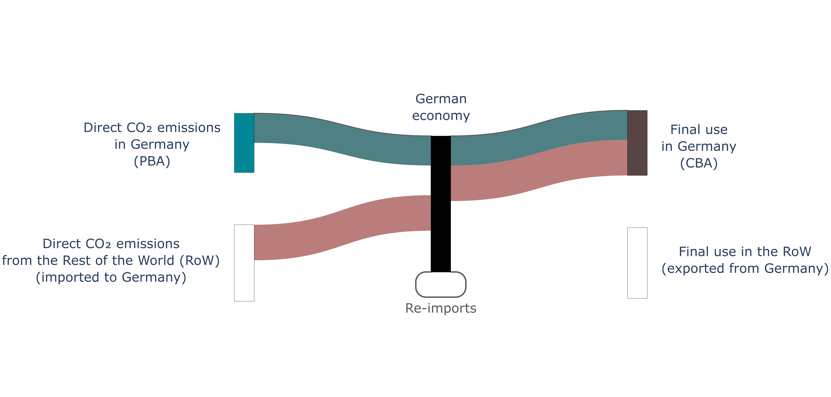
Illustration with one country
Source: Beaufils et al, 2022

Slide 20
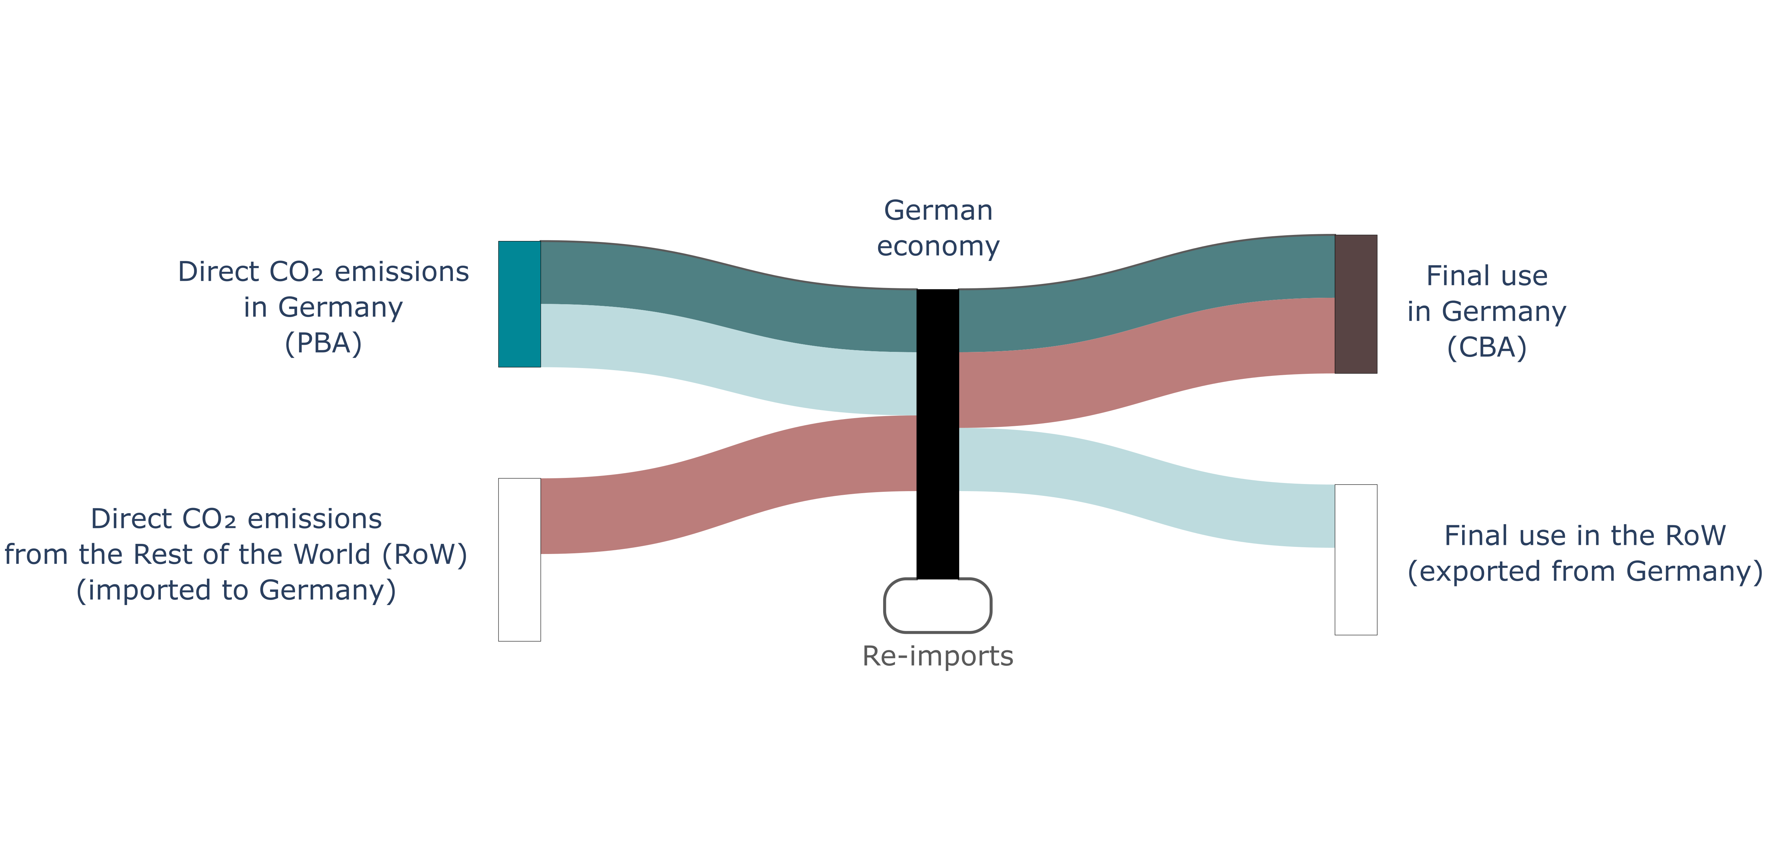
Illustration with one country
Source: Beaufils et al, 2022

Slide 21
Illustration with one country
Source: Beaufils et al, 2022

Slide 22
3. Application of the TBA to the GTAP database, study cases

Slide 23
GTAP data
Using the data from GTAP-MRIO: extension of the standard GTAP Data Base by additionally distinguishing bilateral trade and tariff flows by agents or so-called end-users: firms, private household, government and investors.
Year: 2014
10 areas
Oceania
EastAsia
SEAsia
SouthAsia
NAmerica
LatinAmer
EU_28
MENA
SSA
RestofWorld
10 sectors
GrainsCrops
MeatLstk
Extraction
ProcFood
TextWapp
LightMnfc
HeavyMnfc
Util_Cons
TransComm
OthServices

Slide 24
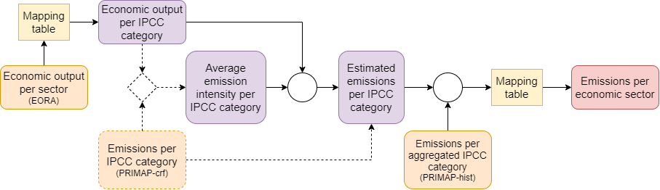
Externality analyzed: Greenhouse gas (GHG)
Emission form the PRIMAP database
Global warming potential (GWP): fourth Assessment Report (AR4)
Greenhouse gases listed in Kyoto protocol
Results expressed in CO2e.
GTAP
Source: Beaufils et al, 2022

Slide 25
Applying the TBA framework to GTAP
Reshaping as MRIO
Integrating GHG environmental externality
Getting the results

Slide 26
GTAP Results

Slide 27
Comparison of the results between GTAP and EORA

Slide 28
GTAP Results – detailed by category

Slide 29
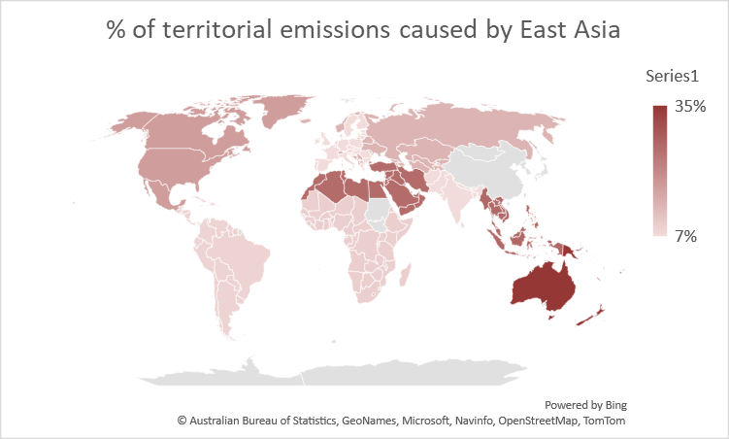
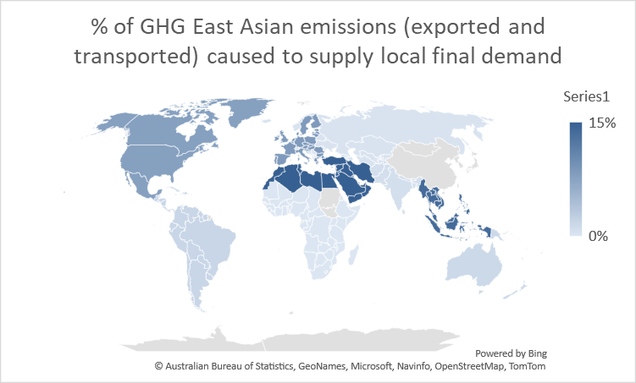
Position in the Global Supply chain
Backward analysis: Percentage of territorial emissions caused by supply chain traversing or ending in East Asia.
  Share of emissions generated in theses countries as a percentage of all emissions generated along the supply chains involving the East Asia economy (imported and transported emissions).
  Indicates the role of the East Asia economy in the supply chains causing territorial emissions.
Forward analysis: Percentage of all emissions caused to supply the local final demand via East Asia economy
  Share of emissions as a percentage of all emissions caused to supply the local final demand via the East Asia economy (exported and transported emissions).
  Indication of the role of the East Asia economy in supplying the final demand of other countries.

Slide 30
4. Conclusion

Slide 31
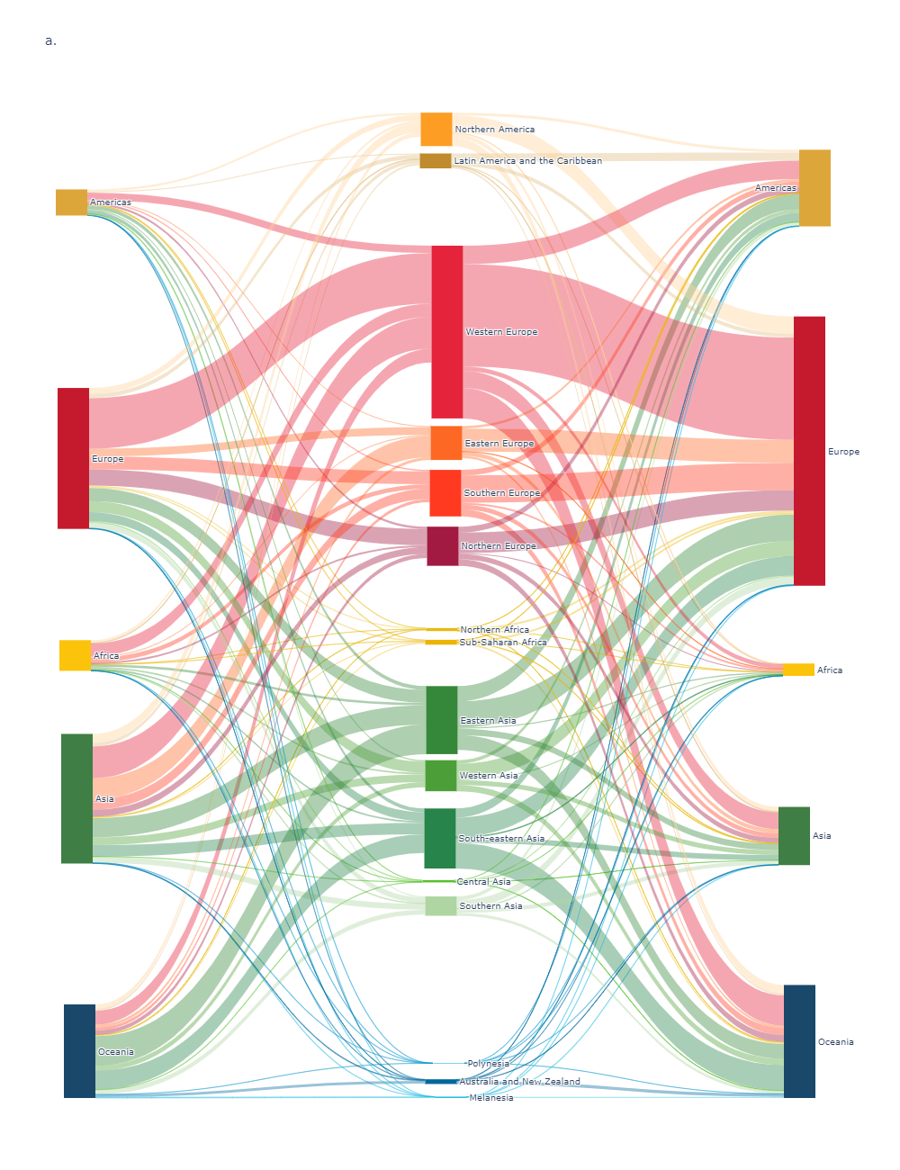
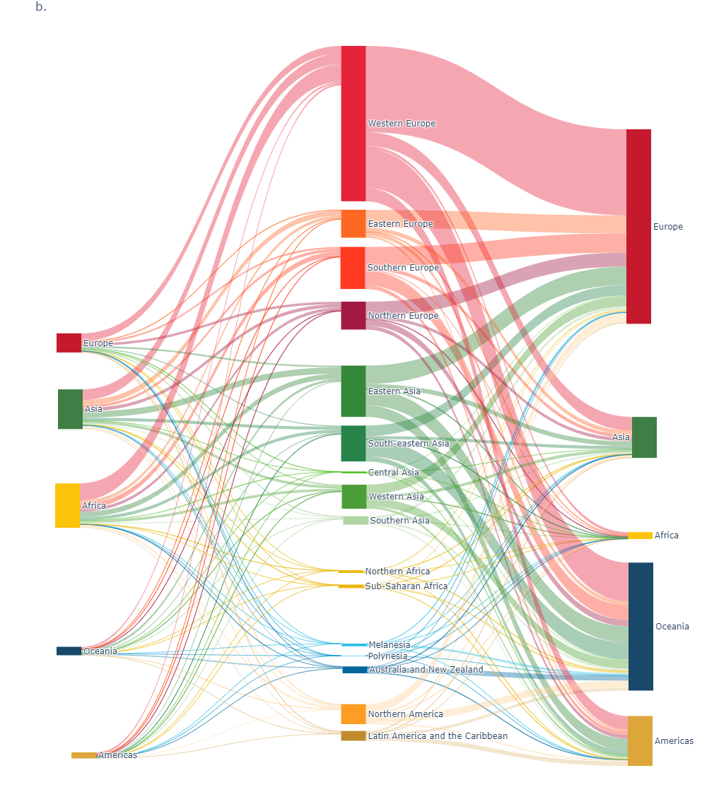
The TBA can be applied to any externality to follow its global flow
GHG emissions, transported externality
Work fatalities, transported externality
Source: Author calculation

Slide 32
Using the TBA to GTAP for GVC analysis
It is worth emphasizing that the TBA computation should be carried out ex post, that is, after the policy-perturbed CGE model has endogenously converged to a solution.
For this reason, the TBA should be viewed as a new tool that allows a better understanding of simulation results irrespective of the structure/assumptions of the model itself.
The TBA can be used as an alternative formulation for a flow-based GVC analysis to investigate the structure of interdependencies in the global trade network, including for instance the identification of countries that have a large portion of their output going through another countries.
Given the importance of GVCs in both theory and empirical analysis, quantitative models that can trace externalities and value-added embedded in gross trade flows are needed in international trade policy analysis.
Such combination analysis (CGE then TBA) could further be used to formulate policy recommendations on how to increase the resilience of the global trade network and pave the way toward a safest a fairer global trade regime.

