Slide 1





Eat good, waste less? Global food loss and waste in the context of healthier and more sustainable diet
Alessandro Gatto, Marijke Kuiper and Hans van Meijl
Wageningen University & Wageningen Economic Research

Slide 2


Healthy Diets (SDG2) VS Food Loss and Waste (SDG12.3): synergies and conflicts
Transitioning to a healthier and more sustainable diet...
- increases the availability of high quality plant based biomass
along global FSC (HLPE, 2014) highly suitable as production
input.
- may stimulate FLW reuse, but risks to concentrate FLW is in
locations where possibilities for reuse are limited or not
competitive.
- If not coupled with reusing strategies, plant-based FLW may
increase air and soil pollution (Porter et al., 2016) reducing the
positive impact of a more sustainable diet.
→ Assessing trade-offs requires an integral understanding of magnitude, composition and location of
lost or discarded food along FSC while simultaneously addressing actors’ behaviour across the
economic system.

Slide 3
Modelling FLW in a globalized food system: challenges & key steps forward
METHODOLOGICAL CHALLENGES
DATA CHALLENGES
CAPTURING PHYSICAL BIOMASS FLOWS
QUANTIFYING FOOD LOSS AND WASTE
Adding consistent tracing of biomass physical quantities along global supply chains to a global GE model (bridging economic and technical modelling of FLW).
Assessing biomass competition (feed, seed, other use, food) through global economy, quantifying magnitude, composition and geographical availability of biomass flows.
3. Tracing food quantities from farm to fork along global
supply chains, identifying production, intermediate and
final food use.
1. New up-to-date global FLW database.
2. Capturing actual food intakes vs food supply based on
FBS (omits retail & consumers waste which can be
substantial).
3. Identify physical magnitude and composition of FLW,
outlining at which supply chain stages FLW occurs.
4. Identify in which region the FLW occurs to assess
spatial scope for FLW.
5. Multidisciplinary assessment of FLW key for policy design.
Technical studies rely on detailed physical data but tend to disregard agent’s behaviour and their interactions (Chaboud & Daviron 2017).
No common definition (Delgado et al., 2020) nor reliable global measurement (Kuiper & Cui, 2021) available to date.
Contrasts in target issues, methodological approaches and FSC specifications result in inconsistent estimates and databases (Xue et al., 2017).
Most adopted estimates from Gustavsson et al. 2011, presents severe limitations due to inconsistent methodology and FLW definition.
Dollar-based quantities typical of GE models are insufficient to assess global challenges related to physical flows of biomass including resource circularity.
tackling
challenges
identifying
challenges
For effective policy design crucial to identify biomass flows along global supply chains.
Current material flow accounting hampers a consistent linkages to technical models (interdisciplinary connection).

Slide 4
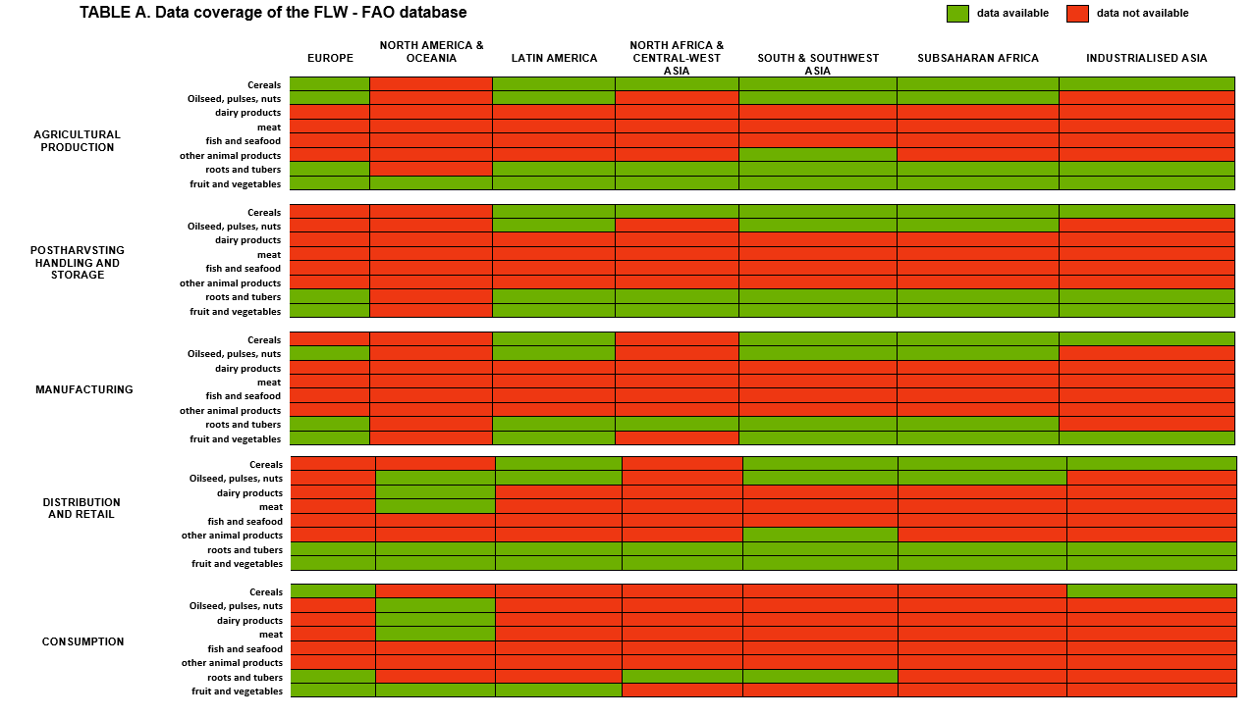
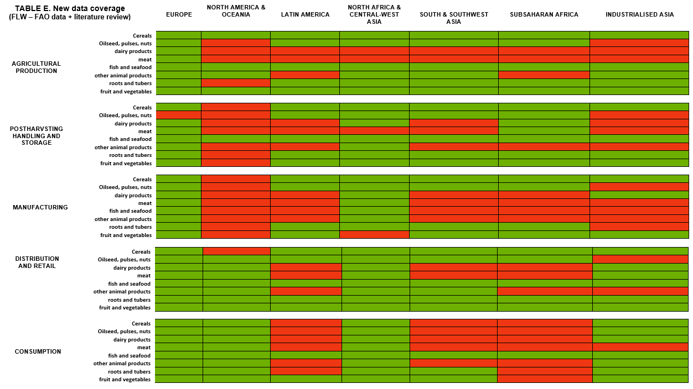
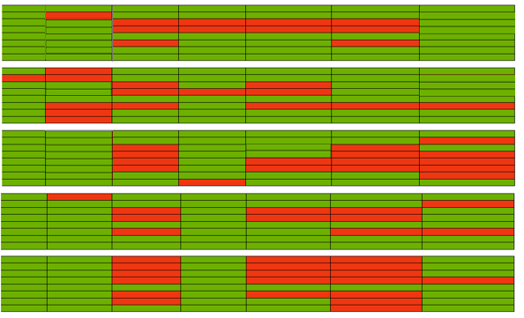
A newly compiled global Food Loss and Waste database
FAO – FLW database 2019
Up-to-date global estimates on
percentages of loss/waste of total food weight
along FSC (FAO-FLW 2019 data core).
Consistent FLW definition in line with SDG-12.3 and with FAO’s FLI and FWI indicators (Fabi and English, 2018).
Expanding overall regional, commodity and supply chain coverage.
Expanding previous literature reviews of (Xue et al., 2017), (Porter et al., 2016), (Delgado et al., 2020) and OECD Food Waste database (2021) with an overall screening of more than 300 sources.
Gatto et al. database

Slide 5
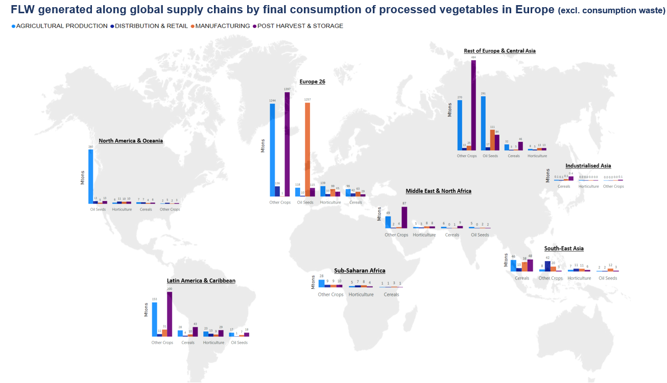
Modelling physical (Mtons) flows of food loss and waste along global food supply chains in a GE framework
1. Building on Kuiper (2022) to subtract monetary components (taxes, international margins, etc) from the value-based flows of the GTAP database,
obtaining “dollar-based quantities”.
→ Author defines “balancing equation” kept as benchmark to test if model consistently holds balances in monetary (and physical) units.
Total production = Intermediate demand (dom + imp) + final demand (dom + imp)
2. From “balancing equation” we derive the Leontief Inverse matrix to obtain full overview of flows through the economy, including sector-to-sector
trade.
( i ): Primary food product produced
( p ): Region of primary food production
( d ): Intermediate food demanding region
( s ): Final food demanding region
( c ): Final commodity demanded
${\left(1\right) QFD}_{i,c}^{p,s,d}={LI}_{i,c}^{p,s}∗ F_{c}^{s,d}$
3. Dividing (1) by total production we obtain shares specifying how a single unit of output flows through the global economy. Here we integrate
physical (Mtons) biomass production data (FAO), defining physical food flows across the global economy and preserving material balances in
monetary and physical units.
4. Incorporating five FSC stages and estimates from our global FLW database to quantify global FLW at each stage of FSC identifying magnitude,
composition and geographical location.
→ Mtons of FLW of product (i) at supply chain stage (t) generated by the consumption of commodity (c)
produced in region (p) and demanded by an household in region (d) from region (s)

Slide 6
MAGNET model and Scenario set – up: transitioning to a global healthier diet
Model & data: MAGNET using GTAP 10 data (2014).
Model Aggregation: 8 global regions complemented by 4 single countries which represent a proxy for countries at different income levels.
Time frame of analysis: 2030
Scenarios: SSP2 scenario (baseline) against EAT – Lancet 2019 dietary scenario.
Basic drivers: SSP2 projections of population, TFP (via GDP projections), crop & livestock yields.
MODEL
SCENARIO
Sustainable healthy diet:
“moving halfway to the Eat-Lancet diet (Willet et al., 2019)
recommendations”.
Implementation:
- shock by defining the % change in per-capita household consumption
to required to towards the Eat-Lancet dietary targets
(1323.8 grams/cap/day).
- split of EAT-Lancet commodities between GTAP commodities
(e.g. sweeteners intakes split in C_B and SUGAR).
- Consumption of food services or processed food represented in
in primary equivalents:
- Computing required % change increase/decrease in order to meet the
dietary constraint, respecting current dietary composition:
Total intake of (c) via primary + processed + services ≤ Eat-Lancet Intakes

Slide 7
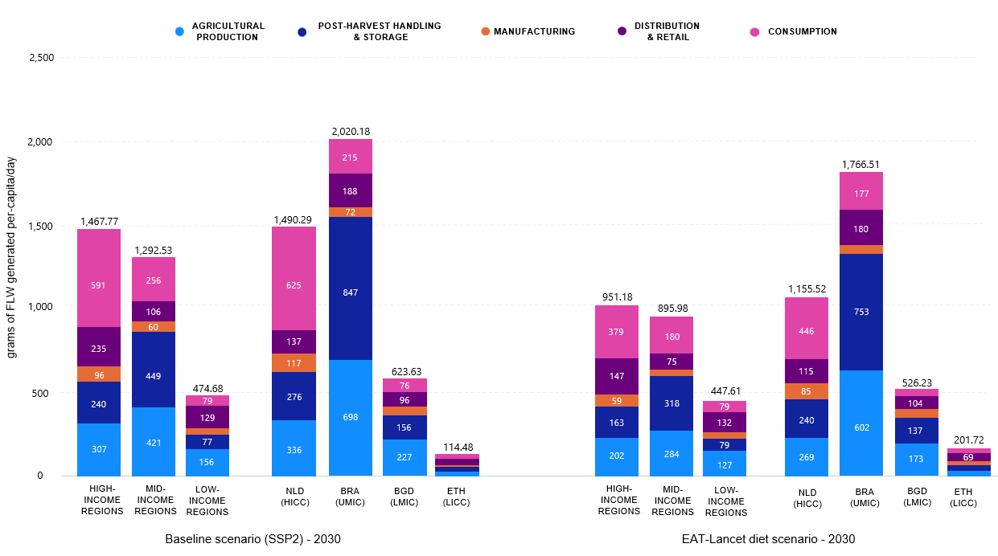
Results (1): Global FLW magnitude
Baseline (SSP2) scenario - 2030
Eat Lancet diet scenario - 2030
Moving to the EAT-Lancet diet decreases average global food demand, reducing FLW to 2.3 billion tons (-17.2%).
Expanding food consumption in 2030 increases global
FLW (11.6%), reaching 2.6 billion tons.
Less trade in fresh plant-based foods decrease losses at Agricultural Production (-18.5%), Post-Harvest Handling & Storage (-29.5%) of low-income regions.
In low-income regions, increasing domestic and export demand enlarges agricultural production losses by an average 15%, cumulatively constituting the largest share (60%) of global FLW.
In high-income regions, lower intakes principally decrease domestic losses at Agricultural Production (-34.2%) and Consumption (-35.4%) stages.

Slide 8
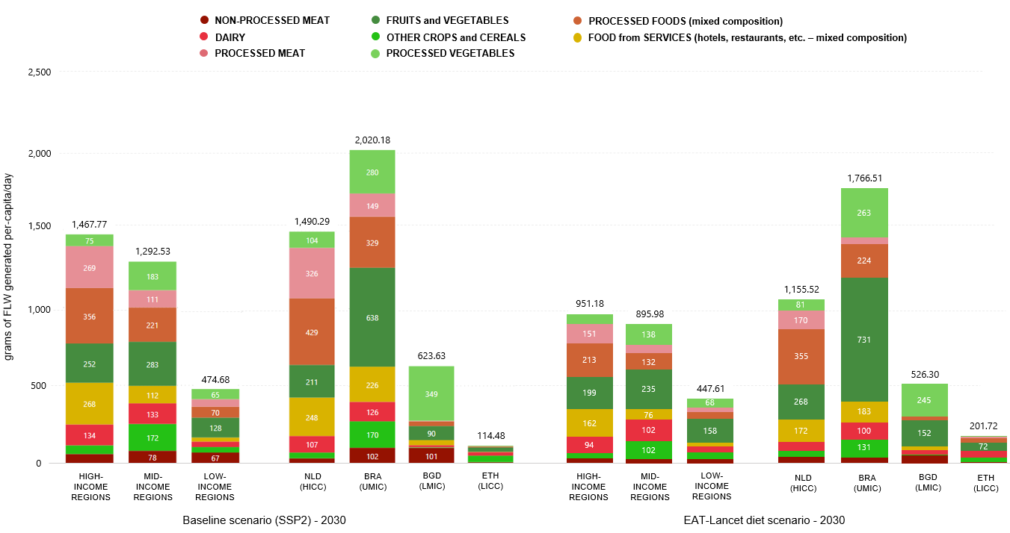
Results (2): Global FLW composition
Baseline (SSP2) scenario - 2030
Eat Lancet diet scenario - 2030
Increasing food demand high-income regions expands shares of processed foods (25.4%), meat (19.2%), and fruit & vegetables (15.6%).
The EAT-Lancet diet enlarges shares of fruit & vegetables and cereals within global FLW (24.4%), replacing ASF (-35.1%) and decreasing loss of calories embedded in FLW.
In low-income regions, increasing consumption of ASF results in growing losses primarily of animal products (41.6%) and cereals (23.2%).
Intakes of ASF increase in low-income regions (currently consuming below EAT-Lancet targets), increasing shares of dairy (49.7%) and fish (98.1%) losses while decreasing shares of other crops (-18.1%).

Slide 9
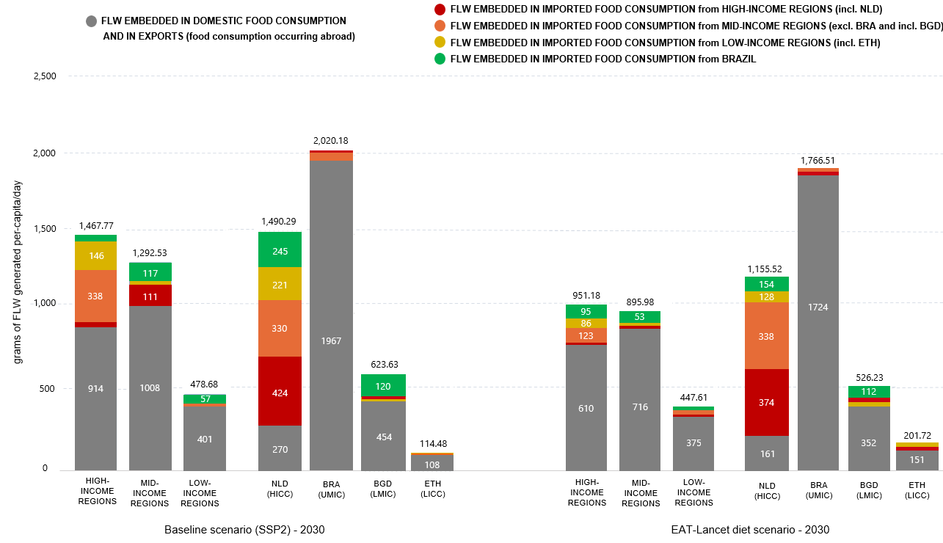
Results (3): Global FLW location
Baseline (SSP2) scenario - 2030
Eat Lancet diet scenario - 2030
Food losses (excl. waste) embedded in imports by high-income regions represent 46.9% of total losses.
The EAT-Lancet diet decreases global trade of highly-perishable plant-based foods (-25.8%), reducing spill-over effects within the global economy.
Domestic losses for export-oriented regions (i.e. Brazil or Ethiopia) reach an
average 95.4% of total losses.
Despite decreasing food import demand mainly for ASF (-70.8%), imports in high-income regions account for 17.5% of total losses in mid-income regions and for 22.3% of total losses in mid- income regions.

Slide 10

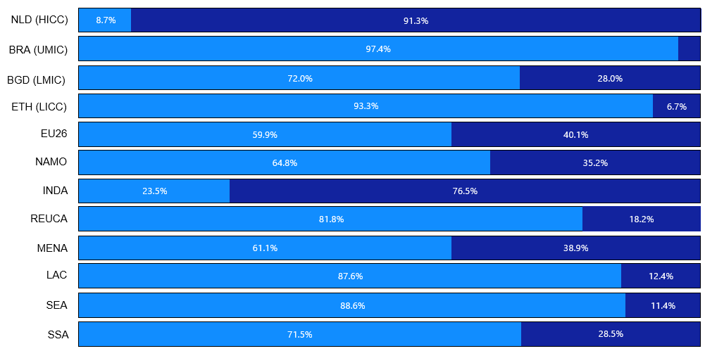
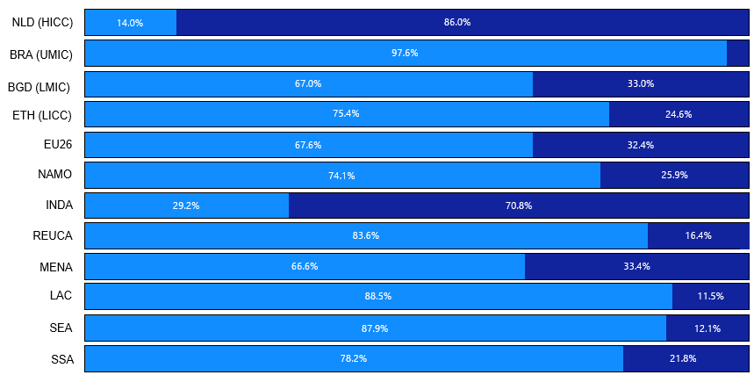
Results (4): Global FLW location
The EAT-Lancet decrease imports of plant-based foods form high-income regions, generating large amounts of farm-level losses in exporting low- and mid-income regions.
As the EAT-Lancet diet decreases food trade, shares of losses generated domestically simultaneously increase.
Higher consumption levels in low-income regions coupled with trade substitution effects (higher plant-based food exports) result in higher domestic losses.
Baseline (SSP2) scenario
2030
Eat Lancet diet scenario
2030

Slide 11
Discussion & Conclusions
→ Food security (SDG 2)
- An healthy and sustainable diet decreases food trade increasing the
potential for domestic food availability.
Next-steps:
- Implementation of FLW accounting in a dynamic modelling
framework (currently only ex-post).
- A more sustainable diet assists reducing total FLW generation simultaneously
reducing calorie losses along FSC.
→ Environmental sustainability (SDG 13)
- Development of FLW abatement cost curves.
- The geographical mismatch between FLW and proficient recycling facilities
risks compromising the environmental benefits of a dietary transition.
- Full integration of FLW tracing into GTAP 11 database with
a special release (Gatto & Chepeliev).
→ Food Loss and Waste (SDG 12.3)
- Key hotspots for FLW generation are farm losses in low- and mid-income regions,
and Consumption stage in high-income regions.
- Applying findings on FLW in a circular economy framework
(forthcoming paper, a circular economy for livestock
sectors based on FLW reuse as animal feed).
- High-income countries may relatively easy meet their SDG 12.3 target, as their
increasing import-embedded FLW is not counted towards their national SDGs,
in turn affecting low- and mid-income regions in achieving SDG12.3.
→ Towards a Circular bio-based economy (SDG 12)
- A healthy and sustainable diet enhances FLW quality increasing its
employability as production input.
- The spatial availability of FLW with a healthy and sustainable diet
limits the creation of domestic material loops for circular purposes.

Slide 12

Questions, comments, ideas?
Alessandro.gatto@wur.nl

