Slide 1
Modelling plastics use and waste in a CGE: Methodology and baseline projections to 2060
Ruben Bibas, OECD
with the modelling team:
Elisa Lanzi, Eleonora Mavroeidi, Maarten Dubois,
Rob Dellink, Daniel Ostale Valriberas, Jean Fouré
GTAP Conference, 9 June 2022

Slide 2
Objective: an Outlook on plastics use, waste and environmental impacts
Innovative modelling of plastics in CGE
Outlook to 2060
CGE analysis, based on ENV-Linkages
Policy relevance:
Osaka Blue Ocean Vision (reduce the additional leakage to the ocean to zero)
UNEA resolution 5/14 (ultimately end plastic pollution)

Slide 3
Modelling approach

Slide 4
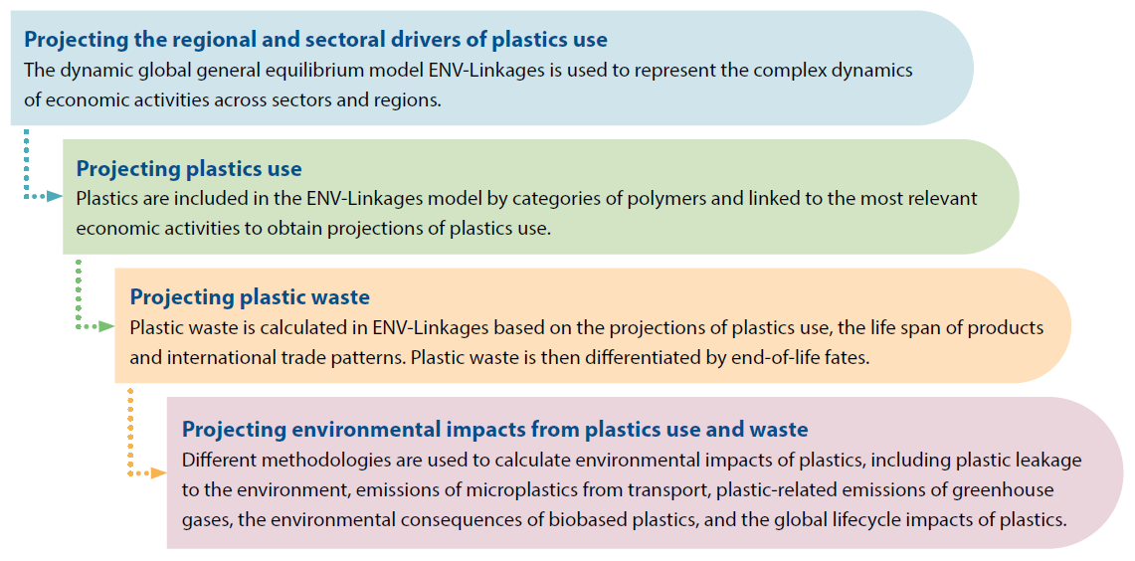
Modelling framework
Modelling tool:
OECD ENV-Linkages model

Slide 5
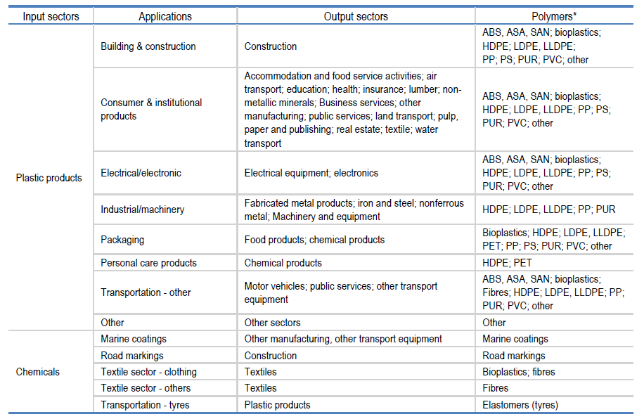
Modelling plastics flows
Source: OECD (2022), Global Plastics Outlook: Policy Scenarios to 2060

Slide 6
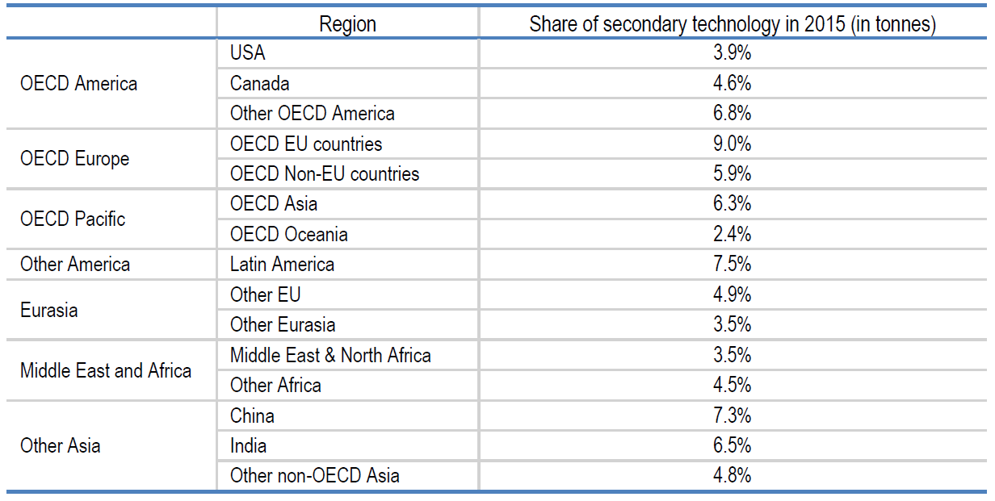
Modelling primary and secondary plastics – calibration of economic DB
Two production technologies producing one good
Shares applied to GTAP sectors (rpp → plp + pls)
Cost shares from Exiobase
  Primary uses most of the fossil fuels
  Secondary uses about half of chemical sector inputs
Source: OECD (2022), Global Plastics Outlook: Policy Scenarios to 2060

Slide 7
Modelling primary and secondary plastics – volumes & dynamics
Calibrated coefficient at base year applied to growth of overall demand for plastics (rpp/chm inputs to other sectors)
Secondary production grows with secondary economic flows (as processed scrap is assumed to be used)
  Calibration of initial volumes: waste collected for recycling + loss rates → fixed point methodology
  Check ex post of scrap availability
Primary is the residual
Source: OECD (2022), Global Plastics Outlook: Policy Scenarios to 2060

Slide 8
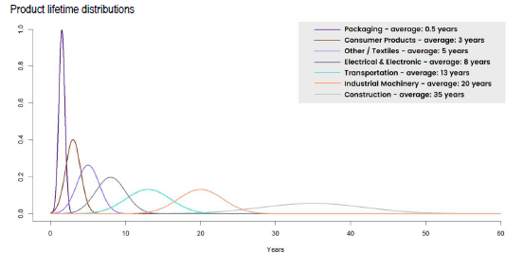
Modelling waste and recycling
Source: adapted from Geyer, Jambeck and Law (2017[1]).

Slide 9
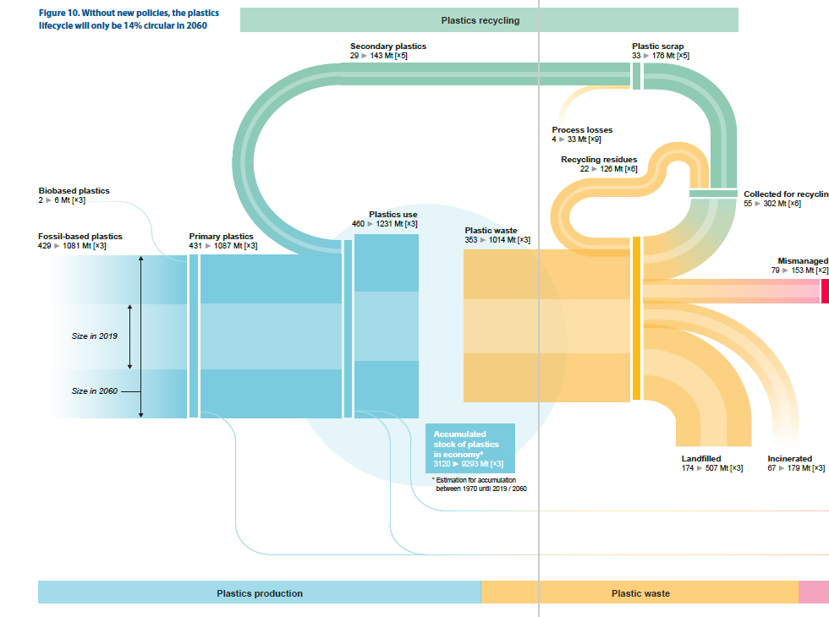
Modelling waste and recycling
Source: OECD (2022), Global Plastics Outlook: Policy Scenarios to 2060

Slide 10
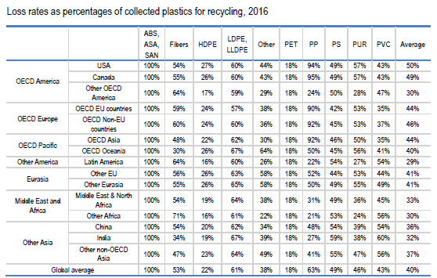
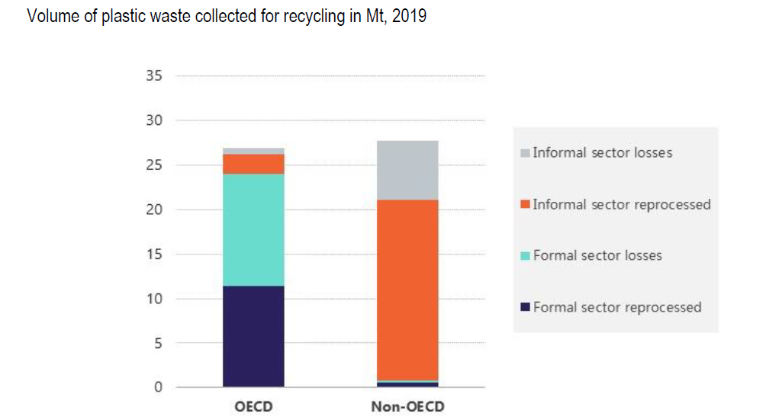
Modelling recycling
Source: OECD ENV-Linkages model, based on Cottom et al. (2020[11]).

Slide 11
Key results

Slide 12
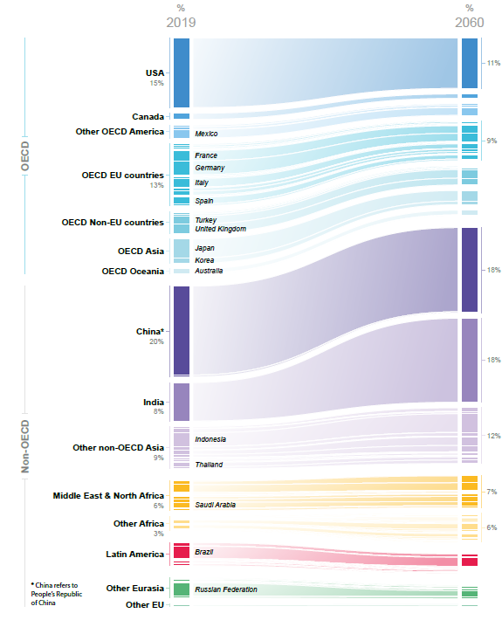
Asia and Sub-Saharan Africa increase their weight in the global economy
Share of global GDP by region, Baseline scenario
Source: OECD (2022), Global Plastics Outlook: Policy Scenarios to 2060

Slide 13
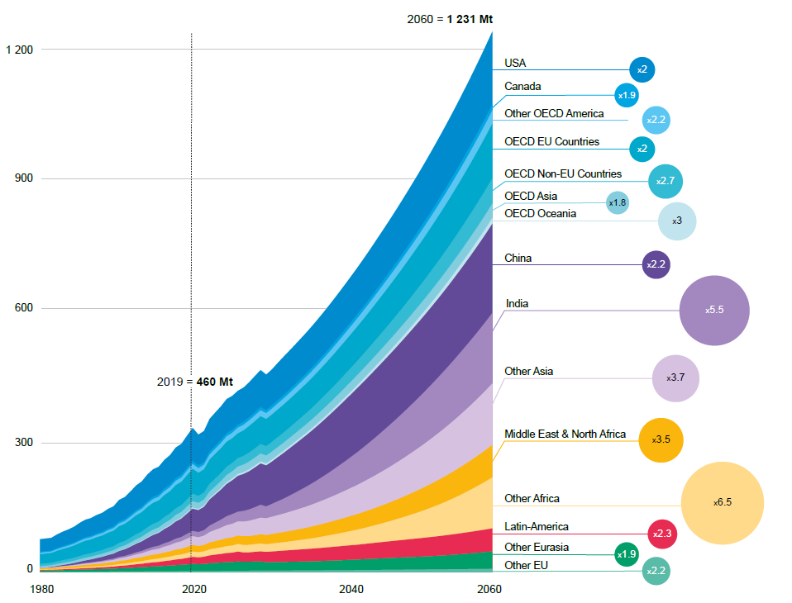
A tripling of the global economy by 2060 will drive plastics use
Plastics use in Mt, Baseline scenario
Source: OECD (2022), Global Plastics Outlook: Policy Scenarios to 2060

Slide 14
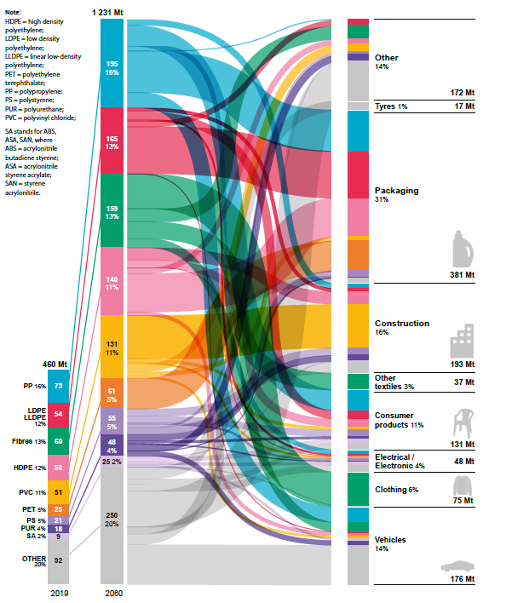
The use of all polymers is projected to significantly increase by 2060
2019-60 increase in plastics use by polymer and application
Source: OECD (2022), Global Plastics Outlook: Policy Scenarios to 2060

Slide 15
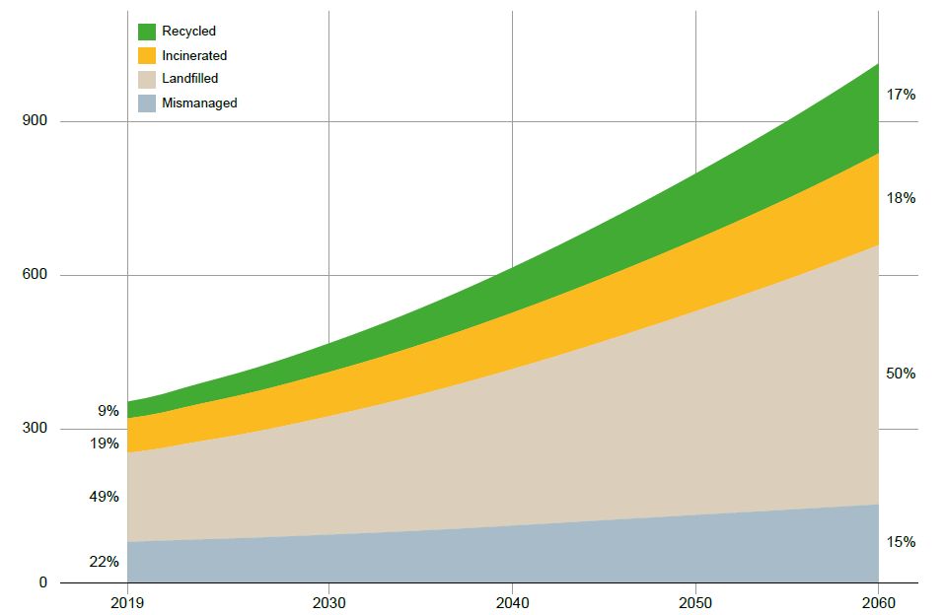
Despite a decreasing share, mismanaged waste volumes double
Plastic waste in Mt by waste management category, Baseline scenario
After disposal of recycling residues
and collected litter
Source: OECD (2022), Global Plastics Outlook: Policy Scenarios to 2060

Slide 16
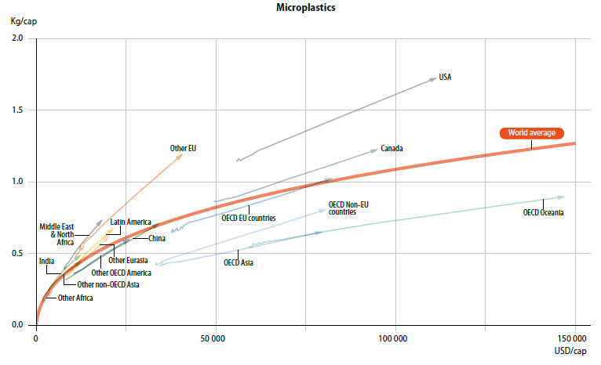
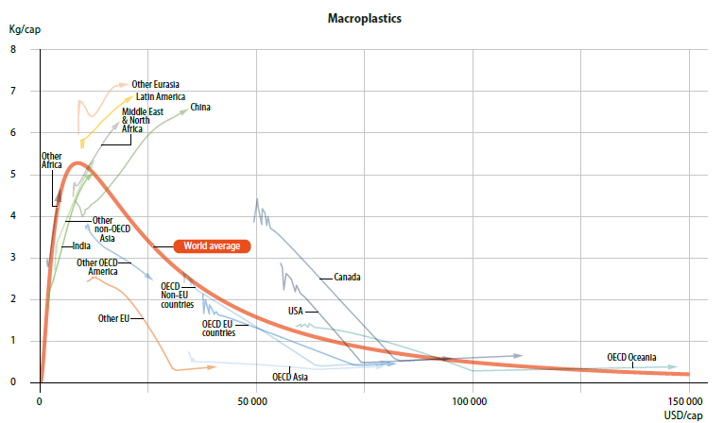
Macroplastic and microplastic leakage show different trajectories when income per capita increases
Per capita leakage (kg) vs. GDP per capita (USD), Baseline scenario
The “World average” line represents regression across time and regions.
Source: OECD (2022), Global Plastics Outlook: Policy Scenarios to 2060

Slide 17
Main messages and next steps
Innovative methodology
  Some sparse literature, but no CGE (link to population or GDP/cap)
  First CGE to link plastic use to economic drivers
  Consistent economic/physical accounting
In the absence of additional policies (projections 2019 → 2060):
  Plastic use to triple 460 → 1231 Mt
  Plastic stocks in economy to tripe 3.1 → 9.3 Gt
  Plastic waste projected to triple 353 → 1014 Mt
  Mismanaged waste projected to double 79 → 153 Mt
  Leakage projected to double 22 → 44 Mt
  Accumulated stocks in rivers & oceans projected to more than triple 140 → 493 Mt
Policy scenarios presented at Session #45 - Environmental Policies (Fri. Jun 10, 2022)
  Policy scenarios for promoting the circularity of plastics (#6612) - 10:11 AM - 10:31 AM
Next steps: regional focus on ASEAN and EU

Slide 18
Thank you for your attention!
https://www.oecd.org/environment/plastics/
Registration link:
https://meetoecd1.zoom.us/webinar/register/WN_1zT6sOrqTWGBYNBUZPGOHQ
Any question?

Slide 19
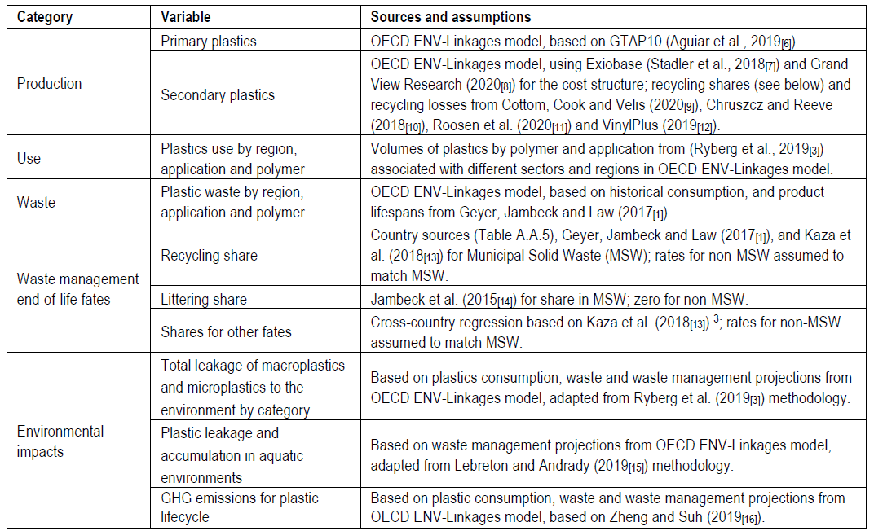
Data requirements

