Slide 1
Economic Supply Chain Impacts of Expanding Electricity Access in Kenya
Jared Woollacott, Candise Henry, Alison Bean de Hernandez, Yongxia Cai, and Chandler Cowell
GTAP Conference 2022

Slide 2
Background
Electrification has been a major focal point for bilateral and multilateral development efforts in recent years
International donors have contributed billions of dollars in aid for electrification efforts across the world
There are important economic development and environmental (if from low emissions technologies) benefits from electrification
Much of existing literature is focused on end-user benefits of electrification
There are also supply-side benefits from building and operating more electricity generating units
Notes:
Much of existing literature is focused on end-user benefits of electrification; and discussions of investment priorities are often around whether there are causal effects of electrification on end-user benefits.
However, there are also supply-side benefits from building and operating more electricity generating units that would be useful to consider in discussions of investment priorities.

Slide 3
Background: End-User Benefits of Electrification and Reliability
Health outcomes:
Decreases individual exposure to indoor pollutants
Educational outcomes:
More study time b/c not collecting fuelwood
Women’s empowerment:
Outdoor lighting increases public safety
Household level: “light” hours allows for more time on income generating activities​
Income generation and economic growth:
Improves nutrition from refrigeration of food
Improves access to life-saving medicines and technologies at health facilities
More study time b/c longer “light” hours
Change gendered social norms by increasing access to information
Household level: higher paying jobs in long run
Broader economy: increased productivity
Broader economy: richer households spend more

Slide 4
Background: Supply-side Benefits of Electrification Investments
Investment dollars spent on wages for those constructing facilities provide direct wage benefits to local or regional residents
Expenditures on procuring goods and services to support construction yield indirect wage benefits throughout the construction supply chain
If wage benefits are local, wages spent for consumption induce another round of spending in the economy
Notes:
Investment in electricity sector capacity supports a variety of economic activity: equipment purchases; labor to manage and execute construction; and the materials, energy, and services required to support construction
The estimation of induced benefits is trickier because of potential “double counting” of benefits, so we focus on direct and indirect benefits here.

Slide 5
Research Questions
What are the supply chain benefits of electricity expansion in Kenya (particularly of renewable technologies)?
What amount of skilled and unskilled labor will be required to meet Kenya’s Least Cost Development Plan?
  What are the implied occupation-level indirect job impacts?
Notes:
To answer the first question, we will be examining the direct and indirect wage and job impacts of on-grid electricity expansion.
To answer the second question, we will assess the implied occupation-level indirect job impacts from combining GTAP and International Labor Organization (ILO) data:
GTAP provide occupation-level wage payments but no corresponding jobs
ILO data provide detailed occupation-level data but at a coarser sectoral resolution
Integrating these data sources provides new information on job impacts

Slide 6
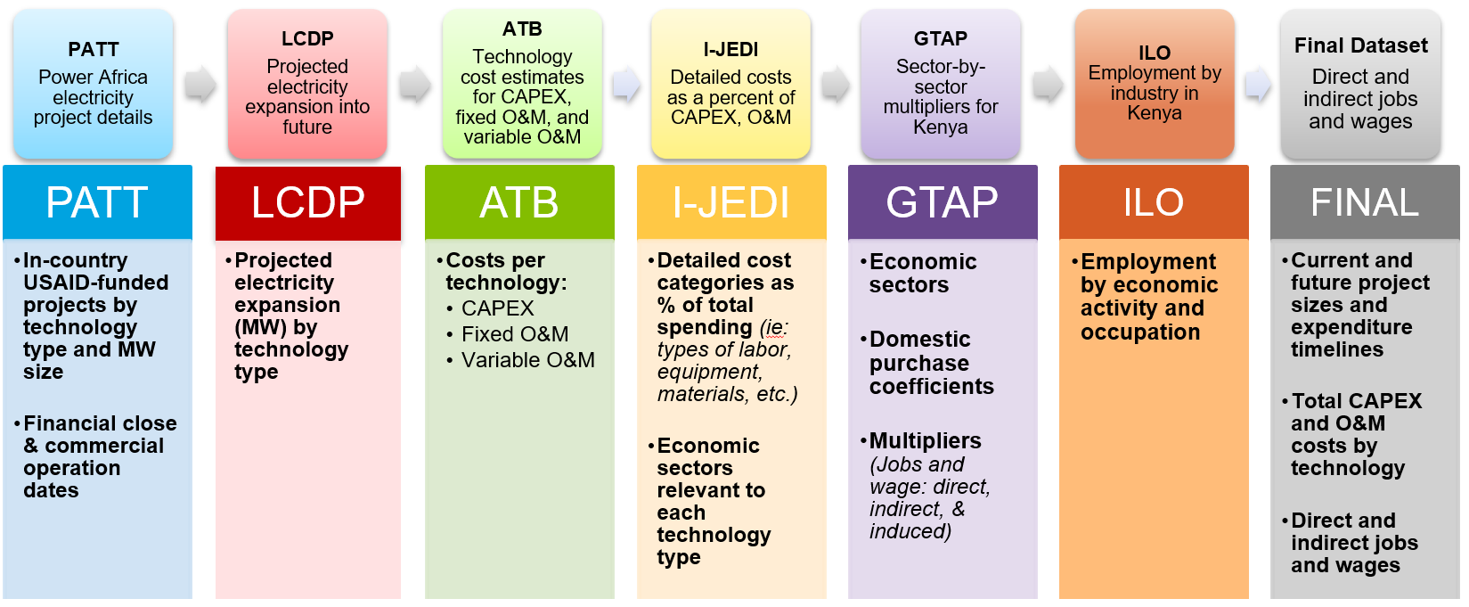
Datasets and Approach
Notes:
PATT: Power Africa Transaction Tracker
LCDP: Least-Cost Development Plan
ATB: National Renewable Energy Laboratory’s Annual Technology Baseline
I-JEDI: NREL’s International Jobs and Economic Development Impacts
Example I-JEDI mapping:

Slide 7
Methods: USAID Historical and Planned Capacity Investments
USAID investments between 2015-2022 make up roughly 30% of total new capacity in Kenya

Slide 8
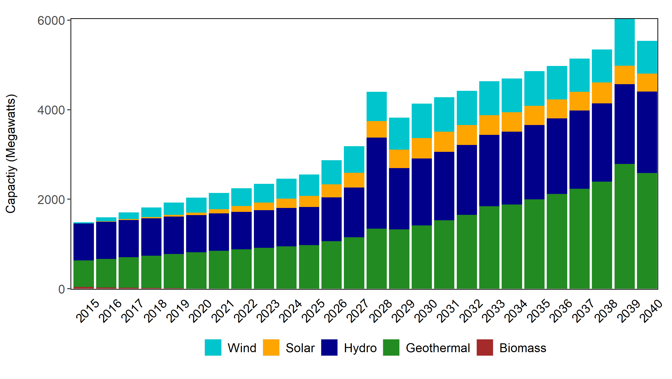
Methods: Kenya’s Projected Investments
We also value future investment requirements of projected electricity expansion out to 2040
We use Kenya’s Least Cost Development Plan (LCDP) 2020-2040 to provide projections of capacity expansion quantity by technology type
Then we map these capacity quantities to ATB to get estimates of future capital and O&M expenditures, which we can then attribute to different economic sectors in terms of direct and indirect benefits
Source: Kenya LCDP 2020-2040
Notes:
We map these capacity quantities to ATB to get estimates of future capital and O&M expenditures, which we can then attribute to different economic sectors in terms of direct, indirect, and induced benefits

Slide 9
Methods: Input-Output Multipliers
Multipliers are calculated using the GTAP Power Version 10 database via Rutherford’s GTAPinGAMS
Labor multipliers come from integrating ILO employment by industry and occupation data with GTAP data
Multipliers include the impact of local purchase coefficients based on GTAP trade data and project-specific inputs from NREL’s I-JEDI
    We apply local purchase coefficients because we are focused on domestic impacts
Direct and Indirect Wage Impacts
 | MGR | TEC | CLK | SRV | LAB | Total
Machinery & Equipment | 0.02 | 0.01 | 0.02 | 0.01 | 0.13 | 0.19
Other Extraction | 0.06 | 0.01 | 0.03 | 0.01 | 0.10 | 0.22
Electrical Equipment | 0.02 | 0.01 | 0.01 | 0.01 | 0.11 | 0.16
Construction | 0.11 | 0.03 | 0.04 | 0.02 | 0.25 | 0.45
Business Services | 0.11 | 0.04 | 0.08 | 0.03 | 0.07 | 0.34
Direct and Indirect Job Impacts (Jobs / Million $)
 | MGR | TEC | CLK | SRV | LAB | Total
Machinery & Equipment | 10.8 | 4.0 | 3.2 | 9.7 | 105.7 | 133.4
Other Extraction | 7.1 | 2.8 | 2.4 | 8.6 | 416.1 | 437.1
Electrical Equipment | 10.1 | 3.6 | 2.8 | 9.2 | 90.7 | 116.3
Construction | 18.3 | 6.1 | 1.3 | 5.5 | 279.5 | 310.8
Business Services | 44.6 | 24.5 | 21.4 | 50.3 | 182.5 | 323.4
Notes:
mgr Officials and Mangers legislators (ISCO-88 Major Groups 1-2),
tec Technicians technicians and associate professionals (Group 3)
clk Clerks (Group 4)
srv Service and market sales workers (Group 5)
lab Agricultural and unskilled workers (Major Groups 6-9)
Local purchase coefficient = how much of purchased spend goes to domestic vs. international market (only count domestic market)
Local purchase coefficients are baked into multipliers because GTAP gives us information on where trade flows, but we also calculate additional local purchase coefficients using I-JEDI
Multipliers are matrix algebra: come up with direct requirements matrix, multiply input coefficients’ direct requirements matrix with local purchase coefficients, then take inverse of matrix to get multipliers

Slide 10
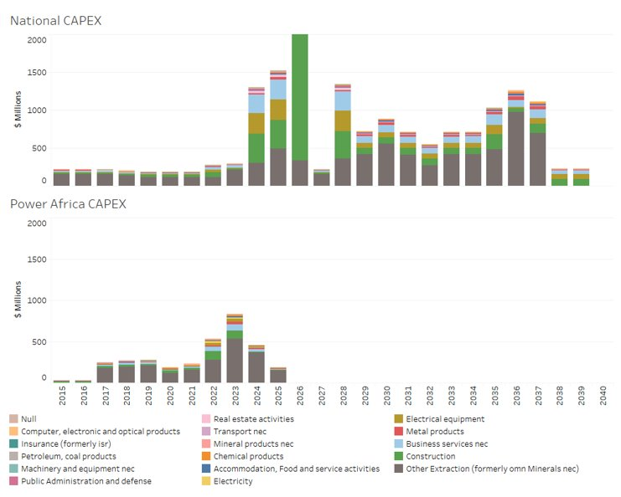
Results: Capital Expenditures by Sector
Capital expenditures are dominated by extraction due to high geothermal
Construction services, which are highly local, are the second highest
There is an expected uptick in capacity additions between 2022-2025 due to LCDP expansion goals

Slide 11
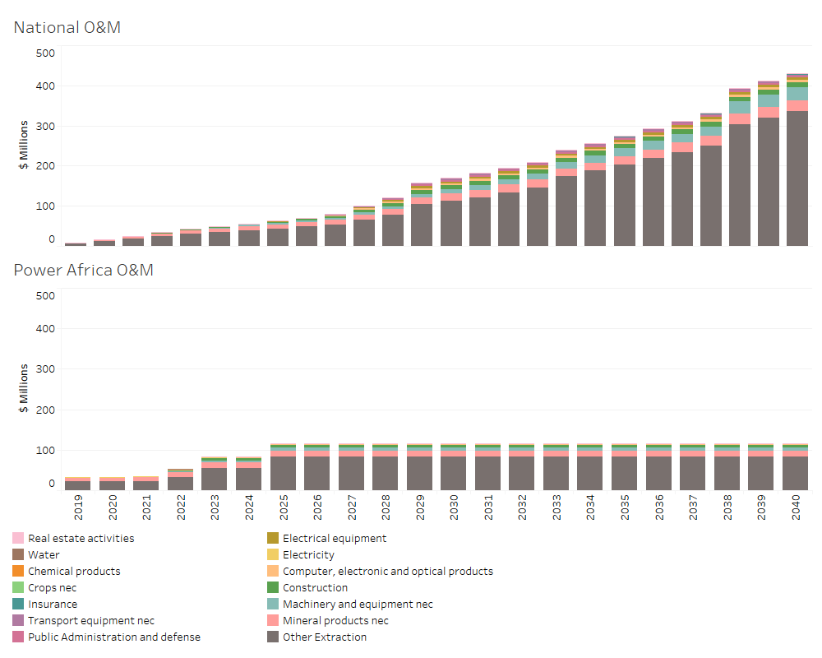
Results: O&M Expenditures by Sector
O&M expenditures are rising steadily given demand projections from the LCDP
Other extraction is still a large component as it is also part of operating geothermal and is predominantly local
Machinery and equipment are the second largest O&M expenditure, which is has a relatively low local purchase coefficient

Slide 12
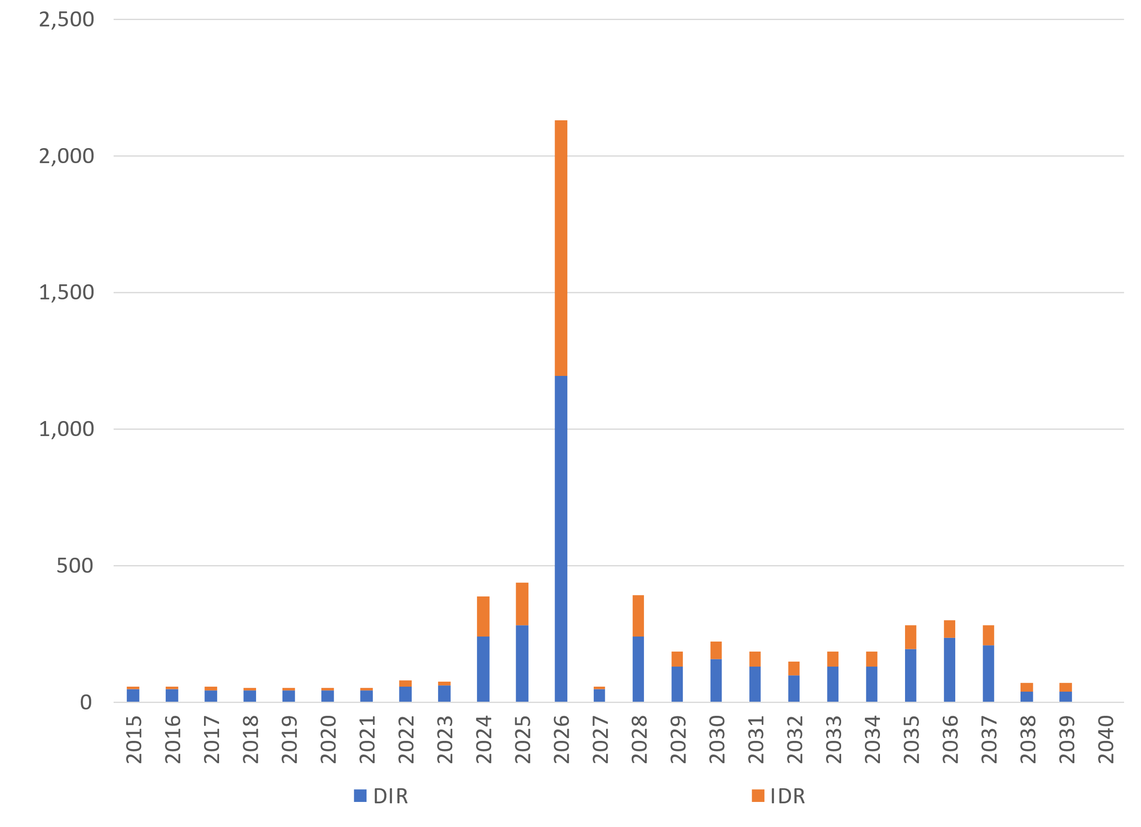
Results: Construction Impacts, Direct & Indirect Income (MM $US)
Notes:
DIR > IDR because direct income for construction includes only construction, extraction, and electricity expenditures → since lots of geothermal extraction in LCDP, there is significant local direct income impacts
2026 jump is due to expected large hydro retirements from KenGen in 2027/2028 so we assume large new construction addition before then
$2bn is roughly 2% of total 2020 GDP

Slide 13
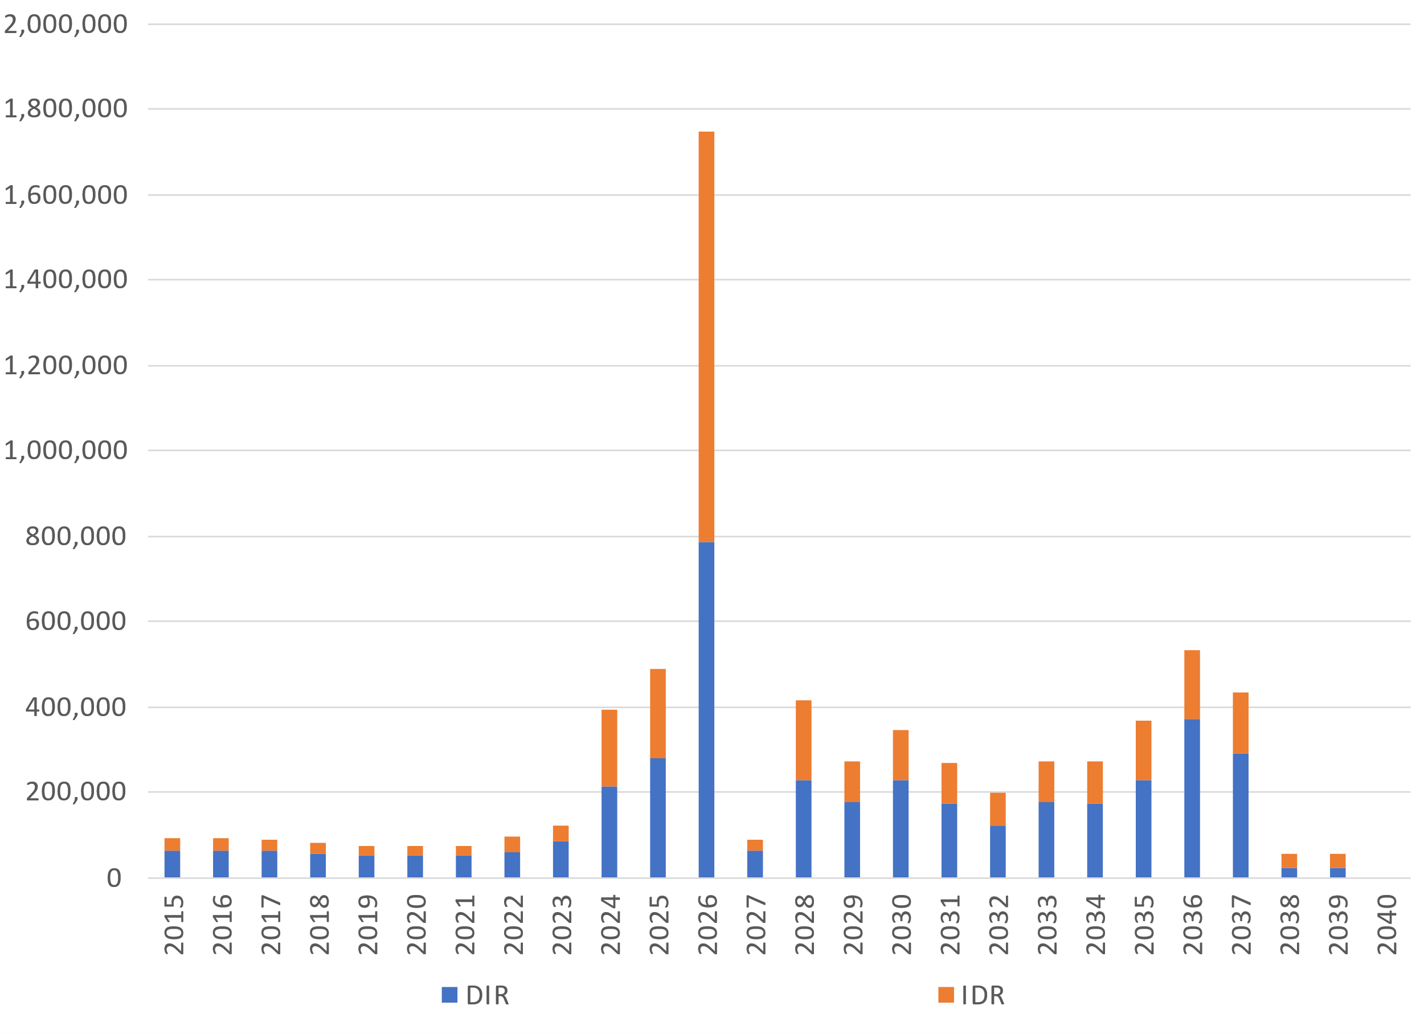
Results: Construction Impacts, Direct & Indirect Jobs
Notes:
Potential of roughly quadrupling jobs impacts to support projected capacity expansion over next 20 years
Potential for significant labor shortages in 2028 to offset large-scale retirement of hydro

Slide 14
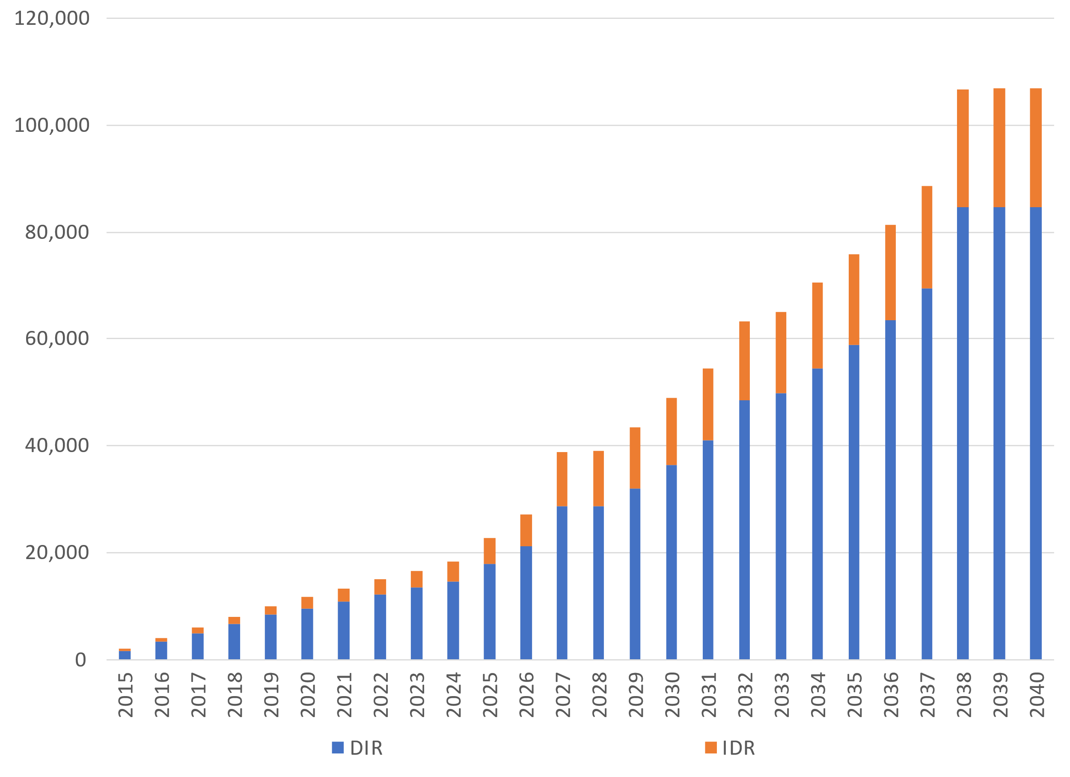
Results: Operating Impacts, Direct & Indirect Jobs
Notes:
Jobs supporting operations will expand by an order of magnitude, 10,000 to 100,000 by 2040, primarily in the extraction sector due to geothermal
Jobs dominated by extraction so mostly direct

Slide 15
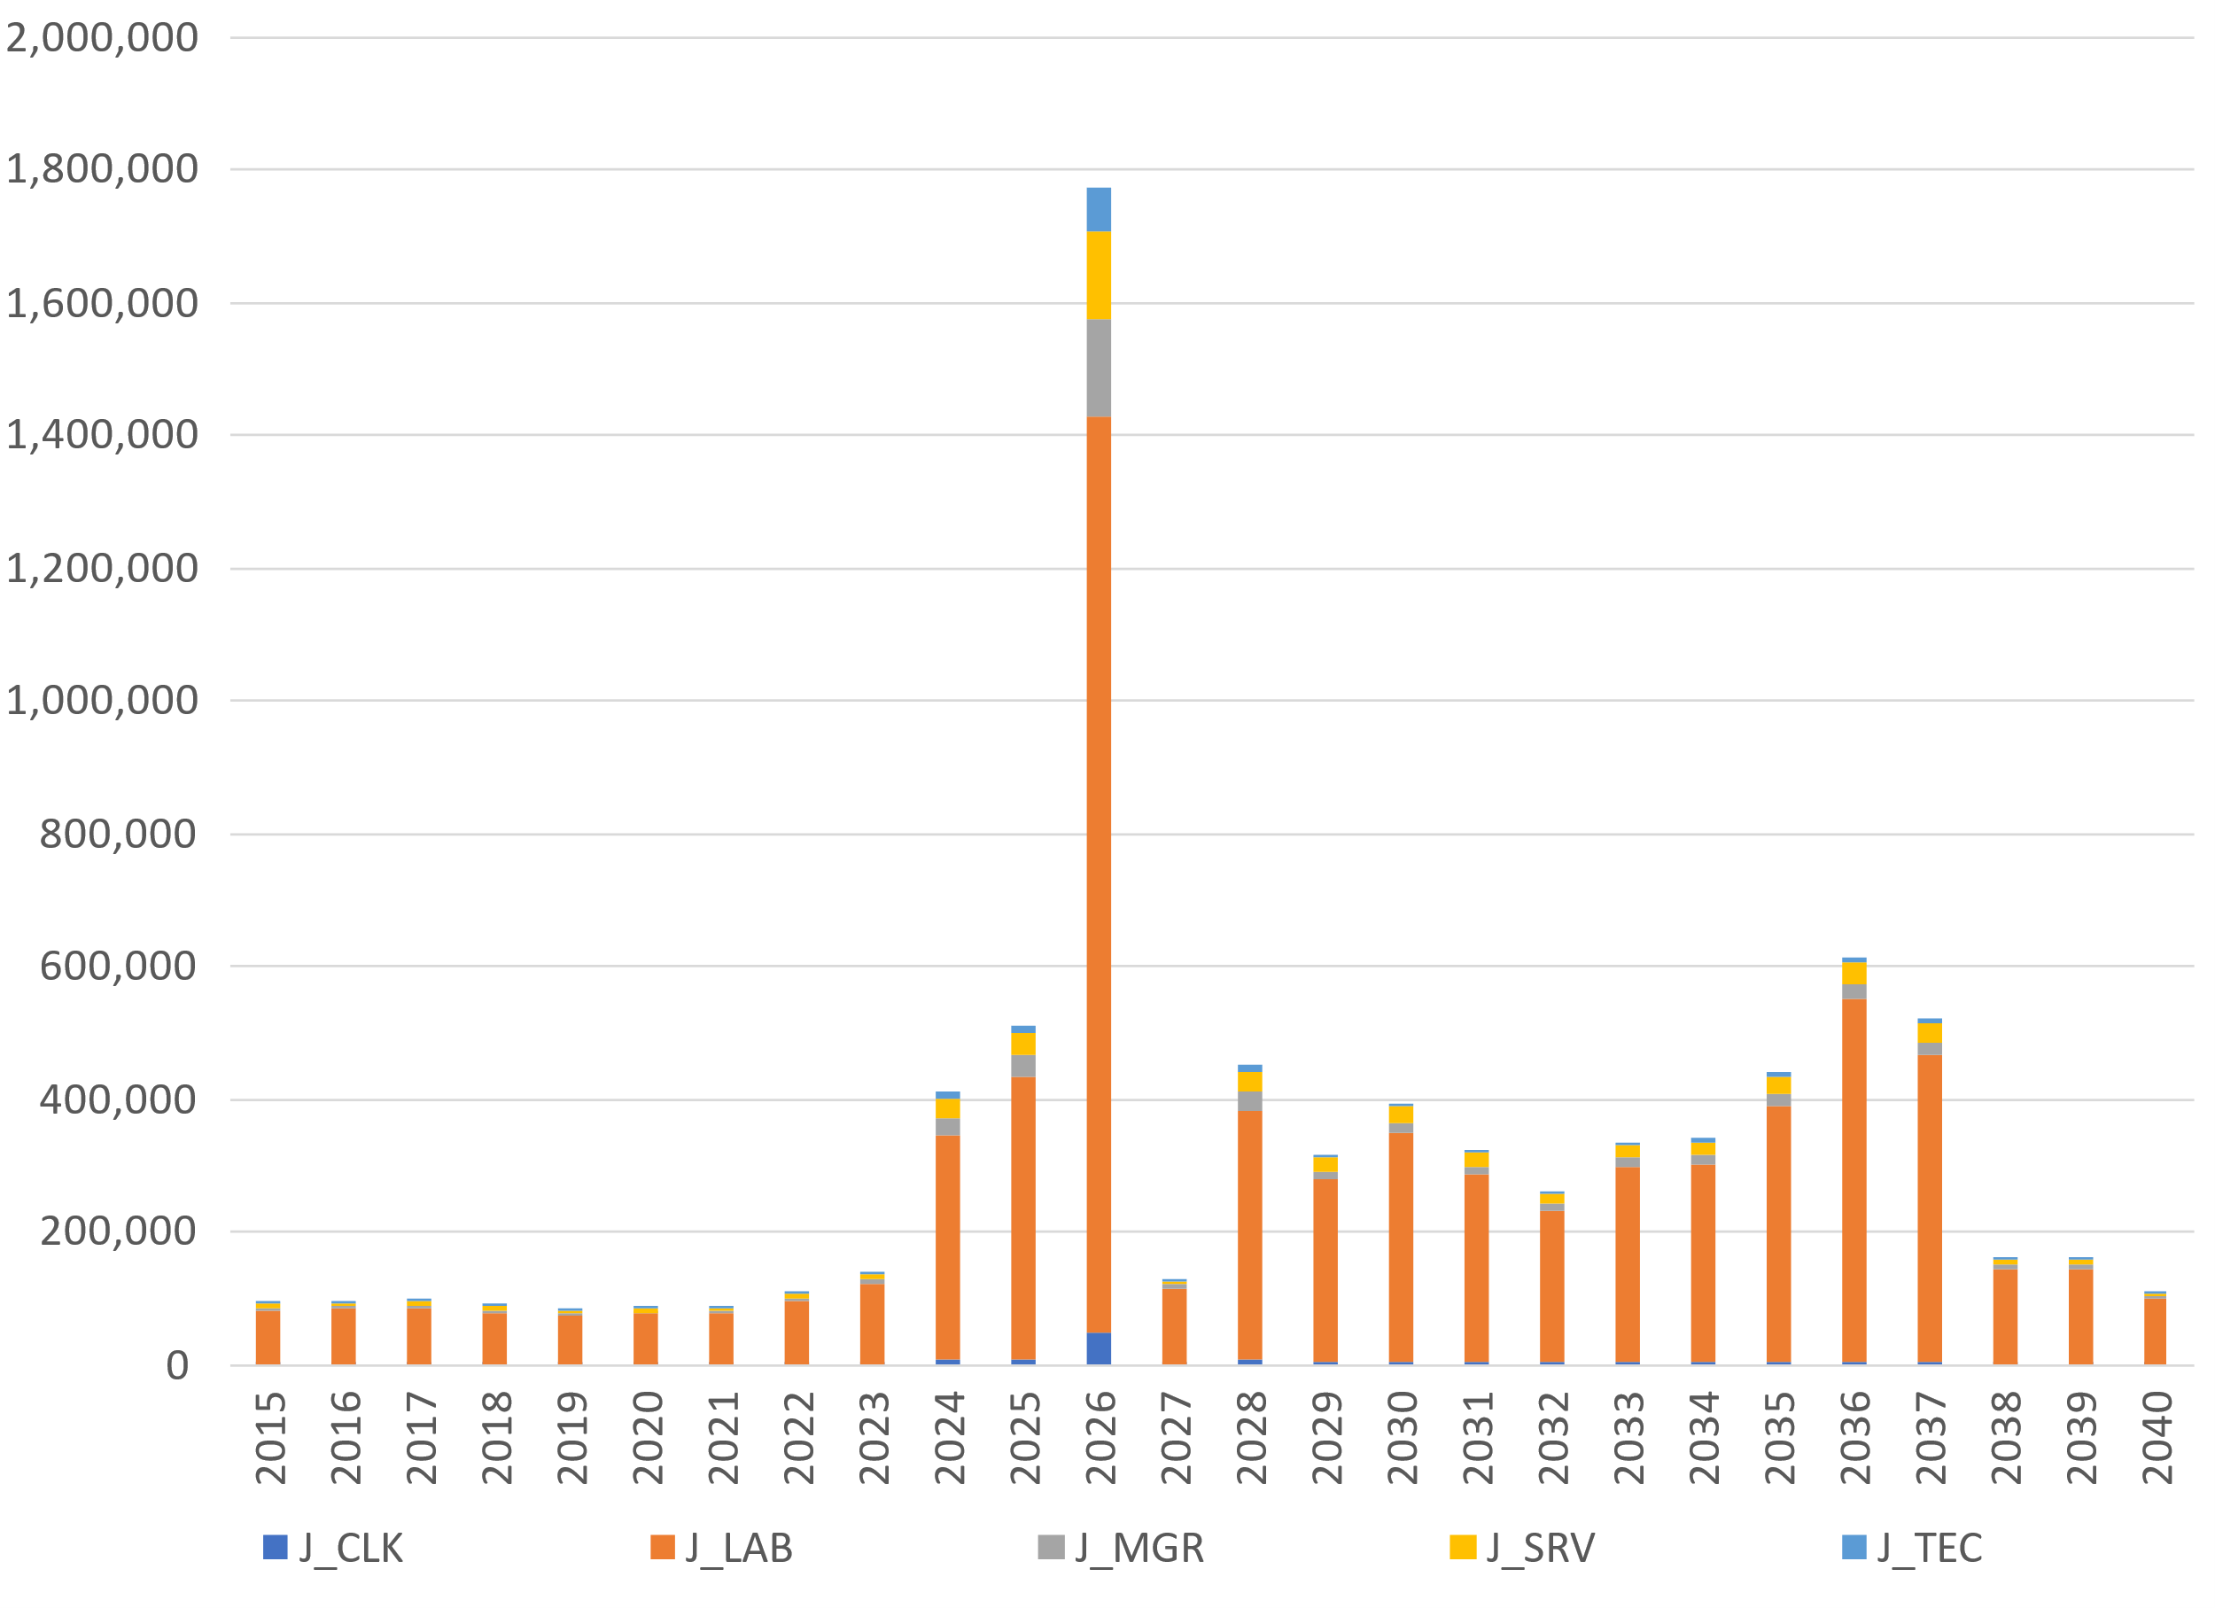
Results: Construction + O&M, Jobs by Occupation
Notes:
Predominantly laborers again due to geothermal extraction work (on both construction and operations sides)
Though there is some increase in more skilled labor which may require additional jobs training

Slide 16
Key Takeaways
Potential of roughly quadrupling jobs impacts to support projected capacity expansion over next 20 years
Jobs supporting operations will expand by an order of magnitude–10,000 to 100,000 by 2040–primarily in the extraction sector due to geothermal
Job expansion is predominantly for unskilled labor, but the scale of expansion will require jobs training for the other skill types
Potential for substantial labor shortages in 2028 to offset hydro retirements
Future Research
Refine quantification of labor impacts
Skills assessment and labor pipeline to support capacity expansion
Job impacts of alternative expansion scenarios (e.g., if not predominantly geothermal)
Notes:
From our multipliers (using GTAP+ILO), our implied average wage is $1,160, which is lower than 2020 GDP per capita of $1,838. This suggests that our mapping of labor categories into expenditure categories could be further refined.
Implied wage = per job per project per year

Slide 17
Thank you!

Slide 18
APPENDIX

Slide 19
Background: Supply-side Benefits of Electrification Investments
Investment in electricity sector capacity supports a variety of economic activity: equipment purchases, labor to manage and execute construction, and the materials, energy, and services required to support construction
Investment dollars spent on wages for those constructing facilities provide direct wage benefits, typically to local or regional residents
Expenditures on procuring goods and services to support construction also support indirect wage benefits throughout the electricity construction supply chain
To the extent wage benefits occur locally, the wages will be spent for consumption, “inducing” another round of spending in the economy

Slide 20
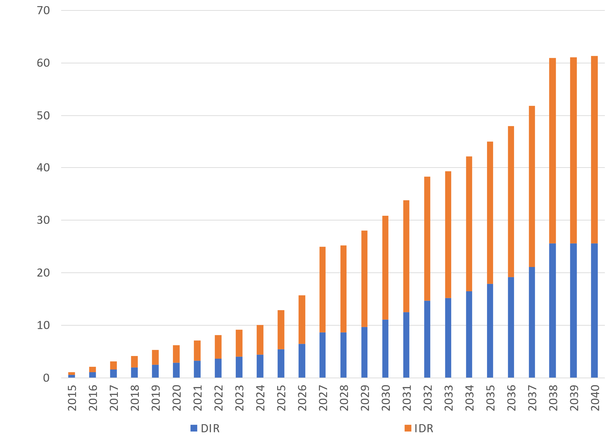
Results: Operating Impacts, Direct & Indirect Income (MM $US)
Notes:
Majority is indirect income
Direct income primarily from laborers

Slide 21
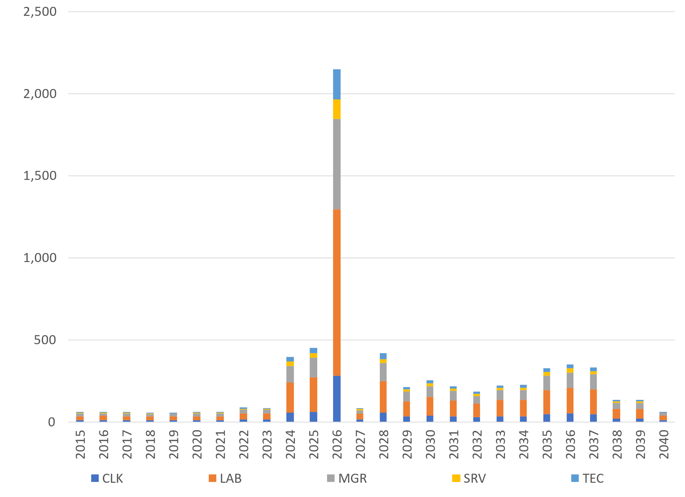
Results: Construction + O&M, Income by Occupation (MM $US)

