Slide 1
Modelling the impacts of a surge in shipping costs
25th Annual Conference on Global Economic Analysis "Accelerating Economic Transformation, Diversification and Job Creation"
Emanuele Ferrari & Panayotis Christidis
June 8-10, 2022 - Virtual Conference

Slide 2
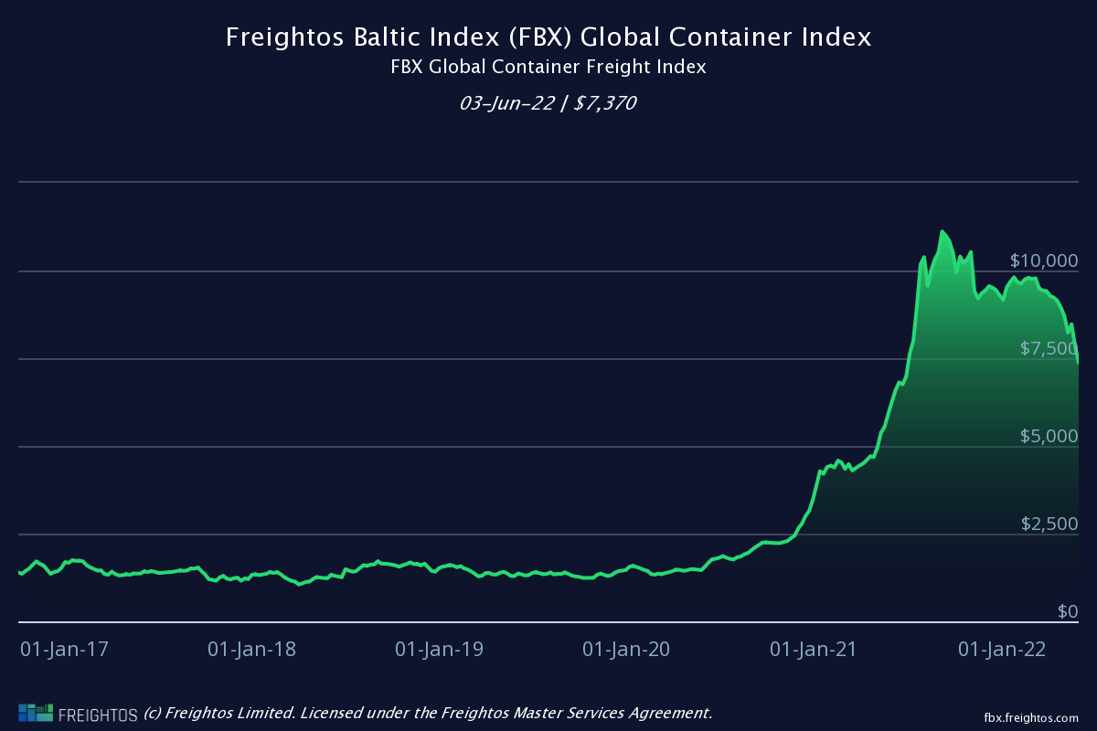
Following the collapse in global trade in the first half of 2020, global merchandise imports recovered, and by November 2020, they reached their pre-crisis level.
The strong recover in global manufacturing activity caused a rise in international orders and resulted in supply bottlenecks, and the rise of ocean freight shipping costs, especially for containerized goods.
Notes:
According to the Freightos Baltic Index (FBX), a global container freight index, the freight rates in August 2021 reached $10,174/FEU, an increase of 466% on the previous year and plateau at around $9,000/FEU during 2022.

Slide 3
Contribution
Evaluate the impact of the increase of freight transport costs on the global economy.
Will it have an impact of domestic price? (Carrière-Swallow et al., 2022).
Will the war in Ukraine cause further disruptions to supply chains, keep global shipping costs, and their inflationary effects higher for longer.
The GTAP model and all GTAP-based models represent transport cost using explicit approach ad have been widely employed for analysis related to the transport sector.
Integrate MAGNET with:
a detailed international transport costs published by UNCTAD (United Nations Conference on Trade and Development).
Distance database
Index transportation costs (Freightos Baltic Index).

Slide 4
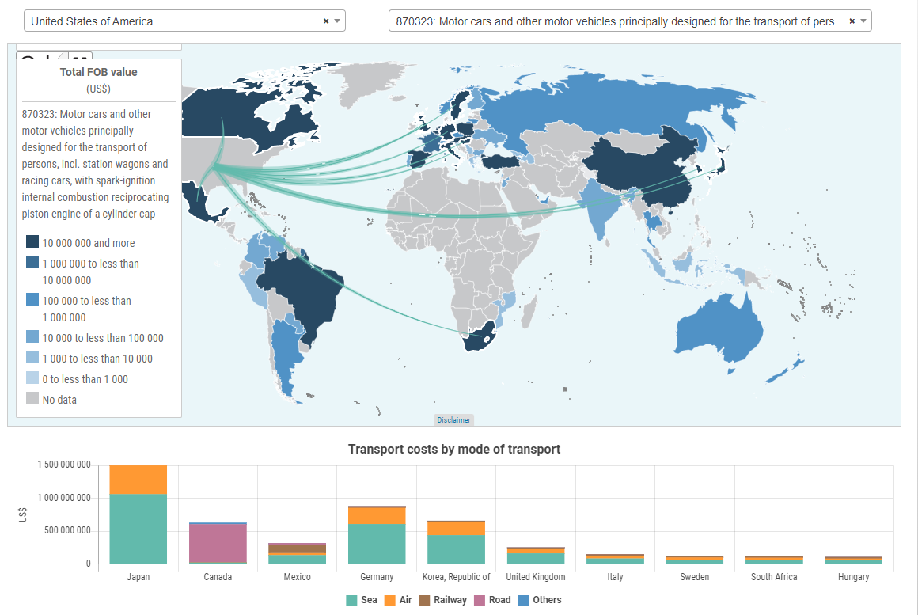
UNCTAD Global Transport Costs Dataset for International Trade
The dataset cover all modes of transport, all commodities and as many countries as possible (COMTRADE Plus):
135 importing countries
235 exporting countries
25 million trade records.
Transport costs are defined as the monetary price charged to transport a commodity from the exporting country to the importing country.
Reference year: 2016
https://unctadstat.unctad.org/EN/TransportCost.html
Notes:
The main new data source used in this work is the UNCTAD Global Transport Costs Dataset for International Trade (UNCTAD, 2021). The dataset includes a set of six input and output tables, each distinguished by mode of transport. In the application presented here, we use the raw data (input) tables for international trade transported by sea. The reference year is 2016.
Additionally, a distance matrix has been added to obtain mode-specific information on transport distances between countries and to include another input variable:

Slide 5
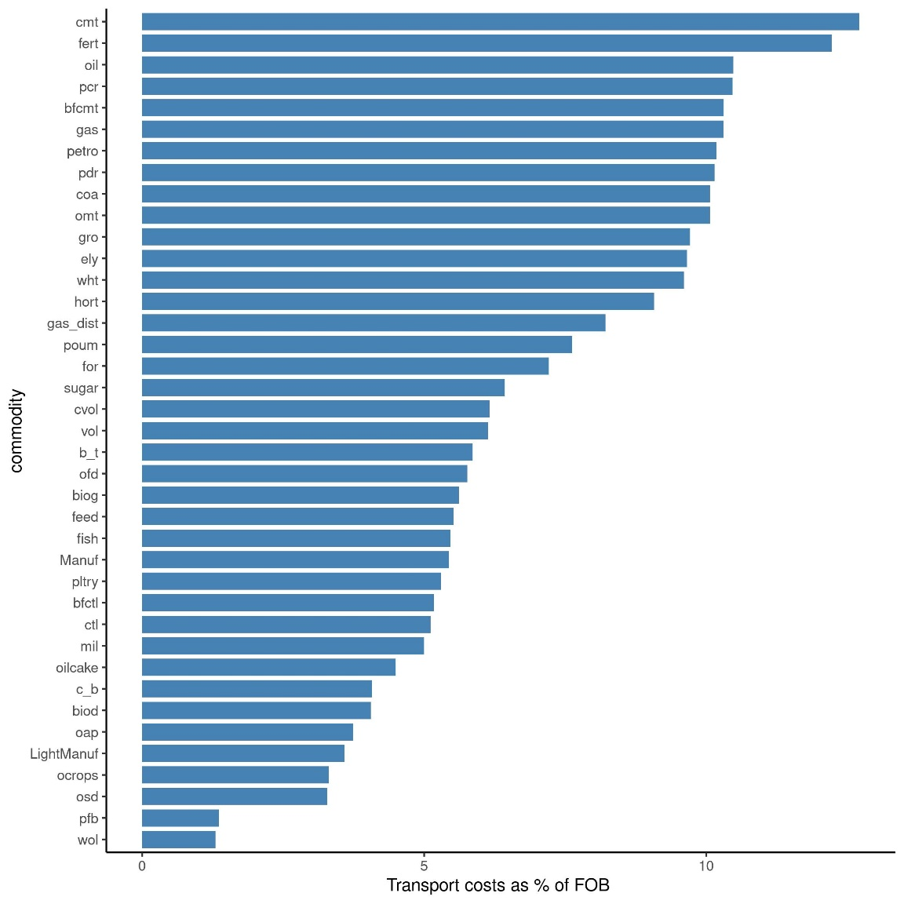
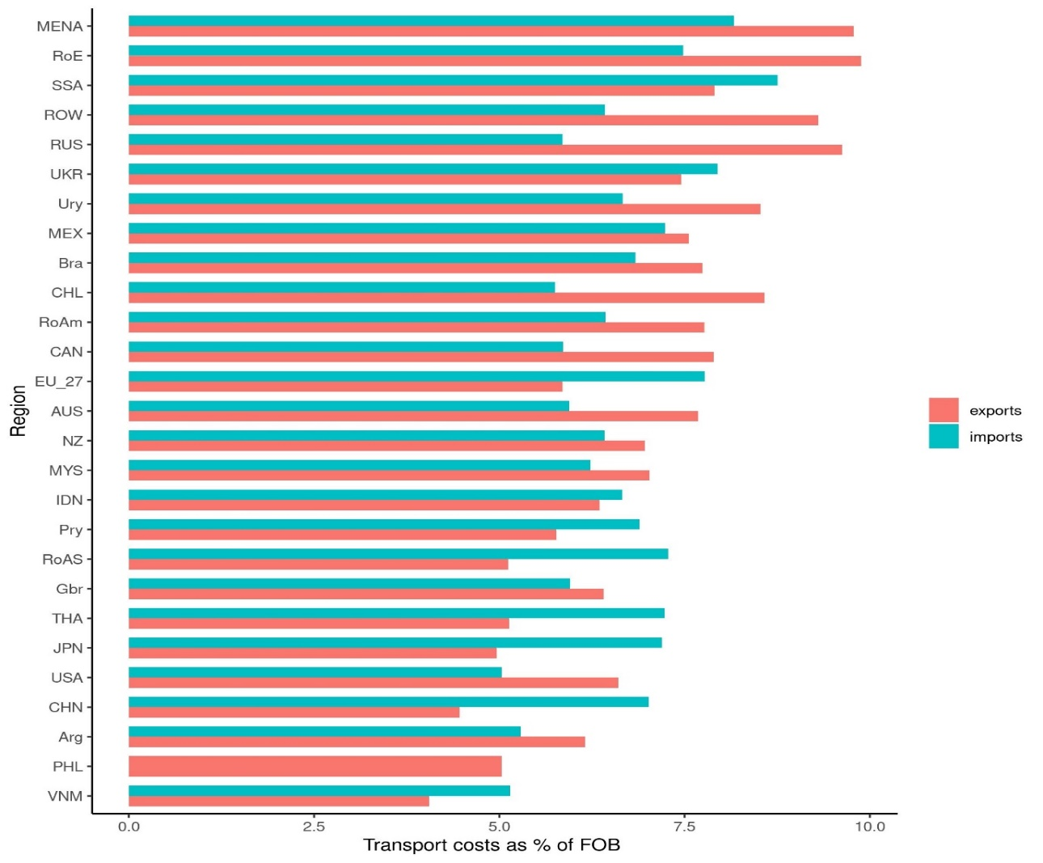
Transport costs as % FOB (commodities and regions)
Notes:
The ratio between transport costs (considered as the difference between CIF and FOB prices according to the UNCTAD definition) and FOB prices. The difference in values reflects an inverse relationship between the value-to-volume ratio and the transport costs per unit of value of the goods transported. The majority of commodities for which transport costs represent more than 6% of FOB price are low value to weight/volume products that are normally transported in bulk (crude oil, rice, gas, oil products, coal, cereals, etc.), or require special conditions for transport (meat, vegetables and fruits, live cattle, etc.)
The interplay of the product mix and geographical distribution is quite visible. Depending on the type of commodities, each region imports/exports, and the geographic distance from the trade partner regions, the average impact of transport costs on prices varies significantly by region, as well as between imports and exports for the same region. China is an example of the difference between imports and exports. Since China’s international maritime trade mainly consists of importing raw material (usually in bulk) and exporting manufactured products (most frequently in containers), transport costs represent 7% of the total FOB value of imports and only 4.5% of the total FOB value of exports. A similar imbalance can be observed for EU27: 7.8% for imports, 5.9% for exports (the difference with China is due to the combination of different product mix and average distances). In contrast, USA and Australia show the opposite pattern: the repercussion of maritime transport costs are higher for exports than for imports, mainly because of the high share of raw materials (oil for the USA, coal and iron ore for Australia) in their total exports. The geographic distribution of their markets also influences, with Australia needing longer transport distances than the USA (or most other regions) on average.

Slide 6
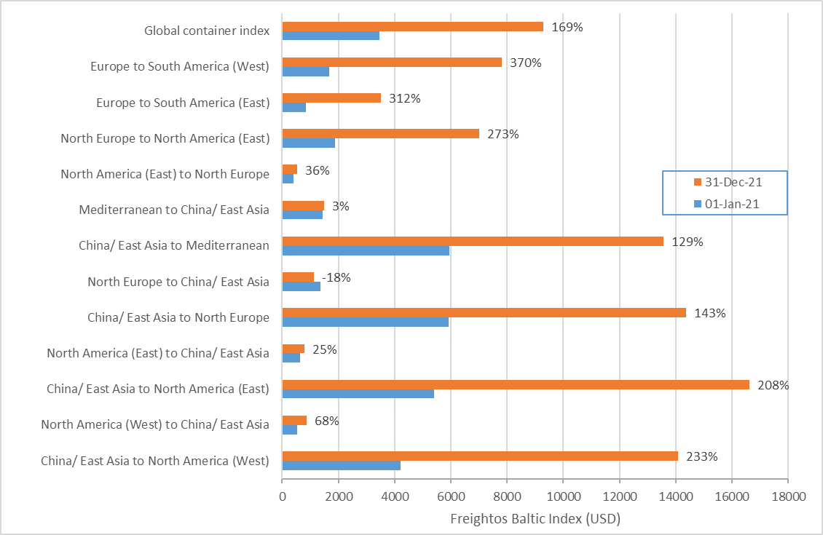
Change in container price index
Notes:
The other main source used in this work concerns the data on the changes in maritime transport rates using the Freightos Baltic Index (Freightos, 2022). The index tracks daily average market rates from container shippers and represents a benchmark for the evolution of prices across the international maritime container transport market. We extracted data for 13 different regional combinations as regards the change in their respective market index between 1st January 2021 and 31st December 2021 (Figure 4). The indexes reflect the market imbalances that led to a steep increase in container rates, namely the increase in exports from China following the post-Covid recovery of international trade, the congestion in Chinese and US West coast ports and the bottleneck created by the lack of empty container

Slide 7
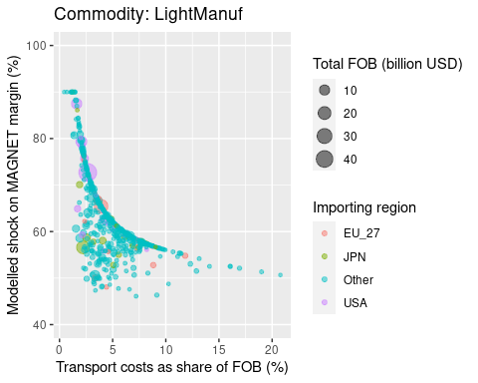
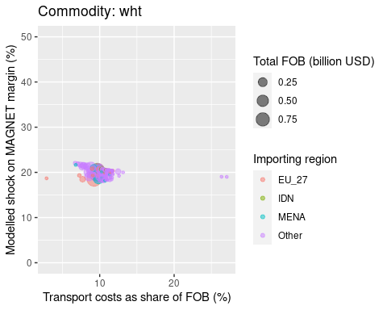
MAGNET margin and transport costs as share of FOB price, by origin-destination combination
Notes:
To simulate the impact of the increases in container shipping rates, we decomposed the transport cost data into elements that can account more accurately for the part that corresponds to the container cost. We formulated a function of transport cost per value of product that distinguished between a fixed part that depends on the loading/discharging port and a variable part that depends on transport distance.
The processed dataset, using MAGNET commodities and sectors, contains 12808 observations. For each commodity c, we applied a regression model that aimed at estimating the variable transport component of total costs:
EU-27 shows more variance in that respect, with imports from certain (distant) destinations having a ratio of over 8%. On the other hand, the change in the estimated change in the MAGNET margin is more limited for the EU than for USA, as direct repercussion of the increase in transport costs from China, which were more pronounced in the case of USA. In contrast, Japanese imports of light manufacturing were affected less, since the distance to China is small (and thus not affected significantly by the increase in container rates) and the transport costs of imports from the USA or Europe did not rise extensively.
For wheat, which at sea is exclusively transported by dry bulk, the transport cost to FOB price ratio tends to concentrate at a higher level around 10% (wheat being- as discussed above- a low volume to weight product). The increase in container rates does not affect the increase in the margin assumed in MAGNET, since transport rates for dry bulk have only increased by 40 on average

Slide 8
Applied Transport shocks

Slide 9
Modelling approach
Data
Processing
Modelling
MAGNET: Multi-sector, multi-region dynamic CGE model.
GTAP Version 10
45 Sectors:
14 primary agriculture commodities, 13 Food and beverages and 18 other sectors.
27 Regions:
EU, UK, Australia, Canada, Japan, Mercosur, Mexico, New Zealand, United States, China, Ukraine, Russia…
Standard GTAP model for international transport.
UNCTAD transport costs data
Aggregation at MAGNET commodity & region levels
Sub-model of transport cost contribution to final prices
Shipping rate indexes (containers & bulk)
Mapping with MAGNET (country groups and transport type)
Estimated change in MAGNET margin
MAGNET simulation of increased transport costs

Slide 10
Results – Global CIF prices and trade volume
Notes:
The volume of world trade would decrease by 0.42%, while the value of world trade would decrease by 0.23%.

Slide 11
Trade results
Global imports
CIF Price index of imports, by region

Slide 12
Results - EU Trade impacts
EU exports pork
EU imports vegetable oils

Slide 13
Macroeconomic results
Terms of trade
GDP

Slide 14
Price index for private consumption expenditure, cereals, primary agriculture and processed food

Slide 15
Sensitivity analysis

Slide 16
Conclusions
The model is sensitive to the variance of transport costs. Applying specific origin-destination dependent margins (as opposed to a uniform increase of the margin per commodity) improves the realism of the results.
The non-uniform increase in transport costs allows demand to shift towards the markets with the lowest CIF price and creates a within-sector substitution effect.
The second order effects on trade across all commodity groups are also considerable. Even commodities that are not directly affected by costs in transport (no change in the margin) present fluctuations in their prices and volumes, reflecting the changing conditions in their input sectors.

Slide 17





Keep in touch
EU Science Hub: ec.europa.eu/jrc
@EU_ScienceHub
EU Science Hub – Joint Research Centre
EU Science, Research and Innovation
EU Science Hub
Notes:
Delete/update as appropriate

Slide 18

Thank you
© European Union 2021
Unless otherwise noted the reuse of this presentation is authorised under the CC BY 4.0 license. For any use or reproduction of elements that are not owned by the EU, permission may need to be sought directly from the respective right holders.
Notes:
Update/add/delete parts of the copy right notice where appropriate.
More information: https://myintracomm.ec.europa.eu/corp/intellectual-property/Documents/2019_Reuse-guidelines%28CC-BY%29.pdf

