Slide 1
Multilateral Context for EU-Australia Economic Cooperation
26th Annual Conference on Global Economic Analysis, Bordeaux
14-16 July 2023
Paul Gretton
East Asia Bureau of Economic Research, Crawford School and
Centre of European Studies
The Australian National University
(Not for quotation or circulation; Comments welcome)

Slide 2
Abstract
Following the GFC, growth in global trade has been sluggish with recent trade and regional tensions providing doubt as to whether these trends will change any time soon. There is, therefore considerable uncertainty about how the EU-Australian economic relationship will evolve over the next decades. This paper first uses longer-term projections of the global economy implemented in the GDyn-FS dynamic global general equilibrium model, to suggest global exports could expand to reach around 35 percent of global output by 2050 from the current level of around 30 percent. Such a change would likely be accompanied by a re-orientation of trade between regions and materially influence the EU-Australia economic relationship and global trading relationships more broadly. It then draws on differences between regions in energy demand, productive capital and the distribution of real wealth to provide a wider context for EU-Australia economic cooperation over the coming decades.

Slide 3
Context of this presentation and intended outcomes
Contribution to Jean Monnet Centre of Excellence Grant Project on Closer Economic Cooperation between EU and Australia
  Coordinated by Centre of European Studies ANU
Deeper understanding of possible future trade growth trajectories in a global context
Some implications of convergence of per capita primary energy consumption for global energy demand
Policy implications bearing on EU-Australia economic cooperation
Analysis Included in a broader workshop
  https://ces.cass.anu.edu.au/sites/default/files/docs/2023/5/2023_vol_14_no_2_CoE_Academic_Workshop.pdf

Slide 4
Methods
Utilize the GDyn-FS model – a multi-region, multi-sector dynamic global general equilibrium model (Ianchovichina & Walmsley 2012, Gretton 2022)
Novel features of GDyn-FS
  Projects a stable long-run base line with non-convex adjustment costs
  Includes a rate of return rule for the allocation of saving between regions
  Relaxes the assumption of fixed shares consumption-saving decisions
  Exhibits imperfect mobility of factors across regions
  Relaxes Leontief technology in intermediate input use
  Includes exogenous national consumption-saving choices and trade intensities
  Can compare projected trade shares in a target year (2050) with shares in a benchmark year (pre-COVID year of 2020)
Model projections complemented with data analysis

Slide 5
A summary database used – 2011 base year projected to 2021 then forward to 2050…
6 regions | 13 industry sectors | 5 primary factor inputs
Australia (AUS) China (CHN) Japan (JPN) United States (USA) European Union +1 (EU28) Rest of the World (ROW) | Grains, Crops, Forestry Livestock, fishing Mining Processed food Textiles and clothing Light manufacturing Heavy manufacturing Utilities Construction Transport and communication Financial services Other services Ownership of dwellings | Land Natural resources Skilled labour Unskilled labour Capital

Slide 6
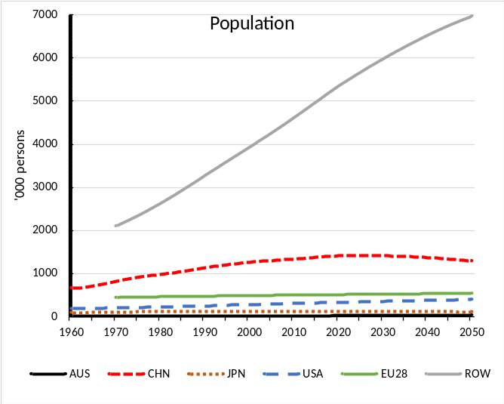
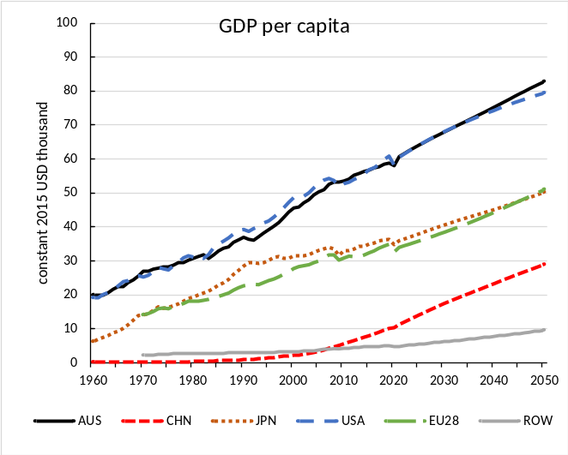
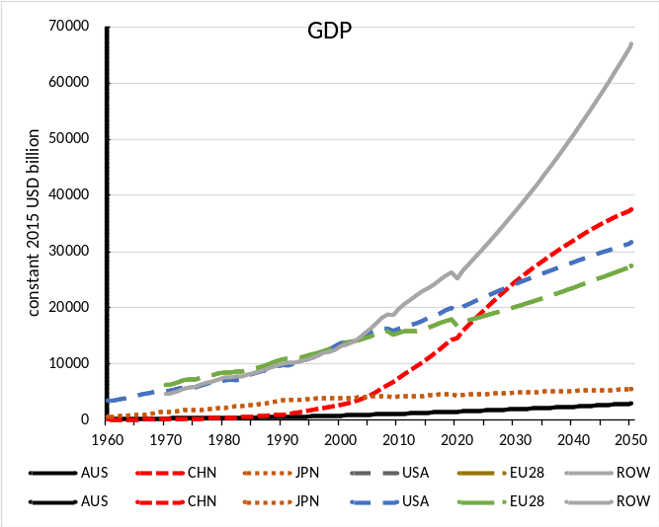
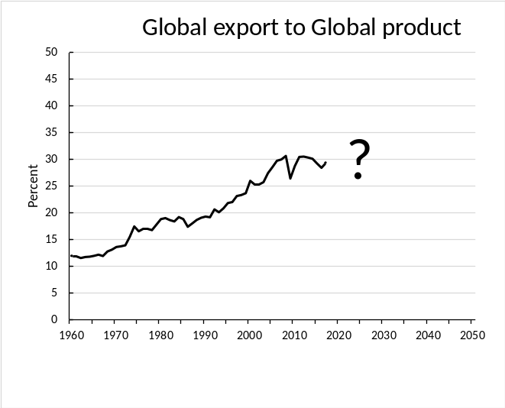
Global population & output are rising, per capita output gaps remain
Key points
  Population expanding in ROW; flat/tapering elsewhere
  GDP: expanded rapidly post-2000 in China, projected to taper; gradual build-up for ROW
  Large differences in per capita output projected to remain
  Likely change in the centre of gravity in global trade & commerce, but uncertain future
  Convergence of per capita output requires energy and capital
Sources: WDI, ILO, IMF, SSP2 (LR projections), Author estimates.

Slide 7
Adopt a scenario approach to consider trade potential of regions
Scenario 1: Moderate increase – central case
  Export shares
    Common criteria except China and ROW: 2019 value uplifted by 10%
    China: Export share to converge to the average of Japan and the USA
    ROW: the 2019 value uplifted by 10% PLUS close half projected gap with EU28
  BoT share: Average across data years (circa) 1960 to 2019
  Import share: Target Export share less target BoT share
Scenario 2: Lower potential
  Scenerio 1 with Uplift of 2.5%; ROW does not close gap with EU28
Scenario 3: Higher potential
  Scenario 1 with Uplift of 20%; ROW closes 75% of gap with EU28

Slide 8
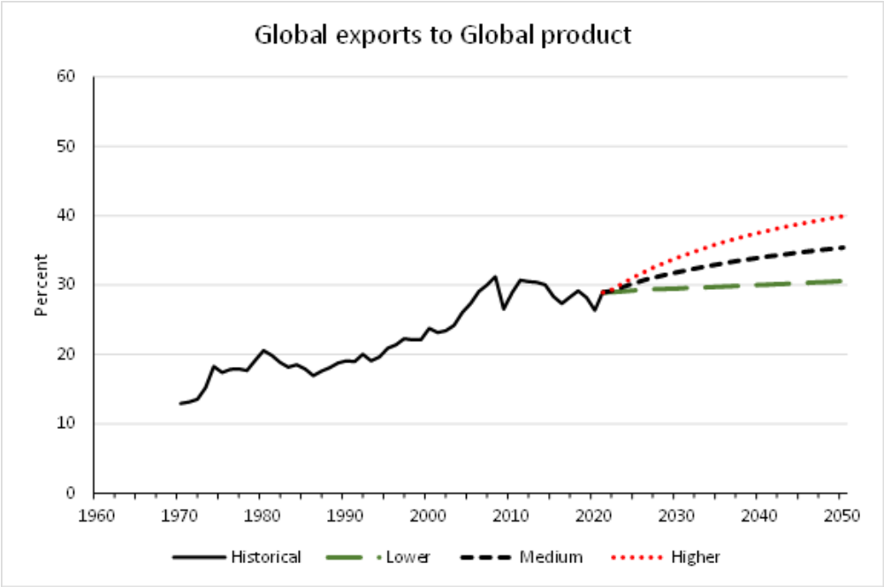
The forward scenarios reflect different potentials compared to history
Under medium growth scenario, exports could reach around 35% of global product by 2050
Implying a trade elasticity of ~1.2 over the 2020 to 2050 period
Higher growth resumes historical growth path
Lower growth represents continuation of status quo
Sources: WDI, Author projections.

Slide 9
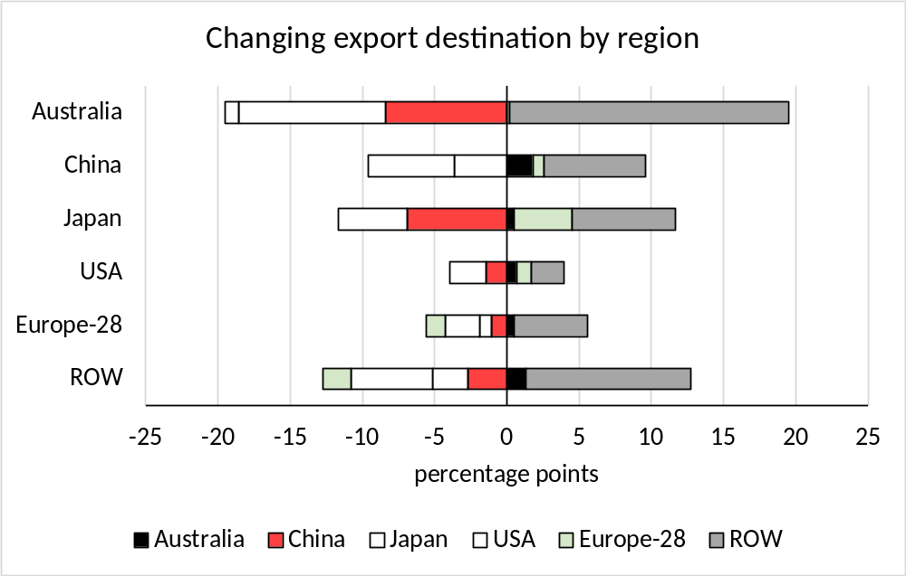
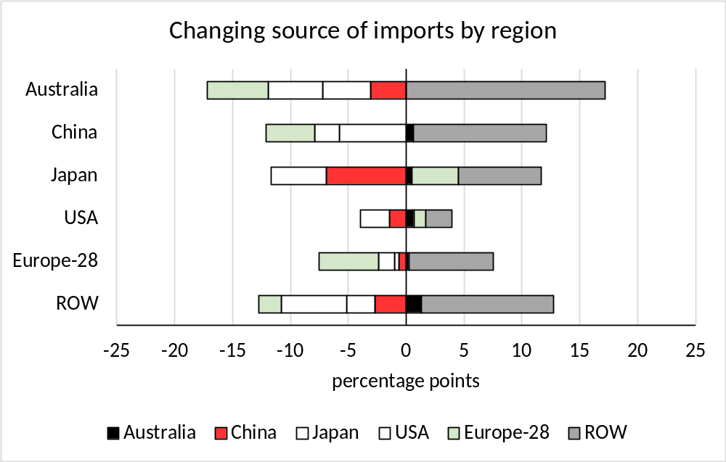
And the trade orientation of all regions likely to shift towards the developing world, 2020 to 2050
Source: Author GDyn-FS projections.
As economic gravity shifts towards the ROW, countries across that area are projected to increase in importance as a destination for exports & as a source of imports
Trade footprint between countries in the ROW area likely to increase

Slide 10
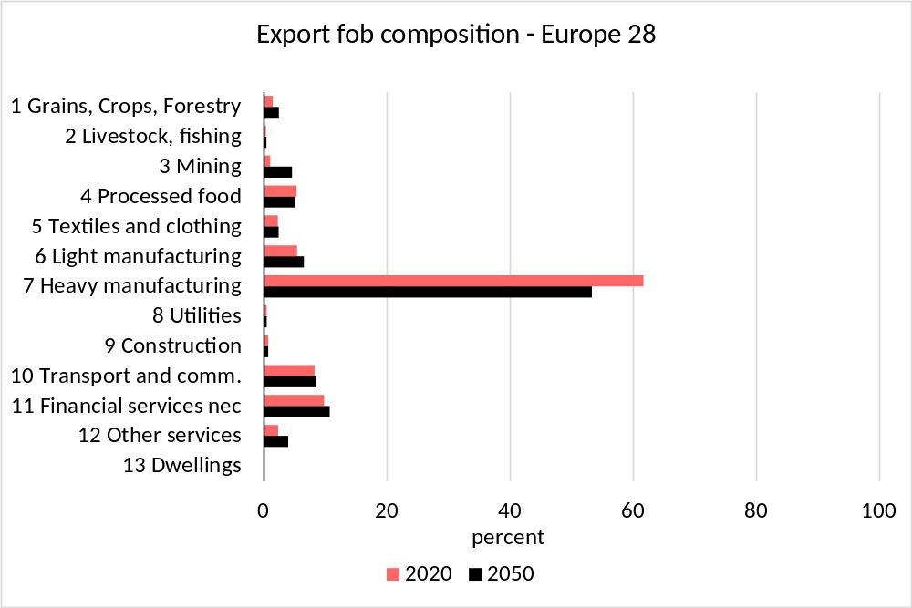
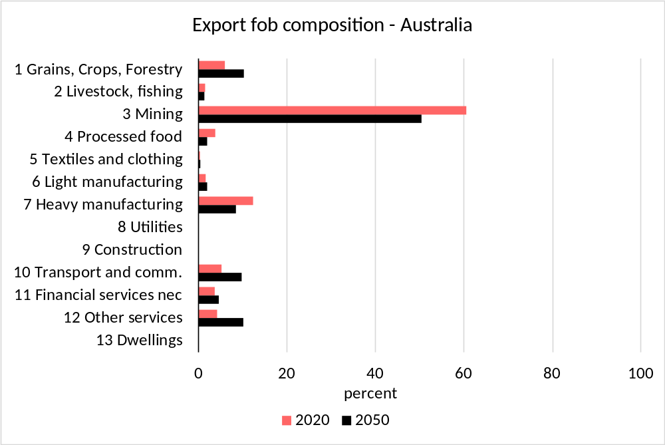
Export focus remains on traditional sectors, but some subtle re-orientation possible
Source: Author GDyn-FS projections.
EU export focus projected to remain with Heavy manufacturing
Australian export focus projected to remain with Mining products
Services exports (mainly to ROW) projected to increase in importance, more so from Australia

Slide 11
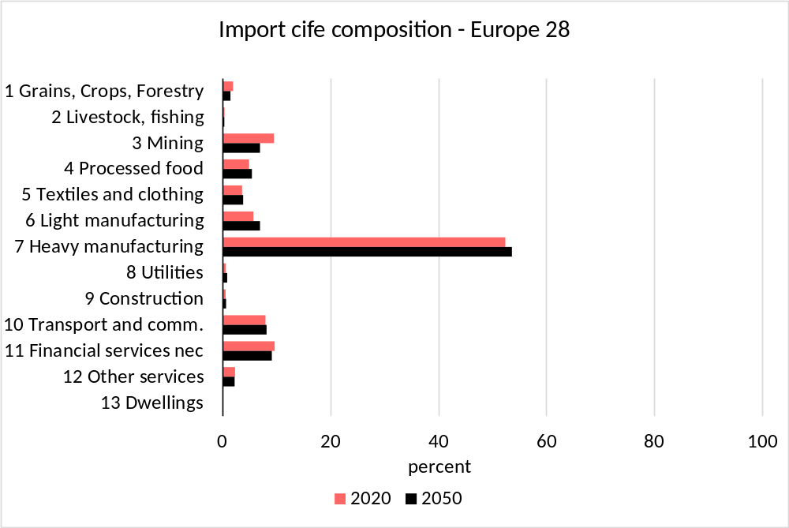
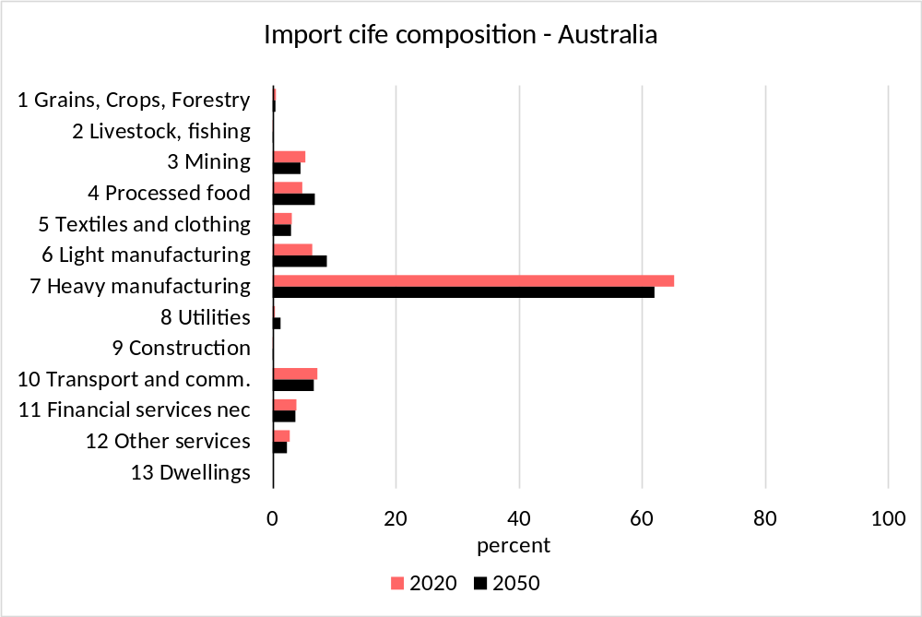
Import focus also remains on traditional sectors, but again some subtle re-orientation possible
Source: Author GDyn-FS projections.
EU import focus projected to remain with Heavy manufacturing - intra-industry trade
Australian import focus projected to remain with Heavy manufacturing - capital goods, vehicles
Some tilting to Light manufactures (particularly from ROW)

Slide 12
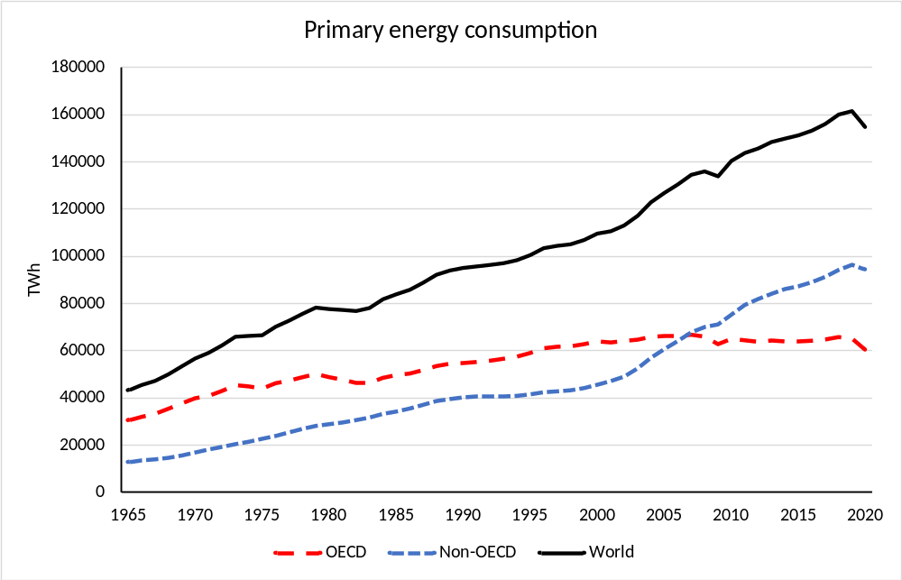
Trade & economic growth has relied on a steady increase in primary energy consumption
Sources: Hannah Ritchie, Max Roser and Pablo Rosado (2020) - "Energy". Published online at OurWorldInData.org at: 'https://ourworldindata.org/energy' (accessed 31 March 2022; Author aggregation.

Slide 13
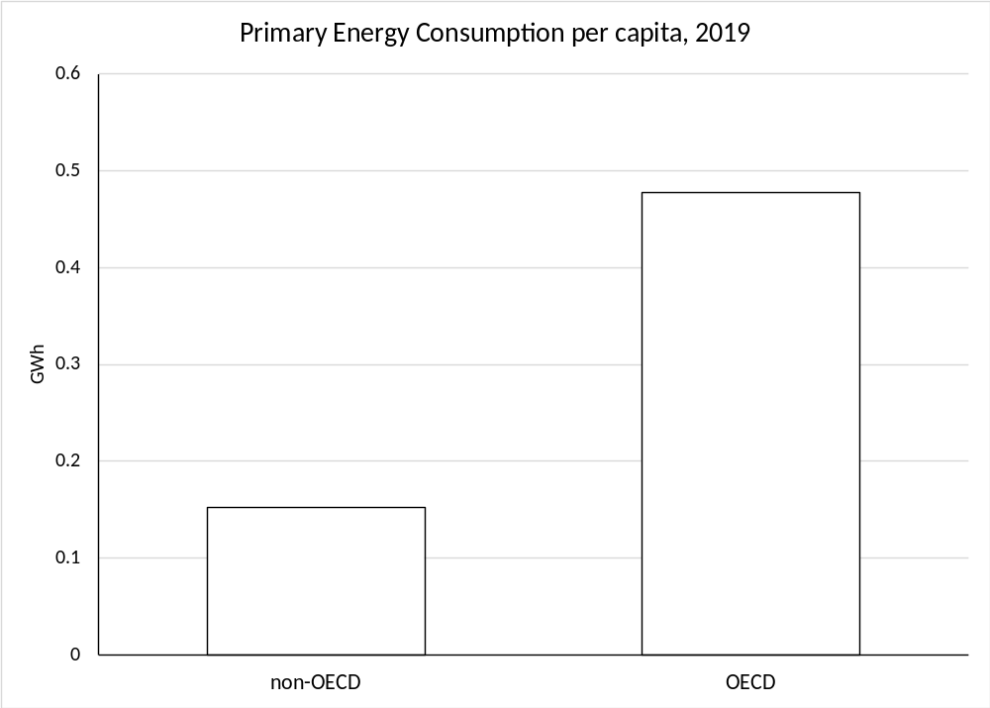
But there remains a wide gap in per capita energy consumption between OECD & non-OECD areas
Sources: Hannah Ritchie, Max Roser and Pablo Rosado (2020) - "Energy". Published online at OurWorldInData.org at: 'https://ourworldindata.org/energy' (accessed 31 March 2022); World Development Indicators; Author calculations.

Slide 14
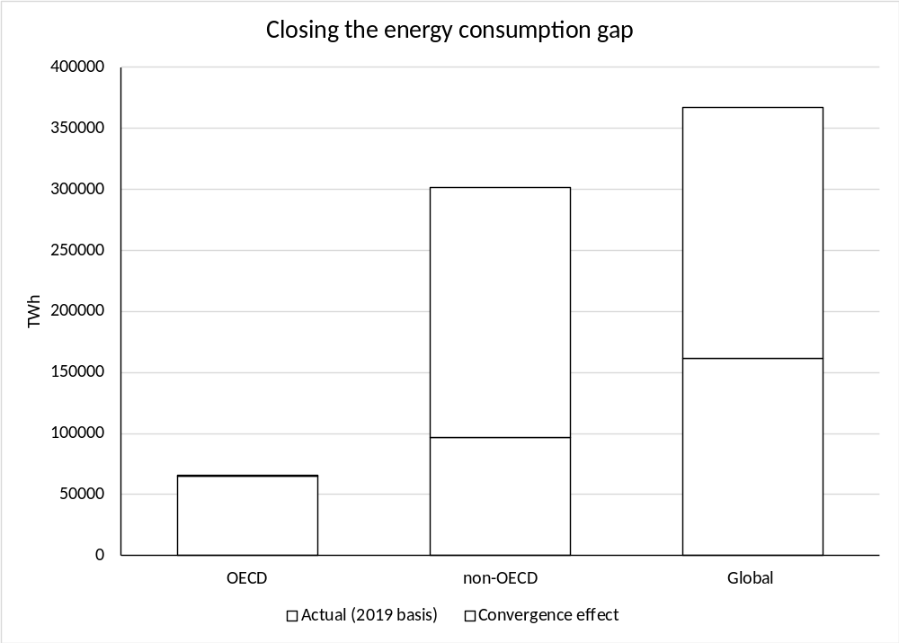
Closing the gap would imply more than doubling of global energy demand & use
Closing the gap would
  Require new technologies & ways of working
  Generate competition for resource and produced inputs (including energy, metals & minerals)
  Compete for domestic and foreign savings to fund new capital formation
  Benefit from open global markets, technological transfer
Sources: Hannah Ritchie, Max Roser and Pablo Rosado (2020) - "Energy". Published online at OurWorldInData.org at: 'https://ourworldindata.org/energy' (accessed 31 March 2022); World Development Indicators; Author calculations.

Slide 15
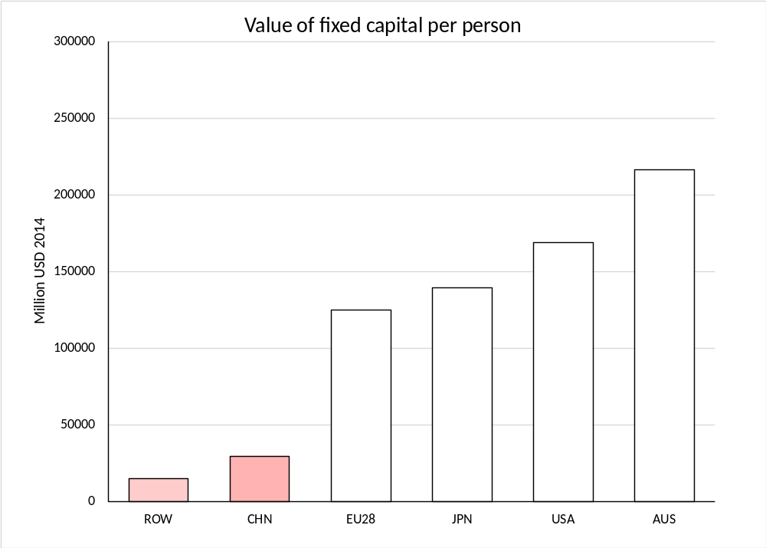
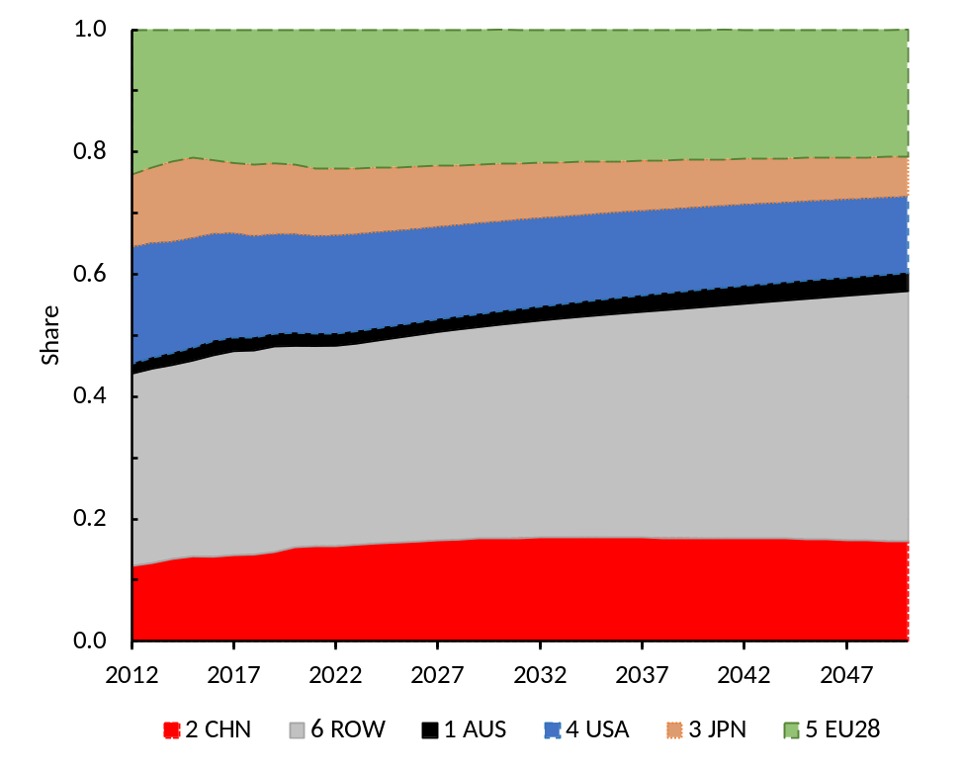
Capital deepening in the developing world will compete for funding and resources
Real wealth holdings across regions
Source: GTAP 10 data base.
Source: Author GDyn-FS projections.
… economic growth and associated accumulation of real wealth will see a changing balance of real wealth holding across regions

Slide 16
Policy implications
Shift of economic gravity between developed and developing world likely
Common elements of high regulatory standards and similar stages of economic development will remain between developed economies and naturally support closer relationships
  Impacts likely most evident and rewarding through the wider cooperation that encourages all countries to reach their productive potential
Premium on domestic policies that
  Increase competitiveness of local firms in existing and new global markets
  Lower the costs of trade across all markets
  Avoid undue impediments to trade and commerce (eg bilateral trade conflicts; RoO)
Premium on innovation and the development of new energy technologies and ways of working that help: (i) meet ongoing global energy demand; and (ii) close the energy gap between OECD and non-OECD economies
Premium on non-discriminatory multi-lateral, plurilateral and open regional institutions that promote cooperation, a non-discriminatory global order and technological transfer

