Slide 1

Assessing macro-economic effects of climate impacts on labour productivity in EU sub-national regions
Gabriele Standardi^{1,2,3} Shouro Dasgupta^{1,2,3}
Ramiro Parrado^{1,2,3} Francesco Bosello^{1,2,3}
¹CMCC – Euro-Mediterranean Center on Climate Change
²EIEE – European Institute on Economics and the Environment
³Cà Foscari University
26th GTAP Conference
14-16 June 2023
Bordeaux - France

Slide 2

Outline
  Motivations and objectives
  Methodology: empirical stategy and sub-national CGE model
  Experiment design: reference scenarios and impact modelling
  Results
  Conclusions

Slide 3
Motivations
Research on occupational health risk from increasing temperatures points to the reduction in labour productivity as a result of natural human responses to avoid damages to health, e.g. workers slow down, take more breaks to re-hydrate, and cool down (Kjellstrom et al., 2009; Parsons, 2014; UNDP, 2016); or they make more mistakes and increase accidental injuries (Bouchama and Knochel, 2002; Schulte and Chun, 2009).
The outputs of agriculture sector and to some extent industrial sector are the most affected by rising temperatures (Dell et al., 2012; Burke et al., 2015; IMF, 2017). There may still be positive impacts on some sectors and regions, e.g. some crops prosper in warmer conditions and summer tourism could benefit from increasing temperatures (Bosello, et al., 2012; Grillakis, et al., 2016), especially in Northern EU countries.
Due to the EU’s strong economic integration, it is important to look into the indirect effects of the climate change impacts and acknowledge the possibility and role of spillovers across different sectors and regions within Europe. Computable General Equilibrium (CGE) models reveal very useful to capture these indirect macro-economic effects because they are able to take into account inter-sectoral and inter-regional interactions via trade, investments and labour/capital reallocation.

Slide 4
Objectives
Assessing indirect macro-economic effects of climate change impacts on labour and analysing potential spillovers across different sectors and sub-national regions within European countries taking into account inter- and intra-national trade.
Comparing our results for Europe with recent CGE macro-economic assessments related to climate-induced impacts on labour productivity (Ciscar et al. 2014; Orlov et al. 2020; García-León et al. 2021). These studies use the Wet Bulb Globe Temperature (WBGT) approach to estimate the effects of climate on labour productivity.

Slide 5
Methodology
We econometrically estimate climate impacts on labour productivity in different RCPs and economic sectors and combine these estimates with high spatial resolution temperature projections from four Regional Climate Models (RCMs).
We implement the climate impacts on labour productivity in a Computable General Equilibrium (CGE) model, whose regional coverage has been extended to the sub-county NUTS2 and NUTS1 EU level (García-León et al., 2021).

Slide 6
Methodology: data for the empirical estimation
- 300+ micro surveys from Integrated Public Use Microdata Series (IPUMS). It comprises data for 130+ countries, including number of hours an individual respondent worked per week at all jobs. We aggregated the data on worked hours to the regional and annual level for two main sectors (agriculture and industry)
- We extracted mean temperature and maximum temperature from ERA5 at a spatial resolution of 0·25° × 0·25° and hourly temporal resolution, which was overlaid on the subregional shapefile from IPUMS
Notes:
Annual count of days with at least 6 consecutive days when daily maximum temperature is greater than 90th percentile.

Slide 7
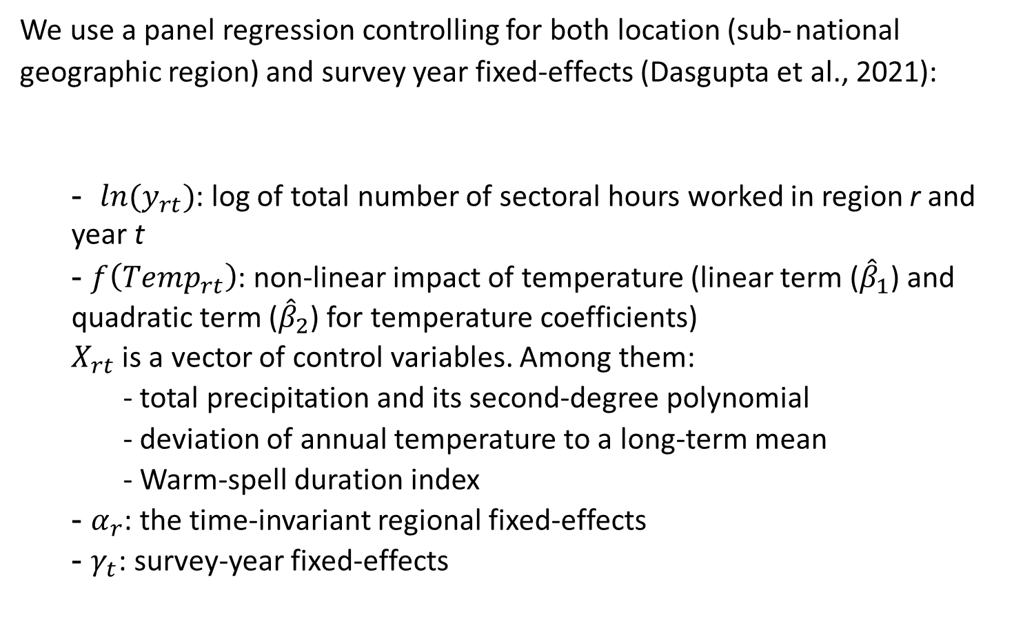
Methodology: empirical framework
We use a panel regression controlling for both location (sub- national geographic region) and survey year fixed-effects (Dasgupta et al., 2021):
  - $ln{(y}_{rt})$: log of total number of sectoral hours worked in region r and year t
  - $f\left({Temp}_{rt}\right)$: non-linear impact of temperature (linear term (${\hat{β}}_{1}$) and quadratic term (${\hat{β}}_{2}$) for temperature coefficients)
  $X_{rt}$ is a vector of control variables. Among them:
    - total precipitation and its second-degree polynomial
    - deviation of annual temperature to a long-term mean
    - Warm-spell duration index
  - $α_{r}$: the time-invariant regional fixed-effects
  - $γ_{t}$: survey-year fixed-effects
$$ln{(y}_{rt})=f\left({Temp}_{rt}\right)+ δX_{rt}+α_{r}+γ_{t}+ ε_{rt}$$
Notes:
Annual count of days with at least 6 consecutive days when daily maximum temperature is greater than 90th percentile.

Slide 8
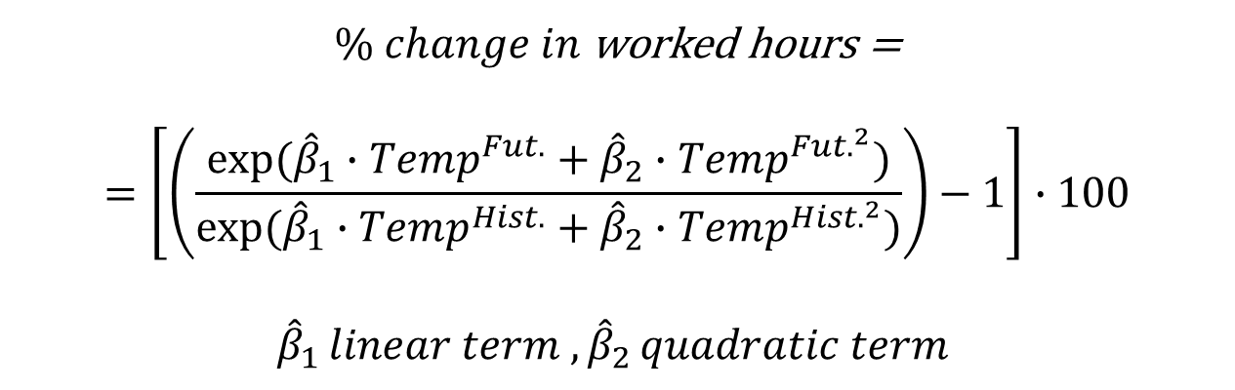
Methodology: climate-induced projections of worked hours
Climate-induced trends in regional and sectoral worked hours are obtained combining the statistically estimated coefficients for temperature with high‐resolution ensemble-mean temperature projections from four Regional Climate Models (RCMs): KNMI RACMO22E, IPSL‐CM5A‐MR, MPI‐ESM‐LR, and CNRM‐CM5 using the delta method (Dasgupta, 2018)
$\% change in$worked hours =
$$=\left[\left(\frac{exp⁡({\hat{β}}_{1}∙{Temp}^{Fut.}+{\hat{β}}_{2}∙{Temp}^{{Fut.}^{2}})}{exp⁡({\hat{β}}_{1}∙{Temp}^{Hist.}+{\hat{β}}_{2}∙{Temp}^{{Hist.}^{2}})}\right)−1\right]∙100$$
$${\hat{β}}_{1 }linear term , {\hat{β}}_{2 }quadratic term$$

Slide 9
Methodology: data sources for the sub-national CGE
We start from the Global Trade Analysis Project (GTAP) 8 database (Narayanan et al., 2012)
We use sub-national information from Eurostat (Economic Accounts for Agriculture, 2018; Structural Business Statistics, 2018; Gross value added at basic prices by NUTS 3 regions, 2018)
To regionalize the national Social Accounting Matrices (SAMs) of the European Union available in the GTAP database at the NUTS2-1 level, we use the methodology in Bosello and Standardi (2018).

Slide 10
Methodology: final geographical aggregation (Eu28)

Slide 11
Methodology: final geographical aggregation (Rest of the World)

Slide 12
Methodology: final sectoral aggregation
 | CGE sectors | Macro-sectors
1 | Vegetables and_Fruits | Primary
2 | Other Crops
3 | Livestock
4 | Timber
5 | Fishery
6 | Coal Extraction | Energy
7 | Oil Extraction
8 | Gas Extraction
9 | Oil Products
10 | Transmission and Distribution
11 | Nuclear
12 | Electricity (Fossils)
13 | Wind
14 | Hydro
15 | Solar
16 | Other Electricity
17 | Light industry | Industry&Const
18 | Heavy industry
19 | Construction
20 | Transport Road | Services
21 | Transport_Water
22 | Transport Air
23 | Services
24 | Public Services
The sectoral aggregation is consistent with the different climate impacts developed in the context
of the Coacch EU project (https://www.coacch.eu/).

Slide 13
Methodology: CGE model description (supply side)
The supply side of the CGE model is based on GTAP-E model (Burniaux and Truong, 2002).
Labour is fully employed
Labour is perfectly mobile across different economic activities but it is immobile at the regional level
In general, labour can be more easily substituted with capital in industry and services while in agriculture, fishery, forestry and mining sectors this possibility is limited by the presence of the other primary factors, land and natural resources

Slide 14
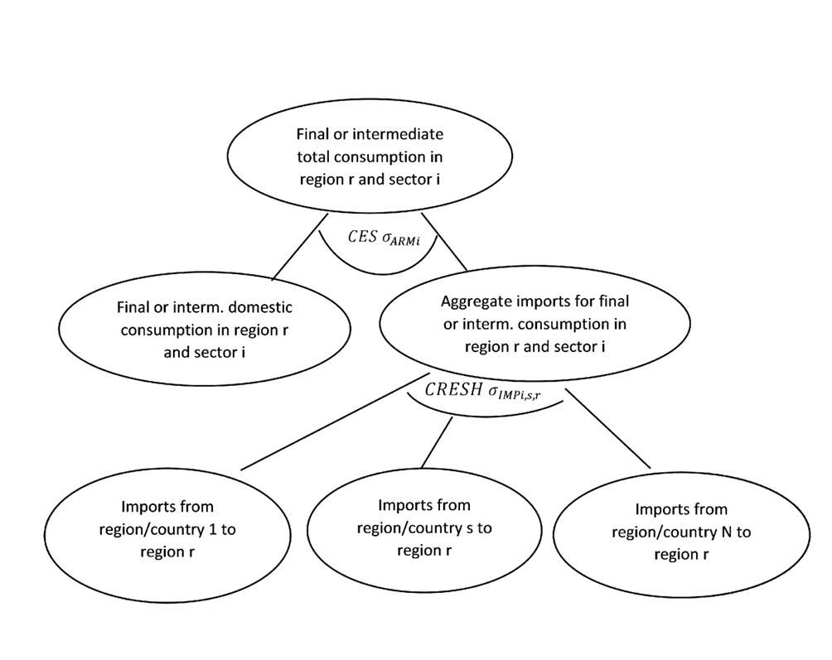
Methodology: CGE model description (inter- and intra-national trade)
We follow the GTAP double nest approach but we employ in the lower nest a CRESH function (Hanoch, 1971; Pant, 2007) which allows for more flexibility in the choice of the bi-lateral substitution for each couple of spatial units. For regions outside EU we keep the original values of the Armington elasticities. For sub-country regions we increase the elasticity value by 50%.

Slide 15
Experiment design: reference scenarios
To examine a wide spectrum of socio-economic and climatic characteristics, the macroeconomic assessment has been performed using nine reference scenarios based on combinations of Representative Concentration Pathways (RCPs) and Shared Socioeconomic Pathways (SSPs). The impact assessment is run from 2015 to 2070.
 | RCP2.6 | RCP4.5 | RCP6.0 | RCP8.5
SSP1 | ● | ●
SSP2 | ● | ● | ●
SSP3 | ● | ●
SSP5 |  | ● |  | ●

Slide 16
Experiment design: reference scenarios
We replicate GDP and population projections available at the country level in the SSP database assuming that sub-national regions follow the country trends.
 | GDP calibration | Stock of labour | Trade openness (Armington) | Elast. Substitut. between Kap&Energy | Climate policy (global carbon tax)
SSP1-RCP2.6 | Total Factor Productivity (TFP) | Follow SSP pop. projections | Default values | 1.5 | Yes
SSP1-RCP4.5 | Total Factor Productivity (TFP) | Follow SSP pop. projections | Default values | 0.75 | No
SSP2-RCP2.6 | Total Factor Productivity (TFP) | Follow SSP pop. projections | Default values | 1.2 | Yes
SSP2-RCP4.5 | Total Factor Productivity (TFP) | Follow SSP pop. projections | Default values | 1 | No
SSP2-RCP6.0 | Total Factor Productivity (TFP) | Follow SSP pop. projections | Default values | 0.75 | No
SSP3-RCP2.6 | Total Factor Productivity (TFP) | Follow SSP pop. projections | Default values reduced by 25% | 1 | Yes
SSP3-RCP4.5 | Total Factor Productivity (TFP) | Follow SSP pop. projections | Default values reduced by 25% | 1 | No
SSP5-RCP4.5 | Total Factor Productivity (TFP) | Follow SSP pop. projections | Default values | 1 | Yes
SSP5-RCP8.5 | Total Factor Productivity (TFP) | Follow SSP pop. projections | Default values | 0.75 | No

Slide 17
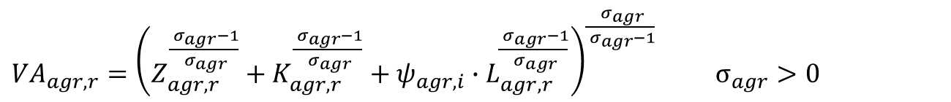
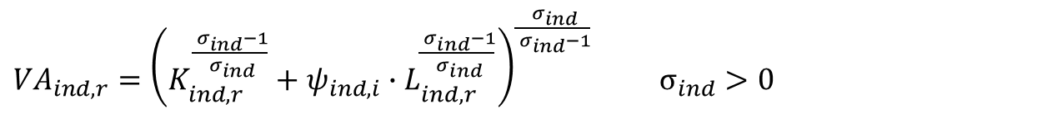
Experiment design: impact modelling
In the CGE, we use the Agricultural Value Added (VA) equation of region r and sector s represented by a Constant Return to Scale (CRS) Constant Elasticity of Substitution (CES) function of land (Z), capital (K), and labor (L) as follows:
${VA}_{agr,r}={\left(Z_{agr,r}^{\frac{{ σ}_{agr}−1}{{ σ}_{agr}}}{+ K}_{agr, r}^{\frac{{ σ}_{agr}−1}{{ σ}_{agr}}}+ ψ_{agr,i}∙L_{agr, r}^{\frac{{ σ}_{agr}−1}{{ σ}_{agr}}}\right)}^{\frac{{ σ}_{agr}}{{ σ}_{agr}−1}} σ_{agr}>0$
Then, we use the Industry Value Added (VA) equation represented by a CRS CES function of capital (K) and labor (L) as follows:
${VA}_{ind,r}={\left(K_{ind, r}^{\frac{{ σ}_{ind}−1}{{ σ}_{ind}}}+ψ_{ind,i}{∙L}_{ind, r}^{\frac{{ σ}_{ind}−1}{{ σ}_{ind}}}\right)}^{\frac{{ σ}_{ind}}{{ σ}_{ind}−1}} σ_{ind}>0$
We assume that % climate change impacts on worked hours coming from the econometric analysis (π) are applied in the previous equations as follows:
$$ψ_{s,r}^{∗}= \left(1+π_{s,r}/100\right)ψ_{s,r}$$

Slide 18
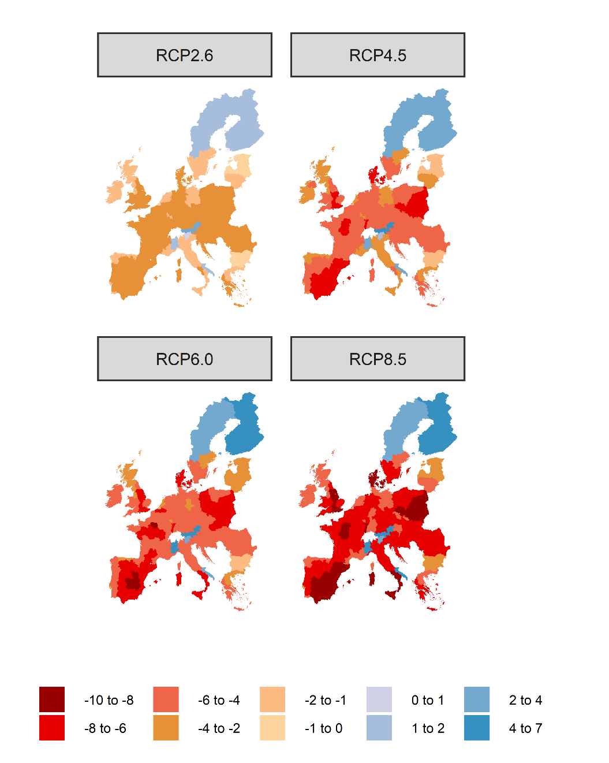
Statistical analysis results: climate-induced impacts on agriculture
% changes in worked hours in the agricultural sector over the period 2015-2070. In the CGE shocks are applied to vegetables and fruits, other crops, and livestock sectors

Slide 19
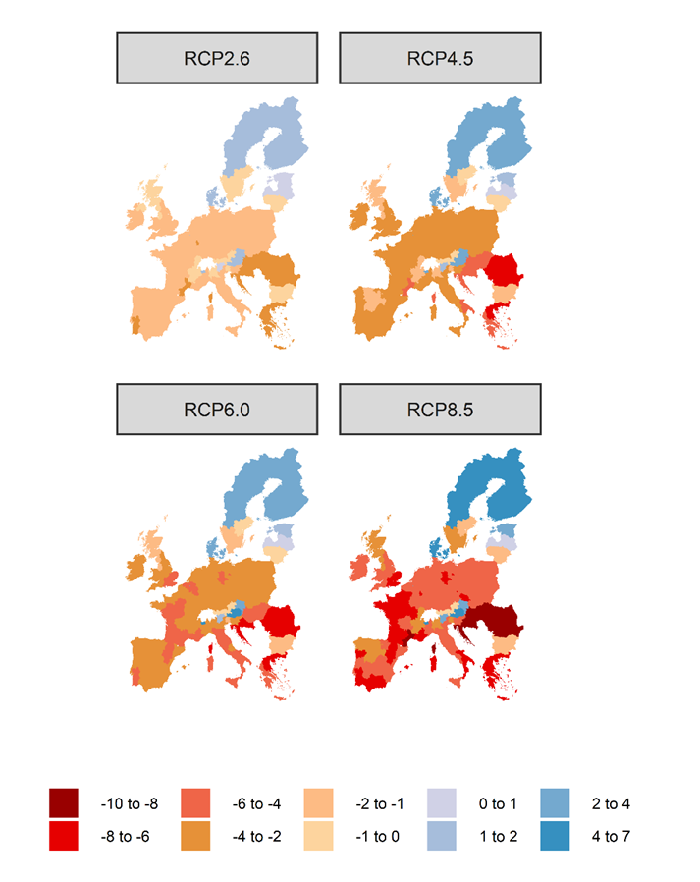
Statistical analysis results: climate-induced impact on industry
% changes in worked hours in the industrial sector over the period 2015-2070. In the CGE shocks are applied to heavy and light industry sectors

Slide 20
Macro-economic results: GDP % Ch. compared to the ref. scenario
EU-28
 | 2030 | 2050 | 2070
SSP1-RCP2.6 | -0.09 | -0.22 | -0.24
SSP1-RCP4.5 | -0.15 | -0.36 | -0.51
SSP2-RCP2.6 | -0.09 | -0.22 | -0.25
SSP2-RCP4.5 | -0.15 | -0.37 | -0.52
SSP2-RCP6.0 | -0.16 | -0.40 | -0.64
SSP3-RCP2.6 | -0.09 | -0.24 | -0.30
SSP3-RCP4.5 | -0.15 | -0.40 | -0.63
SSP5-RCP4.5 | -0.15 | -0.37 | -0.49
SSP5-RCP8.5 | -0.22 | -0.54 | -0.83

Slide 21
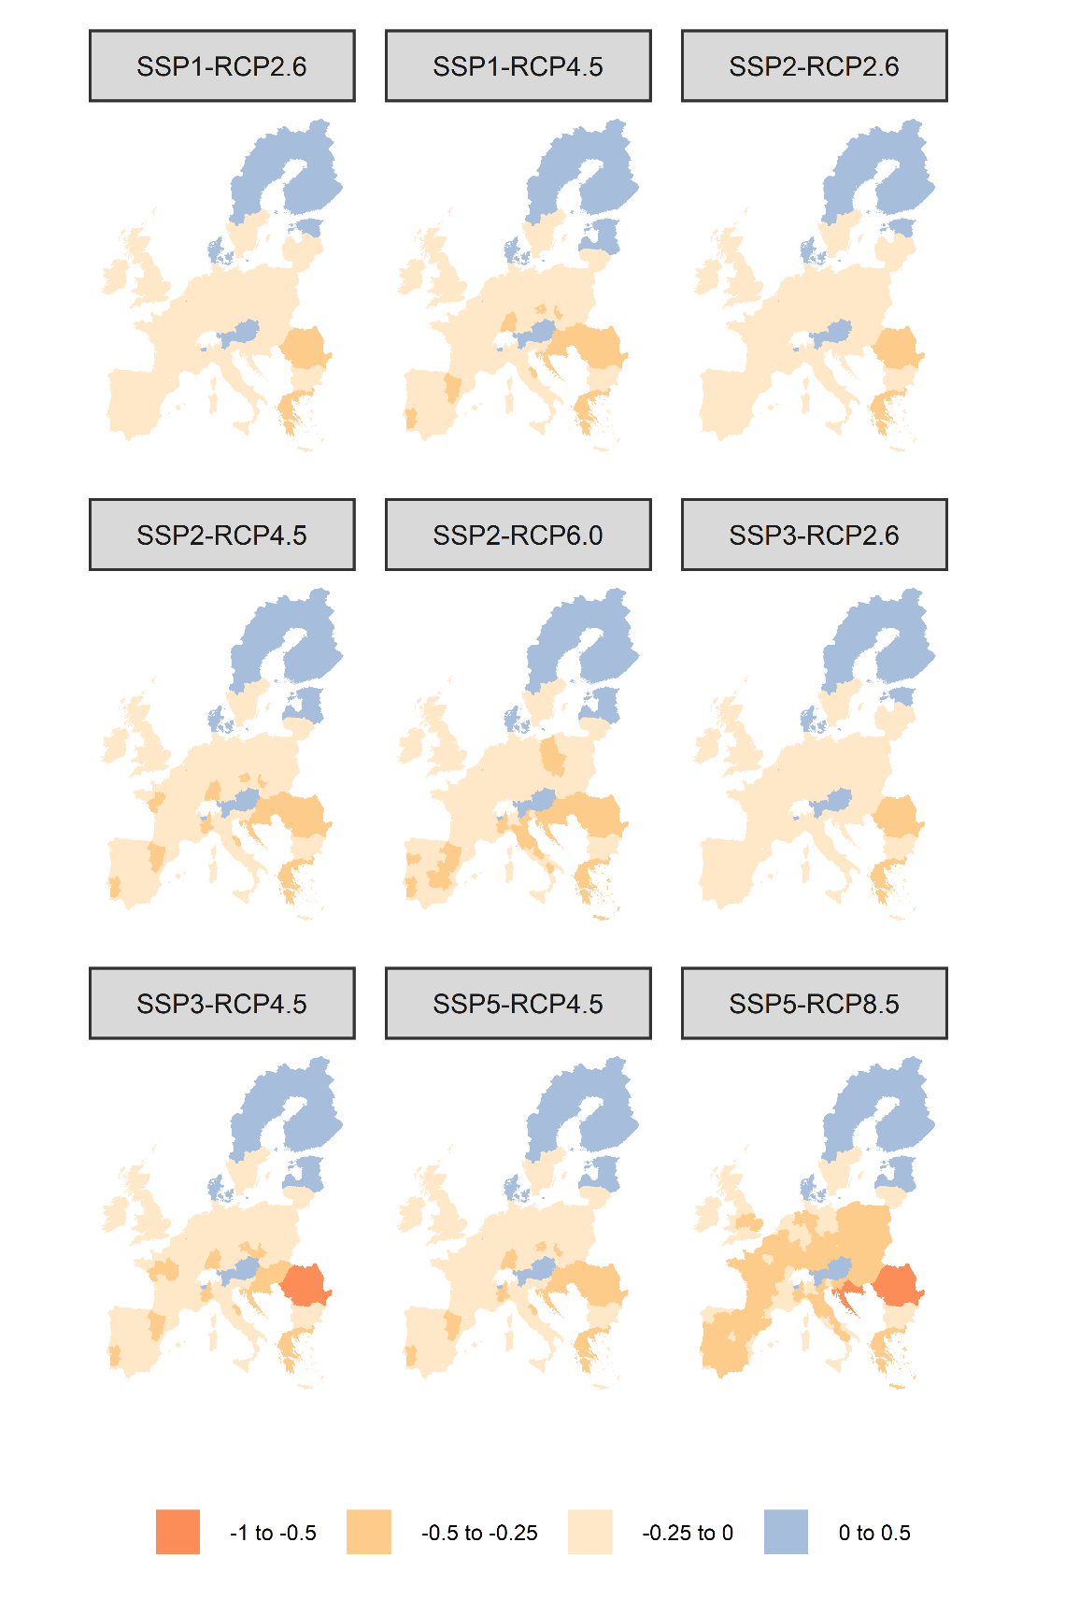
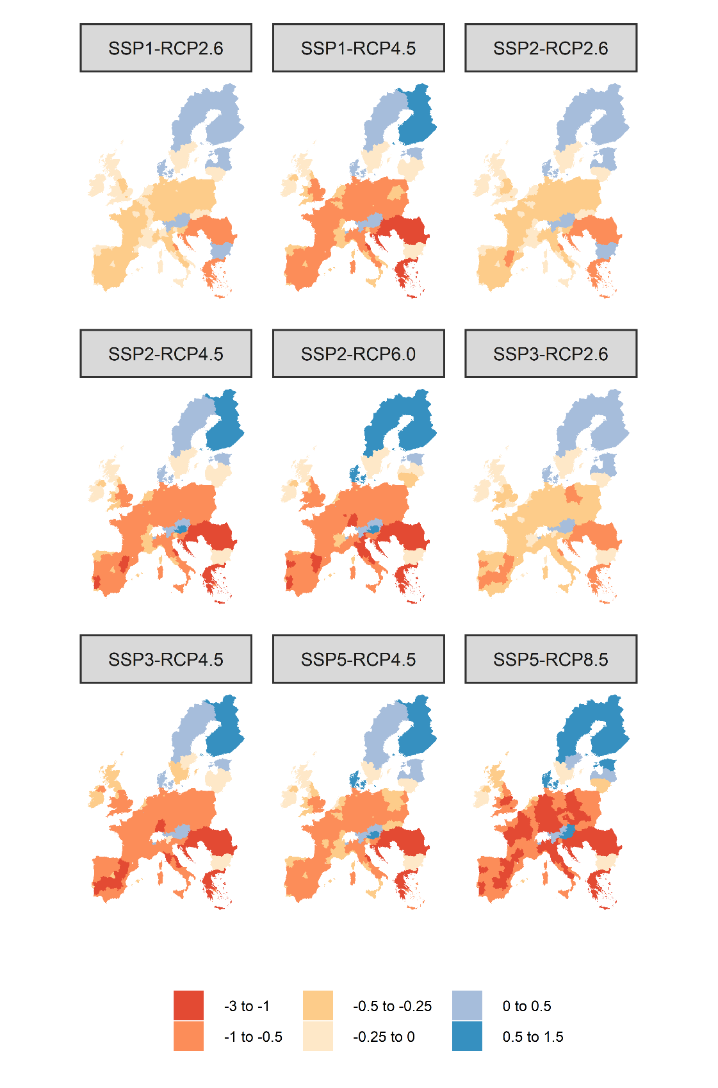
CGE results: GDP % Ch. compared to the ref. scenario
2030
2070

Slide 22
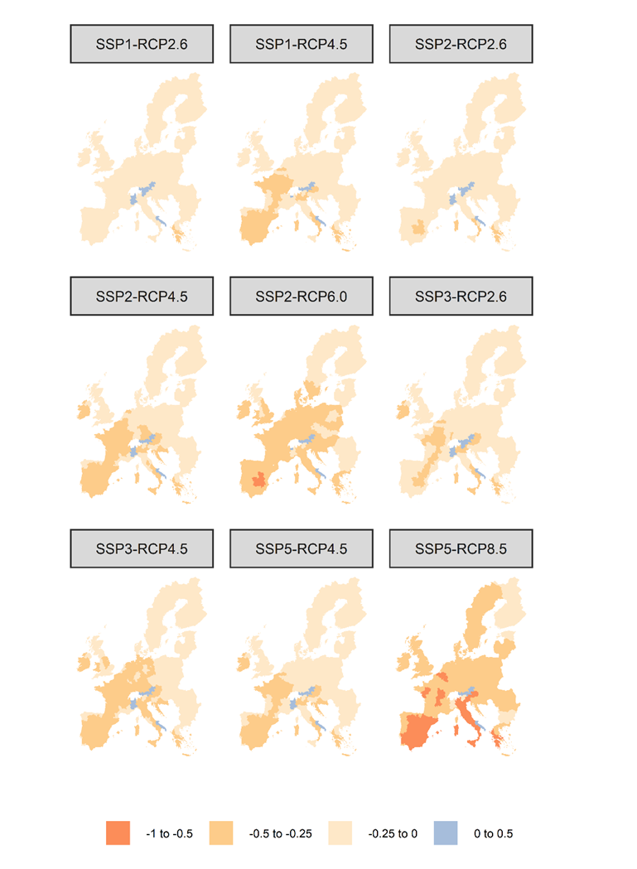
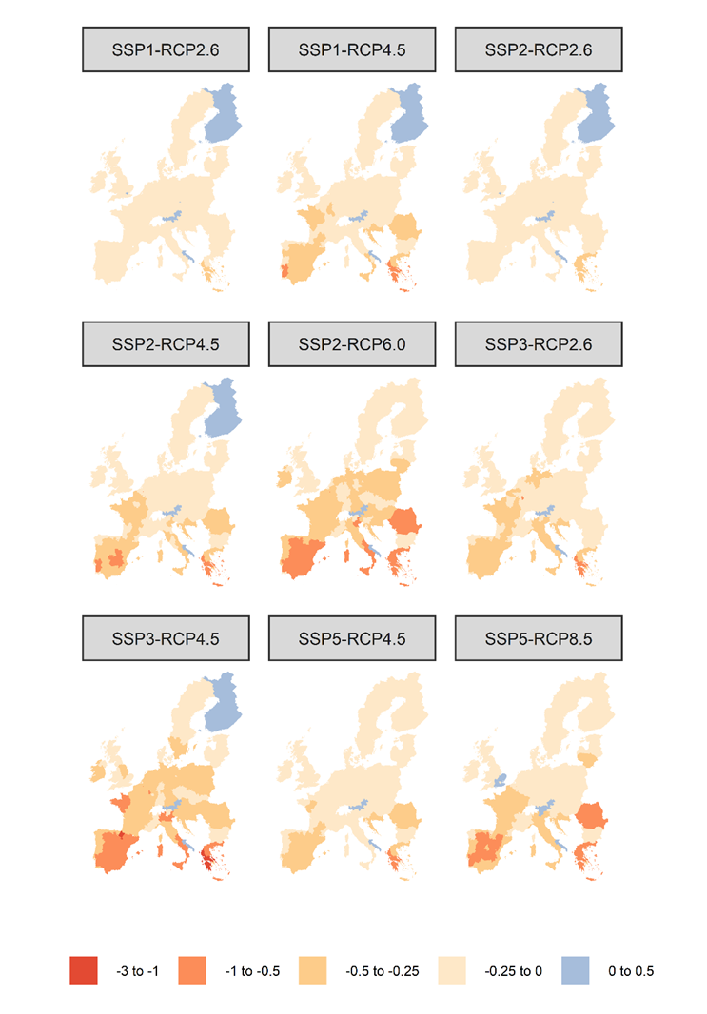
CGE results: % Ch. compared to the ref. scenario in the primary sector
2030
2070

Slide 23
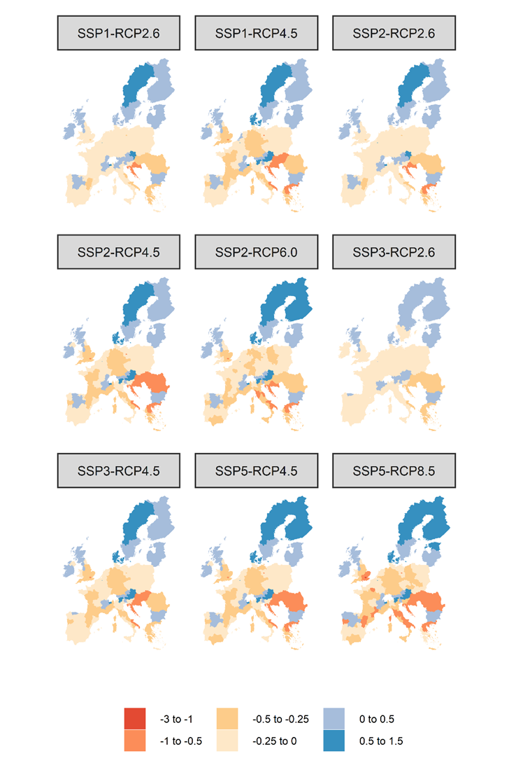
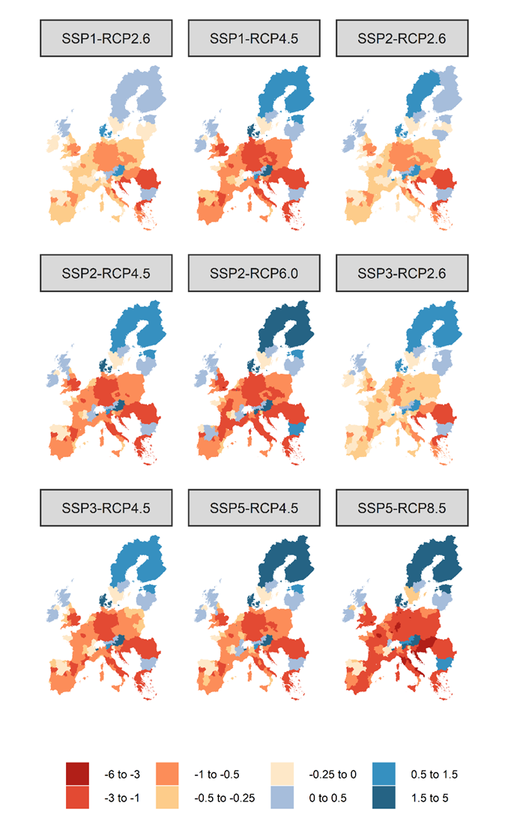
CGE results: % Ch. compared to the ref. scenario in the industry&const sector
2030
2070

Slide 24
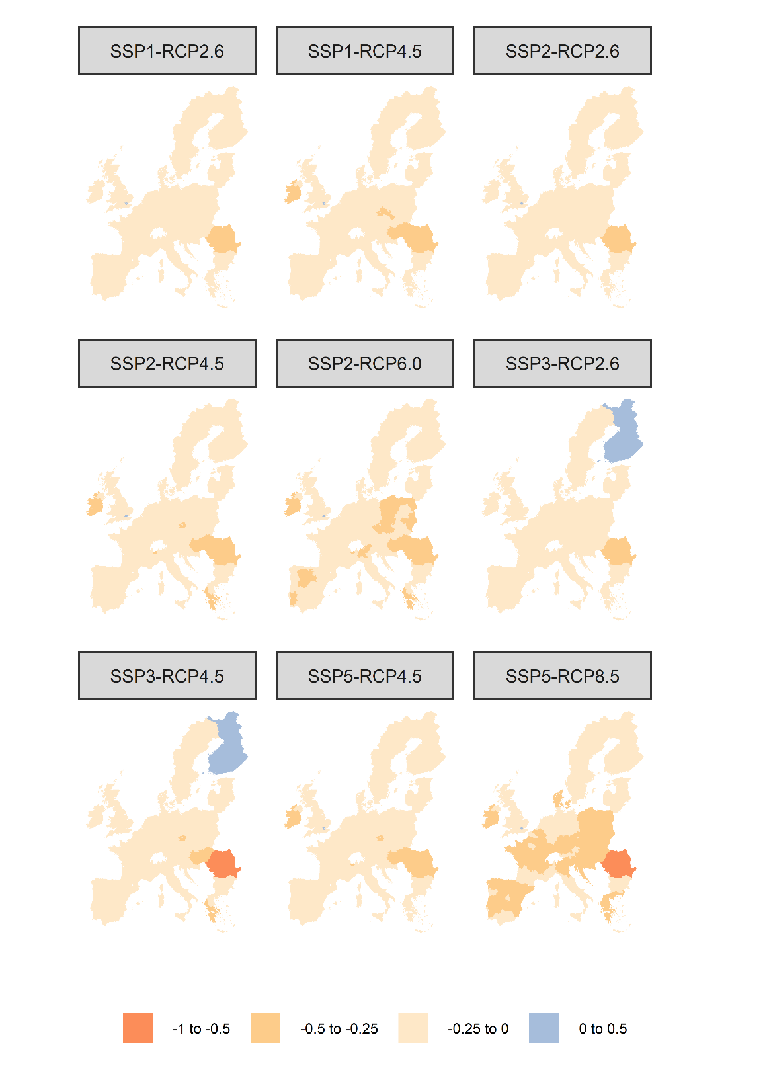
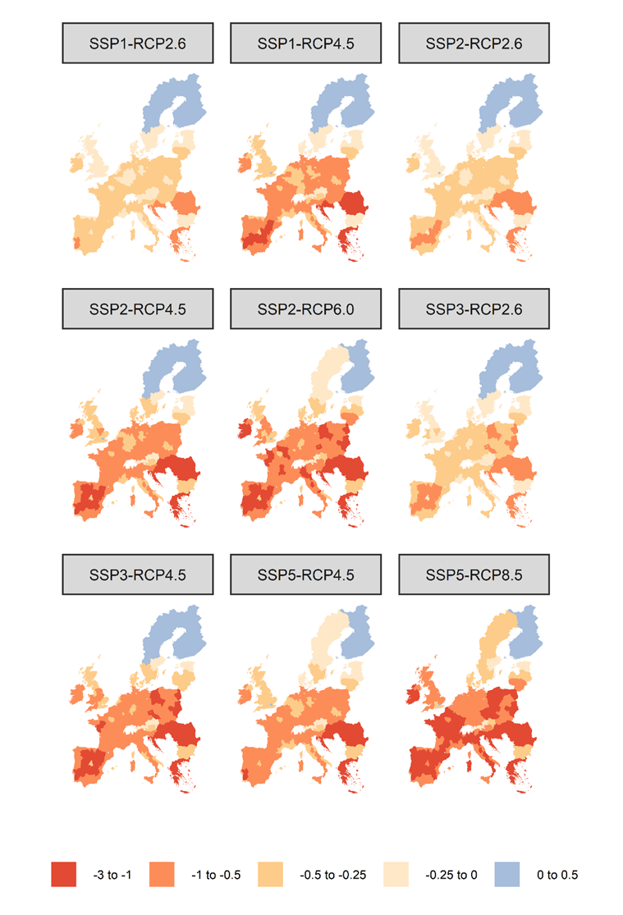
CGE Results: % Ch. compared to the ref. scenario in the services sector
2030
2070

Slide 25
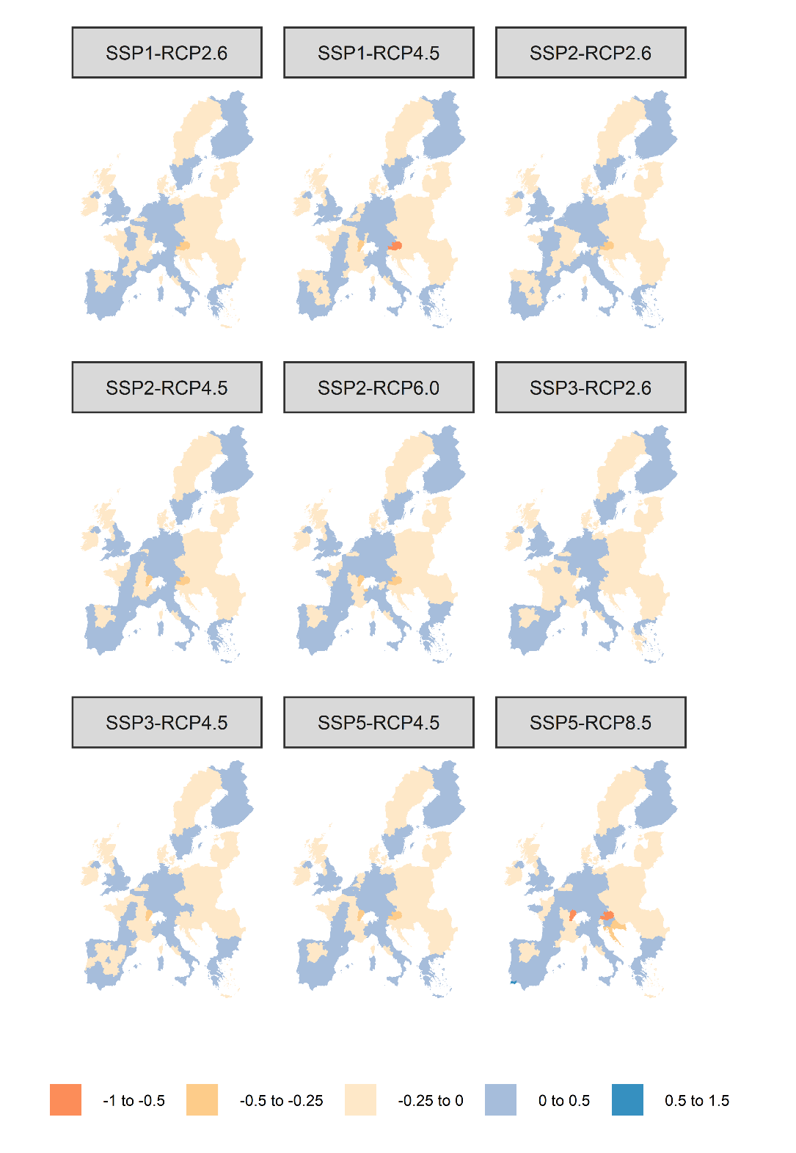
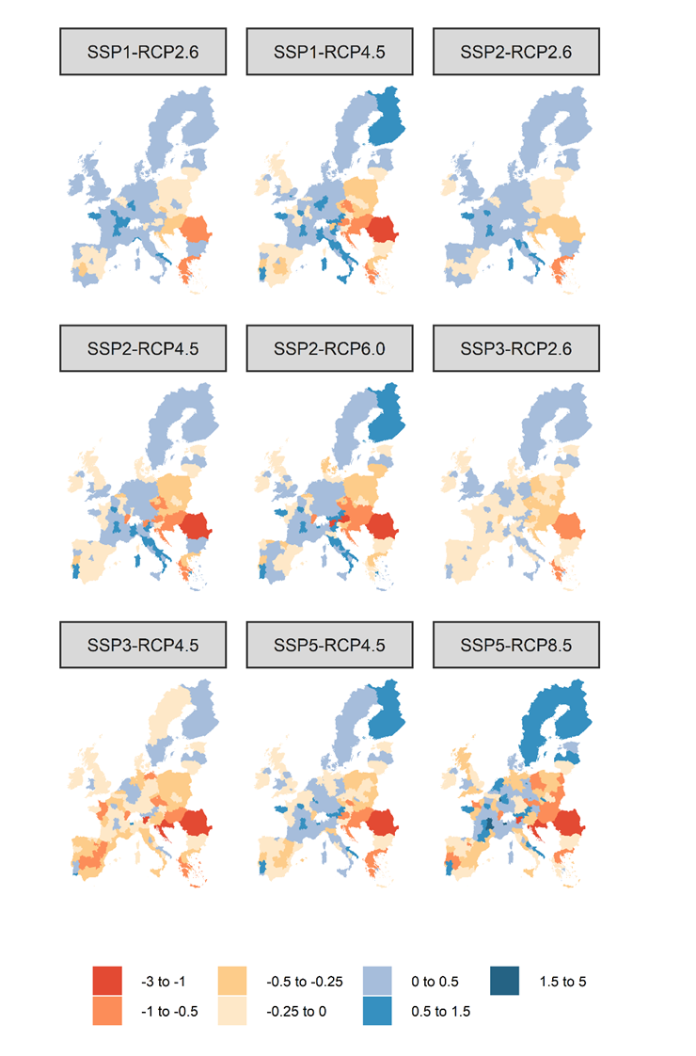
CGE Results: % Ch. compared to the ref. scenario in the energy sector
2030
2070

Slide 26
CGE Results: comparison with previous studies
Ciscar et al. (2014) find that macro-economic losses of climate change impacts on labour productivity could reach 2% of EU GDP by 2080s if current climate conditions persist, and no public adaptation occurs.
García-León et al. (2021) find that in RCP 8.5 average GDP costs will pass from the current average of 0.21% over 1981–2010 to an expected annual average beyond 1.14% in the 2060s for Europe.
Orlov et al. (2020) find that between 2050 and 2100 in RCP8.5 EU GDP will experience economic losses in the range of 0.5-1% compared to the reference scenario.
We find that the GDP loss in SSP5-RCP8.5 could be around 0.85% by 2070 in EU-28.

Slide 27
Conclusions: main results
GDP losses from climate-induce impacts on worked hours may be substantial for the European regions, especially in RCP8.5 and 6.0, and in SSP3.
In general, we notice that Southern Mediterranean and Eastern regions are more subject to macro-economic losses while Scandinavian regions may experience some economic benefits.
The macro-economic results have shown the importance of the sub-national detail because, for example Italian Alpine regions may experience economic benefits while the rest of the country is badly impacted by global warming.
We observe a propagation of the macro-economic effects outside agriculture and industry through the economic channels of inter-sectoral connections and inter- and intra-national trade. We signal negative spillovers especially in the service sector.

Slide 28
Conclusions: policy implications
Implementing appropriate mitigation policies is important to reduce the economic damages from a reduced labour productivity. Indeed, we have seen that higher RCPs are associated with bigger economic losses.
Preserving the European economic integration is another relevant policy issue as we have noted that the trade frictions in SSP3 are ceteris paribus detrimental to the economic performance of the European regions.

Slide 29
Conclusions: next steps
Using WBGT and different types of exposure-response functions to compute inputs for the sub-national CGE and then comparing results
Increasing the sectoral detail of the econometric analysis could be further developed.
Better investigating the role of labour mobility across Europe in the CGE (single EU labour market). Here, we have assumed that labour cannot move outside the region where it is located.
Relaxing the full employment assumption would provide additional insight to the overall macro-economic framework.

Slide 30


Thanks
gabriele.standardi@cmcc.it
 | This project has received funding from the European Union’s Horizon 2020 research and innovation programme under grant agreement No 776479.

