Slide 1
Circular Economy Transition in Türkiye
Maksym Chepeliev¹, Thomas Farole,² Andrea Liverani,² and Dominique van der Mensbrugghe¹
¹Center for Global Trade Analysis, Purdue University
²The World Bank
26th Annual Conference on Global Economic Analysis
June 14-16, 2022
Bordeaux, France

Slide 2
Introduction
Increasing material extraction is putting major pressure on ecosystems (Otero et al., 2020)
Projected income and population growth could more than double global material demand by 2050 (IRP, 2019)
  Such trends could also put at risk the success of future climate mitigation policies, as materials management is a major contributor of the global greenhouse gas emissions (Hertwich et al., 2019).
An absolute decoupling of material use from GDP is essential to preserve safe operating boundaries (Steffen et al., 2015)
In this study we focus on the circular economy (CE) transition policies in Türkiye
  Explore interactions between climate mitigation and CE transition.
  Evaluate impacts of various CE-specific policies.
Notes:
Over the past 70 years, humanity has experienced an unprecedented improvement in the quality of life.
Extreme poverty at a global scale has decreased from over 63% in 1950 to less than 10%, the share of literate world population exceeds 86% - a 30 percentage point increase since the mid-20th century and child mortality has fallen by almost 6 times since 1940 (Roser, 2020).
Consistent with these findings, the literature reports a relatively high resource elasticity of GDP, suggesting that 1% increase in GDP leads to around an 0.8% increase in consumption-based material use both in high-income and low-income countries (thus providing a rather weak evidence even for existence of a relative decoupling between GDP growth and material use.
Constantly growing incomes have substantially increased demand for material goods and therefore materials extraction has grown from 22 billion tons in 1970 to 70 billion tons in 2010 (Schandl et al., 2017; Krausmann et al., 2018; Haberl et al., 2020; Steinberger et al., 2013)

Slide 3
Türkiye has recently launched several CE-focused initiatives
    In 2015, Türkiye launched its Zero-Waste Initiative.
    Circular Economy is flagged as a priority in 2021 Economic Reform Program of the country.
    Türkiye’s goals include creating 100,000 jobs in zero-waste management systems and reaching a recycling rate of 60% by 2035.
    Türkiye is revising its NDC in line with net zero emissions target by 2053.
    The Green Deal Action Plan of Türkiye has been published in 2021 with the aim to establish alignment with the EU Green Deal, including on issues related to the Circular Economy.

Slide 4
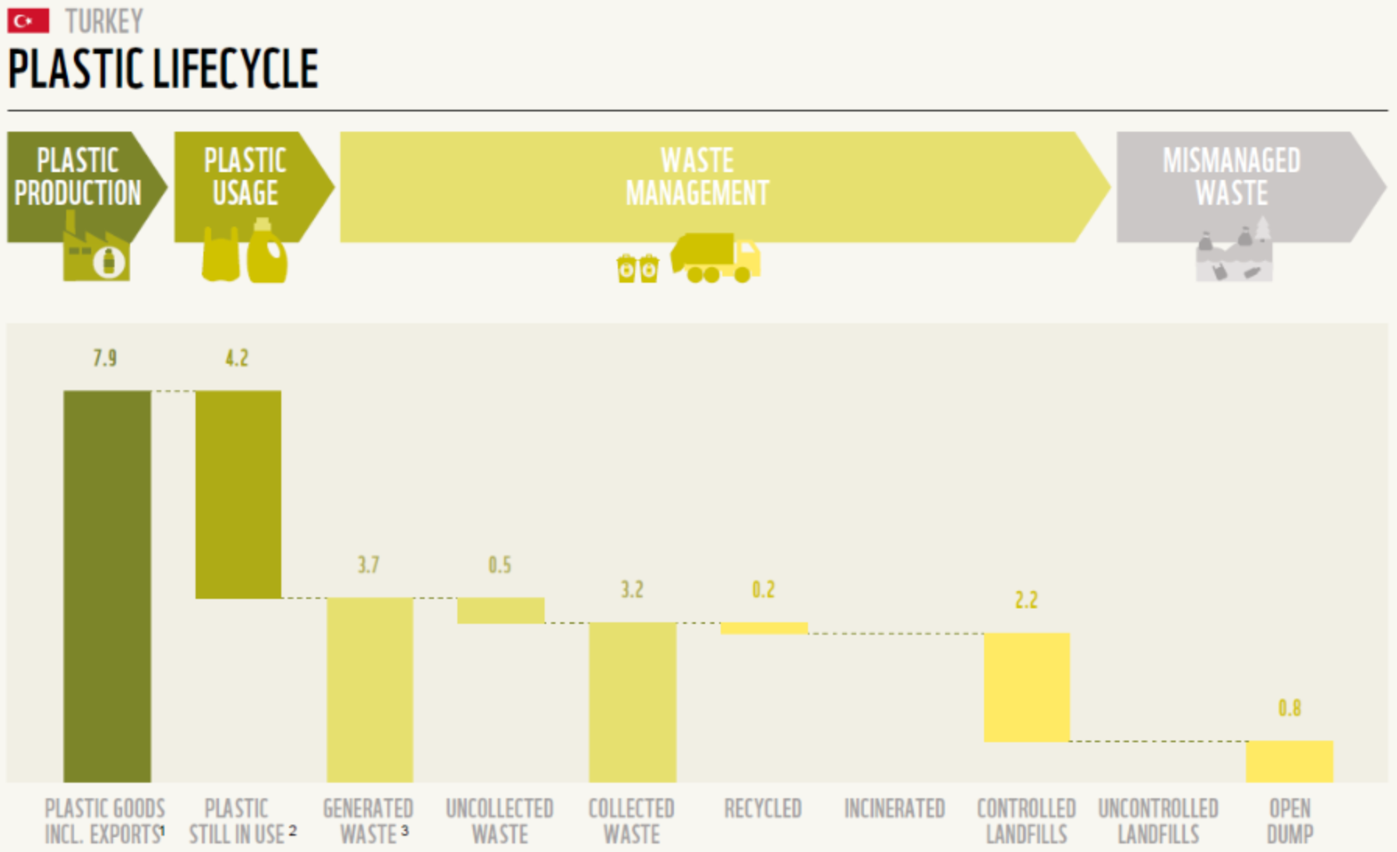
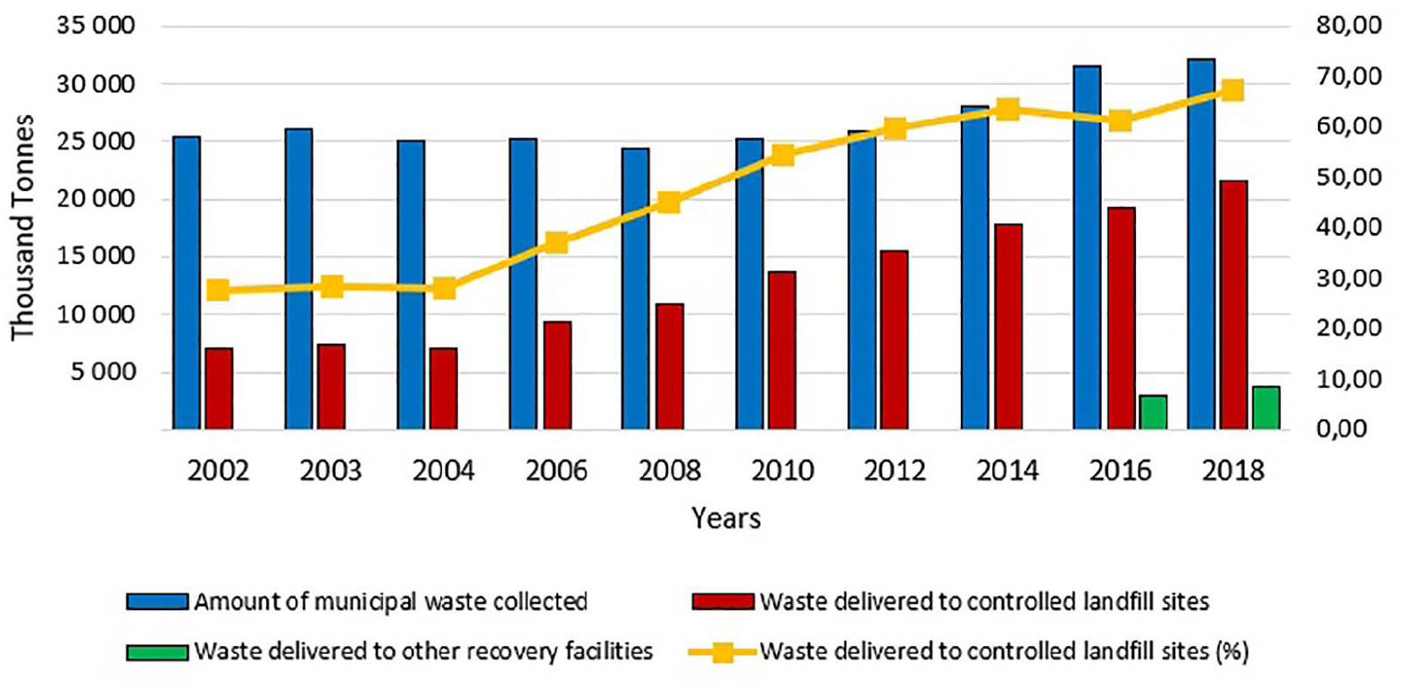
Circularity and waste management practices in Türkiye require major improvements
    Global Waste Index 2022 report (https://sensoneo.com/global-waste-index/) ranks Türkiye in the last place out of 38 considered countries with a recycling rate of 11% and over 41% of waste going to open dump.
    With a substantial share of secondary steel production in the country (over 70%), the recycling rate of plastics is less than 6% (Karasik, 2022).
    Substantial volumes of recycling in the country started to occur only in recent years (Ayçin et al., 2021).
Source: Karasik (2022) https://nicholasinstitute.duke.edu/sites/default/files/projects/Plastic-Pollution-Policy-Country-Profile-Turkey.pdf
Source: Ayçin et al. (2021) https://doi.org/10.1177/0734242X2098878
Notes:
So far, only a handful of EU countries have adopted national resource efficiency or circular economy strategies/action plans.
Thus, an assessment of the regional/local measures, including identification of the potential economic implications and policy trade-offs of such transition is of a high importance for policy makers. It is also important to understand how other policy efforts implemented in the EU, such as a more ambitious climate mitigation policies (e.g., ‘fit for 55’ package), would interact with the circularity agenda, as well as how the circular economy measures can be used to complement other existing policy goals.
https://www.consilium.europa.eu/en/policies/green-deal/eu-plan-for-a-green-transition/
As part of the European Green Deal, with the European Climate Law, the EU has set itself a binding target of achieving climate neutrality by 2050. This requires current greenhouse gas emission levels to drop substantially in the next decades. As an intermediate step towards climate neutrality, the EU has raised its 2030 climate ambition, committing to cutting emissions by at least 55% by 2030.
While most of the existing literature has a global focus (e.g. Winning et al., 2017; McCarthy et al., 2018; Wiebe et al., 2019; Aguilar-Hernandez et al., 2020), future progress in the area of circular economy transition would likely depend on country level actions. To address this point, our analysis focuses on the EU economy and, in particular, four Eastern European Member States – Poland, Romania, Bulgaria and Croatia.

Slide 5
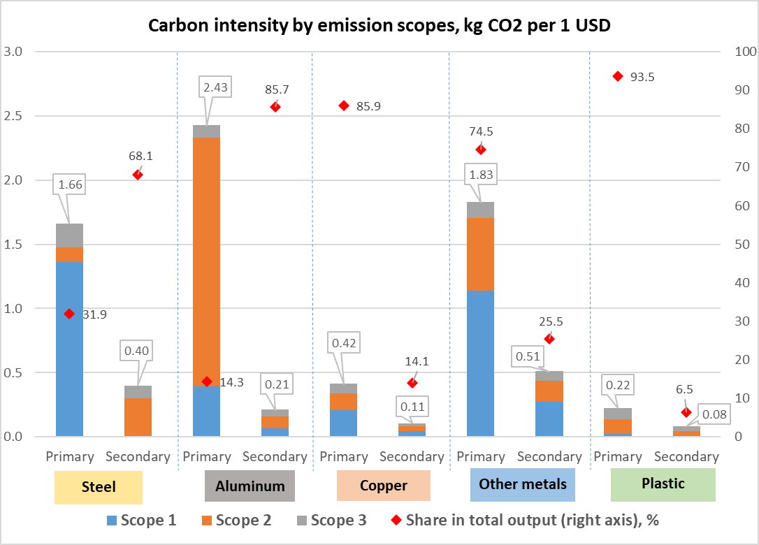
Overview of the GTAP-CE: Emission intensities in TUR
No. | GTAP | New sector | Description
1 | oxt | nmn | Non-metallic minerals mining
2 |  | mio | Mining of iron ores
3 |  | mao | Mining of aluminum ores
4 |  | mco | Mining of copper ores
5 |  | moo | Mining of other ores
6 | rpp | rbr | Rubber products
7 |  | plp | Plastic products – primary
8 |  | pls | Plastic products – secondary
9 |  | plr | Recycling - plastics
10 | i_s | isp | Iron and steel – primary
11 |  | iss | Iron and steel – secondary
12 |  | ris | Recycling - iron and steel
13 |  | isc | Iron and steel casting
14 | nfm | app | Aluminum – primary
15 |  | aps | Aluminum – secondary
16 |  | ral | Recycling - aluminum
17 |  | cpp | Copper – primary
18 |  | cps | Copper – secondary
19 |  | rcp | Recycling - copper
20 |  | mpp | Other metals – primary
21 |  | mps | Other metals – secondary
22 |  | rom | Recycling - other metals
23 |  | nfc | Non-ferrous metals casting
Carbon intensity (kg CO₂/USD) and the share of corresponding
technology in output (%): Türkiye
GTAP-CE database covers 141 regions and 95 sectors
Notes:
In a first step, we introduce two major modifications to the GTAP circular economy (GTAP-CE) database that has been initially developed in Chepeliev et al. (2021).
First, we implement targeted refinements to the representation of energy inputs to the production process of primary and secondary activities, which allows for a better representation of differences in energy and emission intensities across sectors (Figure 1).
Second, we incorporate quantity flows of metal ores and non-metallic minerals to the developed database, thus enabling for an inclusive production- and consumption-based material accounting in terms of volume flows.

Slide 6
GTAP-CE database is coupled with ENVISAGE CGE model
Global computable general equilibrium model
  Recursive-dynamic (2014-2030).
  Vintage capital.
  Türkiye and its key trading partners are disaggregated.
Nested energy demand
Alternative generation technologies (GTAP-Power database).
Preference shifts/technological changes
  Decreasing cost of renewables; increasing preferences toward renewable energy; increasing electrification rates; energy efficiency improvements.
  Model aggregation: 20 regions and 42 activities.
NRG
Energy
NELY
Non-electric
COA
Coal
OLG
Oil & gas
ELY
Electric
OIL
Oil
GAS
Gas
Notes:
In a first step, we introduce two major modifications to the GTAP circular economy (GTAP-CE) database that has been initially developed in Chepeliev et al. (2021).
First, we implement targeted refinements to the representation of energy inputs to the production process of primary and secondary activities, which allows for a better representation of differences in energy and emission intensities across sectors (Figure 1).
Second, we incorporate quantity flows of metal ores and non-metallic minerals to the developed database, thus enabling for an inclusive production- and consumption-based material accounting in terms of volume flows.

Slide 7
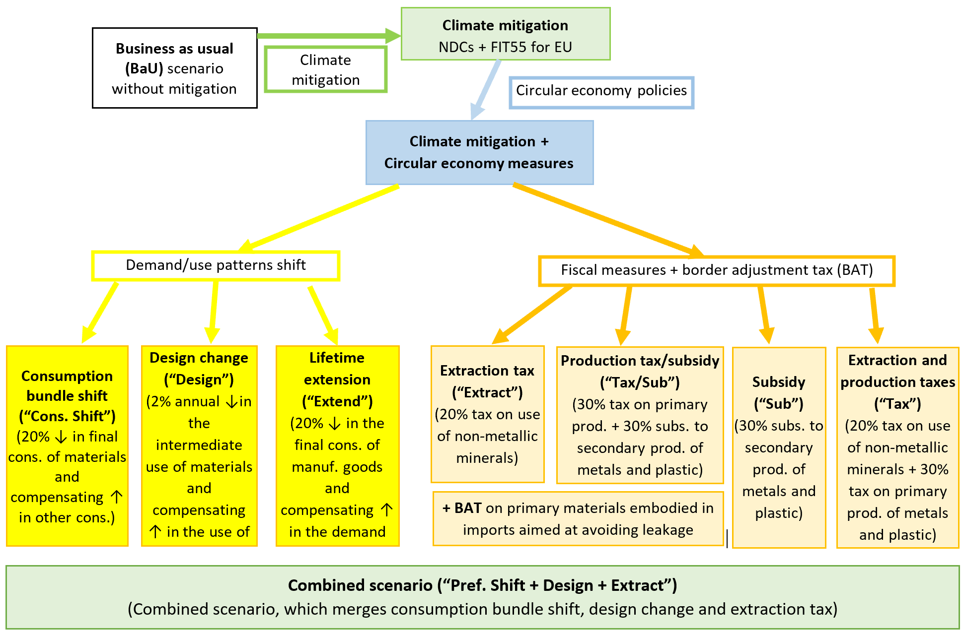
Scenario framework: simultaneously implemented by the EU and Türkiye
Notes:
This slide presents a set of policy scenarios that include various climate mitigation and circular economy-specific policies and measures.
To provide an assessment of these stylized policy scenarios in a ‘what-if’ type framework, we perform a dynamic simulation with a global computable general equilibrium model ENVISAGE (van der Mensbrugghe, 2019).
We further investigate implications of the policy measures on various dimensions of economic, social and environmental wellbeing, such as resource productivity, competitiveness, environmental sustainability, inclusion, economic security and developmental impacts.
First, the baseline scenario or BAU includes implementation of the Nationally Determined Contributions (NDCs) by countries of the world.
Next, a more ambitious mitigation effort is implemented for the EU, which is consistent with the EU Green Deal (EGD) emission reduction targets (55% reduction in emissions in 2030 relative to the 1990 level).
Then a set of circular economy-specific measures:
increased recycling and overall reduction in material use,
change in consumption patterns toward dematerialization,
change in the product design with an increase in material use efficiency and
production life extension.
Fiscal policy (extraction levy)
All these measures provide a stylized representation of different aspects of the circular economy transition and thus allow us to quantify their potential impacts and trade-offs within an economy wide modelling framework.
Apart from shocks in the baseline, all remaining shocks only apply to Europe.
The baseline covers the period 2014-2030 with given growth rate assumptions for GDP and population and mostly static fiscal policies.
The one exception is that the baseline incorporates the so-called Nationally Determined Contributions (NDCs), which are the commitments made by all countries that signed the 2015 Paris Agreement to limit greenhouse gas emissions.
The NDCs are converted to country-specific prices on carbon that depend on a country’s economy and carbon intensity and the stringency of its commitment. Actual implementation of a country’s mitigation policy is likely to rely on one or more instruments, which may include a carbon price.
The actual reference point for the policy simulations, however, is based on a scenario that represents an interpretation of the EU’s Green Deal mitigation target (EGD-NDC).
While the Green Deal in practice includes a broad range of environmental objectives and instruments (EC, 2019), the modelled EGD-NDC scenario focuses on achieving the EU’s enhanced NDC target of reducing CO₂ emissions by 55 percent by 2030 relative to the 1990 level (compared to 40 percent in the BAU scenario).
Again, the model achieves the target primarily through a carbon price, although several fiscal policies are implemented within the EGD-NDC scenario to complement carbon pricing, including: removal of production subsidies to fossil fuels and transportation activities (production tax rates are set to 3 percent); increase in the sales tax for petroleum products (by 5 percent); and, subsidy to renewable generation (5 percent). Thus, the reference scenario in the model incorporates emissions reduction policy but no explicit measures targeting reduction of material use.
The main scenarios are structured around reduction of primary material use in the EU – i.e., improving circularity. These are specified in Table 1. Apart from BAU scenario, all policy shocks introduced in the scenarios apply only to the EU. They are introduced from 2023 and fully implemented by 2027.
The first set of scenarios focuses on reducing extraction and production using primary materials and considers various fiscal policy approaches.
For metals (e.g. steel, aluminium, copper) and plastics, the scenarios assess policies whereby a tax is imposed on primary production (MetalFF-tax), a subsidy is granted to secondary production that uses recycled materials (MetalFF- subsidy), and one in which both the tax and subsidy are combined (MetalFF-total).
In the case of construction materials (non-metallic minerals such as limestone and clay), which account for the largest share of primary materials (in volume terms), recycling and secondary production is uncommon, so only a tax scenario is considered (NMN-tax).
Following the approach in the UK and elsewhere (EEA, 2008), the scenario imposes a tax on extraction of raw minerals rather than taxing the production of processed commodities.
This different treatment of metals and construction materials also offers the opportunity to see how outcomes differ when imposing taxes at different stages in the value chain.
For both the metals and construction materials, additional scenarios assess the implications of imposing border taxes on imports of these materials into the EU (MetalFF-total*BAT and NMN-tax*BAT).
Finally, the primary metals and plastics tax scenario is chosen to illustrate the implications of differing approaches to the use of tax revenues – specifically, transferring tax revenues directly to households (in the base scenario) versus using material tax revenues to reduce taxes on labor (MetalFF-tax*labor).
The second set of scenarios focuses on CE actions that impact the upstream design and consumption of products. Such actions are likely to involve policies that are regulatory and behavioral in nature (although fiscal policy levers may also be relevant), and so scenarios in the model are more exploratory and are defined by CE outcomes rather than by specifying policies. They address the following CE objectives:
‘Designing-out’ materials (Design): The stylized scenario aims to reflect the outcomes of policies that would incentivize firms to invest in design that would reduce the relative use of materials in final products.
Extending product lifetime (Extend): The stylized scenario aims to reflect the outcomes of policies (e.g. extended producer responsibility, right to repair) that would allow for extension of usable life of products and thus reduce relative material disposal and reduce demand for new material.
Reducing consumer demand for materials (PrefShift). The stylized scenario aims to reflect the outcomes of policies (including potentially regulatory, fiscal, as well as behavioral in nature) designed to shift consumption preferences away from material goods (e.g. toward services).

Slide 8
In volume terms, non-metallic minerals dominate supply and demand
Production-based accounting adds domestic extraction and imports of the corresponding raw commodity and subtracting exports.
From a consumption perspective, raw materials used in the production of exported goods should be accounted for in the importing country.
Notes:
Under business-as-usual (BAU) scenario, the production and use of primary materials continues to grow, if only at a pace well below economic growth (Figure 6), maintaining recent trends towards relative, but not absolute, decoupling.
The BAU scenario also shows a substitution between domestic towards imported materials. Across all of Europe, primary materials use as measured by production-based accounting grows by ten percent by 2030 (compared with 2021) under BAU. While being conceptually sound, for open economies, the production-based accounting fails to adequately quantify the life-cycle–wide environmental pressures associated with domestic consumption (Schaffartzik et al., 2014). For instance, if iron ore is used to produce steel in country A, which is further exported and actually consumed in country B, production-based accounting would attribute the iron ore use to country A (where steel was produced) and not country B (where actual consumption of steel took place).
Production-based accounting can be also referred to as a territorial-based accounting that tracks the raw materials (e.g. bauxite ore) at the point of their direct consumption (e.g. country where bauxite is used to produce aluminum). Production-based accounting can be represented via the direct material consumption (DMC) indicator and is obtained by adding domestic extraction and imports of the corresponding raw commodity and subtracting exports (Eurostat, 2001).
To account for the raw commodities embedded into traded goods, consumption-based accounting is considered. From a consumption perspective, raw materials used in the production of exported goods should be accounted for in the importing country. This concept has been also applied in a similar way for the accounting of greenhouse gas emissions (e.g. Davis and Caldeira, 2010; Peters, 2008). When measured in terms of consumption-based accounting though, growth in material use increases to almost twice as much (17 percent) showing the increased relevance of imported materials.

Slide 9
Baseline sees a relative decoupling for all materials, except metal ores, but absolute volumes increase
Notes:
Under business-as-usual (BAU) scenario, the production and use of primary materials continues to grow, if only at a pace well below economic growth (Figure 6), maintaining recent trends towards relative, but not absolute, decoupling.
The BAU scenario also shows a substitution between domestic towards imported materials. Across all of Europe, primary materials use as measured by production-based accounting grows by ten percent by 2030 (compared with 2021) under BAU. While being conceptually sound, for open economies, the production-based accounting fails to adequately quantify the life-cycle–wide environmental pressures associated with domestic consumption (Schaffartzik et al., 2014). For instance, if iron ore is used to produce steel in country A, which is further exported and actually consumed in country B, production-based accounting would attribute the iron ore use to country A (where steel was produced) and not country B (where actual consumption of steel took place).
Production-based accounting can be also referred to as a territorial-based accounting that tracks the raw materials (e.g. bauxite ore) at the point of their direct consumption (e.g. country where bauxite is used to produce aluminum). Production-based accounting can be represented via the direct material consumption (DMC) indicator and is obtained by adding domestic extraction and imports of the corresponding raw commodity and subtracting exports (Eurostat, 2001).
To account for the raw commodities embedded into traded goods, consumption-based accounting is considered. From a consumption perspective, raw materials used in the production of exported goods should be accounted for in the importing country. This concept has been also applied in a similar way for the accounting of greenhouse gas emissions (e.g. Davis and Caldeira, 2010; Peters, 2008). When measured in terms of consumption-based accounting though, growth in material use increases to almost twice as much (17 percent) showing the increased relevance of imported materials.

Slide 10
NDC mitigation policies reduce the use of fossil fuels but have limited impact on the use of other materials
Notes:
The major component of the EU Green Deal is to reduce greenhouse gas (GHG) emissions by 55 percent in 2030 relative to 1990.
This involves a more stringent emission trading system (ETS) regime for energy-intensive and trade exposed sectors (EITE) and a broadening of carbon prices to all other non-ETS activities and households.
Policies targeting GHG emissions reduction under the European Green Deal (EGD-NDC) will have large impacts on fossil fuel (FF) use from a production-based accounting perspective and a smaller, but still significant, impact when measured on a consumption basis.
But while these policies contribute to reduce metal ores (MMO) and non-metallic minerals (NMN) use, the scale of the effect will be minimal – less than 1 percent relative to BAU for metals and 1-2 percent for non-metallic minerals (Figure 7).
Thus, policies that specifically target primary materials will be required.

Slide 11
Drivers of changing material use under NDC scenario: Türkiye vs Europe
Notes:
The major component of the EU Green Deal is to reduce greenhouse gas (GHG) emissions by 55 percent in 2030 relative to 1990.
This involves a more stringent emission trading system (ETS) regime for energy-intensive and trade exposed sectors (EITE) and a broadening of carbon prices to all other non-ETS activities and households.
Policies targeting GHG emissions reduction under the European Green Deal (EGD-NDC) will have large impacts on fossil fuel (FF) use from a production-based accounting perspective and a smaller, but still significant, impact when measured on a consumption basis.
But while these policies contribute to reduce metal ores (MMO) and non-metallic minerals (NMN) use, the scale of the effect will be minimal – less than 1 percent relative to BAU for metals and 1-2 percent for non-metallic minerals (Figure 7).
Thus, policies that specifically target primary materials will be required.

Slide 12
Complementarity of demand-side and fiscal policies
Notes: “prod” and “cons” labels correspond to production- and consumption-based material accounting methods.
Percent changes are reported relative to the total material use under baseline in 2030.
Notes:
Perhaps the most important finding from the analysis comes in a scenario where both the tax and subsidy are combined. In this case, the impact on reducing material use nearly doubles. This suggests the approaches are complementary.
When limited to targeting production, however, subsidies and taxes will both have limited effects on overall consumption trends. Both also have a similar impact on consumption-based material use – in both cases a much smaller impact, which may be expected given that the policy is targeting production rather than consumption and a number of barriers may restrict pricing pass-through to consumers (e.g. leakage- as discussed later).
While the price channel will clearly play an essential role in reducing demand for primary materials, it will not be sufficient on its own. A range of policy approaches will need to be tailored to the specific dynamics of different materials, particularly to address both the production and consumption sides of the equation. Policies targeting upstream product design and downstream consumption can effectively complement fiscal policies. These include:
designing products to reduce material usage (Design);
extending the useable lifetime of products (Extend);
shifting consumer preferences away from materials and toward services (Prefshift).
All three of these approaches could be supported by fiscal measures, and in fact price signals at the consumer level are likely play an important role in shifting demand. But they are also likely to benefit from regulatory (e.g. materials standards; rights to repair, extended producer responsibility) and social / behavioral policies (e.g. education and public awareness, behavioral incentives). Figure 10 presents the results on material use from combination of production-side fiscal policies as well as complementary policies targeting upstream product design and downstream consumption.

Slide 13
Material use VS recycling rates in Türkiye
Achieving absolute decoupling is complicated by a substantial share of non-metallic minerals in Türkiye (85%-90% of total material use).
Non-metallic minerals are primarily used in the production of construction materials (gravel, cement, bricks, etc.), which are hard or not economically feasible to recycle.
Non-metallic minerals have long life-cycle (inflow >> outflow; stock of newly created buildings >> stock of demolished buildings).
CE policies have much more substantial impact on commodities with higher recycling possibilities (Figure on the right)
Notes:
Climate and CE policies are complementary: EGD measures targeting CO₂ emissions will have an impact on material use, but only a modest one. Similarly, materials-focused measures will have only a modest impact on CO₂ emissions.
CE measures can have a significant impact on materials consumption: Scenarios indicate aggregate material production in EU could decline 5-9% (relative to baseline in 2030) under alternative CE policies; for some products (notably metals) substantially larger declines are possible.
Measures must be targeted: Response to CE measures varies substantially by material – e.g. metals reduce most with policies targeting production directly (recycling) and design, while construction materials respond best to design policies (and may require policies better targeting investment rather than consumption); countries’ baseline conditions will also impact outcomes.
Leakage will be a concern for some materials: Significant gaps between production and consumption-based savings for some materials and policies are observed, however these depend on the nature of the underlying policy mechanism:
In the case of production-based actions (scenarios with subsidies to secondary production and taxes on primary production), output of primary materials in the rest of the world increases, partly substituting domestic EU inputs, and an increase in leakage is observed.
A different pattern is observed when consumption or intermediate use-focused measures are implemented. In this case, a substantial negative leakage is estimated, as the EU-wide material demand is falling and it does not matter whether materials are sourced domestically or imported.
Depending on the channel of ‘circularity’, domestic output in Europe could be significantly impacted. The tax and subsidy channel have the greatest impact on domestic output—particularly in those sectors directly impacted by the taxes and subsidies.
The EU Green Deal and the ‘circularity’ scenarios will lead to a short-term increase in unemployment—in general similar between skilled and unskilled workers. However, the impact on unskilled workers will be more pronounced due to the changing production structures that benefit services over material-based inputs.
The negative impacts on real income in 2030 will vary from 0.6 to 1.2 percent in Europe on aggregate and between 0.4 and 2.0 percent across the individual modeled regions in Europe (excluding the two sensitivity analyses).

Slide 14
Moderate macro impacts but increasing skill wage gap
Notes:
The macroeconomic costs of achieving the circular economy will be minor. While CE will no doubt create economic opportunities, alternative policies explored in this assessment – all of which aim to reduce and shift demand – do have macroeconomic costs.14
In the Combined scenario, total annual GDP is around one percent lower relative to the reference scenario in 2030 – for most of the individual policy scenarios, the cost is around 0.3-0.4 percent of 2030 GDP (Figure 16). This may be considered a minor cost, particularly as it does not consider co-benefits of achieving material decoupling (e.g. improved health and productivity resulting from lower pollution, increased biodiversity, etc.). Moreover, it is important to recognize that this ‘cost’ is relative to baseline growth – real GDP in the Combined scenario is still 13.5 percent higher in 2030 versus BAU in 2021. GDP implications at the country level are broadly in line with overall EU trends, with Bulgaria and Poland most exposed to production-side policies targeting metals and fossil fuels and Poland and Romania most exposed to policies that aim to ‘design-out’ materials as inputs in production, perhaps reflecting their positions in European manufacturing value chains.
14 One important methodological note: upstream and consumption scenarios (Design, Extend, PrefShift) do not consider costs (investments) required to achieve them – such investments would be expected to contribute positively to growth.
While labor market impacts from most individual CE policies are modest, in combination (Combine) they are relatively significant for unskilled workers (Figure 19) – relative to the reference scenario unskilled workers see unemployment rise by 0.6 percentage points and real wages decline by 2.6 percent. Skilled workers, by contrast, experience lower unemployment and only slightly lower wages. Impacts vary markedly across individual CE policy scenarios. Fiscal policies targeting production of primary materials has almost no impact on unemployment and wages. By contrast the upstream and demand-side scenarios show much larger effects, with a clear skills-bias. Under all three scenarios (Design, Extend, Prefshift) unemployment rises and wages fall for unskilled workers, while unemployment falls and wages rise for skilled workers.

Slide 15
Conclusions
In recent years, Türkiye started to achieve limited progress on CE, but much remains to be done (country is ranked low on waste management).
No-policy baseline sees a relative decoupling for all materials, except metal ores, but absolute volumes increase.
Climate mitigation and CE policies are complementary
  Achievement of the NDC primarily impacts coal use but has limited implications for use of other materials.
  CE measures can reduce material use up to 14% in 2030 w.r.t. baseline.
  Harder to reduce emissions for commodities with limited recycling options (e.g. gravel, limestone, cement, etc.).
Measures must be targeted: response to CE polices substantially varies by materials.
Macroeconomic costs are moderate but increasing skill premium could result in regressive distributional impacts.
Notes:
Climate and CE policies are complementary: EGD measures targeting CO₂ emissions will have an impact on material use, but only a modest one. Similarly, materials-focused measures will have only a modest impact on CO₂ emissions.
CE measures can have a significant impact on materials consumption: Scenarios indicate aggregate material production in EU could decline 5-9% (relative to baseline in 2030) under alternative CE policies; for some products (notably metals) substantially larger declines are possible.
Measures must be targeted: Response to CE measures varies substantially by material – e.g. metals reduce most with policies targeting production directly (recycling) and design, while construction materials respond best to design policies (and may require policies better targeting investment rather than consumption); countries’ baseline conditions will also impact outcomes.
Leakage will be a concern for some materials: Significant gaps between production and consumption-based savings for some materials and policies are observed, however these depend on the nature of the underlying policy mechanism:
In the case of production-based actions (scenarios with subsidies to secondary production and taxes on primary production), output of primary materials in the rest of the world increases, partly substituting domestic EU inputs, and an increase in leakage is observed.
A different pattern is observed when consumption or intermediate use-focused measures are implemented. In this case, a substantial negative leakage is estimated, as the EU-wide material demand is falling and it does not matter whether materials are sourced domestically or imported.
Depending on the channel of ‘circularity’, domestic output in Europe could be significantly impacted. The tax and subsidy channel have the greatest impact on domestic output—particularly in those sectors directly impacted by the taxes and subsidies.
The EU Green Deal and the ‘circularity’ scenarios will lead to a short-term increase in unemployment—in general similar between skilled and unskilled workers. However, the impact on unskilled workers will be more pronounced due to the changing production structures that benefit services over material-based inputs.
The negative impacts on real income in 2030 will vary from 0.6 to 1.2 percent in Europe on aggregate and between 0.4 and 2.0 percent across the individual modeled regions in Europe (excluding the two sensitivity analyses).

Slide 16
Thank you!
mchepeli@purdue.edu

