Slide 1




Unlocking India's Export Opportunities in ASEAN: Insights from GTAP Model and Viner’s Trade Creation Methodology
27th Annual Conference on Global Economic Analysis
Colorado State University, Fort Collins
June 5-7, 2024
Chandni Dawani¹ and Badri G. Narayanan²
¹ PhD Scholar, The IIS (Deemed to be University), Jaipur, Rajasthan, India
² Affiliate Faculty, Boston College, USA
c.dawani@gmail.com
@c_dawani
linkedin.com/chandni-dawani

Slide 2

Outline
01
04
Methodological Framework
Introduction
02
05
Motivation
Results & Discussion
03
06
Research Objectives
Conclusion

Slide 3
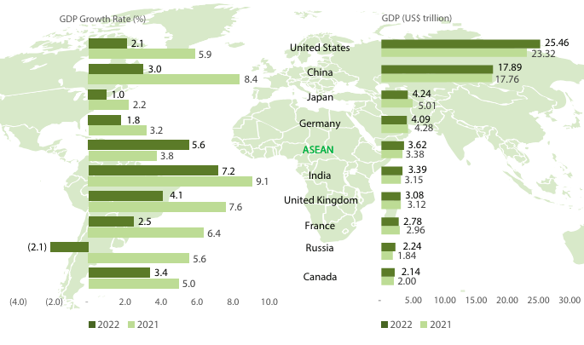
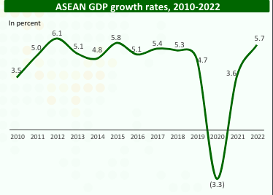
Introduction
ASEAN – emerging and dynamic bloc – impressive growth and immense trade potential
ASEAN grew by 5.7% in 2022, AAGR – 4.4%
(2010-2022)
Comparative Perspective
Source: ASEAN Secretariat, ASEANstats database
Source: ASEAN Secretariat, ASEANstats database

Slide 4

India–ASEAN Economic Co-operation
Recognizing the economic prospects, India actively seeking to capitalize on economic opportunities with the region
India's 'Look East Policy’ - 1991
Developing extensive economic and strategic ties with Southeast Asian countries
India-ASEAN relationship evolved into a strong economic co-dependence
1996 - India’s Membership in ASEAN regional forum
2009 - Signing of the ASEAN-India Free Trade Agreement (FTA) in goods
2015 - Agreement on trade in services and investment entered into force
1992 - Sectoral partnership
2002 - Summit level partner
2014 - Act East Policy

Slide 5
Motivation
Fig 1a Destination of ASEAN Exports, 2017
India-ASEAN Trade Scenario
ASEAN – much more important as a trading partner for India –
10% of India’s total imports
9% of India’s total exports
India accounts for mere –
4% of ASEAN exports and
3% of ASEAN’s global imports
For addressing trade imbalances – India should substantially improve its presence in the ASEAN market
Fig 1b Sources of ASEAN Imports, 2017
Source: GTAP 11 database

Slide 6

Scope and Research Objectives
Analysing the impact of the India-ASEAN FTA using GTAP general equilibrium modelling – with the base year 2017 – both on the external sector and on domestic macroeconomic variables in India and ASEAN
Estimating India’s untapped trade potential at a disaggregated product level (i.e., 6-digit HS) in the individual ASEAN member countries, utilizing the Viner’s trade creation model, for the years 2010 and 2022

Slide 7
Methodological Framework
Experiment Design: Regional and Sector Aggregation
Other Cereals Grains
and Crops
Vegetable Oils and Fats
Simulation using the GTAP 11 database
Other Livestock and
Meat Products
Rice
Bovine Meat Products
Simulation | Regional Aggregation | Sectoral Aggregation | Model specification
Full Liberalization | Cambodia, India, Indonesia, the Lao People’s Democratic Republic, the Philippines, Malaysia, Brunei Darussalam, Singapore, Thailand, Vietnam, the rest of ASEAN (comprising of Myanmar and Timor-Leste), China, EU, USA, Japan, Australia, ROW | 25 sectors | Perfect competition in factors and product markets, and production function, subject to constant returns to scale – standard GTAP specification. Unemployment captured in the model — Fixed Real Wages with Endogenous & Flexible Labour Supply.
Other Processed Food
Other Mining & Extraction
Coal and Oil
Motor Vehicle and Parts
Petroleum Products
Ferrous Metals
Chemical Products
Paper Products
25 Sectors
Electrical Equipment
Other Light Manufacturing
Computer, Electronic & Optical Products
Rubber and Plastic Products
Other Heavy Manufacturing
Pharmaceutical Products
Utilities And Construction
Other Services
Machinery & Equipment nec
Other Business Services
Textiles & Wearing Apparel
Communication

Slide 8
Estimation of Export Potential: Viner’s Trade Creation Model
Under this partial equilibrium framework, export competitiveness is estimated based on ground realities prevailing in the global economy.
In other words, price competitiveness forms the basis for identifying potential products exported by a supplier to an importing country.
In this approach, if a product becomes competitive based on its comparative cost advantage, the volume of increased trade is considered as trade creation.
For estimation of price competitiveness, each product is considered separately at disaggregated level (i.e. at 6-digit HS level).
In this analysis, the export price of each product from j^{th} country (in this case, India) is compared with the corresponding prices offered by its competitors in the k^{th} importing country (i.e., ASEAN member state), and in case some existing supplier is found to be uncompetitive to the potential exporter in price competition, then a portion of the current market share retained by the inefficient supplier – treated as trade potential of the j^{th} country.
This exercise is iterated for different pairs of countries at the disaggregated product level for estimating the export potential of j^{th} country in the k^{th} partner country.

Slide 9
Results & Discussion

Slide 10
CGE Modelling Results
India – experiences a positive impact except for a rise in its GDP price index
Lao – adversely affected by full liberalization of bilateral trade – between India and the ASEAN region
Indonesia – suffers in terms of fall in skilled labour employment levels and increase in its GDP price index
Cambodia, Philippines, Vietnam and the rest of ASEAN – better off in terms of all macro indicators
Percent Change in select macroeconomic variables
Country | Change in GDP Quantity Index | Change in Employment |  | Change in GDP Price Index
 |  | Skilled Labour | Unskilled Labour
India | 0.18 | 0.40 | 0.31 | 0.15
Malaysia | 0.05 | 0.08 | 0.13 | 0.03
Singapore | 0.04 | 0.08 | 0.08 | 0.06
Thailand | 0.06 | 0.16 | 0.14 | 0.06
Cambodia | 0.03 | 0.10 | 0.05 | -0.02
Indonesia | 0.01 | -0.06 | 0.08 | 0.43
Lao PDR | -0.03 | -0.11 | -0.02 | 0.12
Brunei | 0.01 | 0.04 | 0.04 | 0.04
Philippines | 0.03 | 0.06 | 0.05 | -0.04
Viet Nam | 0.24 | 0.39 | 0.45 | -0.05
Rest of ASEAN | 0.01 | 0.04 | 0.02 | -0.05
Source: CGE Simulation Results

Slide 11
CGE Modelling Results
India – the increase in imports (1.38%) surpasses the increase in exports (0.47%)
Significantly high trade deficit for India compared to ASEAN member countries
India – slight improvement in its terms of trade
Exports increase in all ASEAN members except Indonesia, Lao and Brunei
Imports increase in all ASEAN countries
Terms of trade improve except for KHM, PHL and rest of ASEAN
Percent change in trade variables
Country | Change in volume of exports | Change in volume of imports | Change in trade balance (US$ Mn) | Change in terms of trade
India | 0.47 | 1.38 | -4666.72 | 0.15
Malaysia | 0.09 | 0.17 | -45.48 | 0.03
Singapore | 0.00 | 0.08 | -160.99 | 0.03
Thailand | 0.10 | 0.36 | -445.5 | 0.04
Cambodia | 0.06 | 0.06 | -5.31 | -0.02
Indonesia | -0.11 | 0.66 | -730.76 | 0.34
Lao PDR | -0.08 | 0.01 | -2.08 | 0.06
Brunei | -0.04 | 0.05 | -4.54 | 0.01
Philippines | 0.11 | 0.16 | -120.04 | -0.02
Viet Nam | 0.34 | 0.46 | -299.00 | 0.03
Rest of ASEAN | 0.07 | 0.04 | -6.88 | -0.04
Source: CGE Simulation Results

Slide 12
Impact on India – ASEAN Bilateral Trade
Main destinations for Exports from India
India’s largest market access –
Vietnam (33.8%)
Cambodia (30.4%)
Philippines (29.9%)
Thailand (20.6%)
Sectors in India showing highest export growth and
their destinations
Sectors | Main destinations
Rice | Thailand, Philippines, Malaysia
Bovine Meat Products | Thailand, Cambodia
Other Mining and Extraction | Vietnam, Cambodia, Thailand
Other Processed Food | Malaysia, Vietnam, Philippines
Textiles and Wearing Apparel | Philippines, Vietnam, Cambodia
Motor Vehicle and parts | Vietnam, Philippines, Cambodia
Computer, electronic and optical products | Lao and Cambodia
Electrical equipment | Vietnam, Philippines, Cambodia
Machinery and equipment nec | Cambodia, Lao, Vietnam
Percent Change in India’s exports to ASEAN Countries
Source: Based on simulation results.
Source: Based on calculations from simulation results.

Slide 13
Impact on India – ASEAN Bilateral Trade
Major India’s Import Sources from ASEAN
Vietnam (27.3%)
Cambodia (21.2%)
Indonesia (20%)
Thailand (16.2%)
Sectors in ASEAN region showing highest export growth and their originating countries
Sectors | Main source countries
Other Grains and Crops | Indonesia, Vietnam, Lao
Vegetable Fats and Oils | Philippines, Singapore, Indonesia
Other Processed Food | Singapore, Vietnam, Philippines
Textiles and Wearing Apparel | Indonesia, Lao, Singapore
Motor Vehicle and parts | Malaysia, Thailand, Singapore
Rubber and plastic products | Indonesia, Cambodia, Lao
Electrical equipment | Cambodia, Thailand, Philippines
Machinery and equipment nec | Indonesia, Thailand, Malaysia
Pharmaceutical products | Philippines, Singapore, Malaysia
Percent Change in ASEAN Countries exports to India
Source: Based on simulation results
Source: Based on calculations from simulation results

Slide 14
India’s Export Potential in ASEAN Market: Viner’s Trade Creation
India’s Export Potential in ASEAN: A Comparative Analysis (2010 vs 2022)
(US $ Million)
ASEAN region provides a huge potential for trade for Indian Economy – USD 35 billion in 2022 – a substantial increase from USD 16.1 billion in 2010
Total Export potential – composed of two components – Currently Traded Products & Potentially Traded Products
Country | 2022 |  |  | 2010
 | Currently Traded Products | Potentially Traded Products | Total | Currently Traded Products | Potentially Traded Products | Total
Brunei | 66.9 | 42.0 | 108.9 | 26.7 | 38.5 | 65.2
Cambodia | 322.8 | 514.9 | 837.6 | 10.7 | 37.8 | 48.5
Lao* | 58.3 | 67.0 | 125.3 | 2.5 | 52.0 | 54.4
Myanmar | 103.1 | 67.2 | 170.2 | 19.0 | 17.7 | 36.7
Malaysia | 4687.2 | 1023.3 | 5710.5 | 1586.8 | 842.8 | 2429.6
Singapore | 7378.3 | 357.9 | 7736.2 | 3024.9 | 281.5 | 3306.4
Vietnam | 4896.2 | 1544.9 | 6441.2 | 1486.7 | 997.4 | 2484.1
Thailand | 4997.4 | 1122.2 | 6119.6 | 2821.6 | 1844.1 | 4665.8
Indonesia | 3852.0 | 1004.1 | 4856.1 | 1857.7 | 1177.1 | 3034.9
Philippines | 2112.0 | 823.7 | 2935.7 | NA | NA | NA
Total | 28474.2 | 6567.2 | 35041.4 | 10836.6 | 5289.0 | 16125.6
ASEAN Countries - 3 Major Groups
High Level of Trade Potential
SGP, THA, VNM, MYS
Medium Level of Trade Potential
IDN, PHL
Low Level of Trade Potential
KHM, MMR, LAO, BRN
Source: Authors’ calculations based on UN ComTrade, WITS.
Note: Estimation based on aggregation of products at HS 6-digit with bilateral time series data.
*2021, Lao trade data is not available for 2022.
NA: Philippines trade data not available for 2010.

Slide 15
Distribution of Export Potential Across Broad HS-Sectors
India's major export interest in Manufacturing Sector
2010
65% of Total Export Potential
2022
77% of Total Export Potential
India’s Sectoral Export Potential in ASEAN: A Comparative Analysis (2010 vs 2022)
HS Sec | Product Description | 2010 |  | 2022
 |  | Exp Pot. ($ Mn) | Share (%) | Export Pot. ($ Mn) | Share (%)
1 | Live Animals and Animal Products | 303.2 | 1.9 | 725.2 | 2.1
2 | Vegetable Products | 365.7 | 2.3 | 1418.5 | 4.0
3 | Animal or Vegetable Fats & Oils | 135.9 | 0.8 | 151.1 | 0.4
4 | Prepared Foodstuff, Beverages, etc | 640.0 | 4.0 | 1176.3 | 3.4
5 | Mineral Products | 4219.0 | 26.2 | 4609.3 | 13.2
6 | Products of Chemicals | 1338.9 | 8.3 | 3739.2 | 10.7
7 | Plastics & Articles thereof | 1244.5 | 7.7 | 2650.0 | 7.6
8 | Raw Hides & Skins, Leather, etc | 80.2 | 0.5 | 182.7 | 0.5
9 | Wood & Articles of Wood | 50.7 | 0.3 | 133.4 | 0.4
10 | Pulp of wood or of other Fibres | 319.8 | 2.0 | 521.9 | 1.5
11 | Textile & Textile Articles | 509.7 | 3.2 | 1491.0 | 4.3
12 | Footwear, Headgear and Umbrella | 26.2 | 0.2 | 204.2 | 0.6
13 | Articles of Stone, Plaster, Cement | 63.6 | 0.4 | 331.7 | 0.9
14 | Natural or cultured pearls, Jewellery | 885.0 | 5.5 | 2166.9 | 6.2
15 | Base Metals & Articles of Base Metal | 2660.9 | 16.5 | 4046.9 | 11.5
16 | Machinery & Mechanical Appliances | 2414.7 | 15.0 | 8230.3 | 23.5
17 | Vehicles, Aircraft and Vessels | 675.1 | 4.2 | 2230.8 | 6.4
18 | Optical, Photograph & Cinematography | 126.3 | 0.8 | 763.3 | 2.2
19 | Arms and Ammunition | 6.6 | 0.0 | 4.7 | 0.0
20 | Miscellaneous Manufactured Articles | 59.8 | 0.4 | 263.9 | 0.8
21 | Works of Art Collectors' Pieces | 0.0 | 0.0 | 0.0 | 0.0
Machinery & Mechanical Appliances (23.5%)
Base Metals & Articles of Base Metal
(11.5%)
India’s Export Potential concentrated in 5 Sectors
Mineral Products
(13.2%)
Chemical Products
(10.7%)
Plastics & Articles thereof
(7.6%)
Source: Authors’ calculations based on UN ComTrade, WITS
Note: Estimation based on aggregation of products at HS 6-digit with bilateral time series data.

Slide 16
Export Potential – Country & Sector Level
Machinery & Mechanical Appliances
THA
Chemical Products
Base Metals
MYS
SGP
SGP
IDN
THA
VNM
MYS
THA
India's most significant trading partners in the region – representing substantial trade opportunities
In the key sector of Machinery and Appliances – Thailand, Singapore, and Malaysia – 74.5% of India's total export potential with the ASEAN region in this sector in 2022 – representing a slight increase from 72% in 2010
Similarly, in the crucial sector of Chemical Products – Singapore, Indonesia, and Thailand – 60.2% of India's total export potential with the region in this sector – a modest decline from 65.3% in 2010
Furthermore, in the sector of Base Metals, Vietnam, Thailand, and Malaysia – share approx 72-73% of India's export potential with the region in both 2010 and 2022
2010 – 72%
2022 – 74.5%
2010 – 65.3%
2022 – 60.2%
2010 – 73%
2022 – 72%

Slide 17
Conclusion
ASEAN – important trading partner of India – as evidenced by expanding trade relations with the region
Bilateral trade between India and ASEAN – increases by almost US$ 13,000 million – as the scope of the FTA widens – in the event of full liberalization
With GTAP modelling – favourably & adversely affected sectors and countries because of the policy shock
With Viner’s approach – export competitiveness at disaggregated level – that is we see which sectors are more competitive and less competitive in India as compared to other suppliers in the ASEAN market
There is a trade-off – Viner’s results suggest that these sectors (Machinery, Chemical products, Base metals, Plastics, Minerals) in India are competitive as compared to other suppliers in ASEAN market – on the other hand GTAP results show these 5 sectors have low tariffs in India – therefore we see India doesn’t gain large market access in these sectors

Slide 18
Appendix

Slide 19
Impact on Total Trade of India and ASEAN members
Percent Change in Sectoral Exports
India – max increase in exports observed in
bovine meat products (11.3%)
vegetable fats and oils (8.6%)
motor vehicle and parts (8%)
other processed food (6.3%)
Major contribution of rise in exports – large economies of ASEAN – SGP, IDN, THA – come from
Veg fats and oils – THA (8.9%)
Other Grains and Crops – IDN (9.4%)
Rice – SGP (6.5%)
Rubber and Plastic products – IDN (6.4%)
Commodity Group | India | BRN | KHM | IDN | LAO | MYS | PHL | SGP | THA | VNM | MYM_T
Rice | 0.78 | -4.01 | -0.25 | -6.70 | -0.67 | 0.50 | 1.24 | 6.47 | -0.09 | -2.31 | 0.41
Other Grains and Crops | 5.82 | -0.33 | -0.80 | 9.43 | 2.40 | -2.18 | 0.34 | 0.55 | 0.15 | 6.65 | -0.74
Bovine Meat Products | 11.28 | -0.43 | -0.59 | -3.42 | -0.38 | -1.17 | 0.32 | -1.11 | -1.70 | 13.91 | 0.08
Other Livestock and Meat Products | -1.36 | -0.18 | 0.03 | -4.55 | -0.49 | -1.49 | 0.42 | -0.23 | -0.50 | 0.65 | 0.38
Coal & Oil | -1.28 | -0.01 | -0.56 | -0.19 | -0.56 | -0.18 | -0.15 | -0.43 | -0.49 | -0.31 | 0.05
Other Mining and Extraction | -1.6 | -0.04 | -0.38 | -1.29 | -0.14 | -0.08 | -0.04 | -0.23 | -0.87 | 4.21 | 0.06
Veg Fats & Oils | 8.56 | 0.84 | 2.57 | 5.05 | 0.79 | 2.04 | 2.14 | 1.04 | 8.93 | 0.47 | 0.20
Other Processed Food | 6.26 | -0.42 | -1.10 | -1.75 | -1.66 | 0.44 | 0.50 | 3.71 | -0.02 | 1.30 | 0.02
Textiles & Wearing apparel | -0.46 | -0.32 | 0.05 | -1.64 | -0.40 | 0.15 | 0.22 | 0.75 | -0.02 | 0.30 | 0.26
Paper Products | 0.55 | -0.15 | 0.02 | -1.57 | -0.22 | 0.21 | 0.13 | -0.19 | -0.30 | 0.06 | 0.12
Motor Vehicle and parts | 7.99 | -0.33 | -0.48 | -2.59 | -1.46 | 0.30 | -0.44 | 2.24 | 0.99 | 0.32 | -0.47
Other Light Mnfc | -0.08 | -0.40 | 0 | -2.24 | -0.65 | 0.39 | 0.16 | -0.32 | 0.29 | 0.12 | 0.13
Rubber & plastic Prod | 1.8 | -0.17 | 3.63 | 6.39 | -0.27 | 0.46 | 0.77 | 1.72 | 0.71 | 3.15 | 0.55
Petroleum, coal products | -0.26 | -0.01 | 0.13 | 0.82 | -0.03 | 0.38 | -0.02 | 0.32 | 0.21 | -0.04 | 0.71
Chemical products | -0.03 | -0.15 | -0.12 | -0.39 | -0.33 | 0.34 | 0.11 | 0.09 | 0.69 | 0.57 | 0.22
Computer, electronic, optical products | -0.97 | -0.48 | -0.20 | -2.43 | -0.34 | -0.25 | 0.06 | -0.25 | -0.49 | -0.18 | 0.10
Ferrous metals | 1.68 | -0.33 | -0.11 | -1.26 | -0.32 | 0.39 | -0.12 | -1.01 | -0.53 | -0.34 | 0.01
Electrical equipment | 0.89 | -0.48 | 0.04 | -2.17 | -0.62 | -0.09 | 0.12 | 0.07 | -0.13 | 0.07 | 0.26
Machinery and equipment nec | 0.27 | -0.44 | 0.09 | -1.15 | -0.42 | 0.04 | 0.14 | -0.23 | 0.27 | 0.19 | 0.07
Pharma Products | -0.67 | -0.17 | -0.05 | -2.16 | -0.21 | -0.06 | -0.10 | -0.28 | -0.55 | 0.23 | 0.25
Other Heavy Mnfc | -0.65 | -0.24 | -0.03 | -1.62 | -0.23 | 0.28 | -0.06 | -0.27 | -0.35 | 0.14 | 0.07
Utilities & Cons | -0.70 | -0.11 | -0.07 | -1.30 | 0.08 | 0.22 | 0.02 | -0.09 | -0.29 | -0.2 | 0
Communication | -0.85 | -0.09 | -0.06 | -1.30 | -0.21 | 0 | 0.07 | -0.07 | -0.39 | -0.05 | 0.06
Other Business Services | -0.67 | -0.12 | -0.01 | -1.31 | -0.29 | -0.04 | 0.05 | -0.13 | -0.34 | 0.01 | 0.08
Other Services | -0.62 | -0.04 | -0.05 | -1.25 | -0.24 | -0.03 | 0.01 | -0.07 | -0.26 | -0.03 | 0.10

Slide 20
Percent Change in Sectoral Imports
Commodity Group | India | BRN | KHM | IDN | LAO | MYS | PHL | SGP | THA | VNM | MYM_T
Rice | 148.32 | -0.02 | -0.13 | 5.31 | 0.37 | 5.24 | 7.27 | 1.31 | 26.42 | 3.44 | -1.02
Other Grains and Crops | 6.52 | 0.02 | 0.03 | 2.75 | -0.19 | 0.65 | 0.76 | 0.49 | 0.75 | 1.83 | -0.23
Bovine Meat Products | 1.14 | 0.01 | 0.47 | 7.13 | 2.23 | 0.01 | 3.28 | 0.28 | 0.67 | 0.59 | -0.15
Other Livestock and Meat Products | 0.89 | -0.05 | 0.01 | 1.63 | 0.05 | 0.67 | -0.1 | 0.24 | 0.23 | 0.04 | -0.17
Coal & Oil | 0.32 | 0.05 | 0.1 | 0.1 | 0.09 | 0.13 | 0.03 | 0.25 | 0.20 | 0.35 | 0.05
Other Mining and Extraction | 0.64 | -0.05 | 0 | 0.37 | -0.18 | 0.02 | -0.09 | 0.11 | 0.38 | 0.9 | 0.38
Veg Fats & Oils | 10.4 | 0 | 0 | 3.09 | 0.11 | 1.01 | -0.45 | 0.97 | 1.23 | 0.04 | -0.29
Other Processed Food | 6.26 | 0.03 | -0.08 | 1.00 | 0.04 | 0.68 | 0.03 | 0.40 | 0.19 | 2.01 | 0.21
Textiles & Wearing apparel | 1.82 | 0.02 | 0.09 | 0.44 | -0.31 | 0.18 | 0.08 | 0.14 | 0.43 | 0.3 | 0.17
Paper Products | 0.55 | 0.05 | 0.04 | 0.82 | -0.08 | 0.07 | -0.01 | 0.06 | 0.09 | 0.35 | -0.1
Motor Vehicle and parts | 3.55 | 0.09 | 0.22 | 0.88 | 0.05 | 0.16 | 0.39 | 0.17 | 1.09 | 2.06 | 0.09
Other Light Mnfc | 1.13 | 0.12 | 0.11 | 0.97 | 0.12 | 0.16 | 0.46 | 0.13 | 0.52 | 0.32 | 0.06
Rubber & plastic Prod | 12.96 | 0.03 | 0.09 | 1.31 | -0.05 | 0.18 | 0.29 | 0.17 | 0.53 | 0.67 | 0.02
Petroleum, coal products | 0.76 | 0.02 | 0.01 | 0.15 | -0.05 | 0.09 | 0.04 | 0.16 | 0.23 | 0.29 | 0.01
Chemical products | 0.77 | 0.03 | 0.05 | 0.34 | -0.05 | 0.20 | 0.02 | 0.12 | 0.32 | 0.41 | 0.03
Computer, electronic, optical products | 0.69 | 0.1 | 0.07 | 0.29 | 0.04 | -0.08 | 0.05 | -0.06 | 0.08 | -0.1 | 0.05
Ferrous metals | 0.72 | 0 | 0.01 | 0.19 | -0.01 | 1.10 | 0.18 | -0.01 | 0.36 | 0.18 | 0.02
Electrical equipment | 1.47 | 0.1 | 0.06 | 0.26 | 0.07 | 0.12 | 0.16 | 0.12 | 0.29 | 0.4 | 0.05
Machinery and equipment nec | 1.32 | 0.08 | 0.13 | 0.09 | 0.06 | 0.18 | 0.13 | 0.12 | 0.47 | 0.39 | 0.04
Pharma Products | 0.76 | 0.01 | 0 | 1.00 | 0.06 | 0.11 | 0.13 | 0.08 | 0.37 | 0.37 | 0.02
Other Heavy Mnfc | 0.69 | 0.14 | 0.01 | 0.67 | -0.01 | 0.02 | 0.13 | -0.03 | 0.10 | 0.37 | -0.01
Utilities & Cons | 0.83 | 0.13 | 0.06 | 0.93 | 0.13 | 0.12 | 0.13 | 0.18 | 0.29 | 0.54 | -0.02
Communication | 0.62 | 0.02 | -0.01 | 0.62 | 0.05 | 0.05 | -0.03 | 0.01 | 0.16 | 0.22 | -0.06
Other Business Services | 0.55 | 0.04 | 0.01 | 0.65 | 0.11 | 0.07 | 0.02 | 0.02 | 0.18 | 0.24 | -0.07
Other Services | 0.64 | 0.04 | 0.01 | 0.72 | -0.11 | 0.09 | -0.01 | 0.08 | 0.21 | 0.3 | -0.03
India – substantial increase in imports observed in
Rice (148%)
Rubber & Plastic products (13%)
vegetable fats and oils (10%)
Other processed food (6.3%)
ASEAN members –
Bovine Meat Products – IDN (7.1%)
Rice – THA (26.4%),
PHL (7.3%)

Slide 21
Percent Change in Sectoral Output
Commodity Group | India | BRN | KHM | IDN | LAO | MYS | PHL | SGP | THA | VNM | MYM_T
Rice | 0.17 | 0.17 | -0.04 | -0.13 | -0.1 | -2.01 | -0.3 | 0.56 | -0.04 | -0.52 | 0.03
Other Grains and Crops | -0.09 | 0.02 | 0 | 1.04 | 0.12 | 0.69 | 0.02 | 0.38 | 0.01 | 0.95 | -0.06
Bovine Meat Products | 4.59 | -0.08 | -0.17 | -0.59 | -0.44 | 0.23 | -1.96 | -0.03 | -0.03 | -0.71 | 0
Other Livestock and Meat Products | 0.34 | 0.07 | -0.02 | -0.25 | -0.12 | -0.2 | 0 | 0.05 | -0.08 | 0.28 | 0.02
Coal & Oil | -0.04 | -0.01 | 0.04 | -0.14 | 0.01 | 0 | 0.01 | 0.01 | -0.02 | 0.01 | 0.04
Other Mining and Extraction | -0.03 | -0.02 | -0.02 | -0.26 | -0.12 | 0 | 0.01 | -0.02 | -0.03 | 0.17 | 0.03
Veg Fats & Oils | -6.15 | 0.84 | 0.59 | 3.81 | -0.52 | 1.39 | 0.61 | 0.99 | 0.58 | 0.29 | 0.98
Other Processed Food | 0.55 | -0.08 | -0.03 | -0.27 | -0.69 | -0.11 | 0.04 | 2.55 | -0.02 | -0.25 | -0.07
Textiles & Wearing apparel | -0.12 | -0.11 | 0.04 | -1.2 | -0.37 | -0.01 | -0.02 | 0.39 | -0.12 | 0.23 | 0.14
Paper Products | 0.10 | 0 | -0.01 | -0.42 | -0.23 | 0.06 | 0.06 | 0.01 | -0.04 | 0.1 | 0.11
Motor Vehicle and parts | 1.13 | -0.08 | -0.24 | -1.36 | -0.39 | 0.11 | -0.62 | 1.79 | 0.61 | -1.53 | -0.04
Other Light Mnfc | 0.16 | -0.17 | -0.04 | -0.94 | -0.5 | 0.14 | -0.2 | -0.18 | 0.12 | 0.11 | 0.02
Rubber & plastic Prod | -0.72 | -0.09 | 3.07 | 2.81 | -0.27 | 0.17 | 0.06 | 0.84 | 0.45 | 1.24 | 0.35
Petroleum, coal products | 0.09 | 0 | 0.05 | 0.01 | -0.14 | 0.14 | 0 | 0.25 | 0.17 | 0.16 | -0.03
Chemical products | -0.34 | -0.14 | 0.03 | -0.57 | -0.28 | 0.2 | 0.05 | 0.08 | 0.41 | 0.36 | -0.01
Computer, electronic, optical products | -0.10 | -0.20 | -0.10 | -1.78 | -0.34 | -0.23 | 0.06 | -0.24 | -0.33 | -0.19 | -0.01
Ferrous metals | 0.64 | -0.18 | -0.01 | -0.84 | -0.23 | -0.66 | -0.01 | -0.48 | -0.09 | -0.11 | 0
Electrical equipment | 0.26 | -0.44 | 0 | -1.81 | -0.62 | -0.09 | 0.06 | 0.04 | -0.11 | 0 | -0.11
Machinery and equipment nec | 0.29 | -0.36 | -0.05 | -1.09 | -0.36 | 0.02 | 0.14 | -0.17 | 0.20 | 0.22 | 0
Pharma Products | -0.19 | 0.04 | 0.06 | -0.6 | -0.58 | -0.02 | -0.12 | -0.26 | -0.27 | 0.07 | -0.13
Other Heavy Mnfc | 0.08 | -0.02 | 0.06 | -0.8 | -0.18 | 0.14 | -0.01 | -0.11 | -0.08 | 0.13 | 0.04
Utilities & Cons | 0.47 | 0.08 | 0.10 | 0.23 | 0.03 | 0.08 | 0.13 | 0.11 | 0.30 | 0.43 | 0.03
Communication | -0.10 | 0.08 | 0.01 | -0.03 | -0.05 | 0.05 | 0.03 | 0.03 | 0.01 | 0.24 | 0.01
Other Business Services | 0.09 | 0.07 | 0.02 | -0.12 | -0.09 | 0.04 | 0.03 | -0.02 | 0 | 0.24 | 0.03
Other Services | 0.22 | 0.01 | 0 | -0.01 | -0.06 | 0.04 | 0.01 | 0.03 | 0.03 | 0.24 | 0.01
Adversely and favourably affected sectors – in terms of changes in output – due to the implementation of tariff reforms
India experiences – higher increase – Bovine Meat Products, Motor Vehicle and Parts, Ferrous Metals, Machinery and equipment
Output of vegetable fats and oils falls substantially followed by Rubber and plastic products; Chemical products; and Pharmaceutical products
All ASEAN members except Lao experience – maximum increase in output in vegetable fats and oils – Indonesia (3.81%) followed by Malaysia (1.31%)

Slide 22
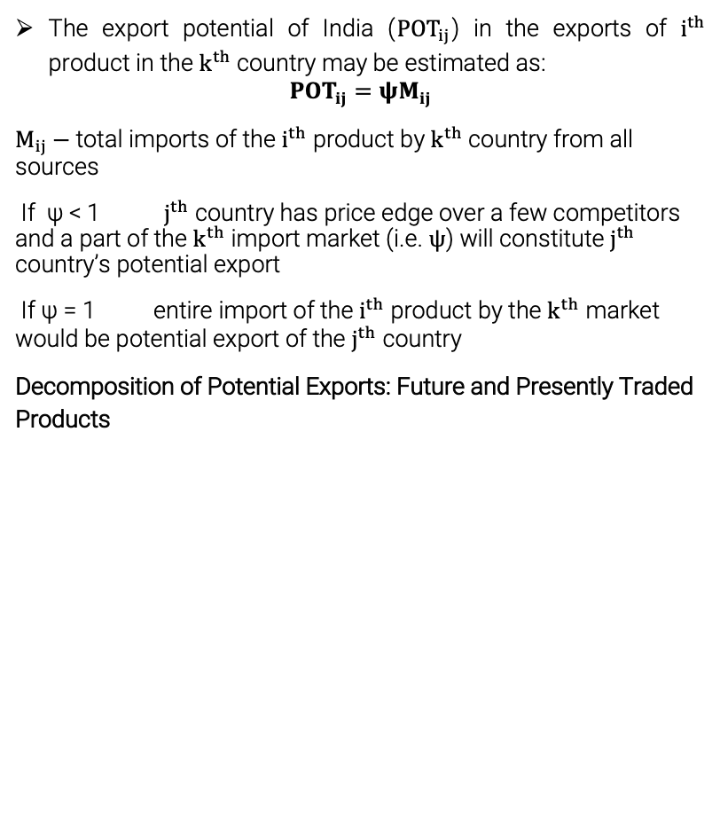
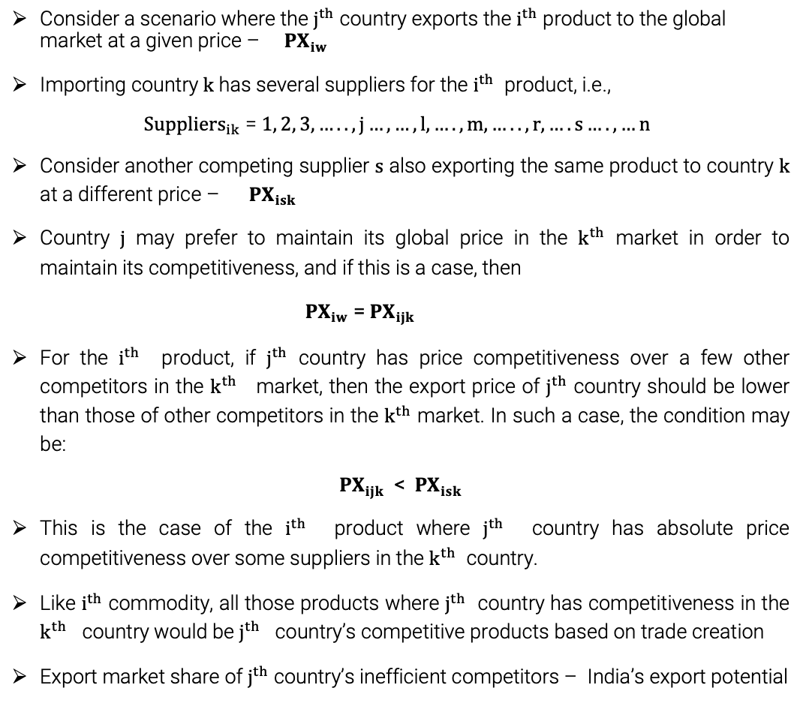
Estimation Procedure
Consider a scenario where the $j^{th}$ country exports the $i^{th}$ product to the global market at a given price – ${PX}_{iw}$
Importing country $k$ has several suppliers for the $i^{th}$ product, i.e.,
${Suppliers}_{ik}$ = $1, 2, 3,…..,j…,…,l,….,m,…..,r,….s….,…n$
Consider another competing supplier $s$ also exporting the same product to country $k$ at a different price – ${PX}_{isk}$
Country $j$ may prefer to maintain its global price in the $k^{th}$ market in order to maintain its competitiveness, and if this is a case, then
${PX}_{iw}$ = ${PX}_{ijk}$
For the $i^{th}$ product, if $j^{th}$ country has price competitiveness over a few other competitors in the $k^{th}$ market, then the export price of $j^{th}$ country should be lower than those of other competitors in the $k^{th}$ market. In such a case, the condition may be:
${PX}_{ijk}$ < ${PX}_{isk}$
This is the case of the $i^{th}$ product where $j^{th}$ country has absolute price competitiveness over some suppliers in the $k^{th}$ country.
Like $i^{th}$ commodity, all those products where $j^{th}$ country has competitiveness in the $k^{th}$ country would be $j^{th}$ country’s competitive products based on trade creation
Export market share of $j^{th}$ country’s inefficient competitors – India’s export potential
The export potential of India (${POT}_{ij}$) in the exports of $i^{th}$ product in the $k^{th}$country may be estimated as:
$${POT}_{ij}=ψM_{ij}$$
$M_{ij}−$total imports of the $i^{th}$ product by $k^{th}$country from all sources
If ψ < 1 $j^{th}$ country has price edge over a few competitors and a part of the $k^{th}$ import market (i.e. $ψ$) will constitute $j^{th}$ country’s potential export
If ψ = 1 entire import of the $i^{th}$ product by the $k^{th}$ market would be potential export of the $j^{th}$ country
Decomposition of Potential Exports: Future and Presently Traded Products
Export potential of the j^{th} country
Trade potential of products which are presently traded - p_{a}
Trade potential of products which are to be traded in future - p_{b}

Slide 23
Thank You

Slide 24
Unlocking India's Export Opportunities in ASEAN: Insights from GTAP Model and Viner’s Trade Creation Methodology
27th Annual Conference on Global Economic Analysis
Colorado State University, Fort Collins
June 5-7, 2024
Chandni Dawani¹ and Badri G. Narayanan²
¹ PhD Scholar, The IIS (Deemed to be University), Jaipur, Rajasthan, India
² Affiliate Faculty, Boston College, USA
c.dawani@gmail.com
@c_dawani
linkedin.com/chandni-dawani

