Slide 1
Scenarios of Global Food Consumption: Implications for Agriculture
Ron Sands
USDA Economic Research Service
27th Annual Conference on Global Economic Analysis
June 5-7, 2024
Colorado State University
Fort Collins, Colorado
The findings and conclusions in this presentation are those of the author and should not be construed to represent any official USDA or U.S. Government determination or policy. This presentation was supported by the U.S. Department of Agriculture, Economic Research Service.
Notes:
Introduce myself
Introduce project

Slide 2
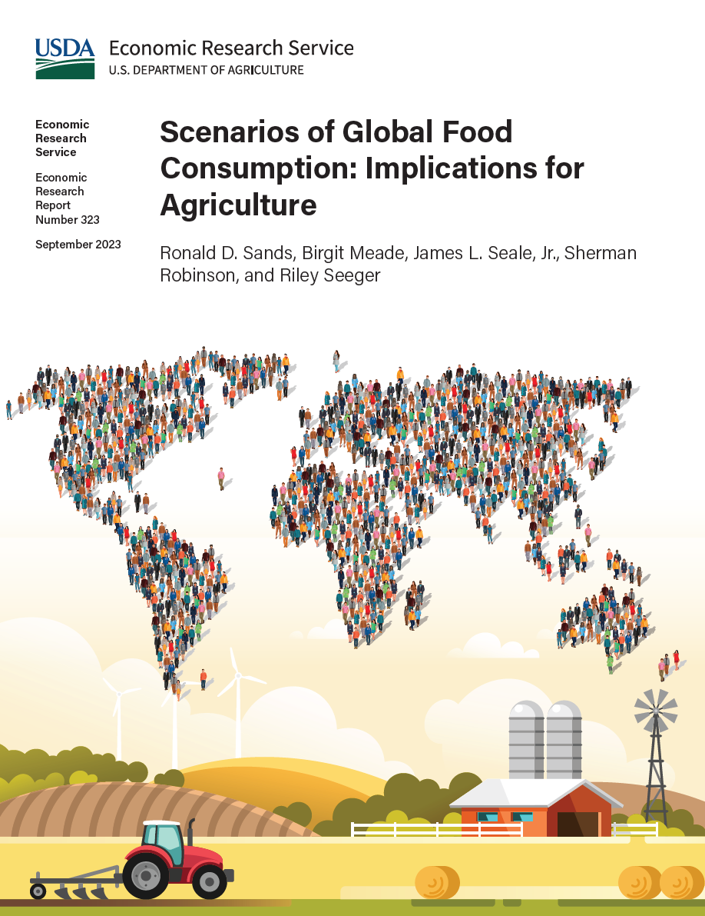
Research Questions
How do increasing population and income affect global demand for crops and food products through 2050?
What is the effect of agricultural productivity growth on food prices and cropland area expansion?
How do alternative assumptions about population growth affect the size of the world agricultural system in 2050?
Notes:
Introduce co-authors
Birgit Meade
Jim Seale
Sherman Robinson
Riley Seeger
Research Questions
1. How do increasing population and income affect global demand for crops and food products through 2050?
2. What is the effect of agricultural productivity growth on food prices and cropland area expansion?
3. How do alternative assumptions about population growth affect the size of the world agricultural system in 2050?

Slide 3
Approach
Retrospective Analysis
Prospective Analysis
Food Balance Sheets (FAO)
  Domestic supply is the quantity of food produced, plus imports, less exports, adjusted for change in storage
  Domestic use includes crops used for seed, animal feed, processed food, non-food uses, and waste during storage and transportation
  Remainder is food available for consumption (food consumed plus post-retail food waste)
International Comparison Program (ICP)
  Coordinated by the World Bank
  Measure the size of world economies based on surveys of the quantities of goods or services that can be purchased within each country
Future Agricultural Resources Model (FARM) developed at ERS
  Global economic model
  Simulates world agricultural and energy systems
  Five-year time steps starting in 2011
Drivers of global change into the future
  population
  per capita income growth
  dietary preference
  agricultural productivity
Notes:
Food Balance Sheets (accounting system)
Food and Agriculture Organization (FAO) of the United Nations
Annual balances for 98 food commodities for nearly all countries
Domestic supply is the quantity of food produced, plus imports, less exports, adjusted for change in storage
Domestic use includes crops used for seed, animal feed, processed food, non-food uses, and waste during storage and transportation
Remainder is food available for consumption
International Comparison Program (ICP)
Coordinated by the World Bank
Measure the size of world economies based on surveys of the quantities of goods or services that can be purchased within each country
ICP data are useful for statistical analysis and modeling of food demand
Future Agricultural Resources Model (FARM) developed at ERS
Global economic model
13 world regions
14 production sectors for primary agriculture
8 production sectors for processed food
Five-year time steps starting in 2011
Simulate drivers of global change into the future
population
per capita income growth
dietary preference
agricultural productivity
climate change effects on agriculture
large-scale demand for bioenergy as part of a climate change mitigation strategy

Slide 4
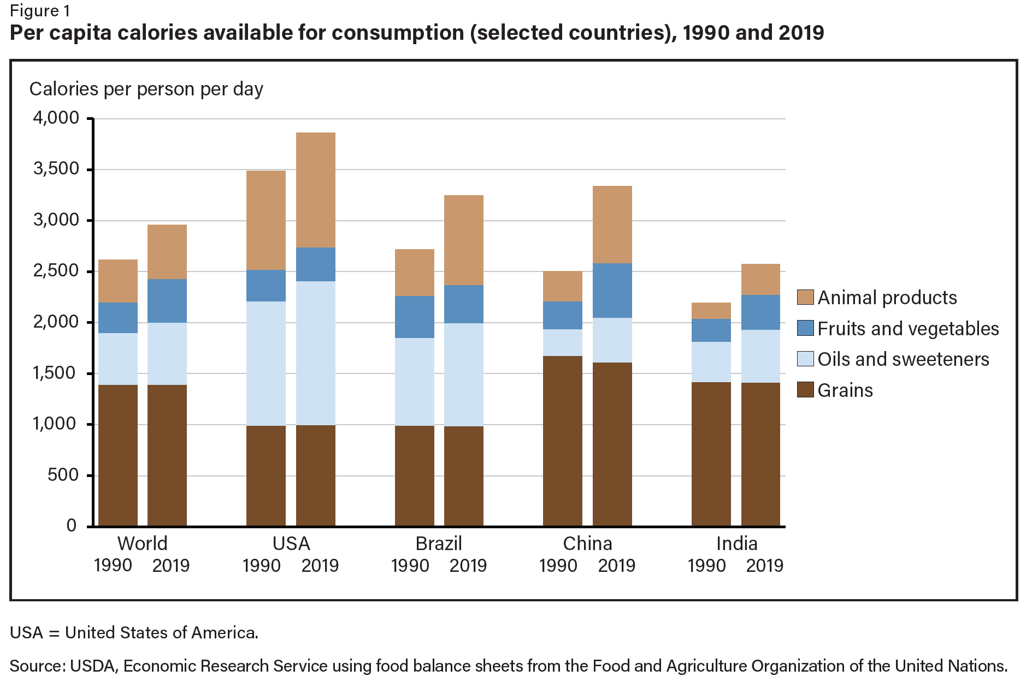
From 1990 through 2019, world population grew by 45 percent to 7.7 billion people, while calories available for food consumption increased by 61 percent
The world average masks large differences across countries
Calories available for consumption equal food consumed plus food waste
Notes:
From 1990 through 2019, world population grew by 45 percent to 7.7 billion people, while calories available for food consumption increased by 61 percent
The world average masks large differences across countries in total calories available per person per day and in calories available in each of the four food commodity groups

Slide 5
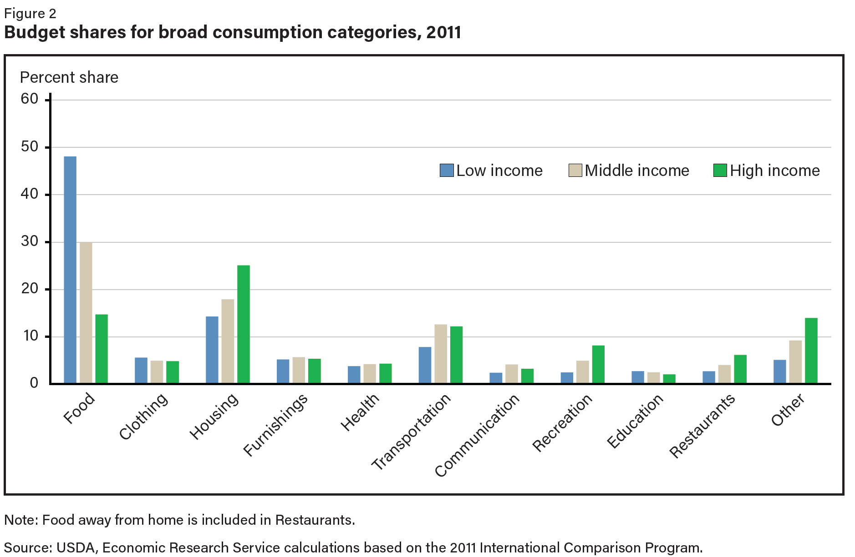
Food at home is by far the most important expenditure category for low- and middle-income economies
  Average budget share of 48 percent in low-income economies
  Average budget share of 30 percent in middle-income economies
Food away from home, which increases with income, is included in restaurants
Notes:
Food at home is by far the most important expenditure category for low- and middle-income economies
Average budget share of 48 percent in low-income economies
Average budget share of 30 percent in middle-income economies
Food away from home, which increases with income, is included in restaurants
Income classes
Low -
Middle -
High -

Slide 6
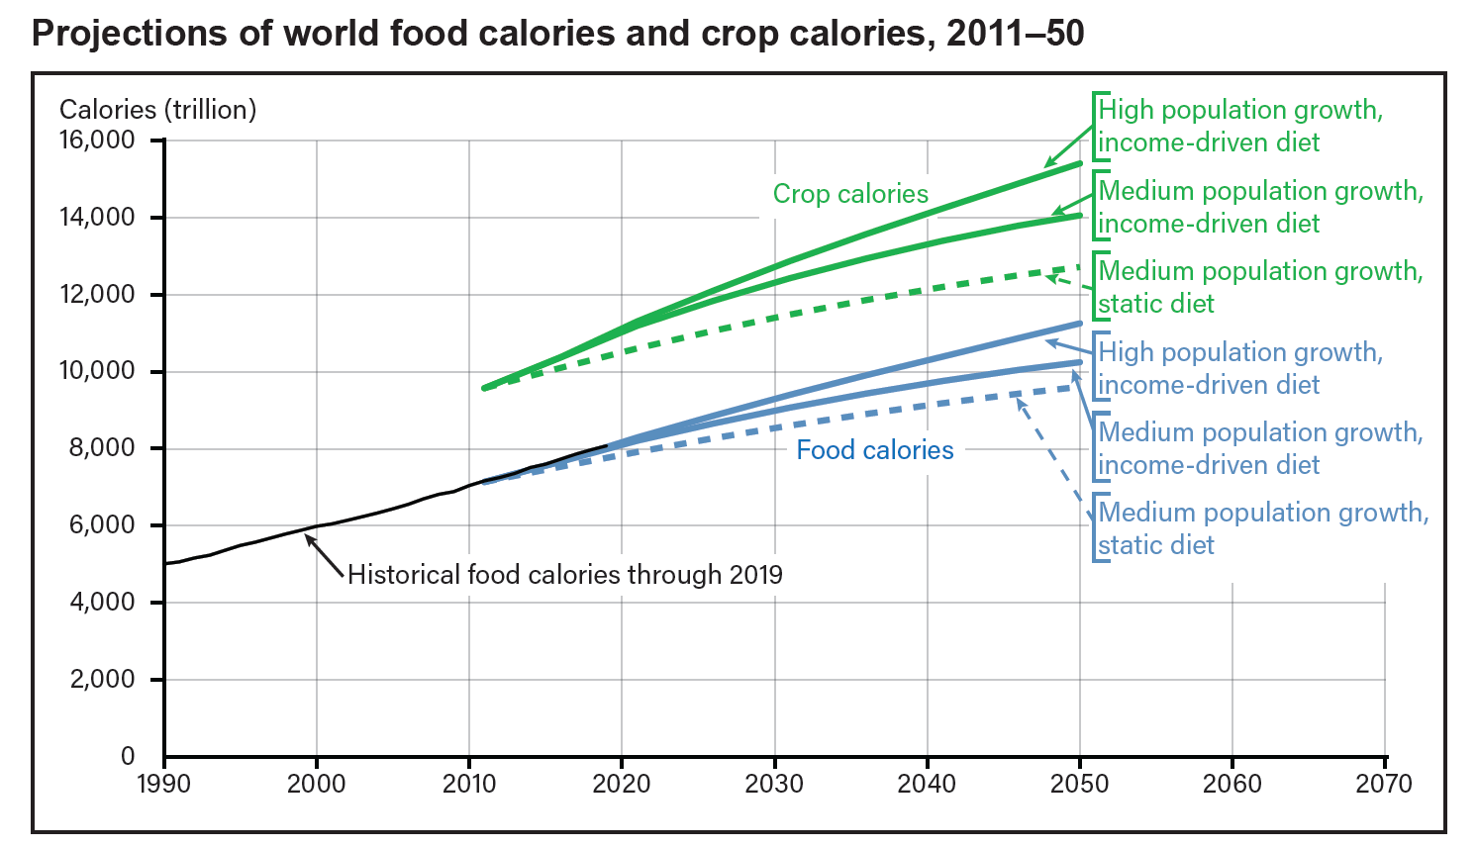
Population and Income Drive Projections of World Food Consumption
A useful measure of the size of the world agricultural system is total calories from crops
Rising per capita incomes have historically implied increasing consumption of
  Total calories
  Animal products
Uncertainty is handled through scenarios
Notes: Three illustrative scenarios are shown: a static diet (per capita consumption of food calories remains constant at 2011 levels in all world regions) with medium population growth; an income-driven diet with medium population growth; and an income-driven diet with high population growth. The static diet is a point of comparison to quantify the effect of income growth on food consumption.
Notes:
A useful measure of the size of the world agricultural system is total calories from crops
Crop calories are greater than calories available for food, primarily due to losses as feed is converted to meat, dairy products, and eggs
Rising per capita incomes have historically implied increasing consumption of animal products, with large increases in feed calories relative to increases in calories consumed as food
Uncertainty is handled through scenarios
Per capita food consumption remains constant over time in the static diet scenario
Uncertainty in population growth is represented by alternative projections from the United Nations.

Slide 7
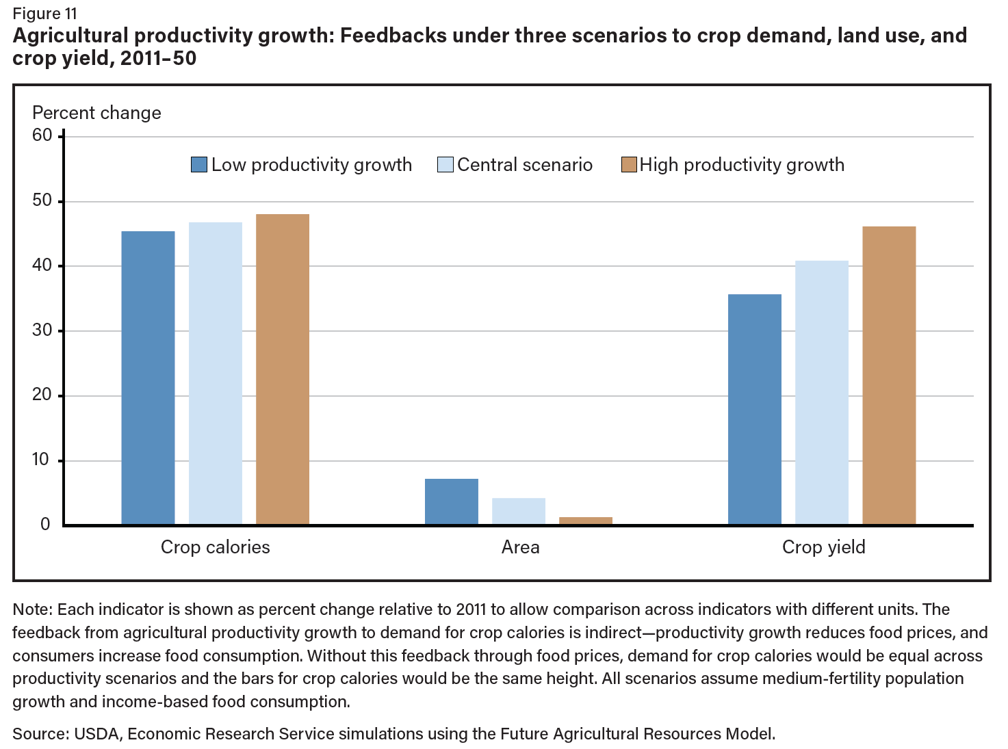
Food prices are lower in high productivity scenarios than in other scenarios, which allows greater consumption of food
If productivity growth were high enough, cropland area could decline
Crop yield increases along with productivity growth
Notes:
Productivity growth rates affect food prices and the amount of land used to grow crops
Food prices are lower in high productivity scenarios than in other scenarios, which allows greater consumption of food
Low productivity growth means more land and non-land resources are brought into agricultural production, increasing the price of agricultural products
If productivity growth were high enough, cropland area could decline

Slide 8
Takeaways
Calories are a convenient unit for representing the size of the world agricultural system
  Calories available for food consumption equal food consumed plus food waste
  Total crop calories include animal feed and represent pressure on the land base
  Conversion efficiency from crop calories to food calories
Strong trend of food consumption increasing with per capita income
  Total calories per person
  Calories of animal products per person
Food (at home) is the largest expenditure category for low- and middle-income economies
Share of income spent on food at home decreases with per capita income
Share of income spent on food away from home increases with per capita income
The rate of future agricultural productivity growth affects
  Crop yield
  Demand for agricultural land
  Food prices and demand for food
Notes:
Retrospective
Strong trend of food consumption increasing with per capita income
Total calories per person
Calories of animal products per person
Food (at home) is the largest expenditure category for low- and middle-income economies
Share of income spent on food away from home increases along with per capita income
Prospective
Calories are a convenient unit for representing the size of the world agricultural system
Total crop calories represent pressure on land base
Calories available for food consumption are driven by consumer demand
Conversion efficiency from crop calories to food calories
The rate of future agricultural productivity growth affects
Crop yield
Demand for agricultural land
Food prices and demand for food

Slide 9
Extra Slides (time permitting)
Notes:
Retrospective
Strong trend of food consumption increasing with per capita income
Total calories per person
Calories of animal products per person
Food (at home) is the largest expenditure category for low- and middle-income economies
Share of income spent on food away from home increases along with per capita income
Prospective
Calories are a convenient unit for representing the size of the world agricultural system
Total crop calories represent pressure on land base
Calories available for food consumption are driven by consumer demand
Conversion efficiency from crop calories to food calories
The rate of future agricultural productivity growth affects
Crop yield
Demand for agricultural land
Food prices and demand for food

Slide 10
Future Agricultural Resources Model (FARM)
FARM now (version 4)
Capabilities
  Global CGE
  Global food demand
  Climate change impacts, adaptation, mitigation
Activities
  AgMIP global economics
  Stanford Energy Modeling Forum (bioenergy studies)
  ERR-323 Scenarios of Global Food Consumption (September 2023)
FARM development (version 5)
New capabilities coming soon
  U.S. CGE (state level) nested within global CGE
GTAP-WiNDC
  Database
  Canonical Model
Technical bulletin and/or ERR
  Multi-breadbasket food shocks
  Application to winter oil crops

Slide 11
 | GTAP 11 data base | WiNDC data base | GTAP-WiNDC | FARM 5 (in development)
Geographical coverage | 160 world regions | 50 U.S. states | 10 world regions 50 U.S. states | 13 world regions 9 U.S. census divisions
Benchmark year | 2017 | 2017 | 2017 | 2017
Household types | 1 | 5 | 5 | 1
Production sectors | 65 | 43 | 43 | 41
Agricultural sectors | Rice Wheat Coarse grains Oil crops Vegetables, fruits, tree nuts Sugar crops Plant-based fibers (cotton) Other crops (hay) Ruminant meat (beef, lamb) Other animal products (pork, poultry, eggs) Milk production + 8 Food processing sectors | Rice Wheat Coarse grains Oil crops Vegetables, fruits, tree nuts Sugar crops Plant-based fibers (cotton) Other crops (hay) Ruminant meat (beef, lamb) Other animal products (pork, poultry, eggs) Milk production | Same as WiNDC | Same as GTAP 11

Slide 12
GTAP-WiNDC version 4.0
Notes:
Subnational U.S. model is nested within global GTAP model. Both are solved simultaneously as a single model.
Tom Rutherford (University of Wisconsin) and Ed Balistreri (University of Nebraska) are working on a version with bilateral trade between U.S. States

Slide 13
Future Agricultural Resources Model (FARM)
Group | Subgroup | Production Sector
Primary agriculture | Crops | Wheat
 |  | Paddy rice
 |  | Other grains
 |  | Oilseeds
 |  | Sugar (cane and beet)
 |  | Vegetables and fruits
 |  | Plant fibers
 |  | Other crops
 | Animal products | Cattle and other ruminants
 |  | Raw milk
 |  | Wool
 |  | Other animal products
 | Fisheries | Fish
 | Forestry | Forestry
Food processing |  | Vegetable oils
 |  | Processed rice
 |  | Sugar
 |  | Beverages and tobacco products
 |  | Other food
 |  | Meat from cattle and other ruminants
 |  | Dairy products
 |  | Other meat products
Energy | Production | Coal
 |  | Crude oil
 |  | Natural gas
 | Transformation | Refined coal and petroleum products
 |  | Electricity
Energy-intensive industries |  | Wood products
 |  | Paper and pulp
 |  | Chemicals, rubber, and plastic
 |  | Nonmetallic minerals
 |  | Iron and steel
 |  | Nonferrous metals
Other industry |  | Other industry
Transportation |  | Land transportation
 |  | Water transportation
 |  | Air transportation
Services |  | Services
Global computable general equilibrium model with 13 world regions, 38 production sectors (FARM 4), and five-year time steps through 2100. FARM 5 adds three production sectors: rubber and plastic products, water, hotels and restaurants, for a total of 41 sectors.
Region name | Notes
Sub-Saharan Africa
India
Other Asia (south)
Brazil
Other South America | Including Central America, Caribbean, and Mexico
Middle East and North Africa | Including Turkey
Economies in Transition | Russia, Belarus, Ukraine, Kazakhstan, Kyrgyzstan, Armenia, Azerbaijan, Georgia, Tajikistan, Turkmenistan, and Uzbekistan
China
Southeast and East Asia | Including Japan
United States
Canada
Europe | Including Estonia, Latvia, and Lithuania
Australia and New Zealand | Including Oceania

