Slide 1

Reversing Deep integration the case of US-Mexico corn trade
Roman M. Keeney and Dewey J. Robertson
Notes:
Introduction:
Good afternoon, thanks for being in attendance.
My name is DJR, just finished my first year in the MS Ag Econ program @ Purdue where I work under Dr. Roman Keeney
Over the last few months we have been working on a paper that focuses on the effects of reversing deep trade integration: using the us-Mexico gm corn trade dispute as the case study

Slide 2
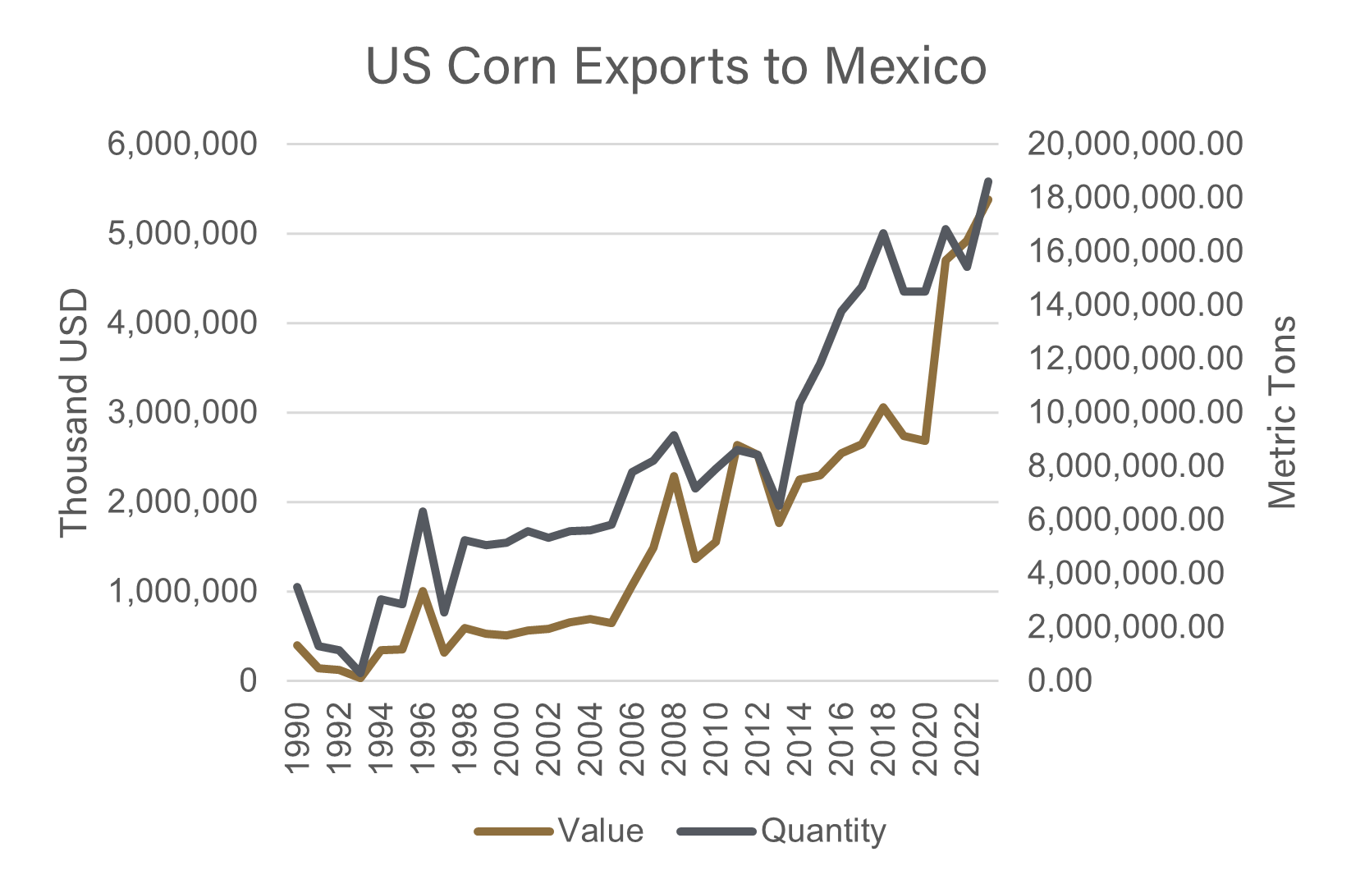
US-Mexico Integration
Free Trade Agreements and Corn Trade Integration
NAFTA (1994-2020): eliminated tariffs on most agricultural products, increased bilateral agriculture trade volume
  US corn exports to Mexico increased from 2.5 million tons to over 15 million tons by the end of NAFTA
USMCA (2020-Present): continuing duty free trade between North American neighbors
  Corn trade continues to increase, 18.6 million ton in 2023
  Provisions for biotechnology ensuring that traded GM products meet safety and risk management standards
Integration in the GTAP database
  25% of US grain exports go to Mexico
  95% of Mexico grain imports are from the US
Notes:
Before we can look at the effects of reversing deep integration, we first need to understand how the integration came to be
Mexico is one of the oldest and strongest trading partners of the US, sharing a boarder helps with trade relations
The movement of FTAs in the early 90 perfectly describes the US-Mexico relationship
NAFTA
USMCA

Slide 3
Changing Trade Relations
President Andrés Manuel López Obrador and a timeline of the GM corn ban
President Andrés Manuel López Obrador won the Mexican election in 2018 ushering in a new agenda for trade and agriculture.
December, 2020: decree issued to phase out the use of glyphosate and genetically modified (GM) corn by January 2024.
February , 2023: decree modified to focus on the ban of GM corn for human consumption.
August, 2023: US formally requests a dispute settlement panel under USMCA.
February, 2024: further decree modifications eliminating January 2024 deadline for banning GM corn for animal feed and industrial uses, pushing effective date to 2025.
November, 2024: final report of the USMCA dispute panel expected.
Notes:
After about 3 decades of deep integration within the agricultural sectors, changing relationships seem to be underway. There seems to be an attitude that is turning from trade liberalization and moving back towards protectionist policies.
President Andrés Manuel López Obrador, who was elected in 2018, led in the changing relations ushering in new agendas for trade and agriculture for Mexico. Chief among the changing agriculture and trade agendas is a push to ban GM corn in the Mexican food system. This ban would cause a huge disruption as corn is chief among commodities imported to Mexico. This ban has been met with pushback from the US and has been modified several times.
Here is a timeline of key events regarding the ban:
December, 2020 – concurrent with this is other domestic agendas to increase domestic production to phase out imports
February, 2023
August, 2023
February, 2024
November, 2024
A worthwhile note to mention here is how the US has responded to past trade disputes in bulk grain commodities. The US-China trade war resulted in high tariffs placed on US soybeans, to which the US responded with subsidies to soybean farmers. The US government has established itself as willing to protect farmer incomes for foreign trade policies.

Slide 4
Research Objectives
How would the potential ban affect North American grain markets? Focus on short run effects.
How does Mexico replace GM imports? How would increased domestic production effect the demand for land in Mexico?
How will grain markets adjust around the ban? What spillovers will there be to the broader food economy?
How does a US policy response – i.e. subsidy to keep constant returns to farmers – further welfare losses?
  US-China trade war: US replaced last trade income with subsidies (Janzen and Hendricks, 2020)
Notes:
Given the history of integration between US-Mexico and the potential ban on GM corn, we are motivated to understand how grain markets could be effected and the spillovers it would have on welfare measures.
Specifically we want to know:
How Mexico would replace lost imports from the GM ban?
Mexico has 2 options, increase domestic production or import from non-GM producers. (Most other large corn exporter s– Brazil and Argentina -- follow more or less the same trend as the US being dominated by GM production)
Increasing domestic production raises accompanying questions: How does land demand and other agricultural production change as land, labor, capital, are shifted from other sectors to corn production.
How grain markets will adjust around the ban?
Mexico increases domestic production, by how much? Does US produce less or export more, displacing others? How much do we expect prices to change in tandem with changing production?
What spillover effect does grain markets have to the food economy? Mexico has a growing beef sector that is wholly possible because of their ability to import large quantities of cheap corn from the US. If prices of domestically produced corn goes up, how will that impact the price of beef?
How a US policy response further welfare losses
We expect the ban to threaten US producer incomes. If the US government placed a subsidy to maintain incomes, what would that look like?

Slide 5
Primary and Secondary Incidence
Cumulative Effects of Initial and Retaliatory Policy
Chepeliev et al. (2023)
  Adverse weather, energy/fertilizer market distortions, domestic policies accumulate to agricultural and food trade disruptions 10x larger than initial supply disruptions.
Adjemian et al. (2021)
  USDA farm programs to compensate farmers from losses during US-China trade war. Aggregate reimbursement payments were 2x larger than the damage.
Chen et al. (2024)
  Chinese subsidies to firms that trade with the US to increase innovation.
Notes:
https://onlinelibrary.wiley.com/doi/full/10.1111/1746-692X.12389
https://www.sciencedirect.com/science/article/pii/S0306919221001305
https://onlinelibrary.wiley.com/doi/full/10.1002/mde.4214

Slide 6
Methods – GTAP Model Aggregations
Tailoring the GTAP model to analyze the Mexican GM corn ban
11 regions (USA, Mexico, Canada, China, India, Japan, UK, EU, Argentina, Brazil, ROW)
18 commodities (disaggregated agriculture, manufacturing services)
GTAP-AGR
  Country specific agricultural supply parameters (factor supply and substitution)
  We set AGR parameters to ½ of the literature values to invoke a shorter than medium run
Notes:
A computable general equilibrium model is the perfect tool to analyze the questions laid out previously as they consider the interconnectedness of the economy.
The GTAP model and accompanying database allow for aggregations so the modeler can focus on commodities and regions of interest. As we want to look at the potential GM corn ban from Mexico we aggregate the model by:
11 regions
18 commodities
We further model modifications by adjusting parameters.
It is important to note here how we consider corn in the GTAP model. Corn is not a stand alone commodity in the database but is rather a component of coarse grains (gro).

Slide 7
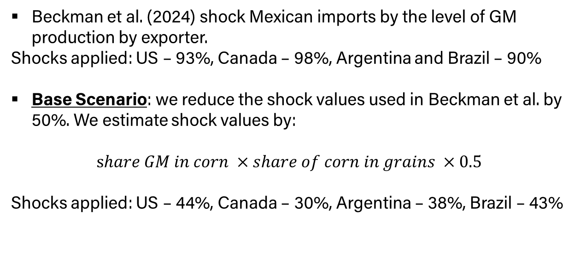
Base Scenario
Primary Incidence: Mexican Import Ban for GM Corn
Beckman et al. (2024) shock Mexican imports by the level of GM production by exporter.
Shocks applied: US – 93%, Canada – 98%, Argentina and Brazil – 90%
Base Scenario: we reduce the shock values used in Beckman et al. by 50%. We estimate shock values by:
$$share GM in corn ×share of corn in grains ×0.5$$
Shocks applied: US – 44%, Canada – 30%, Argentina – 38%, Brazil – 43%
Notes:
To model the effects of both the ban and the potential policy response we have a two-scenario model. Our idea is to shock GM corn imports by 50% to represent a gradual implementation.
Reasons for cutting the shock in half
Trying to pick up the shorter than medium run effects and
Want to try and target the level of import restriction that could trigger a US policy response
Mexico dependence on imports is unlikely to see the drastic 100% ban. We showed that Mexico is already altering all details of the ban to avoid issues. Smaller shocks reflect a more likely gradual implementation.

Slide 8
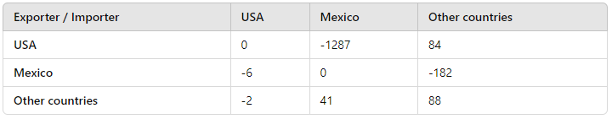
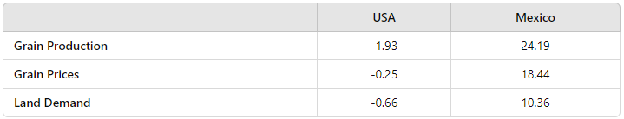
Base Model Results
Bilateral grain trade select results, volume of trade ($mn)
Grain market select results, percent change

Slide 9
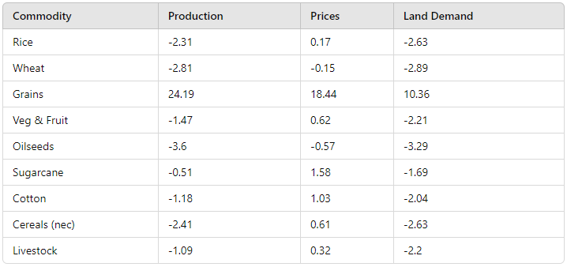
Base Model Results
Percent changes in Mexico’s food economy

Slide 10
Alternative Scenario
Secondary Incidence: US Subsidy to Fix Farm Income
Alternative Scenario: impose constant returns to US farmers in addition to the base scenario. Endogenize an output subsidy variable (to), exogenize returns to farm factors in corn sector (pva).
  We keep returns to farmers constant while acknowledging a subsidy can be higher (Janzen and Hendricks, 2020) or lower

Slide 11
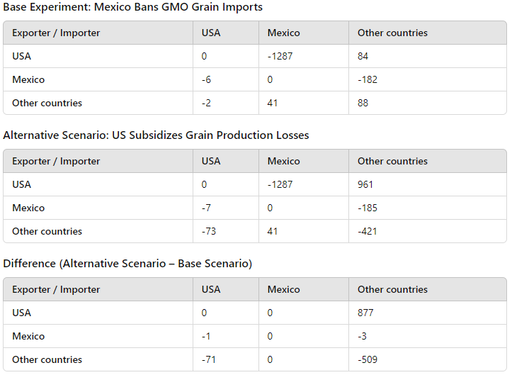
Alternative Model Results
Bilateral grain trade select results, volume of trade ($mn)

Slide 12
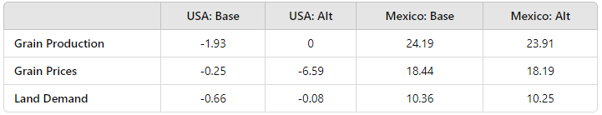
Alternative Model Results
Grain market select results, percent change

Slide 15
Summary and Conclusion
Mexico’s GM ban is welfare reducing and a US policy response would further losses
North American corn market is deeply integrated. US sends excess supplies to Mexico, Mexico has become reliant on US imports.
Mexico reduces output in all agriculture to make up for lost corn imports. Increases price of corn in Mexico as well as land rental rates.
Losing the Mexican market leads to reduced output in the US and surpluses that lower the world price and returns to farmers.
Adding a US policy to keep farm returns the same leads to almost identical production as before the ban, flooding world market further lowering prices.

Slide 16
Thank You
Dewey J. Robertson, Graduate Research Assistant rober785@purdue.edu

Slide 17
Appendix
Bilateral trade shares, GTAP DB, grains
Grain exports from US
Grain imports in Mexico
VXSB VXSB
1 USA 0.000000
2 Mexico 0.251877
3 Canada 0.030113
4 China 0.089435
5 India 0.000383
6 Japan 0.226072
7 UK 0.001514
8 EU 0.015752
9 Argentina 0.001695
10 Brazil 0.000760
11 ROW 0.382399
Total 1.000000
VMSB VMSB
1 USA 0.950317
2 Mexico 0.000000
3 Canada 0.000001
4 China 0.000006
5 India 0.000006
6 Japan 0.000000
7 UK 0.000002
8 EU 0.000037
9 Argentina 0.004774
10 Brazil 0.038485
11 ROW 0.006372
Total 1.000000

Slide 18
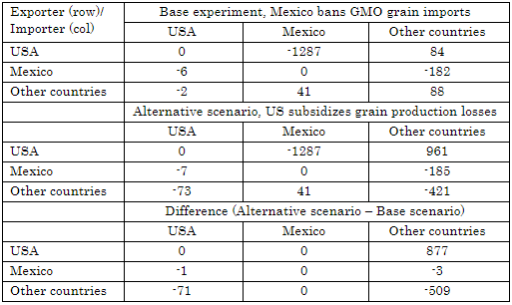
Appendix
Bilateral grain trade select results, volume of trade ($mn)

Slide 19
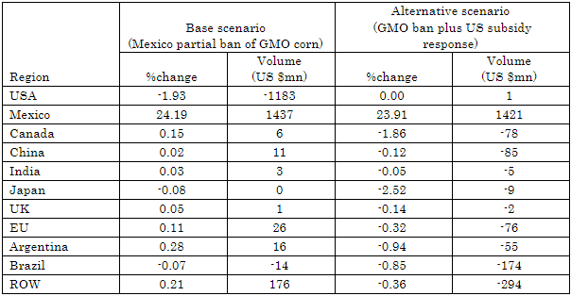
Appendix
Grain output changes by region for both scenarios

Slide 20
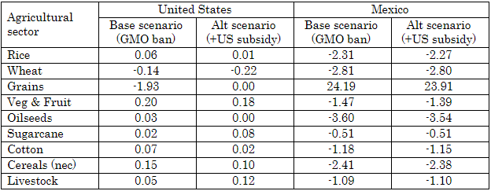
Appendix
Agricultural production changes, US & Mexico (%changes)

Slide 21
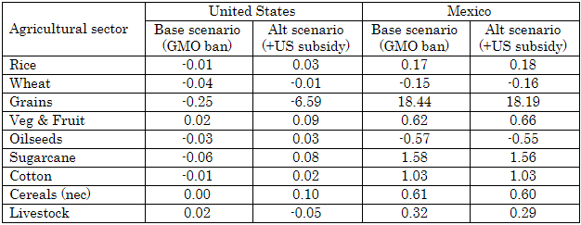
Appendix
Basic prices for agricultural commodities, US & Mexico (%changes)

Slide 22
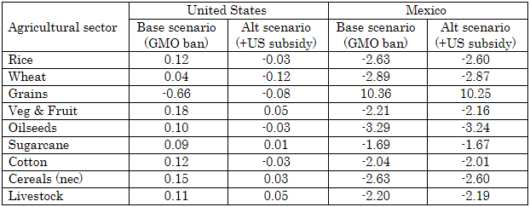
Appendix
Land demands by agricultural sector, US & Mexico (%change)

