Slide 1
Trade Policy as Climate Policy: Payoffs and Tradeoffs
Shantayanan Devarajan
Delfin S. Go
Sherman Robinson
Karen Thierfelder
Paper presented at the 27th Annual Conference on Global Economic Analysis, Colorado State University, June 2024.

Slide 2
Tariffs and Climate Mitigation Strategies
Carbon Border Adjustment Mechanism (CBAM)
  EU27 taxes carbon
  Impose tariffs on imports from regions without a carbon tax
    Tariff rate based on the carbon content in production in the exporting region
      Direct CO2 emission
      Direct and indirect CO2 emission
    Initially for 5 dirty sectors: Fertilizer, Iron & Steel, Aluminum, Cement, and Electricity
    Offset the production advantage in exporters who do not impose a carbon tax
Climate Club (Nordhaus, AER 2015)
  Agree to a tax on carbon
  Impose punitive tariffs on countries not in the coalition

Slide 3
Key Findings
CBAM tariffs offset the unfair competitive advantage of non-compliant countries
  Little effect on the trade of affected countries (because of trade diversion)
  Little impact on global CO2 emissions.
A large climate club works
  Little opportunity for non-members to divert trade => incentive to join club
  Reduce global CO2 emissions
A climate club is complicated
  Likely holdouts – US or China – integrated with countries in their region
  Club members strongly linked to holdout may suffer trade losses, possibly threatening the stability of the club

Slide 4
Nordhaus (AER 2015) – Model Overview
Trade in a homogenous good (classic trade theory)
Single commodity
15 regions
Welfare function includes the utility from global carbon emissions

Slide 5
Nordhaus (AER 2015) – Key findings
Considers a range of carbon taxes per ton of CO2
  $12.5, $25, $50, $100
Considers a range of punitive tariffs from 1% to 10%
Assumes
  Trade laws will be amended so penalty tariffs are acceptable
  Retaliation by non-club members is not allowed
For a low price of carbon ($12.5 or $25 per ton) a punitive tariff of 2% is enough to get full participation in the club
For higher prices of carbon, higher punitive tariffs needed
  10% punitive tariff is not enough to get full participation in the club

Slide 6
GLOBE Model - overview
Multi-sector, multi-region computable general equilibrium (CGE) model
Product differentiation
  Sensitivity to trade elasticities
GTAP v10 data (2014)
  Social Accounting Matrices for 19 regions
  Energy sectors
  CO2 emitted per unit of energy used in production

Slide 7
GLOBE Model – Relevant Behavior
Nested trade structure
  Represent the integration of production and trade in regions such as NAFTA, Europe and East and Southeast Asia
Energy inputs in value added nest for production
  Data on CO2 per unit of energy input used in production
  Carbon tax in the first order condition
    Producers can substitute away from energy inputs in response to increase in input cost due to a carbon tax

Slide 8
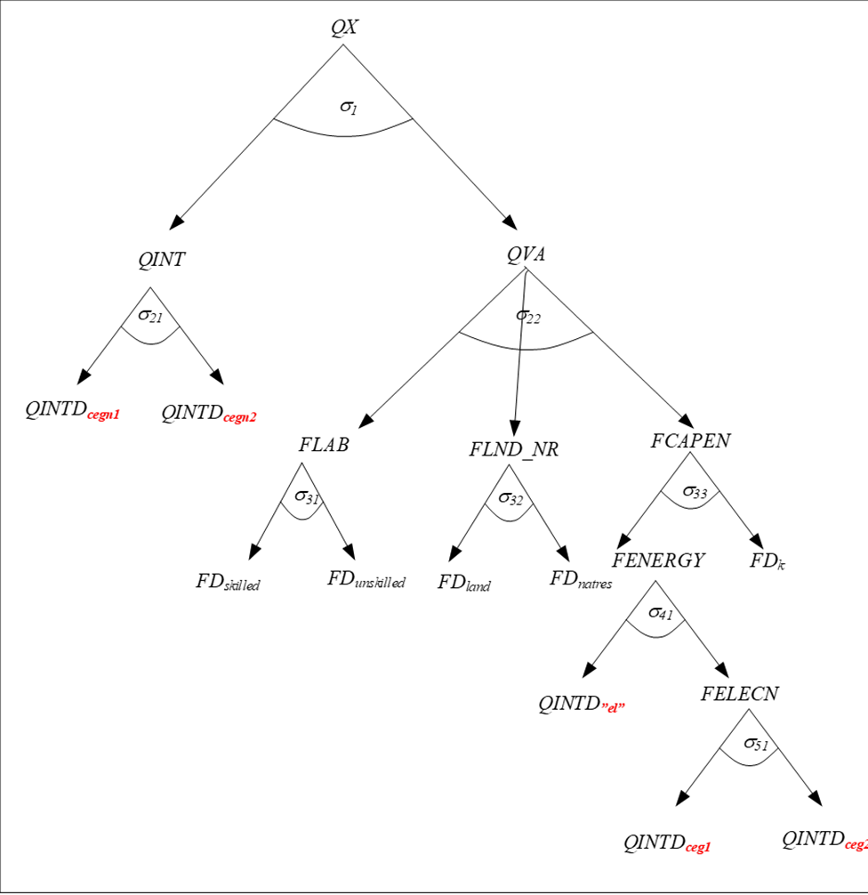
Production: nested CES functions with energy
Producers can substitute away from energy inputs when the cost of those inputs
increases
Output
CES aggregate of aggregate energy and capital
CES aggregate of fossil fuel inputs
CES aggregate of electricity
and non-electricity energy inputs
Notes:
Production nest
Energy inputs are not in fixed proportion
Producers can substitute among fossil fuel types; between fossil fuels and electricity and between aggregate energy and capital
Carbon taxes are included in the first order conditions

Slide 9
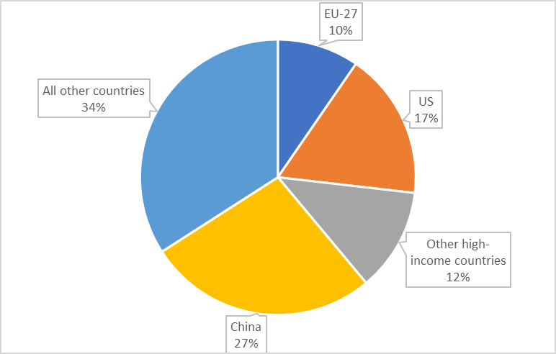
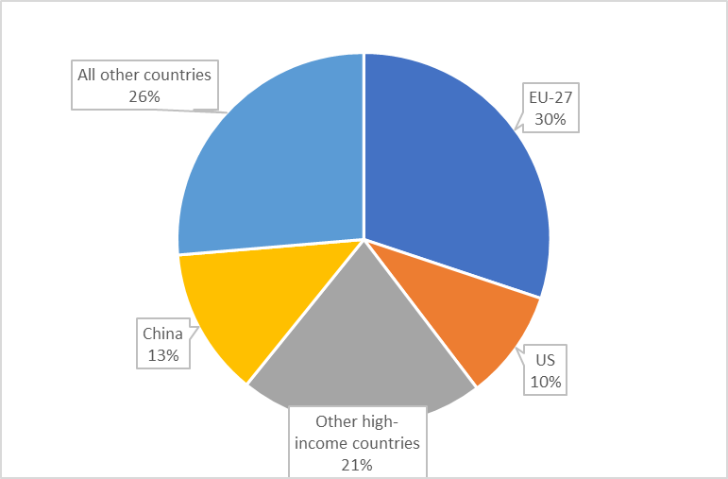
Background
Global CO2 Emissions
Global Trade
The share of global CO2 emissions is higher than the share of global trade for the US and China (source: GTAP v10, 2014 data)
Notes:
Source: GTAP 10
Comment on the shares of global CO2 emissions
Two largest polluters:
China 27%
US 17%
High income regions (US, EU, Other Europe, Other High income) i.e. those who introduce CBAM, 38%, less than half of global CO2 emissions
Comment on the LIMITED reach of trade:
Countries that are not committed to reducing CO2 (US and China) do not account for a lot of global trade:
US accounts for 10% of global trade
China accounts for 13%
Countries that are committed to reducing CO2, do account for a lot of global trade
EU, much larger, at 30%

Slide 10
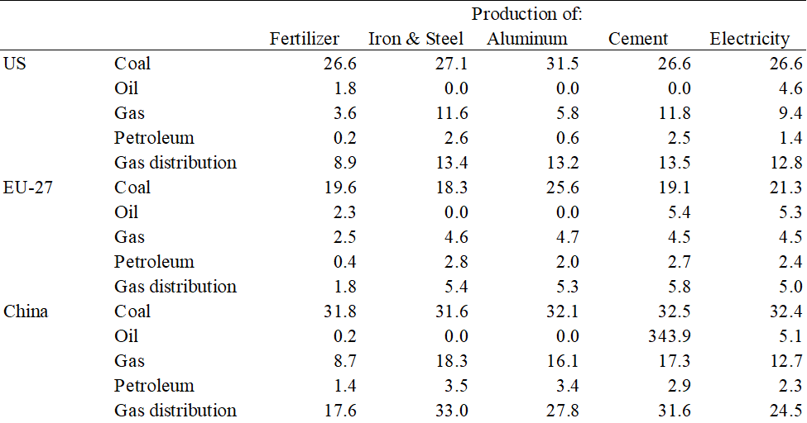
Millions of tons of CO2 emissions per billion dollar of intermediate input use
Notes:
Another way to look at the different starting points by region
Again, these five sectors are the dirty sectors identified in CBAM.
Helps to explain why China has the highest share of global CO2 emission - China is a much dirtier producer than EU 27 or US

Slide 11
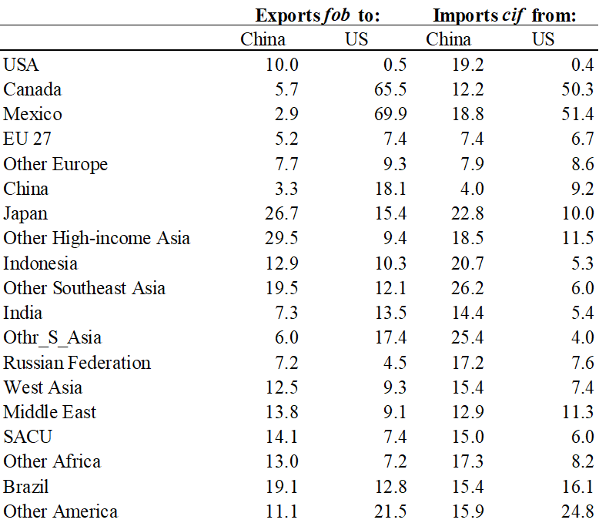

Bilateral trade with US and China (% of total)
Notes:
Trade dependency matters
Canada, Mexico are heavily dependent on the US
East and SE Asia are heavily dependent on China

Slide 12
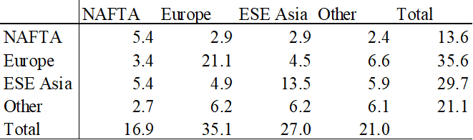
Bilateral Trade
(as a percent of total trade)
Source: GTAP v10, 2014

Slide 13
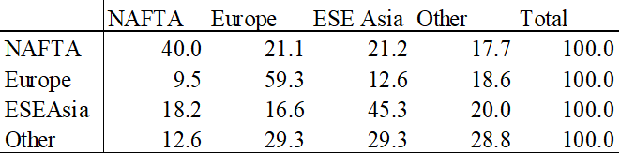
Exports Among Integrated Regions
(percent of each region’s total exports)
Exports are from row region to column region.
Source: GTAP v10, 2014

Slide 14
Scenarios
CBAM
  EU27 has a carbon tax of $75 per ton of CO2
  Tariffs on imports of Fertilizer, Iron & Steel, Aluminum, Cement, and Electricity
    Direct CO2 emissions
    Direct and Indirect CO2 emissions
Climate Club
  Club members impose a carbon tax of $75 per ton of CO2
  Punitive tariff against non-club members of additional 30% on all goods
  Membership includes all regions except one holdout
    US
    China

Slide 15
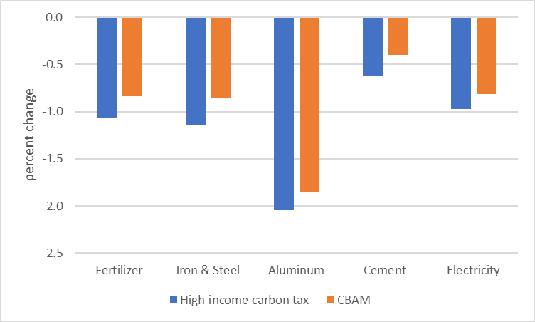
CBAM: Real output EU-27 - ORIGINAL
With direct CBAM tariffs, in addition to a tax on carbon, real output declines less
No impact on global carbon emissions
Notes:
Choose one of the high income regions to discuss, EU-27 and the high trade elasticity case.
Does CBAM level the playing field?
Compare tax on carbon alone (BLUE) to tax on carbon and CBAM tariffs (orange)
Blue output declines due to carbon tax
Orange output declines less because import tariffs encourage domestic production
Trade diversion is possible:
CBAM tariffs apply only to a subset of regions, Not high-income regions, i.e. those that do not have a carbon tax so there is some substitution in the EU-27 away from not-high income regions towards other high income regions

Slide 16
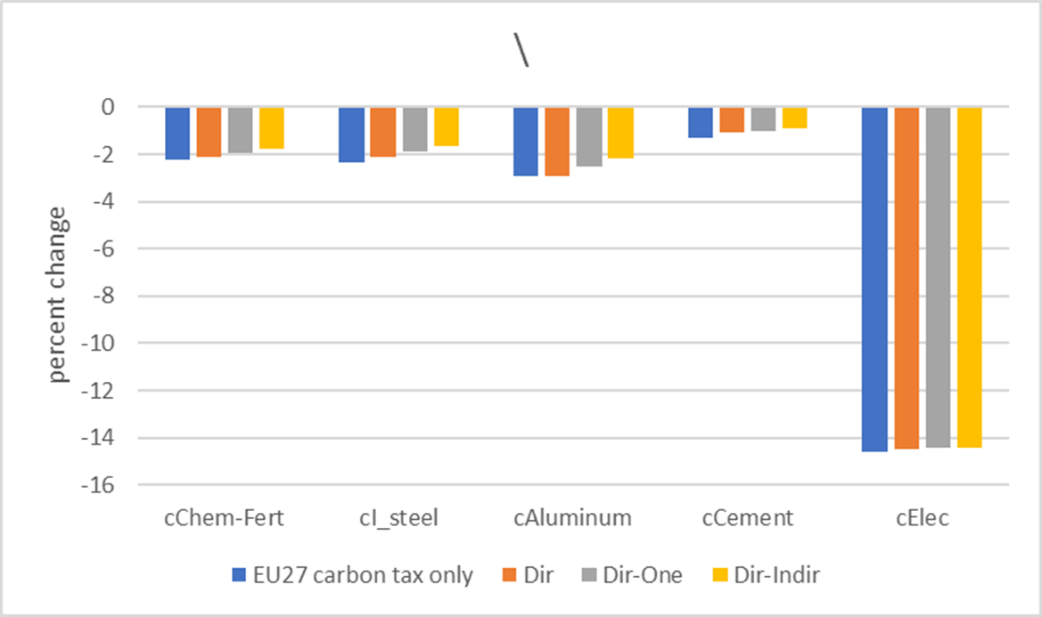
CBAM: Real output EU-27
With CBAM tariffs, in addition to a tax on carbon, real output declines less
No impact of CBAM tariffs on global carbon emissions
Notes:
Does CBAM level the playing field?
Compare tax on carbon alone (BLUE) to tax on carbon and CBAM tariffs (orange)
Blue output declines due to carbon tax
Orange output declines less because import tariffs encourage domestic production
Electricity – dramatic output decline because cost increase with carbon tax and coal as an input to electricity.

Slide 17
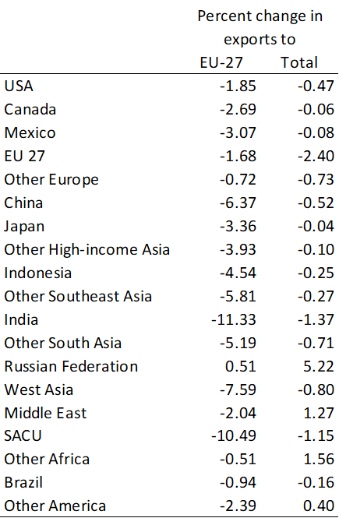

Exports of CBAM Commodities to EU-27
Countries that depend on
EU-27 for 5 CBAM commodities
can diversify exports.
Compare exports to EU-27 to
total exports for India and SACU

Slide 18
Payoff Matrix: Climate Club, US holdout
NAFTA = US, Canada, Mexico Results are given for an aggregate of all club members and for individual NAFTA countries in the club |  | US
 |  | Holdout | Join Club
AO All other countries | Holdout: No tax on carbon and no additional tariffs | US: 0 (0.0) AO: 0 Mexico: 0 Canada: 0 | US: 0.73 (-7 %) AO: -0.47 Mexico: -3.23 Canada: -3.24
 | Join Club: Tax on carbon = $75 and punitive tariffs (30 percentage points) on all trade with non-club members | US -1.82 ( -33%) AO -0.35 Mexico: 1.55 Canada: 1.29 | US: -.44 (-38 %) AO: -0.81 Mexico: -1.01 Canada: -1.50
Notes:
We do not value the benefits, our goal here is to minimize the costs.
Careful discussion of a payoff matrix and solution.
Payoff matrix in terms of negative impact on real absorption, benefits are not immediate and difficult to quantify.
Goal is to achieve a target, pay off matrix shows how to achieve it in the least cost way.

Slide 19
Key Findings
NASH equilibrium: US join, all others holdout (US single member club)
  Punitive tariff strategy does not work!
  Real absorption losses for oil-exporters when there is a tax on carbon
  Reduction in global carbon emission is not in the welfare function
  Looks a lot like classic trade war in trade theory
    Terms of trade gains for the country imposing a tariff
If welfare measure were to include benefit from lower global carbon emissions (Nordhaus) – expect all to join the club
  Big reduction in global CO2 emissions, 38% vs. 7%
When the US is not in the club, linked countries (Mexico and Canada)
  Terms of trade gains with punitive tariffs against the US
  Dramatic decline in trade

Slide 20
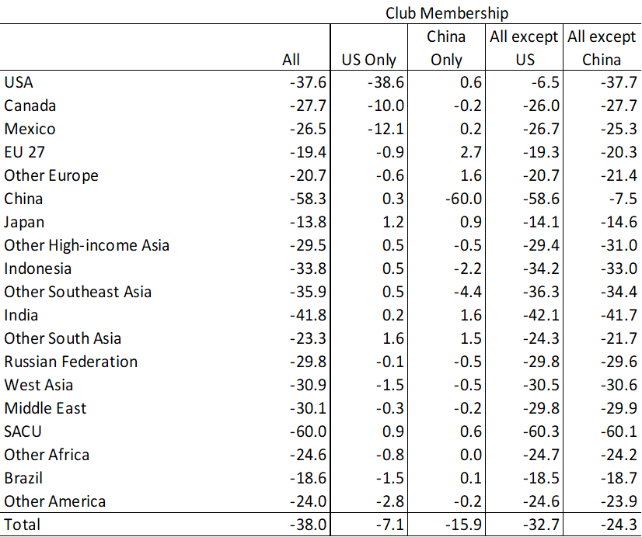
Club Membership and CO₂ Reduction

Slide 21
Payoff Matrix: Climate Club, China holdout
East and Southeast Asia = Japan, Other high-income Asia, China, Indonesia, Other East and Southeast Asia Results are given for an aggregate of club members and the individual club members who are in the region East and Southeast Asia |  | China
 |  | Holdout | Join Club
All other countries | Holdout: No tax on carbon and no additional tariffs | China: 0 ( 0 %) All: 0 Japan: 0 Other H-Asia: 0 Indonesia: 0 Other ESE Asia: 0 | China: 2.13 ( -16 %) All: -0.77 Japan: -0.98 Other H-Asia: -2.03 Indonesia: -2.13 Other ESE Asia: -3.61
 | Join Club: Tax on carbon = $75 and punitive tariffs (of +.3) on non-club members | China: -4.67 (-24 %) All : 0.02 Japan: 1.29 Other H-Asia: 0.71 Indonesia: -0.60 Other ESE Asia: 3.79 | China: -0.71 ( -38 %) All: -0.72 Japan: 0.57 Other H-Asia: -0.03 Indonesia: -2.22 Other ESE Asia:-0.40
Notes:
Why do we get a different Nash equilibrium when China is the holdout?
China is more trade dependent than the US (higher share of trade/GDP) so punitive tariffs are more effective.

Slide 22
Nordhaus - Scenario
Tax on carbon $25 per ton
Punitive tariff of 2% is enough for all regions to join the club
Our analysis:
  Product differentiation
  Many sectors
  Integrated regions via trade in intermediates
    NAFTA
    Europe
    East and Southeast Asia
  Key Finding – need a higher punitive tariff for a club to form

Slide 23
Payoff Matrix, Analysis of Nordhaus Club

Slide 24
Key Findings
Dominant strategy for US - join
  If AO holds out, US join (0.08 > 0)
  If AO joins, US join (-.1 > -0.23)
Dominant strategy for All other regions (AO) - Holdout
  If US holds out, AO Hold out (0 > -0,14)
  If US joins, AO Hold out (-0.07 > -0.21)
Contradict Nordhaus’ claim that for a low tax on carbon, a 2% tariff will be enough for all regions to join.

Slide 25
Conclusion
CBAM tariffs
  Offset the production advantage in countries that do not have a carbon tax
  Do not reduce global CO2 emissions
Climate Club and punitive tariffs
  If the club is large (we consider the extreme of only one holdout, all other regions in the club) – tariff policy can reduce global emissions
    No trade diversion for holdout
    Inflict enough damage to induce the holdout to join the club
  In a more realistic model with product differentiation, many sectors, and integrated regions, a MUCH higher punitive tariff is needed than suggested by Nordhaus

