Slide 1
An Information Theoretic Approach to Estimating Matrices of Economic Data
Scott McDonald
Sherman Robinson
GTAP Conference June 2024

Slide 2
SAM Estimation
Matrices of data are common in economics
  Multilateral, multisectoral international trade flows
  National accounts data tables
A Social Accounting Matrix (SAM) provides the underlying data framework for the national accounts
  Fundamental data for economywide models
  Estimating a recent SAM requires an efficient way to incorporate and reconcile information from a variety of sources
  Need to use recent and consistent multi-sectoral economic data to support policy models and analysis

Slide 3
A National SAM
Expenditures
Receipts
Activity
Commodity
Factors
Institutions
Hshlds
World
Activity
Total sales
Commodity
Intermediate
inputs
Final
demand
Consumption
Exports
Factors
Value added
Institutions
Indirect taxes
Indirect taxes
and tariffs
Factor
income
Saving
taxes
Saving
taxes
Inflows
Hshlds
Factor
income
Payments
to hshlds
transfers
remittances
World
Imports
Factor
income
Institution
income
Hshld
income
Foreign
Exchange
inflow
Totals
Total costs
Total supply

Slide 4
SAM Estimation Problem
Estimating cells of a SAM generally leads to an “ill posed” estimation problem:
  More cells to be estimated than available data: no estimation degrees of freedom
Data from a variety of sources in a variety of forms, measured with error
“Adding up” constraints of national accounts: row sums equal column sums and various aggregates
Theoretical constraints: inequalities, bounds, signs

Slide 5
SAM Estimation
SAM estimation requires a framework that supports reconciliation of a variety of incomplete, often incompatible, prior estimates of SAM elements measured with error
Two types of prior information
  SAM elements and various aggregates
  Measurement error: characteristics of error probability distributions
Information-theoretic Bayesian estimation procedure
  Start with prior estimates of values and information about error generation
  Produce posterior estimates of all SAM elements using an efficient information processing rule

Slide 6
Shannon Information Theory and Entropy
Dealing with measurement error requires estimating probability distributions of error terms, with a minimum of information about the error generating process
Shannon/Jaynes/Laplace/Golan: Entropy is the unique measure of “information” about probabilities that should be used in estimation
Zellner: Efficient or Optimal Information Processing Rule (IPR)
  Use all the information you have
  Do not use or assume any information you do not have
  Close links to Bayesian estimation: Cross entropy is the appropriate measure to use in moving from prior to posterior estimates

Slide 7
Types of Information: SAM Values
SAM from and earlier year
  Input-output data: make/use tables
National accounts data
International trade data
Government and financial flows data
Household surveys
Farm and manufacturing enterprise surveys
Studies of technology and behavior

Slide 8
Types of Information: Technology/Behavior
Coefficients: technology
  Input-output coefficients
  Value added coefficients
Coefficients: behavior
  Household expenditure shares
  Government expenditure shares
  Composition of trade
  Tax rates
Theoretical constraints: inequalities, bounds, and signs

Slide 9
Types of Information: Accounting Identities
Accounting identities for SAM from System of National Accounts
  Row and column sums must be equal
    National accounts identities
  Various macro aggregates

Slide 10
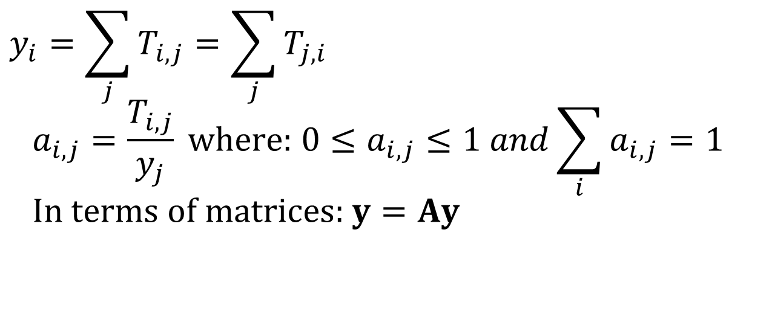
SAM: Values and Coefficients
Define a SAM transactions matrix, T, which is a square matrix specifying payments from columns to rows. Corresponding row and column sums (y) are equal. Define:
$$y_{i}=\sum_{j}{T_{i,j}}=\sum_{j}{T_{j,i}} \\ a_{i,j}=\frac{T_{i,j}}{y_{j}} \text{where}\text{:} 0≤a_{i,j}≤1 and\sum_{i}{a_{i,j}}=1 \\ \text{In} \text{terms} \text{of} \text{matrices}\text{:} y=Ay$$

Slide 11
Accounting Constraints
Row and column sums
Other aggregates (e.g., individual flows and/or national accounts). Define k aggregator matrices G^{(k)} where G_{i,j} = 0 or 1

Slide 12
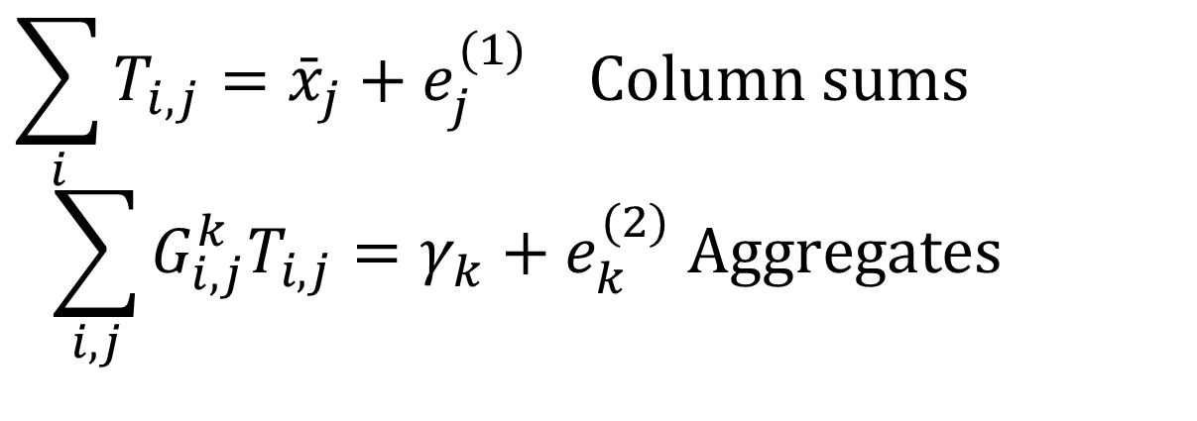
Measurement Errors: Aggregates
$$\sum_{i}{T_{i,j}}={\bar{x}}_{j}+e_{j}^{(1)} \text{Column} \text{sums}$$
$$\sum_{i,j}{G_{i,j}^{k}T_{i,j}}=γ_{k}+e_{k}^{(2)} \text{Aggregates}$$

Slide 13
Measurement Error: SAM cells
Error specification for all SAM cells
  Error on coefficients or values
  Additive or multiplicative errors
  Informative/uninformative prior error distributions
Multiplicative errors
  Logarithmic distribution
  Errors cannot be negative
Additive
  Possibility of entries changing sign

Slide 14
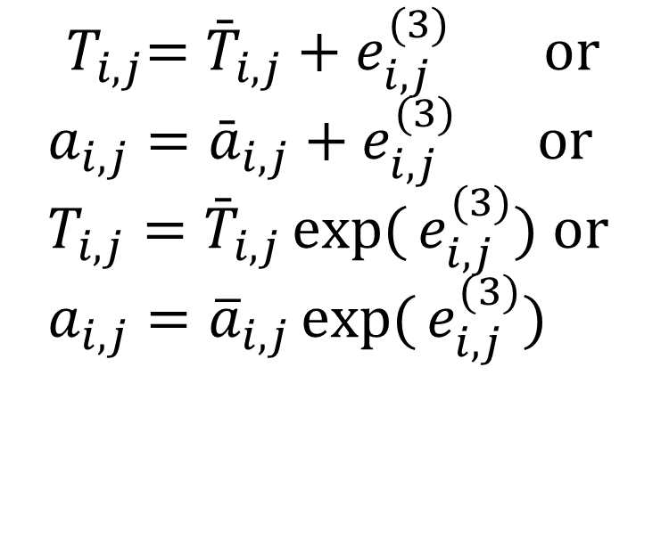
Error in Cells
$${ T}_{i,j}={\bar{T}}_{i,j}+e_{i,j}^{(3)} ​\text{or} \\ a_{i,j}={\bar{a}}_{i,j}+e_{i,j}^{(3)} \text{or} \\ T_{i,j}={\bar{T}}_{i,j}\exp{(}e_{i,j}^{(3)}) ​\text{or} \\ a_{i,j}={\overline{a}}_{i,j}\exp{(}e_{i,j}^{(3)})$$

Slide 15
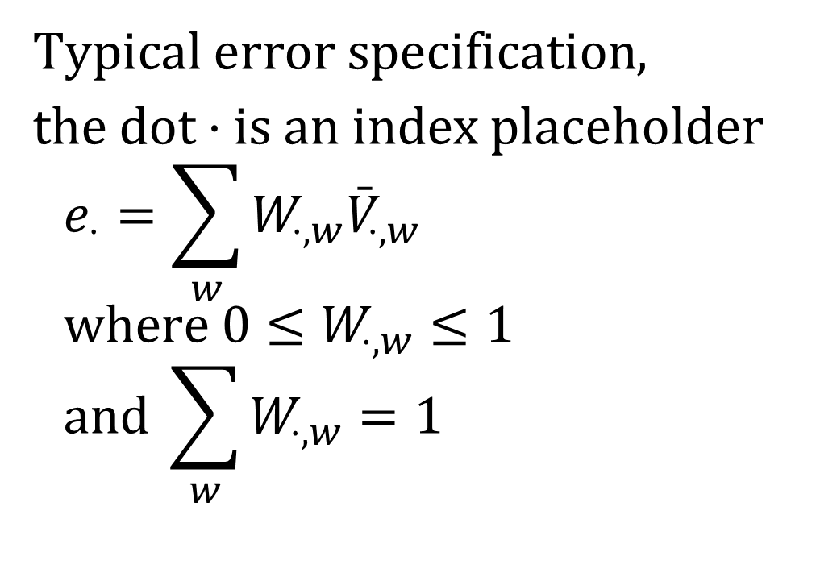
Error Specification:
Discrete Probability Distributions
$Typical error specification$,
the dot · is an index placeholder
$$e_{⋅}=\sum_{w}{W_{⋅,w}{\bar{V}}_{⋅,w}} \\ \text{where} 0≤W_{⋅,w}≤1 \\ \text{and} \sum_{w}{W_{⋅,w}=1}$$

Slide 16
Error Specification
Errors are probability weighted averages of w prior support set values
  V parameters define the domain of the error
    Additive: units of the item being estimated
    Multiplicative: unitless, centered on zero, so exp(0)=1
  W variables are probabilities to be estimated.
Convert problem of estimating errors to one of estimating probabilities
Cross-entropy (CE) estimation of probabilities W
  Shannon entropy, Jaynes on use of CE in estimation, Golan-Judge-Miller specification of discrete probability distributions

Slide 17
Prior Distributions: $\overline{V,}\overline{W}$
Uninformative prior: Discrete uniform distribution with 7-element support set
Informative prior: mean and standard deviation of the measurement error distribution
  Three element support set: two parameters
Informative prior: normal distribution parameters (mean, standard deviation, skewness, kurtosis)
  Five element support set: four parameters
Determines prior on W probability weights, $\overline{W}$

Slide 18
Minimize CE Objective Function
Subject to All Constraints

Slide 19
Conclusion
SAM estimation requires prior information about:
  SAM values
  Characteristics of measurement error
Shannon information theory provides the best framework for handling prior information on SAM values combined with minimal knowledge about the characteristics of measurement error
  Estimation in a Bayesian framework: a cross entropy estimation procedure that is an efficient optimal information processing rule for moving from a prior to a posterior estimate
Any other estimation procedure will introduce unwarranted additional information

Slide 20
SAM Estimation: RAS
Comparison of RAS and Cross-Entropy estimation of SAMs
RAS-CE descriptive entropy estimation
Least squares (LS) approaches
  LS approximation to CE metric
  Any other LS method introduces unwarranted information into the estimation

Slide 21
SAM Estimation: RAS
Estimate A coefficients. Find new set of coefficients “close” to old values and satisfy all new data information and constraints.
  Stone RAS method: start from old balanced SAM and update to new SAM
    Information only on new column/row sums
    Balance by iterative row/column adjustments
  Problem is viewed as mathematical:
    Matrix balancing and SAM updating
Philosophy: “computation” versus “estimation”
  Debate over mathematical methods

Slide 22
SAM Estimation: RAS
Richard Stone: problem was to start from a balanced SAM for some year and then update it to a later year
  Available information on column/row sums for the later year; no new information on cells
RAS method: Iteratively scale rows and columns of T to match new row/column sums
  Problem is viewed as mathematical
    Matrix balancing and SAM “updating”: hybrid methods
    Debate over mathematical methods: computation, not estimation

Slide 23
SAM Estimation: CE-RAS
RAS method: biproportional matrix balancing
Equivalent to solving a CE problem treating the A coefficients as embodying information
  Bacharach, Stone
$Minimize CE\left(A,\overline{A}\right)=\sum_{i,j}{a_{i,j}}\ln\left(\frac{a_{i,j}}{{\overline{a}}_{i,j}}\right)$
where $\sum_{i}{a_{i,j}=1 for all j}$
A coefficients contain information
  Theil: information content of a SAM

Slide 24
CE-RAS Estimates
Descriptive Entropy: Bayesian estimator
  A coefficients are analogous to probabilities
    0 < a_{i,j} < 1, and columns sum to 1.
Problems with probability analogy:
  Negative entries (“switch” procedure)
  Analogy is strained for a SAM: coefficients are technical and behavioral parameters
CE estimator: transform prior and sample information into posterior parameter estimates
  Descriptive of how the SAM moves from one equilibrium to another: many examples in other fields
CE-RAS can be solved by NLP solvers
    No need to use a RAS iterative procedure

Slide 25
CE-RAS and CE-Shannon
The CE-RAS method is not based on Shannon information theory since the A coefficients are not probabilities
  Different kinds of “information”
There is a literature on the use of CE to describe adjustment processes of structural change in behavioral models
  Golan (Info-Metrics) and examples in Chen et al.
  CE describes movement from a system equilibrium to another equilibrium

Slide 26
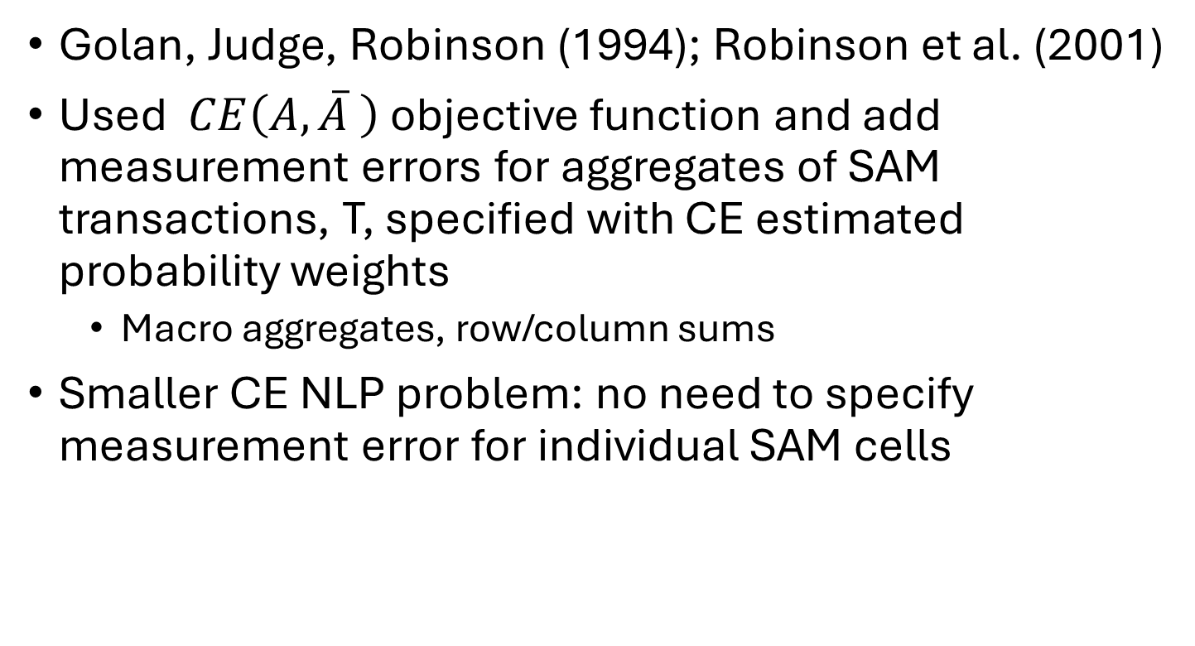
CE-RAS: Hybrid Methods
Golan, Judge, Robinson (1994); Robinson et al. (2001)
Used $CE\left(A,\overline{A} \right)$ objective function and add measurement errors for aggregates of SAM transactions, T, specified with CE estimated probability weights
  Macro aggregates, row/column sums
Smaller CE NLP problem: no need to specify measurement error for individual SAM cells

Slide 27
LS Approximation of CE
Some like least squares (LS) estimators
There is a weighted LS function that approximates the CE function:
$$CE\left(p,\overline{p}\right)≈\sum_{i}{\frac{1}{{\overline{p}}_{i}}{\left(p_{i}−{\overline{p}}_{i}\right)}^{2}}$$
See GJM, p. 31. Links to classical statistics, but weights matter. Unweighted LS does very badly.

Slide 28
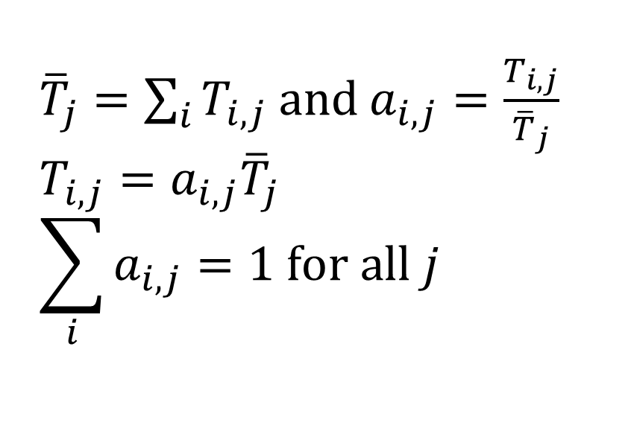
Coefficients and Values: A, T
${\overline{T}}_{j}=\sum_{i}{T_{i,j}}$ and $a_{i,j}=\frac{T_{i,j}}{{\overline{T}}_{j}}$
$$T_{i,j}=a_{i,j}{\overline{T}}_{j}$$
$$\sum_{i}{a_{i,j}=1 for all j}$$

Slide 29
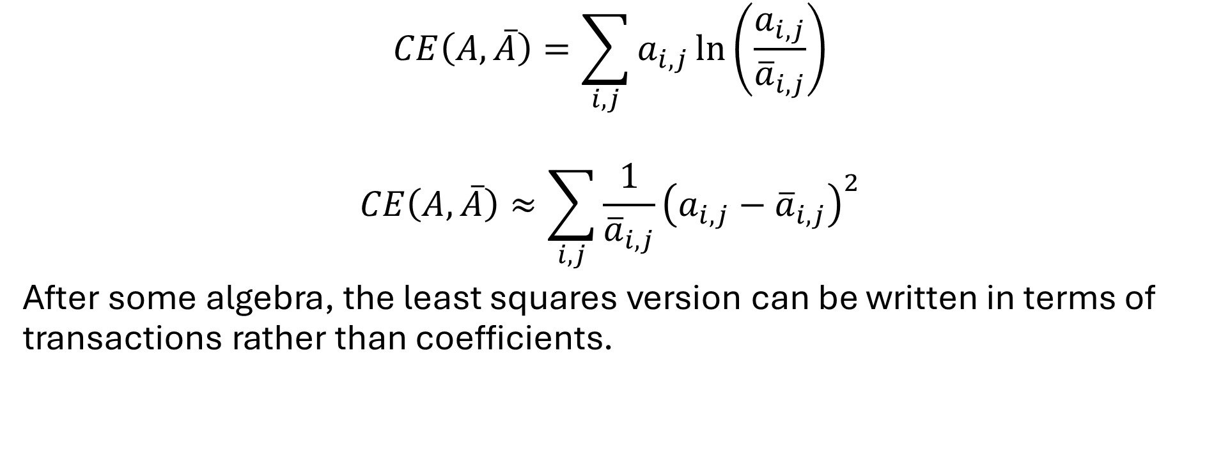
CE-RAS: Least Squares
$$CE\left(A,\overline{A}\right)=\sum_{i,j}{a_{i,j}}\ln\left(\frac{a_{i,j}}{{\overline{a}}_{i,j}}\right)$$
$$CE\left(A,\overline{A}\right)≈\sum_{i,j}{\frac{1}{{\overline{a}}_{i,j}}{\left(a_{i,j}−{\overline{a}}_{i,j}\right)}^{2}}$$
After some algebra, the least squares version can be written in terms of transactions rather than coefficients.

Slide 30
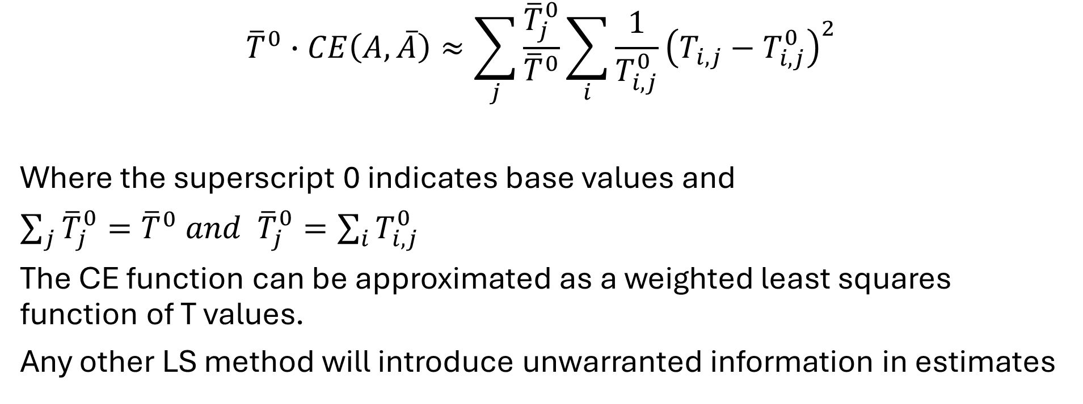
CE-LS in Transactions
$${\overline{T}}^{0}∙CE\left(A,\overline{A}\right)≈\sum_{j}{\frac{{\overline{T}}_{j}^{0}}{{\overline{T}}^{0}}}\sum_{i}{\frac{1}{T_{i,j}^{0}}}{\left(T_{i,j}−T_{i,j}^{0}\right)}^{2}$$
Where the superscript 0 indicates base values and
$\sum_{j}{{\overline{T}}_{j}^{0}={\overline{T}}^{0} and }$ ${\overline{T}}_{j}^{0}=\sum_{i}{T_{i,j}^{0}}$
The CE function can be approximated as a weighted least squares function of T values.
Any other LS method will introduce unwarranted information in estimates

