Slide 1
Estimating the Economy-wide Consequences of Widespread, Long Duration Electric Power Interruptions
June 3, 2024

Slide 2
Overview
Economic Resilience
- Definition & contrast with mitigation
- Examples
LBNL Survey
- Residential
- Commercial
CGE Model
Results
Implication

Slide 3
Interpretations of Disaster Resilience
One approach: any action that reduces hazard losses
But, there’s a perfectly good word for actions taken
before the event – “mitigation”
Best use: actions taken after the disasters strikes:
- can build up resilience capacity beforehand – it’s a process
(inventories, emergency drills, identify back-up locations)
- but these tactics are not implemented until after the disaster begins
Can only prevent property damage before the event
But, can reduce business interruption losses afterwards:
- BI begins when the disaster strikes & continues until recovery
- measured in terms of lost sales revenue, GDP, employment
- Resilience is synonymous with business continuity

Slide 4
Economic Resilience
Static:
- General Definition: Ability of a system to maintain
function when shocked.
- Econ Definition: Efficient use of remaining resources
at a given point in time to produce as much as possible.
Dynamic
- General: Ability & speed of a system to recover.
- Economic: Efficient use of resources over time for
investment in repair and reconstruction, including
expediting the process & adapting to change
Metric: averted losses as % of potential losses

Slide 5
Survey
LBNL, Resource Innovations, Incc. & my own experience
Extend survey to L-T outages & broaden scope of impacts
Not a WTP approach, but rather specific costs & benefits
- costs: income loss, food spoilage
- savings: less spent on electricity during outage
(statistical relationship between interruption attributes & net customer
economic losses)
Resilience Benefits are Avoided Net Cost Savings
Resilience Types
- inherent (back-up generation already in place)
- adaptive (BUG rental/purchase anew; relocation)

Slide 6
Measuring Econ Resilience of 9/11
95% of over 1,100 WTC area firms relocated after 9/11
If all of firms in the WTC area went out of business, direct business interruption (BI) loss would = $58.4B
If all relocation were immediate, then BI = $0
Businesses relocated 2 to 4 months, BI = $16.1B
Resilience Metric: Avoided Loss ÷ Max Potential Loss
$42.3B ÷ $58.4B = 72%

Slide 7
Microeconomic Resilience Tactics
Responses to Input Disruptions
Resilience Tactic | Definition (Activities Involved)
Conservation | Maintaining intended production using lower amounts of an input
Resource Isolation | Modifying a portion of business operations to run without a critical input
Input Substitution | Replacing a production input in short supply with another
Inventories | Continuing business operations using emergency and ordinary stockpiles
Excess Capacity | Using idle plant or equipment in place of damaged ones
Relocation | Moving some or all of the business activity to a new location
Management Effectiveness | Improving the efficiency of business operations in the aftermath of a disaster
Import Substitution | Importing needed production inputs when not available from local suppliers
Technological Change | Improvising the production process without requiring a major investment
Resource Pooling/Sharing | Recontracting, selective exchange of resources, creating new partnerships
Production Recapture | Making up for lost production by working overtime or extra shifts

Slide 8
Hurricane Harvey Survey Results
Tactic | Implementation Cost |  |  | Effectiveness (Avoided Losses) |  |  | Cost-Effectiveness
 | Total Cost (Net) | Average |  | Total Effectiveness (Net) | Average |  | Effectiveness/ Total Cost Ratio
Conservation | -$921,120 | -$25,586 |  | $1,0695,663 | $297,101 |  | -11.6
Resource Isolation | 441,090 | 11,921 |  | 6,149,022 | 170,806 |  | 14.3
Input Substitution | 1,201,875 | 38,770 |  | 9,539,292 | 307,719 |  | 7.9
Inventories | $3,490,610 | $64,640 |  | $4,119,222 | $77,721 |  | 1.2
Excess Capacity | -$2,357,800 | -$157,186 |  | $2,834,450 | $188,963 |  | -1.2
Relocation | $676,100 | $18,780 |  | $11,706,813 | $325,189 |  | 17.3
Mgt Effectiveness | -$4,870,720 | -$69,581 |  | $12,469,063 | $180,711 |  | -2.6
Import Substitution | -$1,016,700 | -$46,213 |  | $8,457,967 | $422,898 |  | -9.2
Technological Change | -$1,513,625 | -$40,908 |  | $4,565,845 | $130,452 |  | -3.2
Production Recapture | $6,543,615 | $145,413 |  | $11,723,025 | $266,432 |  | 1.8
Resource Pooling | $504,855 | $9,708 |  | $9,872,387 | $201,477 |  | 20.8

Slide 9
Disaster Consequences References
Walmsley, T. A. Rose, R. John, D. Wei, J. Hlávka, J. Machado, and K. Byrd. 2023. “Macroeconomic Consequences of the COVID-19 Pandemic,” Economic Modelling 120: 106147.
Rose, A. 2022. “Behavioral Consequences of Disasters: A Basis for Inclusion in Benefit-Cost Analysis,” Economics of Disasters and Climate Change 6: 213-23.
Dormady, N., A. Rose, C. B. Morin and A. Roa-Henriquez. 2022. “The Cost-Effectiveness of Economic Resilience,” International Journal of Production Economics 244: 108371.
Rose, A. 2021. “COVID-19 Economic Impacts in Perspective: A Comparison to Recent U.S. Disasters,” International Journal of Disaster Risk Reduction 102317.
Rose, A., F. Prager, Z. Chen and S. Chatterjee. 2017. Economic Consequences Analysis Tool (E-CAT). Singapore: Springer.
Rose, A., I. Sue Wing, D. Wei, and A. Wein. 2016. “Economic Impacts of a California Tsunami,” Natural Hazards Review 17(2): 04016002.
Rose, A. 2015. “Macroeconomic Consequences of Terrorist Attacks: Estimation for the Analysis of Policies and Rules," in C. Mansfield and V. K. Smith (eds.), Benefit Transfer for the Analysis of DHS Policies and Rules, Cheltenham, UK: Edward Elgar.
Oladosu, G., A. Rose, and B. Lee. 2013. "Economic Impacts of Potential Foot and Mouth Disease Agro-terrorism in the United States: A Computable General Equilibrium Analysis," Journal of Biothreats and Biodefense S12: 001.
Giesecke, J., A. Rose, P. Slovic et al. 2012. "Assessment of the Regional Economic Impacts of Catastrophic Events: A CGE Analysis of Resource Loss and Behavioral Effects of a Radiological Dispersion Device Attack Scenario," Risk Analysis 32: 583-600.
Rose, A., G. Oladosu, B. Lee and G. Beeler Asay. 2009. "The Economic Impacts of the 2001 Terrorist Attacks on the World Trade Center: A Computable General Equilibrium Analysis," Peace Economics, Peace Science, and Public Policy 15: Article 6.
Whitehead, J., and A. Rose. 2009. "Estimating Environmental Benefits of Natural Hazard Mitigation: Results from a Benefit-Cost Analysis of FEMA Mitigation Grants," Mitigation and Adaptation Strategies for Global Change 14: 655-76.

Slide 10
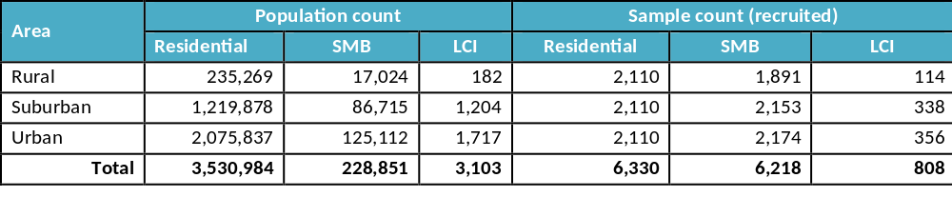
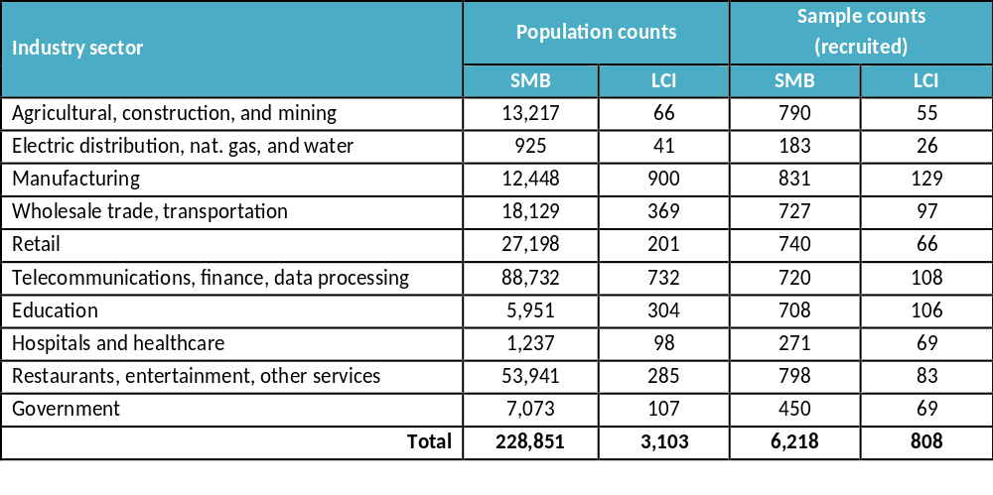
Sample Design Summaries
Sample design summary by geographic area (top);
SMB and LCI sample design summary by industry sector (bottom)

Slide 11
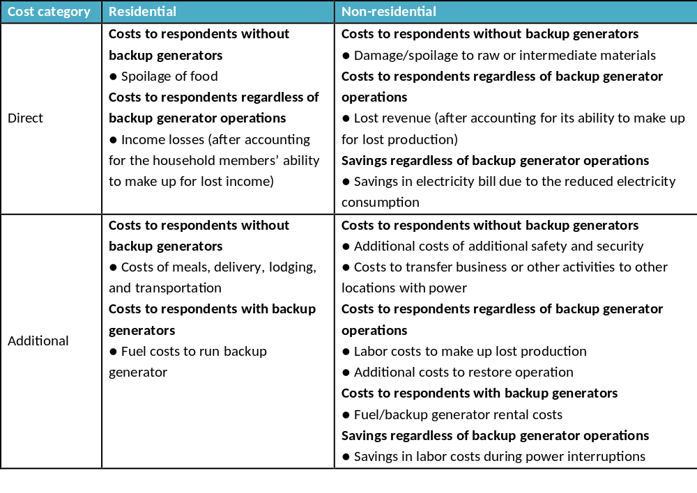
Survey Responses

Slide 12
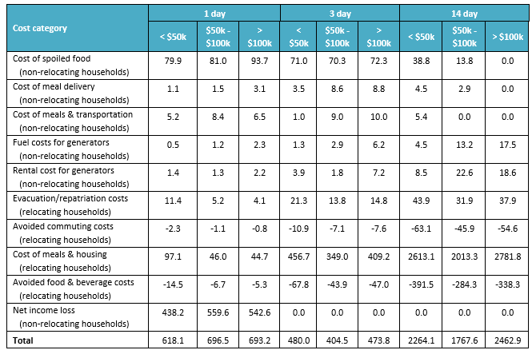
Incurred Costs
(High Backup Generation Scenario)
Total costs incurred by residential customers in Cook County by cost category and interruption duration (high backup generation scenario) ($ millions)

Slide 13
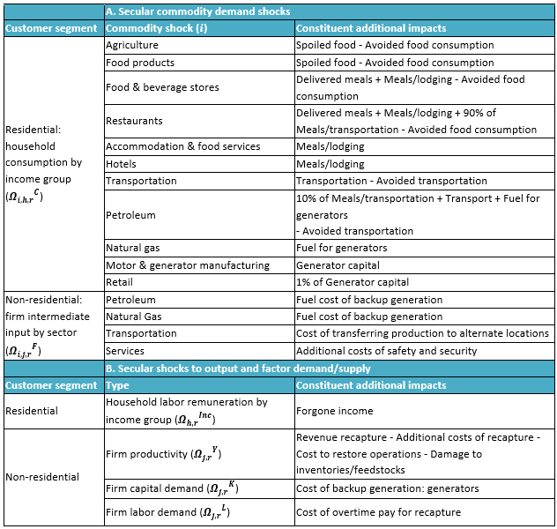
Summary of CGE Model Shocks

Slide 14
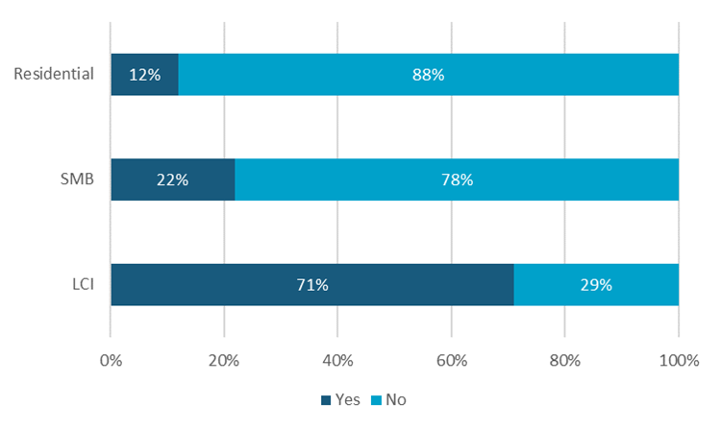
Percentage of Customers with Backup Generation

Slide 15
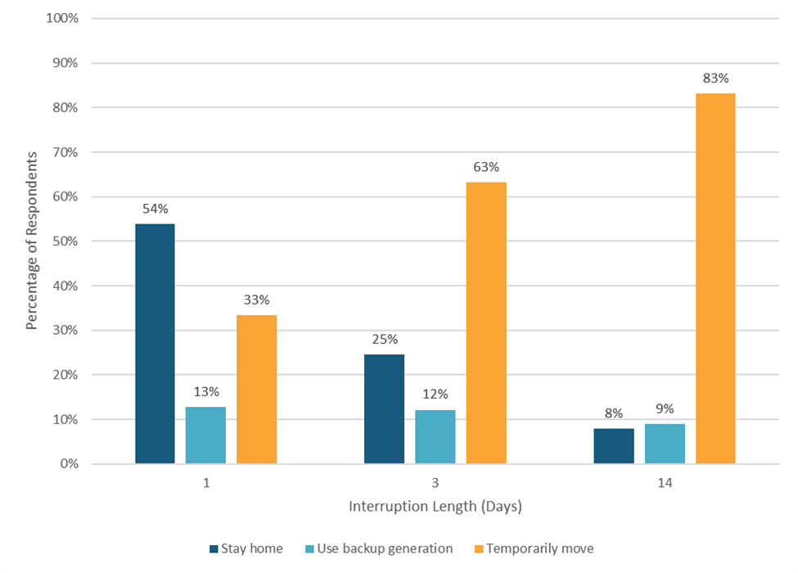
Residential Resilience Tactics by Interruption Duration

Slide 16
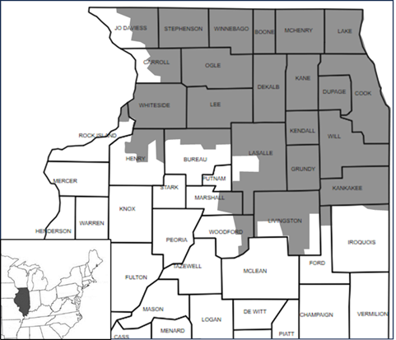

Study Area
Commonwealth Edison’s northern Illinois service area (shaded)
and the city of Chicago (star)

Slide 17
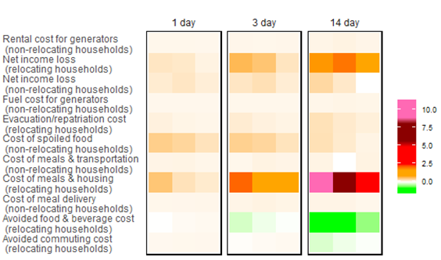
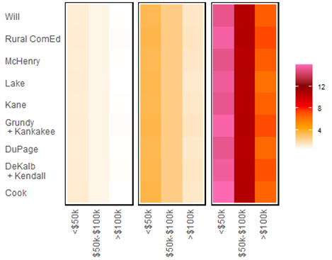
Ancillary Impacts from Survey Results
A
B
Direct additional or avoided expenditures due to disequilibrium resilience adjustments by interruption duration, as a percent of households’ income and sectors’ gross output: by tactic (A) and micro-region (B)

Slide 18
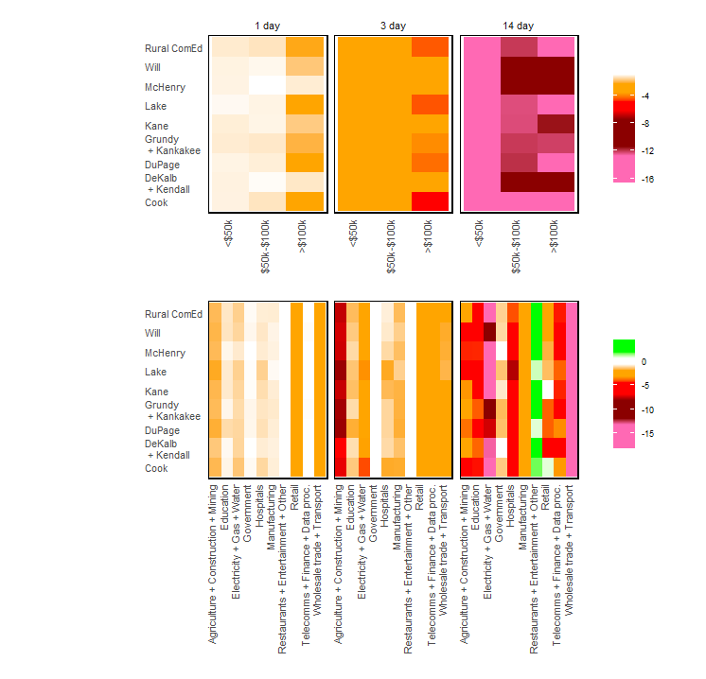
Economic Impacts on
Households and Firms
Simulated by the CGE Model
Sectoral gross output, expressed as percent changes from baseline economic conditions

Slide 19
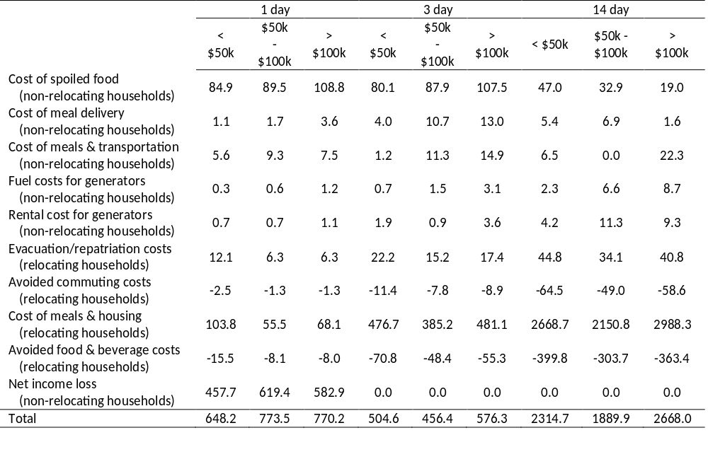
Summary of Survey-derived Dollar Losses from Disequilibrium Residential Resilience Tactics

Slide 20
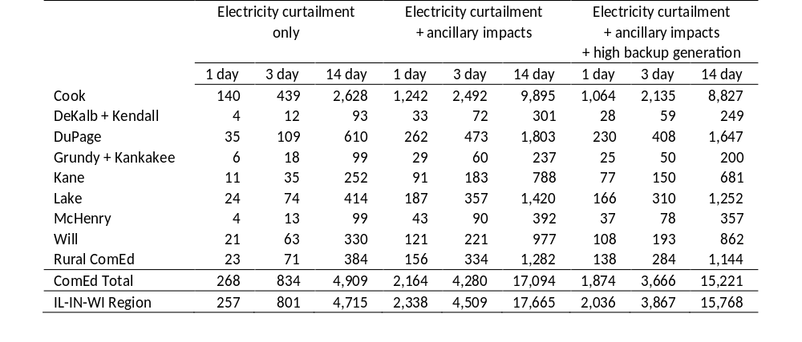
Summary of Simulated GDP Losses

