Slide 1



New Induced Land Use Change (ILUC) emissions assessment: Updates from IPCC guidelines and new estimates of soil carbon from the Harmonized World Soil Database (HWSD)
Authors: Lauren Benavidez, Uris Baldos, Shuo Chen, Qianlai Zhuang and Ye Yuan
Presenter: Lauren Benavidez

Slide 2
Motivation
The use of biofuels is a relevant bioenergy policy that tries to decarbonize the energy system and minimize the environmental impacts of this sector.
GTAP-BIO has been frequently used to evaluate land use changes due to biofuel pathways (Hertel et al., 2010; Taheripour and Tyner, 2013; Taheripour et al., 2017, Zhao et al., 2021).
Changes in land-use related to biofuels pathways may generate emissions. These emissions are known as Induced Land-Use Change (ILUC) emissions.
Estimation of ILUC emissions is an important task in policy analysis of biofuels.
Major bioenergy-focused programs : ICAO-CORSIA and the US Renewable Energy Standard (US-RFS) consider induced land-use change emissions to assess carbon intensity of biofuels.
Land-use change simulations from GTAP-BIO have been complemented with an emissions calculator tool. This tool is the AEZ-EF model (Gibbs et al., 2014 and Plevin et al., 2014).

Slide 3
Motivation cont.
The AEZ-EF model contains a variety of emission factors that are relevant in calculating land use emissions:
  Land-Use transitions obtained from GTAP-BIO by 19 regions and 18 AEZs.
  Emission factors data from the Intergovernmental Panel on Climate Change (IPCC) inventory guidelines (2006).
  Soil carbon and vegetation carbon data estimates by region and agroecological zones (AEZ), taken from Gibbs et al. (2014).

Slide 4
Research objectives
This paper aims to update the soil carbon data of the AEZ-EF model since its original development by studying and updating two major components:
Revise emission factors from IPCC guidelines and update them to the 2019 guideline.
Revise and update the estimates for soil organic carbon (SOC) at the regional and AEZ level for three land cover items: Forest, Cropland, and Pasture.
This paper provides a more accurate and updated tool to estimate induced land-use change emissions to assess the potential environmental effects not only for biofuel pathways but for other potential land-use change policies

Slide 5
Methodology and data
IPCC Emission factors revision and update:
  IPCC inventory guidelines 2019
New Soil Carbon content of land or Soil Organic Carbon (SOC) estimates:
  Harmonized World Soil Database (HWSD) version 2.0 (FAO, 2023).
  New land cover representation following the 2020 data from MODIS (Sulla-Menashe D. and Friedl M.).
  Filter maps (Various sources).

Slide 6
IPCC Emissions factor updates
Mapping new deadwood carbon data that previously was taken from literature (Pan et al., 2011).
  IPCC provides data for broadleaf, needleleaf and all vegetation categories for deadwood.
Updates and revised mapping of litter data from 2019 guidelines.
  IPCC new estimates provides a reclassification for Tropical AEZs.
Revision of the root-to-shoot ratios between aboveground and belowground vegetation biomass carbon.
Revision of inconsistencies in soil stock change factors from IPCC 2006 guidelines.
Minor updates in GWP utilizing IPCC – AR5

Slide 7
SOC estimation
Harmonized Soil Word Database (HWSD) version 2.0
Use of WISE30sec database (Batjes, 2015) with double of soil profiles captured in comparison with HWSD version 1.2
Changes in layers definitions, from two layers to seven layers definitions.
Increase in detail in soil mapping units (SMU) for regions in Asia and Europe.
To address the new layer-definition we leveraged the methodology by Hiederer, R. and M. Köchy (2011) who compared different global SOC estimates using different databases.

Slide 8
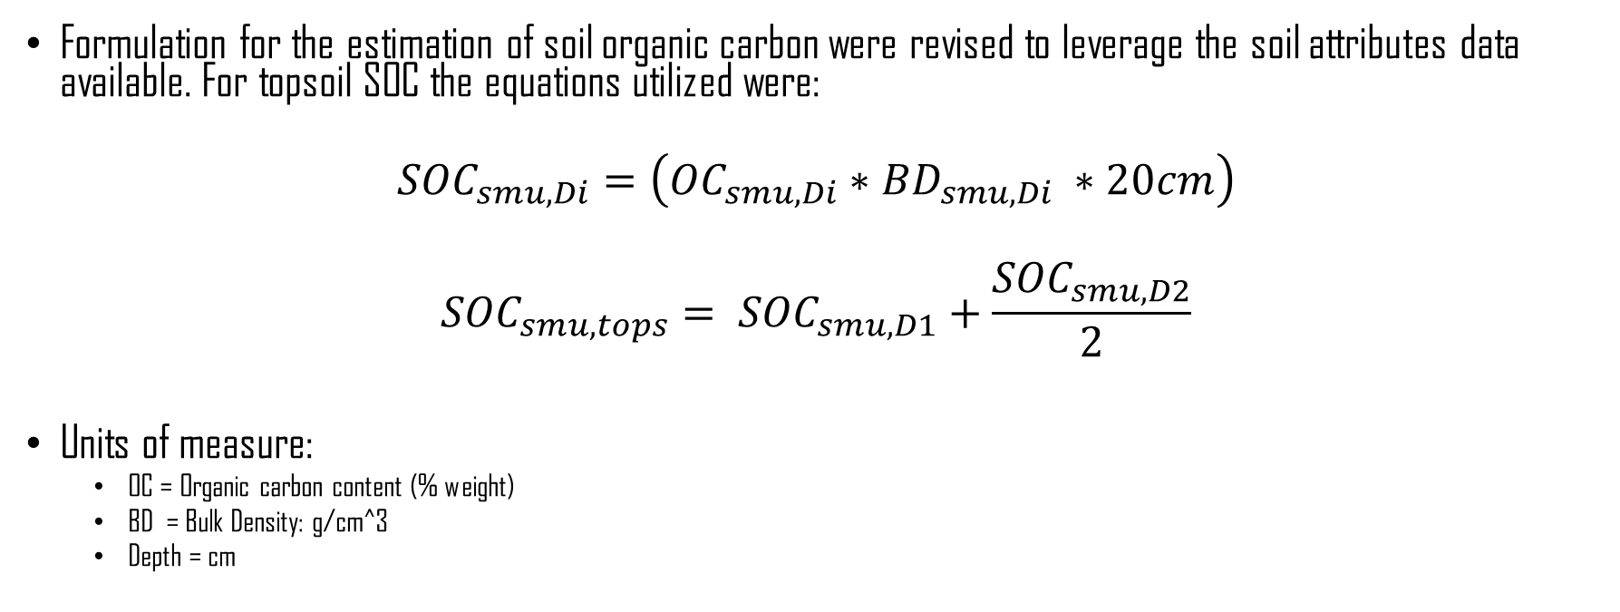
SOC estimation
Formulation for the estimation of soil organic carbon were revised to leverage the soil attributes data available. For topsoil SOC the equations utilized were:
$${SOC}_{smu, Di}=\left({OC}_{smu, Di}∗{BD}_{smu, Di} ∗20cm\right)$$
$${SOC}_{smu, tops}= {SOC}_{smu, D1}+\frac{{SOC}_{smu, D2}}{2}$$
Units of measure:
  OC = Organic carbon content (% weight)
  BD = Bulk Density: g/cm^3
  Depth = cm

Slide 9
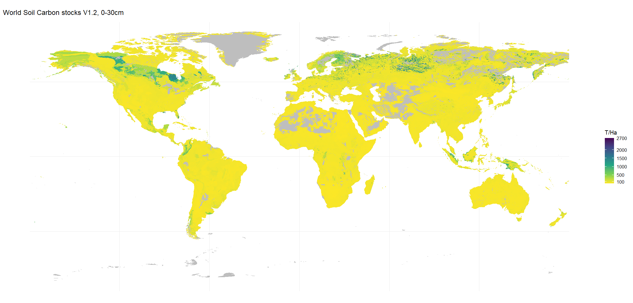
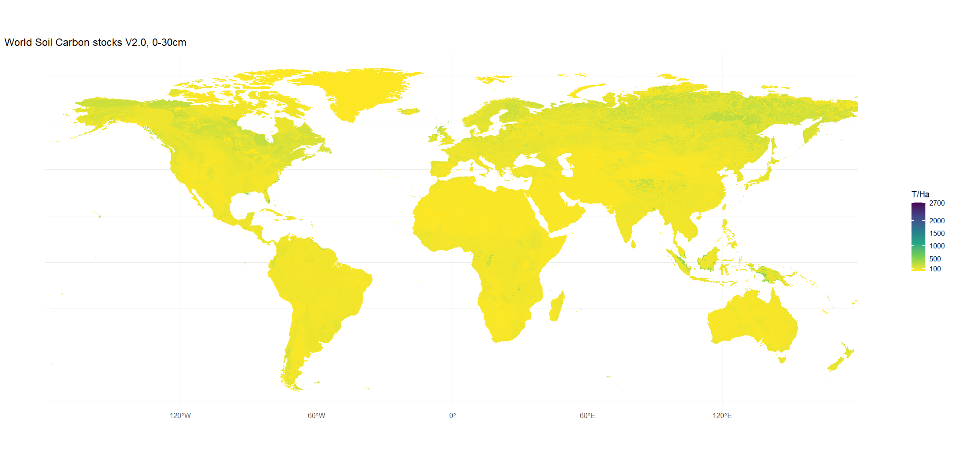
SOC estimation
Topsoil SOC for HWSD version 1.2 and version 2.0
Topsoil SOC: HWSD version 1.2
Topsoil SOC: HWSD version 2.0

Slide 10
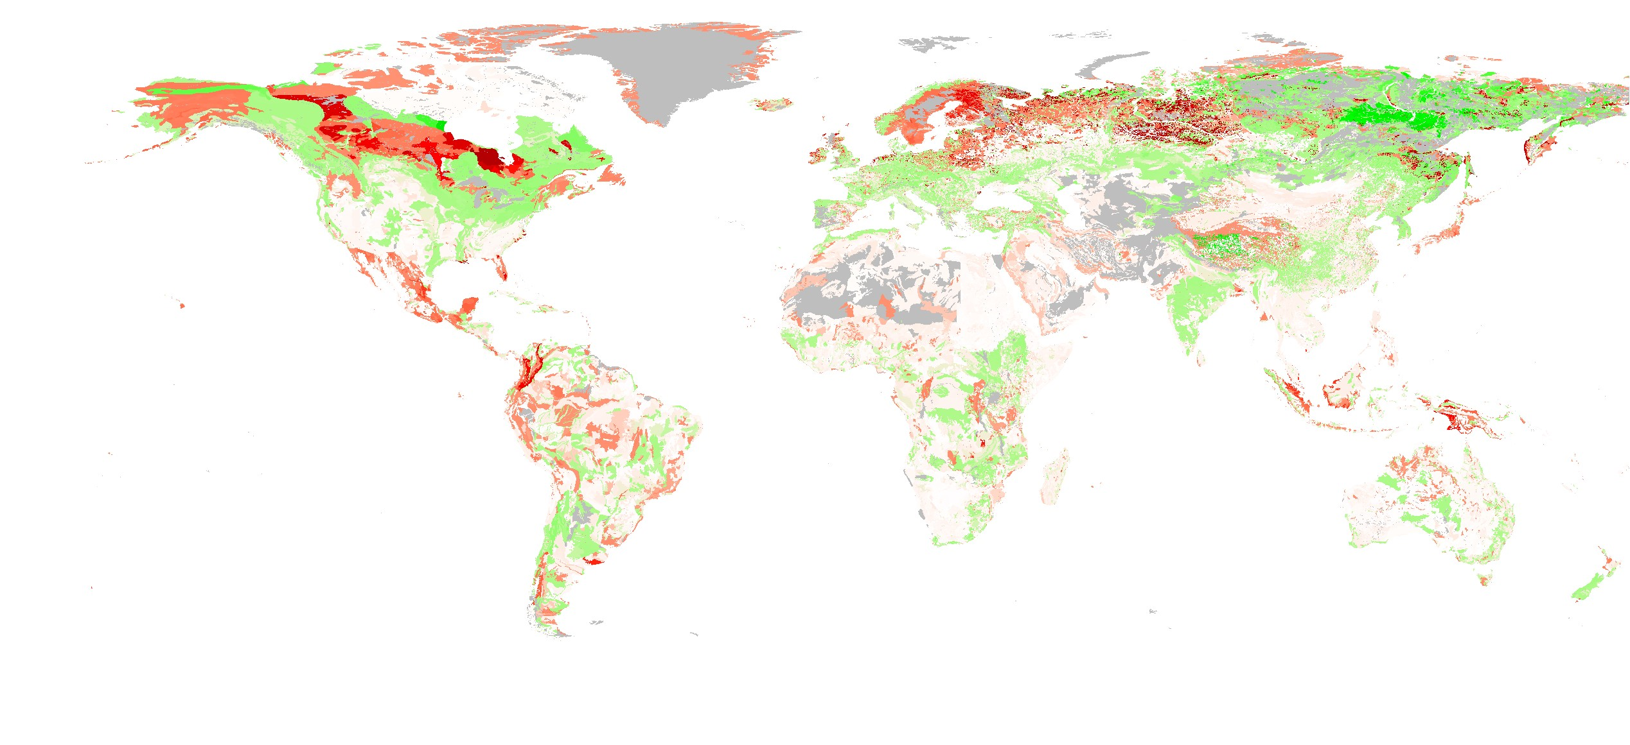

SOC estimation
Differences in SOC topsoil (T/Ha) across HWSD version 1.2 and version 2.0
Difference = SOC-Topsoil HWSD V2.0 – SOC-Topsoil HWSD V1.2
Differences show SOC in at 30cm (Version 1.2 to Version 2.0)

Slide 11
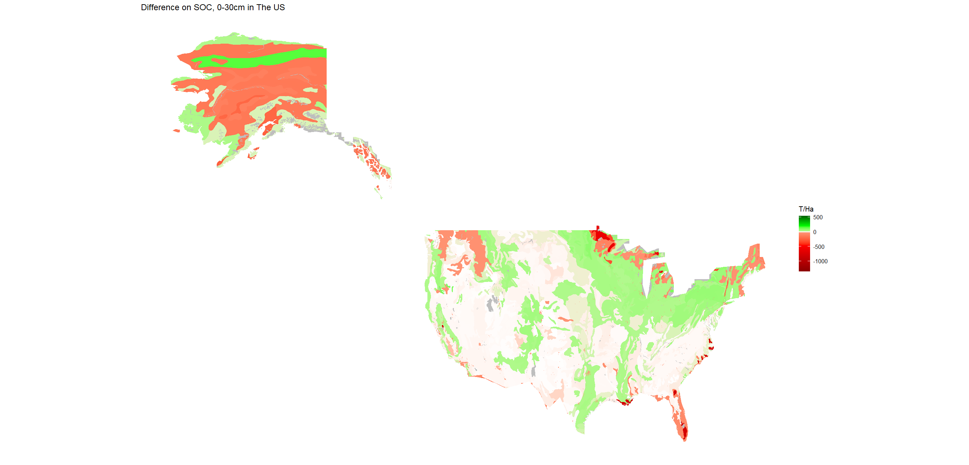
Differences in SOC estimates
US
Difference = SOC-Topsoil HWSD V2.0 – SOC-Topsoil HWSD

Slide 12
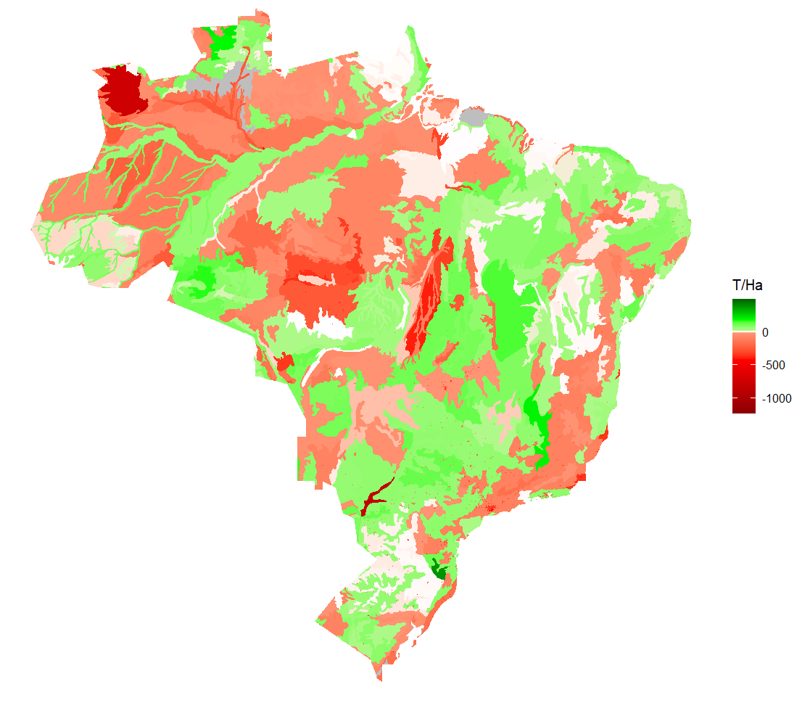
Differences in SOC estimates
Brazil
100
Difference = SOC-Topsoil HWSD V2.0 – SOC-Topsoil HWSD

Slide 13
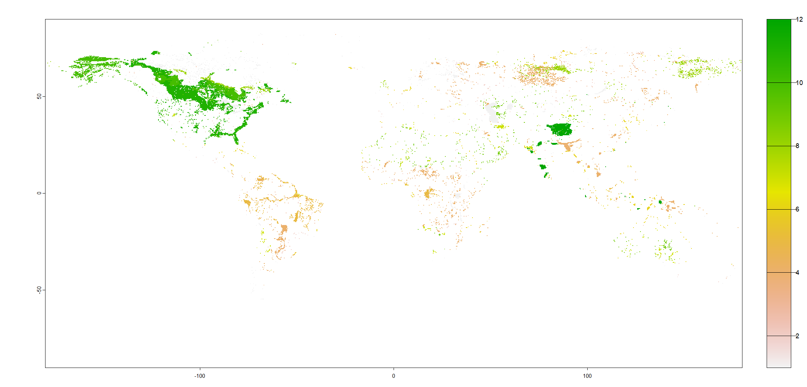
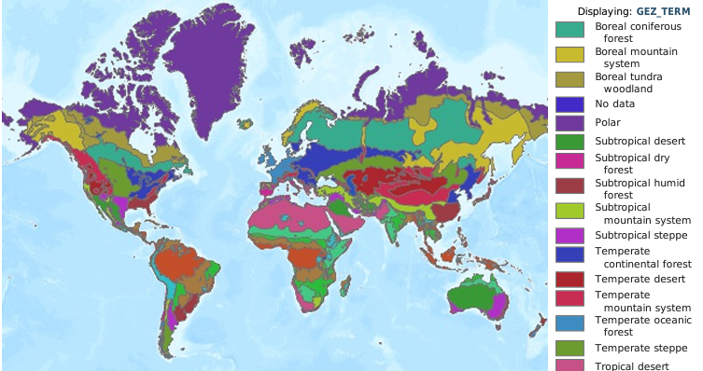
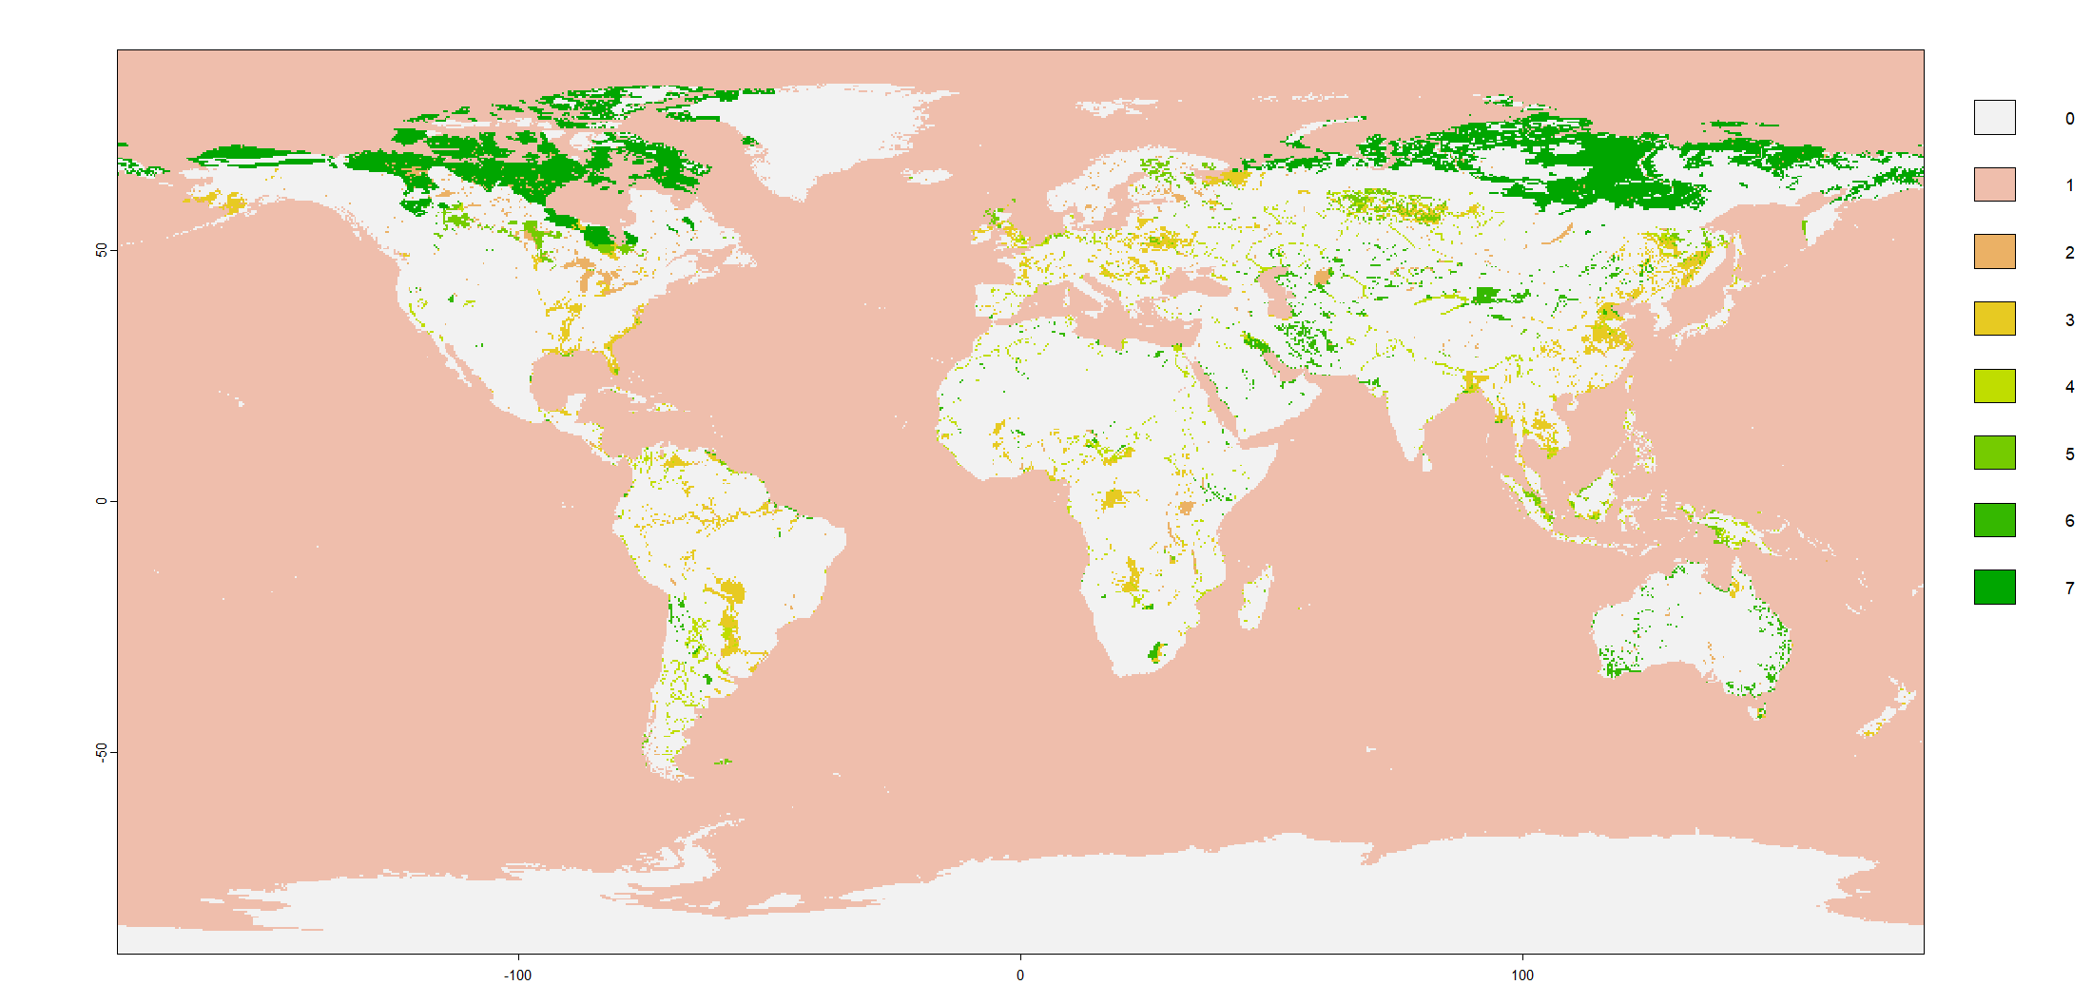
SOC estimation
Leveraging Gibbs et al., 2014 we have applied three map filters. Two wetland areas (Reich, 1997 and GLWD, 2004) and the FAO ecofloristic zones, to filter deserts.

Slide 14
Area of land used in AEZ-EF in SOC estimation
The previous version of SOC used to estimate land use emissions factors, utilized a map that represented cropland and pasture areas for the year 2000.
An important contribution of this research is the substitution of this land-cover representation with a more updated database which also has the feature of being updated regularly to explore land-use dynamics. This database is the MODIS (Moderate Resolution Imaging Spectroradiometer) satellite data contains 13 land cover classifications according to the vegetation and humidity characteristics (Sulla-Menashe D. and Friedl M.).
To have a consistent definition of the three land cover items, we used the FAO definition.

Slide 15
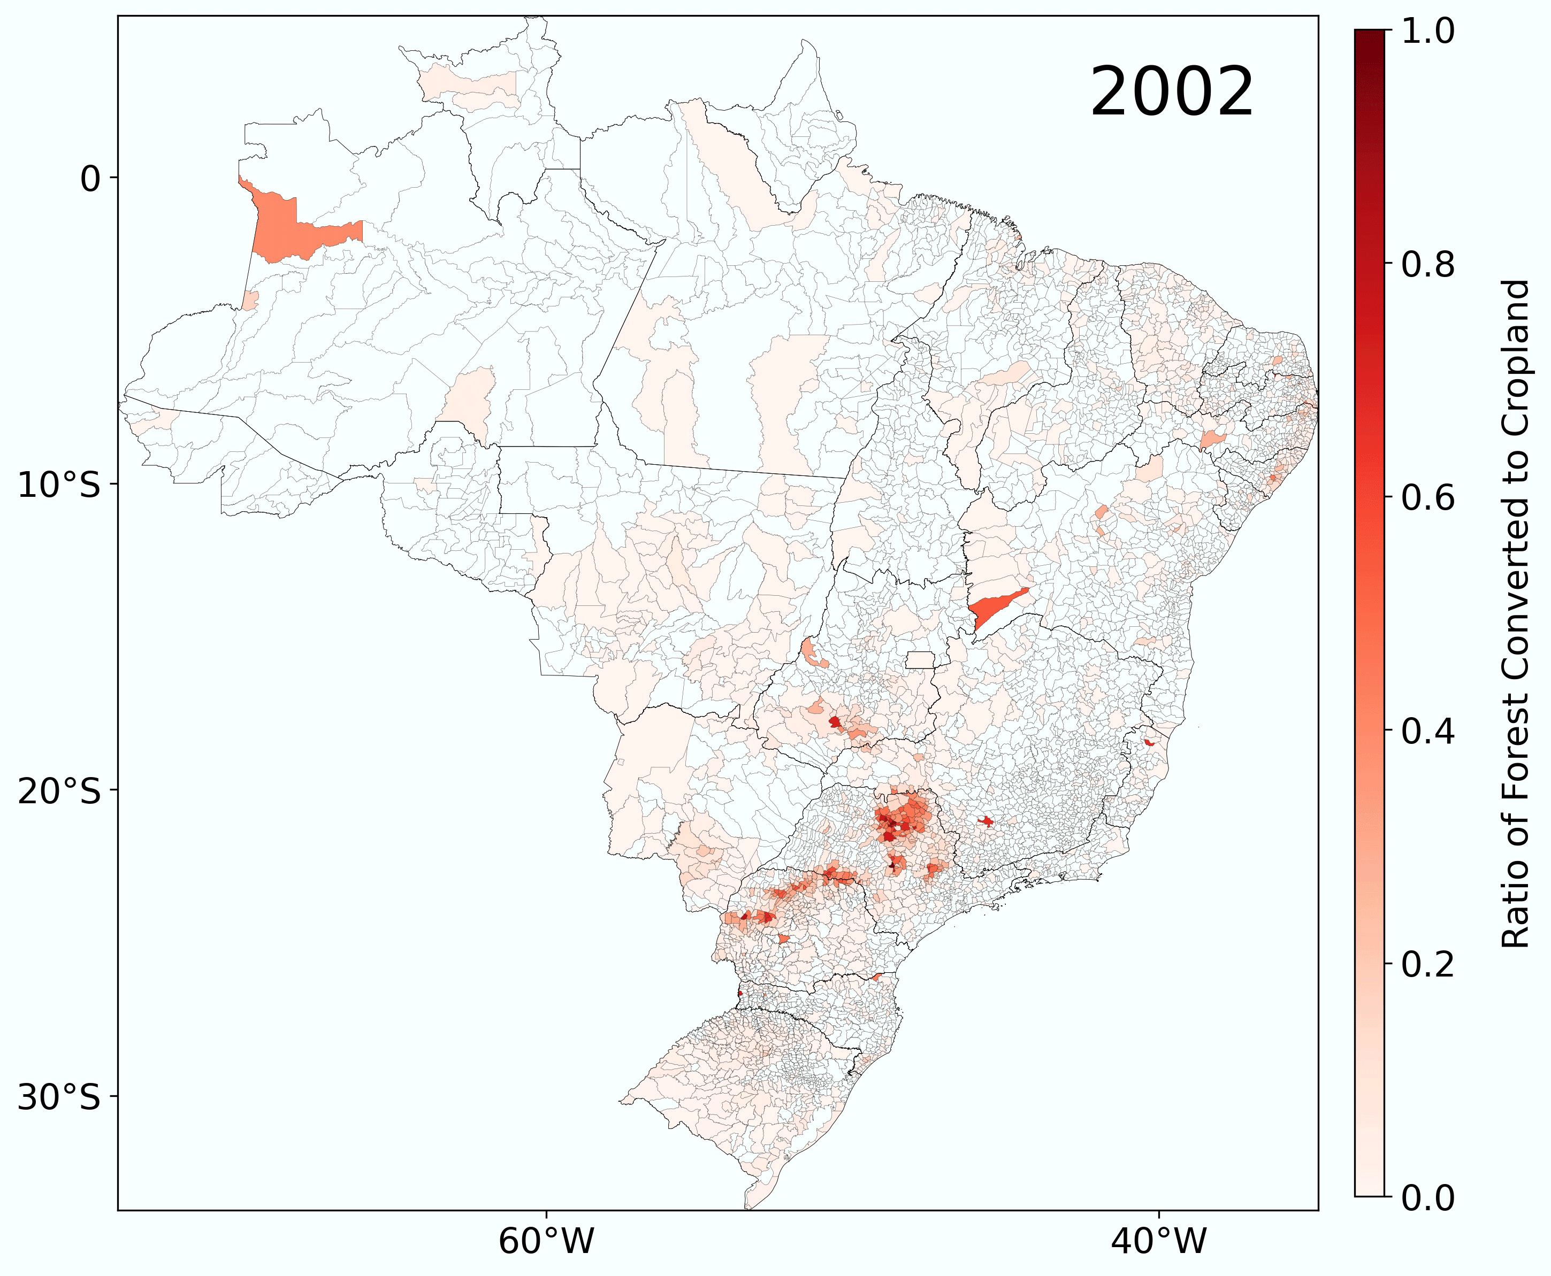
SOC Estimation
MODIS Land representation
Map taken from Chen et al., 2024

Slide 16
Preliminary results
New ILUC emissions are estimated for all regional and global default SAF pathways using the GTAP-BIO results.
Results shows that the updated results are usually different from the original results.
  In most cases the new results tend to show slightly lower ILUC emissions from the original estimations.
  These estimates will differ when adding the soil organic carbon estimates.

Slide 17
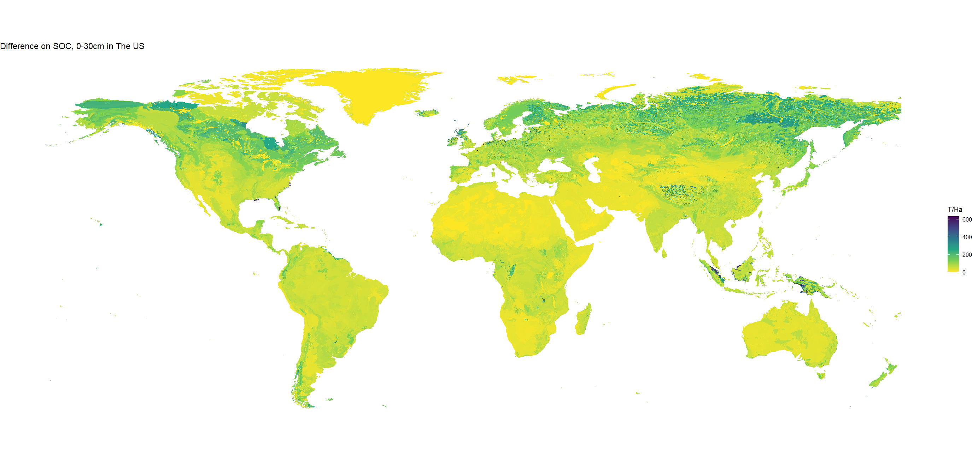
Preliminary results
To estimate the SOC levels at the world level, we did an area weighted average, in this case, the HWSD version 2 gives us an estimate of 64.23 T/Ha, which is lower in comparison with the HWSD version 1.2. The estimated average on this version was 84.75.
The estimates above mentioned do not include wetlands and deserts filtering.
SOC topsoil for HWSD version 2.0

Slide 18
Next Steps
Consolidate a precise definition of managed and unmanaged forest to use in the model and estimates.
Aggregation of estimates at the GTAP-BIO regions level (19 regions).
Introduce new SOC estimates in the already updated emissions estimator and obtain new estimates of Induced Land-Use changes.
Implementation of these estimates and new agricultural lands representation as a permanent tool in GTAP and/or GTAP-BIO to estimate land cover change dynamics and land use change emissions.

Slide 19
Thank you
Questions are welcomed

