Slide 1
Bridging the Gap between Land and Food:
Leveraging FAO
Supply Utilization Accounts to Enhance
Food System Modeling
Xin Zhao
Maksym Chepeliev, Pralit Patel
Page Kyle, Marshall Wise
Joint Global Change Research Institute (JGCRI)

Slide 2
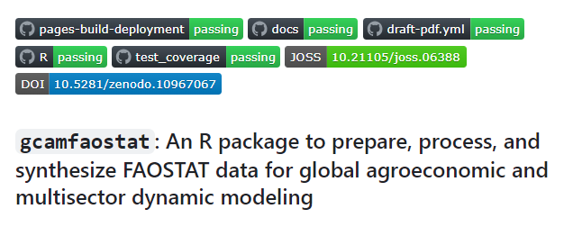
Today’s talk
R package: gcamfaostat (v1.0.0)
  Facilitate the use of FAOSTAT data
As a function in gcamfaostat, we compile Food Balance Sheets using detailed FAO Supply Utilization Accounts
  Connect land and food: a new approach for primary equivalent

Slide 3
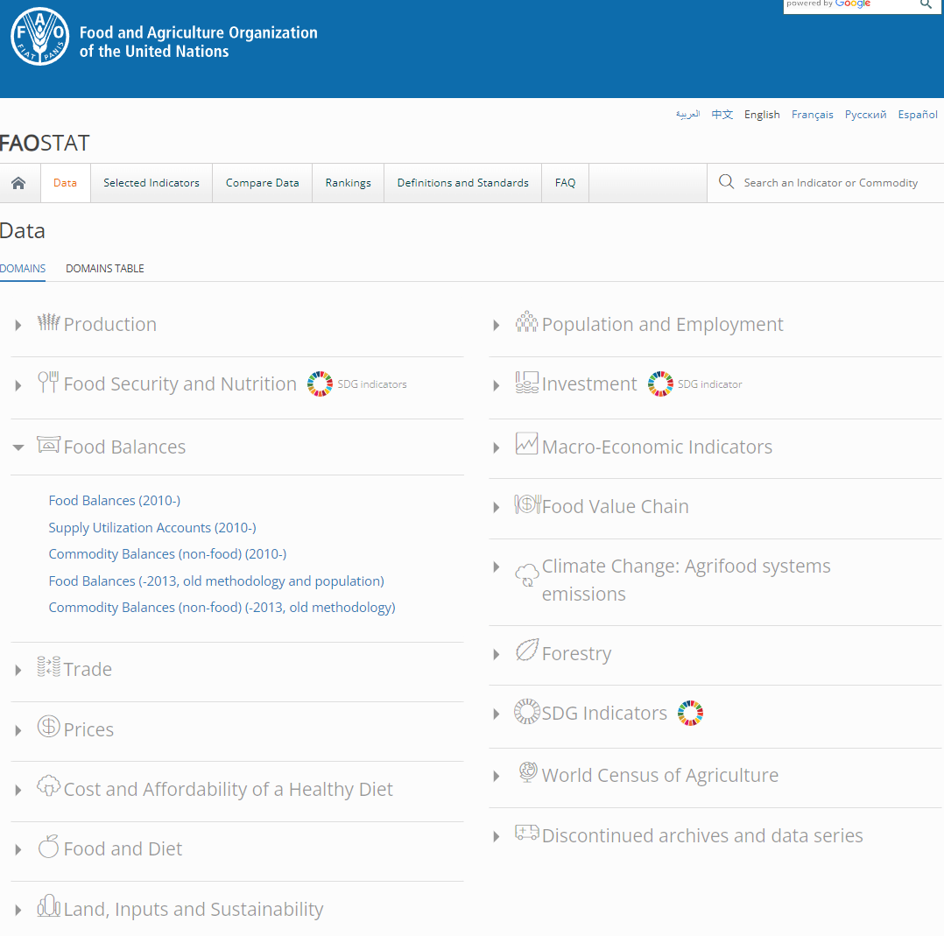
FAOSTAT
(Food and Agriculture Organization Statistics)
FAOSTAT is the major source of data for global agroeconomic modeling.
  Agriculture development, trade, food security, nutrient, dietary health, environment, etc.
Data need to be downloaded, cleaned, processed, and aggregated for modeling.
Every modeling team is doing this with different assumptions.
  Check out section #41 for AgMIP
All the modeling groups can benefit from the concerted efforts of the open-source community.
Need for traceable, transparent, consistent, and easy-to-update tool.

Slide 4

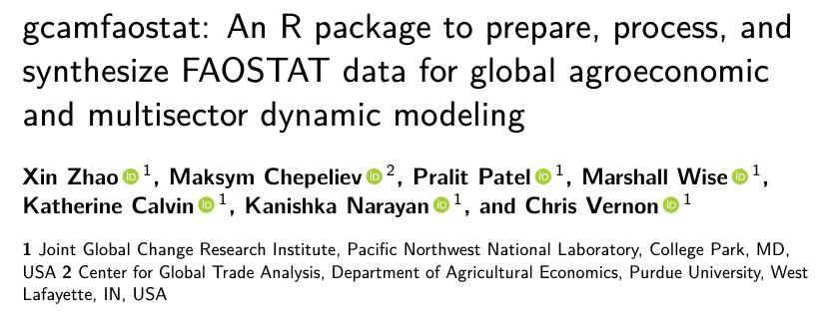
And here is one: gcamfaostat
We developed an R package
GCAM
  Widely used PE/MSD/IAM model maintained by PNNL-JGCRI
  R package: gcamdata
    Translate data into formats (XMLs) GCAM needs
    Cool function to trace data drake
  Will explain more later
But the name doesn’t matter
  New features do
JOSS: https://joss.theoj.org/papers/10.21105/joss.06388
GitHub: https://github.com/JGCRI/gcamfaostat
Website: https://jgcri.github.io/gcamfaostat/

Slide 5
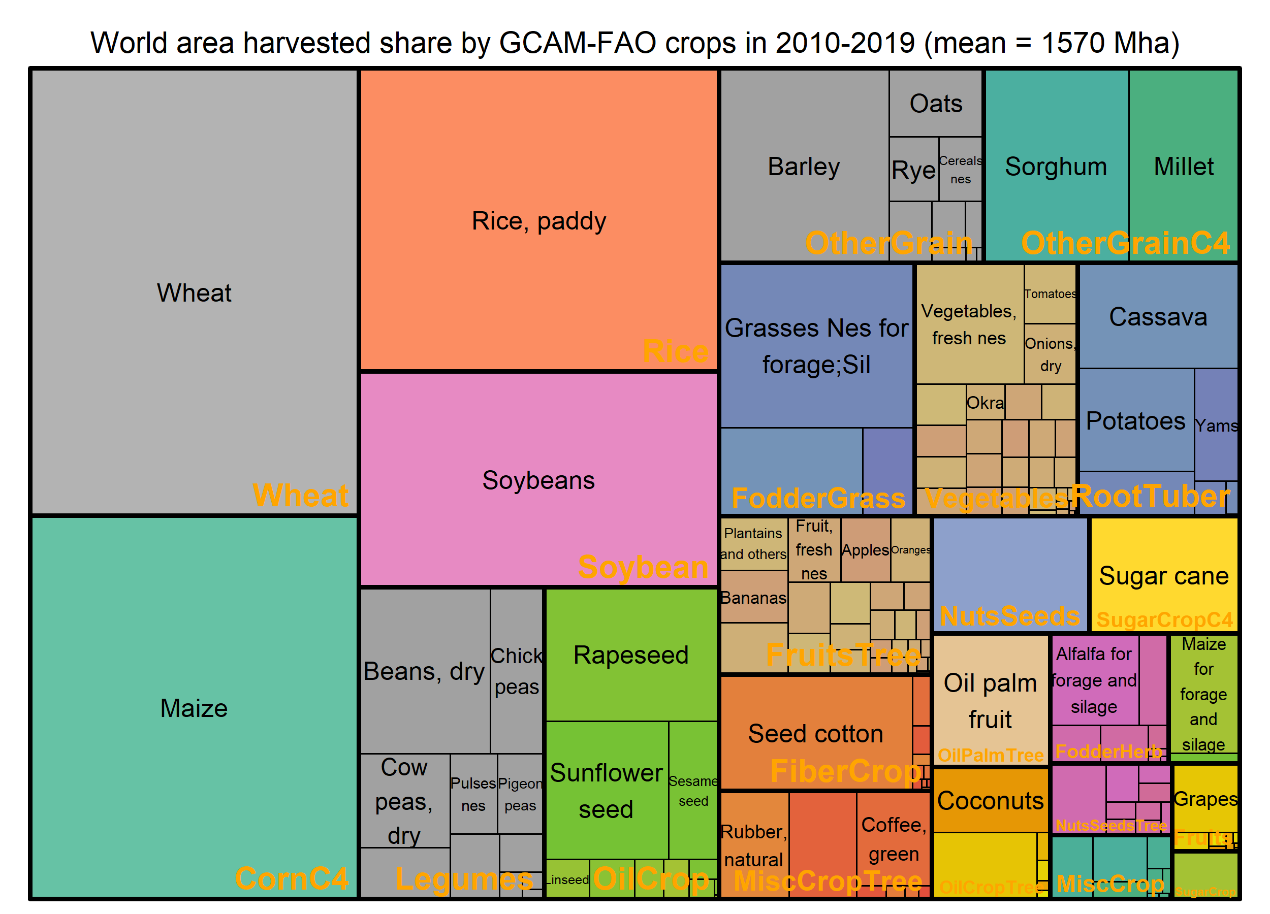
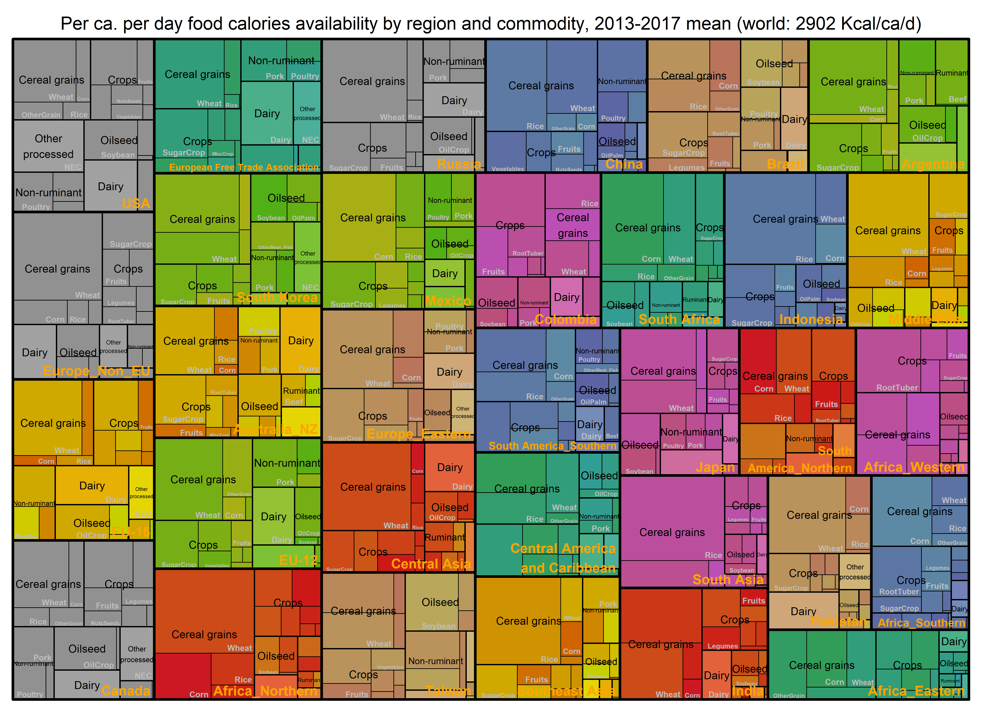
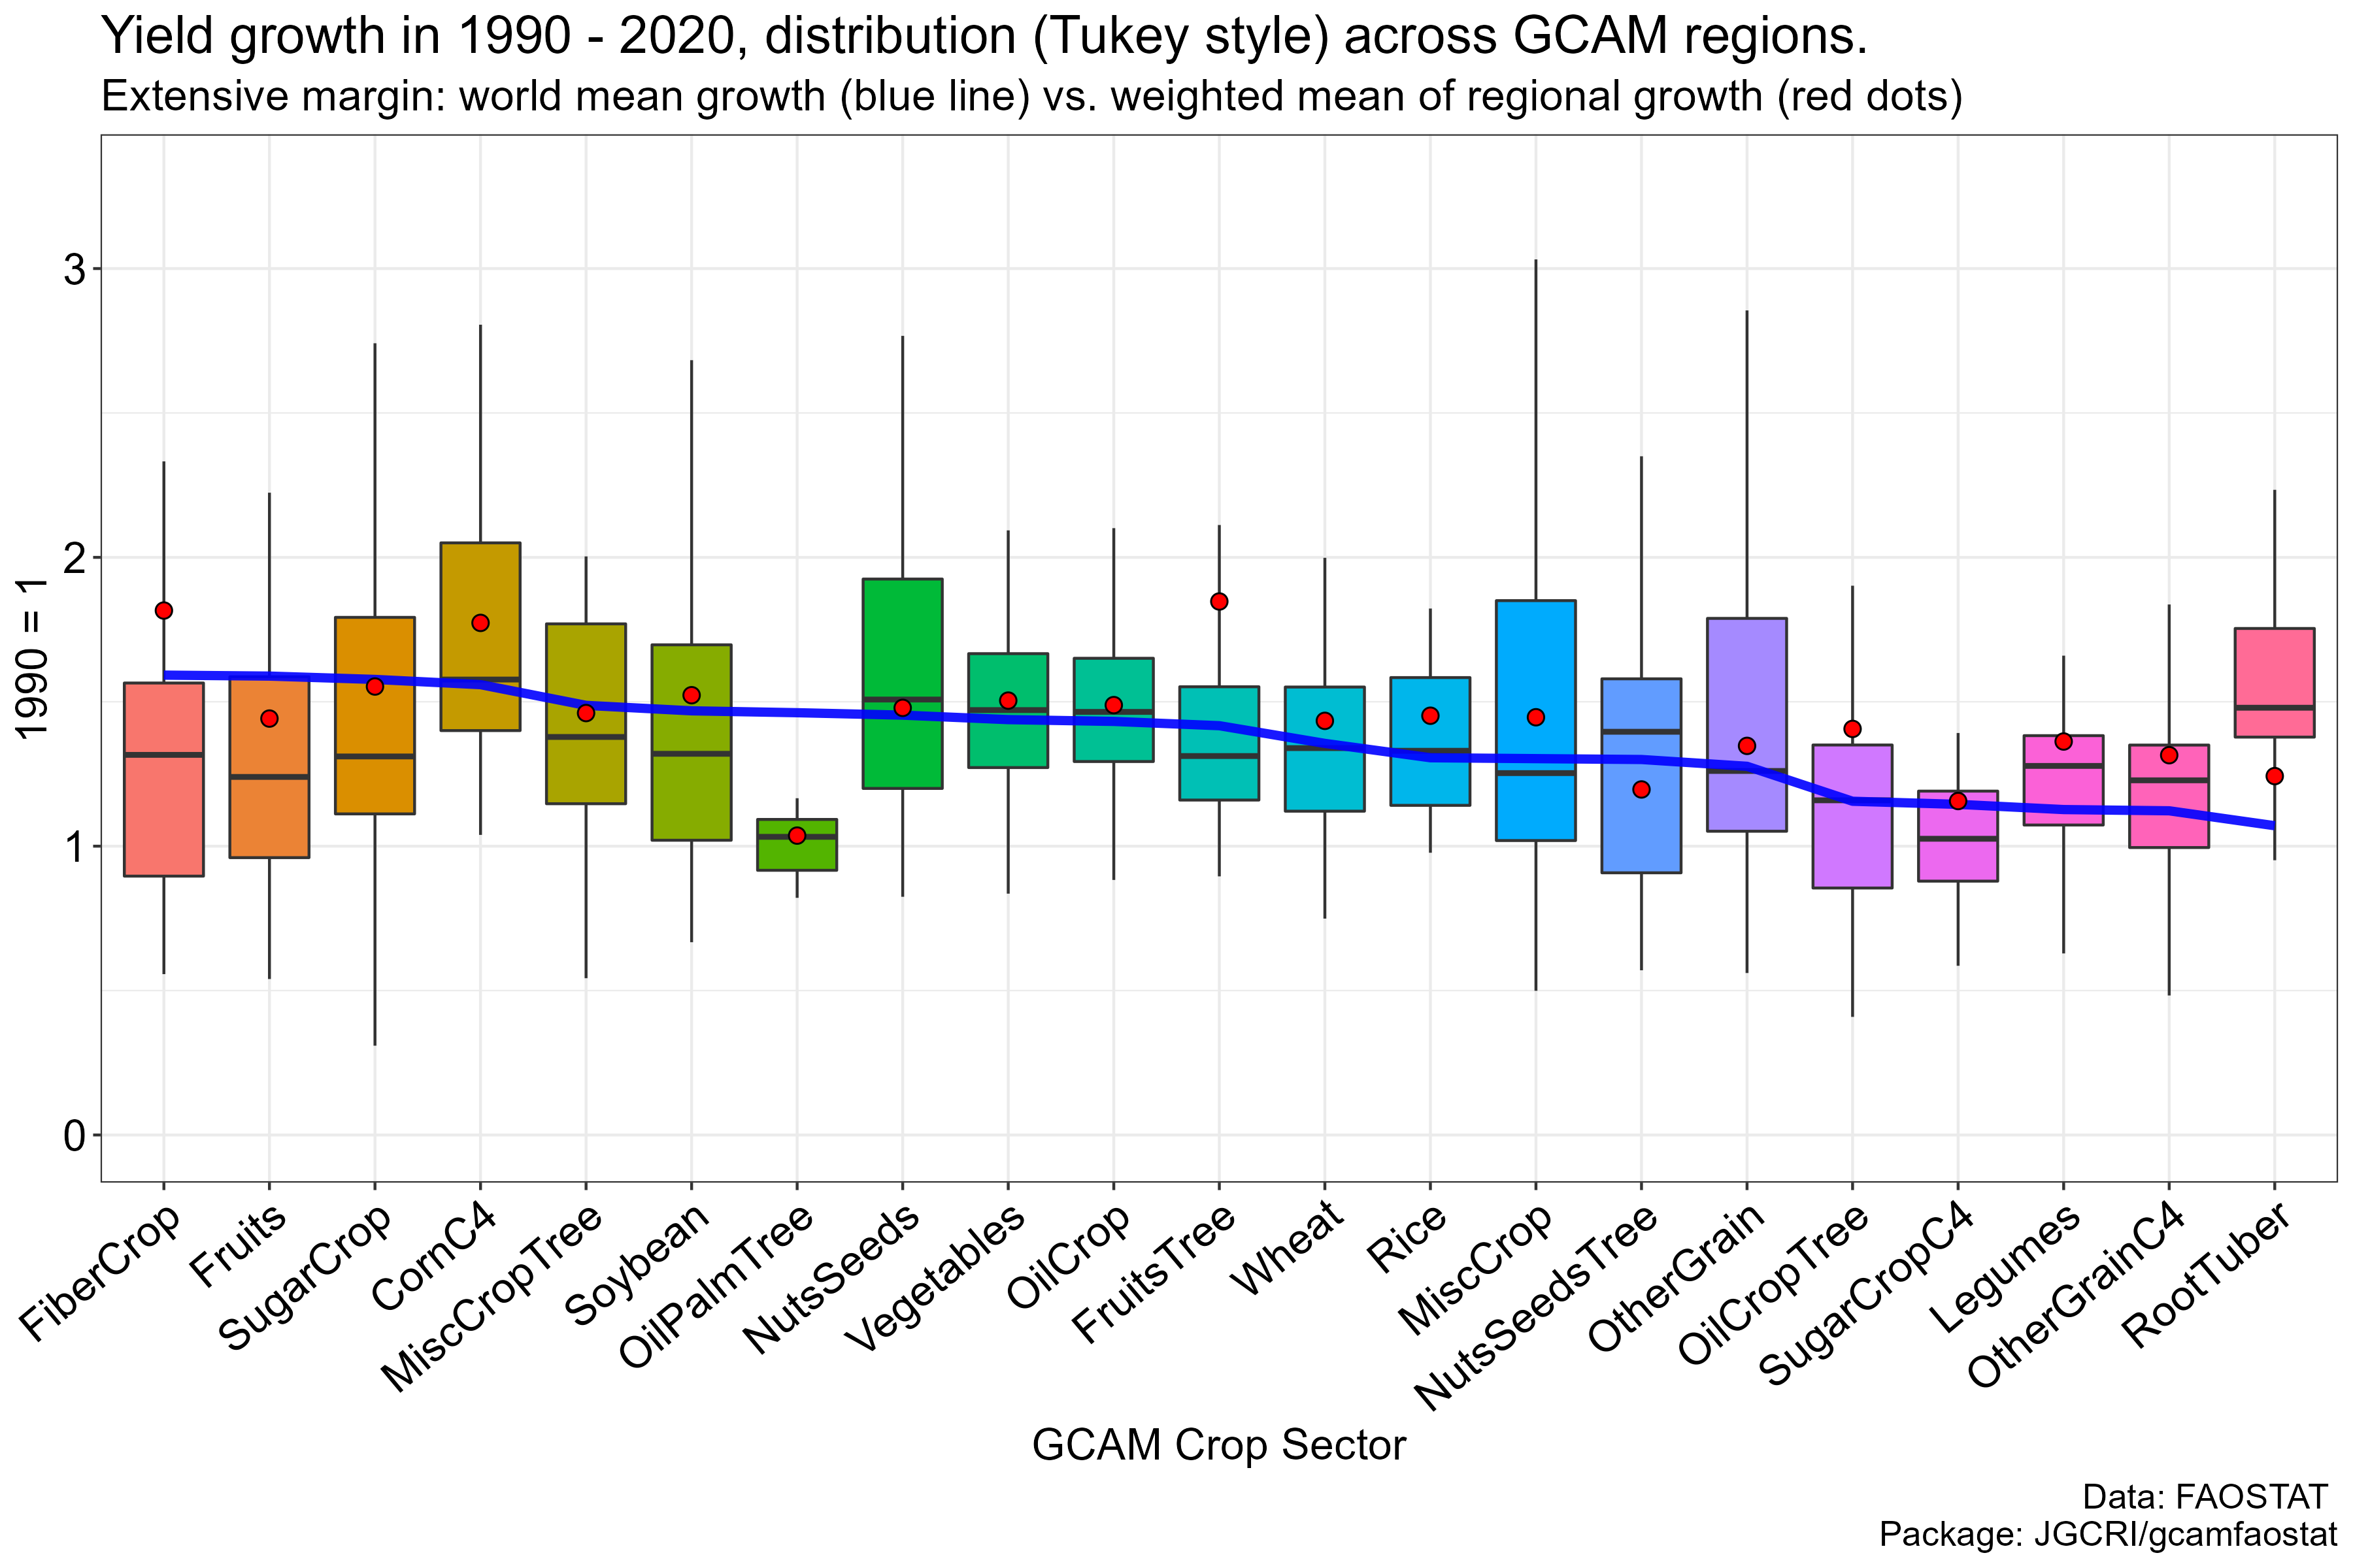
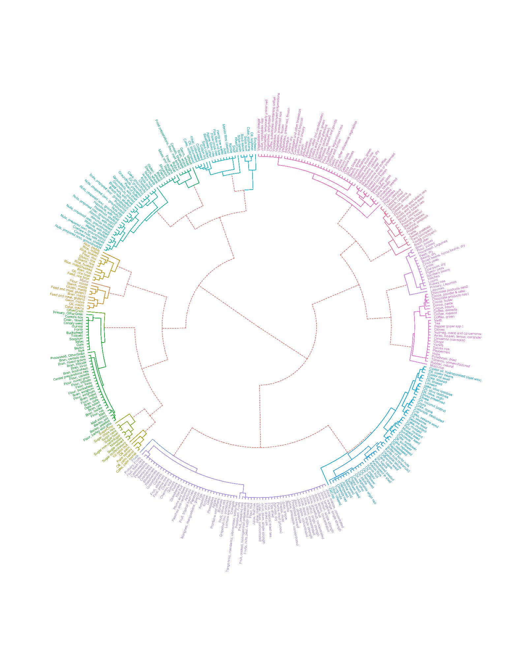
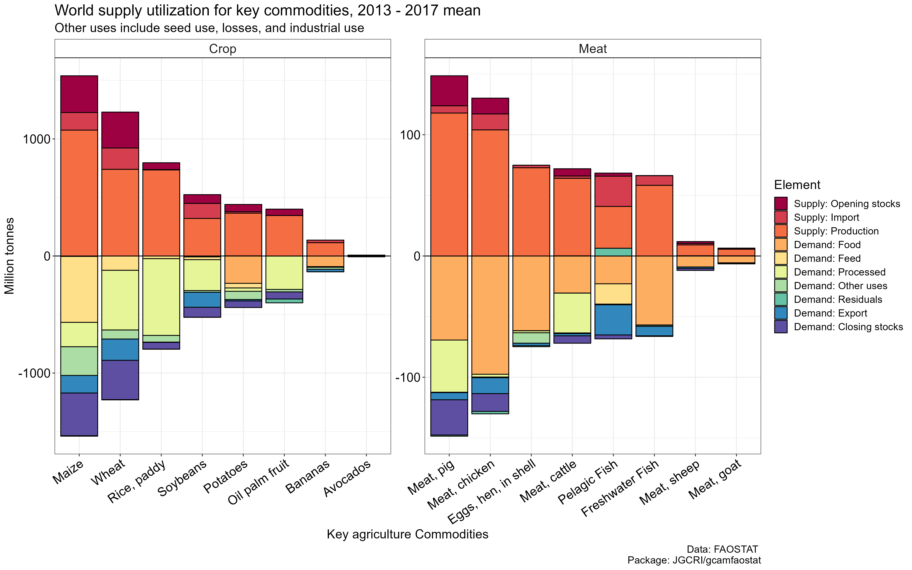
Some functions
Visualization

Slide 6
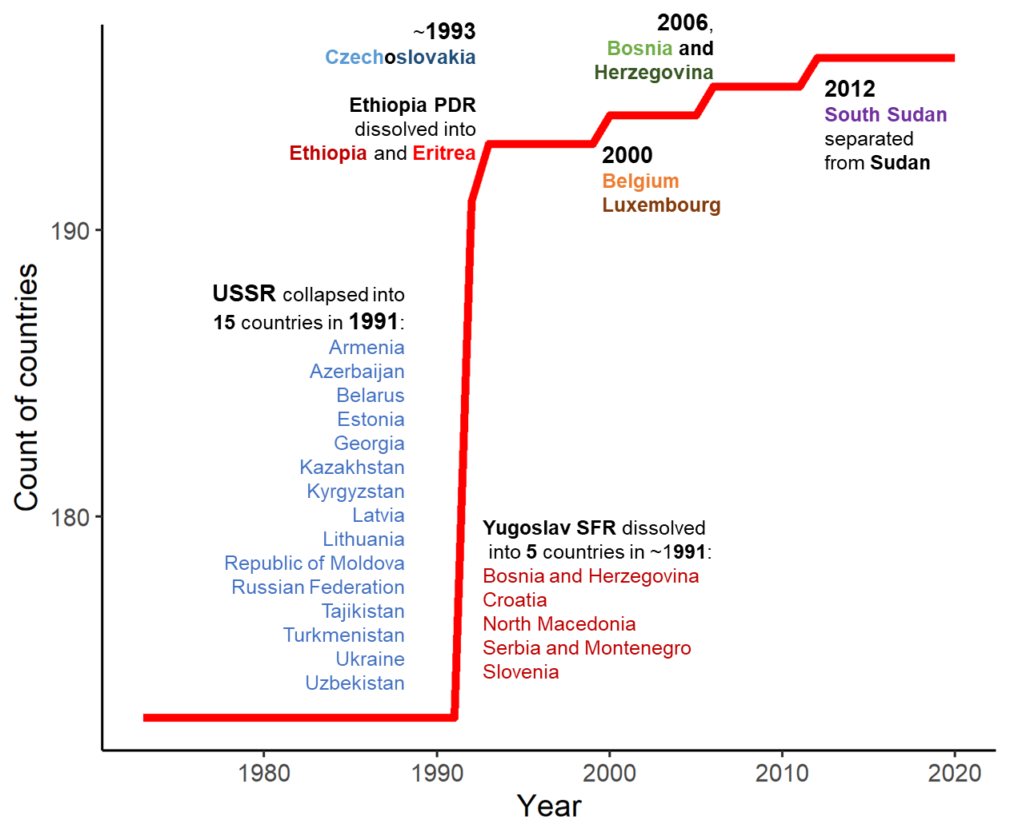
Some functions
Mappings
Still remember the pain of dealing with region/country mappings
Not even mentioning the name changes of countries/sector
  area_code & item_code (or CPC) are prioritized

Slide 7
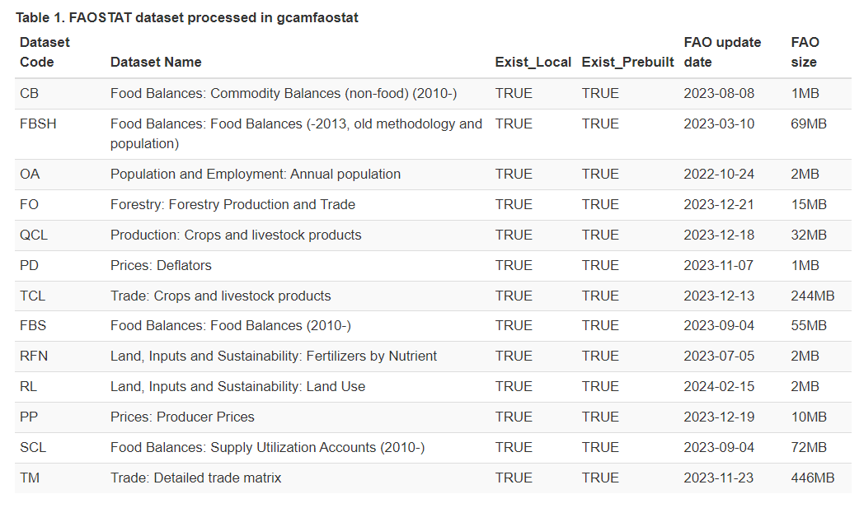
FAO data currently included in gcamfaostat
gcamfaostat_metadata()

Slide 8
FAO data currently included in gcamfaostat
gcamfaostat_metadata()

Slide 9
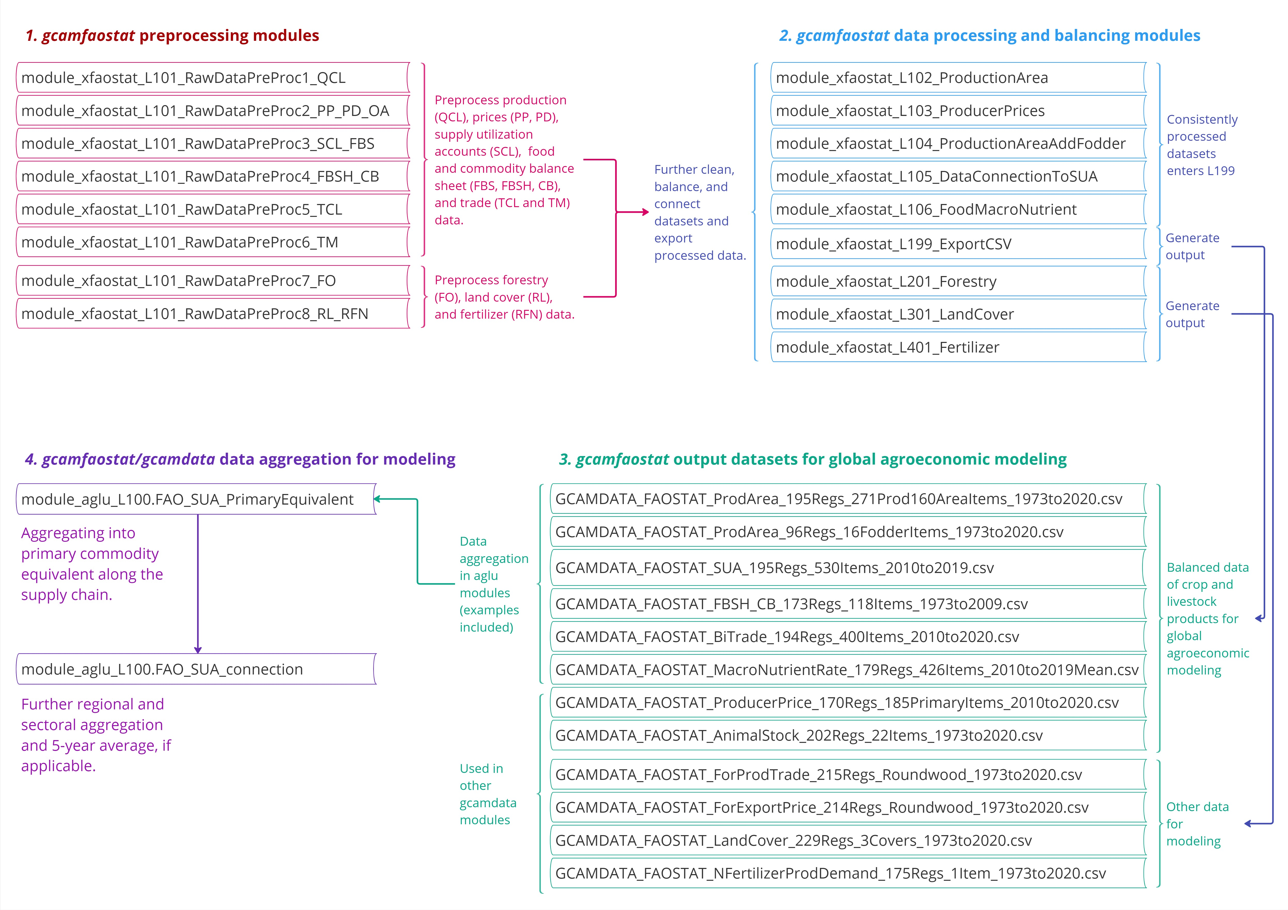
Data processing modules (functions)
driver_drake()
  Runs data processing modules sequentially to generate intermediate data outputs and final output
  Trace data flow

Slide 10
Data processing modules (functions)
Common modules:
driver_drake()
  Runs data processing modules sequentially to generate intermediate data outputs and final output
  Trace data flow
GCAM-specific data/modules:
Aggregation
Average

Slide 11
gcamfaostat goals
Encourage community collaboration and improve efficiency
  Reduce the effort required for data processing.
Facilitate FAOSTAT data use in global economic and multisector dynamic models
  Ensure transparency, traceability, and reproducibility.
Enhance the quality and accessibility of data for the global agroeconomic modeling community
  Reduce model uncertainty
  Foster more robust and harmonized outcomes in a collaborative, efficient, and open-source framework.

Slide 12
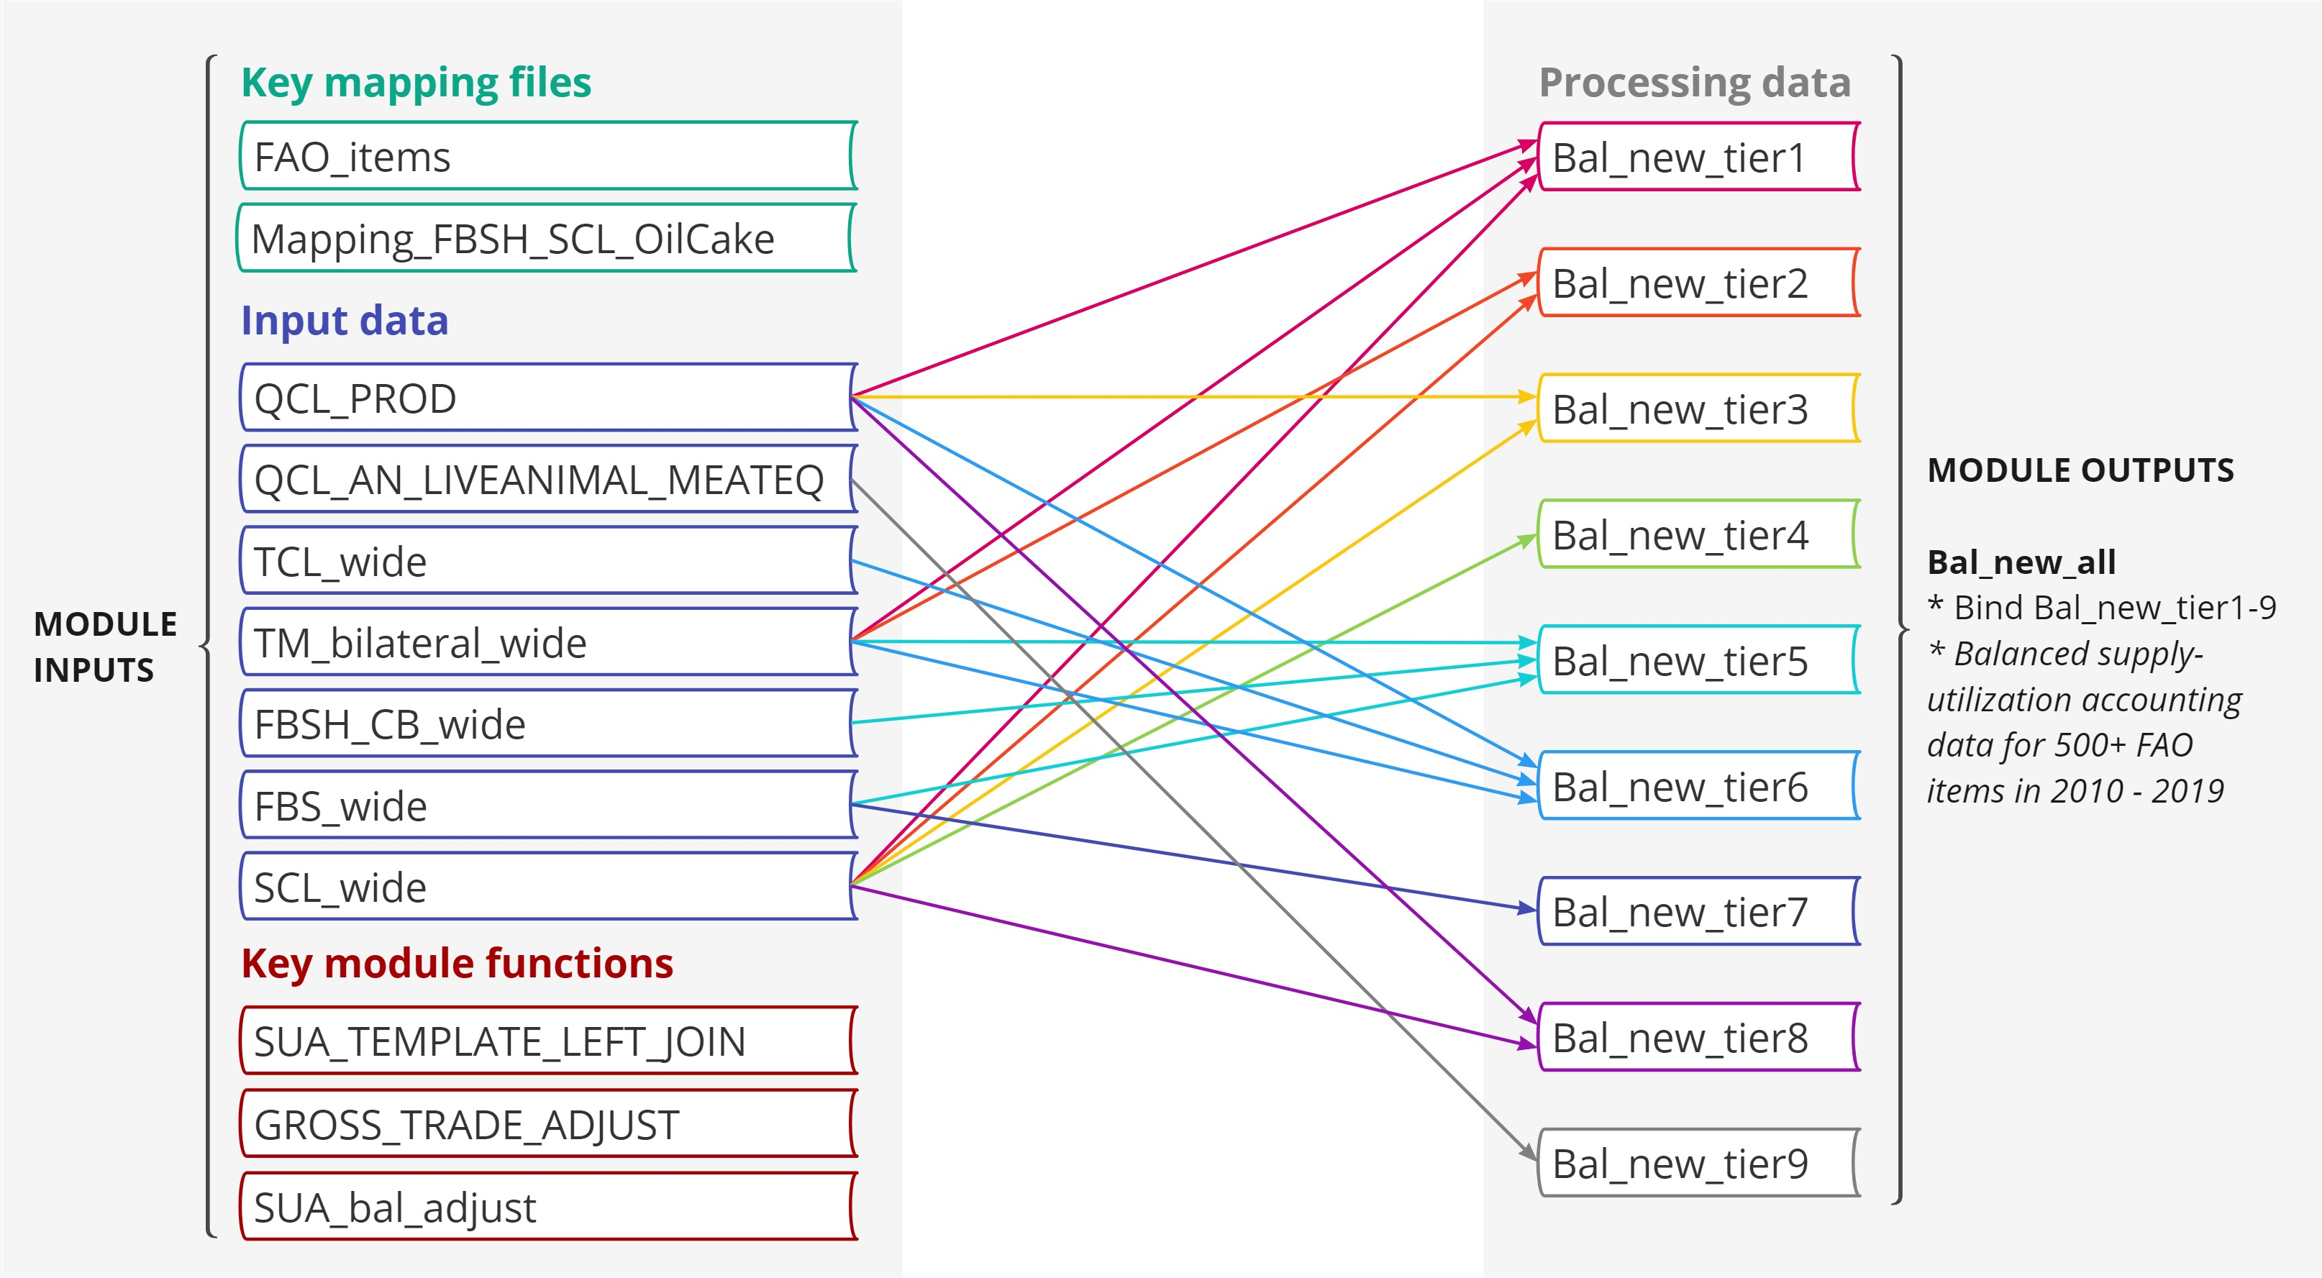
module_xfaostat_L105_DataConnectionToSUA
Harmonize various FAOSTAT datasets to generate a consistent set of agricultural supply and utilization accounts (SUA) data
  Over 500 commodities
  With different quality/assumptions
In comparison, FBS (food balance sheet) had ~100 aggregated commodities
  Lack of connections to bilateral trade and stocks
  With no detailed documentation
There will be another common module for the new primary equivalent approach
  Aggregation across region/sector
  Aggregation vertically along supply chains

Slide 13
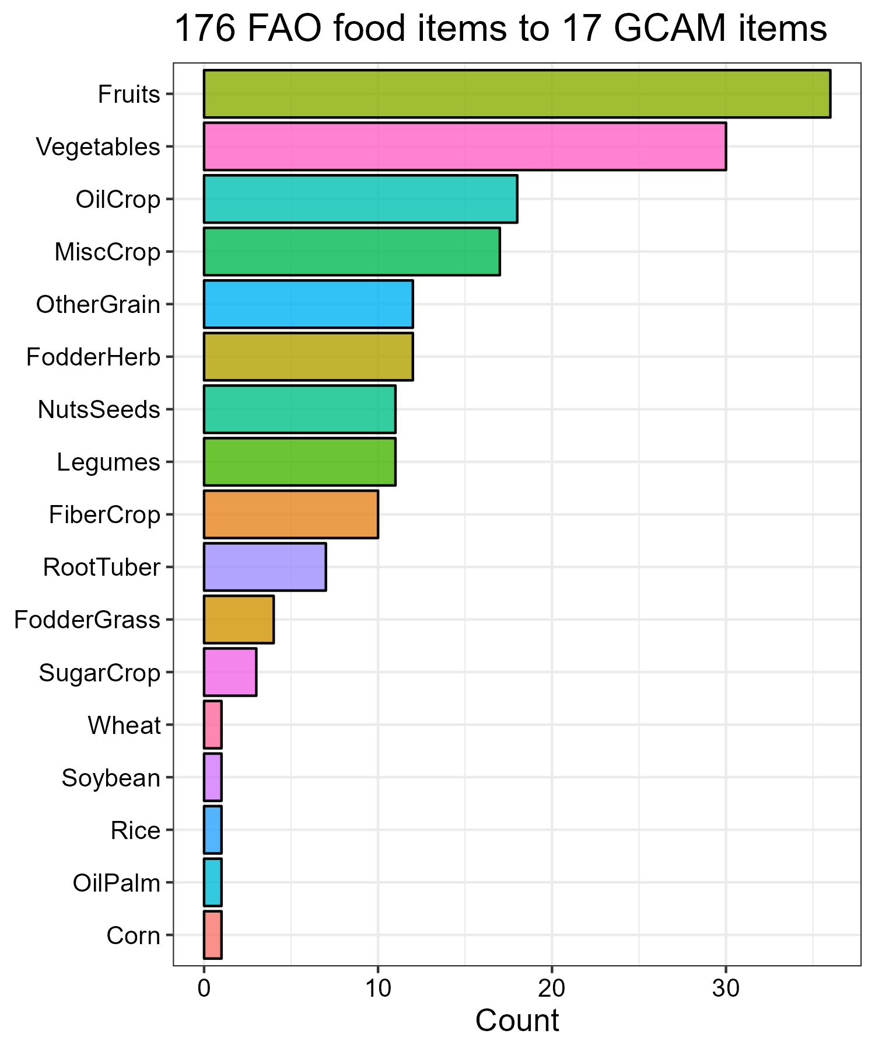
Harvested area:
Mapping 176 FAO crops to 17 GCAM commodities

Slide 14
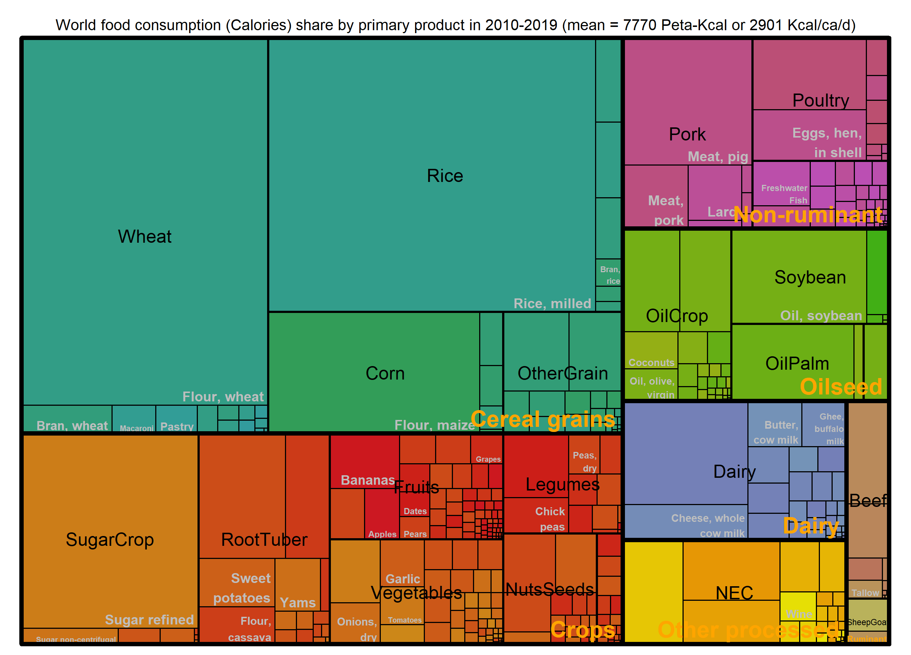
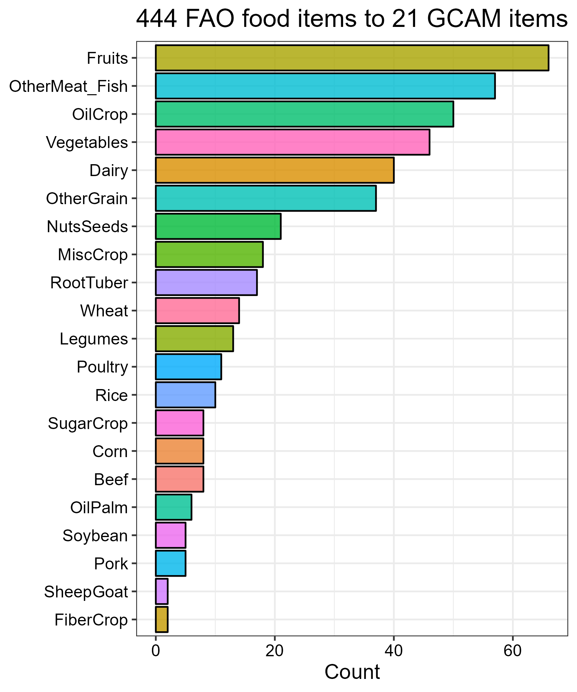
Food Calories:
Mapping 444 FAO food items to 21 GCAM items
World food consumption:
7770 Peta-Kcal per year or ~2900 Kcal/ca./day

Slide 15
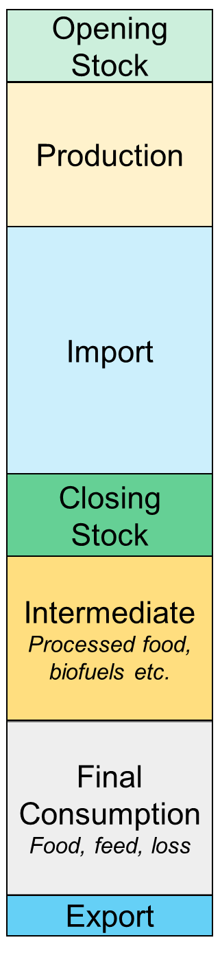
Challenges in connecting land to food
Primary land-based output is usually further processed
Models do not include the full processing chain
Supply utilization accounting:
Supply
Utilization

Slide 16
Challenges in connecting land to food
Primary land-based output is usually further processed
Models do not include the full processing chain
Supply utilization accounting:
Land &
other inputs
Supply
Utilization
Food Tons to Calories

Slide 17
Challenges in connecting land to food
Primary land-based output is usually further processed
Models do not include the full processing chain
Supply utilization accounting:
Land &
other inputs
Processed Food
Supply
Utilization
Food Tons to Calories

Slide 18
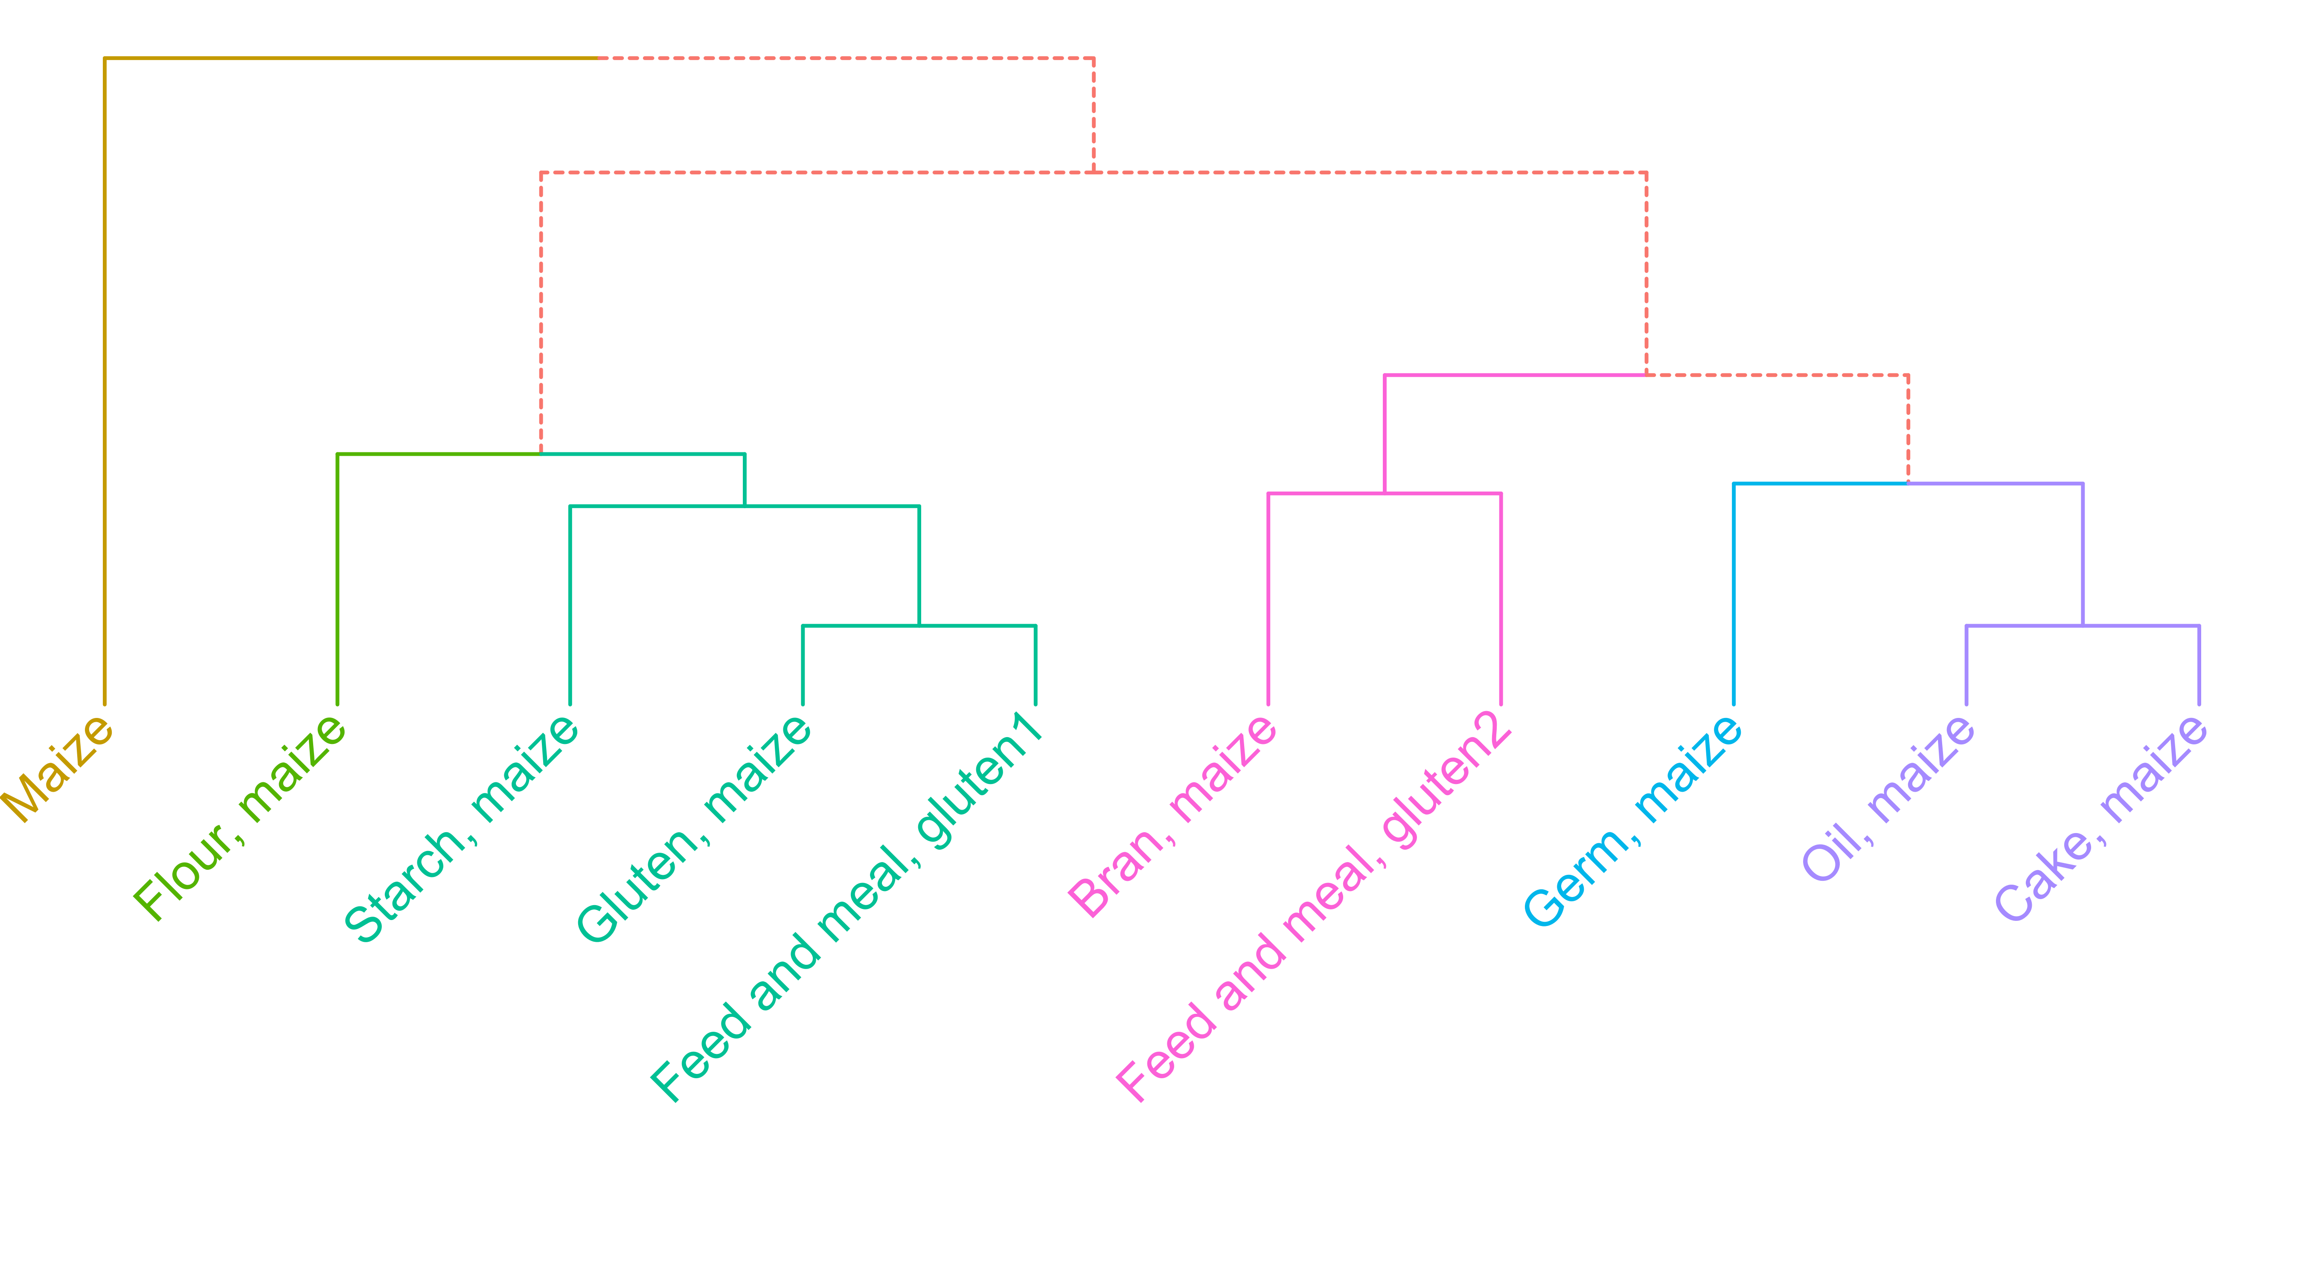
Maize example:
Showing the depth of agri-food sectors
Supply utilization account (SUA) balances for all commodities

Slide 19

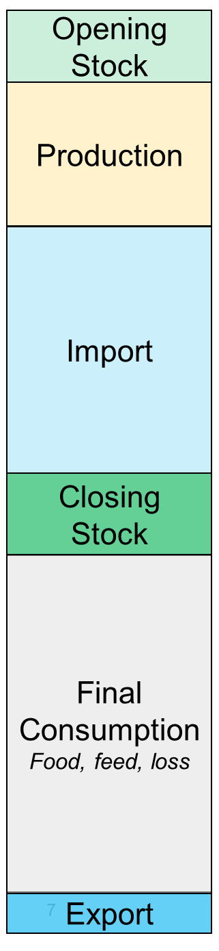
Vertical aggregation:
Primary Commodity Equivalent
Extraction
rate
Starch
Gluten
Etc.
Maize
Extraction
rate
Flour
Germ
Bran

Slide 20
Vertical aggregation:
Primary Commodity Equivalent
Extraction
rate
Starch
Gluten
Etc.
Consistency:
  Space
  Time
  Supply - Utilization
Preserve:
  Yield
  Macronutrients
Maize
Extraction
rate
Flour
Germ
Bran

Slide 21
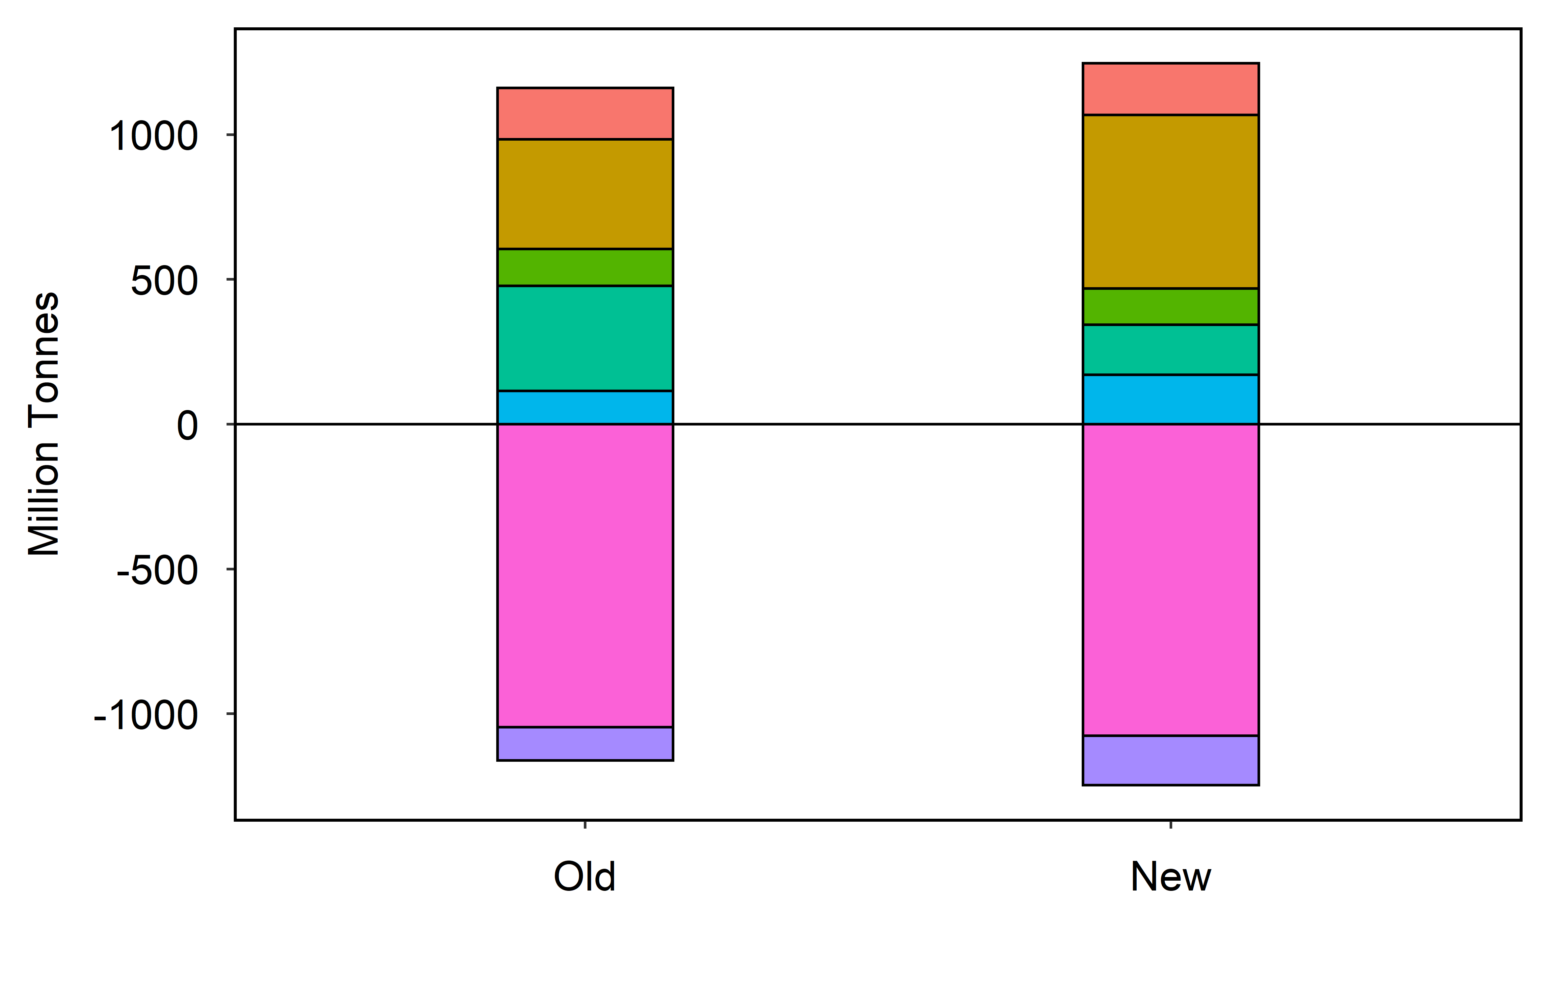
Implications: Corn supply utilization balance
GCAM base data: Corn SUA
Feed-use is larger (+60%)
Other-use is much smaller (-50%)
Similar patterns for other commodities
Direct food: 165 kcal/ca/day
Bioenergy
Feed
Utilization
Food
Others
Export
Supply
Production
Import
Notes:
6% of Calories
~10% of corn supply is direct food consumption

Slide 22
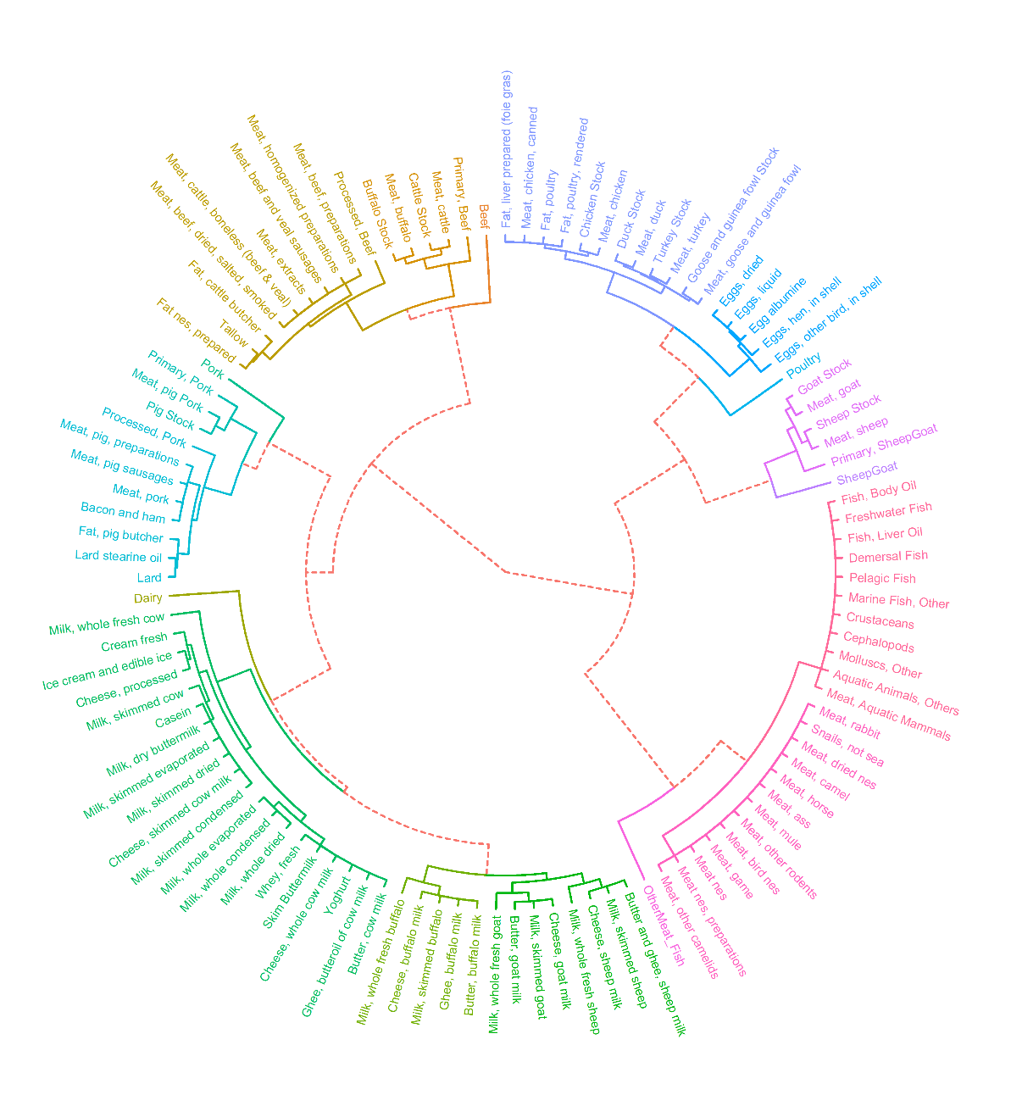
Nested mapping structure
17 GCAM crop commodities
6 GCAM livestock commodities
Fruits

Slide 23
Summary of additional gcamfaostat features/functions
Balanced Supply Utilization Accounting (SUA) dataset of over 500 agricultural and food commodities
A nested commodity mapping to understand the relationship across all the commodities.
A Primary Equivalent function that allows aggregating agriculture and food commodities along the supply chain.
The approach is transparent, reproducible, consistent, and flexible.

Slide 24
Why is the new data approach important?
Bridges the gap between agricultural inputs (e.g., land) and final consumptions (e.g., food)
Enhances data quality and scientific robustness in multisector global economic modeling
Enables further disaggregation of additional regions, agricultural commodities, and processing sectors

Slide 25
Why is the new data approach important?
Bridges the gap between agricultural inputs (e.g., land) and final consumptions (e.g., food)
Enhances data quality and scientific robustness in multisector global economic modeling
Enables further disaggregation of additional regions, agricultural commodities, and processing sectors
Accounts for storage and trade in secondary products
Food is more than food calories
  Macronutrients (protein and fat)
  May include micronutrients in future work
Improves the tracing of monetary and physical flows along supply chains
  Value-added (labor & capital)
  Water, nutrients, emissions, etc.

Slide 26
Next steps and contribution
More developments
  Revise assumptions in low-quality data zones
  Incorporate more data areas into the framework
Data development is never a once-and-for-all task
  Continued efforts are needed to sustain and improve the processing procedures
Promoting broader applications
We welcome and value community contributions to gcamfaostat
  Decentralized development by users

Slide 27
We acknowledge the support from the U.S. Department of Energy, Office of Science, as part of research in the Multi-Sector Dynamics, Earth and Environmental System Modeling Program

Slide 28
GCAM represents all land
Earth’s
surface
Land 29% (14.9 Bha)
Ocean 71%
Land
Habitable Land (10.6 Bha)
30% Barren & Glaciers & Water
Agriculture
5.1 Bha
Natural Forest
3.8 Bha
Other Nature
Habitable
Urban & Built-Up (1%)
Crops
1.6
Grazing
3.2 Bha
Ag-Land
Planted forest (3%)
Other arable land (0.4 Bha)
Planted area (1.2 Bha)
Harvested
area
Area
1.57
176 crops (FAO)

Slide 29
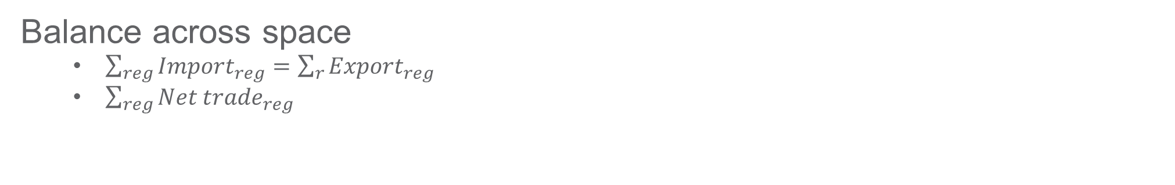

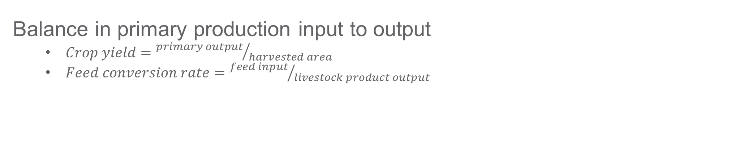

Balancing data across all dimensions
Balance across supply – utilization (market clearing)
  ${{Opening stock}_{reg, t}+{Production}_{reg, t}+Import_{reg, t}=Closing stock}_{reg, t}+{Consumption}_{reg,t}+{Export}_{Reg, t}$
Balance across space
  $\sum_{reg}{{Import}_{reg}}=\sum_{r}{{Export}_{reg}}$
  $\sum_{reg}{{Net trade}_{reg}}$
Balance in primary production input to output
  $Crop yield={primary output}/{harvested area}$
  $Feed conversion rate={feed input}/{livestock product output}$
Balance across time
  ${{Opening stock}_{t}=Closing stock}_{t−1}$
  ${{Opening stock}_{t}+Stock variation_{t} =Closing stock}_{t}$
Balance along supply chains
  $extraction rate={senondary production}/{primary processed used}$
Balance in food availability and macronutrients
  Tracing for calories, protein, and fat in food tonnes

