Slide 1


An investment determination mechanism with segmented capital markets
Hao David Cui and Zuzana Smeets Křístková
Wageningen Economic Research
Jun. 6, 2024

Slide 2
Overview
The global bank approach: expected rates of return equalization and net investment growth rates equalization
Investment determination under segmented capital markets
Model settings for MAGNET
Comparing projections across four different model versions
Summary

Slide 3
Introduction – why investment matters
One of the four pillars on the expenditure side of GDP, shaping the macroeconomic structure of the model
Given the stability in consumption (private and government) changes, investment growth has an immediate impact on trade balance developments, and vice versa. So the stability in one determines the stability in the other.
Impact on capital stock accumulation and the resulting impact on total factor productivity in baseline calibrations, and a flow-on effect on the labour-capital substitution and other related indicators - but not the focus of this study
So, it’s important to get investment projections right

Slide 4
The global bank approach: expected rates of return equalization
Expected rate of return by region
rore(r) = rorc(r) - RORFLEX(r) * [ke(r) - kb(r)]
where rore: expected rate of return rorc: current rate of return
kb: start of year capital stock growth ke: end of year capital stock growth
RORFLEX: response parameter
Expected rate of return equalization
rore(r) = rorg
where rorg: global expected rate of return
End of year capital stock, start of year capital stock, and investment
ke(r) = INVKERATIO(r) * qinv(r) + [1.0 - INVKERATIO(r)] * kb(r)
where qinv: gross regional investment
INVKERATIO: ratio of investment to end of year capital stock

Slide 5
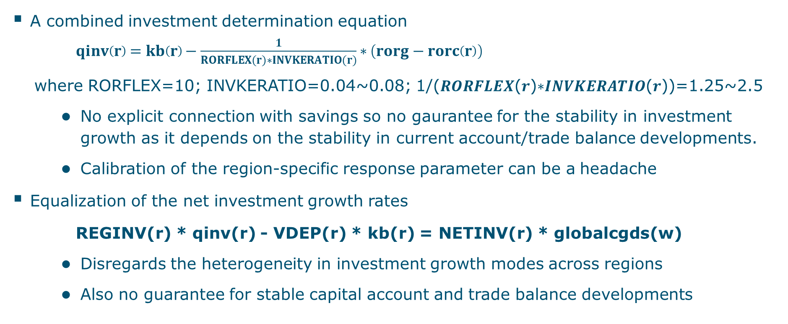
The global bank approach: summary
A combined investment determination equation
$qinv\left(r\right)=kb\left(r\right)−\frac{1}{RORFLEX(r)∗INVKERATIO(r)}∗\left(rorg−rorc\left(r\right)\right)$
where RORFLEX=10; INVKERATIO=0.04~0.08; 1/(𝑹𝑶𝑹𝑭𝑳𝑬𝑿(𝒓)∗𝑰𝑵𝑽𝑲𝑬𝑹𝑨𝑻𝑰𝑶(𝒓))=1.25~2.5
  No explicit connection with savings so no gaurantee for the stability in investment growth as it depends on the stability in current account/trade balance developments.
  Calibration of the region-specific response parameter can be a headache
Equalization of the net investment growth rates
REGINV(r) * qinv(r) - VDEP(r) * kb(r) = NETINV(r) * globalcgds(w)
  Disregards the heterogeneity in investment growth modes across regions
  Also no guarantee for stable capital account and trade balance developments

Slide 6
Segmented capital markets
Market clearing for savings:
qsave(r) = NETINVDOM(r)/SAVE(r)*qnetinv(r) + (1-NETINVDOM(r)/SAVE(r)) *sum(g,REG, NETINVMSHR(g)*qnetinv(g))
where qsave(r): percentage change in real savings in region r;
qnetinv: percentage change in real net investment in region r;
NETINVDOM(r)/SAVE(r): share of savings allocated to domestic investment;
NETINVMSHR: share of foreign net investment in region r in the world’s net investment
The existing savings-investment price link:
psave(r) = pinv(r) + sum{s,REG, [[NETINV(s)-SAVE(s)]/GLOBINV] * pinv(s)}
where pinv: percentage change in regional prices for investment goods
psave: percentage change in regional savings price
The investment allocation condition – equalization of risk premium adjustments:
pinv(r) = psave(r) + walrasshift
where walrasshift: a scalar variable determined by the “Walras Law”, replacing rorg

Slide 7
Advantages with segmented capital markets
Explicit connections between regional investment and savings, enabling tapping into the stability offered on the savings side, which is bound by a utility-elasticity weighted Cobb-Douglas income allocation.
Stable relative price (risk premium) movements between investment and savings, guided by a price wedge determined by the “Walras Law”.
Free modellers from calibrating the region-specific response parameter RORFLEX.
Free modellers from making additional assumptions to exogenize trade balance developments, which may cause unecessary inconsistencies.

Slide 8
Model settings
MAGNET (2024) based on GTAP model v7, database v11 (2017)
8 aggregate regions with a focus on major economies: EU, North America, and China
96 commodities aggregated from 131 standard MAGNET commodities
SSP2 baseline 2017-2050 with four model versions:
  R10: with the default response parameter RORFLEX = 10, so the combined response coefficient value shown in equation (4) ranges 1.2~2.5 approximately.
  R100: with the default response parameter RORFLEX = 100, so the combined response coefficient value shown in equation (4) ranges 0.12~0.25 approximately.
  NINV: equalization of net investment growth rates across regions, which replaces the equalization of expected rates of return across regions.
  SCM: segmented capital markets

Slide 9
Assumed GDP growth rates in the baseline (%)

Slide 10
Projected investment growth (%)

Slide 11
Projected change in trade balance (%)
 | Model | 2017 (million USD) | 2017-2023 (%) | 2023-2030 (%) | 2030-2040 (%) | 2040-2050 (%) | 2017-2050 (%)
EU | R10 | 440901 | 47.3 | 55.6 | 52.5 | 12.9 | 294.8
 | R100 | 440901 | -2.8 | -10.9 | -21.5 | -14 | -41.5
 | NINV | 440901 | -2.1 | -1 | -7.2 | 13.8 | 2.4
 | SCM | 440901 | 15.6 | 25.2 | 35.4 | 20.4 | 136
North America | R10 | -632470 | -47.7 | -221.2 | 223.8 | 43.9 | -395.6
 | R100 | -632470 | 16 | 23.4 | 32.9 | 18.6 | 125.6
 | NINV | -632470 | 46.2 | 65.5 | 66.6 | 34.7 | 442.8
 | SCM | -632470 | 11.9 | 16.9 | 27.3 | 15.4 | 92.2
China | R10 | 194128 | -761.9 | 167.3 | 94.2 | 23.4 | -4338.3
 | R100 | 194128 | 92.8 | 76.7 | 77.8 | 28 | 675.4
 | NINV | 194128 | 297.1 | 88.5 | 75.2 | 13 | 1382
 | SCM | 194128 | 0.1 | 8.9 | 17.6 | 23.4 | 58.2

Slide 12
Summary
Difficult to calibrate the response parameter to get desirable baseline projections on investment growth and trade balance developments.
The default RORFLEX=10 leads to muted investment growth and aggressive trade balance growth in the EU; too muted investment growth in North America and too aggressive investment growth in China such that the trade balance flips over in the two economies.
RORFLEX=100 leads to aggressive investment growth and a shrinking trade balance in the EU, an aggressive expansion in China’s trade balance, as well as inconsistent rates of return globally.
Net investment growth rates equalization homogenizes investment growth modes across regions, leading to aggressive investment growth and muted trade balance developments in the EU, aggressive investment growth and a rapid deterioration in trade balance in North America, muted investment growth and an aggressive trade balance expansion in China.
Segmented capital markets overall projects expected investment growth and stable trade balance developments, consistent with the assumed SSP2 trajectories for these economies.

Slide 13
Comments and questions ?

Slide 14
A comparison with ORANI-G
Sectoral investment growth:
x2tot(i) – x1cap(i) = finv(i) – 0.33*(omega – r1cap(i))
where x2tot: investment growth in sector i x1cap: capital stock growth
finv: exogenous shifter omega: economy-wide rate of return
r1cap: capital rents growth
Export demand:
x4(c) ‐ f4q(c) = ‐ABS[EXP_ELAST(c)]*[p4(c) ‐ phi ‐ f4p(c)]
where x4: export demand for commodity c p4: export price
phi: exchange rate f4q: horizontal (quantity) shifter
f4p: vertical (price) shifter ‐ABS[EXP_ELAST(c)]: elasticity parameter
Why the mechanism works in ORANI-G:
  a simple and stable trade/export response without the highly elastic Armington trade system on source region choices
  This stability in trade, in conjuction with stable growth in private and government consumptions, ensures a stable investment response as the model’s residual

Slide 15
Projected private consumption growth (%)

Slide 16
Projected government consumption growth (%)

Slide 17
Projected savings growth (%)

Slide 18
Projected change in expected rate of return (%)

Slide 19
Projected change in current rate of return (%)

