Slide 1



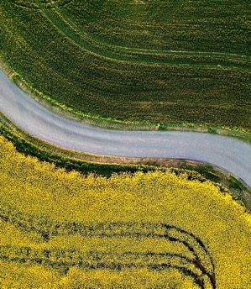
Exploring regional heterogeneity in Food Systems Transformation: A multi-model ensemble perspective
Presented by Thais Diniz Oliveira
June 7th, 2024

Slide 2

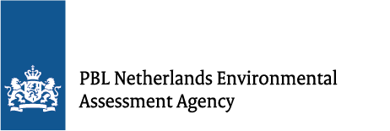










Cornell University Thais Diniz Oliveira Marina Sundiang Daniel Mason-D’Croz Matthew Gibson Mario Herrero | European Commission Joint Research Centre (JRC) Jordan Hristov Ignacio Pérez Domínguez Gianmaria Tassinari Ferike Thom | International Food Policy Research Institute (IFPRI) Abhijeet Mishra Timothy Sulser Shahnila Dunston Keith Wiebe | International Institute for Applied Systems Analysis (IIASA) Petr Havlik Marta Kozicka | National Institute for Environmental Studies & Kyoto University Kazuaki Tsuchiya Shinichiro Fujimori Tomoko Hasegawa Kiyoshi Takahashi
Netherlands Environmental Assessment Agency (PBL) Jonathan Doelman Elke Stehfest Detlef Van Vuuren | Potsdam Institute for Climate Impact Research (PIK) Felicitas D. Beier Alexander Popp Hermann Lotze-Campen David Meng-Chuen Chen Jake Tommey Isabelle Weindl Benjamin Leon Bodirsky | Purdue University Maksym Chepeliev Dominique van der Mensbrugghe Lauren Benavidez | U.S. Department of Agriculture Ronald Sands | Wageningen University Marijke Kuiper Willem-Jan van Zeist Hans van Meijl Thijs de Lange
Jonas Jägermeyr Gerald Nelson Marco Springmann Philip Thornton
This work was supported in part by Cornell Atkinson Center for Sustainability.
This work was supported in part by the Bill and Melinda Gates Foundation.
This research was supported in part by the U.S. Department of Agriculture, Economic Research Service. The findings and conclusions in this publication are those of the authors and should not be construed to represent any official USDA or U.S. Government determination or policy.
Part of Cornell’s work leading on the modelling assessment for EAT-Lancet Commission 2.0

Slide 3
Note: This is an on-going research project
Results presented today are preliminary and are not for citation

Slide 4
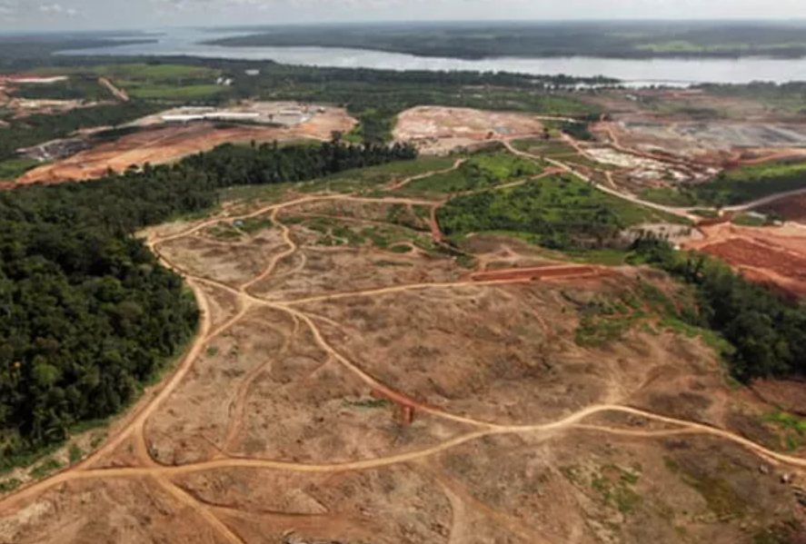
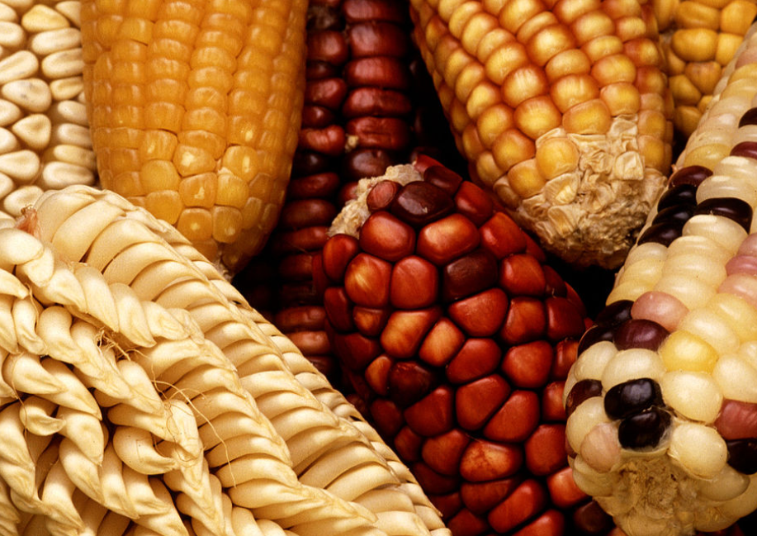
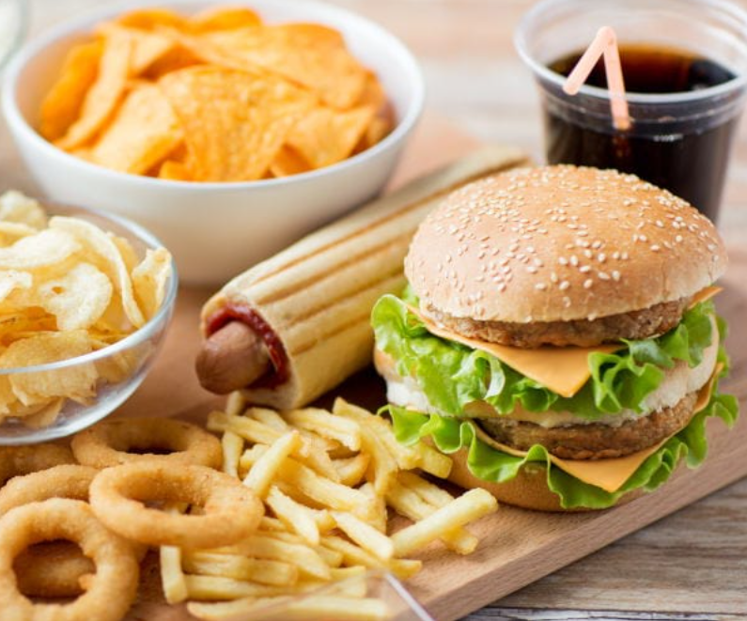
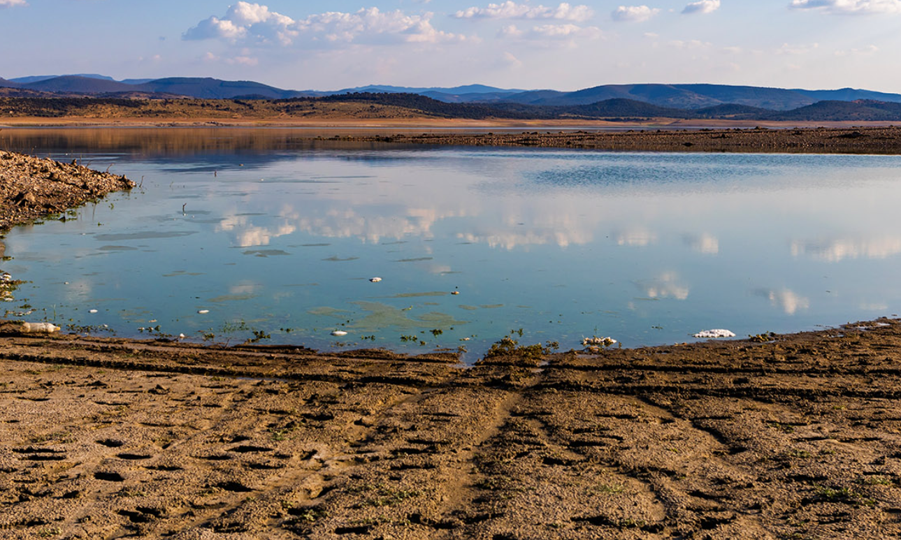
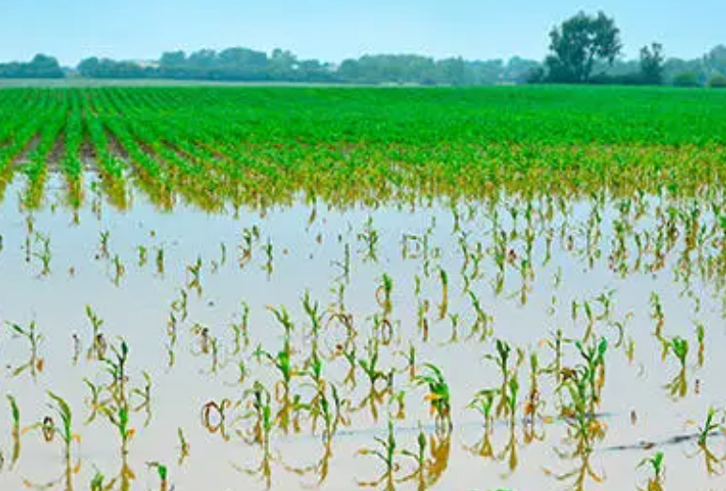

Current food systems require urgent transformation
Degradation of terrestrial and aquatic ecosystems (Costa-Pierce et al., 2022)
Biodiversity loss (Benton et al., 2021)
Current dietary patterns are failing to nourish people (Gonzalez Fischer & Garnett, 2016)
Inequalities
Land
Affordability
Depletion of water resources (Ringler et al., 2022)
Climate change (Clark et al., 2020; Holden et al., 2018),
Malnutrition in all its forms and other dietary risks are a leading cause of global poor health (Swinburn et al., 2019)
Notes:
Malnutrition (e.g., stunting, obesity, NCDs, etc.)
Current food systems require urgent transformation: more sustainable, inclusive of the poor and marginalized populations, healthy and climate-resilient
Although small farms make up 72 per cent of all farms, they occupy just 8 per cent of all agricultural land. In contrast, large farms – which account for only 1 per cent of the world’s farms – occupy 65 per cent of agricultural land. This gives large farms disproportionate control, and there is little incentive to develop technologies that could benefit resource-poor small-hold farmers, including those in developing countries.
At the other end of the food supply chain, food that is affordable to the poor may be energy-dense but is often nutrient poor. Micronutrient deficiencies may impair cognitive development, lower resistance to disease, increase risks during childbirth and, ultimately, affect economic productivity. The poor are effectively disadvantaged both as producers and consumers.

Slide 5
Exploring Regional Heterogeneity in Food Systems Transformation: A Multi-model Ensemble Perspective
Current dietary patterns and food production have been closely associated with and affected by the degradation of terrestrial and aquatic ecosystems (Costa-Pierce et al., 2022), significant depletion of water resources (Ringler et al., 2022), biodiversity loss (Benton et al., 2021) and climate change (Clark et al., 2020; Holden et al., 2018), being food systems responsible for a third of global anthropogenic Greenhouse Gas (GHG) emissions (Crippa et al., 2021).
Unsustainable food systems fail to nourish people adequately (Gonzalez Fischer & Garnett, 2016), with malnutrition in all its forms, and other dietary risks being a leading cause of poor health globally (Swinburn et al., 2019).
Reshaping food systems towards more sustainable, inclusive of the poor and marginalized populations, healthy and climate-resilient futures is urgent.

Slide 6





Exploring Regional Heterogeneity in Food Systems Transformation: A Multi-model Ensemble Perspective
The EAT-Lancet 1.0 report was published in 2019 (Willett et al., 2019). It explored critical aspects of the food systems and their connection: healthy diets, human health, environmental sustainability and necessary actions to achieve such a transformed food system.
How regional economies respond to achieving a healthy diet and to what extent such transition reshapes the future socioeconomic and environmental trajectories?
Challenges
Exposure
Opportunities
Notes:
Built on the EAT-Lancet 2.0 report

Slide 7
Exploring Regional Heterogeneity in Food Systems Transformation: A Multi-model Ensemble Perspective
Region | Full name
CAN | Canada
USA | United States
BRA | Brazil
CHN | China
IND | India
OSA | Other South and Central America
EUR | Europe
FSU | Former Soviet Union
MEN | Middle East and North Africa
SSA | Sub-Saharan Africa
SEA | South-East Asia
OAS | Other Asia
ANZ | Australia and New Zealand
WLD | World
Based on modelling protocols developed as part of the Agricultural Model Intercomparison and Improvement Project (AgMIP).
Notes:
Multi-model ensemble: allows to map drivers of change, and navigate the complexities and uncertainties of the pathways to achieving healthy diets by 2050 based on dynamic responses (a key distinction between from previous modelling efforts).

Slide 8
Exploring Regional Heterogeneity in Food Systems Transformation: A Multi-model Ensemble Perspective
BAU
Business as usual scenario based on SSP2 with a higher climate impact reflected by RCP 7.0
BAU Productivity changes
EL2
Full EAT-Lancet Scenario, without mitigation and with higher climate impacts based on RCP 7.0
BAU climate and land policies based on NPi
EL2 diet achieved by 2050
BAU assumptions on diet by 2050
High productivity growth rate (SSP1)
Reduction of FLW
BAU climate and land policies based on NPi
BAU assumption on FLW
Reduced food loss and waste
Productivity trends
Dietary shift
Crop: Jägermeyr et al. (2021)
Livestock: Thornton et al. (2022)
Labor: Nelson et al. (2024)
Data on food consumption categorized by food group and region for both the benchmark and flexitarian diet updated from EAT-Lancet 1.0
Consumer preference shift starting in 2020 and simulated as a linear transition to healthy diets by 2050
Notes:
As a reminder, this has been represented as a combination of the 3 components, and dietary shifts have been achieved through consumer preference shifts across the ensemble (getting the changes for free).
Crop: Using IPSL GCM Average of GGCMI crop model ensemble (RCP 7.0) for soybean, maize, wheat, and rice.
Livestock productivity shocks (RCP 7.0) from Thornton et al. (2022) based on changes in higher temperatures.
High productivity growth rate consistent with SSP1 productivity trends

Slide 9
How does BAU 2050 look like from a regional perspective?
GDP is growing faster than the population and doubling by 2050.
More optimistic income increase in Low-middle-income regions: SSA [+240 to +425%], IND [+231 to +301%] and OAS [+150 to +302%] compared to EUR [+52 to +63%] and USA [+57 to +62%]

Slide 10
How does BAU 2050 look like from a regional perspective?
GDP is growing faster than the population and doubling by 2050.
More optimistic income increase in Low-middle-income regions: SSA [+240 to +425%], IND [+231 to +301%] and OAS [+150 to +302%] compared to EUR [+52 to +63%] and USA [+57 to +62%]
Global agricultural production is increasing
SSA (+111%), MEN (+81%) and OAS (+80%). SSA: trends are driven by increases in crops [+70 to +136%] and livestock production [+63 to +152%] and result from productivity increases of similar magnitudes in the sectors
Notes:
Global agricultural production is increasing by 35% [+22 to +44%]
These are the regions where food consumption is increasing the most:
CRP - SSA (95%), OAS (52%), MEN (37%), in addition to IND (31%).
LSP - SSA (134%), OAS (72%), MEN (59%), in addition to IND (52%).
CHN the median only increases for LSP consumption (+12%) and slightly decreases for CRP (-5%)

Slide 11
How does BAU 2050 look like from a regional perspective?
GDP is growing faster than the population and doubling by 2050.
Global trade increases by a third of its 2020 size
More optimistic income increase in Low-middle-income regions: SSA [+240 to +425%], IND [+231 to +301%] and OAS [+150 to +302%] compared to EUR [+52 to +63%] and USA [+57 to +62%]
The top exporting regions are OSA (17%), BRA (15%), EUR (13%) and USA (11%).
Global agricultural production is increasing
SSA (+111%), MEN (+81%) and OAS (+80%). SSA: trends are driven by increases in crops [+70 to +136%] and livestock production [+63 to +152%] and result from productivity increases of similar magnitudes in the sectors
Notes:
Global trade increases: suggest a more interconnected food system by 2050.

Slide 12
How does BAU 2050 look like from a regional perspective?
GDP is growing faster than the population and doubling by 2050.
Global trade increases by a third of its 2020 size
More optimistic income increase in Low-middle-income regions: SSA [+240 to +425%], IND [+231 to +301%] and OAS [+150 to +302%] compared to EUR [+52 to +63%] and USA [+57 to +62%]
The top exporting regions are OSA (17%), BRA (15%), EUR (13%) and USA (11%).
Global agricultural production is increasing
Overall use of natural resources is increasing
Area expansion in SSA [+10% to +48%], SEA [-2% to +29%], OSA [+7 to +20%] and OAS [+1 to +33%]
Loss in forest cover across all regions
Increases in emissions, particularly in LMIs, being livestock production the primary driver.
Regional example: median agricultural land use increases by 17% in SSA, reducing forests and other natural vegetation [+25% to +10%], increasing total emissions [+24% to + 227%]; for crop-related emissions, increases [51% to 118%] are due to intensified use of fertilizer [+60% to +192%]
SSA (+111%), MEN (+81%) and OAS (+80%). SSA: trends are driven by increases in crops [+70 to +136%] and livestock production [+63 to +152%] and result from productivity increases of similar magnitudes in the sectors
Notes:
Use of natural resources: increase to sustain the expanding food system, potentially placing an environmental burden on people and the planet.
Global harvested area expands [+5% to +13%] (Sundiang et al.) as well as the land dedicated to the agricultural sector [+3%-13%], increasing the median greenhouse gas emissions by +37% [+19% to +107%] globally.
Livestock production as a primary driver of increases in emissions in LMI regions: uncertainties in terms of magnitude.

Slide 13
How does EL2 2050 look like compared to BAU 2050?
Lower calory availability and food demand in all regions
  Lower prices everywhere, despite uncertainties in the magnitude
The largest reductions are in the USA (-29%), SSA (-24%), BRA (-21%), CAN (-20%), and ANZ (-17%), mostly due to a reduction in livestock.
However, all regions need to consume more vegetables, fruits and nuts, and oilseeds, and less of the other food groups, except:
  BRA for OSD (-4%)
  ANZ for RIC (+10%)
  IND for NRM (+14%)
Two of five models suggest positive changes in VFN prices across all regions:
  OAS (+16%)
  SEA (+16%)
  IND (+1%)
  A smaller food system
The largest reductions in agricultural production occur in the USA (-38%), EUR (-33%), CAN (-30%), BRA (-29%) and ANZ (-27%).
Top 3 producers with the largest share of global agricultural production: CHN (+16%), SSA (+14%) and IND (+12%).
Notes:
IND, SSA, OAS are the regions with lower reductions in calo from livestock
CALO: in the USA (-32%), ANZ (-29%), BRA (-26%), EUR (-24%), MEN (-24%) and SEA (-24%), mostly due to reduction in livestock.
CHN also significantly reduces LSP consumption (-50%).
Prices: uncertainties especially for LSP – IND has the lowest reduction (-11%).
VFN: lower model agreement on the direction and magnitude of price changes.
Falling prices potentially make healthy diets more affordable.
VFN: All regions need to consume by 2050, but the EL2 show that it wouldn’t still be enough.
BRA: it gets what is needed by 2050, overshooting, that’s why it reduces in EL2 2050.
Other reductions: IND is the region that adjusts the least in terms of red meat consumption (-8%) compared to BAU 2050.
Pojections also show significant production declines for BRA (-29%) and OSA (-25%). These changes result in a slight reduction in their contribution to global food production, counterbalanced by increases in other regions. However, the top three producers with the largest production share remain unchanged, CHN (+16%), SSA (+14%) and IND (+12%) as changes in the food systems are taking place simultaneously worldwide

Slide 14
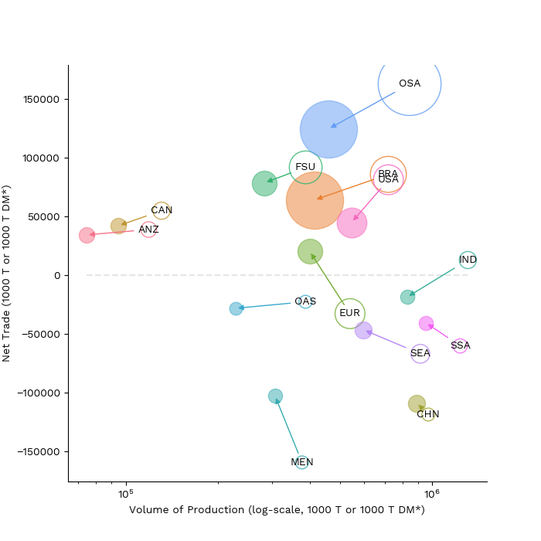
Production and international trade
Relationship between international trade and production
Notes:
By 2050, global agricultural exported volumes decline in the EL2 scenario by 23% compared to BAU 2050. In this smaller export market, certain regions become more dominant. Global Food systems transformation offers trade opportunities to CHN, SEA, MEN and SSA by reducing trade deficits while for EUR it implies a shift towards increased exports that leads to a trade surplus

Slide 15
Production and international trade
There are trade opportunities in this smaller trade market :
  CHN, SEA, MEN and SSA reduce net trade
  EUR shifts towards increased exports
Food systems transformation represents a median gain in BRA’s international food market share from 14% in BAU 2050 to 19% in EL2.
This results in a 5-pp increase in the export share of OSD and VFN under EL2 compared to BAU 2050, offsetting the drop in the cereal’s share from 29% to 22%.
CHN responds for the largest VFN share of the export food basket across all regions.
But EL2 also creates opportunity costs in producing and exporting more VFN in IND, increasing its global share of exports from 8% to 12%.
Relationship between international trade and production
Notes:
By 2050, global agricultural exported volumes decline in the EL2 scenario by 23% compared to BAU 2050.
CHN holds the largest share of the global volume of food production in the ensemble (Table 1), with a median of 28%, and accounts for approximately 5% of global agricultural exports, a 2-percentage point (pp) increase from BAU 2050.
SSA and SEA are also key agricultural producers worldwide, responding to 25% of the global agricultural production but only contributing to 9% of global agricultural exports.
OSD serve as an important nutritional source, also used in animal feed Despite decreased demand for livestock production and subsequently production that reduces the need for animal feed, healthy diets include a daily consumption of oilseeds.

Slide 16
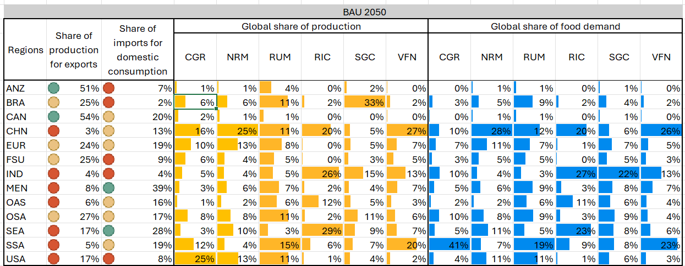
Regional profile

Slide 17
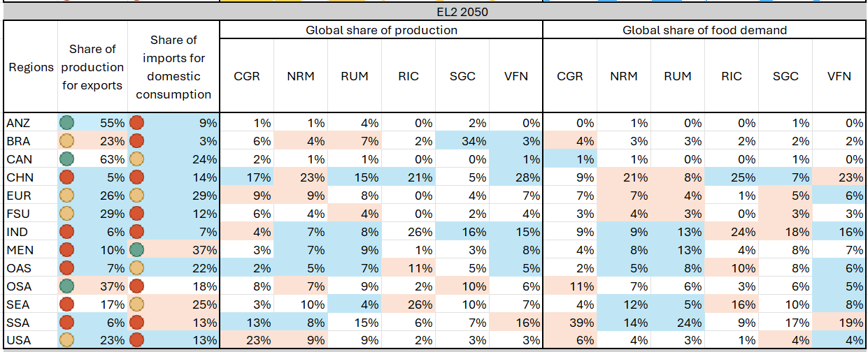
Regional profile
Decreasing | Increasing | No change
Notes:
Most regions see an increase in their share of production that is exported.

Slide 18
Emissions and area in EL2 2050 compared to BAU 2050
Regions | Area |  |  |  |  |  |  |  |  | Total GHG emissions
 | Agriculture |  |  | Cropland |  |  | Pasture
 | Median | Min | Max | Median | Min | Max | Median | Min | Max | Median | Min | Max
ANZ | -3 | -64 | -1 | -6 | -51 | 26 | -14 | -68 | 3 | -49 | -48 | -76
BRA | -39 | -63 | -2 | -12 | -53 | -2 | -51 | -75 | -7 | -62 | -78 | -68
CAN | -7 | -39 | 0 | -4 | -33 | 10 | -49 | -64 | 84 | -42 | -46 | -58
CHN | -4 | -48 | 1 | -2 | -50 | 7 | -10 | -63 | 8 | -36 | -35 | -50
EUR | -14 | -54 | 21 | -4 | -63 | 21 | -36 | -62 | -2 | -46 | -53 | -42
FSU | -8 | -44 | 3 | -2 | -62 | 13 | -15 | -57 | 6 | -23 | -38 | -27
IND | -5 | -19 | -1 | -4 | -19 | 8 | -11 | -31 | 15 | -48 | -26 | -27
MEN | -6 | -37 | -2 | 0 | -29 | 9 | -6 | -49 | -2 | -46 | -27 | -43
OAS | -5 | -21 | -2 | -4 | -37 | 8 | -3 | -45 | 5 | -32 | -32 | -39
OSA | -29 | -52 | -3 | -4 | -60 | -1 | -40 | -64 | 3 | -58 | -70 | -59
SEA | -11 | -47 | -5 | -13 | -38 | -2 | -18 | -60 | 21 | -40 | -14 | -60
SSA | -17 | -46 | -2 | -9 | -35 | 13 | -18 | -55 | 3 | -51 | -21 | -56
USA | -16 | -55 | -4 | -7 | -60 | 32 | -43 | -73 | 0 | -56 | -47 | -37
WLD | -9 | -46 | -3 | -5 | -38 | 3 | -22 | -61 | 3 | -43 | -40 | -53
Notes:
Agricultural land use is reducing everywhere but particularly in BRA (-31%), with uncertainties in the magnitude
Land use in grasslands reduces between -7% (OAS) to -49% (USA)
Projections for BRA in the EL2 scenario indicate a substantial and the largest median decrease in harvested area (-39%), with changes from BAU in 2050 ranging from -63% to -2%, mostly driven by higher crop yields [-22% to 58%] from lower fertilizer use. In OSA, there is a similar downward trend in the total area used for agricultural production, with variations across models ranging from -52% and -4%. There is an overall agreement regarding the changes in the total area occupied by agricultural production in IND, with a median decrease of 5%. Lower usage of fertilizer input decreases the median yields by 14% while reducing total nitrogen emissions by -25%.

Slide 19


Regional comparison
Next step...
Food systems transformation
Vulnerability
Dependency on key food groups
Vulnerability
(attributes)
Exposure
Exposure
Employment effects on the livestock sector: CHN (-78%), OSA (-65%), BRA (-65%), and ANZ (-62%) Environmental effects: BRA (-62%), OSA (-58%), USA (-56%) and SSA (-51%)
- Sensitiveness
- Capacity
- People
- Livelihoods
- Resources
Actions
In progress: Final submission of results using updated inputs
Coupling with Mitigation
Benefits
CHN SSA
Notes:
Vulnerability is a highly theoretical, contextual and place-specific concept
Coping and adaptive capacity are integral characteristics of vulnerability as “vulnerability is related both to the differential exposure and sensitivity of communities to stimulus such as climate change and also to the particular adaptive capacities of those communities to deal with the effects or risks associated with the exposures” (see Paloviita et al. 2017).
the most important element of reducing vulnerability is to enhance the adaptive capacity of people, at various levels of decision-making from the individual up to the national and regional.
- establishing safety net programmes for the most vulnerable households
- insurance may be an increasingly important way to help smallholders become more resilient (Thornton et al 2014)

Slide 20
References
Benton, T. G., Bieg, C., Harwatt, H., Pudasaini, R., & Wellesley, L. (2021). Food system impacts on biodiversity loss: Three levers for food system transformation in support of nature. Chatham House, London.
Clark, M., Macdiarmid, J., Jones, A. D., Ranganathan, J., Herrero, M., & Fanzo, J. (2020). The role of healthy diets in environmentally sustainable food systems. Food and Nutrition Bulletin, 41(2_suppl), 31S-58S.
Costa-Pierce, B. A., Thorarensen, H. T., & Strand, Å. (2022). Editorial: Ocean/aquatic food systems: Interactions with ecosystems, fisheries, aquaculture, and people. Frontiers in Sustainable Food Systems, 6,
Crippa, M., Solazzo, E., Guizzardi, D., Monforti-Ferrario, F., Tubiello, F. N., & Leip, A. (2021). Food systems are responsible for a third of global anthropogenic GHG emissions. Nature Food, 2(3), 198–209.
Gonzalez Fischer, C., & Garnett, T. (2016). Plates, pyramids, planet. FAO/FCRN.
Holden, N. M., White, E. P., Lange, Matthew. C., & Oldfield, T. L. (2018). Review of the sustainability of food systems and transition using the Internet of Food. Npj Science of Food, 2(1), 18.
Jägermeyr, J., Müller, C., Ruane, A. C., Elliott, J., Balkovic, J., Castillo, O., Faye, B., Foster, I., Folberth, C., Franke, J. A., Fuchs, K., Guarin, J. R., Heinke, J., Hoogenboom, G., Iizumi, T., Jain, A. K., Kelly, D., Khabarov, N., Lange, S., … Rosenzweig, C. (2021). Climate impacts on global agriculture emerge earlier in new generation of climate and crop models. Nature Food, 2(11), 873–885.
Nelson, G. C., Vanos, J., Havenith, G., Jay, O., Ebi, K. L., & Hijmans, R. J. (2024). Global reductions in manual agricultural work capacity due to climate change. Global Change Biology, 30(1), e17142. Ringler, C., Agbonlahor, M., Barron, J., Baye, K., Meenakshi, J. V., Mekonnen, D. K., & Uhlenbrook, S. (2022). The role of water in transforming food systems. Global Food Security, 33, 100639.
Springmann, M., Clark, M., Mason-D’Croz, D., Wiebe, K., Bodirsky, B. L., Lassaletta, L., de Vries, W., Vermeulen, S. J., Herrero, M., Carlson, K. M., Jonell, M., Troell, M., DeClerck, F., Gordon, L. J., Zurayk, R., Scarborough, P., Rayner, M., Loken, B., Fanzo, J., … Willett, W. (2018). Options for keeping the food system within environmental limits. Nature, 562(7728), 519–525.
Swinburn, B. A., Kraak, V. I., Allender, S., Atkins, V. J., Baker, P. I., Bogard, J. R., Brinsden, H., Calvillo, A., De Schutter, O., Devarajan, R., Ezzati, M., Friel, S., Goenka, S., Hammond, R. A., Hastings, G., Hawkes, C., Herrero, M., Hovmand, P. S., Howden, M., … Dietz, W. H. (2019). The Global Syndemic of Obesity, Undernutrition, and Climate Change: The Lancet Commission report. The Lancet, 393(10173), 791–846.
Thornton, P., Nelson, G., Mayberry, D., & Herrero, M. (2022). Impacts of heat stress on global cattle production during the 21st century: A modelling study. The Lancet Planetary Health, 6(3), e192–e201.
Willett, W., Rockström, J., Loken, B., Springmann, M., Lang, T., Vermeulen, S., Garnett, T., Tilman, D., DeClerck, F., Wood, A., & others. (2019). Food in the Anthropocene: The EAT–Lancet Commission on healthy diets from sustainable food systems. The Lancet, 393(10170), 447–492.

Slide 21









GTAP CONFERENCE 2024
Thank you
Thais Diniz Oliveira | tdo27@cornell.edu
Thais Diniz Oliveira | tdo27@cornell.edu
www.cals.cornell.edu/food-systems-global-change
@ThaisDinizOliveira
@ThaisDinizOliv1

Slide 22
Regional changes in food demand in EL2 compared to BAU 2020
 | VFN | OSD | RIC | SGC | RUM | NRM | CGR | DRY
ANZ
BRA
CAN
CHN
EUR
FSU
IND
MEN
OAS
OSA
SEA
SSA
USA
N=8

Slide 23
Regional changes in food demand in EL2 compared to BAU 2050
 | VFN | OSD | RIC | SGC | RUM | NRM | CGR | DRY
ANZ
BRA
CAN
CHN
EUR
FSU
IND
MEN
OAS
OSA
SEA
SSA
USA
N=8
Notes:
ANZ RIC = +10%
BRA OSD = - 4%
IND NRM = +14%

Slide 24
How does BAU 2050 looks like from a regional perspective?
GDP is growing at a faster rate than the population and double by 2050. Low-and-Middle Income (LMI) regions experience a more optimistic income increase (SSA [+240 to +425%], IND [+231 to +301%] and OAS [+150 to +302%]) compared to EUR [+52 to +63%] and USA [+57 to +62%], with higher model agreement on these changes.
Global agricultural production is increasing and distributed across regions: SSA (+111%), MEN (+81%) and OAS (+80%). SSA: trends are driven by increases in crops (+70 to +136%) and livestock production (+63 to +152%) and result from productivity increases of similar magnitudes in the sectors.
Global trade increases by a third of its 2020 size, expanding across all regions and suggesting a more interconnected food system by 2050. Top exporting regions are OSA (17%), BRA (15%), EUR (13%) and USA (11%).
The multi-model ensemble indicates a rise in the overall use of natural resources to sustain the expanding food system in the BAU scenario, potentially placing an environmental burden on people and the planet.
  In this larger global food system, harvested area expands [+5% -13%] (Sundiang et al.), especially in SSA [+10% to +48%], SEA [-2% to +29%], OSA [+7 to +20%] and OAS [+1 to +33%], and therefore, the total land dedicated to the agricultural sector [+3%-13%], increasing the median greenhouse gas emissions by +37% [+19% to +107%] globally.
  There is a loss in forest cover across all regions under the BAU scenario.
  Regionally, the largest increases in emissions originate from LMICs and align in showing that the primary driver is livestock production, although with uncertainties in terms of magnitude. For instance, in SSA agricultural land use increases by a median of 17% at the costs of forests and other natural vegetation, which decrease between 25% and 10%.

Slide 25
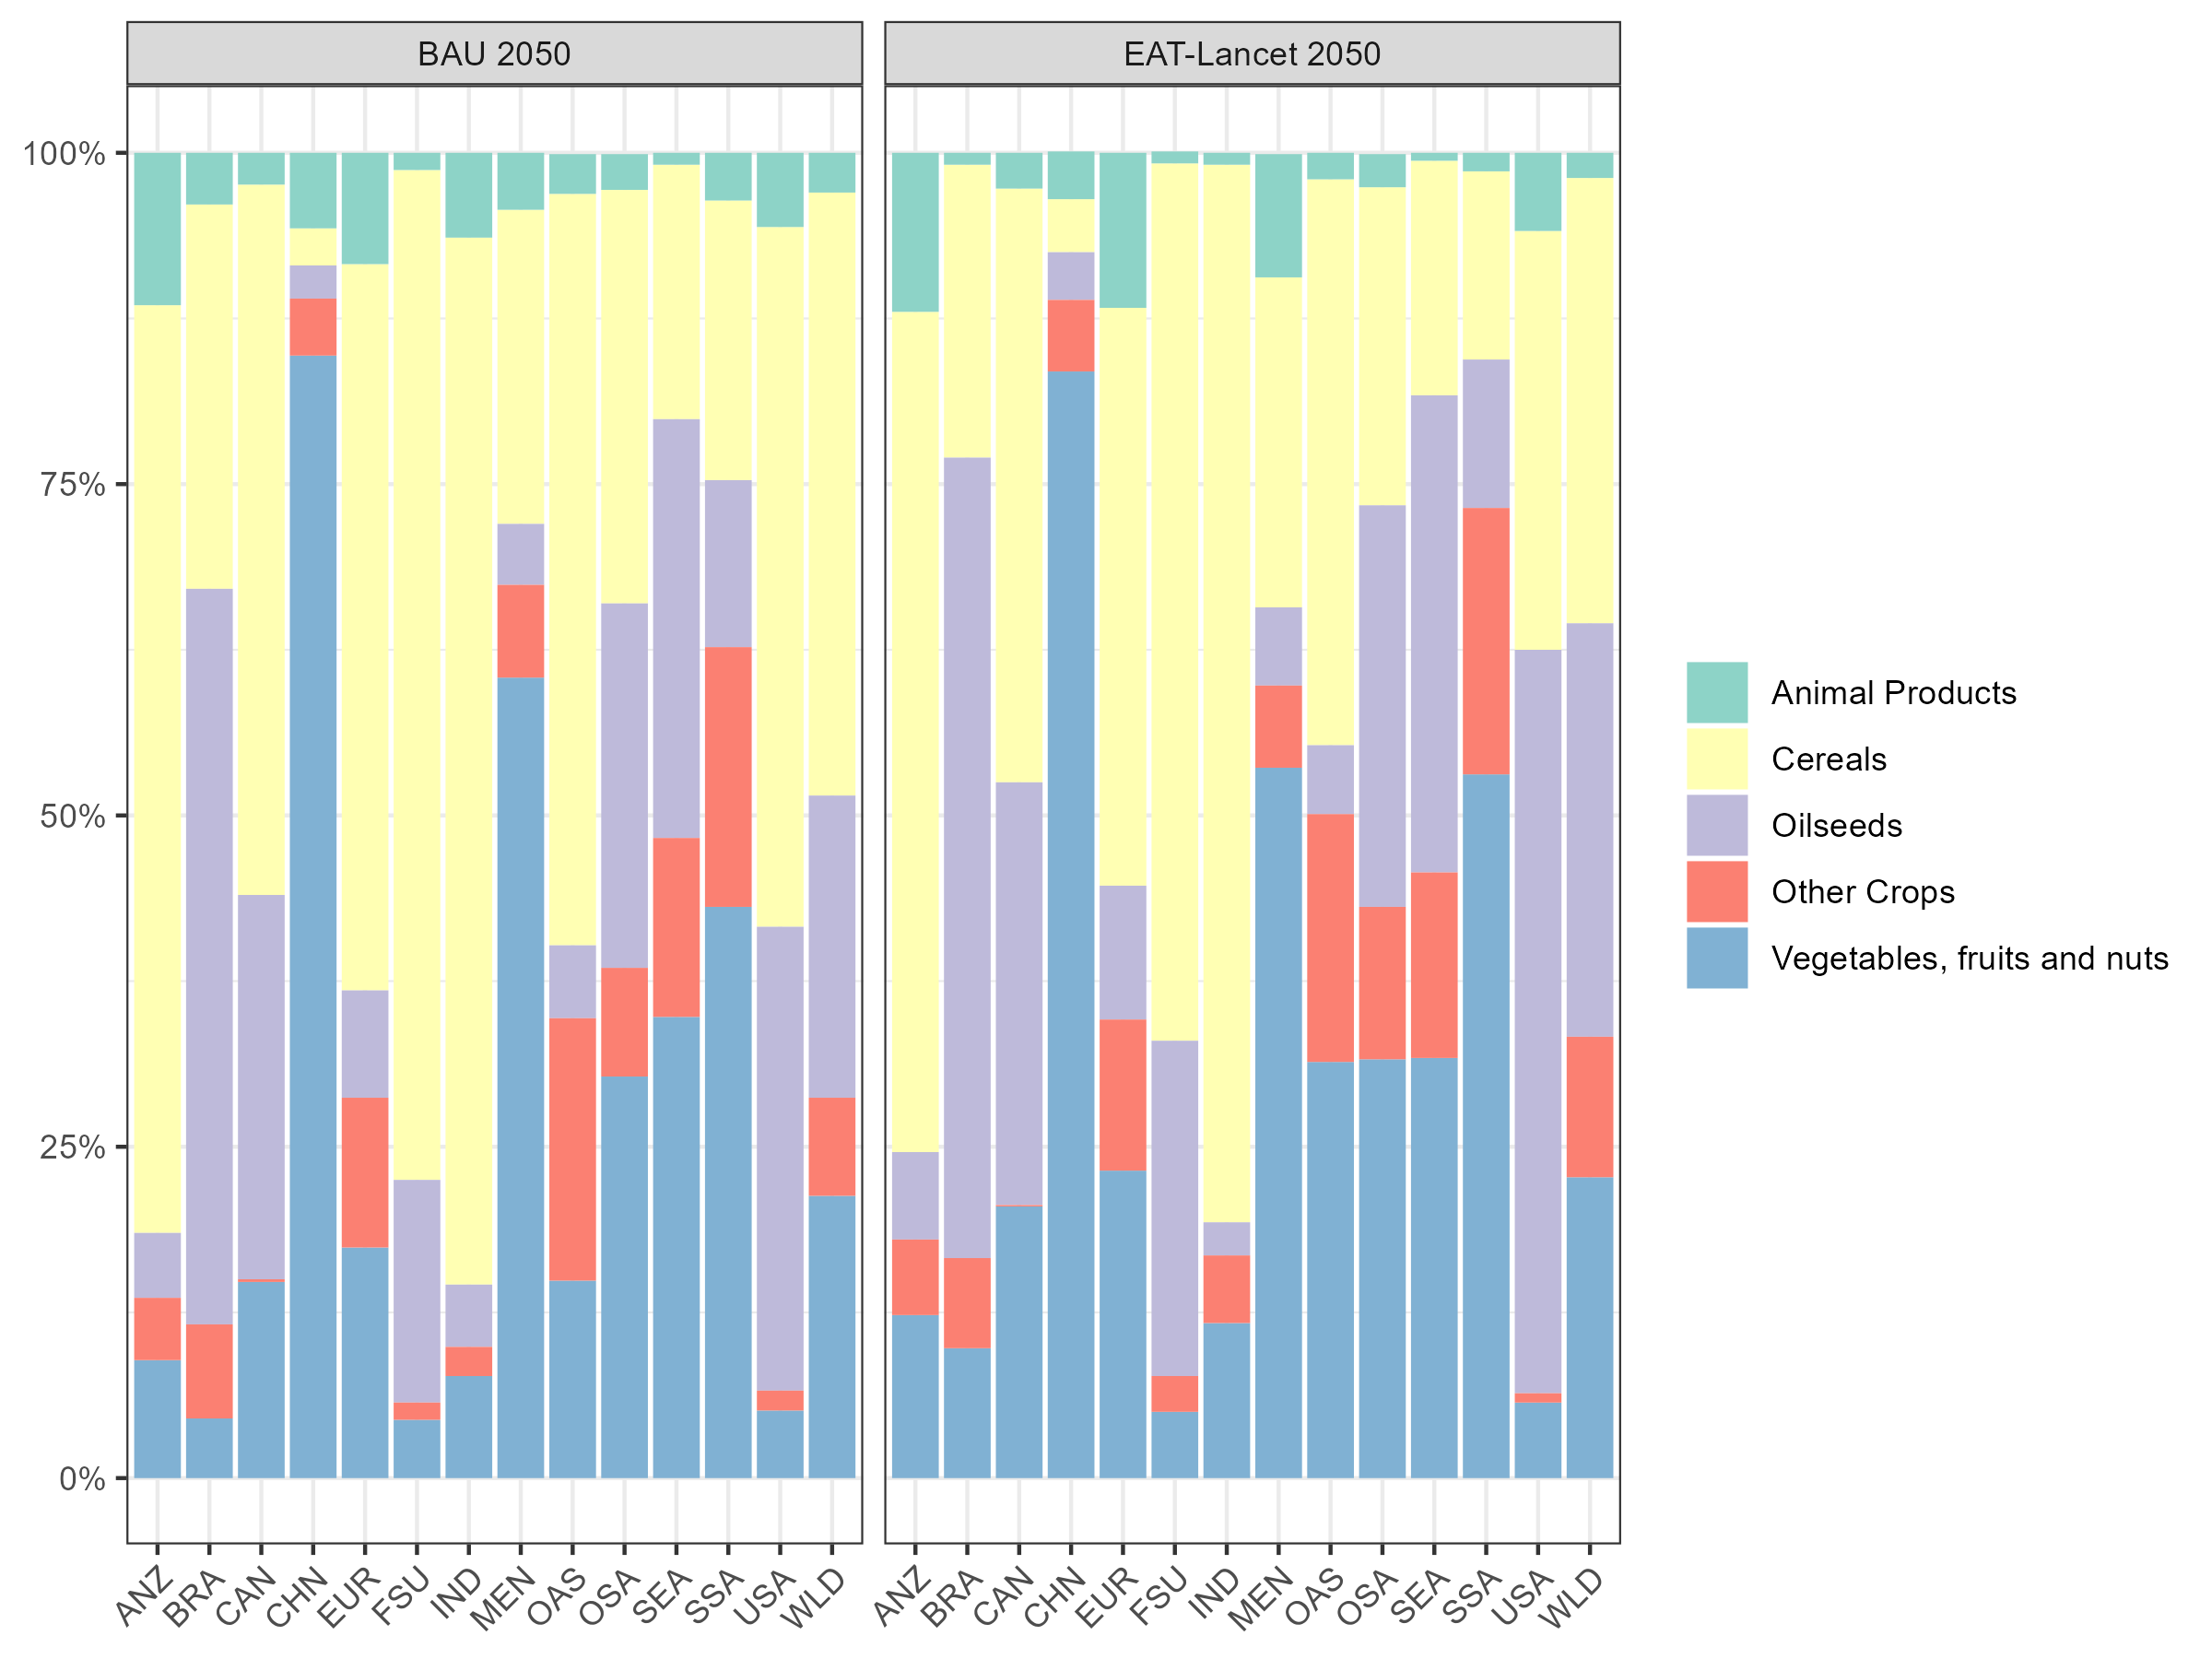
Production and international trade
Relationship between international trade and production
Exports composition
Notes:
By 2050, global agricultural exported volumes decline in the EL2 scenario by 23% compared to BAU 2050. In this smaller export market, certain regions become more dominant. Global Food systems transformation offers trade opportunities to CHN, SEA, MEN and SSA by reducing trade deficits while for EUR it implies a shift towards increased exports that leads to a trade surplus

