Slide 1
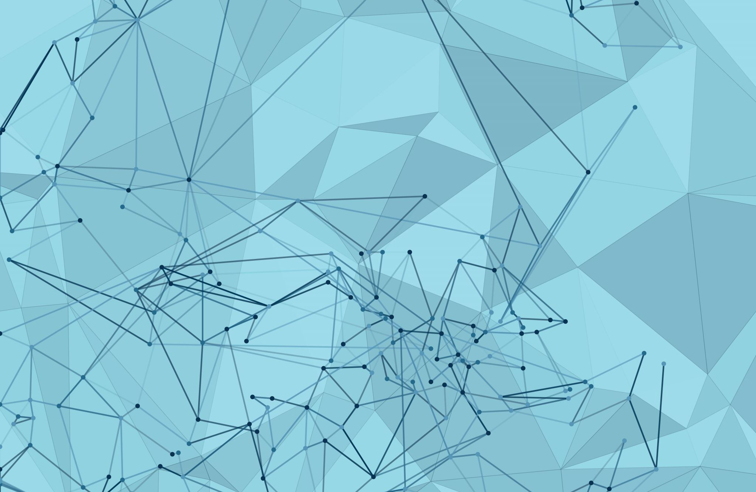

Evaluating Inclusive Growth Model: Case for Pakistan
Author: Jazib Mumtaz, PhD
Co-Author: Sayed Irshad Hussain, PhD
Karachi, Pakistan

Slide 2
Table of Contents
Introduction
Background & Motivation
Objectives
Contribution/Research Gap
Methodology
Related Literature
Theoretical Framework
Scenarios
Results & Discussion
Conclusion

Slide 3
Introduction
Trickle-down Economics in Pakistan
Policies focused on privatization, deregulation, and reduced social spending
Increased GDP but worsened poverty, inequality, and unemployment
Benefits of growth remained concentrated among the wealthy
Banerjee (2025) highlights the importance of factors beyond GDP growth in reducing poverty, focusing on income inequality and the concentration of wealth among the wealthy.

Slide 4
Motivation and Background
Uneven growth patterns in Pakistan over the last 20 years
Periods of high growth linked with increased inequality
Need for policies that balance growth and equity
Source: Author’s calculation

Slide 5
Objectives
Trickle-down economics has failed to deliver its promises in Pakistan due to various reasons. One of the main criticisms is that the benefits of economic growth, tax cuts, and deregulation have remained concentrated in the hands of the already wealthy, exacerbating income inequality.
Trickle-down economics have led to a reduction in government spending and social welfare programs, which negatively impacted the well-being of vulnerable populations (Atif et al., 2012).
Pakistan has seen uneven growth patterns for many years. In the era of high growth income inequality was seen elevated. On the other hand, when the focus was given to social spending, growth was found to be hurt.
The objective of the study is to develop a sustainable growth model by evaluating the impact of liberal policies and socioeconomic policies on macro indicators and households.

Slide 6
Contribution/Research Gap
Methodological Gap
Most of the studies have measured the household determinants of poverty alleviation and income inequality through panel data or at a single point in time
No study have analyzed the structural change impact of two different policies in Pakistan
The study is based on household level to analyze the impact of income distribution
The study would provide a testing framework to create an inclusive growth model through which sustainable growth can be achieved along with improving income distribution

Slide 7
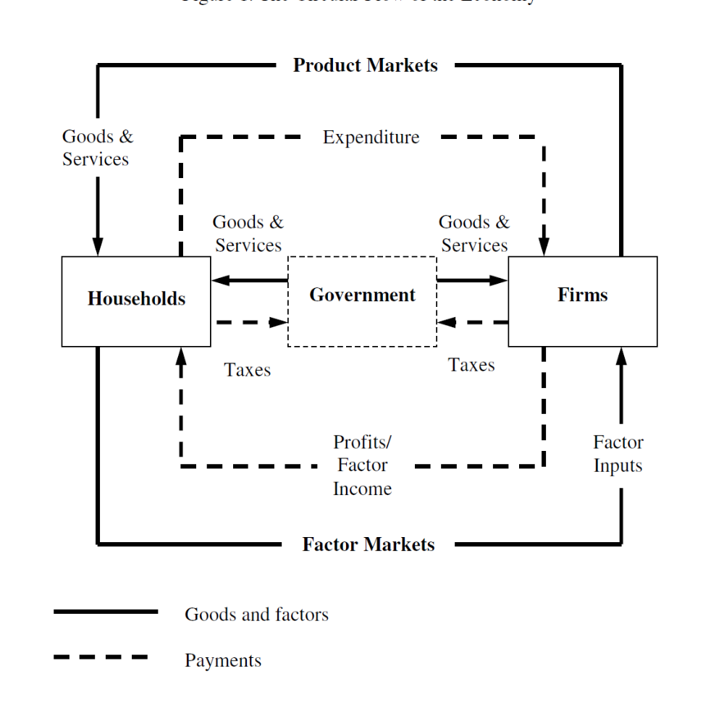
Methodology
General equilibrium theory is based on the Walrasian model of equilibrium.
Walrasian Equilibrium
The Circular Flow and Walrasian Equilibrium
Equilibrium and Social Accounting Matrix
SAM to a CGE Model:

Slide 8
Related Literature
Tirmazee and Haroon (2015) analyzed the inclusiveness of growth in Pakistan. They estimate inclusive growth with the use of the social welfare index and mobility index. The results of the study revealed that Pakistan’s income grew efficiently but without equity. However, when wealth is taken as an indicator there was neither efficiency nor equity, therefore growth in Pakistan was not inclusive.
Sung Hee Jwa (2016) explained various reasons to achieve sustained indigenous and inclusive growth. The author discussed the role of markets, corporations, and government in achieving inclusive growth.
Zaidi (2006) discussed the nature of growth in Pakistan during the 2004-05. He analyzed the trend and assessed the issues related to high growth rate during the era of military government in Pakistan. He pointed out high inequality, increasing trade deficits and inflation as some of the few indicators in a high growth economy. Social expenditures have remained to be lower as percentages of GDP whereas military expenditure continues expand.
Lechheb et al. (2019) analyzed the relationship among economic growth, poverty and inequality. The results revealed that increase in inequality could decrease GDP per capita. One percent increase in Gini index and poverty gap would reduce GDP per capita by 3.8% and 6.8% respectively.

Slide 9
Theoretical Framework-Capability Theory:
The theoretical framework of this thesis is based on the works of Nobel Laurate Amritya Sen. His theory of Capability Approach provides the basis of human development and sustainable growth. The Capability approach is defines as theoretical framework that involves two approaches. The first approach entails that human beings are free to achieve well-being which has a primary importance. The second approach pertains to the understanding of well-being in terms of person’s capabilities and functioning
Capabilities are doings and beings that a person can achieve if he chooses to such as getting education, fulfillment of nourishments, getting married and so on. Functioning are capabilities that have been comprehended (Sen, 1990).
Resources
Capabilities
Functioning
Utility
Income
Access
Use of services
Satisfaction
Income Distribution
Access
Use of services
Satisfaction
Even Distribution
Sustainable Development
Poverty Alleviation

Slide 10
My GTAP Model
The MyGTAP model allows more flexibility in the treatment of households and government behavior through the removal of the representative regional household from the standard GTAP model. MyGTAP model with additional data for Pakistan has been taken from (Amir, Khan., Walmsley, Terrie., & Mukhopadhay, Kakali 2020).
The MyGTAP framework also allows for additional factors of production and multiple private households to be added for one or more countries using additional data supplied from a social accounting matrix (SAM) or household survey. These data are incorporated into the augmented MyGTAP framework using a facility developed by Minor and Walmsley (2013).
Data for 16 household types (or representative households)5 and 12 factors of production are incorporated into this database using data obtained from the 2010 11 Pakistani SAM (IFPRI, 2016).6 The framework, developed by Minor and Walmsley (2013), incorporates the household data into GTAP, ensuring that the household data are consistent with the original GTAP data
The 16 types of household provided in the Pakistani SAM classify households by geographical zone and type of settlement (i.e., rural or urban) Household types are based on land ownership and the size of the land owned. For instance, medium rural farms are greater than 12.5 acres, and small farms are those less than 12.5 acres. Landless farmers own no land, but may operate land on an owners behalf, thereby receiving rents from land (IFPRI, 2016).
The households are ordered by per capita income. Rural farm worker (quartile 1) and rural non-farm worker (quartile 1) households account for 14 percent of the population and have the lowest per capita incomes – when converted to US Dollars, their annual per capita income is just US$ 240 and US$ 332 respectively. Urban (quartile 4) households have the highest per capita incomes, over US$ 4,423. An examination of the data reveals that 89 percent of the poor households (defined as earning less than $2 per day) are rural, split (roughly) equally between farm and non-farm households. The three richest household categories are primarily (65 percent) urban households, followed by rural non-farm households (24 percent).

Slide 11
Research Scenarios & Model Closure
The objective was to analyze the impact of poverty alleviation and income distribution policies on sustainable economic development. Pakistan had seen uneven growth patterns for many years. In the era of high growth income inequality was seen elevated
On the other hand, when the focus was given to social spending, growth was found to be hurt.
To evaluate the impact three types of scenarios were created.
  In the first scenario government’s social spending was increased by 10 percent
  In the second scenario business output was increased by 10 percent.
  In the third scenario business output along with social spending was increased simultaneously by 5 percent and 15 percent.
Output shock(qo) is for Business output and real transfers from govt to households for Social Spending
Model Closure
  variables would include tax, tariff rates, elasticities of supply and demand, and shift and share coefficients used in equations
  Endogenous variables would be welfare, GDP, sectoral output, household income, and inequality
  The model is based on the assumptions that labor and capital are mobile, land and natural resources are sluggish, foreign incomes are dependent on the price change of factor incomes and investments are dependent on the rate of return.

Slide 12
Results
Policy Impact on Macroeconomic Variables - % change
Macro Variable | Social spending | Business Output | Social spending + Output
 | 10% | 10% | 15%/5%
GDP | -0.010 | 2.360 | 1.210
Exports | 0.310 | -0.170 | 0.340
Imports | -0.069 | 3.370 | 1.620
Household income | -0.054 | 2.810 | 1.350
Government expenditure | -0.017 | 1.950 | -0.810
Private expenditure | 0.031 | 2.890 | 1.520
source: Author's simulation

Slide 13
Results
Policy Impact on Household's Real Income - % change
Codes | Household's description | Social spending | Output | Social spending + Output
 |  | 10% | 10% | 15%/5%
hhd_rs1 | Rural small farmer (quartile_1) | 0.78 | 0.67 | 1.40
hhd_rs234 | Rural small farmer (quartile_2,3,4) | 0.38 | 0.55 | 0.73
hhd_rm1 | Rural medium farmer (quartile_1) | 5.14 | 3.91 | 9.62
hhd_rm234 | Rural medium farmer (quartile_2,3,4) | 0.54 | 0.91 | 1.15
hhd_rl1 | Rural farmer landless (quartile_1) | 0.87 | 2.52 | 2.51
hhd_rl234 | Rural farmer landless (quartile_2,3,4) | 0.39 | 1.76 | 1.40
hhd_rw1 | Rural farm worker (quartile_1) | 0.80 | -2.61 | -0.29
hhd_rw234 | Rural farm worker (quartile_2,3,4) | 0.29 | -0.50 | 0.09
hhd_rn1 | Rural non farm (quartile_1) | 0.10 | 3.88 | 2.15
hhd_rn2 | Rural non farm (quartile_2) | 0.00 | 3.69 | 1.91
hhd_rn3 | Rural non farm (quartile_3) | -0.06 | 3.58 | 1.77
hhd_rn4 | Rural non farm (quartile_4) | -0.10 | 3.49 | 1.67
hhd_u1 | Urban (quartile_1) | 0.27 | 3.34 | 2.12
hhd_u2 | Urban (quartile_2) | 0.01 | 3.43 | 1.78
hhd_u3 | Urban (quartile_3) | -0.09 | 3.45 | 1.65
hhd_u4 | Urban (quartile_4) | -0.14 | 3.49 | 1.60
source Author's simulation

Slide 14
Results
Policy Impact on Real Factor Rewards - % change
Factor codes | Factor Description | Social spending | Output | Social spending + Output
 |  | 10% | 10% | 15%/5%
flab_s | Labor small farmer | 0.424 | -21.918 | -11.377
flab_m | Labor meduim farmer | 0.438 | -21.646 | -11.208
flab_w | Labor farm worker | 0.442 | -22.834 | -11.89
flab_l | Non farm low skilled | -0.091 | -5.057 | -2.718
flab_h | Non farm high skilled | -0.206 | -5.14 | -2.927
flnd_s | land small | 0.415 | 5.36 | 3.33
flnd_m | land medium | 0.436 | 5.142 | 3.243
flnd_l | land large | 0.459 | 4.901 | 3.147
fliv | livestock | 0.422 | -0.694 | 0.163
fcap_a | capital-agriculture | 0.458 | 4.954 | 3.174
fcap_f | capital-formal | -0.099 | 2.706 | 1.276
fcap_i | capital-informal | -0.137 | 2.383 | 1.057
source Author's simulation

Slide 15
Results
Policy Impact on Inequality Gini Index - % change
Inequality Index | Base | Social spending | Output | Social spending + Output
 |  | 10% | 10% | 15%/5%
Gini Index | 0.450 | -0.151 | 0.49 | 0.05
source Author's simulation

Slide 16
Conclusion
The objective of the study is to develop an inclusive growth model which increases GDP without increasing income inequality
Pakistan’s economic size reached to USD 400 billion but the size remains negligible considering the population of 250 million.
In this environment, even an average annual growth rate of 7 to 8% is worthless due to the country's enormous infrastructure gaps in the physical and social spheres, as well as its stagnant export volume and constantly rising import volumes
Poverty, inequality, and unemployment have increased due to the adoption of neo-liberal policies with high inflation and stagnant GDP growth (Zaidi, 2005)
Increase focus on social spending along with the business-friendly policies would result in declining inequality
The model would provide a testing framework to create an inclusive growth model through which sustainable growth can be achieved along with improving income distribution.

Slide 17
Thank You

Slide 18
References
Adams Jr, R. H. (2004). Economic growth, inequality and poverty: estimating the growth elasticity of poverty. World development, 32(12), 1989-2014.
Ali, W., & Abdullah, A. (2015). The impact of trade openness on the economic growth of Pakistan: 1980-2010. Global Business and Management Research, 7(2), 120.
Amini, C., & Bianco, S. D. (2016). Poverty, growth, inequality and pro-poor factors: New evidence from macro data. The Journal of Developing Areas, 231-254.
Bengtsson, S., Barakat, B., Muttarak, R., & Kebede, E. (2018). Education and the sustainable development agenda.
Haq, R., & Farooq, N. (2016). Impact of CPEC on social welfare in Pakistan: A district level analysis. The Pakistan Development Review, 597-618.
Haq, R., & Farooq, N. (2016). Impact of CPEC on social welfare in Pakistan: A district level analysis. The Pakistan Development Review, 597-618.
Haq, R., Zia, U., & Arif, G. M. (2006). Governance and Pro-poor Growth: Evidence from Pakistan [with Comments]. The Pakistan Development Review, 761-776.
Hussain, S. S., & Sabri, P. S. U. (2014). National environmental policy development for sustainable economic growth in developing countries: a case study of Pakistan. The International Journal of Social Quality, 4(1), 78-94.
Hyder, S. K., Ahmed, Q. M., & Jamal, H. (2015). Simulating the impact of income distribution on poverty reduction. The Pakistan Development Review, 931-944.
Jwa, S. H. (2016). Achieving sustained, indigenous and inclusive growth. The Pakistan Development Review, 55(4), 267-287.
Kakwani, N., Son, H. H., Qureshi, S. K., & Arif, G. M. (2003). Pro-poor growth: Concepts and measurement with country case studies [with comments]. The Pakistan Development Review, 417-444

Slide 19
Lechheb, H., Ouakil, H., & Jouilil, Y. (2019). Economic growth, poverty, and income inequality: Implications for lower-And middle-income countries in the era of globalization. The Journal of Private Equity (Retired), 23(1), 137-145.
Lélé, S. M. (1991). Sustainable development: a critical review. World development, 19(6), 607-621.
Siddiqui, R., & Kemal, A. R. (2006). Poverty-reducing or poverty-inducing? A CGE-based analysis of foreign capital inflows in Pakistan.
Steer, A.; Wade-Gery, W. Sustainable Development: Theory And Practice For A Sustainable Future. Sustain. Dev. 1993, 1, 23–35
Thorat, S., & Dubey, A. (2012). Has growth been socially inclusive during 1993-94-2009-10?. Economic and Political Weekly, 43-53.
Tirmazee, Z. S., & Haroon, M. (2015). Growth in Pakistan: inclusive or not?. The Pakistan Development Review, 335-350.
Warr, P. (2004). Globalization, growth, and poverty reduction in Thailand. ASEAN Economic Bulletin, 1-18.
Zaidi, S. A. (2014). Different governments, same problems: Pakistan’s economy 1999–2013. South Asia in transition: Democracy, political economy and security, 109-126.

