Slide 1
Potentials impacts of reducing food loss and waste
Claude Nénert
Diego González González
Céline Giner
Hubertus Gay
25-27 June 2025

Slide 2
1. Food Loss and Waste in Aglink-Cosimo

Slide 3
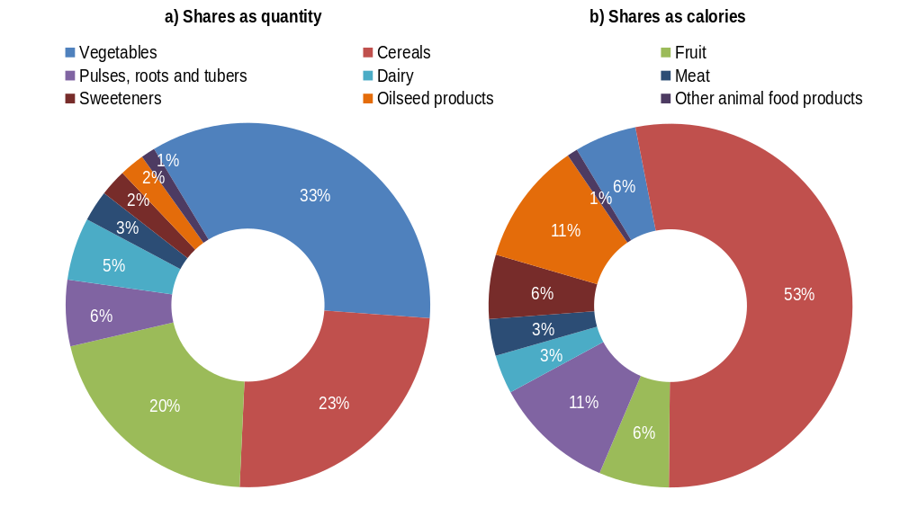
The issue of Food Loss and Waste
13% of food produced is lost after harvesting and before reaching retail markets (FAO2019)
19% is wasted by households, food services and retail (UNEP 2024)

Slide 4
The Aglink-Cosimo model characteristics
Exogenous non-agricultural markets
  partial equilibrium model for the main agricultural commodities, as well as biodiesel and bioethanol
Competitive agricultural markets
Non-spatial trade
Recursive-dynamic markets
  projection over ten years for purposes of forward-looking policy analysis and planning, but model projections are currently up to 2040 to assess long term implications

Slide 5
FLW data incorporation in Aglink-Cosimo
Value chain losses account for all losses occurred between the level at which production is recorded and retail (and not including retail).
  Source: FAO Food Balance Sheets (FBS) from FAOSTAT and FAO Food Loss and Waste Database.
Distribution waste accounts for all food lost at retail distribution level.
  Source: caloric waste shares from FAOSTAT Food Security tables
Household waste accounts for all food waste occurred at household level
  Source: Post Harvest Loss Information System (SIPPOC) data and FAO Food Loss and Waste Database
  rescaled to align with global estimates from UNEP

Slide 6
2. Costs of reducing FLW

Slide 7
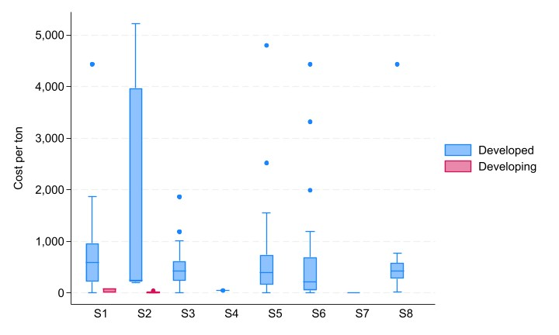
Literature review: costs of reducing FLW
Food supply chain stages
S1 | S2 | S3 | S4 | S5 | S6 | S7 | S8
Primary agricultural (on farm) | Agricultural handling & storage | Food processing & packaging | Wholesale | Retail | Hospitality & food services | Public food procurement | Private households
Food Loss (Decrease in the quantity or quality of food resulting from decisions and actions by food suppliers in the chain, excluding retail, food service providers and consumers) |  |  |  | Food Waste (Decrease in the quantity or quality of food resulting from decisions and actions by retailers, food services and consumers)

Slide 8
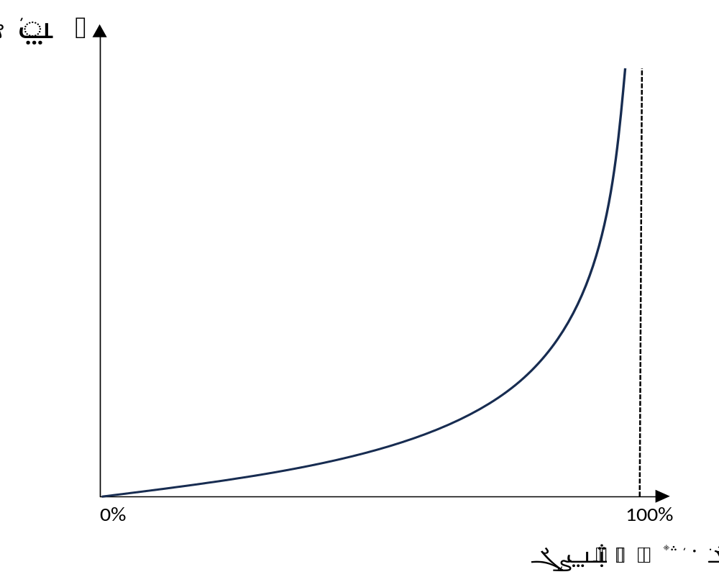
Do costs increase as FLW is reduced?
  Cost structure of public policies

Slide 9
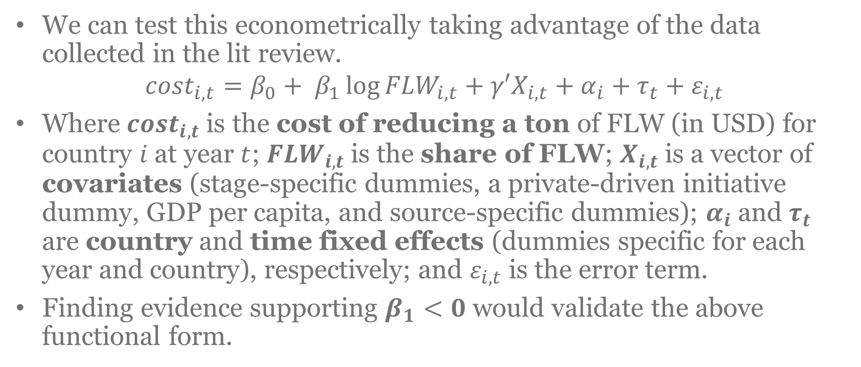
Do costs increase as FLW is reduced?
We can test this econometrically taking advantage of the data collected in the lit review.
$${cost}_{i,t}=β_{0}+ β_{1}\log{{FLW}_{i,t}+γ′X_{i,t}}+α_{i}+τ_{t}+ε_{i,t}$$
Where ${cost}_{i,t}$is the cost of reducing a ton of FLW (in USD) for country $i$ at year $t$;${ FLW}_{i,t}$is the share of FLW; $X_{i,t}$is a vector of covariates (stage-specific dummies, a private-driven initiative dummy, GDP per capita, and source-specific dummies); $α_{i}$and $τ_{t}$ are country and time fixed effects (dummies specific for each year and country), respectively; and $ε_{i,t}$ is the error term.
Finding evidence supporting $β_{1}<0$ would validate the above functional form.

Slide 10
Cost estimates for Aglink-Cosimo countries
We estimate costs for reducing FLW (USD/ton) for each country by estimating a simpler regression using GDP per capita, a development dummy, and controlling for year and source fixed effects.
Costs are estimated for the year 2023 and represent the implicit cost of reducing FLW (i.e., before any actual reduction is carried out).

Slide 11
3. Scenario description and methodology

Slide 12
Scenario description and methodology
We compare different FLW reduction scenarios against the Outlook baseline: from 5% to 50% reduction.
We assume constant future FLW shares in the baseline.
We assume achieving FLW reductions by 2030 (linearly extrapolated).
We assume transmission of food waste reduction to food demand.
  Exception for countries with high prevalence of undernourishment, which may opt to increase food intake instead.
We assume new implementation cost estimates

Slide 13
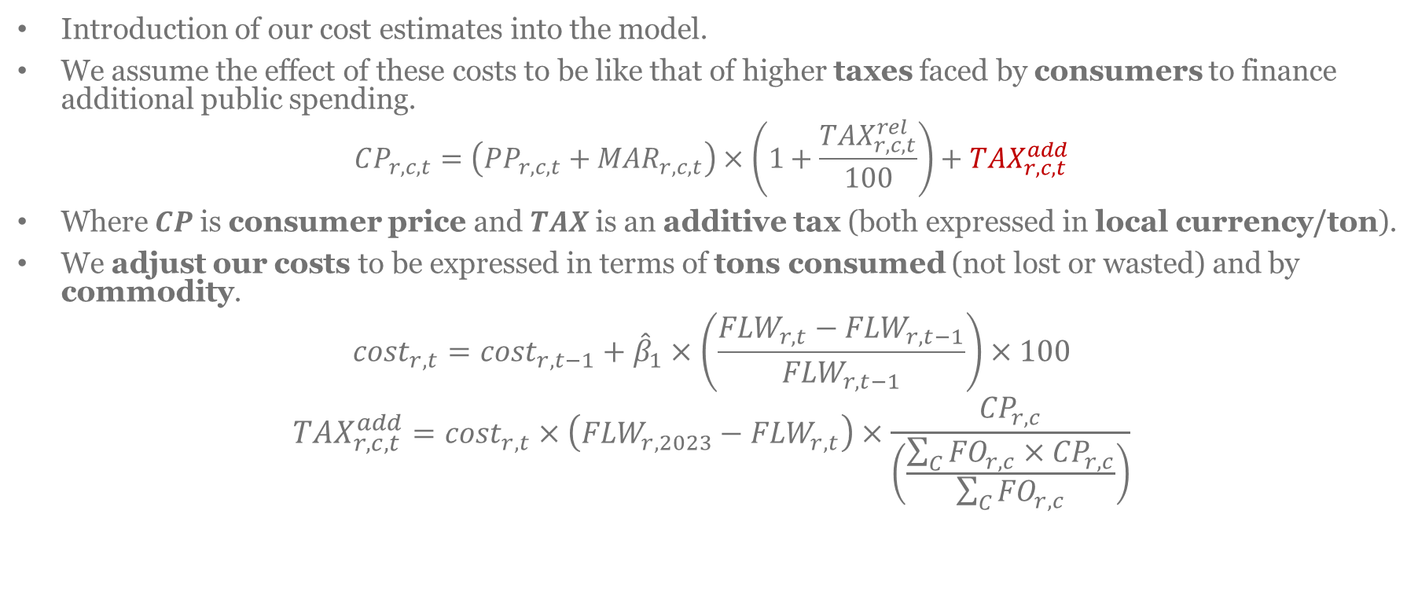
Scenario description and methodology
Introduction of our cost estimates into the model.
We assume the effect of these costs to be like that of higher taxes faced by consumers to finance additional public spending.
$$CP_{r,c,t}=\left(PP_{r,c,t}+MAR_{r,c,t}\right)×\left(1+\frac{{TAX}_{r,c,t}^{rel}}{100}\right)+{TAX}_{r,c,t}^{add}$$
Where $CP$is consumer price and $TAX$is an additive tax (both expressed in local currency/ton).
We adjust our costs to be expressed in terms of tons consumed (not lost or wasted) and by commodity.
$${cost}_{r, t}={cost}_{r,t−1}+{\hat{β}}_{1}×\left(\frac{{FLW}_{r,t}−{FLW}_{r,t−1}}{{FLW}_{r,t−1}}\right)×100$$
$${TAX}_{r,c,t}^{add}={cost}_{r,t}×\left({FLW}_{r,2023}−{FLW}_{r,t}\right)×\frac{{CP}_{r,c}}{\left(\frac{\sum_{C}{{FO}_{r,c}×{CP}_{r,c}}}{\sum_{C}{{FO}_{r,c}}}\right)}$$

Slide 14
4. Scenarios results

Slide 15
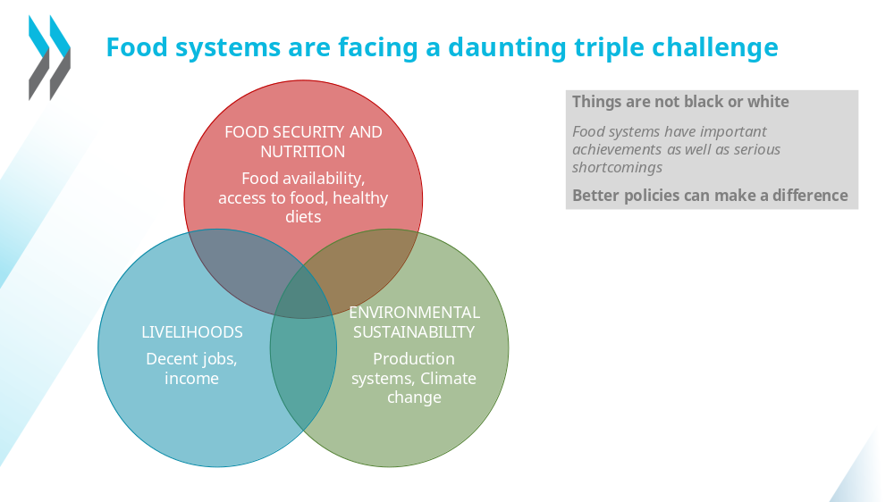


Slide 16
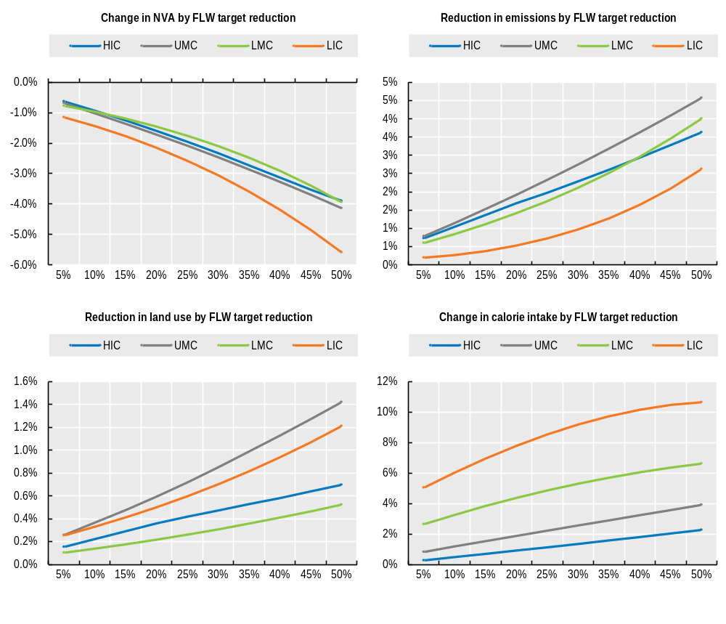
Triple challenge impacts: per regions
Livelihood challenge: Focus on agricultural income
Sustainability challenge: Focus on GHG emissions and land use
Food security challenge: Focus on calorie intake
Change in variable of interest
FLW reduction compared to 2023 levels

Slide 17
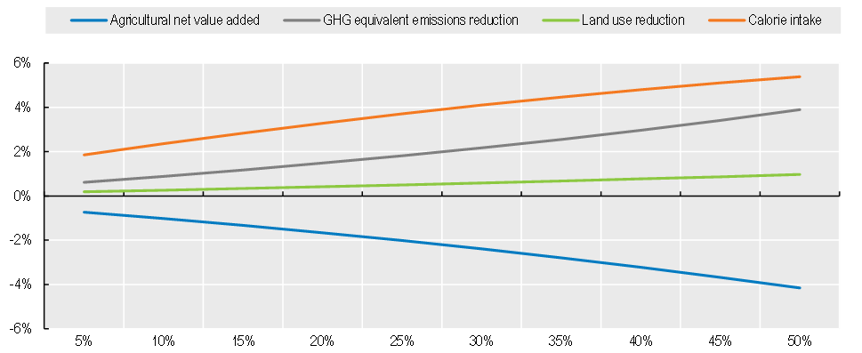
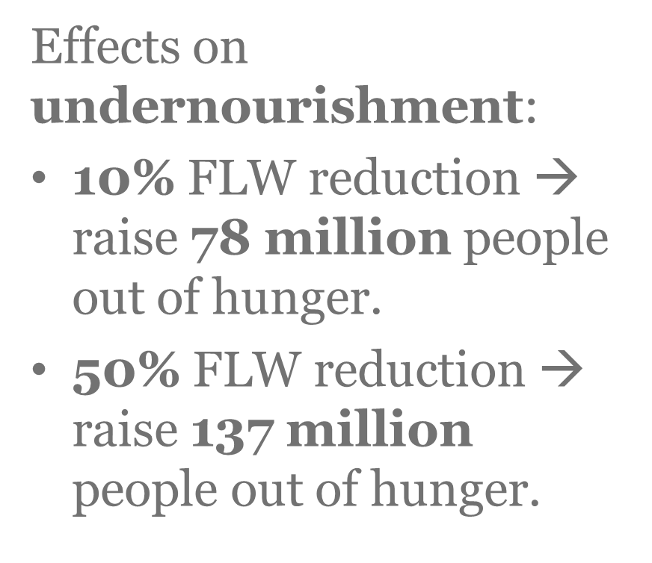
Triple challenge impacts: worldwide
FLW reduction compared to 2023 levels

Slide 18
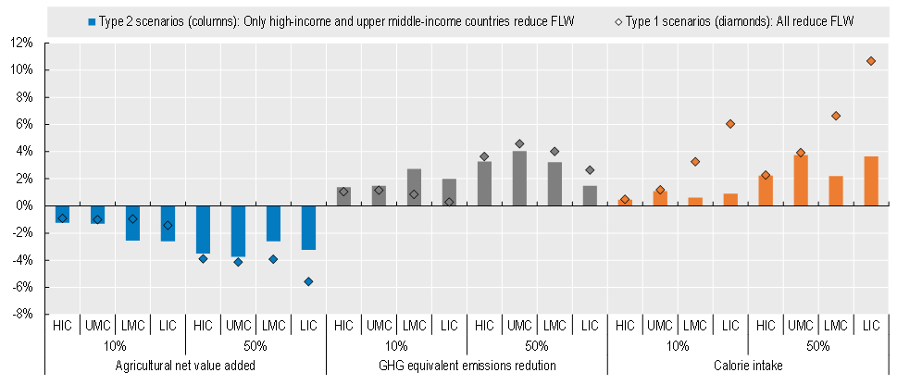
Triple challenge impacts: only HIC and UMC reduce

Slide 19
Thank you for your attention

