Slide 1
Trade, energy efficiency and low carbon development in Kenya
2025 GTAP Conference— Kigali, Rwanda
Shadrack Mwatu
Email: smwatu@kippra.or.ke
KIPPRA

Slide 2
Outline
Introduction
Methodology
Results
Conclusion and policy implications

Slide 3
Introduction
Greenhouse gases (GHG) emissions are on rise in Kenya.
Emissions are rising in the transport, energy and industrial sectors.
Projections indicate energy production and consumption will be key contributors to emissions.
Rise in emissions due to consumption of fossil fuels in energy generation and in meeting transportation, household and industrial uses.
Enhancing energy efficiency could reduce consumption of fossil fuels, reduce GHG emissions, and transition the economy towards a low carbon development path.

Slide 4
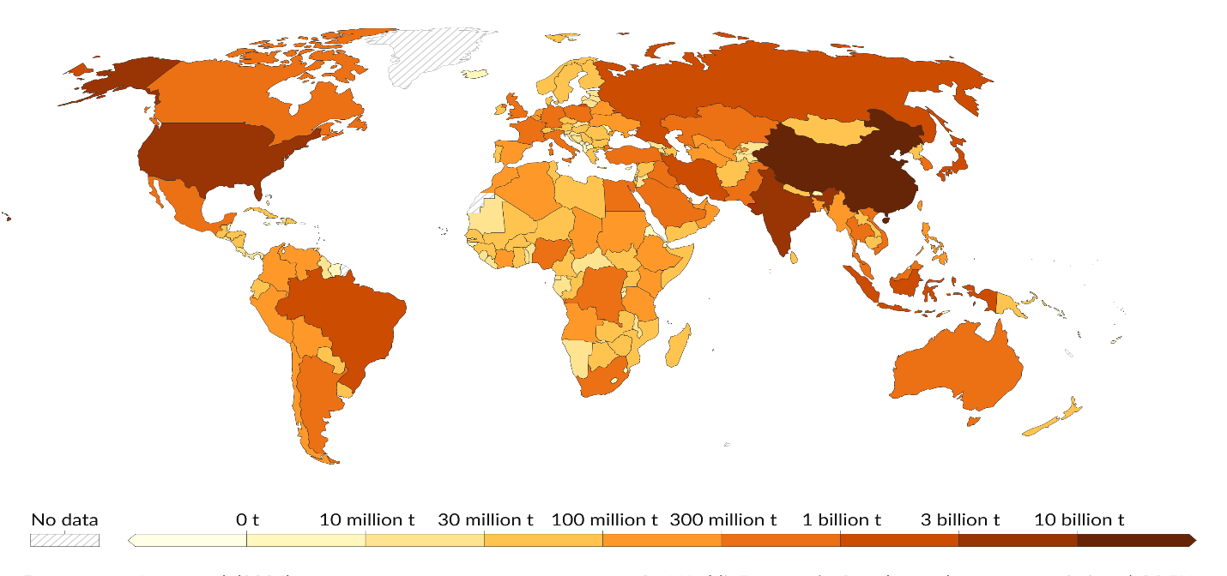
Introduction …
Kenya’s policy and regulatory framework supports transition to a low carbon development:
  Nationally Determined Contribution (NDC)
  National Climate Change Framework Policy
  The Climate Change Act
  Energy Transition and Investment Plan
The transition to a low carbon development is, however, hampered by financing and technological capacity constraints.
The country does not have comparative advantage in production of low carbon technologies that would support energy efficiency.
Low carbon technologies are usually embedded in commodities like machinery and equipment and constitute the largest investment demand.
Kenya

Slide 5
Introduction …
Importing low carbon technologies could improve energy efficiency and transition the economy towards a low carbon development path.
Financing is needed to support importation of the low carbon technology products.
Kenya’s NDC commits to implement mitigation and adaptation measures by mobilizing:
  13% of the required financial resources domestically
  87% of the required financial resources through international support
The study assesses the macroeconomic (e.g., GDP) and environmental (e.g., GHG emissions) implications of the two financing options to access low carbon technology.

Slide 6
Methodology
Applies single-country CGE (JRC, 2020) calibrated to the 2020 SAM for Kenya.
Has a GHG emissions module.
Suitable for ex-ante policy analysis in small-open economies, like Kenya.
CES production function supports imperfect substitution between low carbon technology and fossil fuels.
Low carbon technology embedded in machinery & equipment.
Machinery & equipment account for:
  38.74% of investment demand in imports
  1.20% of marketed output
  57.00% import penetration and 24.50% export intensity.
Factor of production | Category | Factor of production | flab | feng | fcap | fland | fqint | fva | ftop | Total
flivst | agr | flivst |  |  | 1 |  |  |  |  | 1
fcp_ag | agr | fcp_ag |  |  | 1 |  |  |  |  | 1
fcp_na | agr | fcp_na |  |  | 1 |  |  |  |  | 1
feng | agr | feng |  |  | 1 |  |  |  |  | 1
fcp_ag | oth | fcp_ag |  |  | 1 |  |  |  |  | 1
fcp_na | oth | fcp_na |  |  | 1 |  |  |  |  | 1
Feng | oth | feng |  |  | 1 |  |  |  |  | 1
flivst | fod | flivst |  |  | 1 |  |  |  |  | 1
fcp_ag | fod | fcp_ag |  |  | 1 |  |  |  |  | 1
fcp_na | fod | fcp_na |  |  | 1 |  |  |  |  | 1
feng | fod | feng |  |  | 1 |  |  |  |  | 1
f_c_oman | agr | f_c_oman |  |  |  |  | 1 |  |  | 1
f_c_petr | oth | f_c_petr |  | 1 |  |  |  |  |  | 1
f_c_mach | oth | f_c_mach |  | 1 |  |  |  |  |  | 1
f_c_oman | oth | f_c_oman |  | 1 |  |  |  |  |  | 1
f_c_petr | fod | f_c_petr |  | 1 |  |  |  |  |  | 1
f_c_mach | fod | f_c_mach |  | 1 |  |  |  |  |  | 1
f_c_oman | fod | f_c_oman |  | 1 |  |  |  |  |  | 1
flab | agr | flab |  |  |  |  |  | 1 |  | 1
flab | oth | flab |  |  |  |  |  | 1 |  | 1
flab | fod | flab |  |  |  |  |  | 1 |  | 1
fcap | agr | fcap |  |  |  |  |  | 1 |  | 1
fcap | oth | fcap |  |  |  |  |  | 1 |  | 1
fcap | fod | fcap |  |  |  |  |  | 1 |  | 1

Slide 7
Methodology …
Indirect taxes levied on machinery and equipment include import tariffs and sales taxes.
  Constitute tax revenue for the government.
  51.54% is from import tariffs
  48.46% is from sales tax.
Gross supply of machinery & equipment in SAM is 3.5%-relatively low.
Each type of fossil fuel (e.g., coal, oil, natural gas) has a specific emission factor.
  represents the amount of CO2 emitted per unit of energy consumed.
The CO2 emissions resulting from the combustion of fossil fuels are linear function of the quantity of energy commodities used.
The base dataset on emissions is based on the 2017 GTAP11 database (Aguiar et al., 2022).

Slide 8
Methodology …
Two options to finance increase in imports of machinery & equipment (effective capital).
financing through domestic resources—assumes elimination of custom tariffs on imports of effective capital.
financing through international support—assumes effective capital is supplied at lower world market prices.
  commitment by advanced economies to support net zero transition in developing economies.
Both scenarios increase supply of effective capital by 32.57%.
100% elimination of tariffs on effective capital.
7.74% reduction of world market prices for effective capital.

Slide 9
Results …
Percentage changes relative to baseline.
Both scenarios associated with 6.84% and 6.66% reduction in supply of fossil fuels as leading sources of GHG emissions.
The two interventions have positive impacts on:
  GDP
  Exports
  Imports
  Domestic production
  Household consumption
  Domestic demand, and
  Supply of low carbon technology machinery (effective capital)
Both scenarios reduce greenhouse gas emissions by 3.99% and 4.26% respectively.
Indicator | SIM1(Tariffs removal) | SIM2 (Reduction in world market prices)
GDP at factor cost | 0.14 | 0.23
Real GDP | 0.09 | 0.18
Exports | 6.12 | 3.93
Imports | 2.89 | 3.36
Household consumption | 0.27 | 0.37
Government revenue | -1.59 | 0.62
Total investment expenditure | -0.84 | 1.41
Domestic production | 0.85 | 0.96
Domestic demand | 0.14 | 0.53
Petroleum prices | -1.32 | -1.37
Machinery prices | -5.39 | -5.54
Machinery supply | 32.57 | 32.57
Petroleum supply | -6.84 | -6.66
GHG emissions (CO2eq) | -4.26 | -3.99

Slide 10
Results …
Indicator (SIM2) | Transport | Energy | Industry
 |  |  | Construction | Chemicals | Mining | Non-metallic minerals | Petroleum | Other manufacturing
Value added | 0 | 1.29 | 2.16 | 4.76 | 0.46 | 0.58 | 2.72 | 2.22
Petroleum demand | -1.38 | -3.79 | -9.13 | -12.9 | -7.06 | -0.50 | -16.65 | -11.83
Machinery demand |  | 30.2 | 22.9 | 17.8 | 25.78 | 34.66 | 12.8 | 19.33
Commodity output | -0.87 | 0.28 | 1.87 | 4.83 | -0.29 | -0.54 | 1.27 | 2.06
Commodity prices | 0.74 | 0.53 | -0.07 | -1.05 | 0.24 | 0.75 | -1.37 | -0.42
Quantity of intermediate inputs | -0.74 | 0.80 | 2.22 | 5.52 | 0 | -0.27 | 1.6 | 2.61
Price of intermediate inputs | 0.38 | -1.12 | -0.69 | -2.03 | -0.63 | -0.19 | -2.07 | -1.34
GHG emissions | -1.38 | -3.79 | -9.13 | -12.8 | -7.06 | -0.61 | -16.65 | -11.83
Indicator (SIM1) | Transport | Energy | Industry
 |  |  | Construction | Chemicals | Mining | Non-metallic minerals | Petroleum | Other manufacturing
Value added | -0.04 | 1.21 | -0.10 | 5.38 | -0.40 | -0.37 | 3.01 | 2.46
Petroleum demand | -1.18 | -3.64 | -10.9 | -12.1 | -7.61 | -1.27 | -16.08 | -11.35
Machinery demand |  | 29.9 | 20.1 | 18.5 | 24.60 | 33.15 | 13.18 | 19.55
Commodity output | -0.75 | 0.38 | -0.33 | 5.57 | -0.99 | -1.29 | 1.76 | 2.39
Commodity prices | 0.61 | 0.42 | -0.25 | -1.02 | 0.17 | 0.64 | -1.32 | -0.41
Quantity of intermediate inputs | -0.65 | 0.86 | 0.04 | 6.24 | -0.71 | -1.09 | 2.08 | 2.91
Price of intermediate inputs | 0.31 | -0.99 | -0.65 | -1.94 | -0.61 | -0.09 | -1.98 | -1.24
GHG emissions | -1.18 | -3.64 | -10.9 | -12.1 | -7.61 | -1.27 | -16.08 | -11.36

Slide 11
Implications for policy
Two financing options reduce greenhouse gas emissions and foster low carbon development.
International community could commit to finance supply of low carbon technology commodities at lower world market prices.
Design incentives targeted to:
  transport, construction, mining, and non-metallic minerals sectors— decline in value-added (SIM1).
Short-term subsidies to cushion consumers against welfare erosion from rising energy and transport prices.
Incentives to target developing skills and knowledge needed to support domestic production of low carbon technologies.

