Slide 1


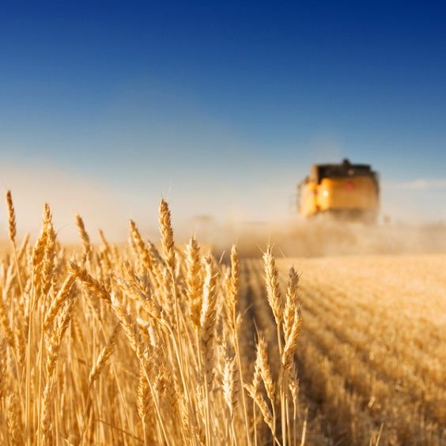
Pathways toward sustainable livestock farming in the EU: a macroeconomic analysis.
GTAP, 18th June 2026
Heleen Bartelings, Elisa Bardazzi, Marcos Esau Dominguez Viera

Slide 2
Background

Slide 3
Introducing the EU Horizon project: Pathways
The future of livestock systems is a critical area of inquiry, given the pressing need to balance environmental sustainability, economic viability, and social equity in the evolving landscape of livestock farming across Europe.
Five different pathways are determined by stakeholders describing a more sustainable livestock sector in the EU.

Slide 4
Aim of the analysis
Evaluate the trade-offs associated with future alternative scenarios by:
Determining macro economic impacts
Environmental impacts
Nutritional impacts
By applying MAGNET and simulating the impact of these scenarios compared to a Business-as-Usual scenario (BAU).

Slide 5
5 different Pathways: Livestock in the EU in 2050
Rural Renaissance boosting local communities priority
Animal Welfare
Welfare animal main priority
Efficiency first
animal production as efficient as possible
Feed no Food
land is not used for animal feed production
No livestock no animal production in the EU

Slide 6
Pathways: Implementation
Animal Welfare
Increase capital & labour per animal
More grazing, less feed
Protect EU market with tariffs
Rural Renaissance
More demand domestic product, tariffs, increase labour, decrease capital
Efficiency first
Less labour, more capital, more technology, less grazing
Feed no Food
no feed production and import, more grazing, more biomass use
No livestock 90% reduction of both livestock and processing

Slide 7
Methods

Slide 8
Livestock in MAGNET
6 Processing sectors
Beef meat
Other Cattle meat
Poultry meat
Pig meat
Processed Milk
Textiles
Capital
6 Animal sectors
Beef cattle
Other Cattle
Poultry
Pigs
Raw Milk
Wool
Meat
milk
leather
Labour
Land
Feed
Animals
feed
12 Crop sectors
Paddy rice, Wheat,
Grains, Vegetables,
Fruits, Nuts, Pulses, Roots & Tubers, Oilseeds, Sugar beet,
Fibres, other crops (including forage)
Services and other
Manure
Fossil fertilizers

Slide 9
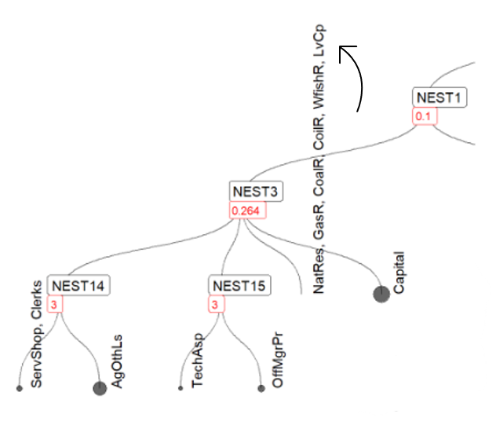
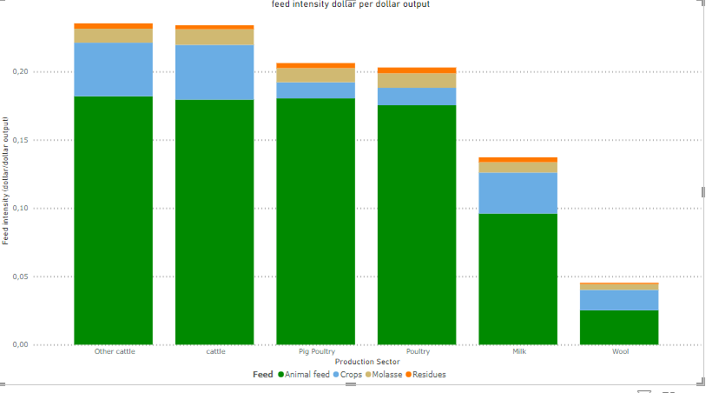
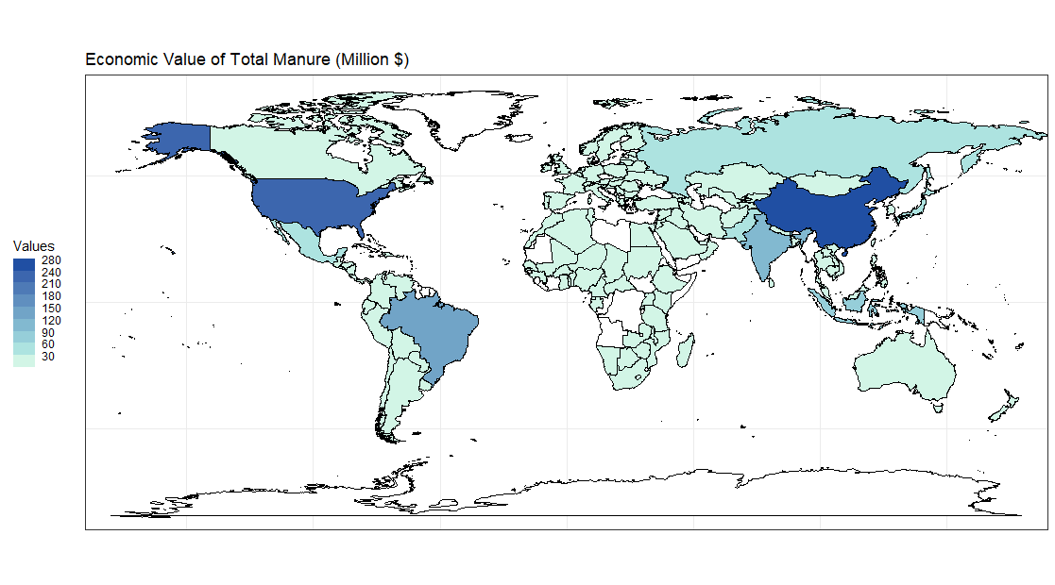
Adjustments made to livestock
♻️ Manure Module
  • Explicit manure generation by livestock sectors used as fertilizer and feedstock biogas
  • 52-country database
  • 1990–2021 coverage
Benefit: Tracks nutrient and environmental flows
🐄 Live Capital
  • Livestock separated from generic capital
  • Sector-specific herd capital
  • Dairy, beef, other cattle, pigs
  • Primary production factor
Benefit: Better representation of livestock assets
🌾 Feed Module
  • Animal-specific feed requirements
  • Crops, residues, molasses, feeds
  • Feed restrictions by livestock type
Benefit: More realistic feed demand

Slide 10
Results

Slide 11
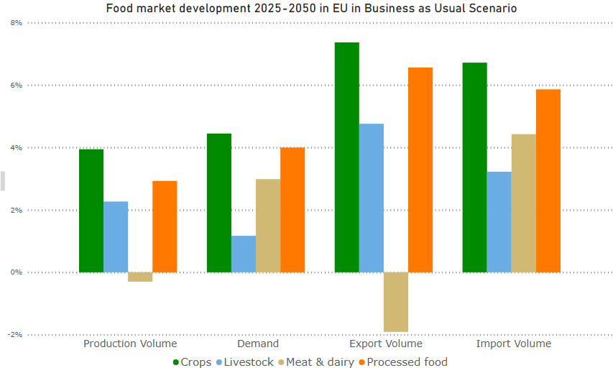
Business-as-Usual (BAU): Food indicators
Moderate GDP and population growth lead to increased food demand
Demand for crops and processed food grow more then animal products
Animal products production declines, increased demand met through imports

Slide 12
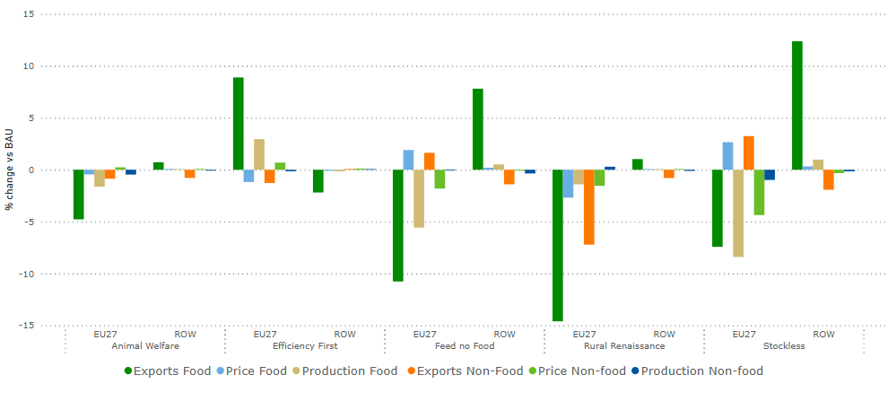
Economic impacts vs BAU in 2050
Production & trade declines in all but efficiency first.
Food becomes more expensive in all but efficiency first.

Slide 13
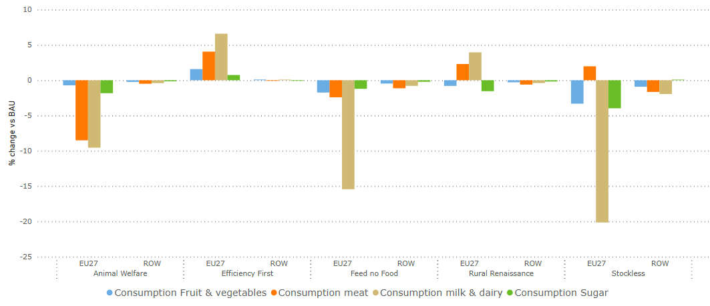
Nutritional impacts vs BAU in 2050

Slide 14
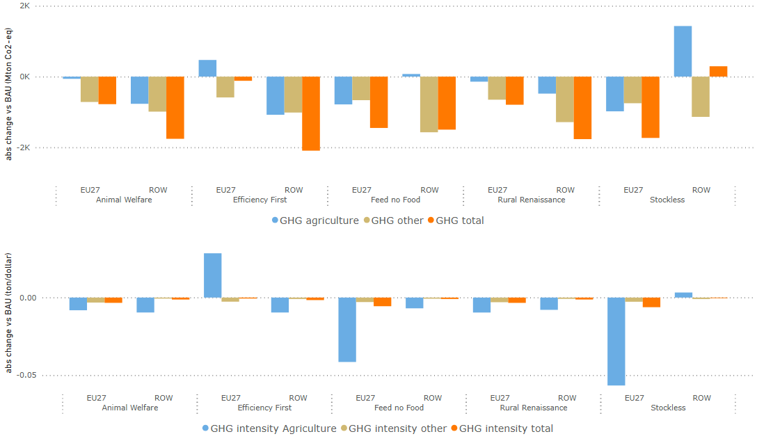
Environmental impacts vs BAU in 2050

Slide 15
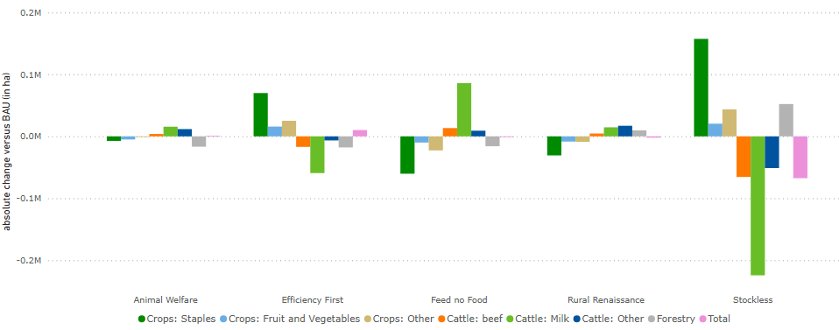
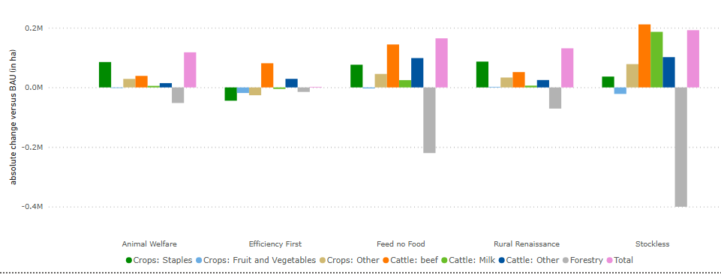
Land demand changes vs BAU in 2050
EU
Land pressure EU stays constant
Land between livestock and crops redistributed
ROW land pressure increases
ROW

Slide 16
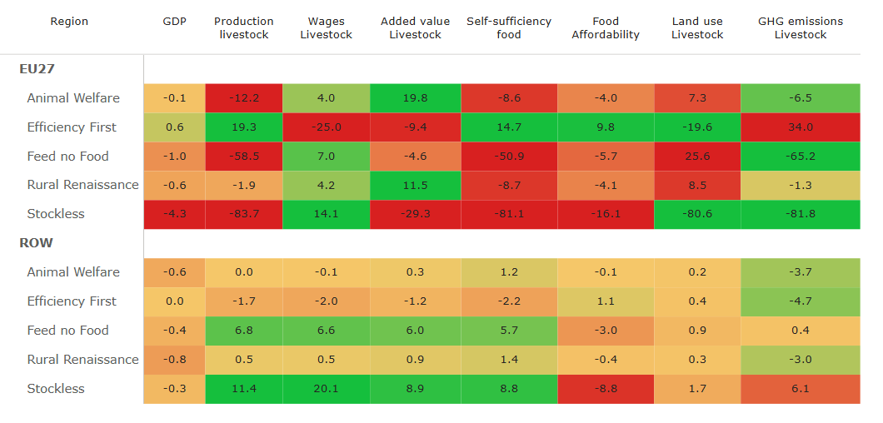
Overview of key indicators in the EU and ROW

Slide 17
Conclusions

Slide 18
Conclusions
High Animal Welfare most positive, with increases both in the economy/production side and emissions, and only mild repercussions on nutritional outcomes and GDP.
Only Efficiency First, increases food affordability.
Stockless has the largest impact on the rest of the world. This storyline boosts livestock production and wages outside the EU, but also increases emissions and lowers diet affordability due to new competition for exports.

Slide 19
Conclusions (Cont.)
Overall, most storylines present pros and cons and potentially a mix of them, will be necessary to achieve a future that is sustainable from all its three main components.

Slide 20
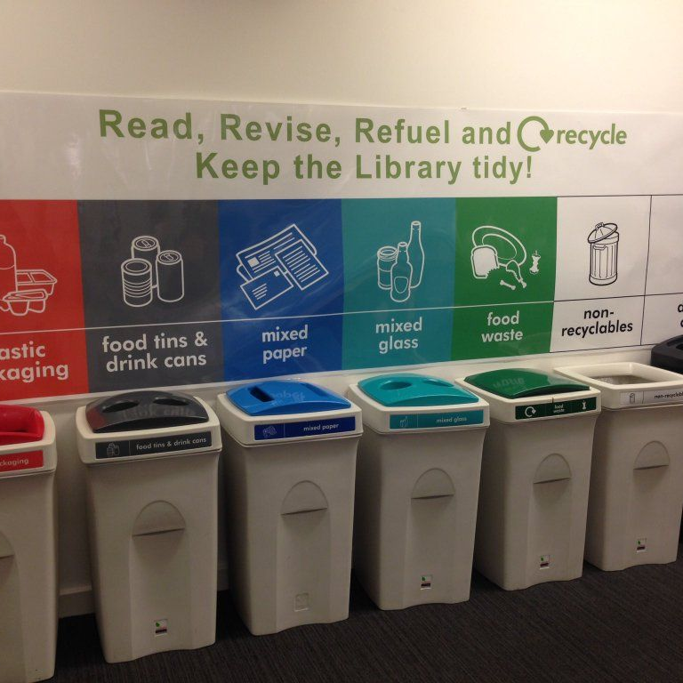
Thank You!
More information about MAGNET can be found at:
https://www.magnet-model.eu/

Slide 21
ANNEX

Slide 22
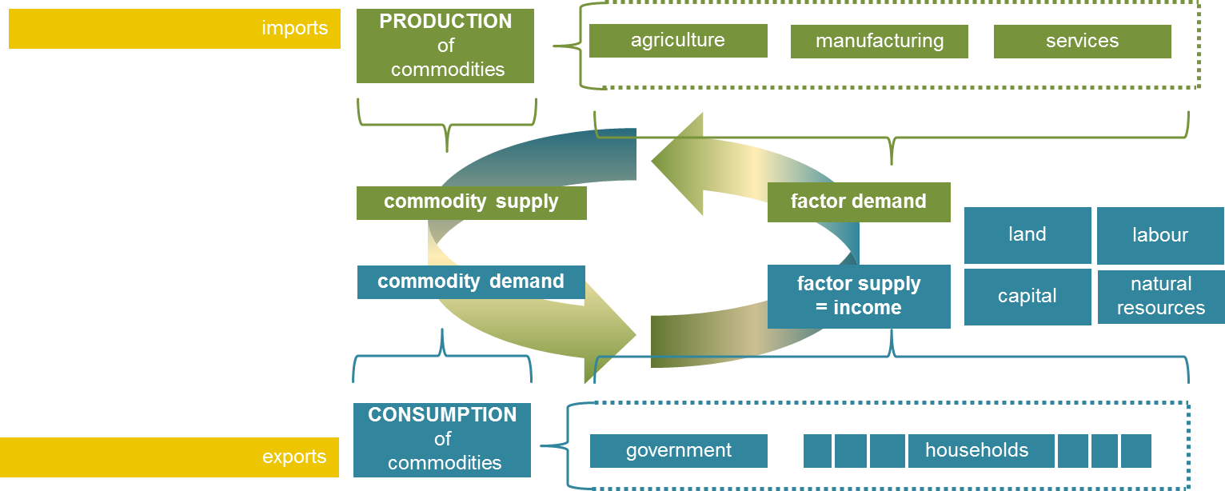
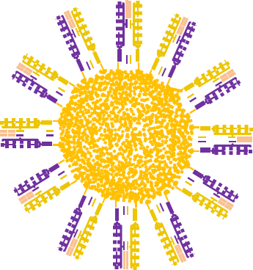
MAGNET – a complete economic model of nations in the global economy
Prices
Notes:
CGE model: models economy, producers, consumers. Producers buy factors, make products. Consumers sell factors and use income to buy products. Whole system in equilibrium by prices. World model -> als imports and exports

Slide 23
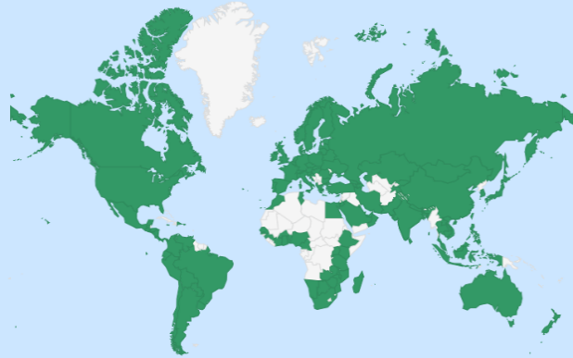
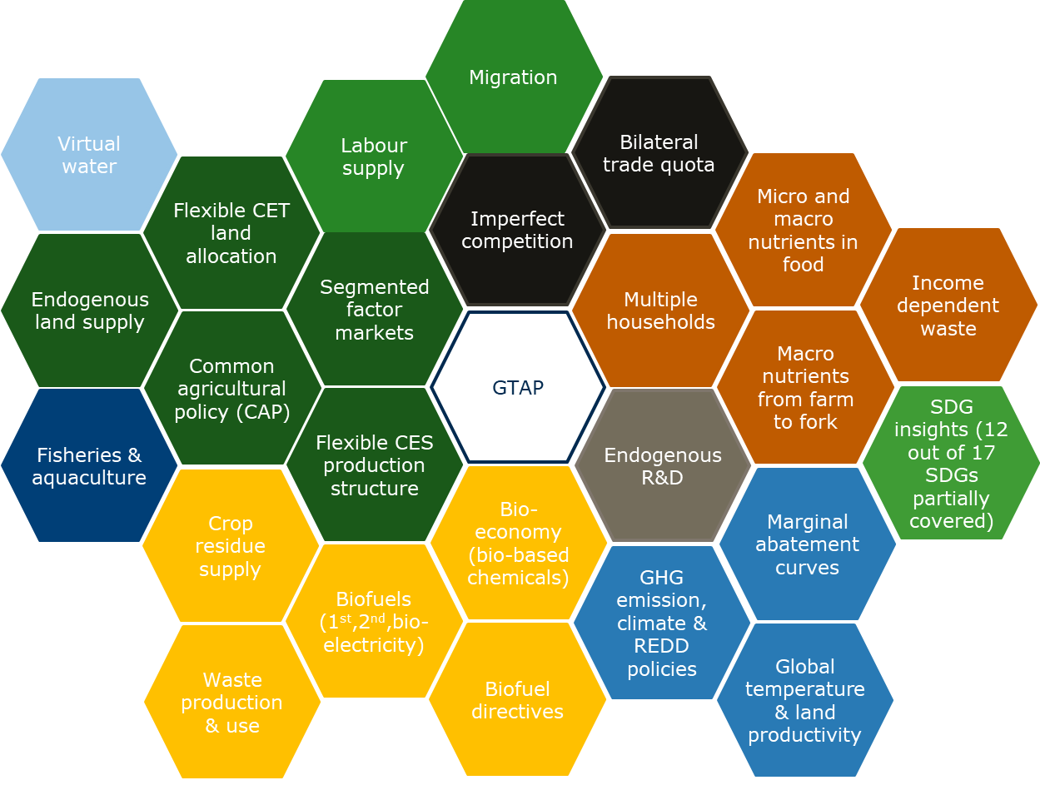
MAGNET - modular design philosophy
GTAP model (and data) at the core - shared international starting point for global CGE models
160 regions, >100 sectors, 15 production factors (land, 5 labour types, capital, natural resources (forestry/mining), 3 fossil fuel resources, 4 wild fish stocks)
Extensions
  added as modules
  creating parallel universes of different equations
MAGNET is thus a model platform, not a single model
Notes:
Magnet based on Gtap -> uses data -> build lots of extensions more sectors and production factors then original data, modular setup can turn stuff on or off

Slide 24
Live Capital in MAGNET
Activities relying on standing herds in Magnet
Raw milk
Other cattle
Beef cattle
Pigs
Account Section | Adapted Variable
Activities Column | Input Value Added, Taxation on Firm Endowment use
Endowment Colum | Regional Household Revenue (dependent on endowments), Total taxation, Total Investment account
Investment column | Import and domestic value of livestock sectors, taxation of imported and domestic livestock sectors
Basic Assumptions
- live capital is sector-specific -> it is not possible to exchange it between livestock sectors
- Live capital is introduced into the production structure at the same level as the other primary inputs (e.g., other capital, labour), and the elasticity of substitution is maintained
- The quantity of herd capital is assumed to be fixed (i.e. the quantity of livestock owned in the base year of calibration will remain unchanged (possibly change in future)

Slide 25
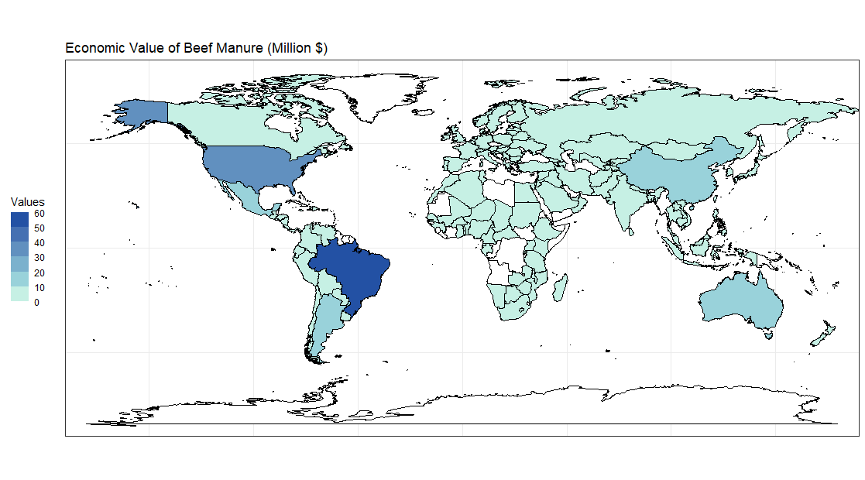
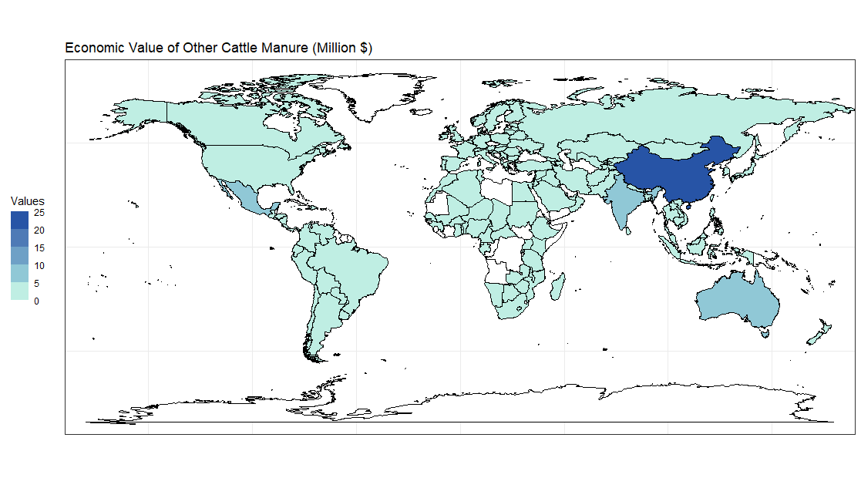
Manure in MAGNET
Mapping between Data Sources
from 1990 to 2021 for 52 countries
MAGNET name | OECD Livestock | Brown (2021) Livestock
Dairy | Beef (splitted) | Dairy
Other cattle | Sheep, goats, horses | Sheep, Horses
Beef cattle | Beef (splitted) | Beef, veal
Pigs | Pigs | Hogs
Poultry | Poultry | Chicken, Turkeys

Slide 26
Different feed types and residues as feed
Feedtypes | Commodities
Crops | Nuts
Crops | Crops
Crops | Fruit
Crops | Vegetables
Crops | Sugar cane, sugar beet
Crops | Other agriculture
Residues | residue osd
Residues | residue gro
Residues | residue pdr
Molasse | Sugar and molasses
Crops | Roots and tubers
Crops | Pulses
Animal feed | Cattle feed
Animal feed | Pig feed
Animal feed | Fish feed
Animal feed | Feed poultry

