Slide 1
Impacts of developed countries' degrowth and capital redistribution on international economic convergence under climate change mitigation policies
Limeng Fan^{1*}, Shinichiro Fujimori^{1,2,3}
1 Kyoto University, Kyotodaigaku Katsura, Nishikyoku, Kyoto, Japan.
2 National Institute for Environmental Studies (NIES), Ibaraki, Japan
3 International Institute for Applied System Analysis (IIASA), Laxenburg, Austria
*Corresponding author
Notes:
Thank you so much for your introduction.
In this research, we investigated the amount of financial transfer which can compensate developing countries for macroeconomic costs of under the 1.5°C target.

Slide 2
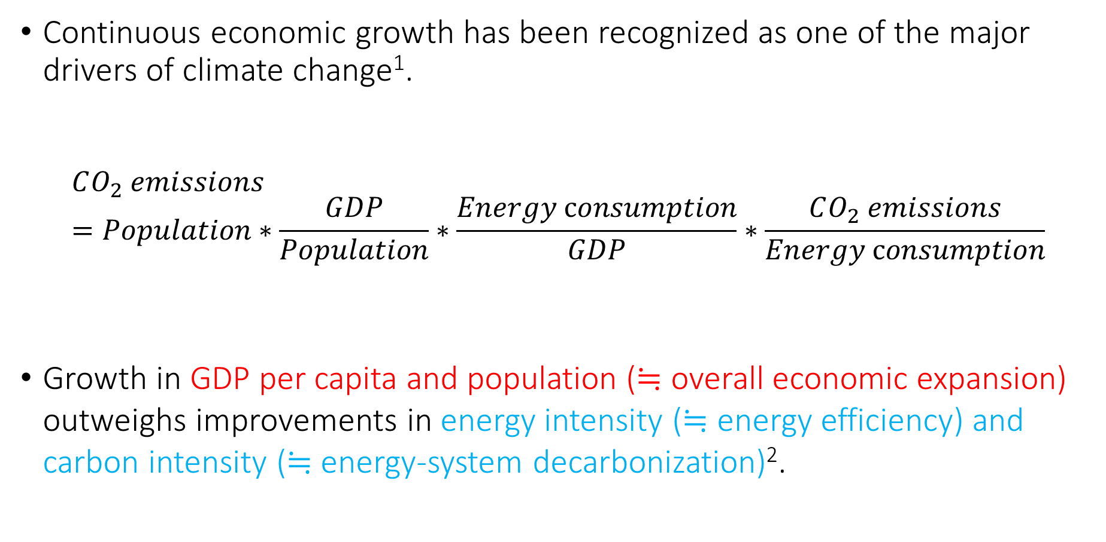
Introduction
Continuous economic growth has been recognized as one of the major drivers of climate change¹.
$$CO_{2} emissions=Population∗\frac{GDP}{Population}∗\frac{Energy \text{c}onsumption}{GDP}∗\frac{CO_{2} emissions}{Energy \text{c}onsumption}$$
Growth in GDP per capita and population (≒ overall economic expansion) outweighs improvements in energy intensity (≒ energy efficiency) and carbon intensity (≒ energy-system decarbonization)².
increase
decrease
= energy intensity
= carbon intensity

Slide 3
Introduction
Degrowth has been proposed as an alternative pathway for achieving climate mitigation².
Degrowth:
a process of political and social transformation that reduces a society’s throughput while improving the quality of life³
Degrowth has the potential to reduce reliance on rapid technology improvement by directly reducing energy demand
Lowering sustainability and socio-technical feasibility risks
Notes:
large-scale Carbon Dioxide Removal (CDR) technologies and rapid renewable energy transitions

Slide 4
Objective of this research
Research gaps
  The focus on developing countries⁴.
  Redistributing surplus capital from the North to the South
  Whether accelerated economic growth in developing countries makes climate targets more difficult to achieve
Objective
  How does international redistribution of surplus capital under a post-growth transition affect the difficulty of achieving climate targets?
Note: due to the limitations in fully representing a comprehensive degrowth transition, we adopt the broader term, post-growth, which encompasses zero growth and steady-state economics⁵.
Notes:
many developing countries still require economic growth for human development.
developing countries often exhibit higher emission intensities than developed economies due to less efficient technologies and a more carbon-intensive fuel mix

Slide 5
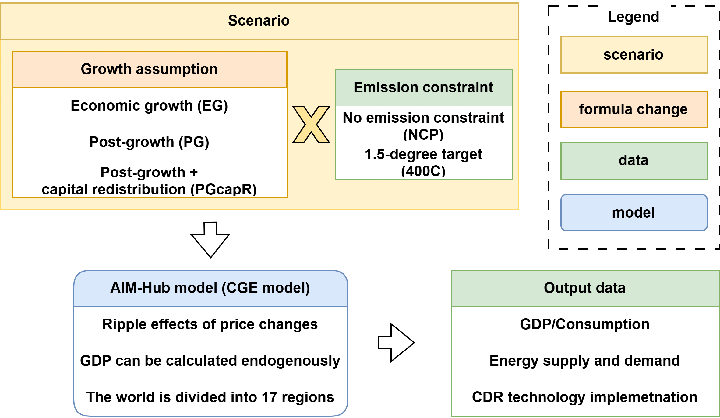
Methodology – overview
Other settings
Population, GDP and technology assumptions (TFP and AEEI): follow historical trends (SSP2)^{7,8}
Simulation period: 2005–2100
Definition of developed countries: OECD (excluding Turkey)
Definition of developing countries: All others
6
Figure: Overview of the Methodology
Notes:
e.g. 1.5_GDP4%_INV scenario means developed countries offer the financial support equal to 4% of their GDP to developing countries investment under 1.5°C target

Slide 6
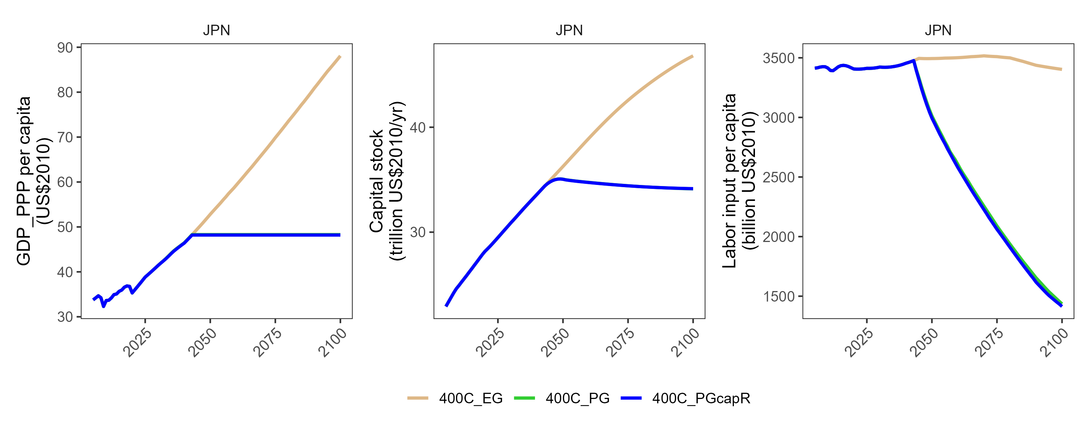

Methodology – PG scenario
Japan
Japan
Japan
Figure: GDP, capital stock, and labor input in developed regions
$$GDP=TFP∗f(K,L)$$

Slide 7
Methodology – PG scenario
Japan
Japan
Japan
Reached the threshold
Start of stabilized GDP per capita
Figure: GDP, capital stock, and labor input in developed regions
$$GDP=TFP∗f(K,L)$$
flexible → fixed

Slide 8
Methodology – PG scenario
Japan
Japan
Japan
Scaled down capital formation to keep capital relatively constant.
Reduction in labor input due to zero growth and productivity improvements.
Figure: GDP, capital stock, and labor input in developed regions
fixed
$$GDP=TFP∗f(K,L)$$
fixed → flexible

Slide 9
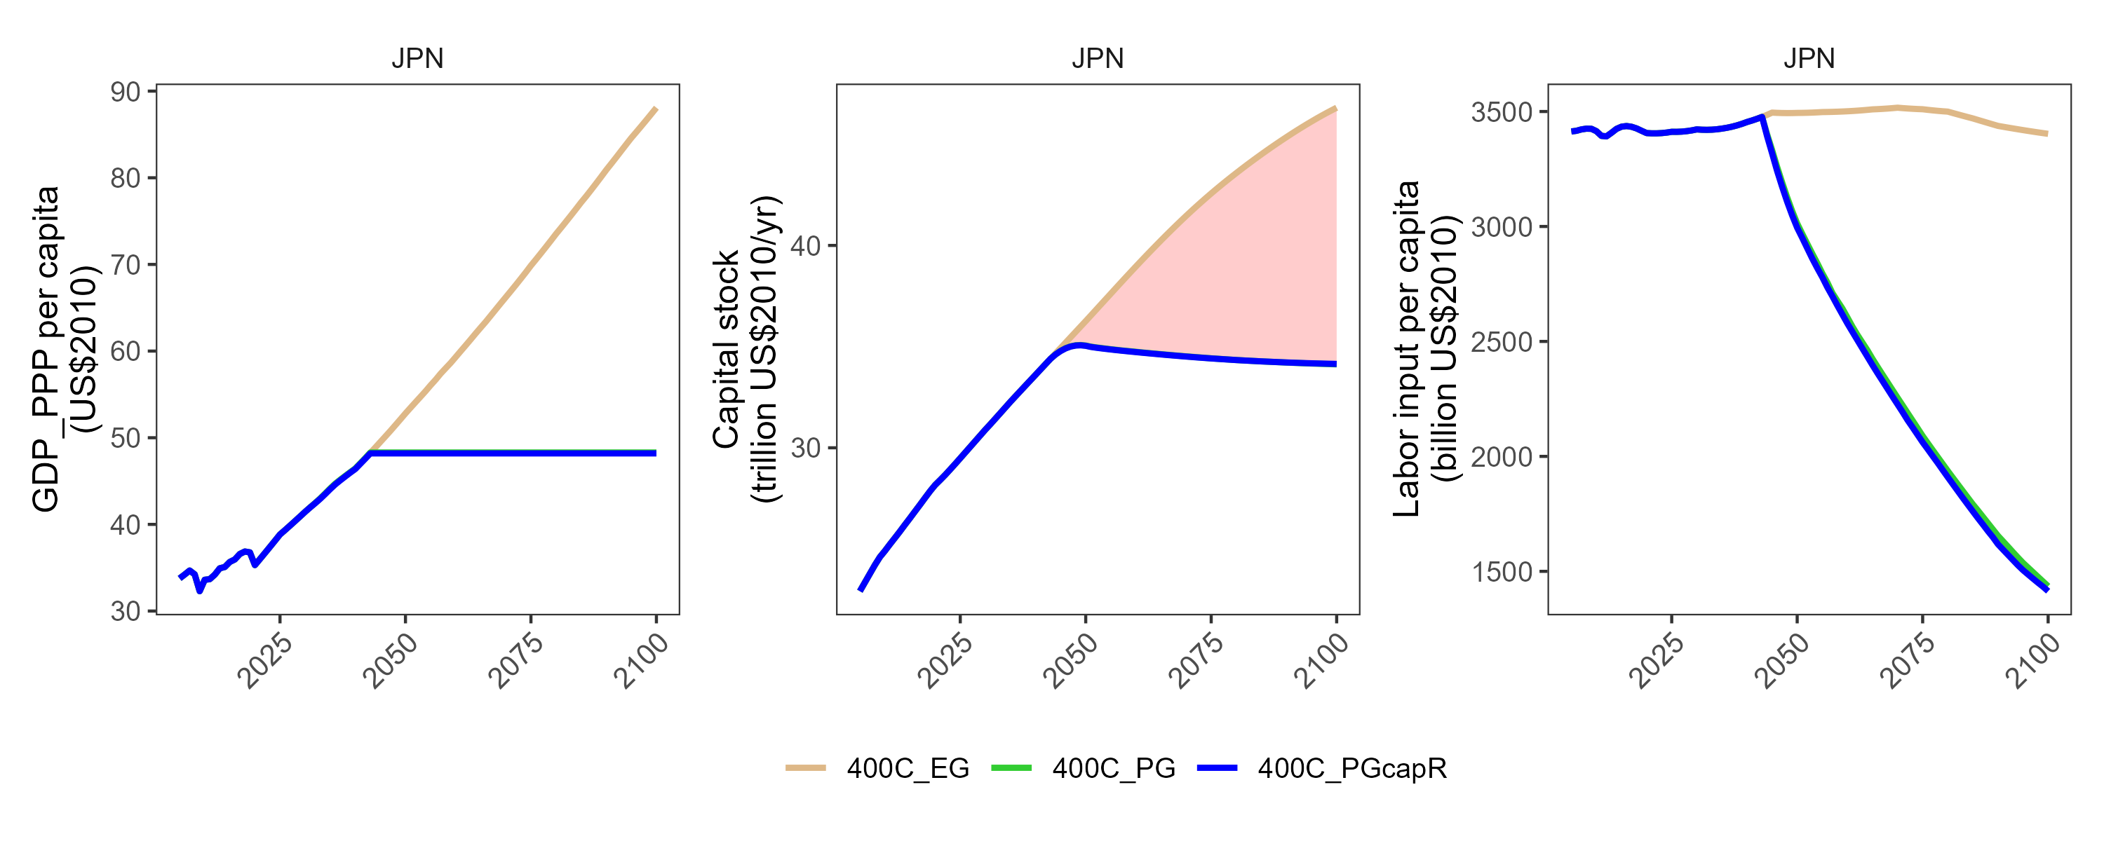
Methodology – PG scenario
Japan
Japan
Japan
The difference is transferred as financial support to developing countries.
Figure: GDP, capital stock, and labor input in developed regions
Funds contributed by developed countries are allocated among developing countries based on the inverse ratio of their GDP per capita.
Transfer amounts are reduced from the latter half of the century to avoid abrupt economic changes.

Slide 10
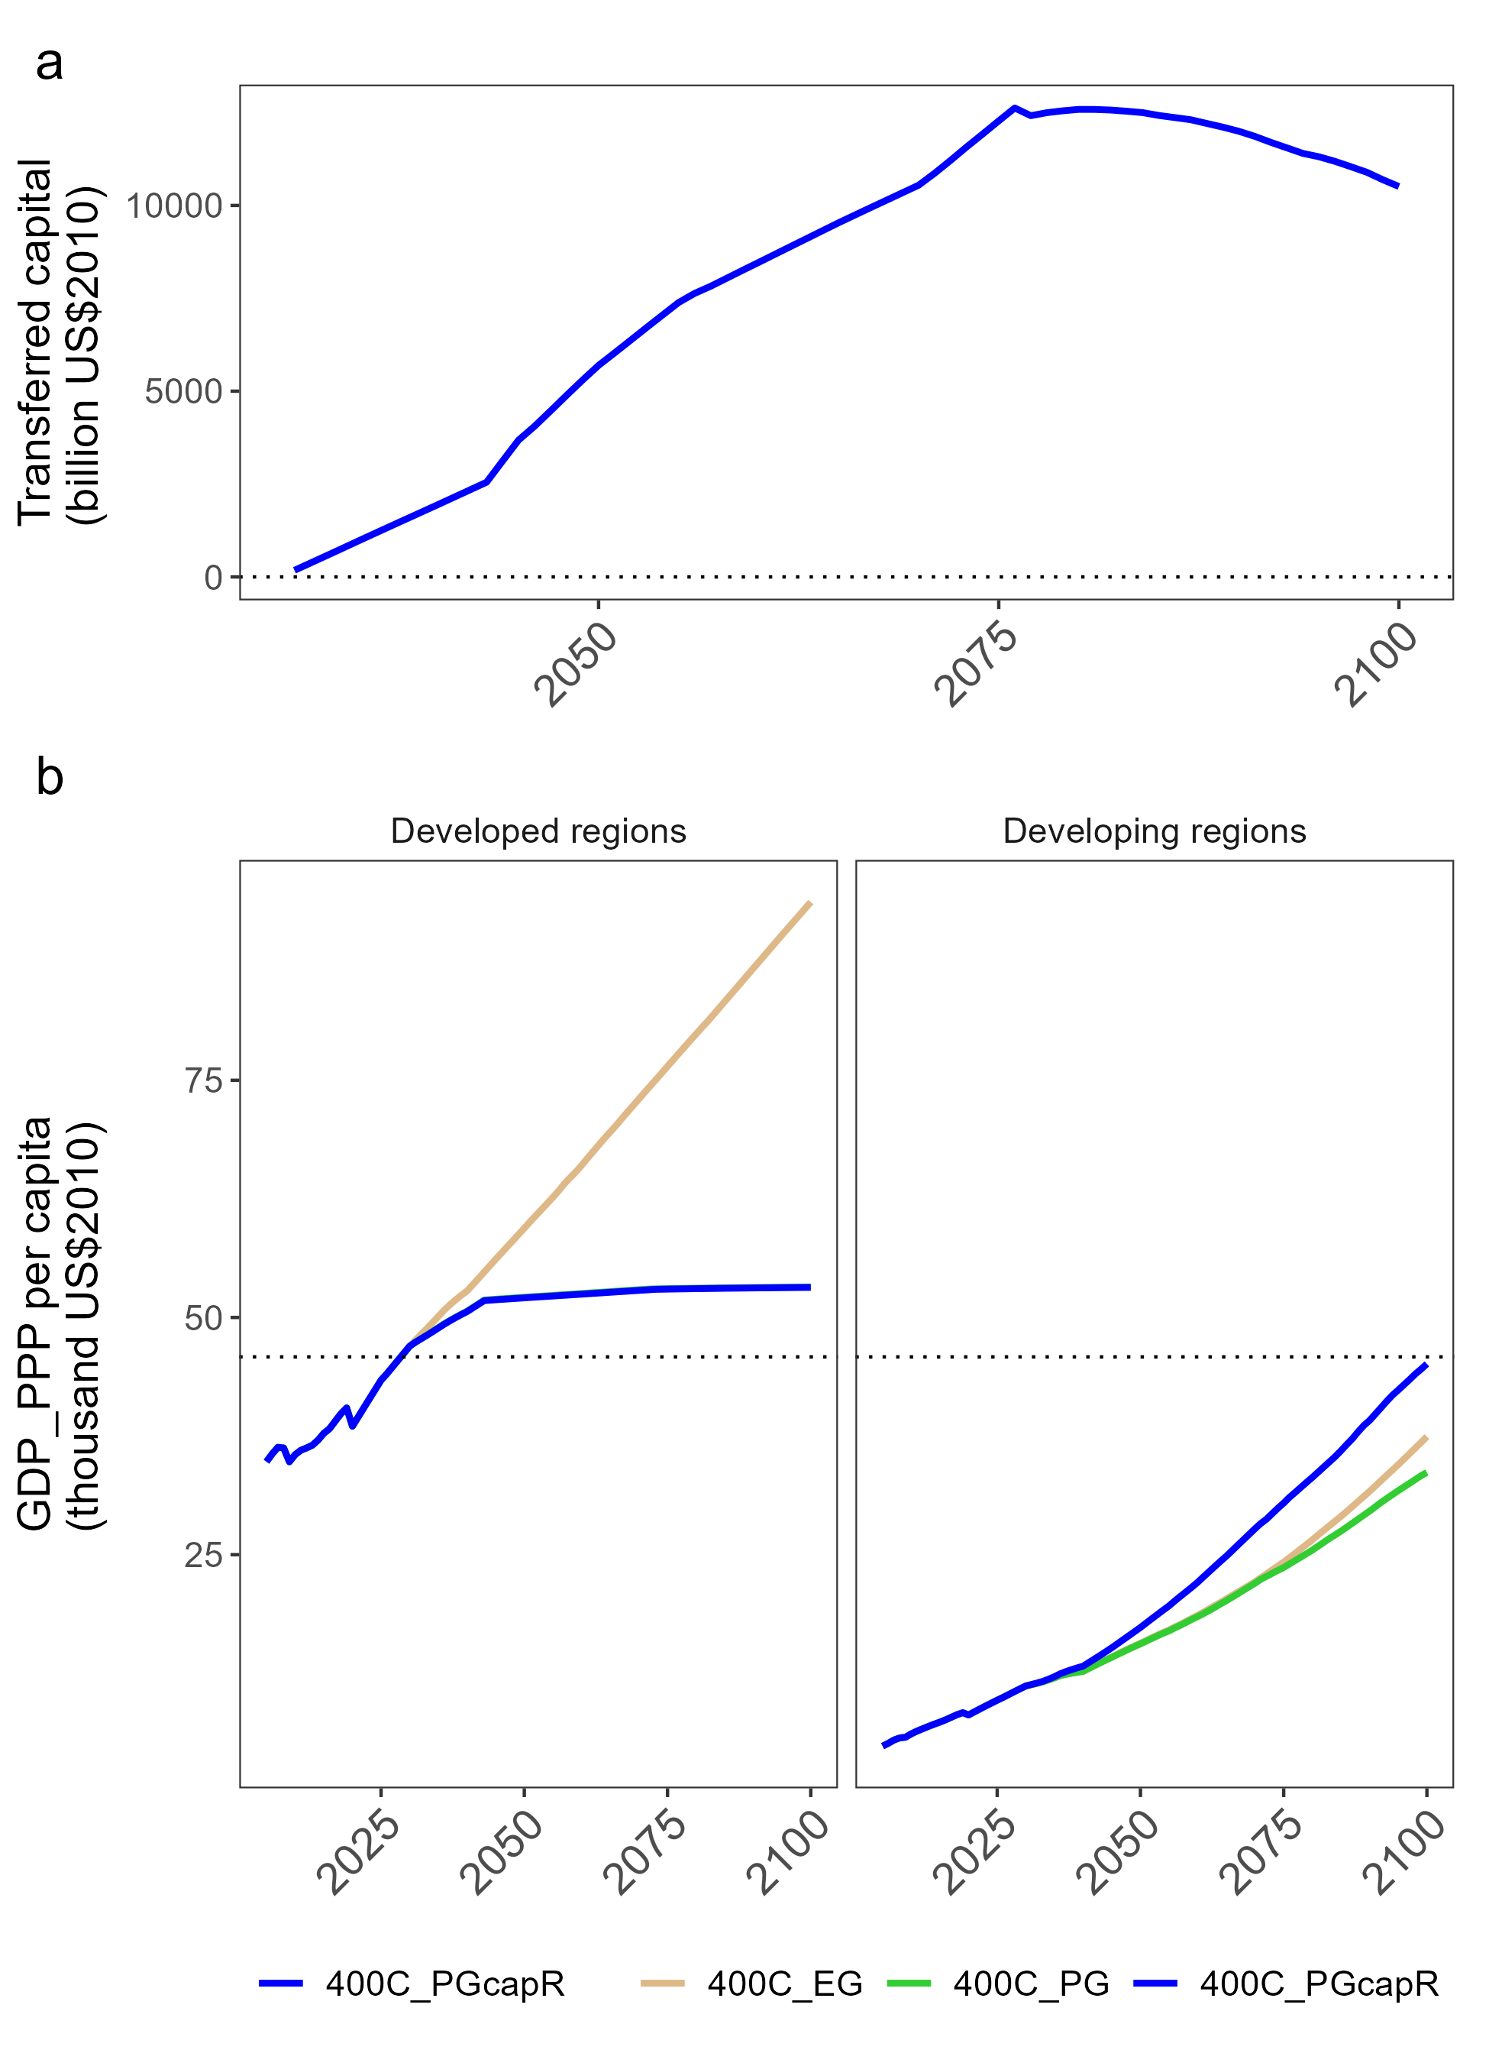
Results: Economic impact
Large-scale capital redistribution
  Average transfer:8.2 trillion US$2010/year (2031-2100 average)
  Transfers increase as developed regions enter post-growth.
Development in the Global South
  Financial support substantially accelerates economic growth.
  Without redistribution, post-growth in developed countries provides almost no positive spillover.
Figure: Economic impact. a: the amount of current transfer. b: GDP per capita

Slide 11
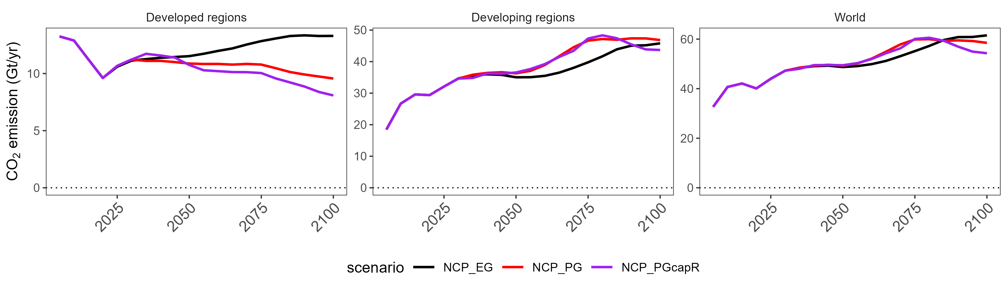
Global emissions
  Stabilized GDP per capita alone does not substantially reduce cumulative global emissions.
  Cumulative emissions remain around 4200–4300 GtCO₂.
Mechanism
  Emissions decrease in developed countries.
  Lower global energy prices stimulate energy demand in developing countries.
  The increase in developing-country emissions offsets reductions in developed regions.
Figure: CO₂ emissions in developed countries, developing countries

Slide 12
Table: Impact on mitigation measures
Scenario (400C) | Energy Intensity Average Annual Change Rates (2030-2050) | Renewable Energy Average Annual Change Rates (2030-2050) | CDR Installation (2030-2100)
EG | -2.2% | 8.8% | 1000 GtCO₂
PG | -1.9% | 8.6% | 1000 GtCO₂
PGcapR | -2.1% | 9.1% | 980 GtCO₂
Post-growth without capital redistribution
  Lower economic activity reduces mitigation pressure.
  Slower improvements in:
    Energy intensity
    Renewable energy expansion
Post-growth with capital redistribution
  Renewable energy expansion slightly accelerates.
  Cumulative CDR deployment slightly decreases.
  Overall mitigation indicators remain similar to the baseline.

Slide 13
Summary
International capital redistribution under post-growth economy does not substantially worsen climate mitigation feasibility.
Post-growth in developed countries can coexist with rapid development in the Global South through capital redistribution.
  Capital redistribution has only limited impacts on mitigation measures.
  Developed regions may improve well-being through reduced labor input.
Implications
  Stabilized GDP per capita alone is insufficient for climate mitigation.
  Carbon pricing, renewable energy deployment, and CDR remain essential.
  Capital redistribution can reduce international inequality while remaining compatible with climate goals.

Slide 14
Thank you.
Limeng Fan
PhD student, Kyoto University
han.reiho.22r@st.kyoto-u.ac.jp
367, C1-3, C-cluster, Kyoto-Daigaku-Katsura,
Nishikyo-ku, Kyoto 615-8540 Japan

Slide 15
Reference
Dhakal, S. et al. Emissions Trends and Drivers. Climate Change 2022: Mitigation of Climate Change. Contribution of Working Group III to the Sixth Assessment Report of the Intergovernmental Panel on Climate Change (2022) doi:10.1017/9781009157926.004.
Keyßer, L. T. & Lenzen, M. 1.5 °C degrowth scenarios suggest the need for new mitigation pathways. Nat. Commun. 12, 2676 (2021).
Kallis, G. et al. Research On Degrowth. Annu. Rev. Environ. Resour. 43, 291–316 (2018).
Cosme, I., Santos, R. & O’Neill, D. W. Assessing the degrowth discourse: A review and analysis of academic degrowth policy proposals. J. Clean. Prod. 149, 321–334 (2017).
Edwards, A., Brockway, P. E., Bickerstaff, K. & Nijsse, F. J. M. M. Towards modelling post-growth climate futures: a review of current modelling practices and next steps. Environ. Res. Lett. 20, 053005 (2025).
Fujimori, S., Masui, T. & Matsuoka, Y. AIM/CGE V2.0 Model Formula. Post-2020 Climate Action: Global and Asian Perspectives 201–303 (2017).
O’Neill, B. C. et al. A new scenario framework for climate change research: the concept of shared socioeconomic pathways. Clim. Change 122, 387–400 (2014).
Riahi, K. et al. The Shared Socioeconomic Pathways and their energy, land use, and greenhouse gas emissions implications: An overview. Glob. Environ. Change 42, 153–168 (2017).

Slide 16
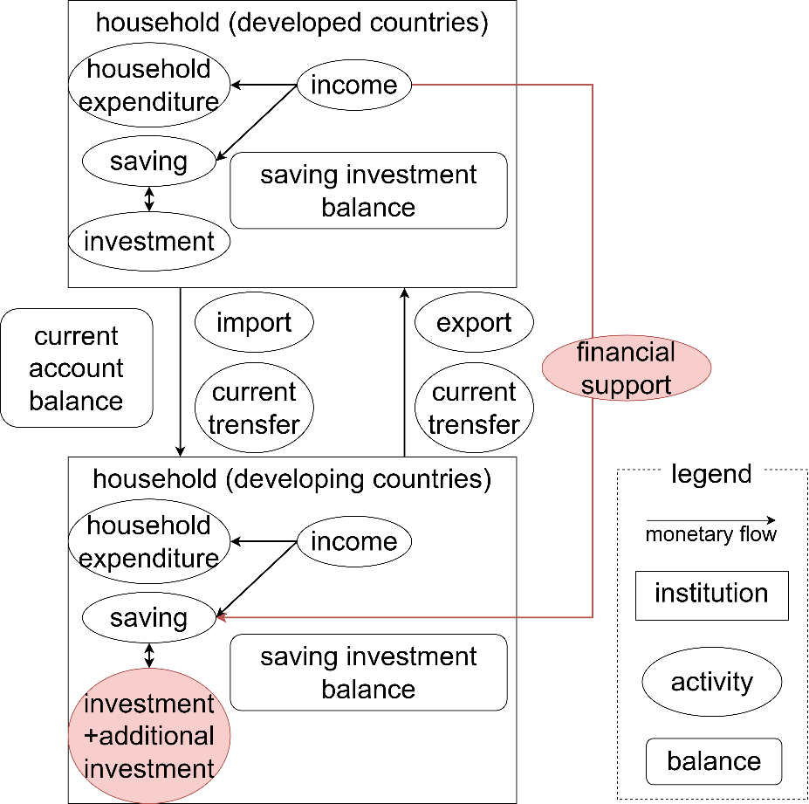
Methodology – modeled monetary flow

