Slide 1


Integrating a Global CGE Model with a Terrestrial Nitrogen Flow Model for Assessing Climate Policy
Impacts on Agriculture
Yuto Osugi , Koga Yamazaki, Shinichiro Fujimori(Kyoto University)
Tomoko Hasegawa (Ritsumeikan University)
Kazuya Nishina (National Institute for Environmental Studies)

Slide 2
Background

Slide 3
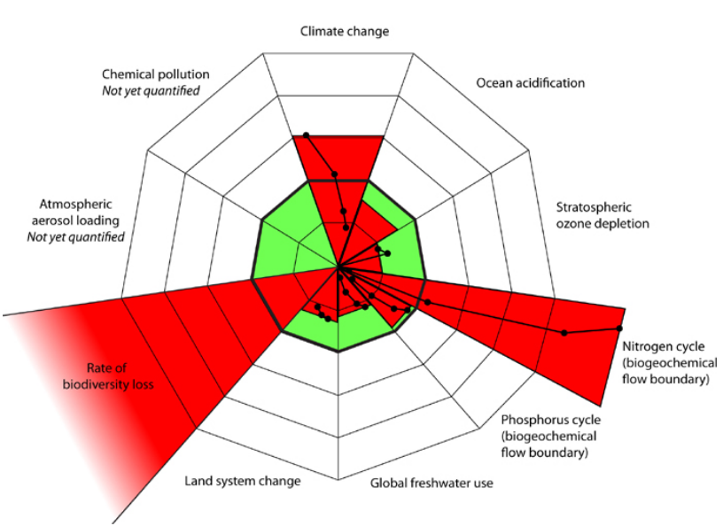
The amount of reactive nitrogen in terrestrial ecosystems has more than doubled compared with pre-industrial levels ¹⁾
Reactive nitrogen causes environmental impacts : human health, soil acidification, ecosystem disruption, tree mortality, and reductions in crop yields ²⁾
In the planetary boundaries framework, a threshold of 82 Tg N yr⁻¹ has been proposed for the globally allowable amount of anthropogenic nitrogen fixation; however, anthropogenic nitrogen fixation has greatly exceeded this threshold³⁾⁴⁾
Notes:
Reactive nitrogen in terrestrial ecosystems has increased dramatically due to human activities.Compared with pre-industrial levels, the amount of reactive nitrogen has more than doubled.Reactive nitrogen can cause a wide range of environmental impacts, including effects on human health, soil acidification, ecosystem disruption, tree mortality, and reductions in crop yields.In the planetary boundaries framework, a threshold of 82 teragrams of nitrogen per year has been proposed as the globally allowable amount of anthropogenic nitrogen fixation.However, current anthropogenic nitrogen fixation has already greatly exceeded this threshold.This means that nitrogen pollution is already beyond a safe global limit, and its management is an important environmental issue.

Slide 4
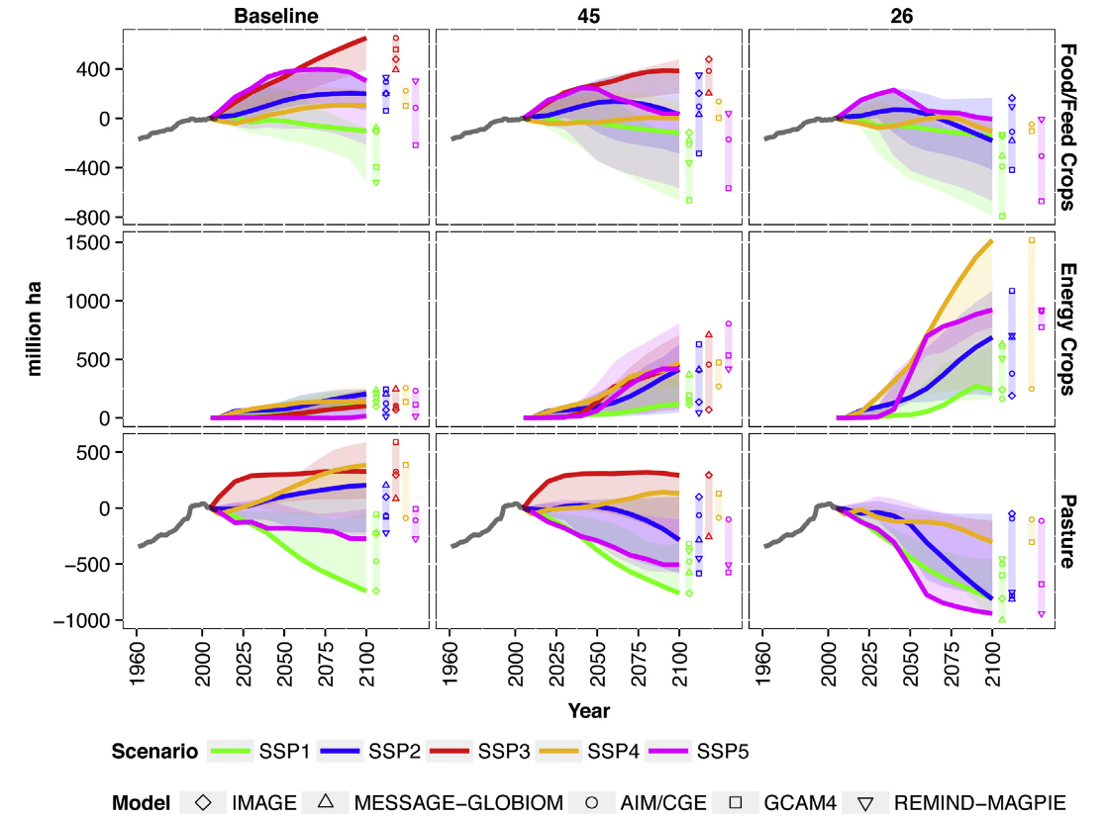
Various policies, including climate change mitigation measures, can affect nitrogen flows in agricultural land
RCP4.5, RCP2.6
Ex.)
The areas of cropland and pastureland differ substantially depending on the emission scenario, which also affects nitrogen flows.
Popp et al. (2017)⁵⁾
Notes:
Various policies, including climate change mitigation measures, can affect nitrogen flows in agricultural land.
For example, previous studies have shown that the areas of cropland and pastureland differ substantially depending on the emission scenario, such as RCP4.5 or RCP2.6.
Since land use, crop production, and livestock production are closely related to nitrogen inputs and outputs, changes in climate policy can also affect terrestrial nitrogen flows.
Therefore, it is important to evaluate nitrogen flows under different future scenarios.

Slide 5
What we did
Research gap
Assessing the impacts of policies such as mitigation measures on the nitrogen cycle is important; however, there is no nitrogen-specific model within the AIM integrated assessment framework.
Objective
Developing a grid-based nitrogen budget model that can be linked with AIM models and establish a foundation for analyzing nitrogen-related issues from multiple perspectives.
Notes:
The research gap is that, although assessing the impacts of policies such as climate mitigation on the nitrogen cycle is important, there is currently no nitrogen-specific model within the AIM integrated assessment framework.
The objective of this study is to develop a grid-based nitrogen budget model that can be linked with AIM models.
By doing so, this study aims to establish a foundation for analyzing nitrogen-related issues from multiple perspectives, including agriculture, atmospheric emissions, land use, and river water quality.

Slide 6
Overview of the methodology

Slide 7
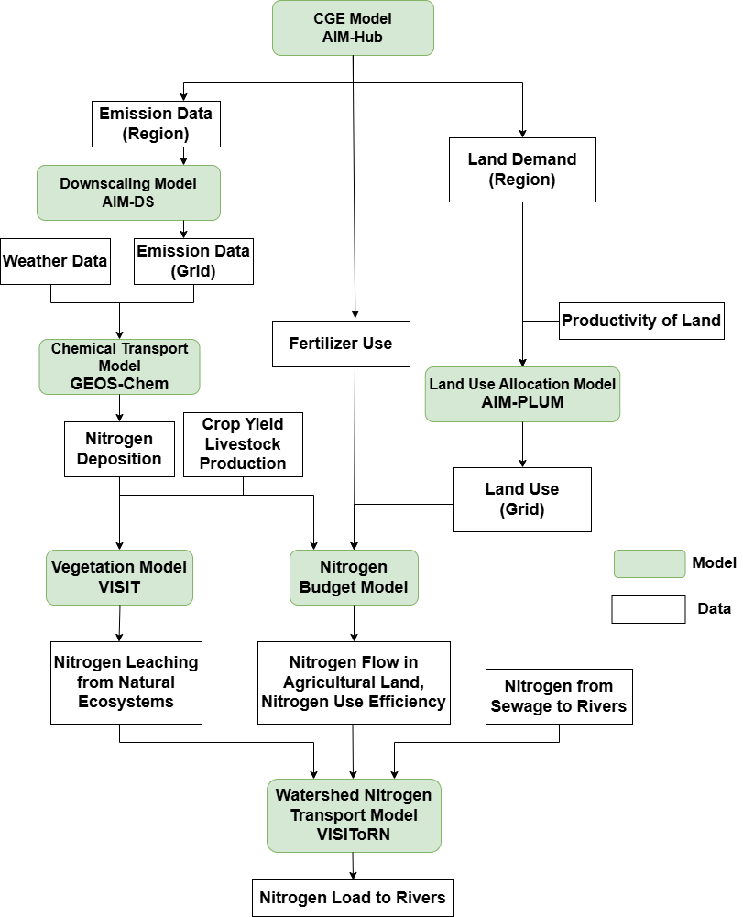
Models
The nitrogen budget model estimates nitrogen flows in agricultural land based on synthetic fertilizer input, livestock production, land use, nitrogen deposition, and other variables estimated by the upstream models
VISIToRN estimates nitrogen loading to rivers based on agricultural nitrogen leaching and natural nitrogen leaching estimated by the vegetation model VISIT
Notes:
This slide shows the overall model framework.
The nitrogen budget model estimates nitrogen flows in agricultural land based on several inputs estimated by upstream models.
These include synthetic fertilizer input, livestock production, land use, nitrogen deposition, crop yield, and other related variables.
In this way, the framework connects integrated assessment models with terrestrial nitrogen flow and river nitrogen loading.

Slide 8
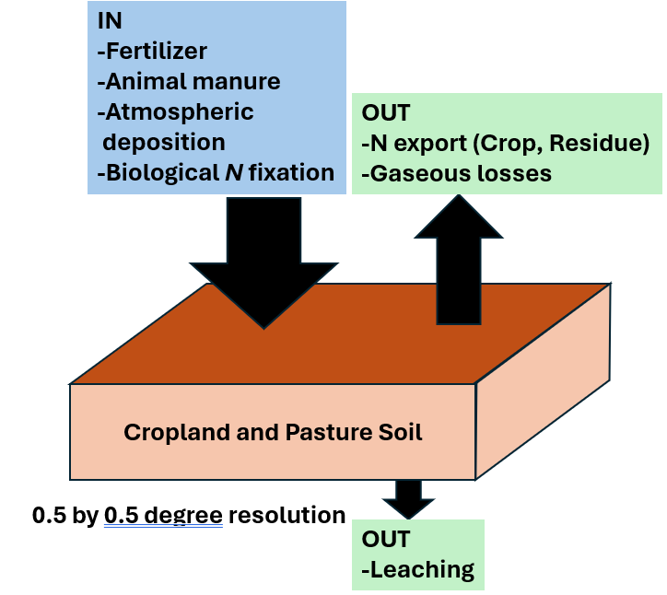
Models
Nitrogen budget model
Target area : global cropland and pasture
Resolution : 0.5°×0.5°
IN=INfer+INman+INdep+INfix
OUT=OUTcrop+OUTres+OUTgas+OUTlea
INfer : nitrogen content of synthetic fertilizer
INman : nitrogen content of manure
INdep : nitrogen deposition
INfix : biological fixation
OUTcrop : nitrogen content of crops
OUTres : nitrogen content of crop residues
OUTgas : nitrogen emissions to the air
OUTlea : nitrogen leaching
Notes:
The nitrogen budget model targets global cropland and pastureland at a spatial resolution of 0.5 degrees by 0.5 degrees.
The nitrogen input is defined as the sum of four components:
synthetic fertilizer, manure, atmospheric deposition, and biological nitrogen fixation.
The nitrogen output is defined as the sum of nitrogen contained in crops, nitrogen contained in crop residues, gaseous nitrogen emissions, and nitrogen leaching.
In this model, nitrogen leaching is calculated as the remaining nitrogen after subtracting crop uptake, residue recovery, and gaseous emissions from total nitrogen input.

Slide 9
Models
 | Overview of the calculation method
INfer | Estimated based on regional synthetic fertilizer inputs and crop yields from AIM-Hub, land use from AIM-PLUM, and other related data.
INman | The total amount of manure is calculated using livestock excretion rates per animal, livestock density from AIM-PLUM, and other related data, and is then allocated to each grid cell based on land-use shares from AIM-PLUM.
INdep | Estimated using nitrogen deposition from GEOS-Chem and land use from AIM-PLUM.
INfix | Estimated using nitrogen fixation rates for each crop and land-use shares from AIM-PLUM.
OUTcrop | Estimated using the nitrogen content of each crop, crop yields from AIM-Hub, land-use shares from AIM-PLUM, and other related data.
OUTres | Basically estimated in the same way as OUTcrop, but using the crop-to-crop-residue ratio.
OUTgas | Estimated using a regression equation⁶⁾ with precipitation, soil carbon content, and fertilizer input as explanatory variables.
OUTlea | Estimated by subtracting OUTcrop, OUTres, and OUTgas from the total IN

Slide 10
Scenarios
Socioeconomic scenario
SSP2(Shared Socio-economic Pathways): a moderate scenario
Emission scenarios
Baseline
… a business-as-usual scenario without any specific emission constraints
500C
… a stringent climate change mitigation scenario that limits cumulative CO₂ emissions after 2018 to 500 GtCO₂
Target years
2010, 2030, 2050, 2100
Notes:
In this study, the socioeconomic scenario is SSP2, which represents a moderate development pathway.
Two emission scenarios are considered.
The first is the Baseline scenario, which is a business-as-usual scenario without specific emission constraints.
The second is the 500C scenario, which is a stringent climate change mitigation scenario.
In this scenario, cumulative CO₂ emissions after 2018 are limited to 500 gigatons of CO₂.
The target years are 2010, 2030, 2050, and 2100.

Slide 11
Results

Slide 12
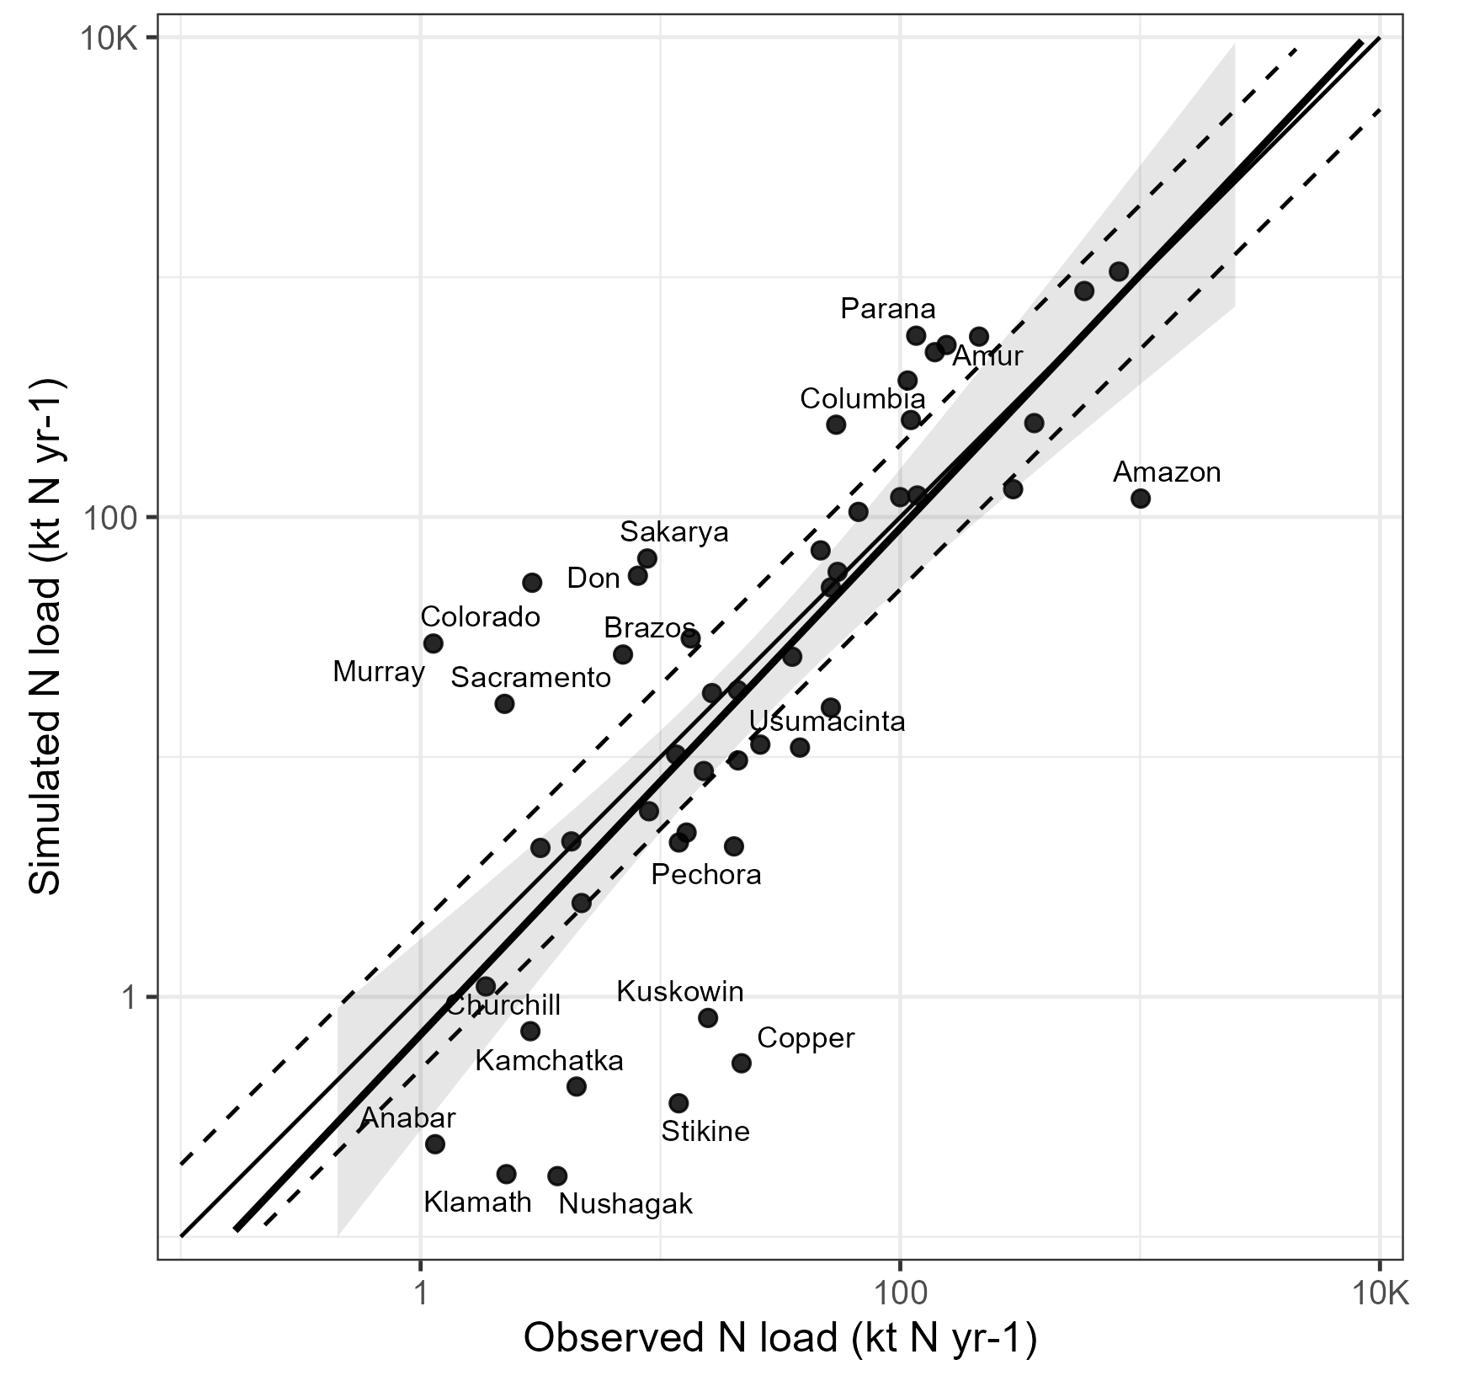
River N load (Comparison with observation)
RMSE 191%
R² 0.42
Compared with observations, the model generally reproduces both the magnitude of nitrogen loads and the relative ranking among rivers.
The estimated values ​​in this study were calculated for 2010, while the observed values ​​used for comparison are based on 1995 data from He et al. (2011)

Slide 13
Nitrogen gas emissions
Nitrogen emissions from agricultural soils and the entire agricultural sector in the nitrogen budget model used in this study and other emission inventories (2010, Tg N yr⁻¹)
 |  | NO_{x} | NH₃ | N₂O
Nitrogen Budget Model (this study) | Agricultural land soil | 2.5 | 19.5 | 4.5
 | Agricultural total | 2.5 | 48.4 | 4.5
AIM-Hub | Agricultural land soil | 1.0 | 25.9 | 3.9
 | Agricultural total | 1.1 | 35.0 | 4.1
EDGAR | Agricultural land soil | 1.0 | 26.4 | 3.4
 | Agricultural total | 1.8 | 36.7 | 3.7
CEDS | Agricultural land soil | 0.8 | 20.0 | 2.4
 | Agricultural total | 1.1 | 36.2 | 4.1
FAOSTAT | Agricultural land soil | (NO_{x}+NH₃) 31.8 |  | 3.8
The nitrogen budget model used in this study assumes a higher share of emissions from sources other than agricultural soils, such as manure management systems, compared with AIM-Hub
Notes:
This slide compares nitrogen gas emissions from the nitrogen budget model with other emission inventories.
The target gases are NOx, NH3, and N2O.
For agricultural land soil, the estimates from this study are generally comparable to those from AIM-Hub, EDGAR, CEDS, and FAOSTAT.
The nitrogen budget model used in this study assumes a higher share of emissions from sources other than agricultural soils, such as manure management systems, compared with AIM-Hub.

Slide 14
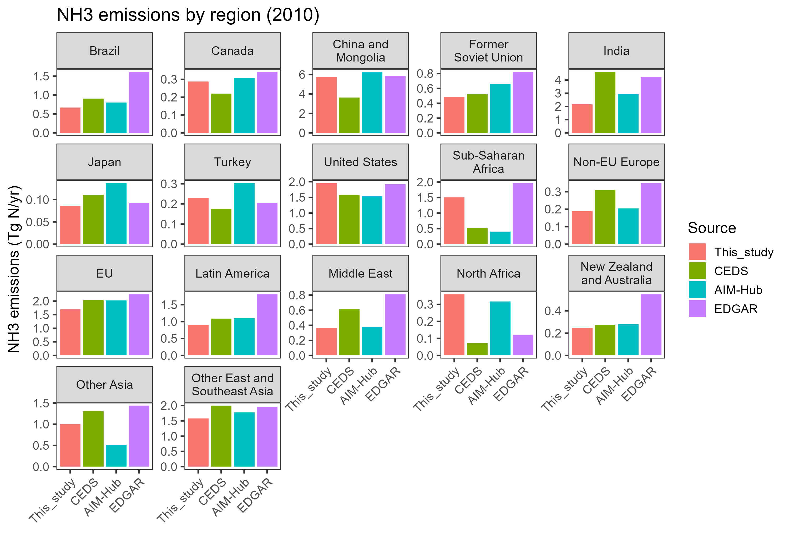
NH3 emissions from agricultural soil (Regional)
Comparing this study with the estimates from AIM-Hub, discrepancies were particularly observed in Sub-Saharan Africa and Other Asia, where the proportion of INman in the input is large
Comparison of nitrogen balance models in this study with agricultural soil-derived NH3 emissions from other emission inventories (2010)
Notes:
This slide shows regional comparisons of NH3 emissions from agricultural soils.
The results from this study are compared with other emission inventories, including CEDS, AIM-Hub, and EDGAR.
Overall, the estimates are broadly comparable, but discrepancies are observed in some regions.
In particular, differences are large in XAF and XSA.
These are regions where the proportion of manure nitrogen input is relatively large.

Slide 15
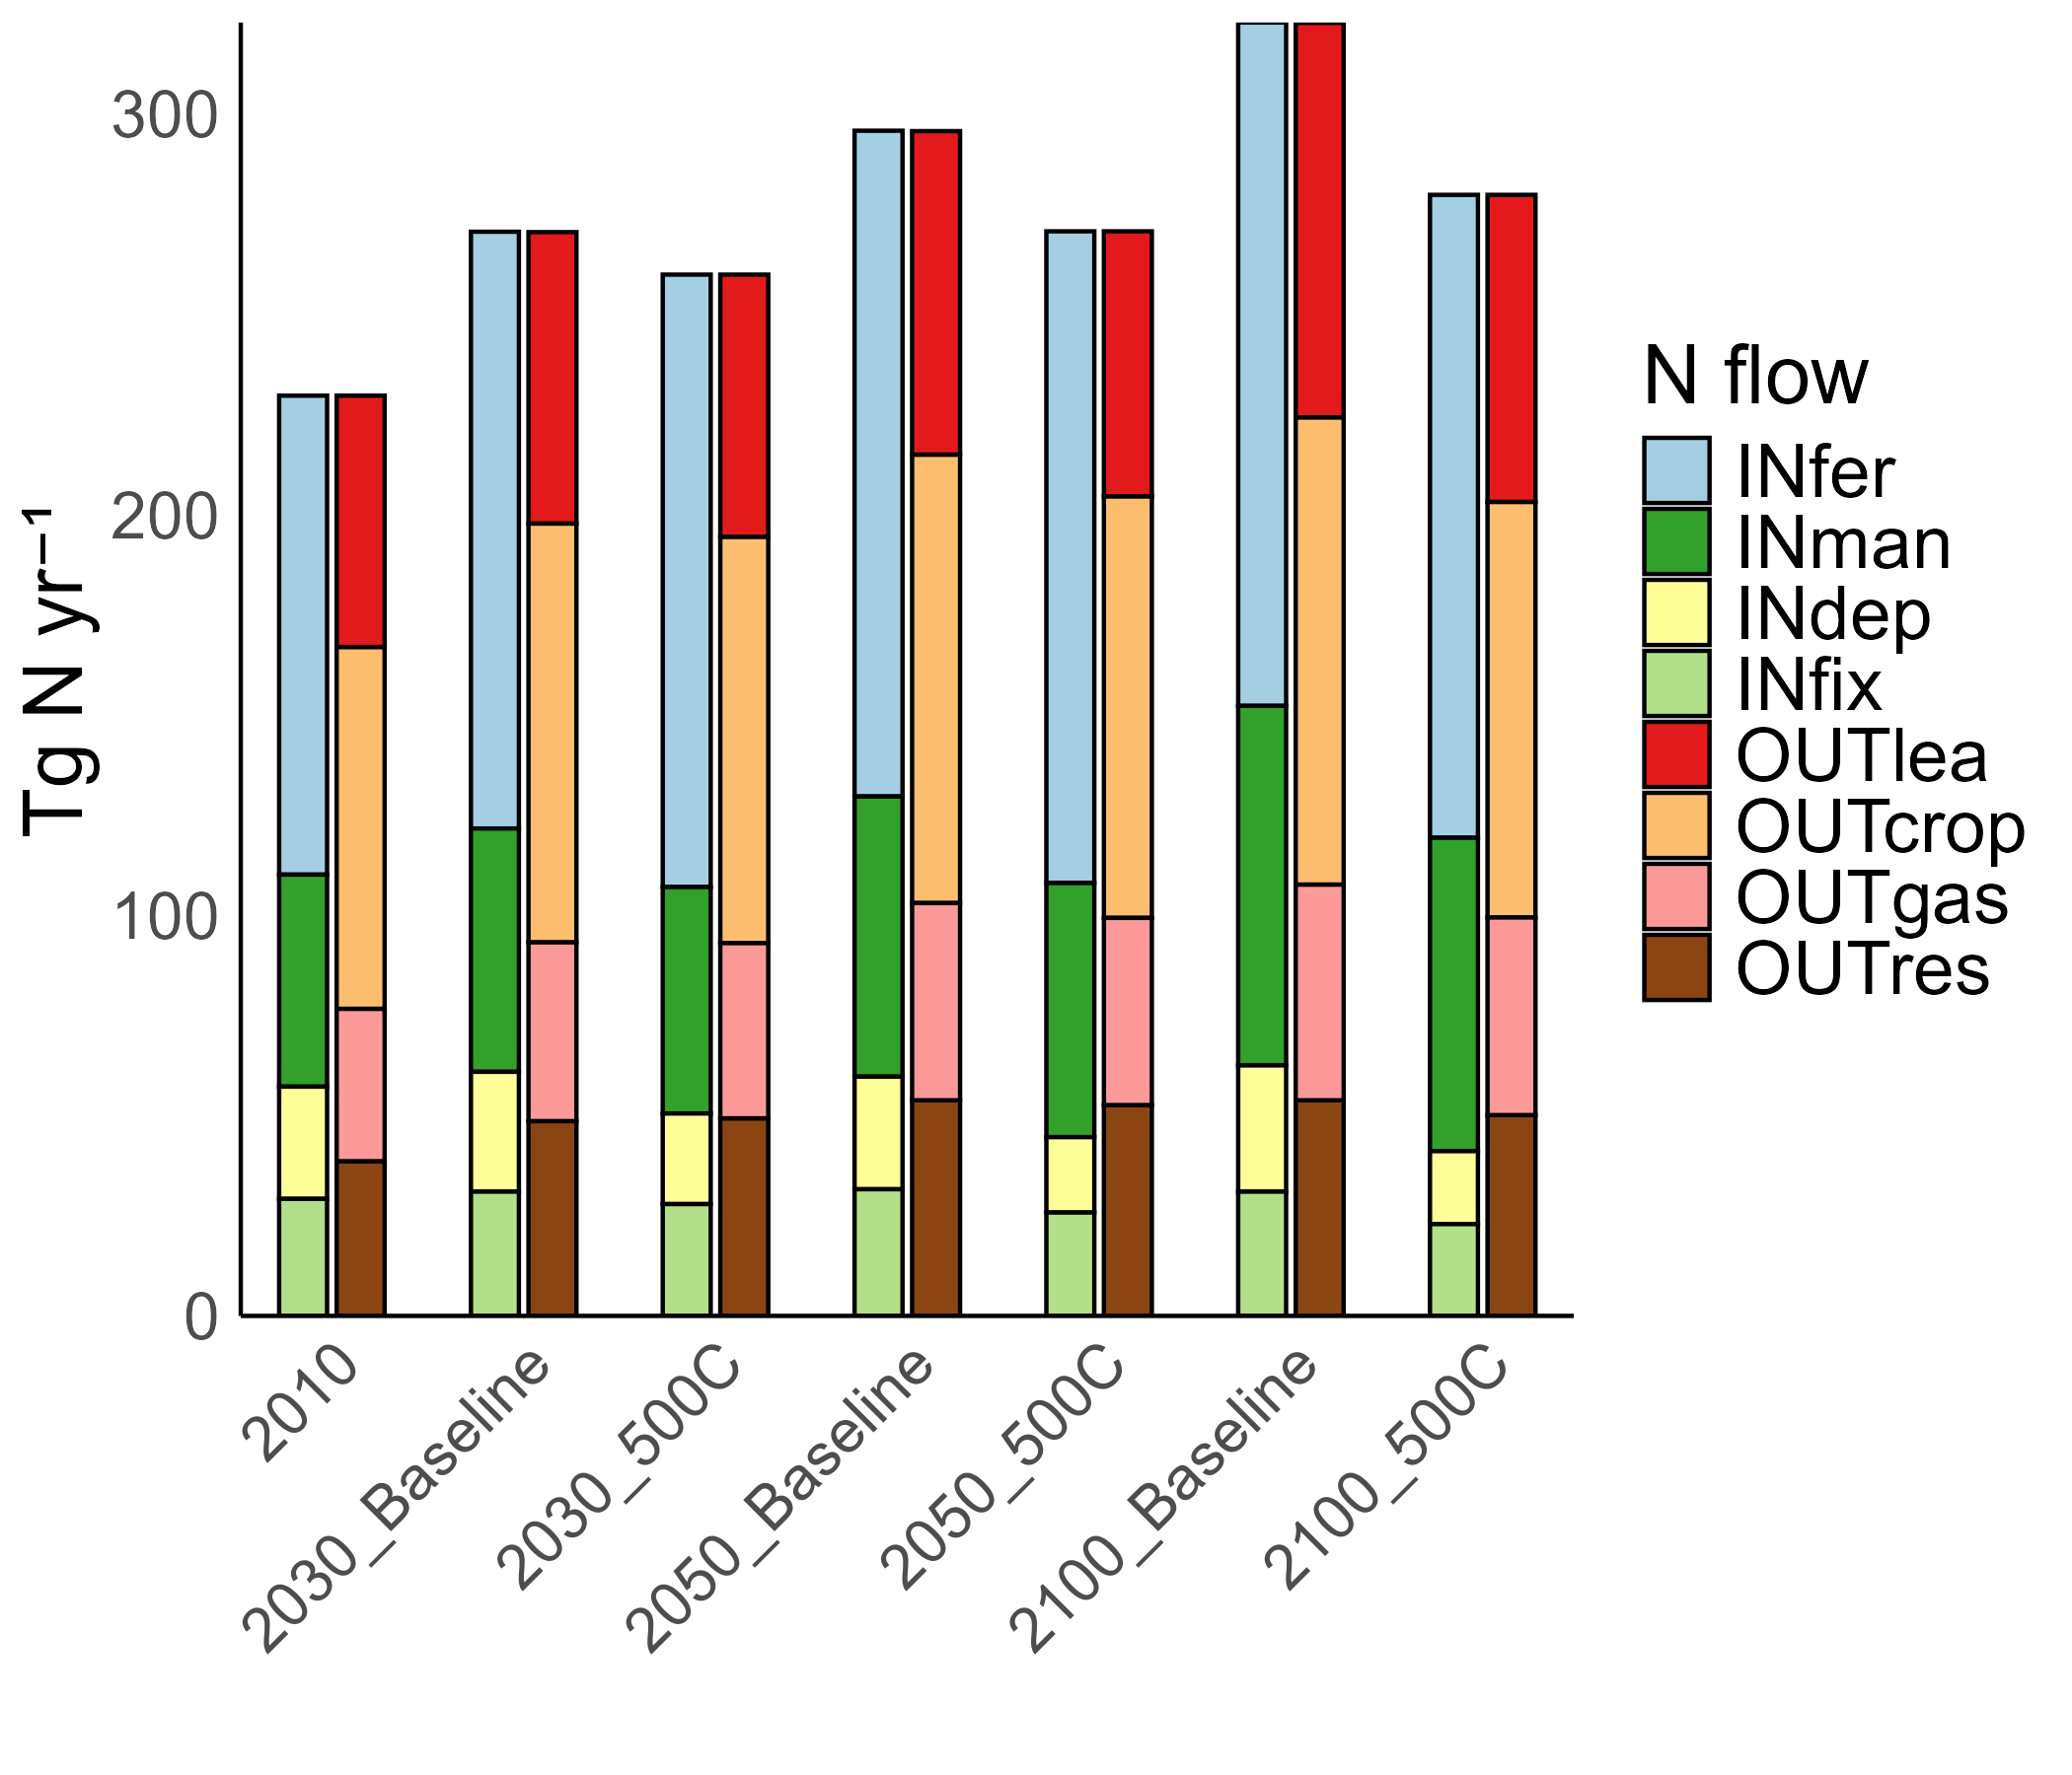
N budget in agricultural land
Due to increasing food demand and livestock production, INfer, INman, and OUTcrop increase after 2030 in each scenario
Nitrogen use efficiency is higher in the 500C scenario, suggesting that mitigation measures may improve nitrogen use efficiency
Notes:
This slide shows future changes in the nitrogen budget in agricultural land.
Due to increasing food demand and livestock production, synthetic fertilizer input, manure input, and nitrogen contained in crops increase after 2030 in both scenarios.
However, the nitrogen use efficiency is higher in the 500C scenario than in the Baseline scenario.
This suggests that climate change mitigation measures may have a co-benefit of improving nitrogen use efficiency.

Slide 16
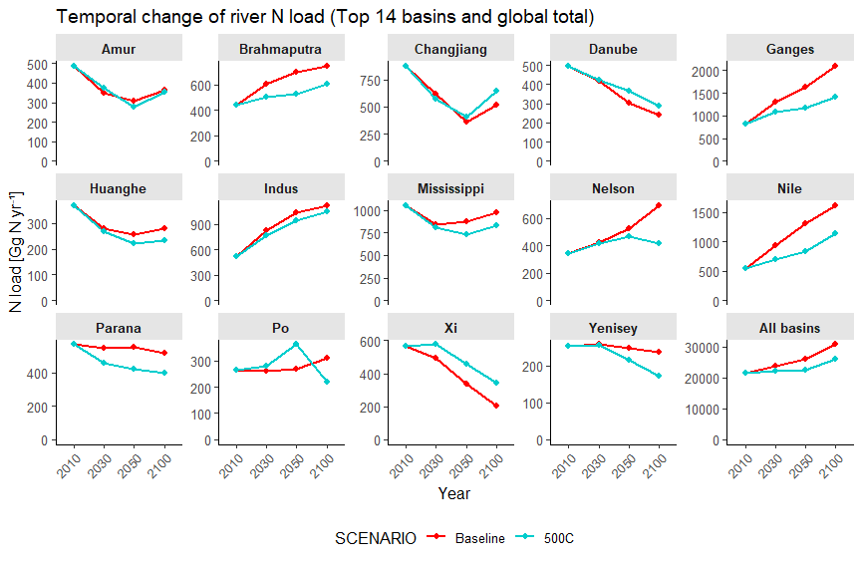
Future river N load
Mitigation measures suppress the increase in nitrogen inputs to agricultural land, thereby limiting the rapid rise in nitrogen loading in basins such as the Nelson River Basin
Temporal changes in nitrogen loading in major rivers and all basins (Gg N yr⁻¹)
Notes:
This slide shows temporal changes in nitrogen loading in major rivers and all basins.
The results indicate that climate mitigation measures suppress the increase in nitrogen inputs to agricultural land.
As a result, the rapid increase in nitrogen loading is limited in several basins.
For example, in the Nelson River Basin, nitrogen loading increases strongly in the Baseline scenario, but this increase is suppressed in the 500C scenario.

Slide 17
Discussions and conclusions

Slide 18
Summary
We newly developed a grid-based terrestrial nitrogen budget model that can be linked with the AIM framework and examined its validity
Climate change mitigation measures can bring the co-benefit of reducing nitrogen losses from agricultural land
The framework developed in this study will serve as a foundation for a wide range of research on climate change, nitrogen cycles, atmospheric chemistry, land use, and the water environment
Notes:
In this study, we newly developed a grid-based terrestrial nitrogen budget model that can be linked with the AIM framework.
We also examined its validity by comparing gas emissions with existing inventories and river nitrogen loads with observational data.
The results suggest that climate change mitigation measures can bring the co-benefit of reducing nitrogen losses from agricultural land.
The framework developed in this study will serve as a foundation for a wide range of research related to climate change, nitrogen cycles, atmospheric chemistry, land use, and the water environment.

Slide 19
Limitations
OUTlea is calculated by subtracting other outputs, such as the amount recovered as crops and residues and emissions into the atmosphere, from the nitrogen input to farmland. Therefore, OUTlea absorbs not only the uncertainty of leaching itself, but also the estimation errors of other nitrogen flows
In comparing estimated and observed values ​​regarding nitrogen load on rivers, the target years do not match
Notes:
First, OUTlea, or nitrogen leaching, is calculated by subtracting other outputs from total nitrogen input.
Therefore, OUTlea includes not only uncertainty in leaching itself, but also estimation errors in other nitrogen flows, such as crop uptake, residue recovery, and gaseous emissions.
Second, in the comparison between estimated and observed river nitrogen loads, the target years do not match.
The model estimates are for 2010, while the observational data are based on 1995.

Slide 20
Reference
1) Galloway, J. N.(1990): The global nitrogen cycle: changes and consequences.
2) Craig, B. W., & Friedland, A. J.(1991): Spatial patterns in forest composition and standing dead red spruce in montane forests of the Adirondacks and northern Appalachians,Environmental Monitoring and Assessment, 18(2), 129–143.
3) De Vries, W., Kros, J., Kroeze, C., & Seitzinger, S. P., Assessing planetary and regional nitrogen boundaries related to food security and adverse environmental impacts, Current Opinion in Environmental Sustainability, Vol.5, pp. 392–402, 2013.
4) Galloway, J. N., Aber, J. D., Erisman, J. W., Seitzinger, S. P., Howarth, R. W., Cowling, E. B., & Cosby, B. J., The Nitrogen Cascade, BioScience, Vol.53, pp. 341, 2003.
5) Popp, A., Calvin, K., Fujimori, S., Havlik, P., Humpenöder, F., Stehfest, E., Bodirsky, B. L., Dietrich, J. P., Doelmann, J. C., Gusti, M., Hasegawa, T., Kyle, P., Obersteiner, M., Tabeau, A., Takahashi, K., Valin, H., Waldhoff, S., Weindl, I., Wise, M., ... Vuuren, D. P. V.(2017): Land-use futures in the shared socio- economic pathways,Global Environmental Change, 42, 331–345.
6) Lesschen, J. P., Stoorvogel, J. J., & Smaling, E., Scaling soil nutrient balances: Enabling mesolevel applications for African realities, Food and Agriculture Organization of the United Nations, 2004.

Slide 21
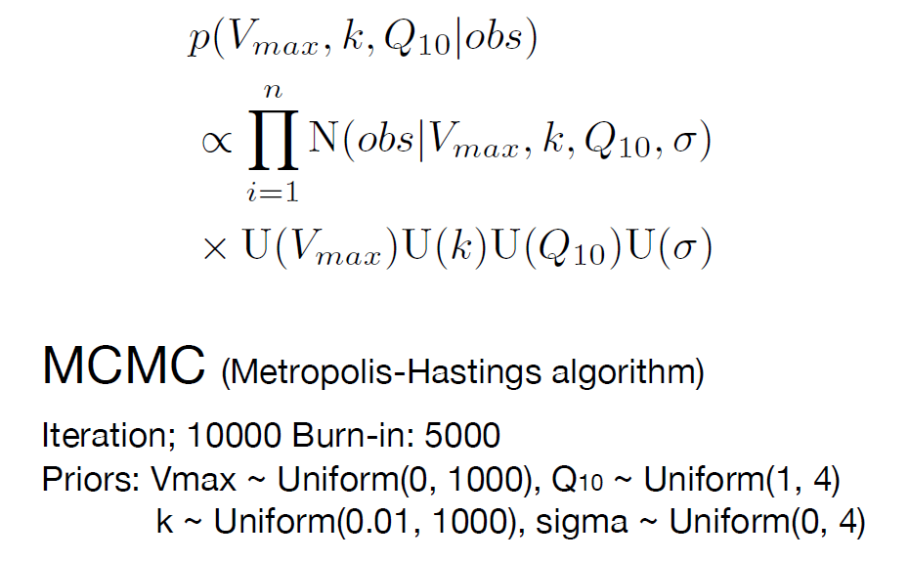
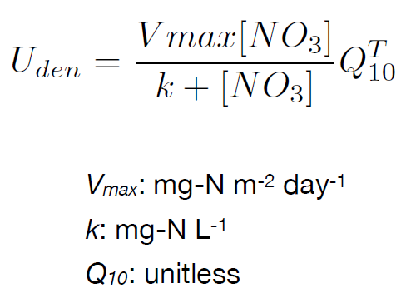
Calibration in VISIToRN
Bayesian calibration
Posterior for 3 parameters
By repeatedly sampling parameter sets and comparing simulated river nitrogen loads with observations, MCMC identifies plausible parameter values that improve model performance while accounting for parameter uncertainty.
It is assumed that the observed value, obs, is distributed around the model-calculated value with an error characterized by the standard deviation σ
Notes:
VISIToRN was calibrated using Bayesian calibration with the Metropolis-Hastings MCMC algorithm.
In this calibration, parameter sets are repeatedly sampled, and simulated river nitrogen loads are compared with observations.
Through this process, MCMC identifies plausible parameter values that improve model performance while also accounting for parameter uncertainty.
The calibration focuses on three main parameters related to denitrification processes:
maximum reaction rate, the half-saturation constant, and the temperature sensitivity parameter Q10.
The observed value is assumed to be distributed around the model-calculated value with an error characterized by the standard deviation sigma.

Slide 22
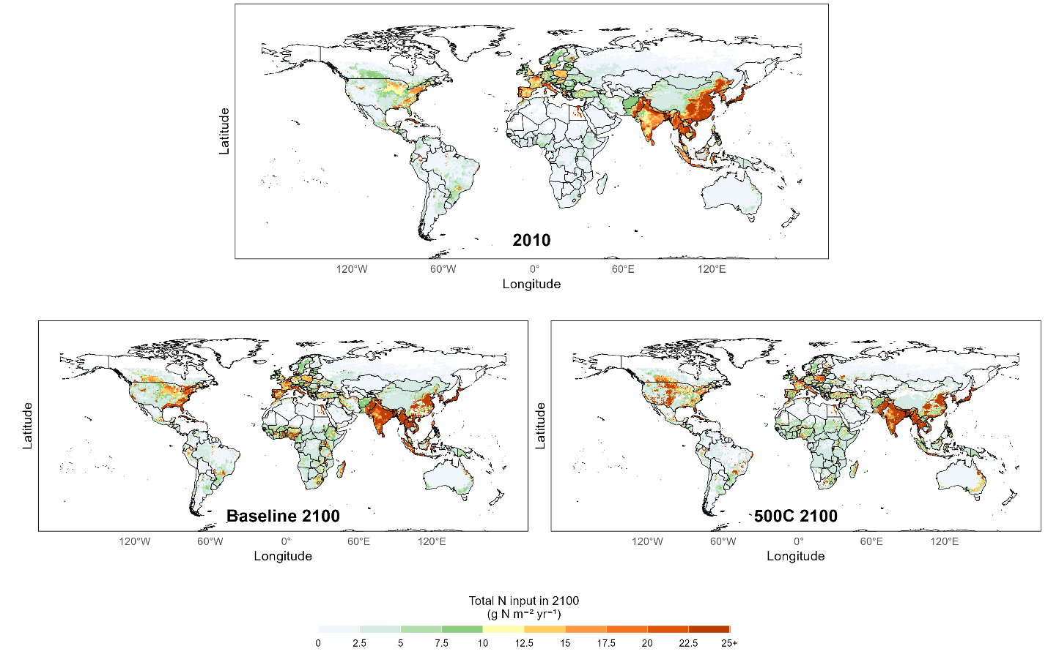

Slide 23
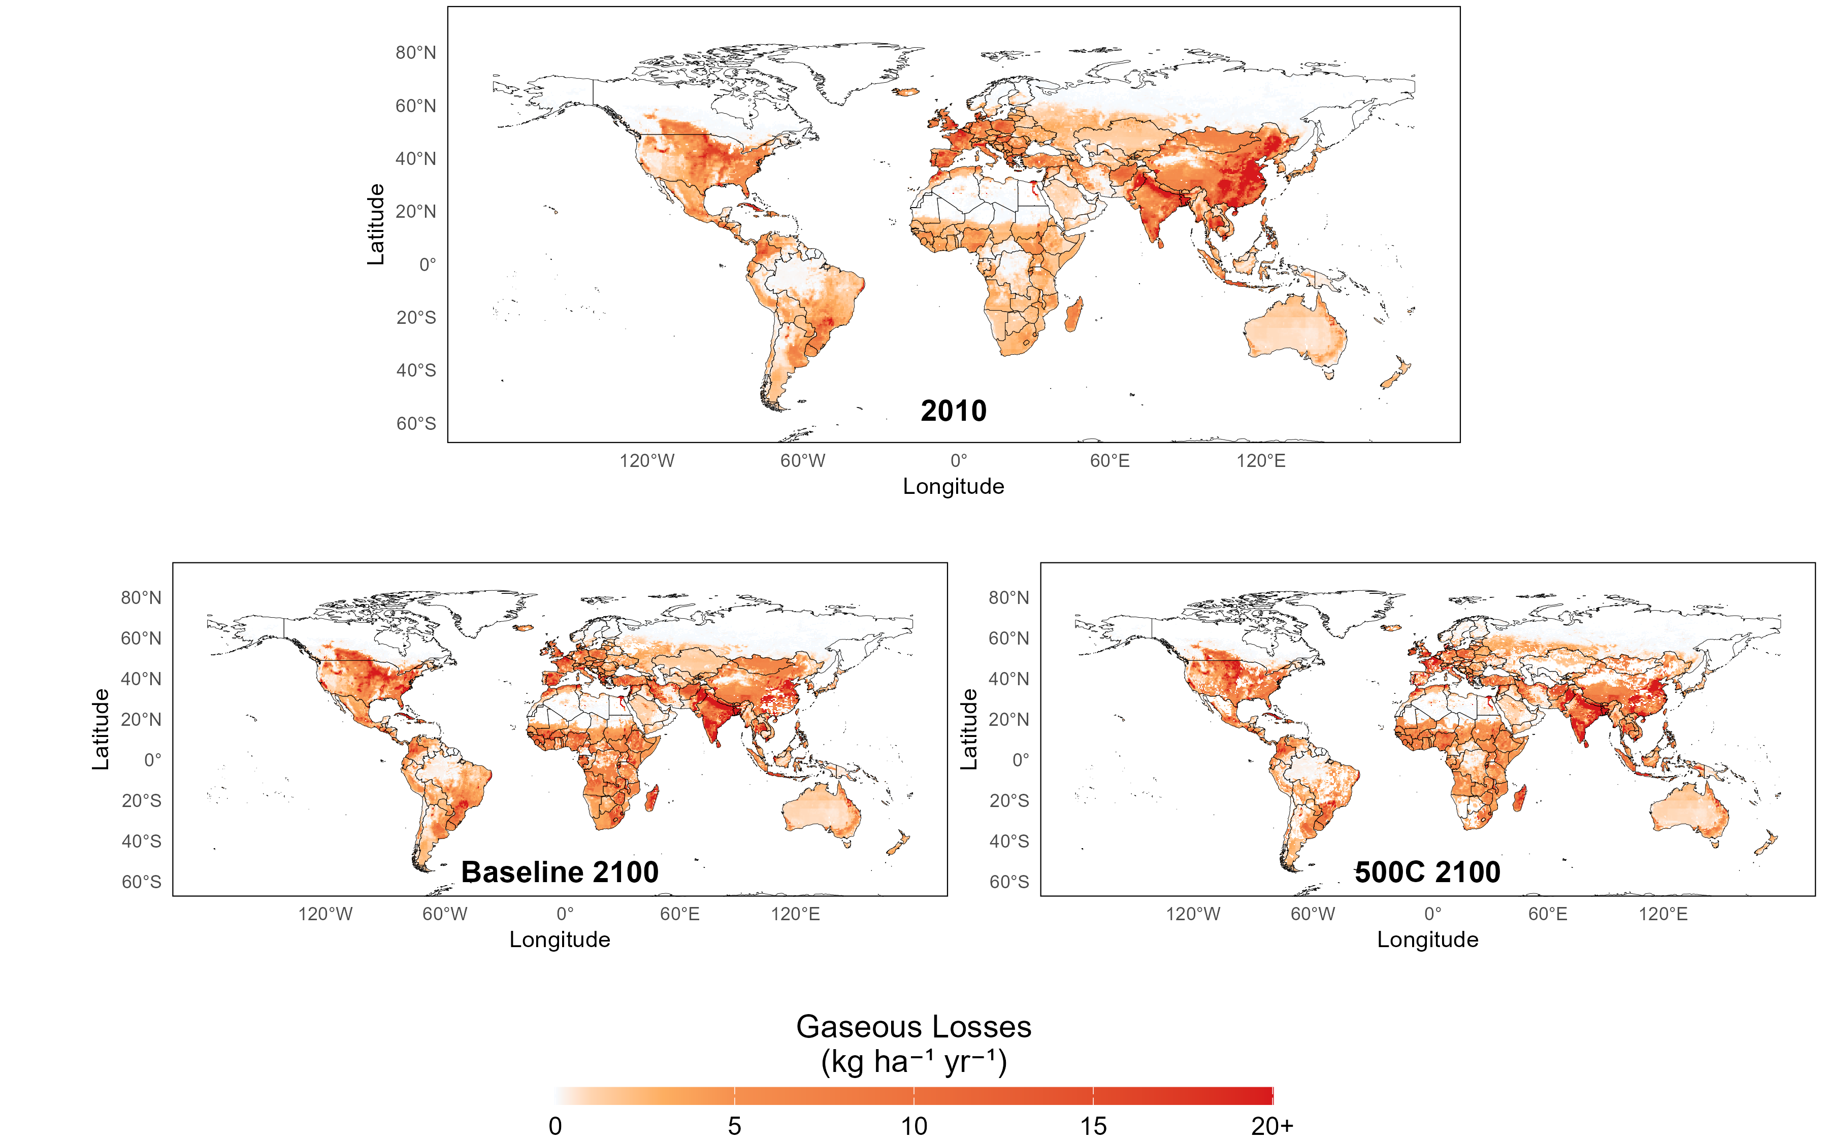

Slide 24
（Baseline）

Slide 25
（500C）

