Slide 1
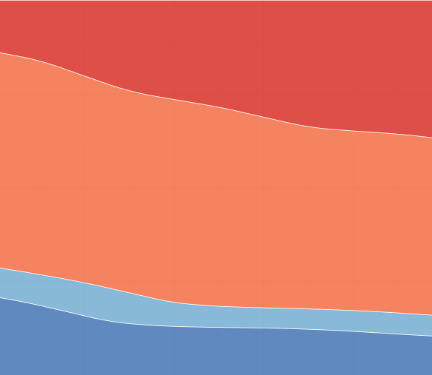


Advancing Dynamic CGE with demographically driven labour markets for short-term rigidity
By Kisshor Samyrao
Department for Business & Trade (UK)

Slide 2
Content of Presentation
The need for more rigidity
Proposal for labour rigidity & MLS
Application of model to Japanese economy and immigration

Slide 3
The need for rigidity (1/2)
Governments are concerned about the transition path
Even favourable policies in the long-run will produce short-run reallocation that may adversely impact workers/consumers/financial markets in the short-run.
Adverse policies are likely to be even more negative in the short-run as market forces cannot mitigate its effects.
Sub-regional impacts can likely vary considerably in the short-run, before converging in the long-run
Current CGE modelling concentrates on long-run
Elasticities are long-run
Land is homogenous (standard GTAP)
Labour is extremely aggregated, and mobile to normalise wages across sectors.
Capital is homogenous
Only Capital accumulation exhibits rigidity (in dynamic model)
We miss:
Demand adjusts much quicker than supply – meaning we hope to see large price shocks in endowments – and therefore larger welfare impacts – than conventionally modelled in GTAP.
Labour market rigidities mean that policies should have a much more drastic impact on different wage types than modelling.
In the following presentation I focus on our developments on labour within the dynamic CGE model.

Slide 4
The need for rigidity (2/2)
The issue with standard modelling assumptions is that it omits the painful transition paths that take place to achieve a new labour market equilibrium. And often makes unrealistic assumptions to achieve a new hypothetical equilibrium. Take the following example of US tariffs on Japanese motor vehicles.
MVH
MVH
Japan’s unskilled labour stock
Japan’s skilled labour stock
Japan’s unskilled labour stock
Japan’s skilled labour stock
In the baseline, MVH employs two types of labour, as does all sectors in the model. A shock like a MVH tariff by the US will lower Japanese MVH exports, output, and sales prices – depressing wages in the sector and encouraging labour to leave for other sectors in search of higher wages.
Assuming long-run modelling assumption, the labour stock will perfectly adjust to a new national equilibrium price – with MVH employing less, and other sectors employing more.
Can existing MVH workers reallocate to other industries?
Will the wage change in MVH be the same as other sectors?
Should a weakness in MVH generate a windfall for other Japanese sectors?
All other sectors
All other sectors
Visualisation of baseline labour allocation to Japanese sectors
4
Visualisation of post-sim labour allocation to Japanese sectors

Slide 5



Proposal for Labour market in GTAP (1/4)
Back to first principles: new joiners into the labour force have limited learned sector-specific skills. And are the most mobile labour type. With age, workers have built learned-skills in their incumbent sector – and are shown to be increasingly immobile. With age, workers are less likely to move sectors to chase wage differentials.
Outside labour force
Outside labour force
20 years old | 30 years old | 40 years old | 50 years old | 60 years old

Slide 6
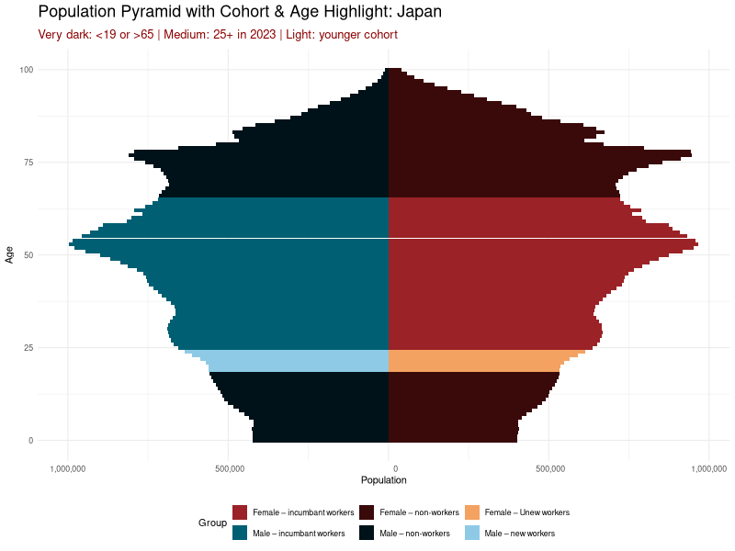
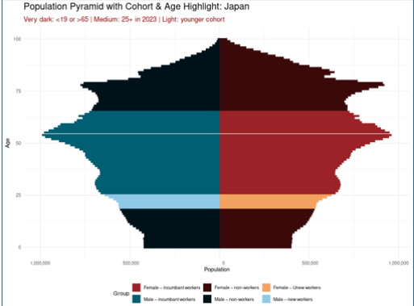
Proposal for Labour market in GTAP (2/4)
Split Labour stock into: fully mobile (youthful) labour, and sector-specific labour (established/incumbent workers)
Fall all regions in model, estimate % of working population (19-65yr olds) are highly mobile (youthful): I set as share of labour forced ages 19-25yr olds. Set this % of labour stock as “Multi-disciplinary labour”.

Slide 7
Proposal for Labour market in GTAP (3/4)
Visualisation of baseline labour allocation to Japanese sectors
unskilled agri. labour stock
Agri-foods
skilled agri labour stock
Japan’s multi-disciplinary labour type
Each sector employs from 3 labour types: their incumbent skilled, incumbent unskilled, and (the youthful) multi-disciplinary labour type
Based off the nation’s starting share of youthful workers, each sector employs a fixed share of its workers as “multi-disciplinary” labour stock.
A nation’s labour stock is made up of a disaggregated unskilled pool, and a very disaggregated skilled pool – indicating the medium degree of mobility of the former, and limited mobility of the latter
MVH
skilled engineer labour stock
unskilled manu. labour stock
ELE
skilled BFI labour stock
OBS
unskilled Services labour stock
Services
skilled transport labour stock

Slide 8
Proposal for Labour market in GTAP (4/4)
Visualisation of post-sim labour allocation to Japanese sectors
The economic impact of the policy shock is centred on the target sector’s incumbent labour market
Beneficial reallocation of labour is confined to sectors that employ the same incumbent labour type
The only mechanism by which a policy shock can impact labour markets in third sectors is via wage pressure of the (youthful) multi-disciplinary labour market
unskilled agri. labour stock
Agri-foods
skilled agri labour stock
Japan’s multi-disciplinary labour type
MVH
skilled engineer labour stock
unskilled manu. labour stock
ELE
skilled BFI labour stock
OBS
unskilled Services labour stock
Services
skilled transport labour stock

Slide 9
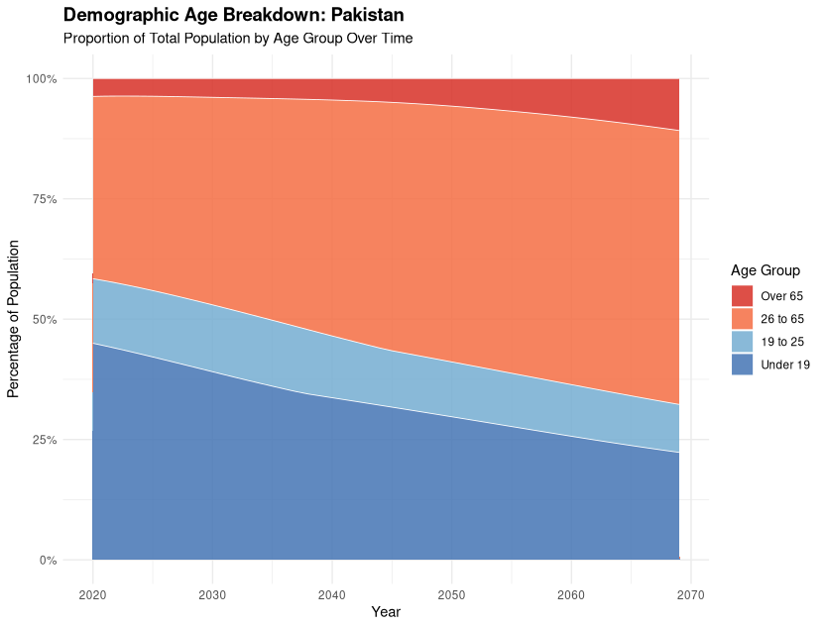
Project the disaggregated labour market in dynamics (1/2)
To allow the model to tend towards a long-run, fully mobile equilibrium, I propose adjustment of the labour stock in the model to align with demographic trends – where the share of the population occupied by the multi-disciplinary type grows to encompass the majority of the labour market.

Slide 10
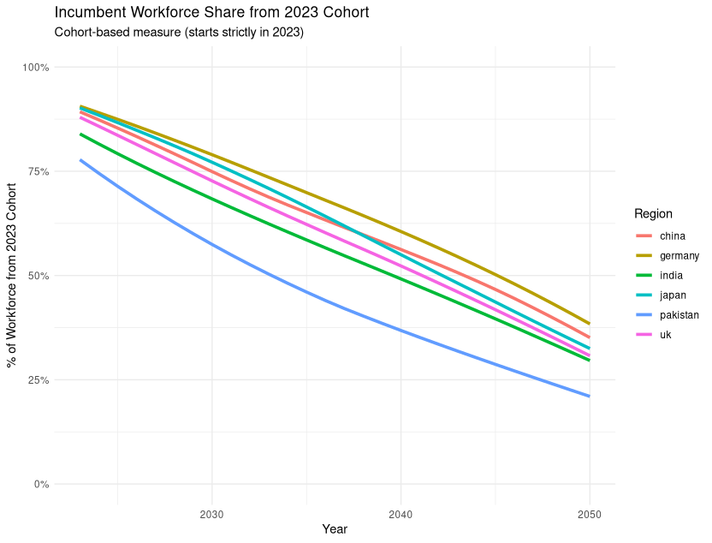
Project the disaggregated labour market in dynamics (2/2)
Applied to all regions within a dynamic CGE model, projections now inherently bake in short-run labour market rigidities – limiting the ability for labour reallocation (and expanding wage differentials) in short/medium run.
An aging population now represents a labour force with larger labour market rigidities, and less dynamism in the face to changes to macroeconomic shocks.
Japan and Germany are among the most aged working population in this study, whilst Pakistan and India are among the least.

Slide 11
Application of model to the case of Japanese Immigration (1/4)
We have now a more realistic labour market, with rigidities, and shortages driven by wage differentials and limited young workers.
How would the addition of +1000 worker visa (by type) affect the Japanese economy?
Japanese GDP | Welfare | Trade Balance | Sub-regional impact
Skilled Business, Finance, Insurance workers
Skilled Engineering and Technician workers
Unskilled Agriculture workers

Slide 12
Application of model to the case of Japanese Immigration (2/4)

Slide 13
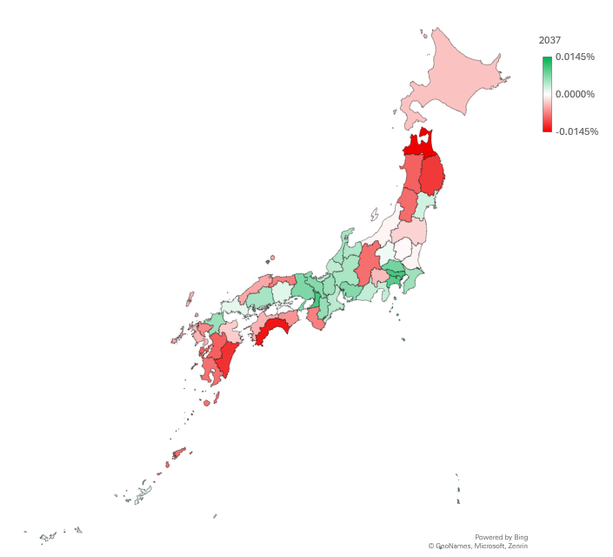
Application of model to the case of Japanese Immigration (3/4)
Heat map of changes in real purchasing power by prefecture
More incumbent agricultural workers will lower their average wage in Japan
Lower costs for agri-labour lowers food costs – depressing CPI
Urban centres of Japan see real wage growth
Rural areas of Japan see average wages fall.
Immigration has distributional impacts by prefecture

Slide 14
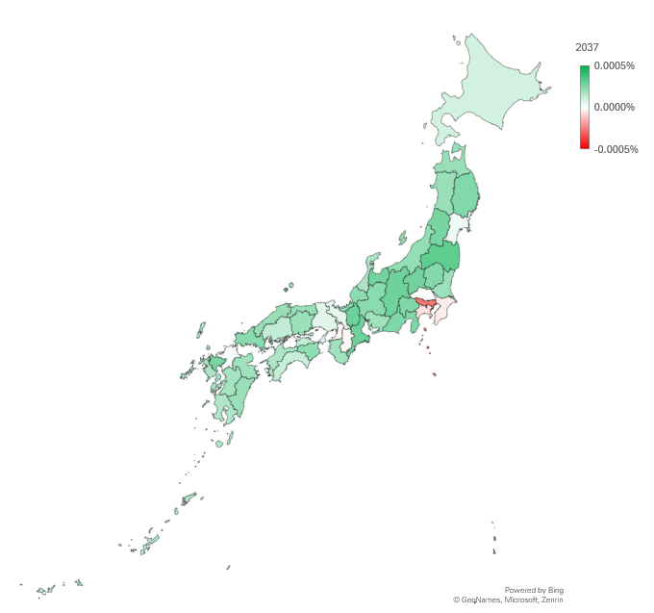
Application of model to the case of Japanese Immigration (3/4)
Heat map of changes in real purchasing power by prefecture
More BFI workers marginally lowers their wage
Lower financial services costs pass through to all worker’s CPI
Tokyo sees a permanent fall is average real wages
National real wages fall in the first 4 years of the immigration before recovering
Immigration has distributional impacts by prefecture

Slide 15
Concluding remarks
Current GTAP Dynamic Model is too mobile
Economic literature highlights the rigidity of labour
Incumbent workers are most immobile – connecting demographics to labour mobility
GTAP database can be altered to include short-run rigidity
This presentation shows with limited assumption, rigidity can be created
Establishing a multi-disciplinary labour type (connecting to youth, allows you to bake into the model varied rates of market adjustment
Sub-regional and distributional analysis are enhanced
Modelling shows the aggregate negative impact of immigration to national purchasing power in the short-run, and the slow recovery – by prefecture, and labour type.
The scope of GTAP has also expanded to allow analysis of even immigration

Slide 16
Annex

Slide 17
Deep dive into impact from +1000 BFI visa
The rise in BFI workers is largely absorbed into Japan’s OBS sector – who consequentially releases some unskilled services and multi-disciplinary labour into the market.
The release of unskilled services and multi-disciplinary labour is absorbed by Japan’s construction sector – adding more detail on the labour market dynamics from this policy change.

