Slide 1



29th Annual Conference on Global Economic Analysis
June 17-19, 2026 - Kyoto
A multi-model assessment of technological constraints on Europe’s energy transition
Maro Baka (E3M)
This work was supported by the European Commission Horizon Europe projects “IAM COMPACT”, “TRANSIENCE”, and “ENTICE” under Grant Agreements No. 101056306, 101137606, and 101184775, respectively.
Alongside Panagiotis Fragkos, Eleftheria Zisarou, Dirk-Jan Van De Ven, Shivika Mittal, Lorenzo Rinaldi, Matteo Rocco, Clàudia Rodés-Bachs, Natasha Frilingou,
Conall Heussaff & Alexandros Nikas

Slide 2
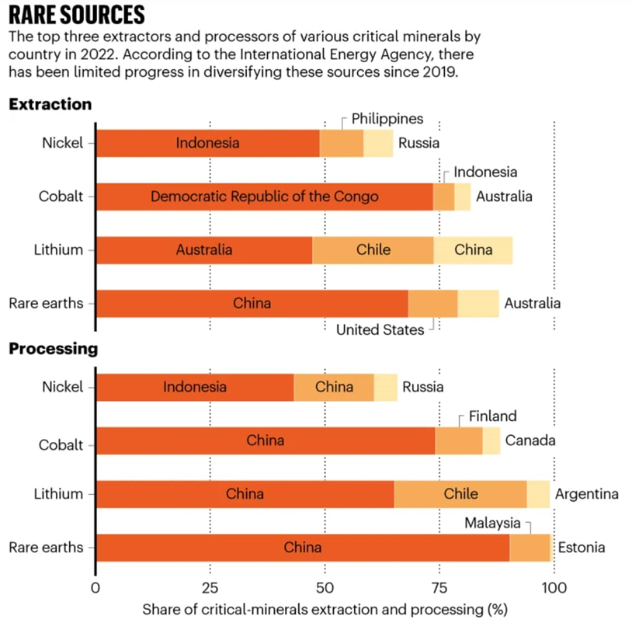


Context
EU’s net-zero pathway depends on few critical technologies
Renewables, batteries, biomass, CCS
These technologies rely on global supply chains
Vulnerable to geopolitical tensions, trade restrictions, and material shortages
Most studies assume smooth technology deployment
What happens if/when disruptions occur?
RQs
Implications of limited access to critical low-carbon tech (RES & batteries, biomass, CCS) for achieving 2030/2050 targets (EU)?
(Ukraine war, material concentration in China—could limit access to these technologies)
Energy mix, FF dependence, system costs, sector vulnerability

Slide 3
Model ensemble
Model | Type | Solution Horizon | Tech choice
GCAM (BC3) | Partial equilibrium | Recursive-dynamic (myopic) | Logit choice
PROMETHEUS (E3M) | Energy-system | Recursive-dynamic (myopic) | Logit choice
TIAM (CICERO, Imperial) | Partial equilibrium | Intertemporal (perfect foresight) | Winner takes all
MARIO (POLIMI) | Input – Output | Comparative-static simulation | -

Slide 4
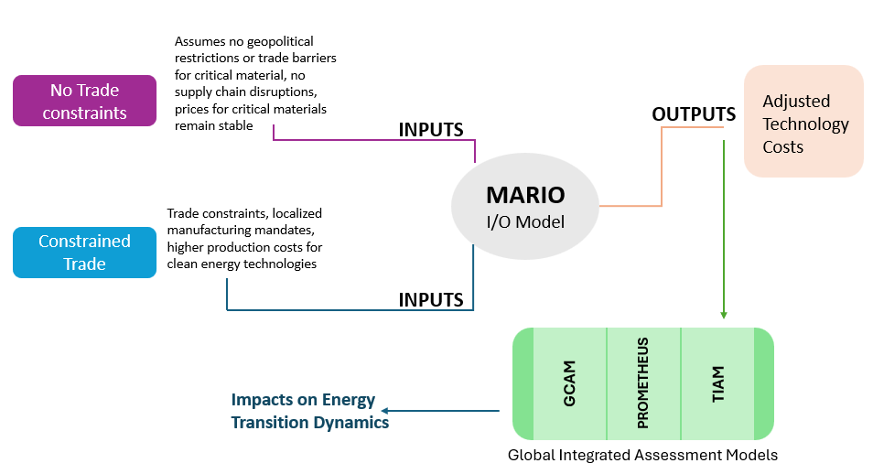
Methodology

Slide 5
Scenarios
Scenario | Short description
NDC-LTT | Globally: NDC targets for 2030, LTTs for 2050 (e.g., net zero in the EU)
NDC-LTT-LimRES | Limited expansion of RES and energy storage, including batteries, due to material unavailability and geopolitical tensions: cleantech costs increase due to import constraints in materials and clean technologies (MARIO)
NDC-LTT-LimBIO | Restricted biomass use for energy purposes in the EU (5-6 EJ cap by 2050)
NDC-LTT-LimCCS | Restricted CCS deployment in the EU (10-20 Mt CO₂ cap by 2050).

Slide 6
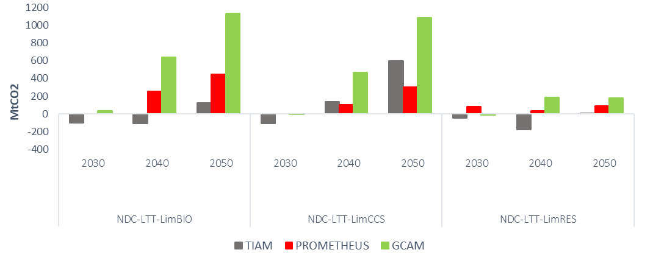
Attainability of net zero by 2050
Cleantech constraints raise emissions: Limiting scale-up of RES, batteries, or biomass significantly increases CO₂ emissions (and/or costs), especially post-2030 (high reliance on fossil fuels)
Biomass and CCS are critical: Constraints on biomass and CCS lead to the largest emission spikes (hard to replace in industry, CDR, etc.)
Perfect foresight
Differences in EU CO2 emissions between alternative scenarios with the baseline scenario in 2030-2050. Source: GCAM, PROMETHEUS, and TIAM.

Slide 7
Long-term impact on EU transportation
NDC-LTT-LimRES
Higher battery costs decelerate EV adoption
Post 2035: Without cheap RES and batteries, electrification stalls
Oil demand in transport stays higher than baseline (esp. freight & aviation)
Risk: EU imports more oil and gas (transitional); weaker energy security
NDC-LTT-LimBIO
Post-2035: no large-scale biofuels for aviation/shipping
Heavy and costly reliance on synthetic fuels (H₂-based)
Road transport: faster push to EVs (due to liquid biofuel unavailability)
NDC-LTT-LimCCS
Limited direct effects (esp. until 2030)
Electricity price spikes (costlier technologies in power generation) lead to increased consumption of liquid (incl. petroleum, biofuels) & synthetic

Slide 8
Adaptability of the EU built environment
NDC-LTT-LimRES
2030: electricity prices rise, slowing heat pump adoption
Onwards: Slower electrification of heating; holding onto gas boilers
District heating may rely more on fossil fossil backup
Slower, more gas-reliant decarbonisation: higher costs, higher lock-in risks
NDC-LTT-LimBIO
2030: small impact (biomass is niche in buildings already)
Onwards: no biomass for heating (pellets, stoves, small boilers)
Heavier reliance on heat pumps and electricity
Regions with slower electrification (e.g., Eastern EU): longer persistence of gas boilers (higher emissions)
NDC-LTT-LimCCS
Less relevant
Indirect effect: no district heating from waste/biomass with CCS (drop in negative emissions)
2050: residual emissions elsewhere add pressure for higher efficiency

Slide 9
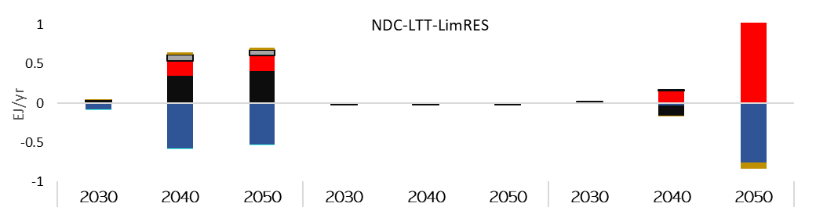
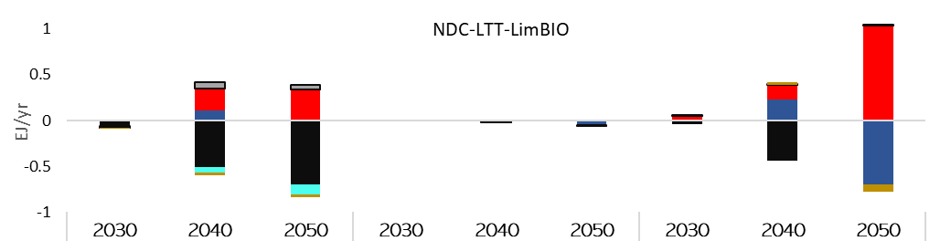
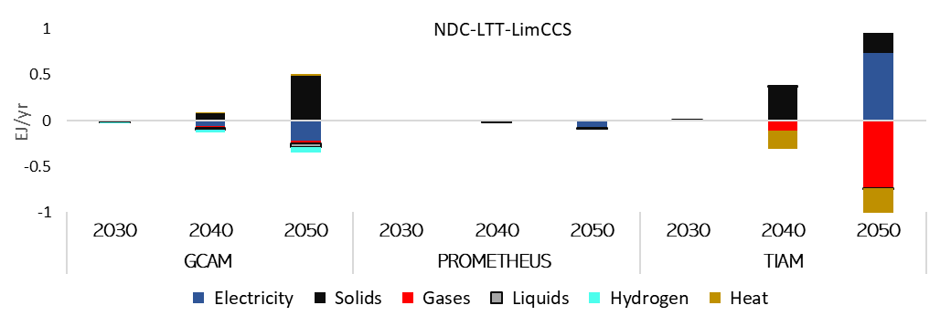
Prospects for industrial decarbonisation
Limited RES and batteries: Increased electricity costs, reduced supply reliability, slower electrification, delayed transition to green H₂ and low-emission industrial heat
Biomass constraints: Limited fossil fuel substitution (esp. in hard-to-electrify sectors), no potential for CDR to offset residual industrial emissions, higher reliance on imported gases and system costs
CCS constraints: CCS sole option for process emissions in EIIs; lower emission cuts, lock-into residual CO₂, increased dependence on carbon-intensive production routes—diverging model responses
Notes:
biomass provides both a renewable feedstock and a source of industrial heat

Slide 10
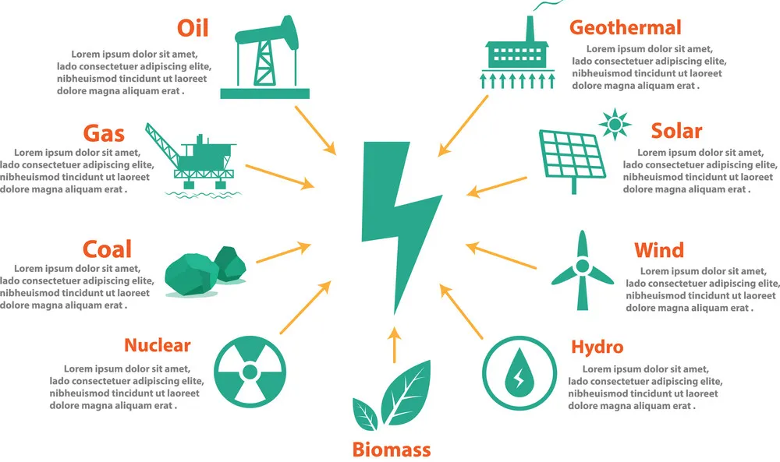
Crippled EU power-sector potential
NDC-LTT-LimRES
NDC-LTT-LimBIO
Limits BECCS—Weaker potential for negative emissions
Other dispatchable clean options (nuclear, hydro) expand; near-term gas acts as bridge fuel
NDC-LTT-LimCCS
Harder push on non-CCS tech

Slide 11
Conclusions
Europe's path to climate neutrality remains dependent on a limited set of technologies, each with a distinct role in decarbonisation
Tech constraints pose measurable risks to achieving 2030 and 2050 goals; higher emissions, system costs, fossil fuel imports
Limiting biomass or CCS produces the largest emission increases (up to 1.1GtCO₂ by 2050 for the same level/intensity of policy as in the unconstrained path); RES & battery constraints have smaller (still significant) long-term impact
Asymmetric sectoral impacts:
Power sector compensates via nuclear and gas, raising costs and import dependency
Industry faces persistent process emissions without CCS and biomass feedstocks
Transport remains tied to fossil fuels without efficient biofuels or electrification capacity
Buildings can decarbonise if clean electricity is cheap and widely available. Any constraint on RES or biomass slows down the shift to clean heating, keeps gas boilers in use, and raises costs for households

Slide 12
Thank you!
^{Maro Baka}
^{maro.baka@ricardo.com}
Full list:
Panagiotis Fragkos, Maro Baka, Eleftheria Zisarou, Dirk-Jan Van De Ven, Shivika Mittal, Lorenzo Rinaldi, Matteo Rocco, Clàudia Rodés-Bachs,
Natasha Frilingou, Conall Heussaff, Alexandros Nikas
This work was supported by the European Commission Horizon Europe projects “IAM COMPACT”, “TRANSIENCE”, and “ENTICE” under Grant Agreements No. 101056306, 101137606, and 101184775, respectively.

