Slide 1


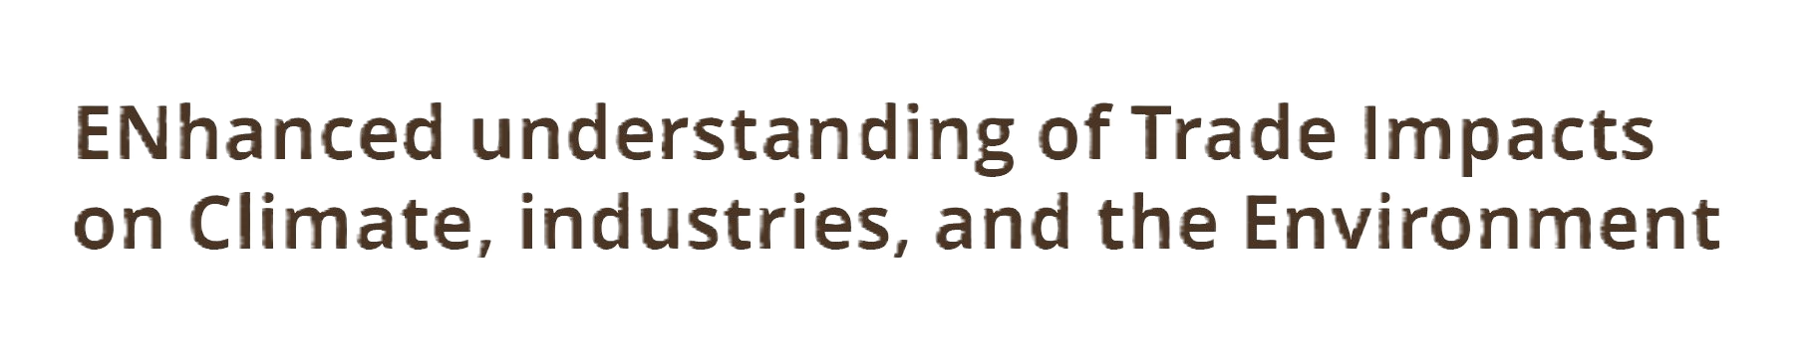
29th Annual Conference on Global Economic Analysis
June 17-19, 2026 - Kyoto
Industrial Policy Nationalism has negative impacts on economies and the climate
Panagiotis Fragkos (E3M)
Alongside Lukas Hermwille, Kostas Fragkiadakis, Dimitris Fragkiadakis

Slide 2


What is Industrial Policy Nationalism?
Industrial Policy Nationalism (IPN):
Priority of growth and development of domestic industries
Support of industrial domestic production in the face of external competition
Common features:
  protectionism (usually in the form of feed-in-tariffs)
  strategic investments
Three global trends drive Industrial Policy Nationalism:
Increased attention to supply chain resilience (COVID pandemic)
Increasing uncertainty of industrial energy supply (Russian invasion of Ukraine/ global energy crisis)
Increasing competition over the benefits of the climate transformation

Slide 3
Research question and objectives
Objective:
Implications of Industrial Policy Nationalism:
economic development
structural resilience & import dependency
climate action globally
Analytical Steps:
What is Industrial Policy Nationalism?
Which policies contribute?
Develop Scenario protocol for different variations of Industrial Policy Nationalism
Comparison of macroeconomic and sectoral indicators – focus on resilience and import dependency

Slide 4
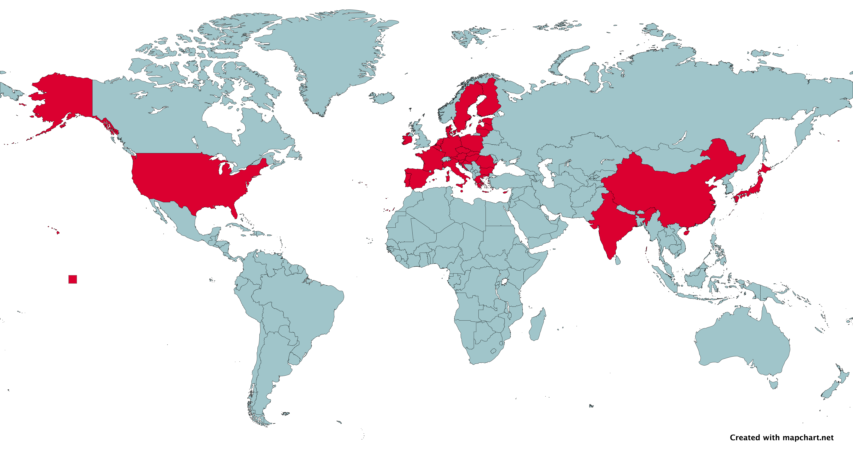
Policies that (allegedly) contribute to Industrial Policy Nationalism
EU: Net-Zero Industry Act
& Carbon Border Adjustment Mechanism
CN: Made in China 2025 & Dual Circulation
US: Inflation Reduction Act
IN: Production Linked Incentives
JP: Green Transformation (GX) Act

Slide 5
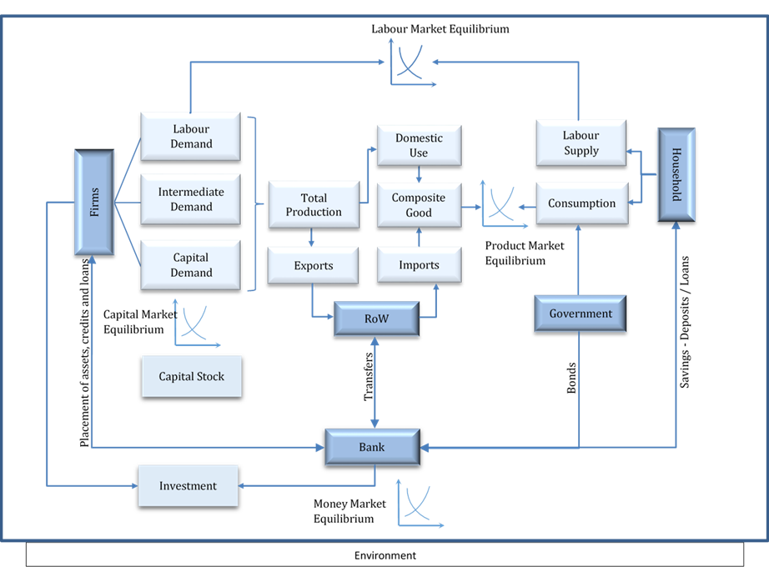
The global CGE model GEM-E3
Model outputs
GDP
GDP components (Investments, Gov. consumption, Private consumption, Imports, Exports), Private consumption by purpose
Production / Exports / Imports by economic activity
Employment by economic activity and by skill
Unemployment rate
Bilateral trade flows by economic activity
GHG emissions by country, economic activity and gas type, Carbon price
Detailed energy system projections
Investments by sector
Fiscal balance
Default version covers 54 countries/regions and 60 sectors

Slide 6
Baseline & 3 Alternative Scenarios of Industrial Policy Nationalism
All scenarios: Climate Mitigation Ambition – NDCs (2030) & long-term national net-zero targets
 | Status quo ante (baseline) | Strong Industrial Policy Nationalism (sIPN) | Weak Industrial Policy Nationalism (wIPN) | Transatlantic Friendshoring (TF)
Trade relations between five industrial rivals (EU, US, CN, IN, JP) | No restrictions | Import duties/tariffs – imported prices increase by 50% Clean Energy Technologies (Solar PV, wind turbines, EVs, batteries) Selected commodities (lithium, steel, aluminium, copper, rare earth materials, cars, chemicals) |  | Same as in sIPN and wIPN No restrictions between US and EU
Trade relations with rest of the world | No restrictions | Import duties/tariffs – imported prices increase by 50% Clean Energy Technologies Selected commodities | No restrictions
Alternative Trade Scenarios: Tariff revenues from imported green tech are used to subsidise domestic green technology industries

Slide 7


^{Scenario Results}

Slide 8
Economic Impacts of Industrial Policy Nationalism
Impact on global GDP
Impact on national GDP in 2050
Alternative trade scenarios: negative impacts in all 5 major economies – larger impact in the strong IPN scenario
Weak trade scenarios (wIPN, TF) – Improved relative competitiveness of “Rest of world” (import tariffs only between five major economies)
Substantial GDP gains in South Korea (strong PV and battery manufacturing capacities - increased competitiveness and production)
Alternative trade scenarios (2050): 0.3%-1% reduction in global GDP (trade barriers in clean technologies and related commodities)
Strong industrial nationalism scenario – larger GDP impact

Slide 9
Environmental Effects of Industrial Policy Nationalism
Impact on global emissions
Alternative trade scenarios (2050): limited impact on global emissions (-0.6%-0.2%) – main driver of emissions: net-zero targets
Opposing trends – small global net effect:
Increase of emissions: larger clean technology costs (trade tariffs)
Decrease of emissions: reduced GDP
Regional reallocation of industrial activity with mixed effects

Slide 10
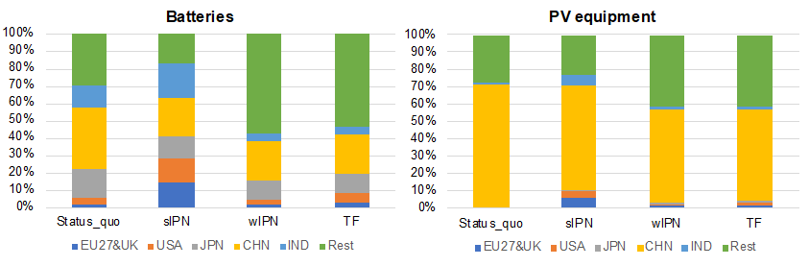
Does Industrial Policy Nationalism “Work”?
Global Market Share in 2050
Strong INP scenario: importers increase their market share (EU, USA, IND - batteries) / exporters decrease (CHN), but still EU/USA remain large green tech importers
Weak INP scenarios (wIPN, TF): limited effects globally esp. for major importers.
Import tariffs are imposed on products in the value chain of green industries (e.g., steel, aluminium), thus leading to increased domestic production costs in the five major economies triggering the substitution of imports from China at the benefit of RoW and in particular South Korea.

Slide 11
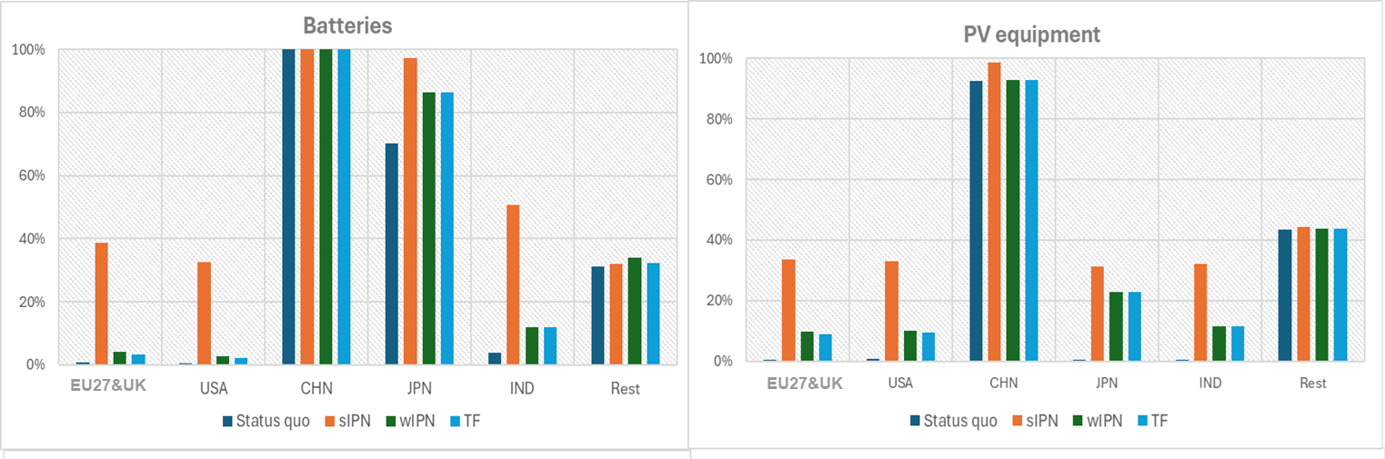
Does Industrial Policy Nationalism “Work”?
Share of demand covered by domestic supply in 2050
Policies of Alternative Trade Scenarios aim to increase the share of domestically covered “green” demand in the five major economies and reduce their import dependency
Strong INP Scenario – significant impact in EU, USA, JPN, IND
Weak INP Scenario (wIPN) – Batteries: limited impact in EU, USA (substitution of imports) – domestic share increases in JPN, IND
– PV : domestic share increases in EU, USA, JPN, IND

Slide 12

Conclusions
    New era of industrial geopolitics – Industrial Policy Nationalism increasingly integrated in national policies.
    Strong Industrial Policy Nationalism (global tariffs) – cost of climate action for the EU and major emitters increases.
    Industrial Nationalism – strong scenario – limited impact in domestic green industries
    – weaker scenarios: ineffective (import substitutions)
    Prudent industrial policy should seek global collaboration over rivalry. We need a technology race against the climate and not against each other!

Slide 13

Thank you for your attention!
Panagiotis Fragkos
panagiotis.fragkos@ricardo.com

